Slide 1
7. Memory and Programmable Logic

Slide 2
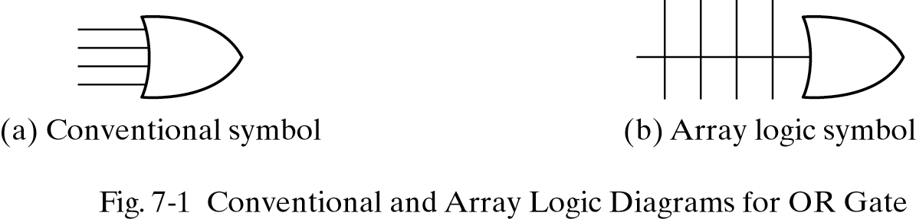
7.1 INTRODUCTION
Memory
RAM(random access memory): read and write operation
ROM(read only memory) : only read operation
Programmable Logic Device
PLD(programmable logic device)
PLA(programmable logic array)
PAL(programmable array logic)
FPGA(field programmable gate array)

Slide 3
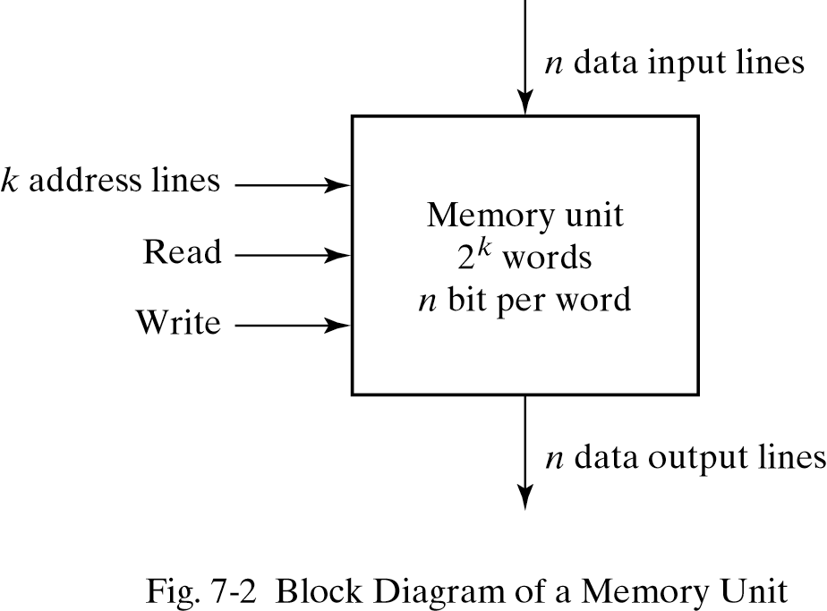
7.2 RANDOM-ACCESS MEMORY
The address lines select one particular word.
A decoder inside the memory accepts this address and opens the paths needed to select the word specified.

Slide 4
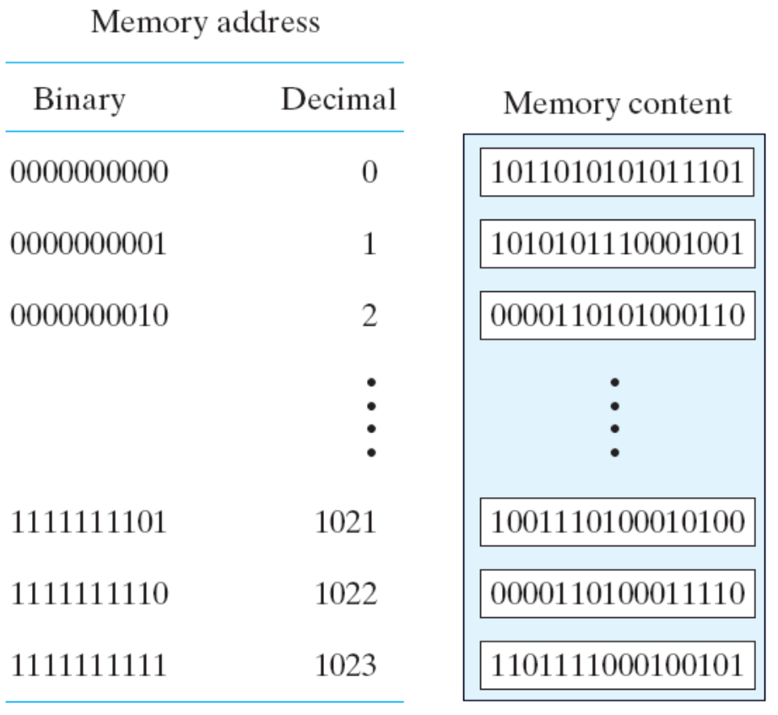
7.2 RANDOM-ACCESS MEMORY
1024x16 Memory
The 1K * 16 memory has 10 bits in the address and 16 bits in each word.

Slide 5
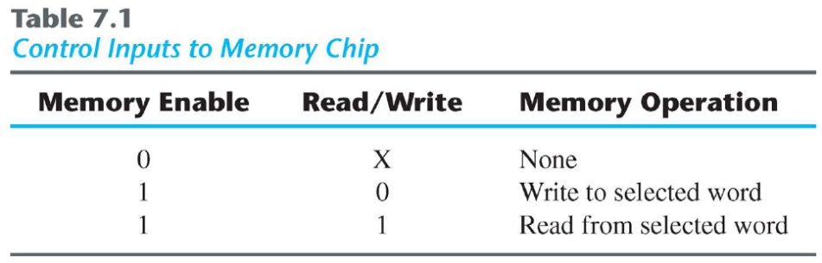
7.2 RANDOM-ACCESS MEMORY - Write and Read Operations
Write operation
1.Transfer the binary address of the desired word to the address lines.
2.Transfer the data bits that must be stored in memory to the data input lines.
3.Activate the write input
Read operation
1.Transfer the binary address of the desired word to the address lines.
2.Activate the read input.

Slide 6
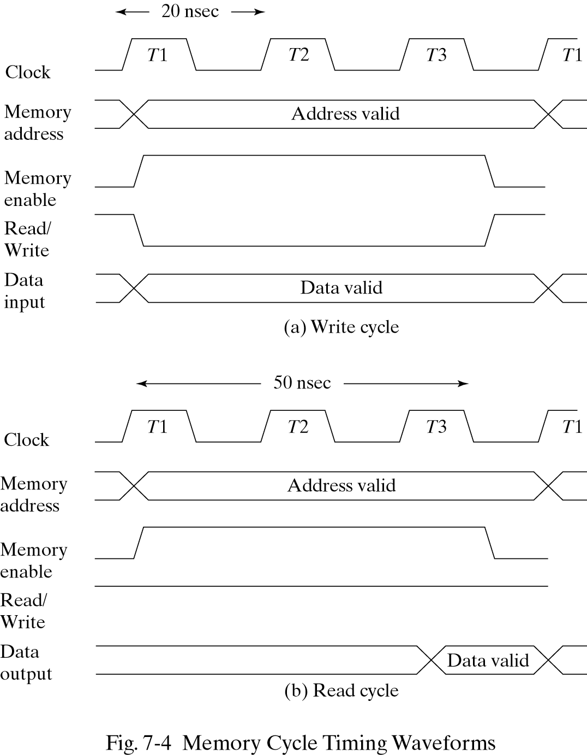
7.2 RANDOM-ACCESS MEMORY - Timing Waveforms

Slide 7
7.2 RANDOM-ACCESS MEMORY - Types of Memories
Random access Memory -each word occupy one particular location.the access time is always the same
Sequential access Memory-information is read out only when the required word has been reached. the access time is variable.
Volatile -Memory units lose the stored information when power is turned off.
Nonvolatile-A nonvolatile memory retains its stored information after removal of power. ex) magnetic disk ,ROM(Read Only Memory)
Static RAM-The stored information remains valid as long as power is applied to the unit. Static RAM is easier to use and has shorter read and write cycles.
Dynamic RAM-The capacitors must be periodically recharged by refreshing the dynamic memory. Dynamic RAM offers reduced power consumption and larger storage capacity

Slide 8
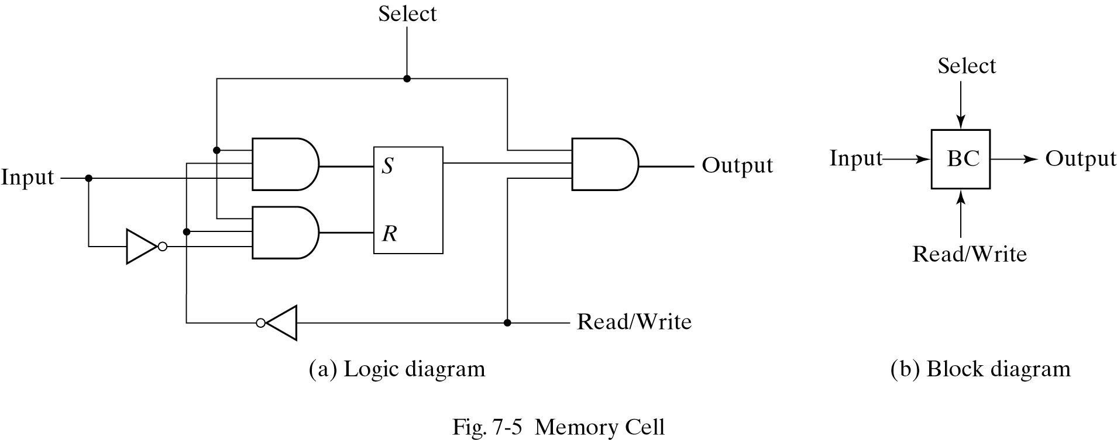
7.3 MEMORY DECODING - Internal Construction
The equivalent logic of a binary cell that stores one bit of information
The binary cell stores one bit in its internal flip-flop
It has three inputs and one output. The read/write input determines the cell operation when it is selected.

Slide 9
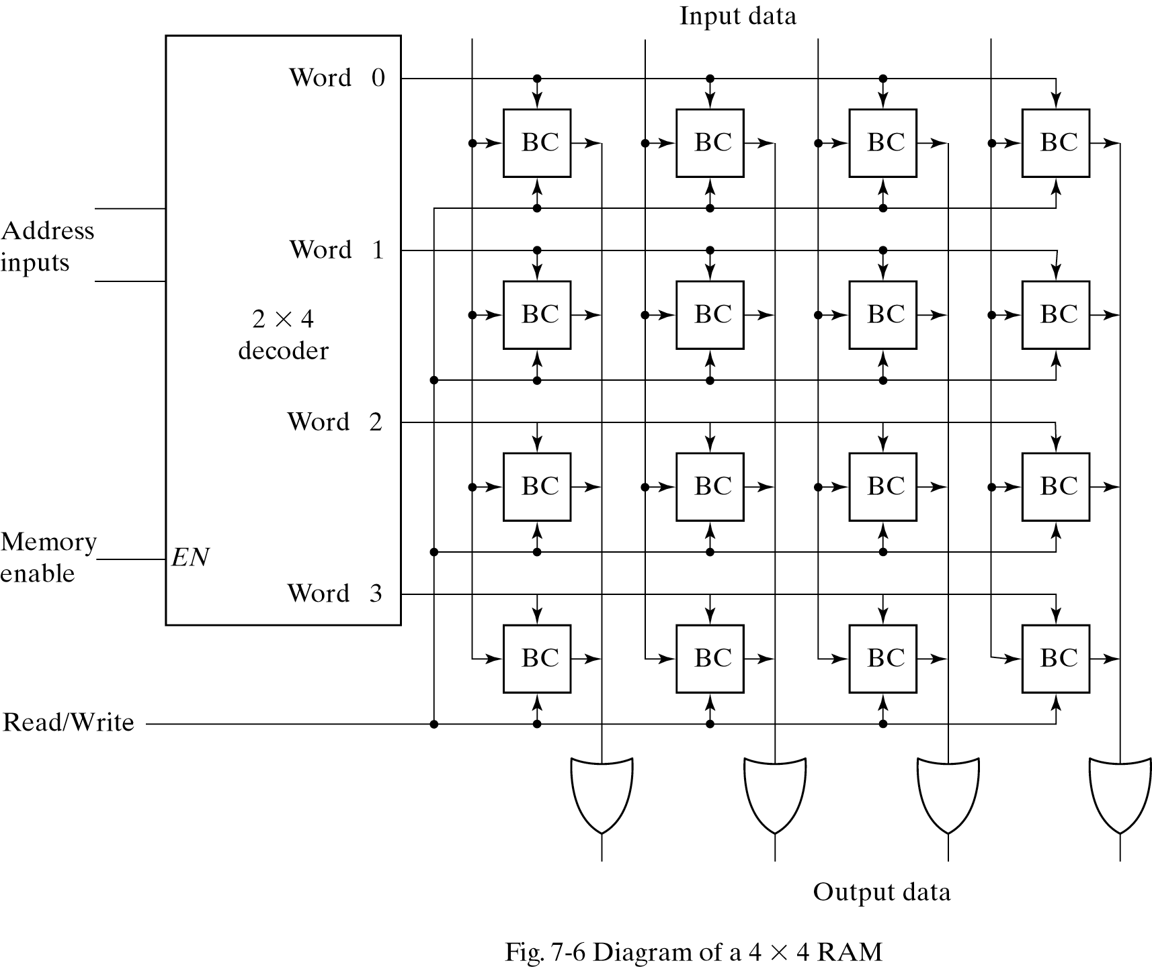
7.3 MEMORY DECODING - Internal Construction

Slide 10
7.3 MEMORY DECODING - Internal Construction
It has 16 binary cells
Memory enable=0; all outputs of the decoder =0 , none of the memory words are selected.
Memory enable=1; one of the four words is selected. The read/write input determines the operation.
During the read operation, the four bits of the selected word go through OR gates to the output terminals.
During the write operation, the data available in the input lines are transferred into the four binary cells of the selected word.

Slide 11
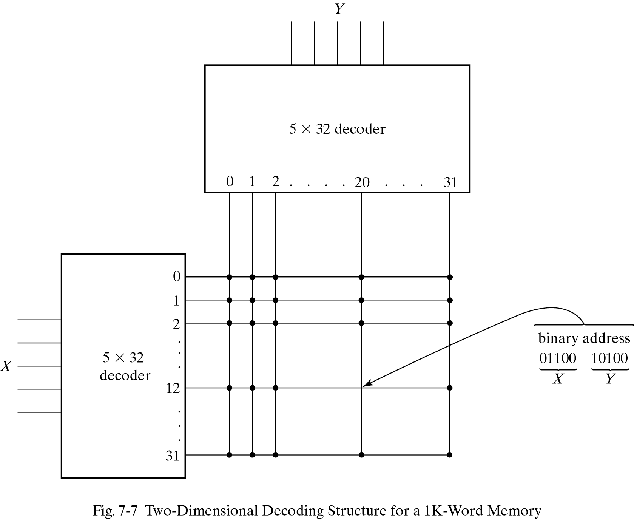
7.3 MEMORY DECODING - Coincident Decoding
The basic idea in two-dimensional decoding is to arrange the memory cells in an array that is close as possible as square. In this configuration, two k/2-input decoders are used instead of one k-input decoder.
In the two-decoder case,we need 64 AND gates with five inputs in each.
If the word address is 404, X=01100 (12) and Y=10100(20).

Slide 12
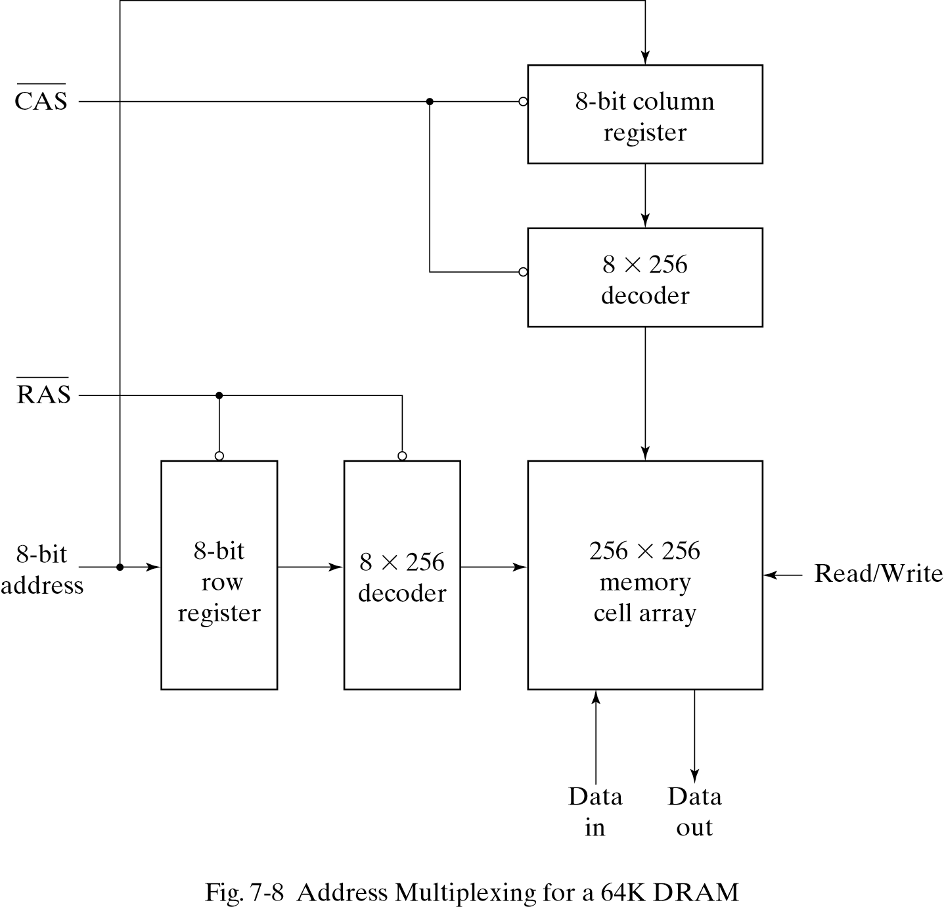
7.3 MEMORY DECODING - Address Multiplexing
To reduce the number of pins in the IC package, designers utilize address multiplexing whereby one set of address input pins accommodates the address components.
Since the same set of pins is used for both parts of the address, the size of the package is decreased significantly.

Slide 13
7.4 ERROR DETECTION AND CORRECTION
8-bit data word =>11000100
Bit position 1 2 3 4 5 6 7 8 9 10 11 12
P1 P2 1 P4 1 0 0 P8 0 1 0 0
P1=XOR of bits(3,5,7,9,11)=0 (XOR performs the odd function.)
P2=XOR of bits(3,6,7,10,11)=0
P4=XOR of bits(5,6,7,12)=1
P8=XOR of bits(9,10,11,12)=1
In memory, Bit position 1 2 3 4 5 6 7 8 9 10 11 12
0 0 1 1 1 0 0 1 0 1 0 0
When the 12 bits are read from memory ,The four check bits
C1=XOR of bits (1,3,5,7,9,11) C2=XOR of bits (2,3,6,7,10,11)
C3=XOR of bits (4,5,6,7,12) C4=XOR of bits (8,9,10,11,12)

Slide 14
7.4 ERROR DETECTION AND CORRECTION - Hamming code
Since the bits were stored with even parity C=C8C4C2C1=0000 (No error)
Bit position 1 2 3 4 5 6 7 8 9 10 11 12
0 0 1 1 1 0 0 1 0 1 0 0 No error
1 0 1 1 1 0 0 1 0 1 0 0 Error in bit 1
0 0 1 1 0 0 0 1 0 1 0 0 Error in bit 5
Check bits C8 C4 C2 C1
With error in bit 1 : 0 0 0 1
With error in bit 5: 0 1 0 1
The error can be corrected by complementing the corresponding bit.

Slide 15
7.4 ERROR DETECTION AND CORRECTION
- Single-Error Correction , Double-Error Detection
The Hamming code can detect and correct only a single error. Multiple errors are not detected.
To correct a single error and detect double errors ,we include the additional parity bit.
If C=0 and P=0 No error occurred
If C=1 and p=1 A single error occurred , which can be corrected
If C=1 and P=0 A double error occurred, which is detected but cannot be corrected
If C=0 and P=1 An error occurred in the P13 bit

Slide 16
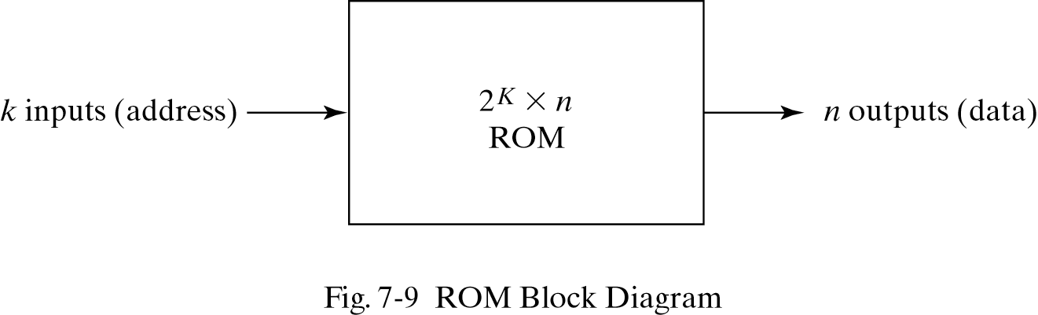
7.5 READ-ONLY MEMORY
ROM=Decoder + OR gates
-permanent binary information is stored.
k input lines and n output lines
The number of output lines ,n= the number of bits per word

Slide 17
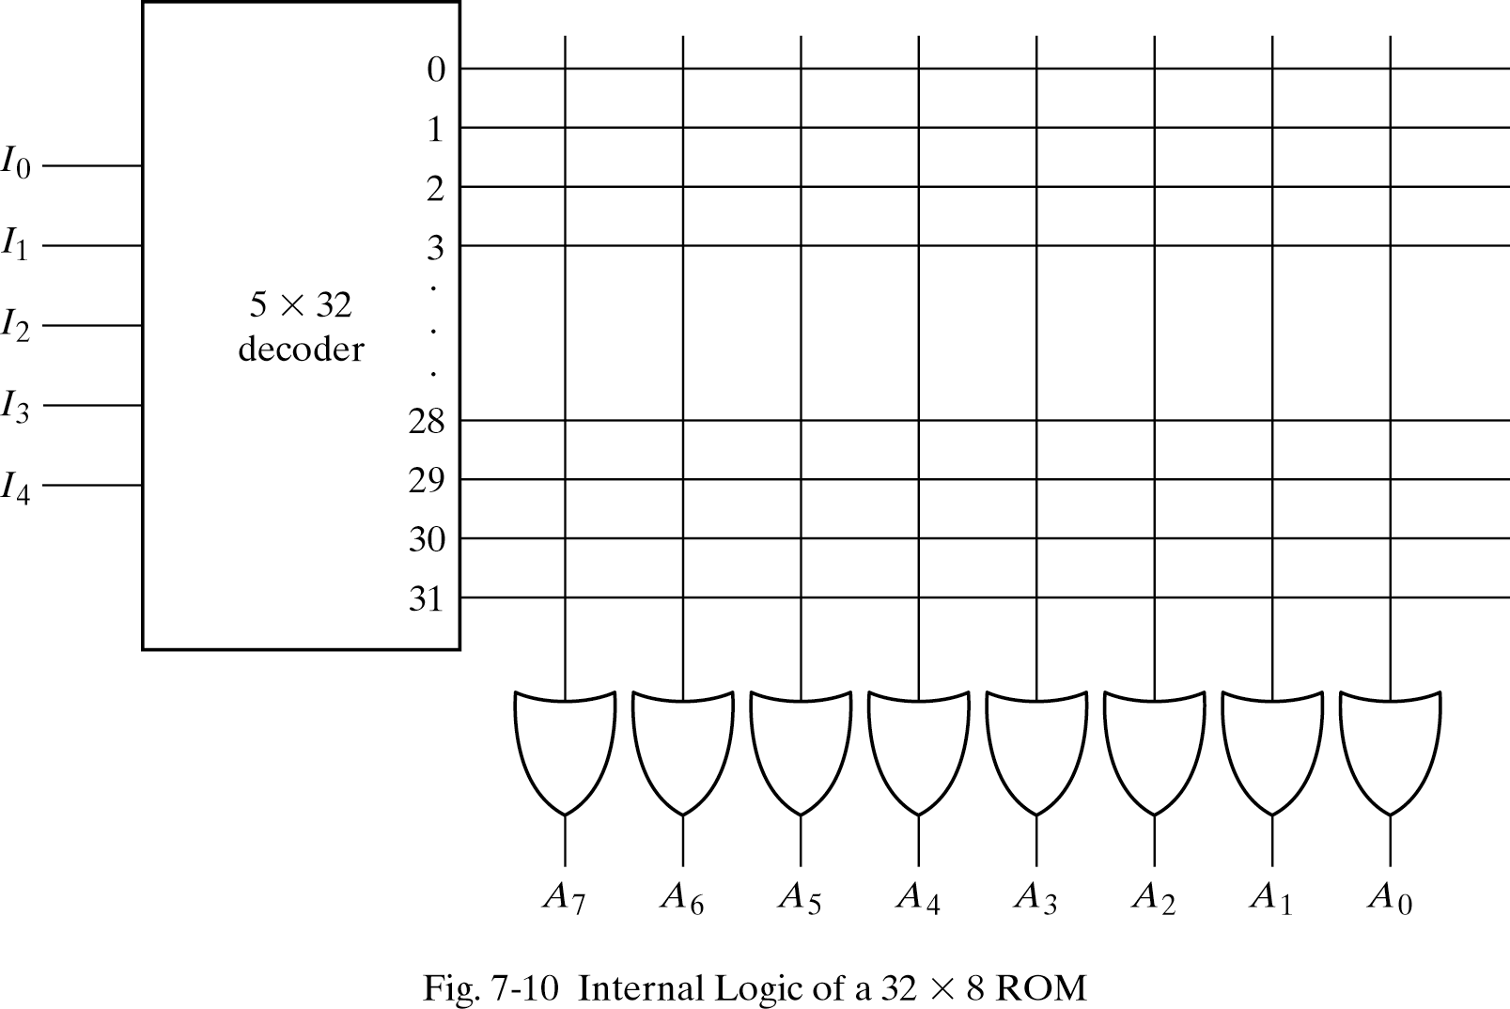
7.5 READ-ONLY MEMORY
ROM = AND gates connected as a decoder + a number of OR gates
5 X 32 decoder has 32 AND gates and 5 inverters.
32 words

Slide 18
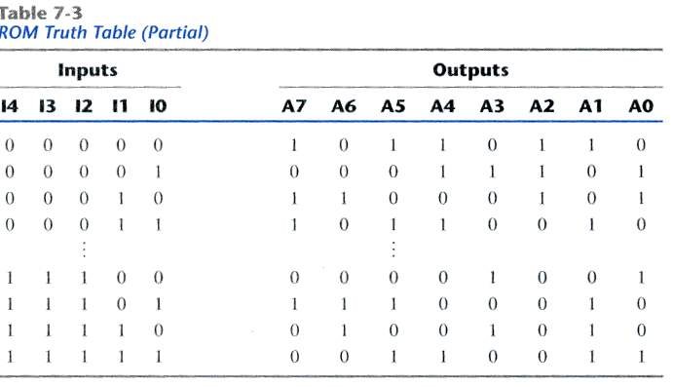
7.5 READ-ONLY MEMORY
ROM Truth Table(Partial)

Slide 19
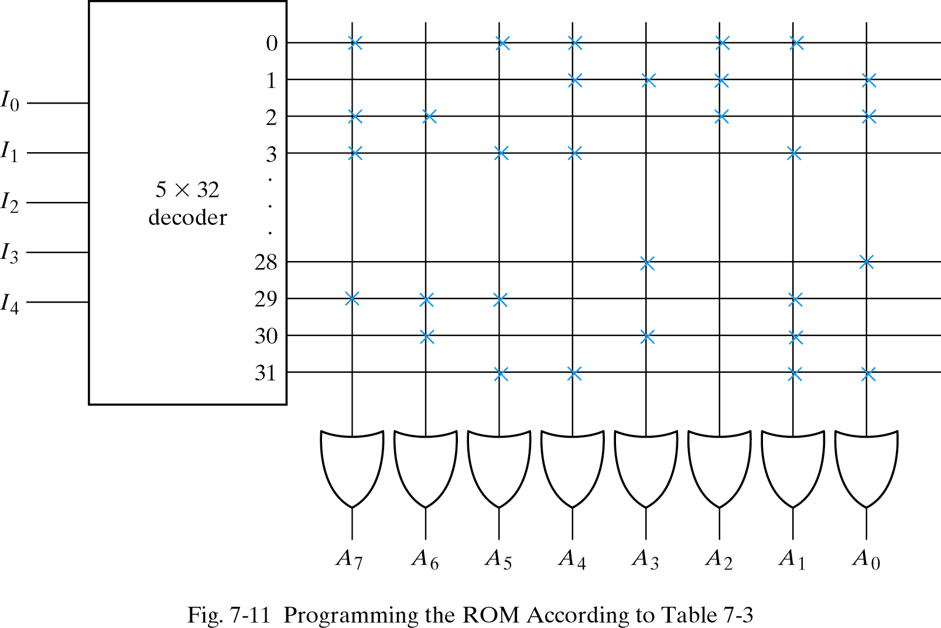
7.5 READ-ONLY MEMORY - Combinational Circuit Implementation
‘1’
‘0’
A7(I4,I3,I2,I0)=Sum of minterms(0,2,3,…,29)
Input->00011(3)
Others-> all ’0’
Output->10110010

Slide 20
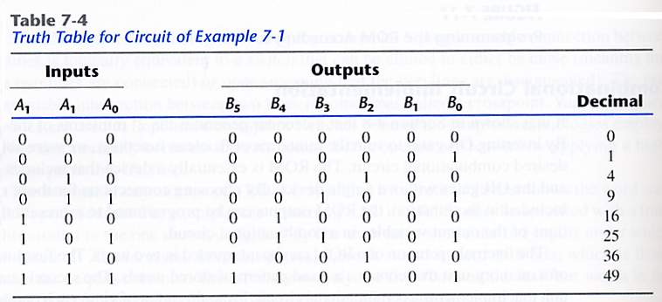
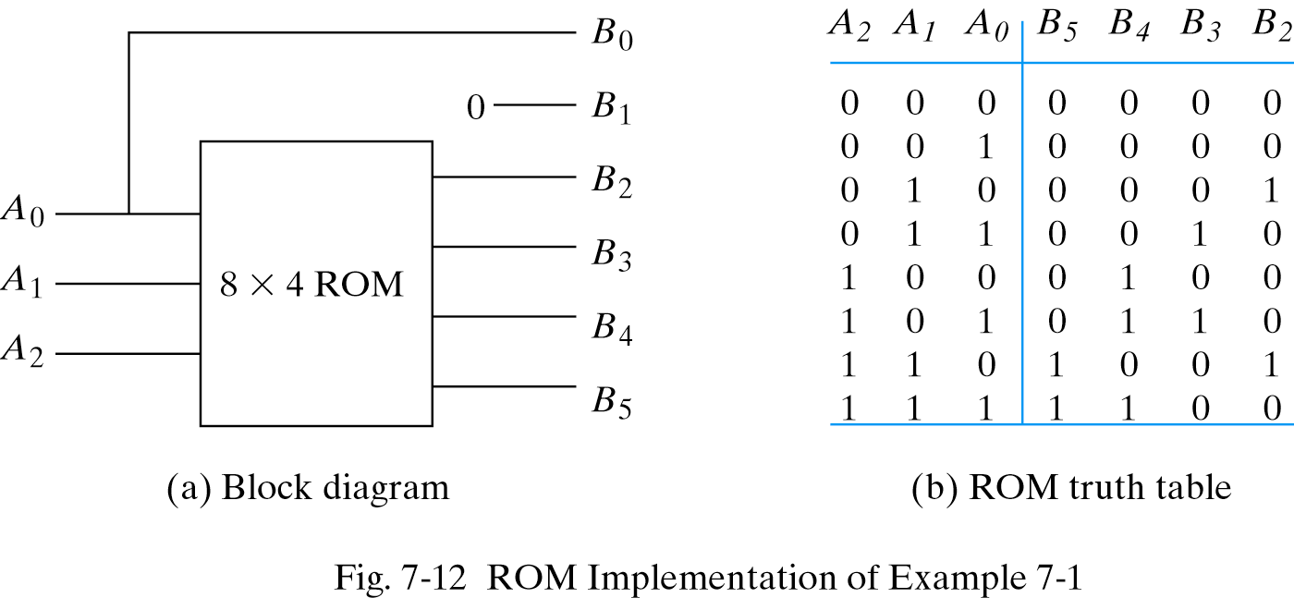
7.5 READ-ONLY MEMORY - Combinational Circuit Implementation
EXAMPLE 7-1

Slide 21
7.5 READ-ONLY MEMORY - Types of ROMs
For large quantities, mask programming is economical .
For small quantities , programmable read-only memory(PROM) is more economical.(all ‘1’s)
PROM- irreversible and permanent
EPROM(Erasable PROM)- can be restructured to the initial value(UV light->discharge)
EEPROM(Electrically erasable PROM)- can be erased with electrical signals instead ultra violet light.

Slide 22
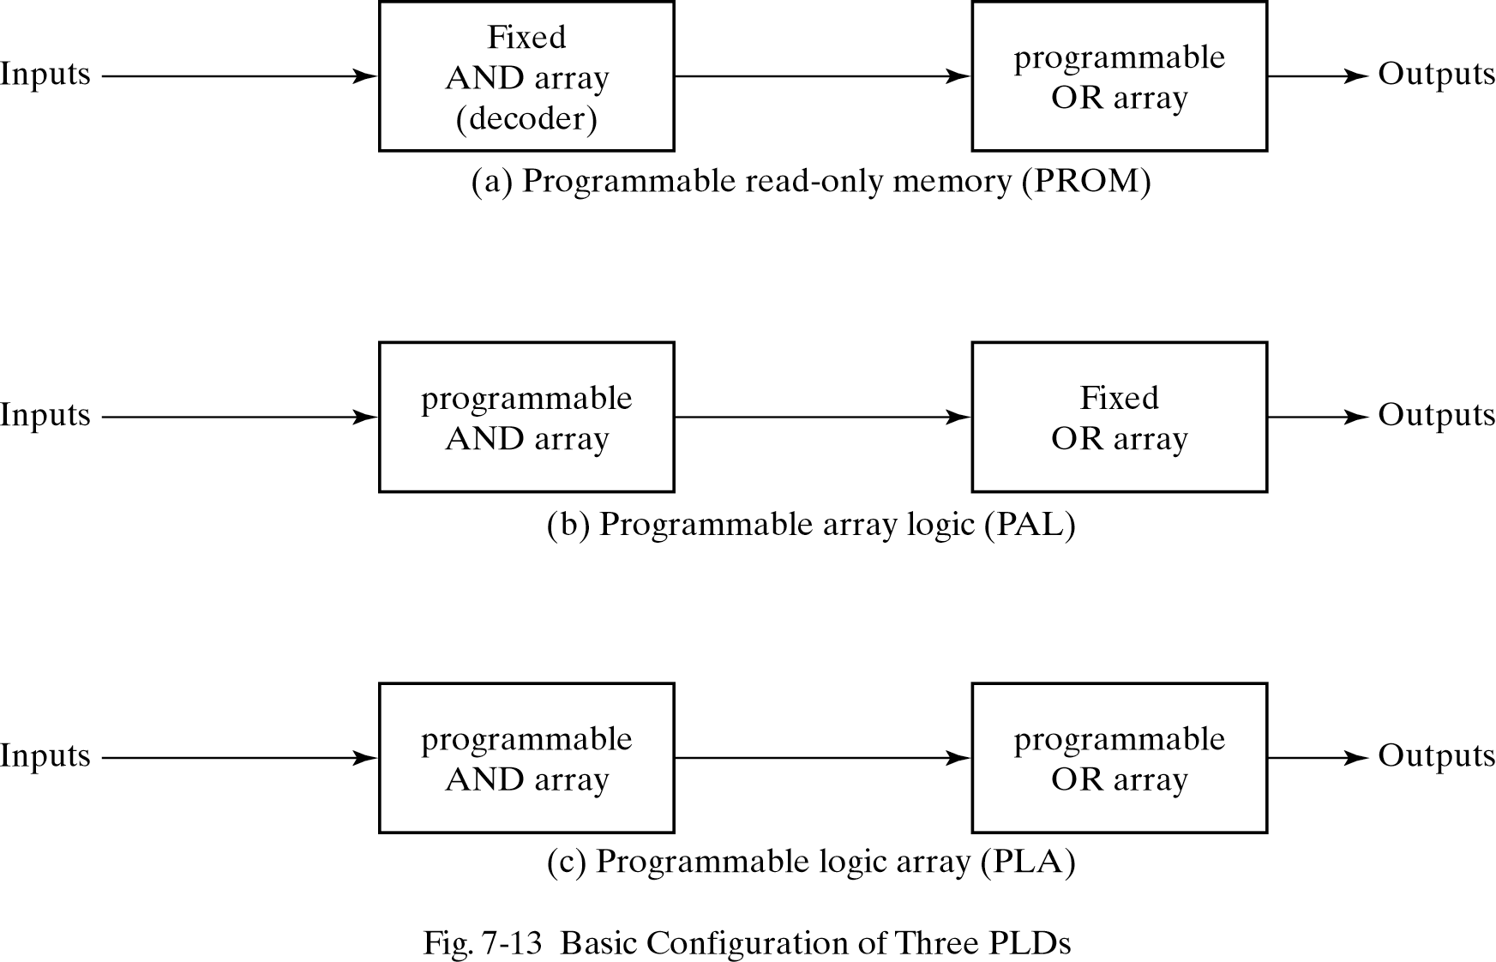
7.5 READ-ONLY MEMORY - Combinational PLDs
A combinational PLD is an IC with programmable gates divided into an AND array and an OR array to provide an AND-OR sum of product implementation.
Three major types PLDs
(a)fixed AND array +programmable OR array
(b)programmable AND array + fixed OR array
(c )programmable AND array + programmable OR array

Slide 23
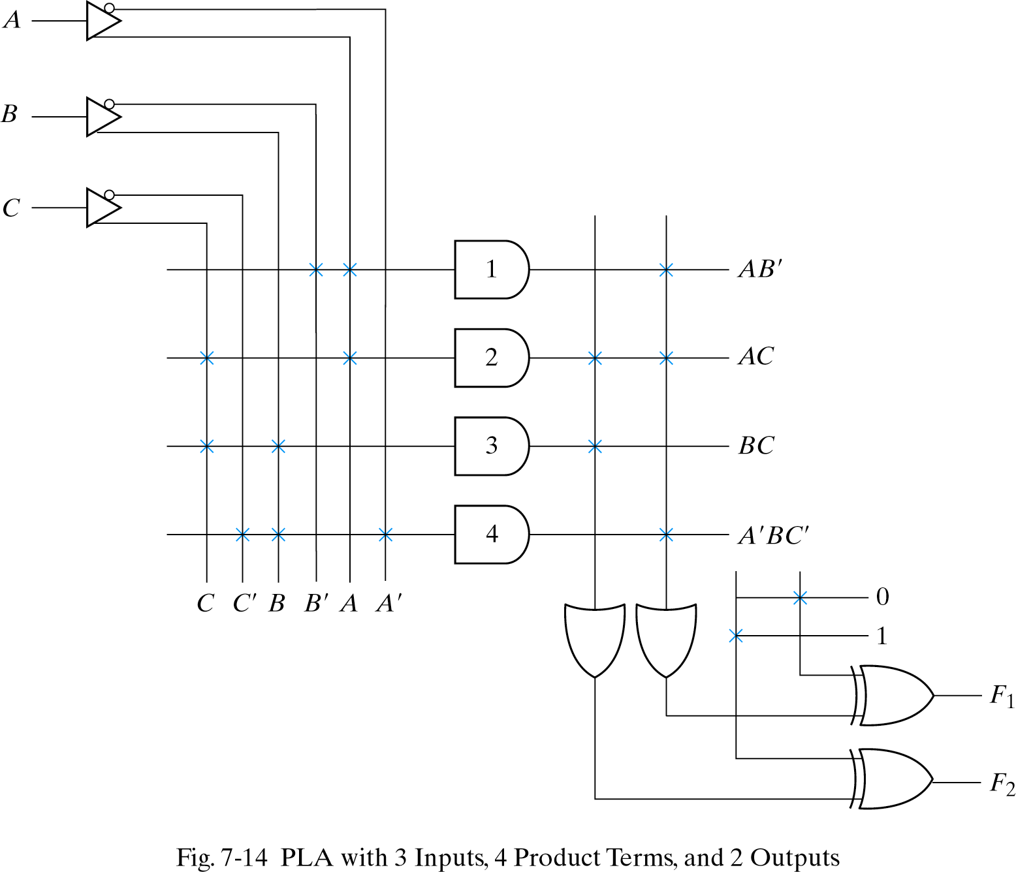
7.6 PROGRAMMABLE LOGIC ARRAY
Programmable OR array
Programmable AND array

Slide 24


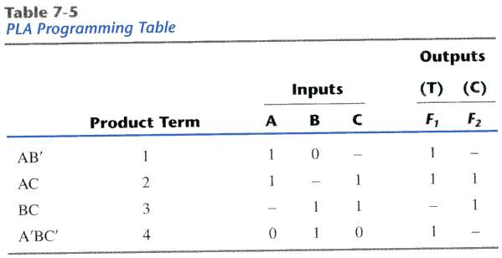
7.6 PROGRAMMABLE LOGIC ARRAY
PLA Programming Table
The PLA does not provide full decoding of the variables.(decoder <->AND array)
The PLA consists of n inputs ,m outputs , k product terms(AND gate) ,and m sum terms(OR gate)
The number of programmed fuses is
, whereas that of a ROM is
F1=AB’ + AC + A’BC’
F2= (AC + BC)’

Slide 25
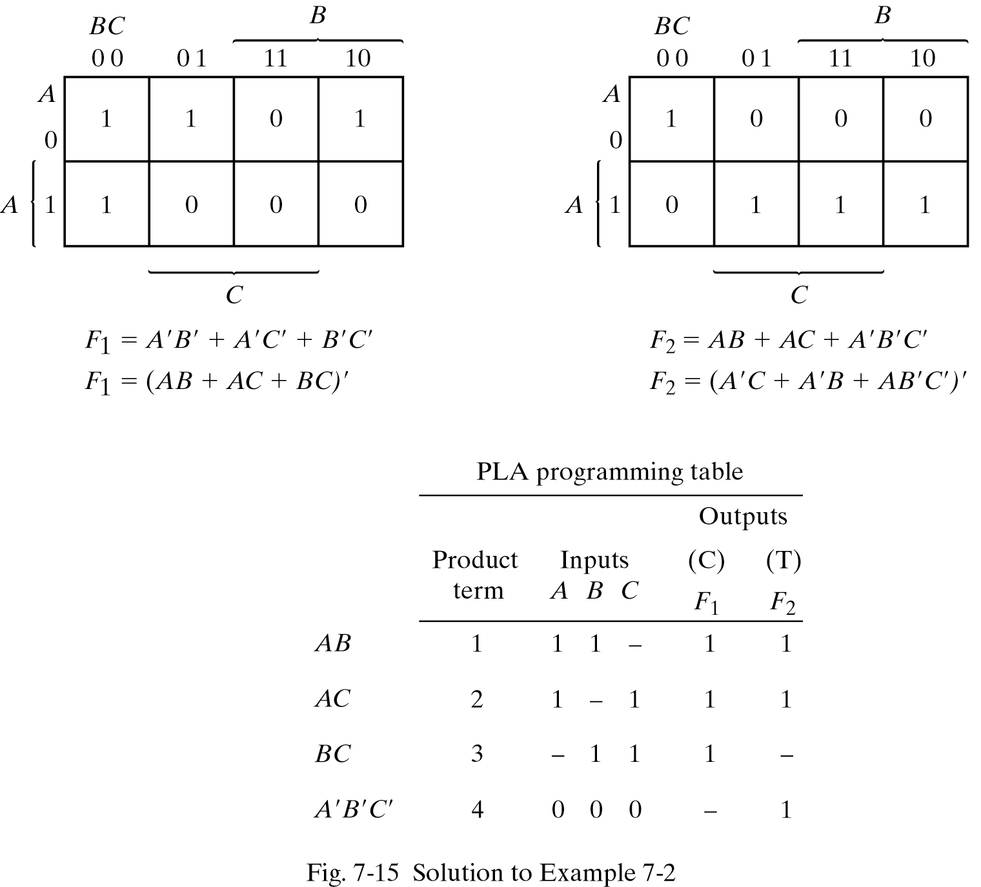
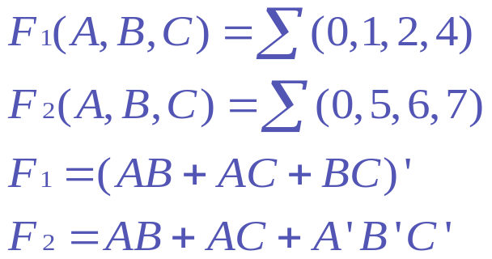
7.6 PROGRAMMABLE LOGIC ARRAY
EXAMPLE 7-2

Slide 26
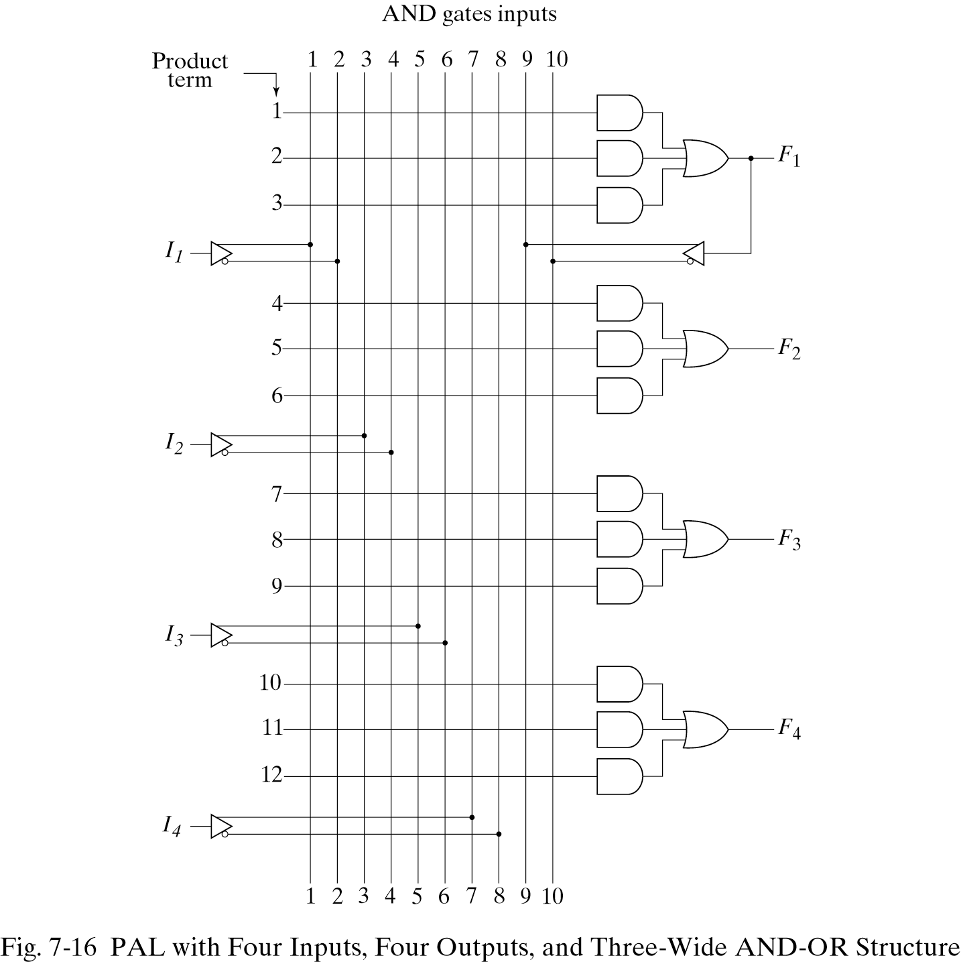
7.7 PROGRAMMABLE ARRAY LOGIC
PAL-With a fixed OR array and a programmable AND array.
-Not as flexible as the PLA(Only the AND gate are programmable.)

Slide 27
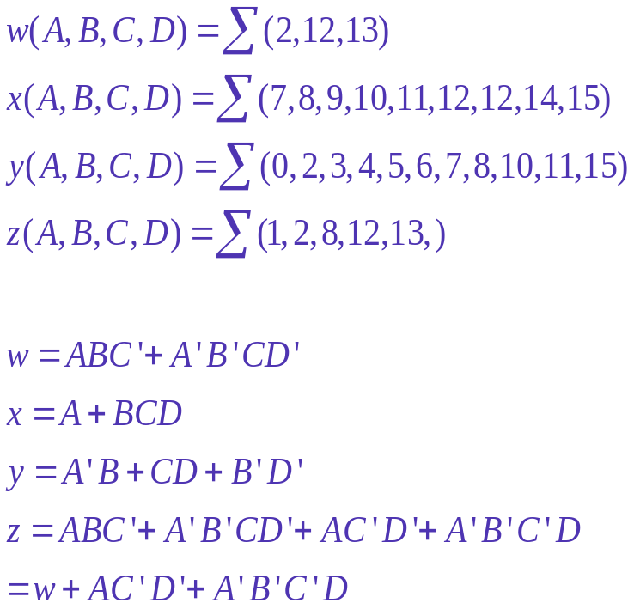
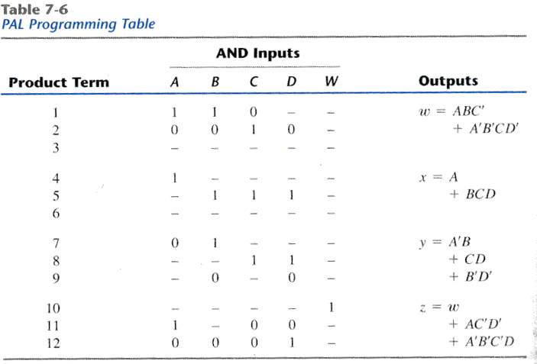
7.7 PROGRAMMABLE ARRAY LOGIC
Example(PAL)

Slide 28
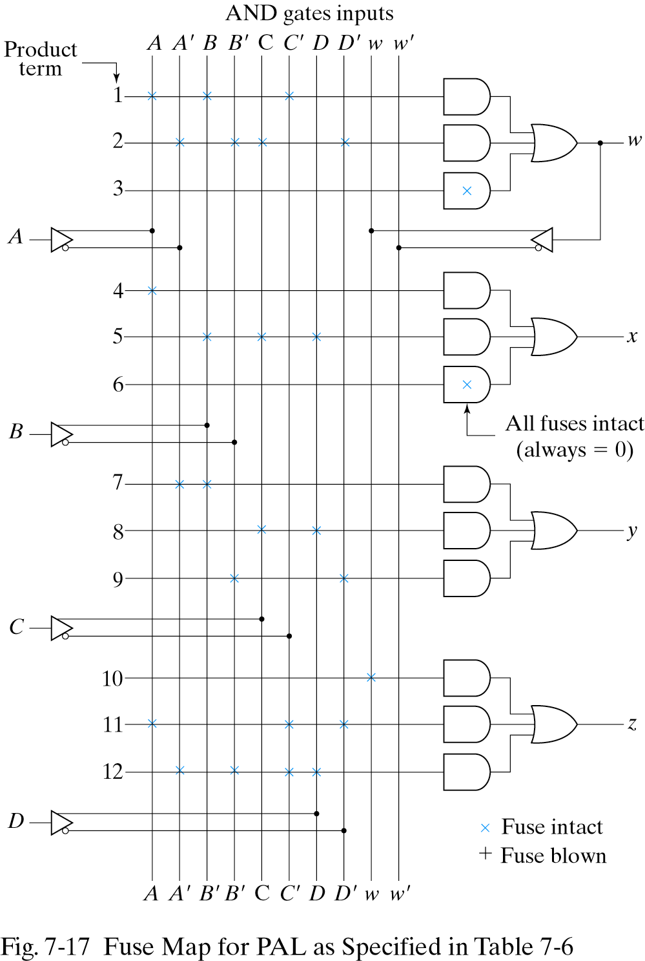
7.7 PROGRAMMABLE ARRAY LOGIC
Fuse Map for PAL

Slide 29
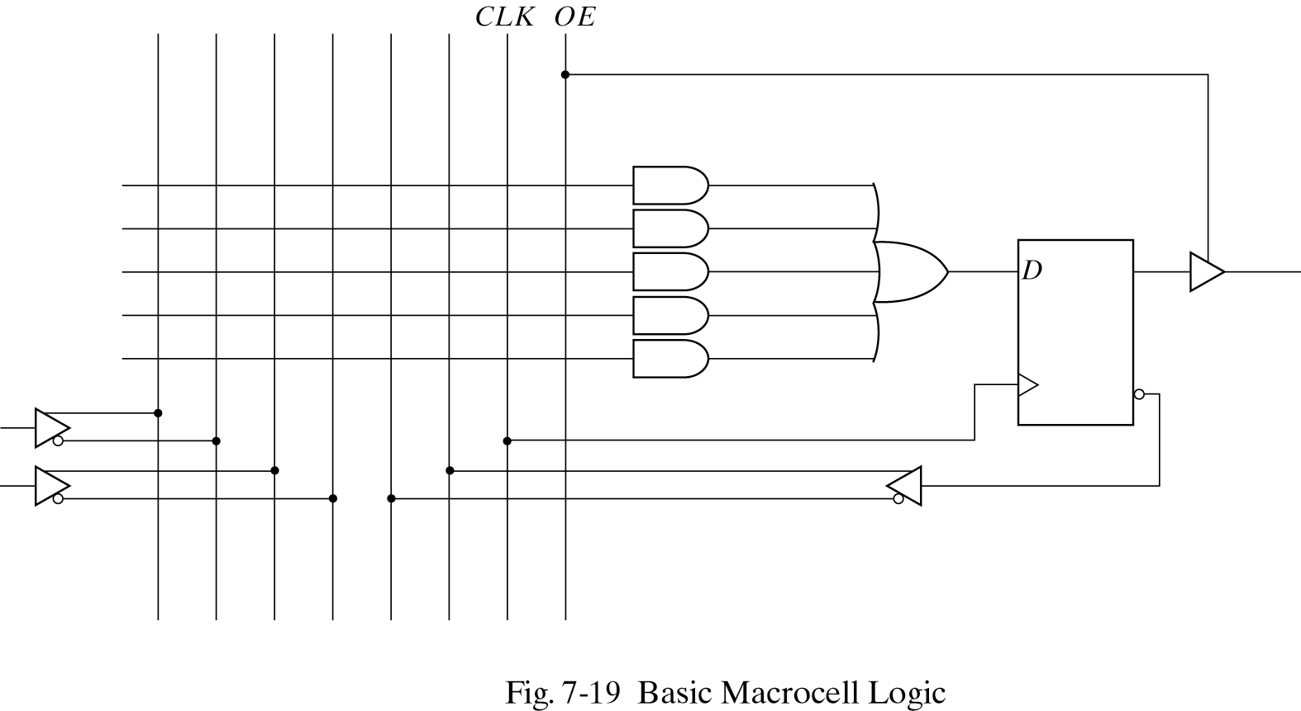
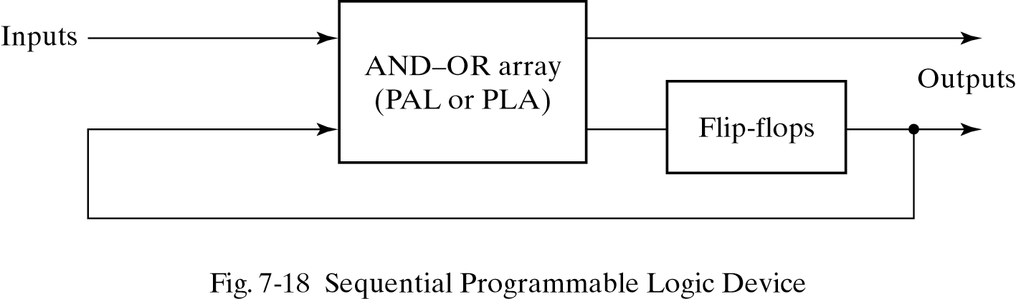
7.8 SEQUENTIAL PROGRAMMABLE DEVICES
Sequential(or simple) Programmable Logic Device (SPLD)
Complex Programmable Logic Device(CPLD)
Field Programmable Gate Array(FPGA)
PAL

Slide 30
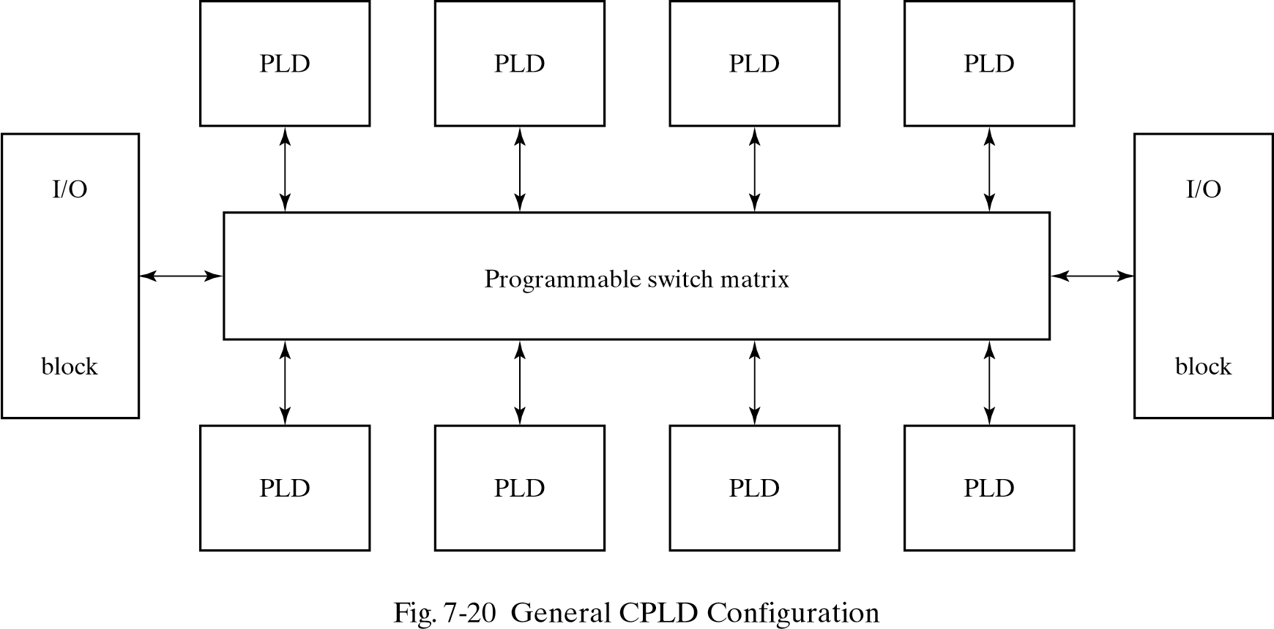
7.8 SEQUENTIAL PROGRAMMABLE DEVICES
CPLD &FPGA
CPLD-a collection of individual PLDs
FPGA(Field Programmable Gate Array)
-a VLSI circuit that can be programmed in the user’s location.
-look-up tables,multiplexes,gates, and flip-flops

Slide 31
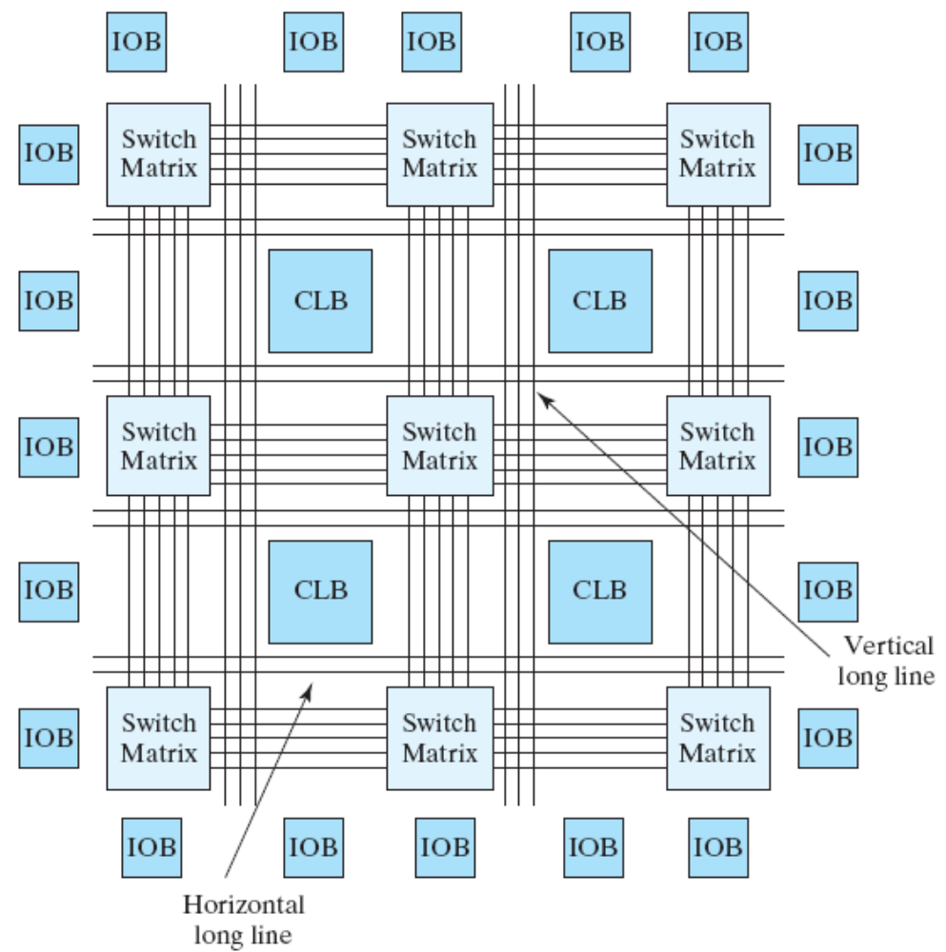
7.8 SEQUENTIAL PROGRAMMABLE DEVICES
Xilinx Structure

Slide 32
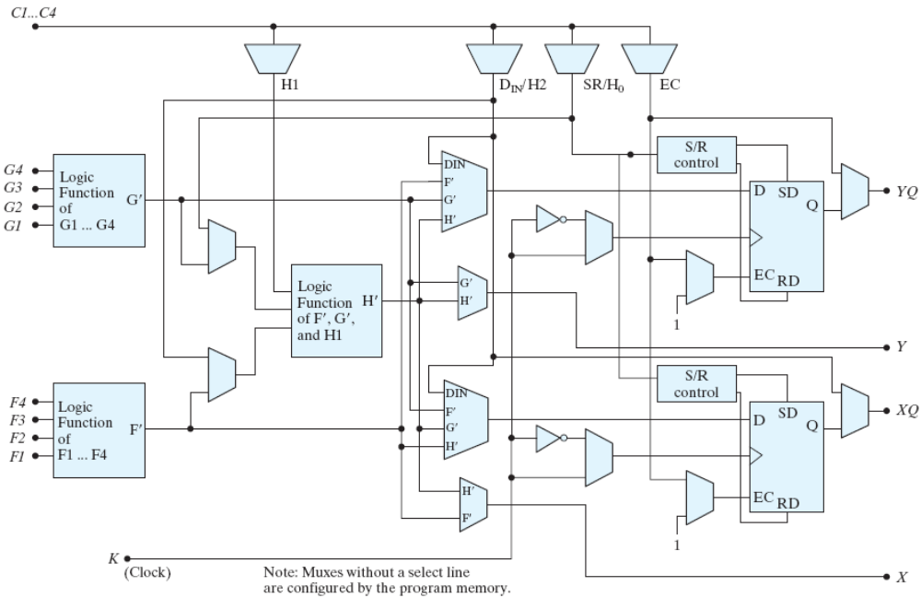
7.8 SEQUENTIAL PROGRAMMABLE DEVICES

Slide 33
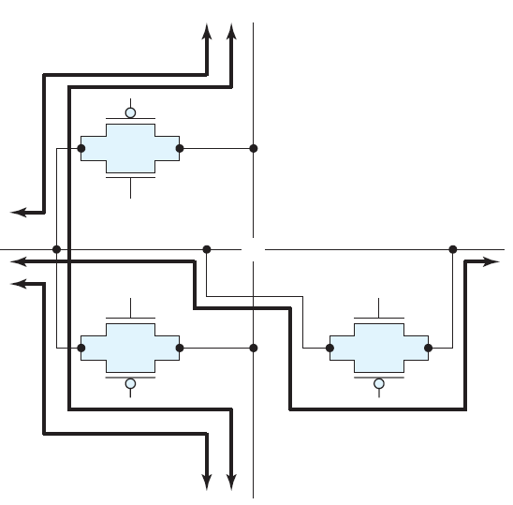
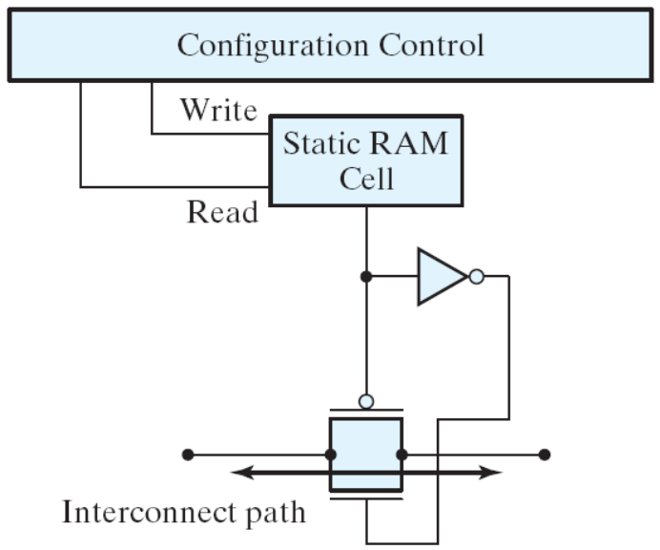
7.8 SEQUENTIAL PROGRAMMABLE DEVICES

Slide 34
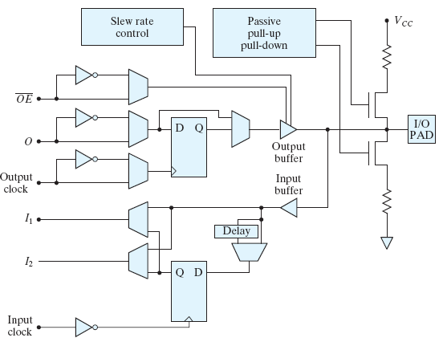
7.8 SEQUENTIAL PROGRAMMABLE DEVICES

Slide 35
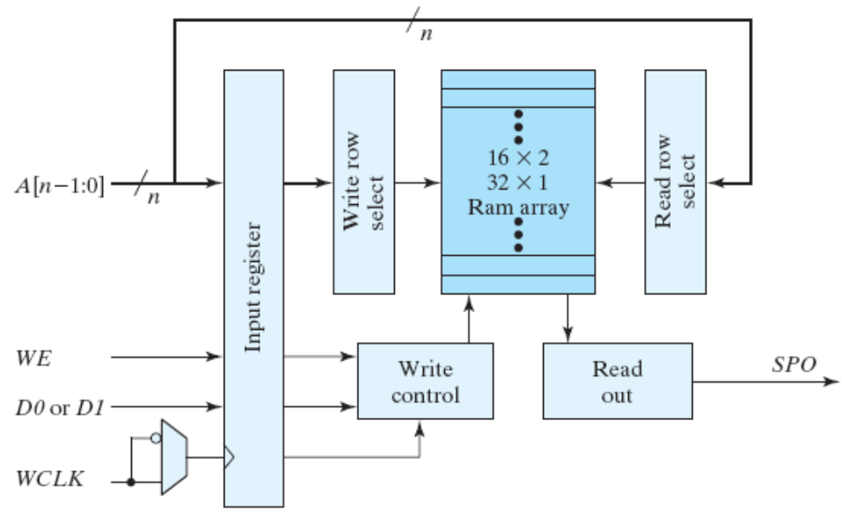
7.8 SEQUENTIAL PROGRAMMABLE DEVICES

Slide 36
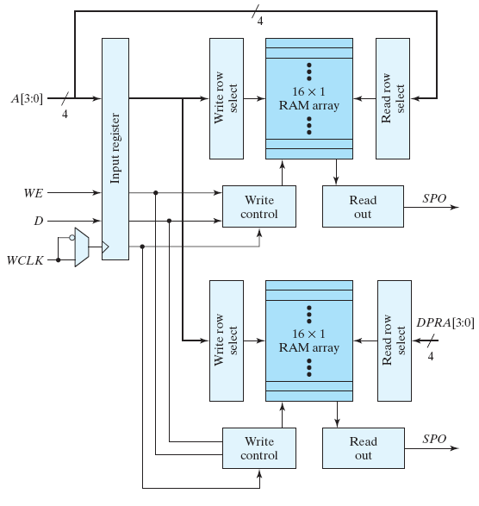
7.8 SEQUENTIAL PROGRAMMABLE DEVICES

Slide 37
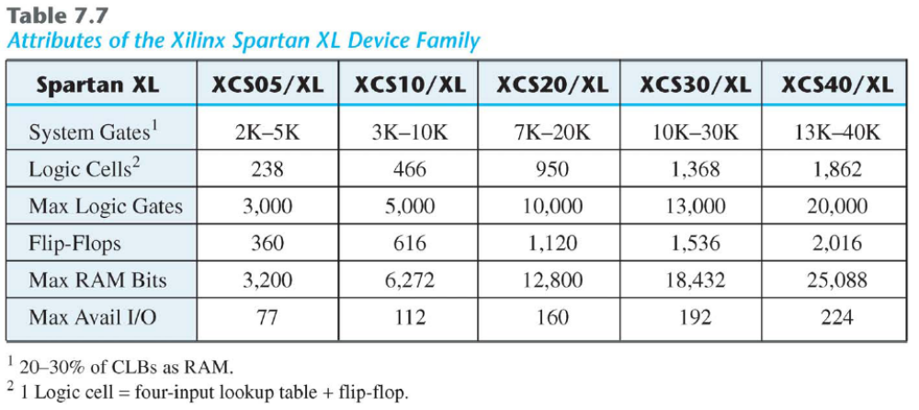
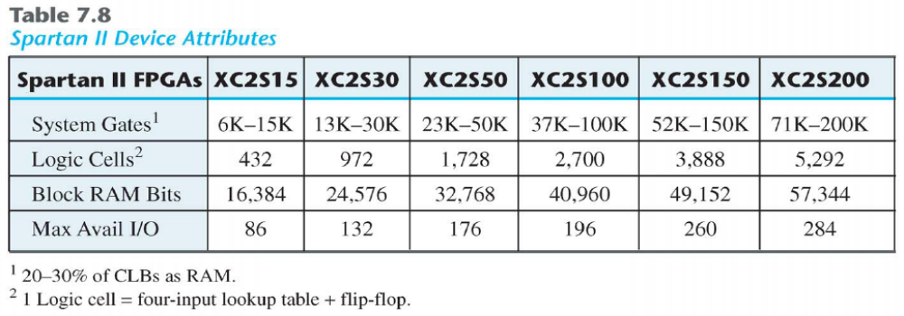
7.8 SEQUENTIAL PROGRAMMABLE DEVICES

Slide 38
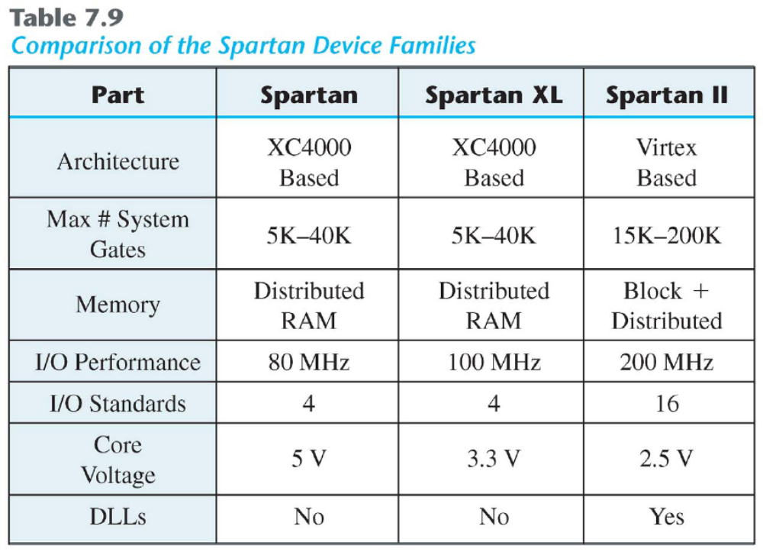
7.8 SEQUENTIAL PROGRAMMABLE DEVICES

Slide 39
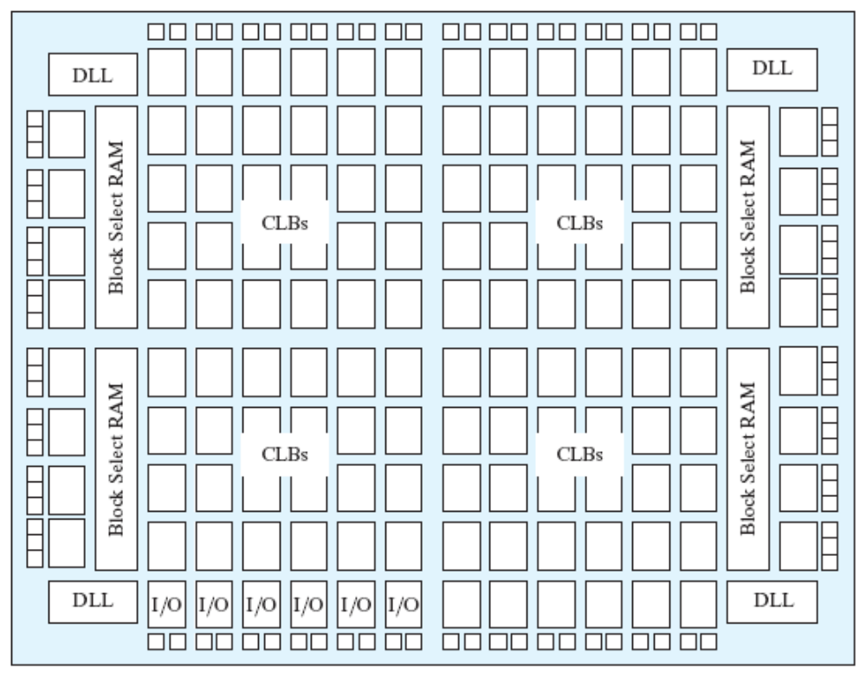
7.8 SEQUENTIAL PROGRAMMABLE DEVICES

Slide 40
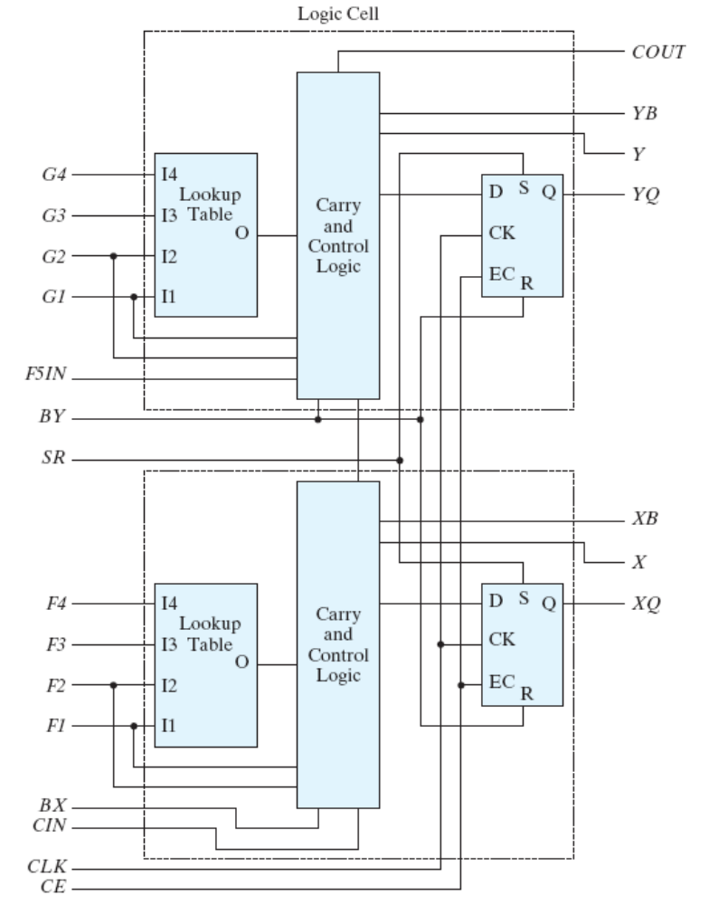
7.8 SEQUENTIAL PROGRAMMABLE DEVICES

Slide 41
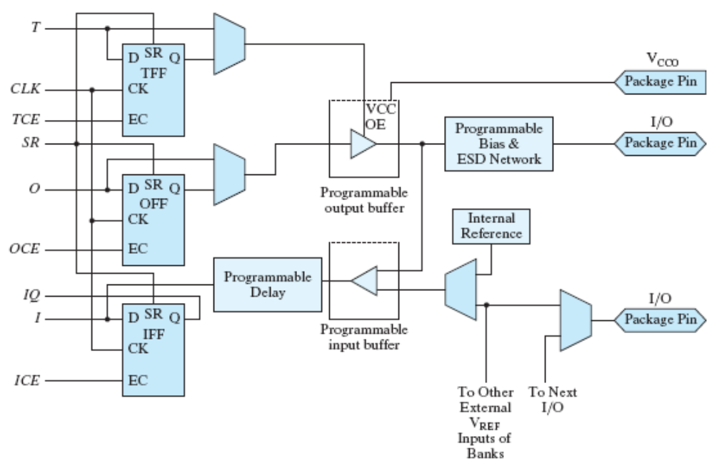
7.8 SEQUENTIAL PROGRAMMABLE DEVICES

Slide 42
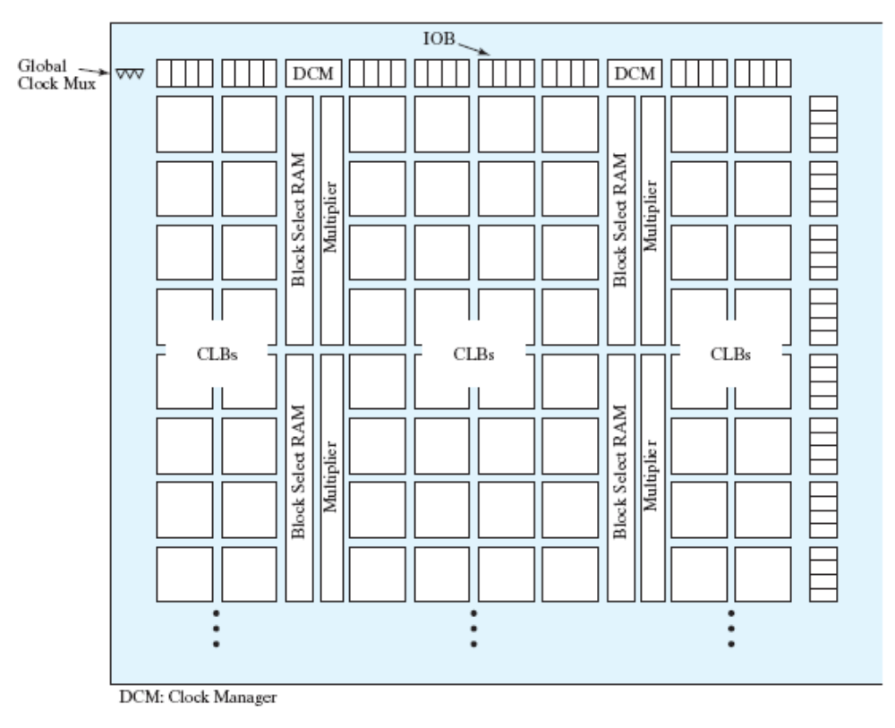
7.8 SEQUENTIAL PROGRAMMABLE DEVICES

Slide 43
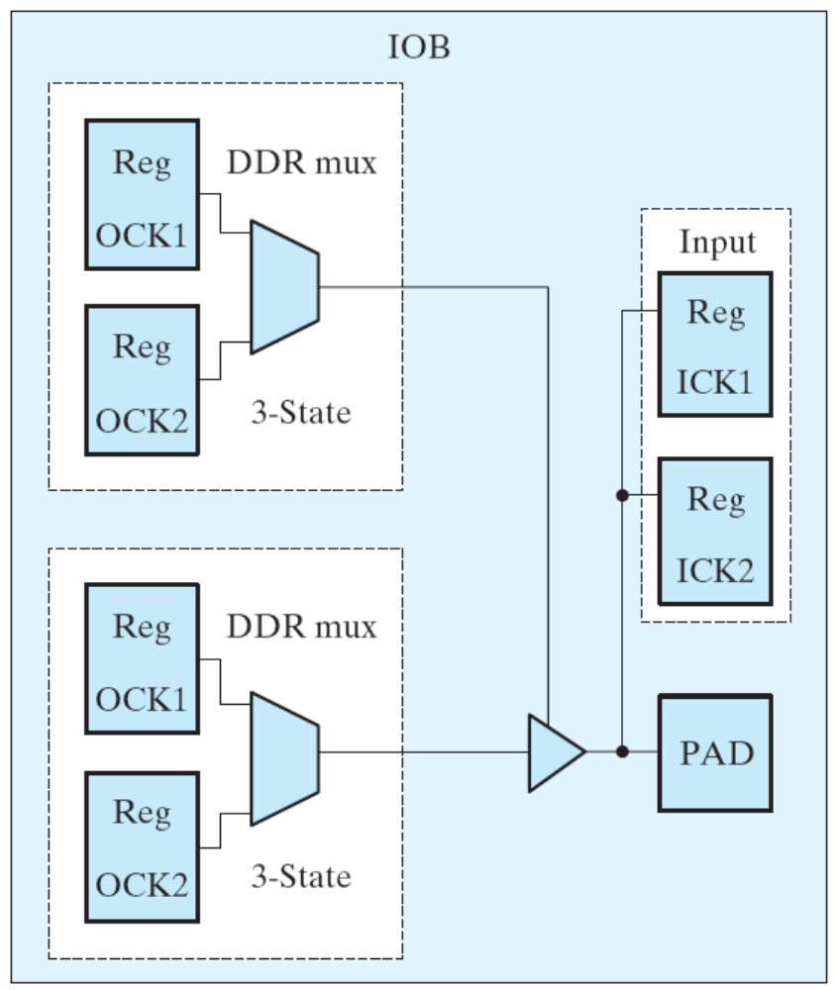
7.8 SEQUENTIAL PROGRAMMABLE DEVICES

Slide 44
7.8 SEQUENTIAL PROGRAMMABLE DEVICES

