Slide 1
9. Asynchronous Sequential Logic

Slide 2
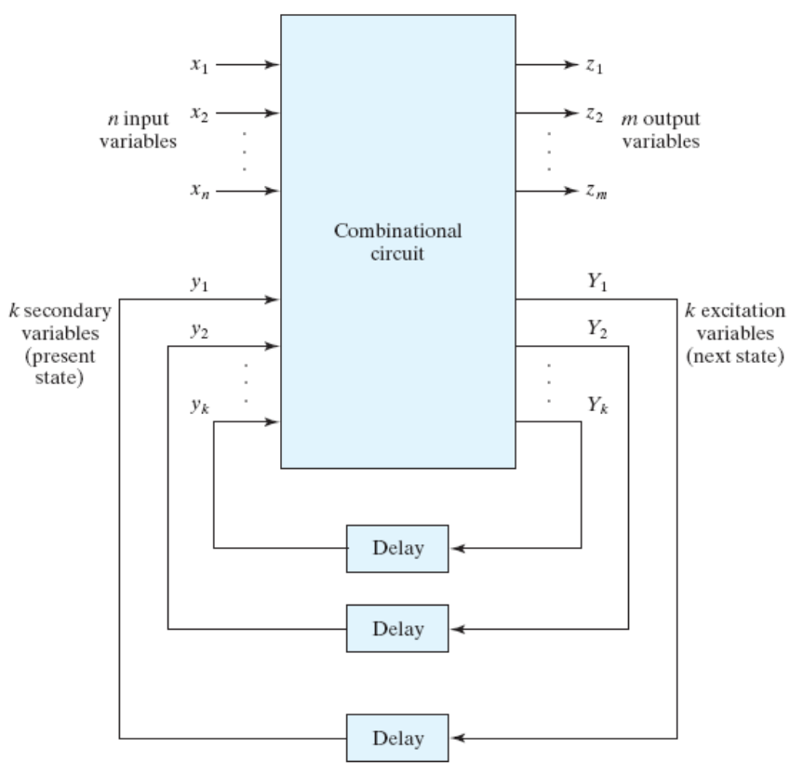
9.1 Introduction
Synchronous sequential circuits
: using clock pulse
Asynchronous sequential circuits
: not using clock pulse
- The change of internal state
occurs when there is a change in
the input variables.
- The timing problems involved in
the feedback path.

Slide 3
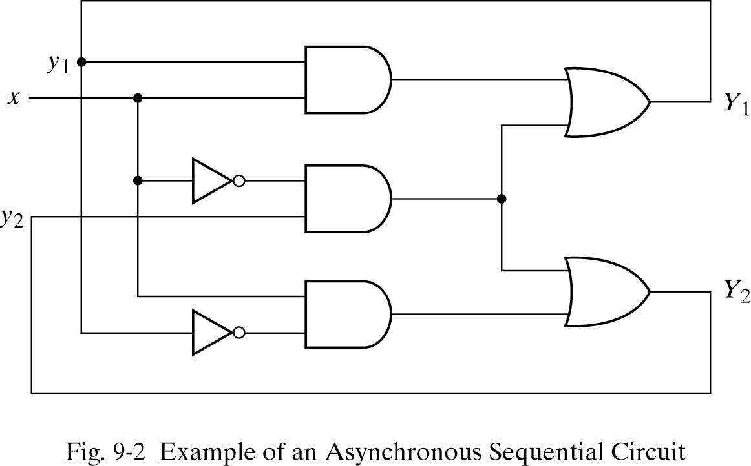
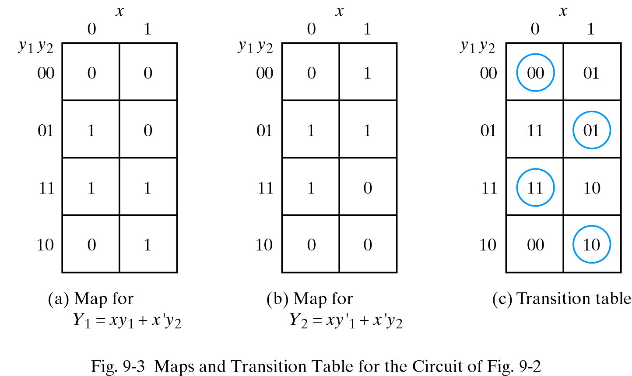
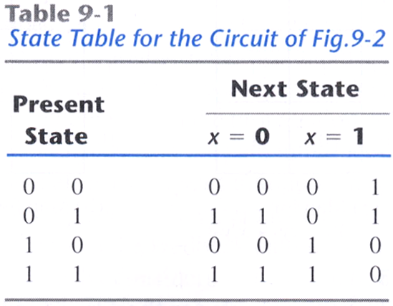
9.2 Analysis Procedure – Transition Table
Y₁=xy₁+x`y₂
Y₂=xy`₁+x`y₂

Slide 4
9.2 Analysis Procedure – Transition Table
The procedure for obtaining a transition table
1. Determine all feedback loops in the circuit.
2. Designate the output of each feedback loop with variable Y_{i} and its
corresponding input with y_{i} for i=1,2,…,k, where k is the number of
feedback loops in the circuit.
3. Derive the Boolean functions of all Y’s as a function of the external
inputs and the y’s.
4. Plot each Y function in a map, using the y variables for the rows and
the external inputs for the columns.
5. Combine all the maps into one table showing the value of Y=Y₁Y₂…Y_{k}
inside each square.
6. Circuit those value of Y in each square that are equal to the value of
y=y₁y₂…y_{k} in the same row.

Slide 5
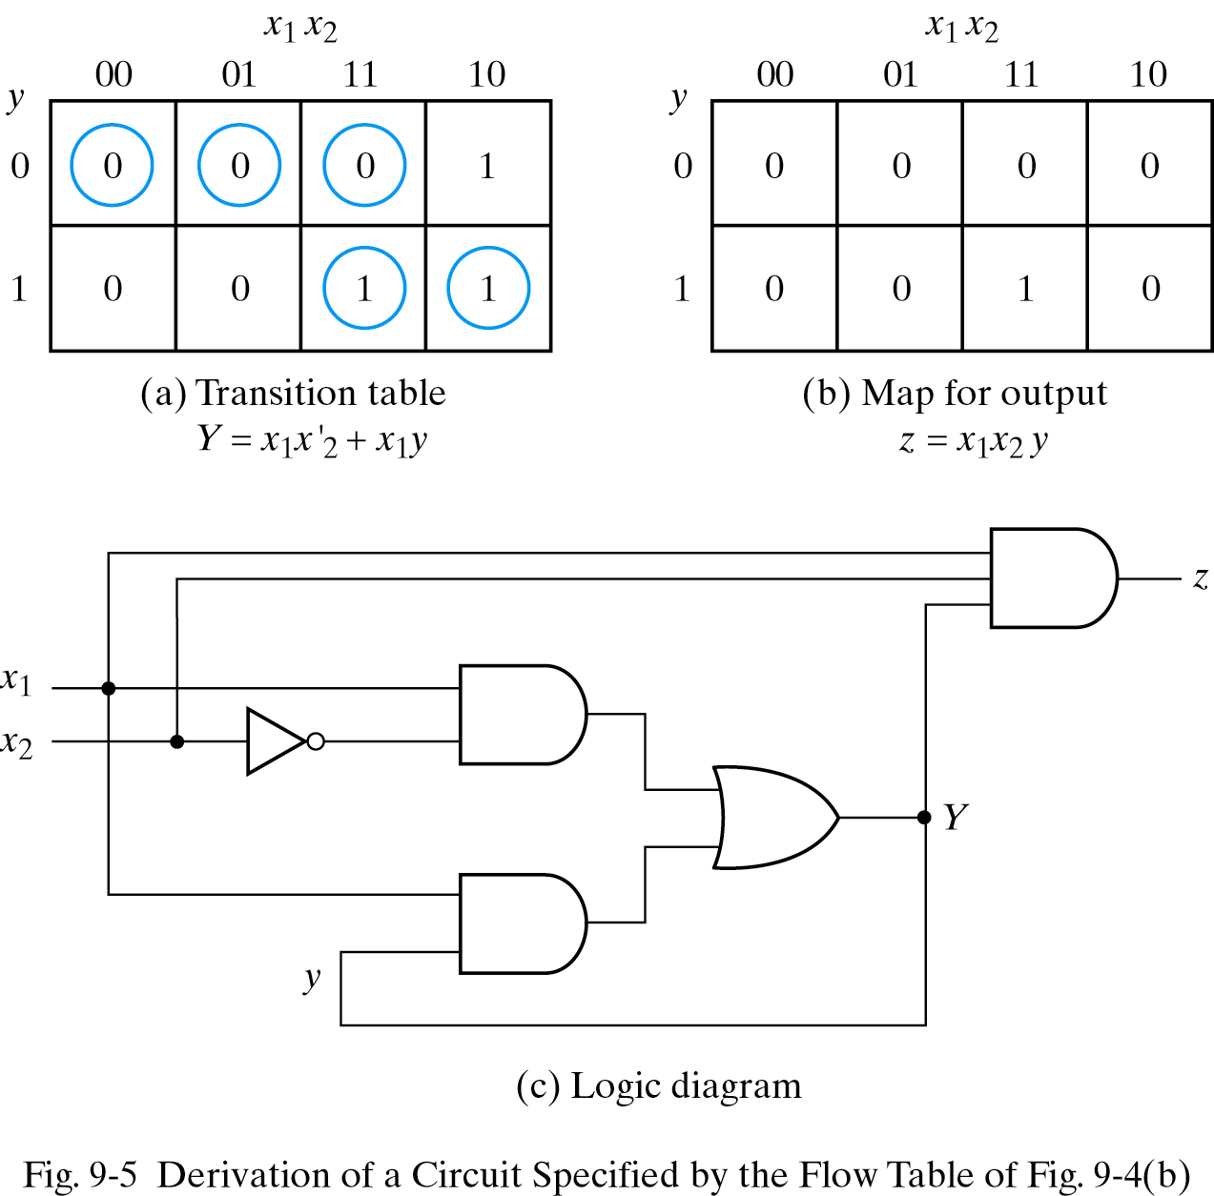
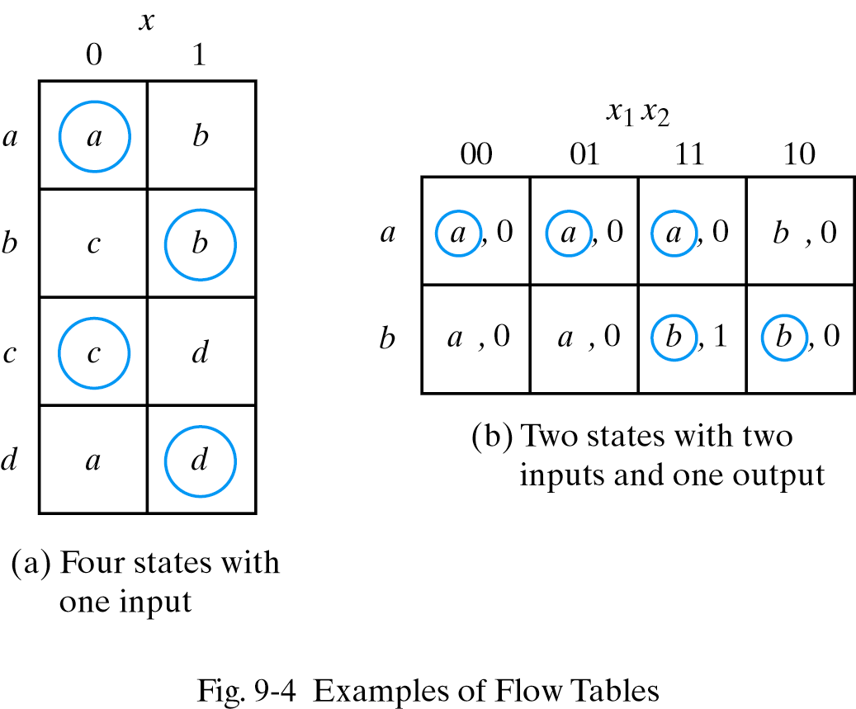
9.2 Analysis Procedure – Flow table
Similar to a transition table exception that the internal states are symbolized with letters rather than binary numbers.
Including the output values of the circuit for each stable state.

Slide 6
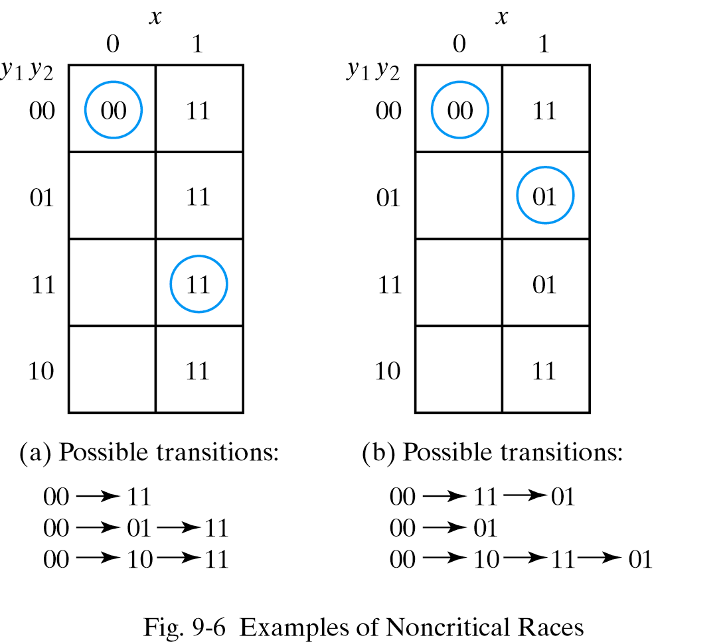
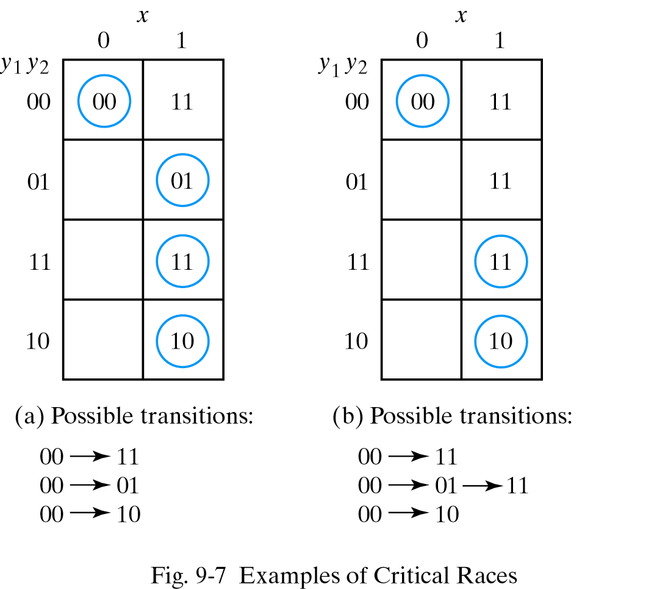
9.2 Analysis Procedure – Race Conditions
Two or more binary state variables change value in response to a change in an input variable.

Slide 7
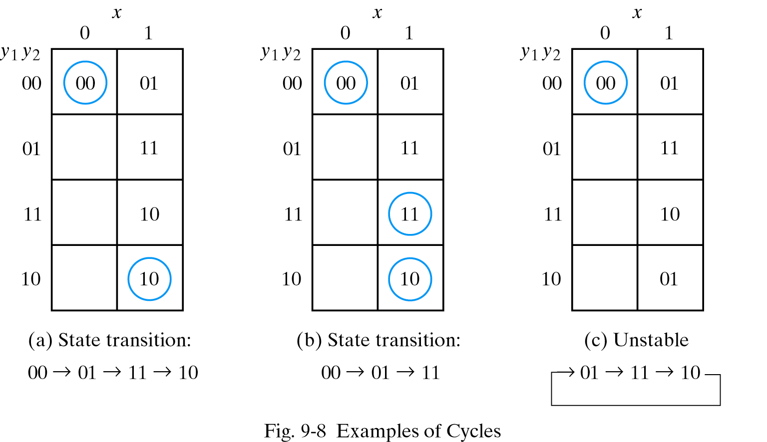
9.2 Analysis Procedure – Race Conditions

Slide 8
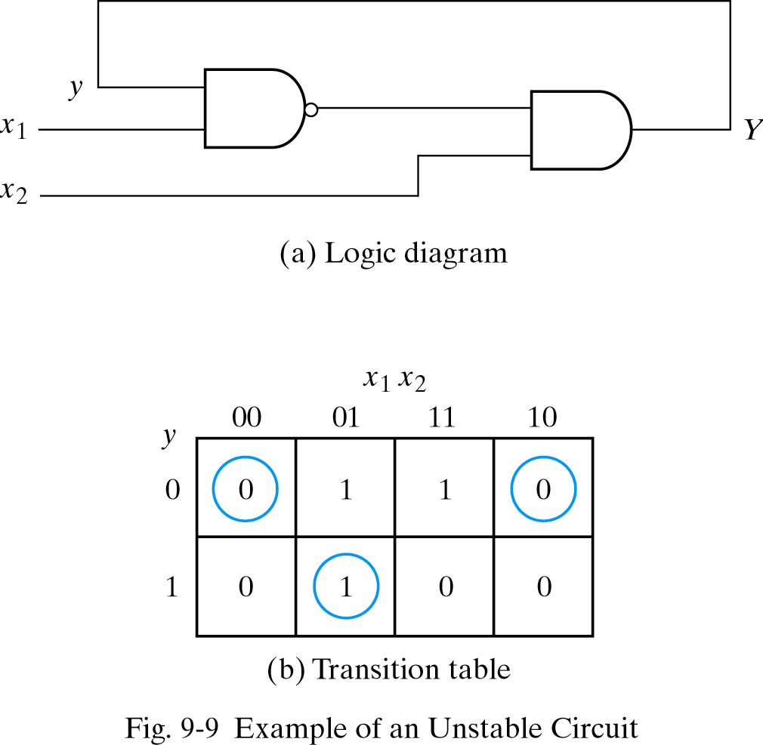
9.2 Analysis Procedure – Stability Considerations
An unstable condition will cause the circuit to oscillate.
Y=(x₁y)’x₂=(x`₁+y`)x₂=x`₁x₂+x₂y`

Slide 9
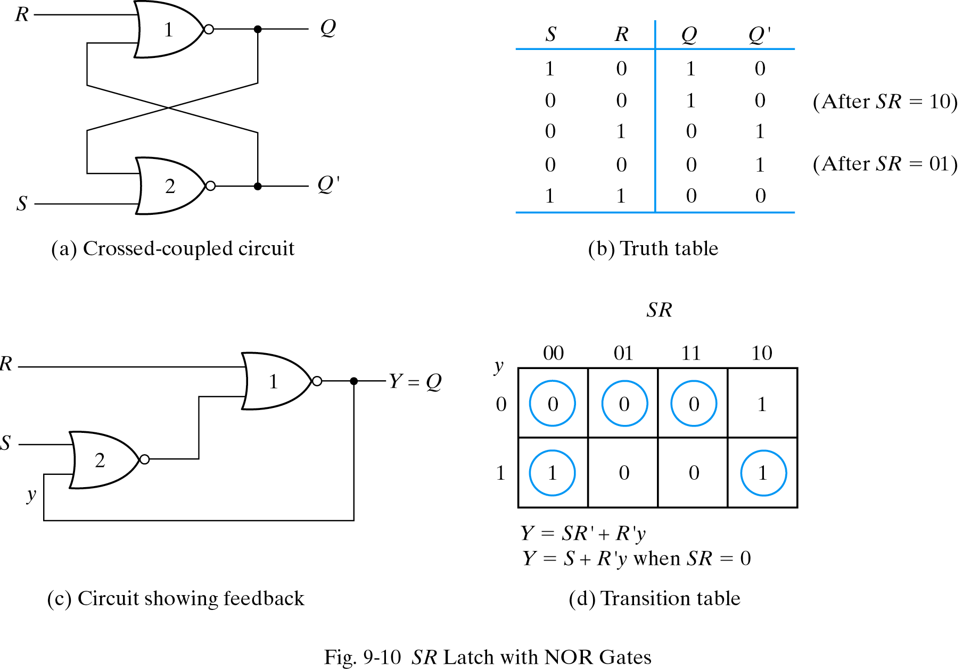
9.3 Circuits with Latches – SR Latch

Slide 10
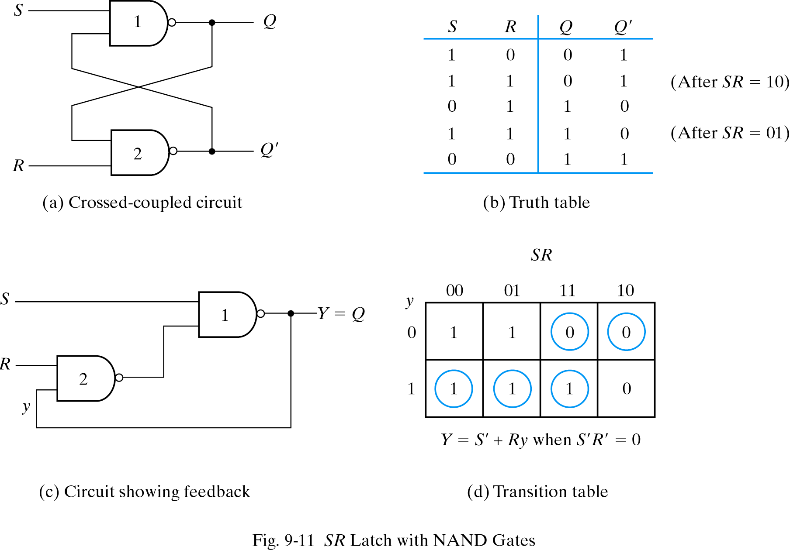
9.3 Circuits with Latches – SR Latch

Slide 11
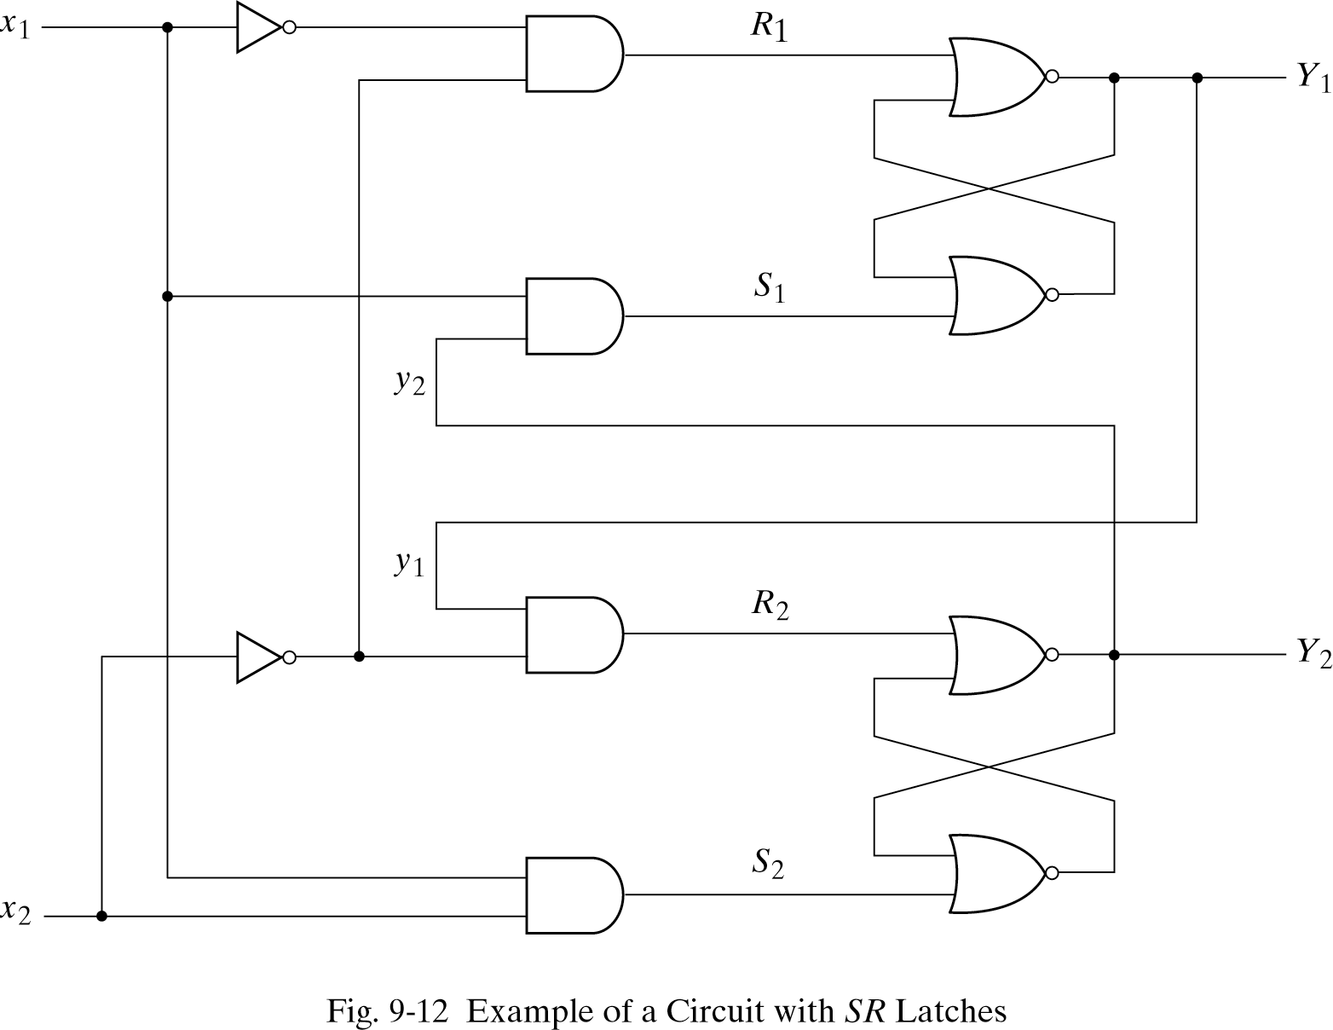
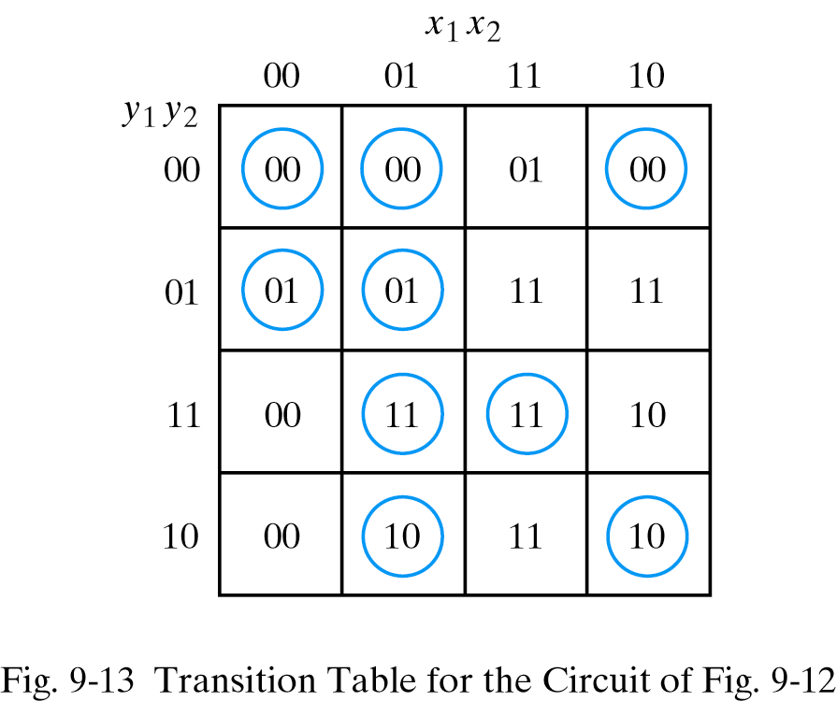
9.3 Circuits with Latches – Analysis Example
S₁=x₁y₂
R₁=x`₁x`₂
S₂=x₁x₂
R₂=x`₂y₁
Y₁=S₁+R`₁y₁=x₁y₂+(x₁+x₂)y₁=x₁y₂+x₁y₁+x₂y₁
Y₂=S₂+R`₂y₂=x₁y₂+(x₂+y`₁)y₂=x₁y₂+x₂y₂+y`₁y₂

Slide 12
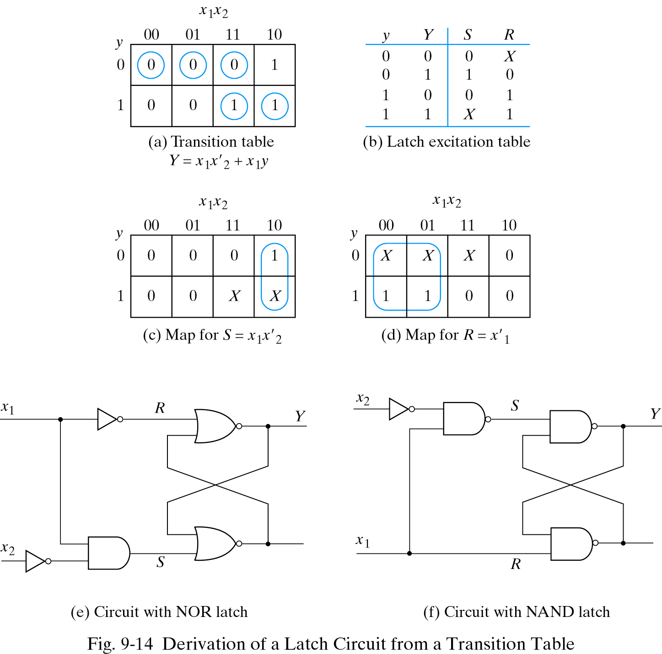
9.3 Circuits with Latches – Latch Excitation Table

Slide 13
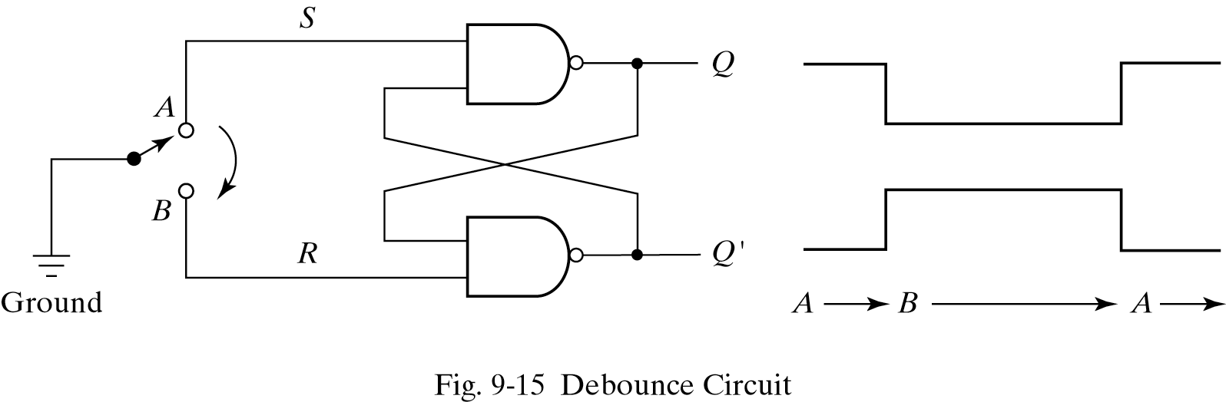
9.3 Circuits with Latches – Debounce Circuit
Producing a smooth transition of the binary signal from 0 to 1 or from 0 to 1.
S=0, R=1 Q=1, Q`=0
S=1, R=0 Q=0, Q`=1

Slide 14
9.4 Design procedure
Design step
Obtain primitive flow table from design
specification
Reduce states
Assign binary numbers to letter symbols
→ transition table
Derive logic diagram

Slide 15
9.4 Design procedure - Design example
Gated latch circuit (specification)
Two inputs : G(gate), D(data)
One output : Q
G=1 : D input is transferred to the Q
  G=0 : Q does not change
  G=1→0 : Q retains previous input D

Slide 16
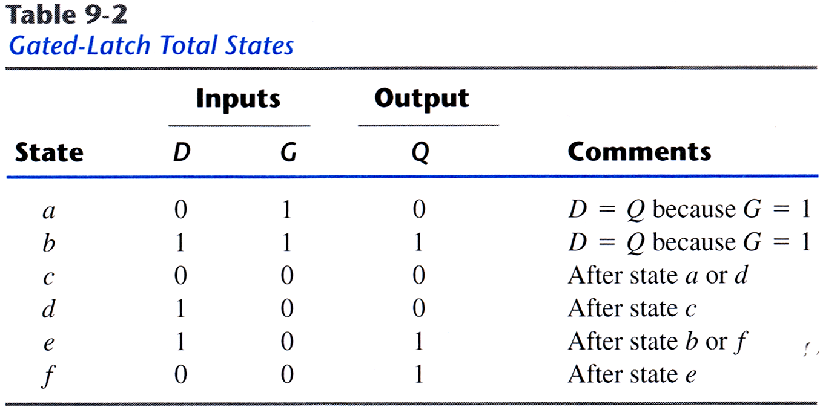
9.4 Design procedure - Primitive flow table
Gated latch total states
Fundamental mode : simultaneous transitions of two input variables are not allowed

Slide 17
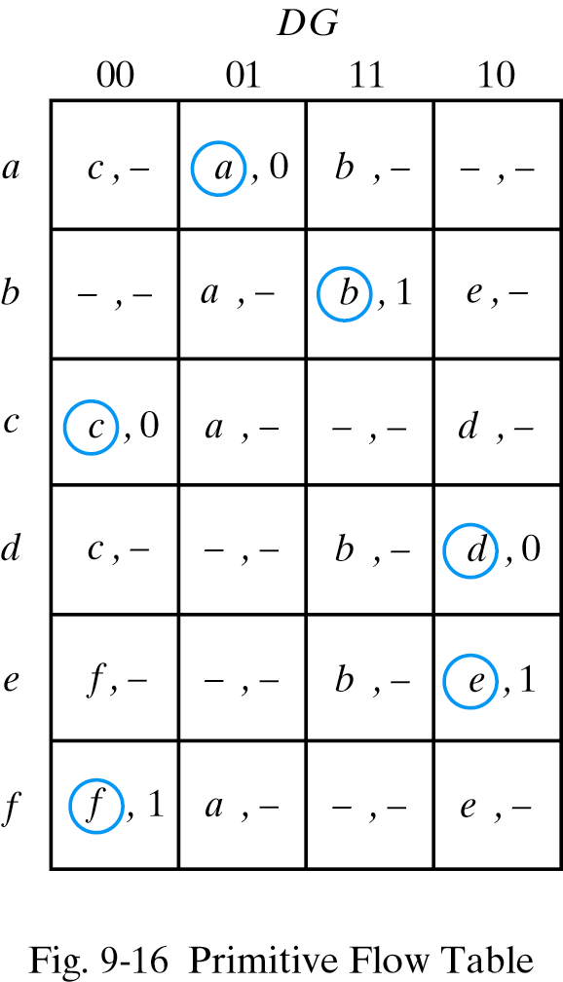
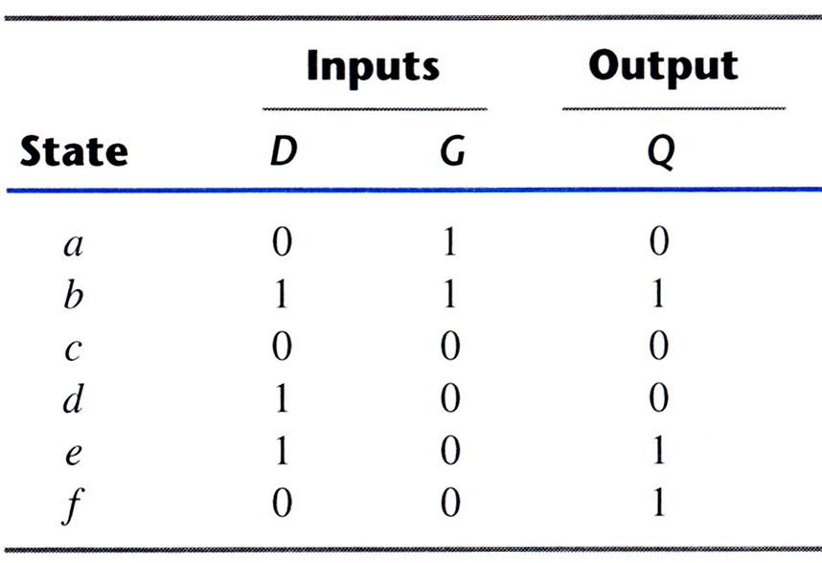
9.4 Design procedure - Primitive flow table
c,- ; d,- ; e,- : from the comments
-,- : both input variables cannot change

Slide 18
9.4 Design procedure - Reduction of the primitive flow table
Merging : the grouping of stable states to one
common row
Merging rules
Non conflicting states and outputs in a column
If any state circled, also circled in merged row
Output value is included in merged row

Slide 19
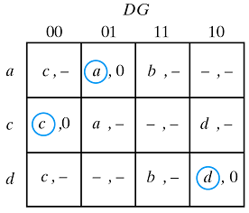
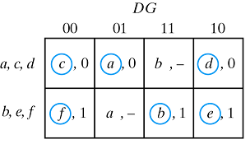
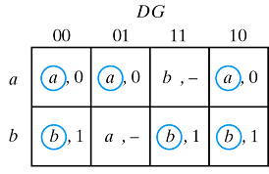
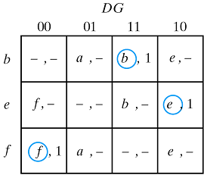
9.4 Design procedure - Reduction of the primitive flow table
From fig.9-16

Slide 20
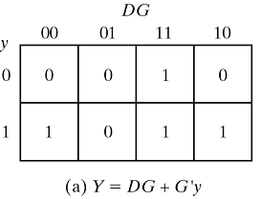
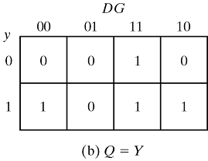
9.4 Design procedure - Transition table & Logic Diagram
Assign binary values to each states
(flow table → transition table)
a→0, b→1
Don’t care condition

Slide 21
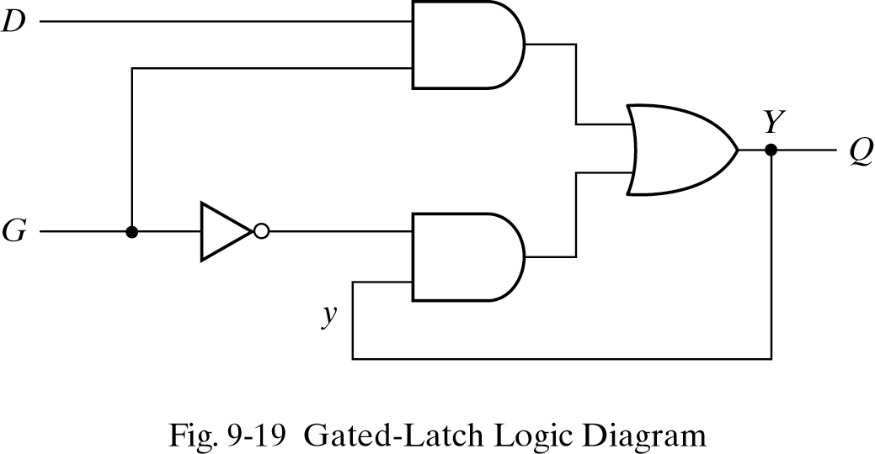
9.4 Design procedure - Transition table & Logic Diagram
Y=DG+G′y, Q=Y

Slide 22
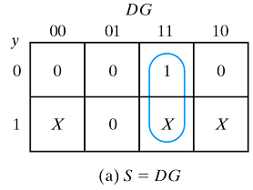
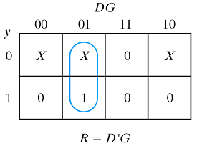
9.4 Design procedure - Transition table & Logic Diagram
Logic diagram with SR latch
- By excitation table

Slide 23
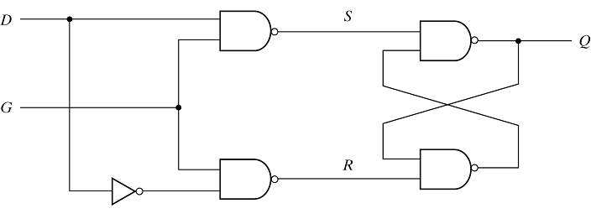
9.4 Design procedure - Transition table & Logic Diagram
Logic diagram with SR latch
- S=DG, R=D′G

Slide 24
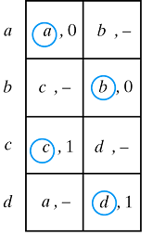
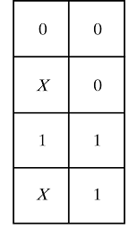
9.4 Design procedure - Assigning output to unstable states
Have to avoid momentary false output during transition
0-0 : - must be 0
0-1 : - can be 0 or 1
(Assign output value)

Slide 25
9.5 Reduction of state and flow tables
Implication table : can find equivalent states
Make cross whose outputs are not equal for
every input
Enter the implied states
Check equivalent and non-equivalent state

Slide 26
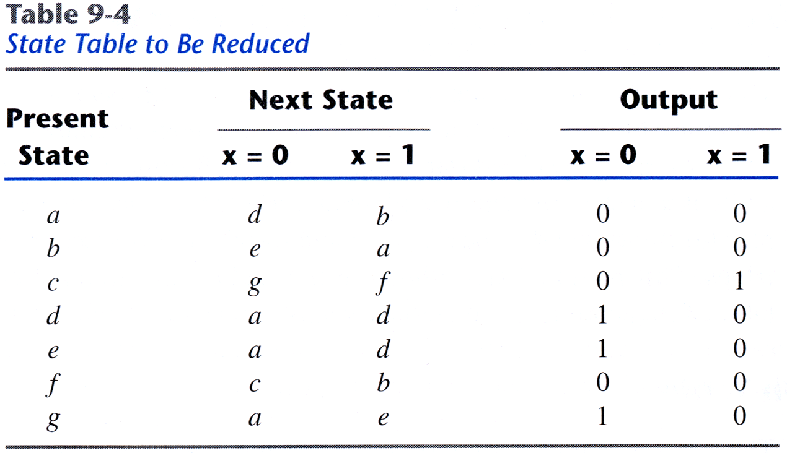
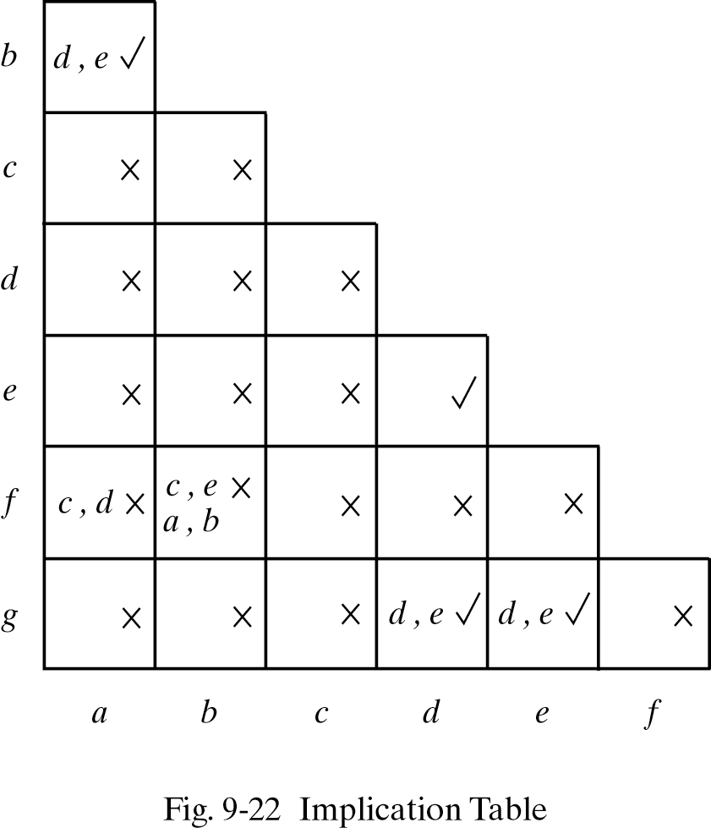
9.5 Reduction of state and flow tables - Implication table & state table
X : not equivalent
√ : equivalent

Slide 27
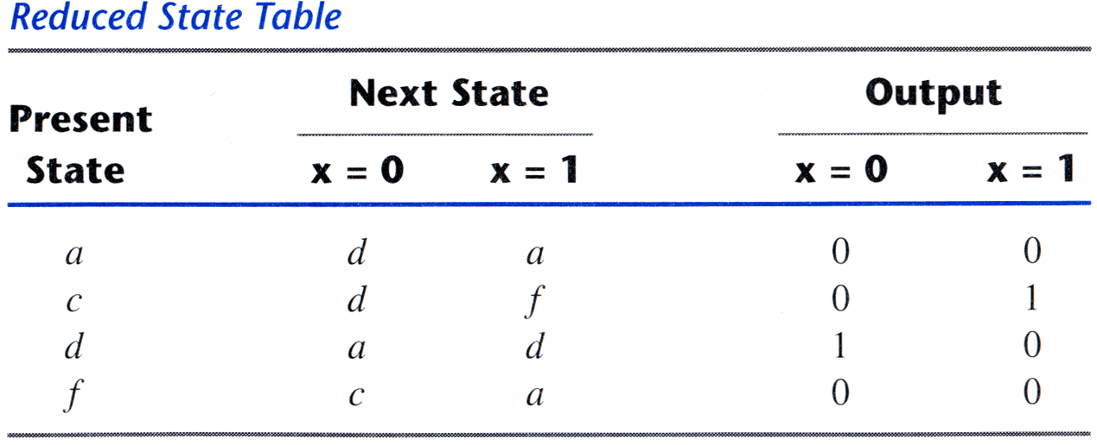
Reduced state table
9.5 Reduction of state and flow tables - Implication table & state table
- 4 equivalent states exist
→ (a,b) (d,e) (d,g) (e,g)
- 7 states reduced to 4 states
→ (a,b) (d,e,g) (c) (f)

Slide 28
9.5 Reduction of state and flow tables - Merging of the flow table
In case of incompletely specified states
Compatible : two incompletely specifide states that can be combined
Steps for merging a flow table
Determine all compatible pairs
Find maximal compatibles
Find a minimal collection of compatibles satisfying closed covering condition

Slide 29
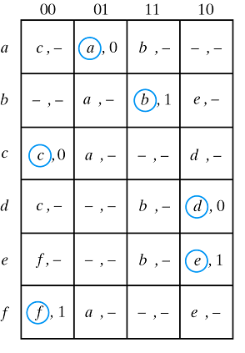
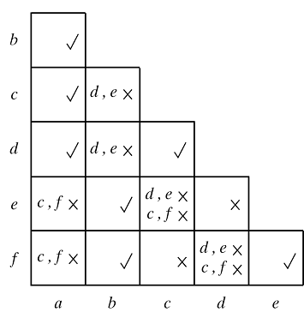
9.5 Reduction of state and flow tables - Compatible pairs
Identical pair and no conflict in output

Slide 30
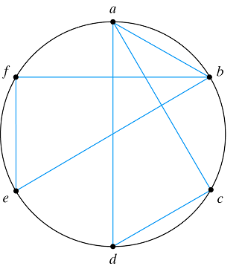
9.5 Reduction of state and flow tables - Maximal compatibles
All the possible combinations of the compatible states
state
Compatible pair
All compatible pairs : (a,b) (a,c) (a,d) (b,e) (b,f) (c,d) (e,f)
Maximal compatibles : (a,b) (a,c,d) (b,e,f)

Slide 31
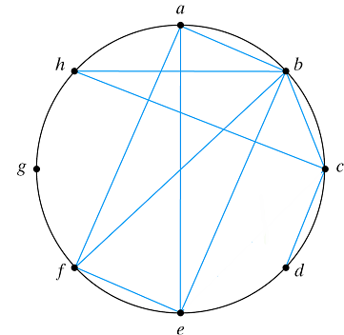
9.5 Reduction of state and flow tables - Merger diagram
In case of 10 compatible pairs
Maximal compatibles : (a,b,e,f) (b,c,h) (c,d) (g)

Slide 32
9.5 Reduction of state and flow tables - Closed covering condition
Row merging must satisfy closed covering condition
Covering : compatible set include all the states of original state table
Closed : two closure condition exist

Slide 33
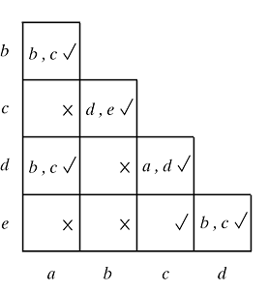
9.5 Reduction of state and flow tables - Closed covering condition
Closure
- No
No implied states in compatibles
Implied states are in the compatible set

Slide 34
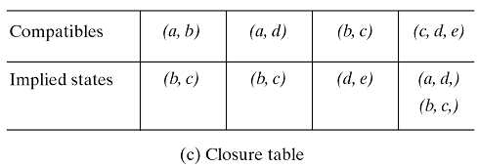
Minimal collection of compatibles
9.5 Reduction of state and flow tables - Closed covering condition
Choosing a set of compatibles
Maximal compatibles : (a,b) (a,d) (b,c) (c,d,e)
To satisfy closed covering condition, we select : (a,d) (b,c) (c,d,e) or (a,b) (b,c) (d,e)

Slide 35
9.6 Race free state assignment
To avoid critical race is important when assign binary variables
  → adjacent assignment(differ only one variable : 010 and 011 are adjacent)
Two types of method exist
Shared-row method
Multiple-row method

Slide 36
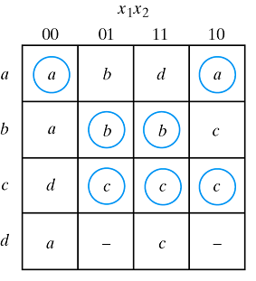
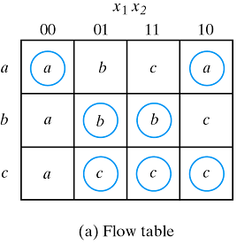
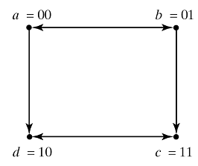
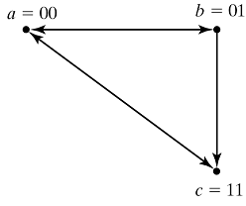
9.6 Race free state assignment - Three-row flow-table example
Add an extra row
Add row d

Slide 37
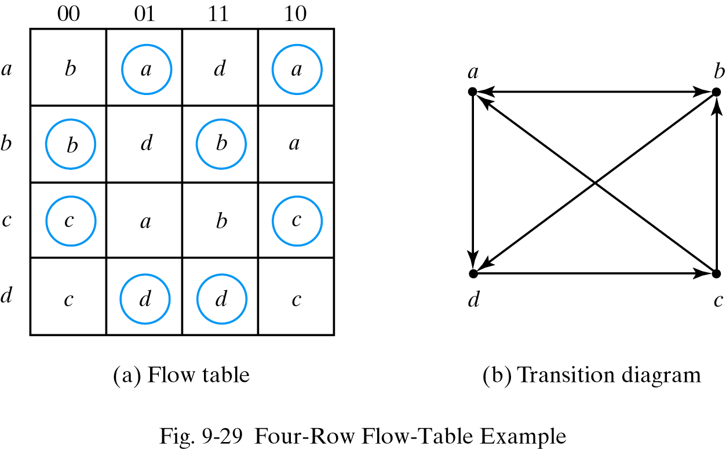
9.6 Race free state assignment - Four-row flow-table example
3 binary state variables are needed

Slide 38
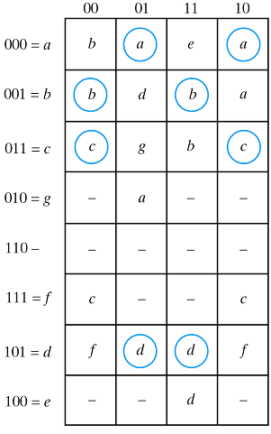
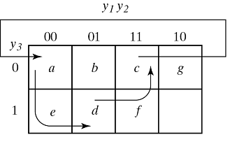
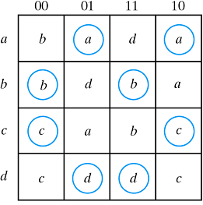
9.6 Race free state assignment - Four-row flow-table example
Assignment map

Slide 39
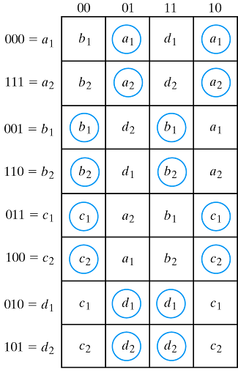
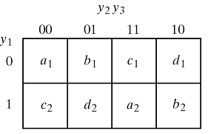
9.6 Race free state assignment - Multiple-row method
Not effective but
easy to apply
Divide one stable
state to two states
(Assignment map)

Slide 40
9.7 Hazards
Another circuit restriction like critical race
Unwanted switching transition at the output(temporary false output value)
Caused by different propagation delay of different paths exhibit

Slide 41


9.7 Hazards - Hazards in combinational circuits
Static-1-hazard : temporary false output 0 occurs
AND-OR circuit
NAND circuit

Slide 42

9.7 Hazards - Hazards in combinational circuits
Eliminating a hazard
- Enclose two minterm
111→101
→Requires the addition of redundant gates

Slide 43
9.7 Hazards - Hazards in sequential circuits
In synchronous circuits, hazards are not of concern
In asynchronous circuits, it makes some wrong stable states by feedback

Slide 44

9.7 Hazards - Implementation with SR latch
Another way to avoid static hazard
Change gate 3 to part of latch
1
0
1→0
0→1

Slide 45


9.7 Hazards - Implementation with SR latch
Consider a NAND SR latch
1
1
0
NAND occurs static-1-hazard : though two inputs are momentarily 1, Q remains 1 because of Q'

Slide 46
9.8 Design example
1
Design
specification
2
Primitive
flow table
3
Merging
the rows
4
5
6
Binary
assignment
Transition
Table,
Output map
Logic diagram
with SR latch

Slide 47
9.8 Design example - Design specification
Negative edge triggered T flip-flop
Two inputs : T(toggle), C(clock)
One output : Q
Toggle happens when T=1 and C changes 1 to 0

Slide 48


9.8 Design example - Primitive flow table

Slide 49

9.8 Design example - Merging of the flow table
Compatible pairs : (a,f) (b,g) (b,h) (c,h) (d,e) (d,f) (e,f) (g,h)

Slide 50

9.8 Design example - Merging of the flow table
Merger diagram
- From merger diagram we can get maximal
compatible set
Maximal compatible : (a,f) (b,g,h) (c,h) (d,e,f)

Slide 51


Reduced flow table
9.8 Design example - Merging of the flow table
- From maximal compatible, can reduce flow table

Slide 52


9.8 Design example - State assignment and transition table
Have to put adjacent assignment value
Reduced flow table
Transition table
Output map
(Q=y2)

Slide 53


9.8 Design example - Logic diagram
From the excitation table of SR latch
In case of Y1

Slide 54


9.8 Design example - Logic diagram
In case of Y2

Slide 55






9.8 Design example - Logic diagram

