Slide 1
10 . Digital integrated circuits

Slide 2
10.1 Introduction
IC digital logic families
RTL : Resistor-transistor logic
DTL : Diode-transistor logic
TTL : Transistor-transistor logic
ECL : Emitter-coupled logic
MOS : Metal-oxide semiconductor
CMOS : Complementary MOS

Slide 3
10.2 Special characteristics
Fan-out
Power dissipation
Propagation delay
Noise margin

Slide 4
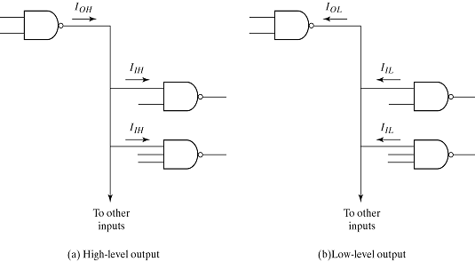
10.2 Special characteristics - Fan-out
The maximum number of inputs that can be connected to the output of a gate
Calculated from the current ratio
Select small value
IOH/IIH,
IOL/IIL

Slide 5
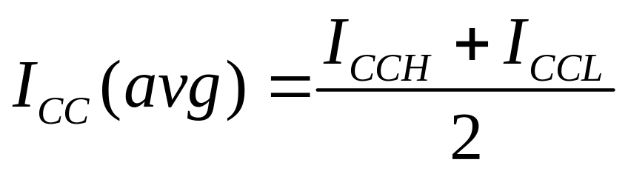
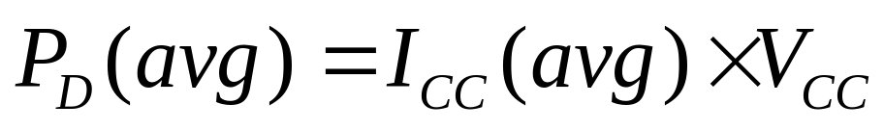
10.2 Special characteristics - Power dissipation
Power delivered to the gate from the power supply
Take the average current, ICC(avg)
Average power dissipation

Slide 6
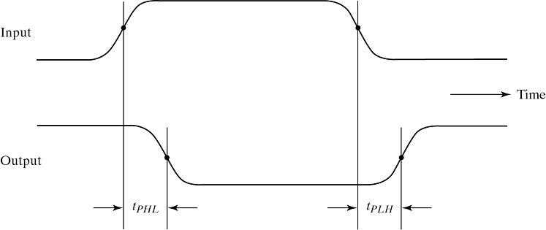
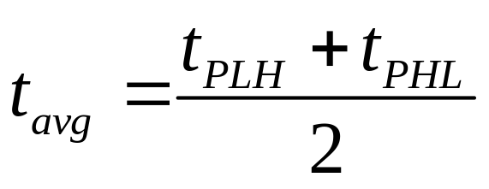
10.2 Special characteristics - Propagation delay
Average transition delay time for the signal to propagate from input to output
Calculated from tPLH and tPHL
50% point

Slide 7
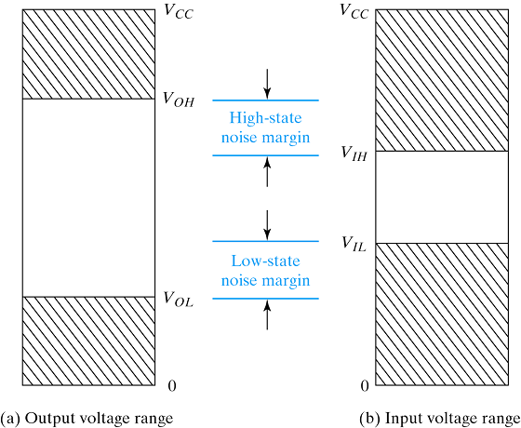
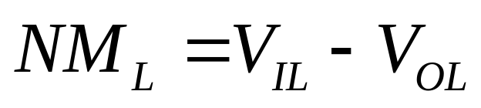
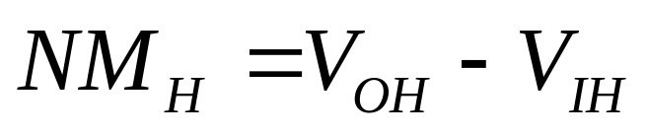
10.2 Special characteristics - Noise margin
The maximum noise signal that can be tolerated by the gate

Slide 8
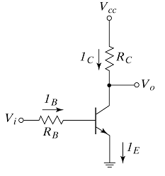
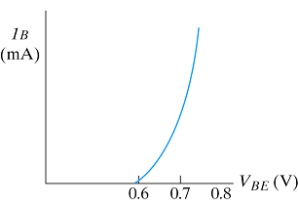
10.3 Bipolar transistor characteristics
npn transistor characteristics
Base characteristic
Cut off : no base current flow
Inverter circuit

Slide 9
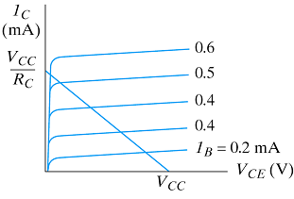
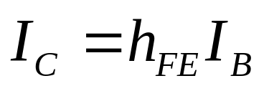
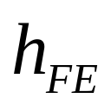
10.3 Bipolar transistor characteristics
npn transistor characteristics
- Collector characteristic
VCE-IC characteristic
: dc current gain

Slide 10
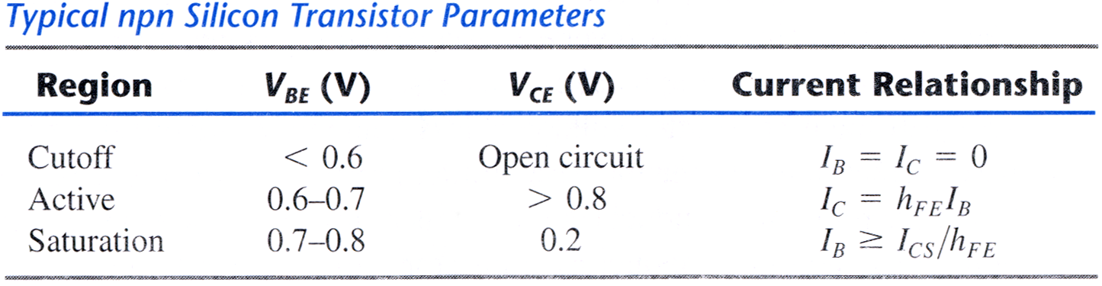
10.3 Bipolar transistor characteristics
Operation region
- Transistor operation
ICS : maximum collect current flowing during saturation
Saturation : though IB is increased, IC stay constant

Slide 11
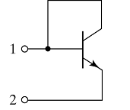
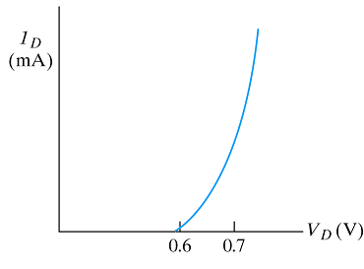
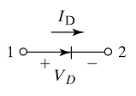
10.3 Bipolar transistor characteristics
IC diode from bipolar transistor
- Collector connect to the base
Act as base-emitter junction
Diode characteristic
Graphic symbol

Slide 12
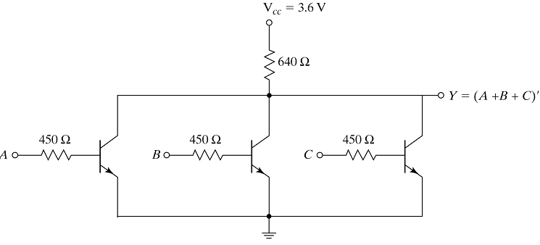
10.4 RTL and DTL circuits
RTL basic NOR gate
Low=0.2V
High=1 to 3.6V
Any input is high, the transistor is on→Y=low
All inputs are low, transistors are off→Y=high

Slide 13
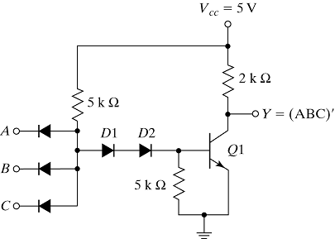
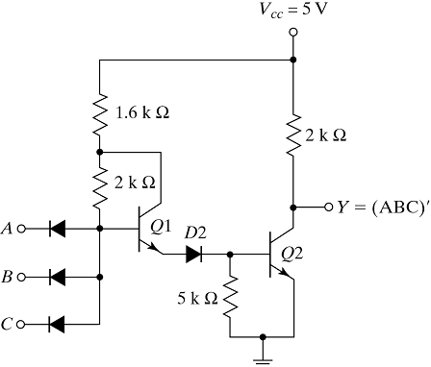
10.4 RTL and DTL circuits - DTL basic gates
Basic NAND and modified gate
Low=0.2V
High=4 to 5V
Any input is low, input diode conduct→Q1 cutoff, Y=high
All inputs are high, input diodes are off→Q1 saturation, Y=low
Modified gate can drive large amount of current→increase fan-out capability

Slide 14
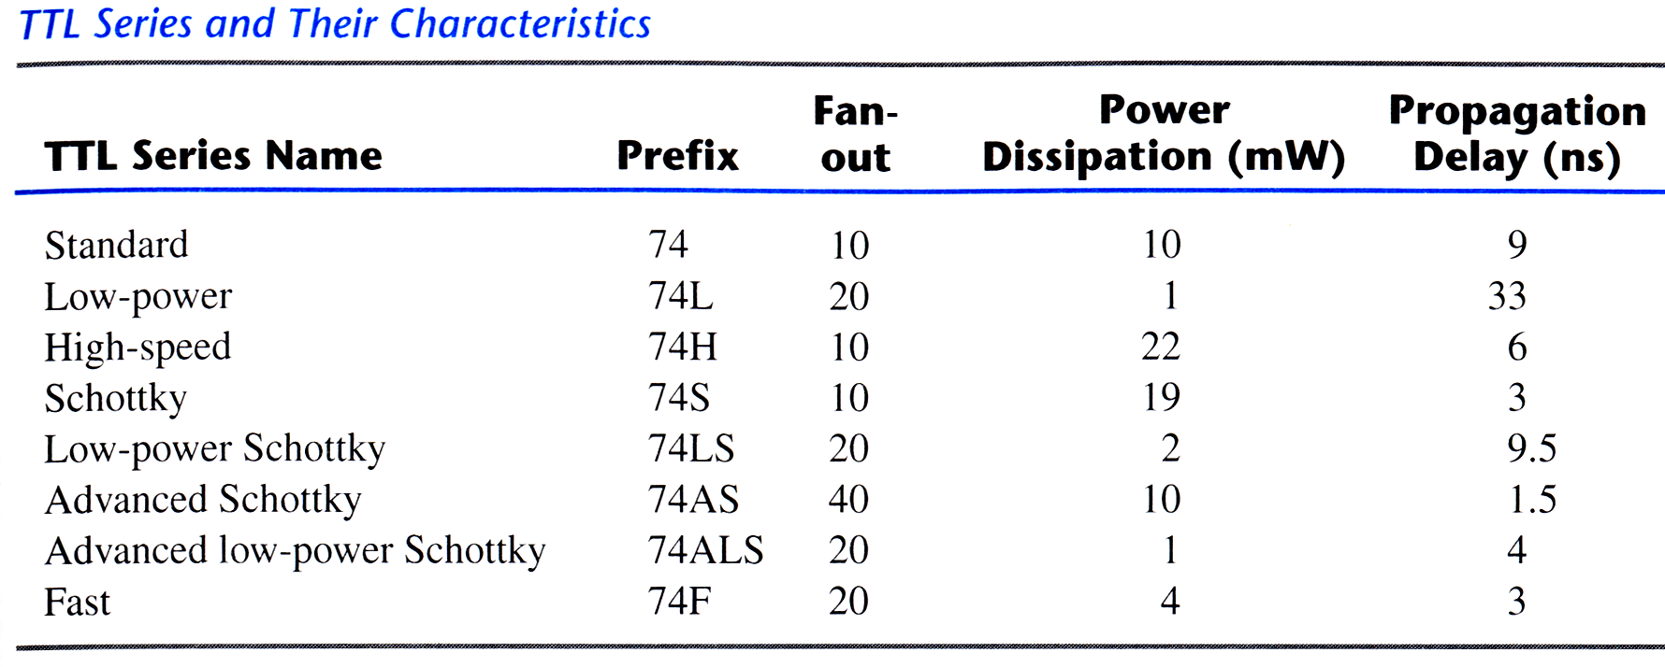
10.5 Transistor-transistor logic(TTL)
Improved type of DTL
Power dissipation ↔ delay : trade-off by RC network
Higher R value : power dissipation ↓, delay ↑
Lower R value : power dissipation ↑, delay ↓

Slide 15
Output configuration
10.5 Transistor-transistor logic(TTL)
Output configuration
- Have three different types of output configuration
- Open-collector output
- Totem-pole output
- Three-state output

Slide 16
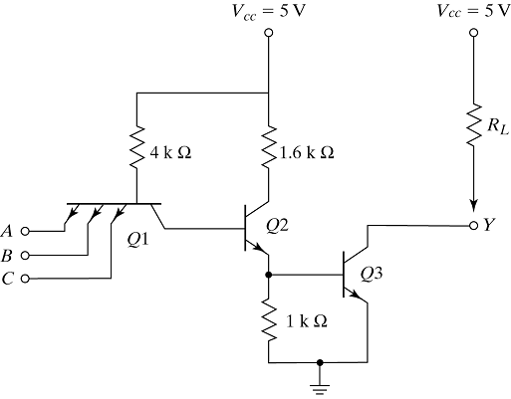
10.5 TTL - Open Collect Output Gate
Modified circuit of DTL gate
Q1, Q2 act as D1, D2 of DTL
Can reduce the delay time
Three application exist
D1
D2
-Lamp
-Wired AND logic
-Common bus system
Open-collector NAND gate

Slide 17
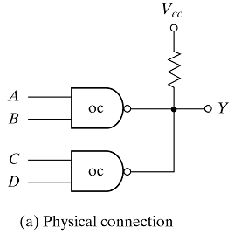
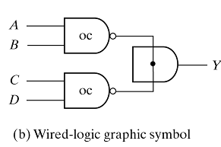
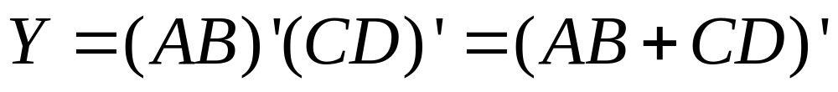
10.5 TTL - Open Collect Output Gate
Wired AND logic
- To tie the outputs of several open-collector TTL gates
Wired AND function

Slide 18
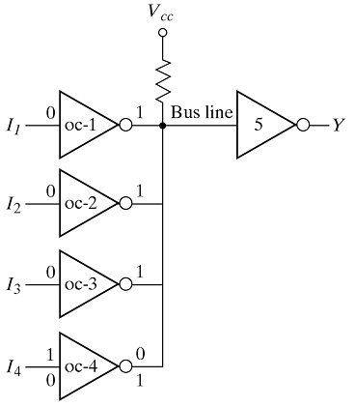
10.5 TTL - Open Collect Output Gate
Common bus
- Connection of several sources tied to a common bus line
Stay at 1
The data of I4 transferred to Y
Y=I4

Slide 19
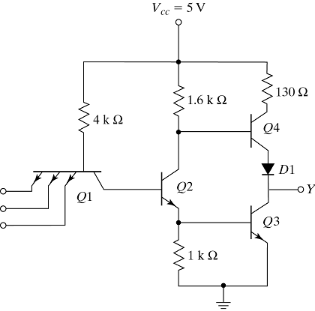
10.5 TTL - Totem-pole output
Active pull-up circuit can reduce the propagation delay
Can reduce RL

Slide 20
10.5 TTL - Schottky TTL gate
Eliminate saturation condition by placing schottky diode between base and collector → schottky transistor
Can reduce propagation delay without the sacrifice of power dissipation

Slide 21
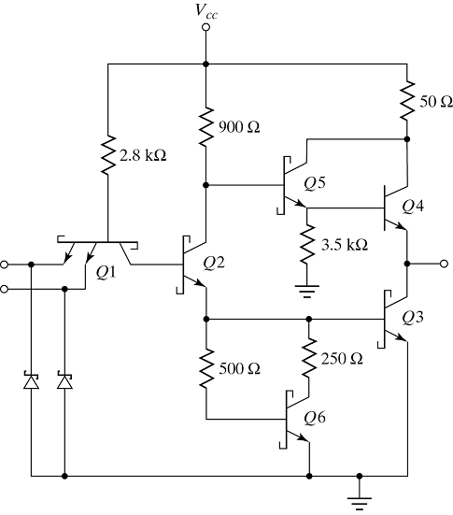
10.5 TTL - Schottky TTL gate
Darlington pair : double emitter-follower
Darlington pair : very high current gain, low resistance
Schottky diode : clamp any ringing in input lines

Slide 22
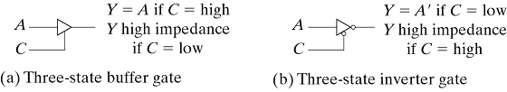
10.5 TTL - Three-state gate
Wired outputs of totem-pole gate for the purpose of forming a common bus system
Graphic symbol of three-state gate

Slide 23
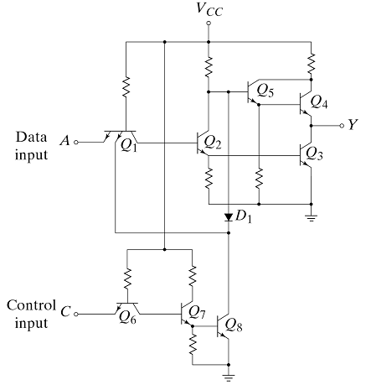
Three-state inverter gate
10.5 TTL - Three-state gate
C=low → Y=A'
C=high → Y=high
impedance
Totem-pole TTL gate
Open-collector gate

Slide 24
10.6 Emitter-coupled logic(ECL)
Non saturated digital logic
Used in very high speed operation
Worst noise immunity and power dissipation
Consist of three parts

Slide 25
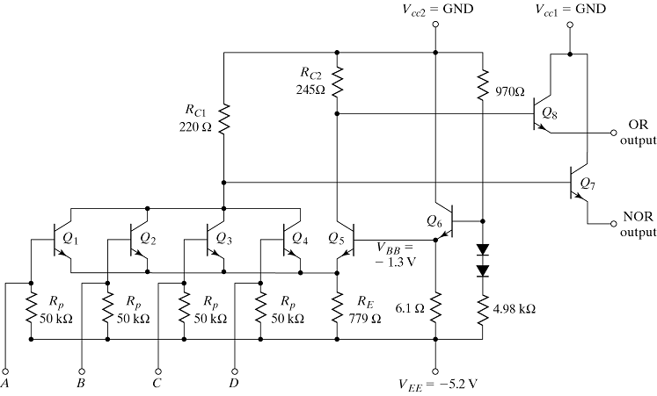
10.6 Emitter-coupled logic(ECL)
Differential input amplifier
Temperature and voltage compensated bias
Emitter-follower outputs

Slide 26
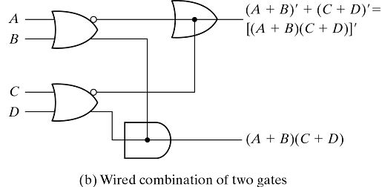
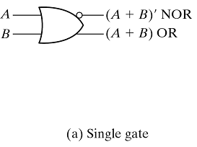
10.6 Emitter-coupled logic(ECL)
Graphic symbols of ECL gates

Slide 27
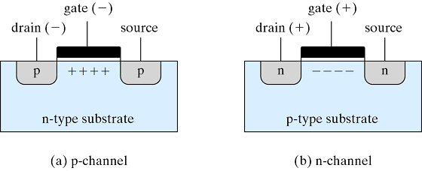
10.7 Metal oxide semiconductor(MOS)
Unipolar transistor : current flows by only majority carrier
Gate voltage control the current that flows through the channel
Current flow

Slide 28
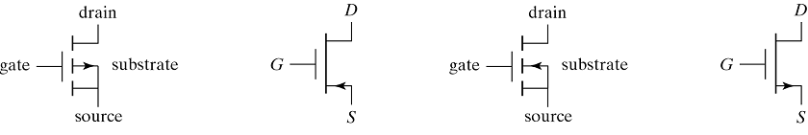
10.7 Metal oxide semiconductor(MOS)
Types of MOS
- p-type MOS
- n-type MOS
- Enhancement mode
- Depletion mode
By majority carrier
By existence of channel at zero volt condition
p-channel MOS
n-channel MOS

Slide 29
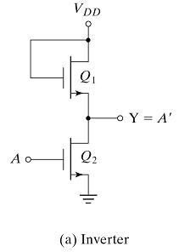
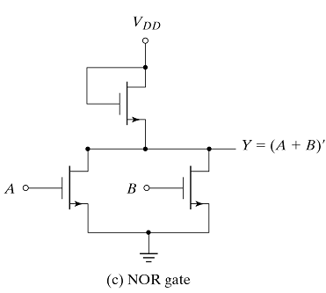
10.7 Metal oxide semiconductor(MOS)
MOS logic circuits
- MOS can be used as resistor
rDS=VDS/ID

Slide 30
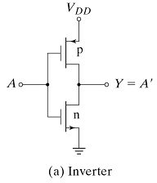
10.8 Complementary MOS(CMOS)
Both n/p-type devices fabricated on the same substrate
A=high , NMOS is on PMOS is off
A=low , NNOS is off PMOS is on
There is no direct path between VDD and GND

Slide 31
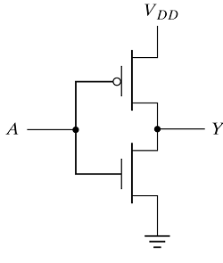
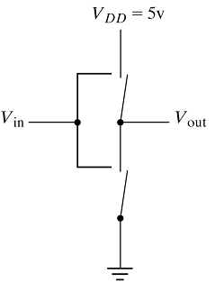
10.8 Complementary MOS(CMOS)
Switch model of CMOS
- MOS can be considered as electronic switch
Logic model
Switch model

Slide 32
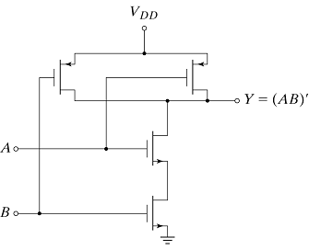
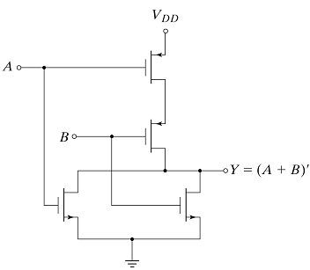
10.8 Complementary MOS(CMOS)
CMOS logic circuits
NAND gate
NOR gate

Slide 33
10.8 Complementary MOS(CMOS) - CMOS characteristics
Static state : very low power dissipation
Fabrication process is simpler than TTL
Have greater packaging density
Good noise immunity
Reasonable propagation delay

Slide 34
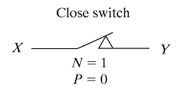
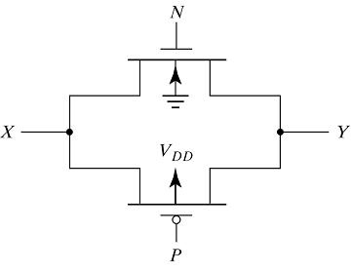
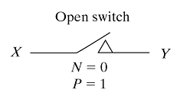
10.9 CMOS transmission gate circuits
Electronic switch controlled by an input logic level

Slide 35
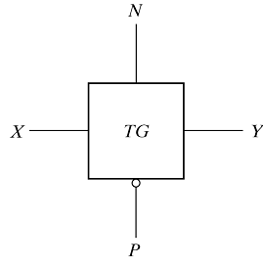
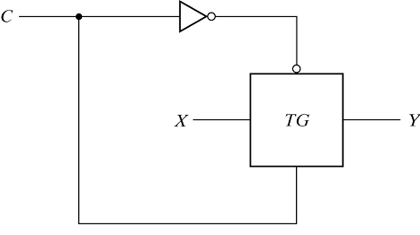
10.9 CMOS transmission gate circuits
CMOS transmission gate
- Block diagram and widely used type of transmission
gate(bilateral switch)
Bilateral switch
Block diagram
C=1, switch is closed
C=0, switch is open

Slide 36
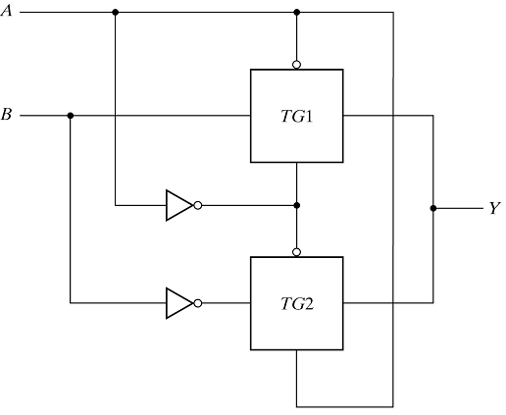
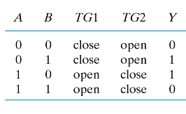
10.9 CMOS transmission gate circuits
Exclusive-OR gate
- XOR gate constructed with transmission gate
A=0 → Y=B'
A=1 → Y=B

Slide 37
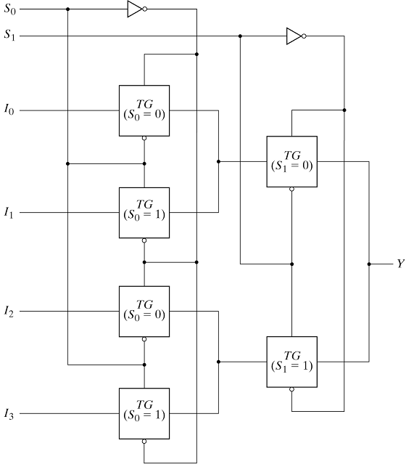
4-to-1 line multiplexer
10.9 CMOS transmission gate circuits
TG is controlled by selection inputs
S0 S1 | Y
0 0 1 0 0 1 1 1 | I0 I1 I2 I3

Slide 38

Gated D-latch
10.9 CMOS transmission gate circuits
1
2
C=1, make path through TG1 → Q=D
C=0, TG1 is open → Q retains the transition
time value of D

