Slide 1
Arduino Environment
Arduino platform
Arduino board
Direct programming
Arduino schematics
Arduino IDE
Compiling code
Arduino shields libraries
Arduino basic setup
Arduino simulators

Slide 2
Arduino platform

Slide 3
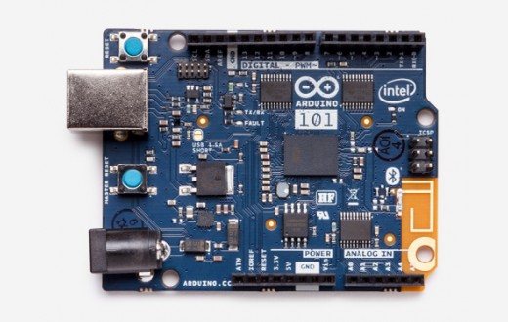
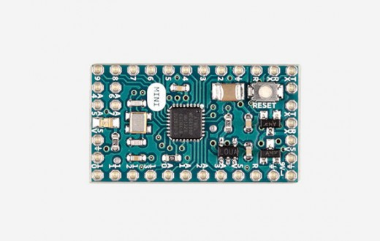
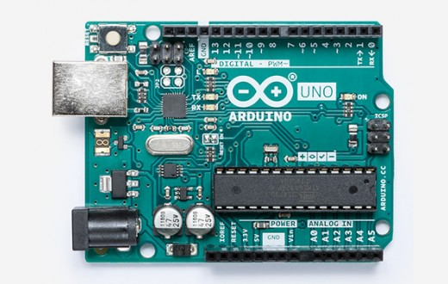
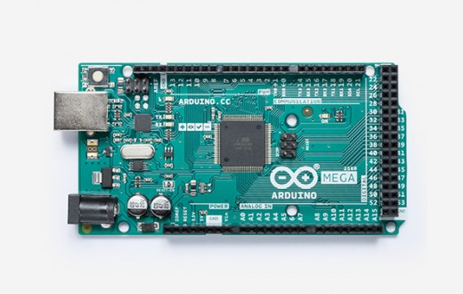
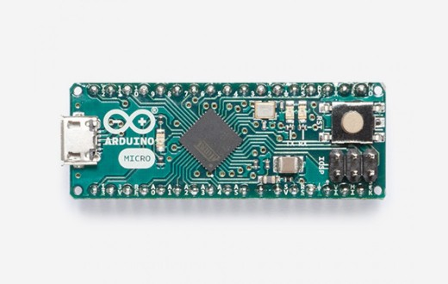
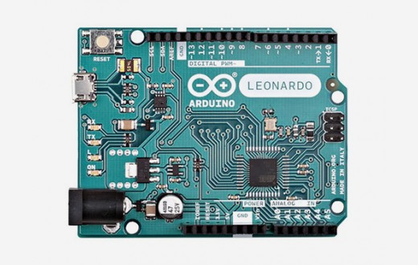
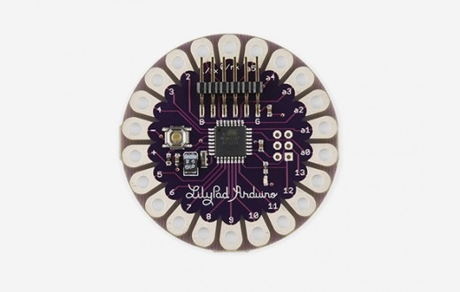
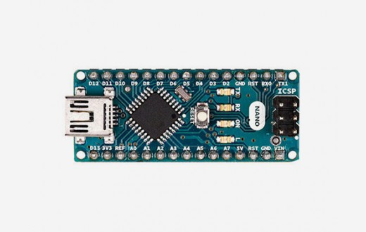
Arduino

Slide 4
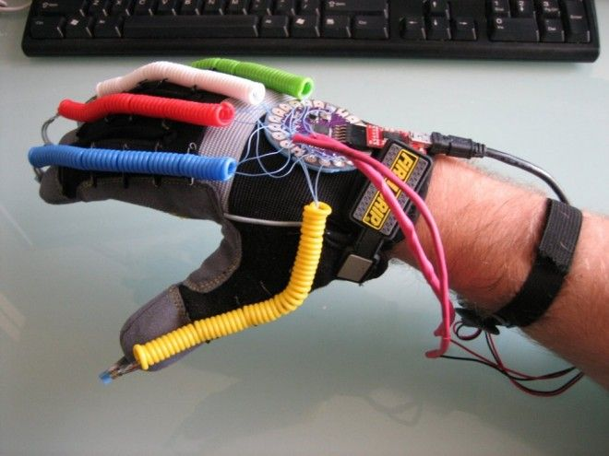
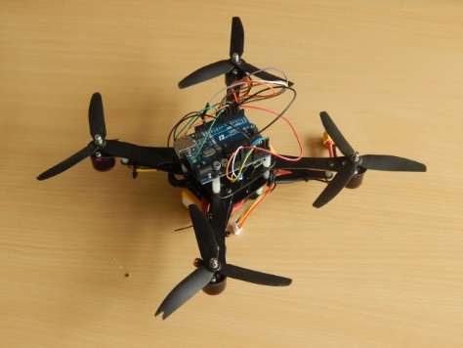

Arduino applications

Slide 5

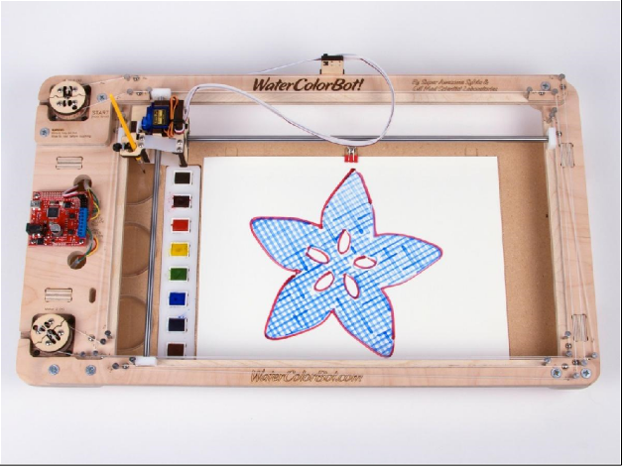

Arduino applications

Slide 6

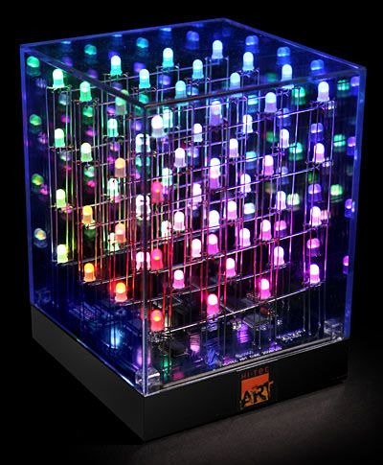
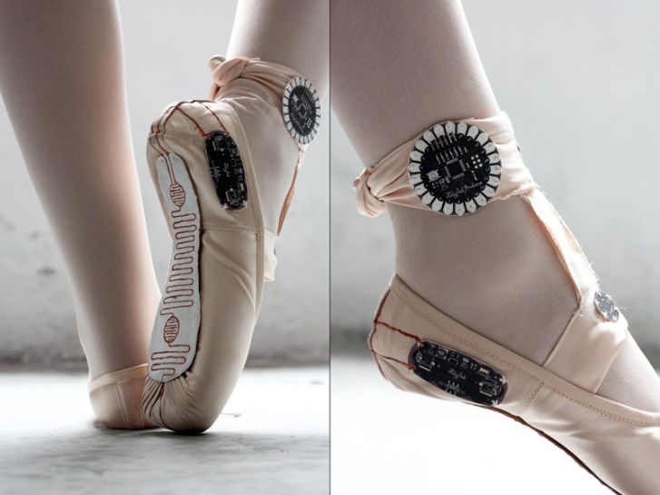
Arduino applications

Slide 7
Arduino environment
A development board
8-bit microcontroller
Programming hardware
USC programming interface
I/O pins

Slide 8
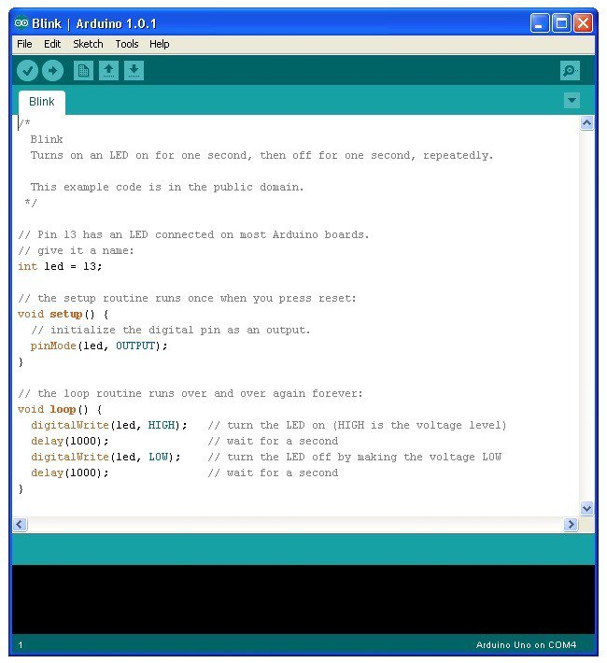
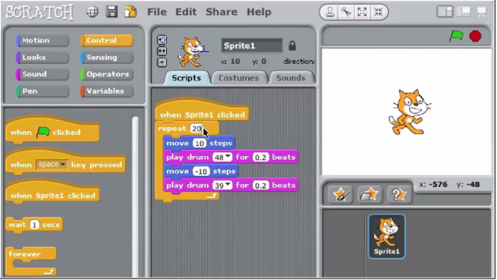
Arduino environment
A software environment
Cross-compiler
Debugger
Simulator
Programmer

Slide 9
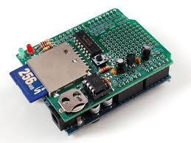
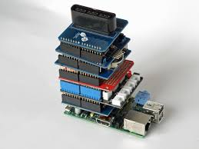
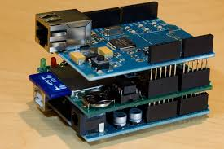
Arduino environment
Special-purpose “shields”
Daughter boards
Unique functionalities
Easy to attach
Good libraries provided

Slide 10
Arduino board

Slide 11
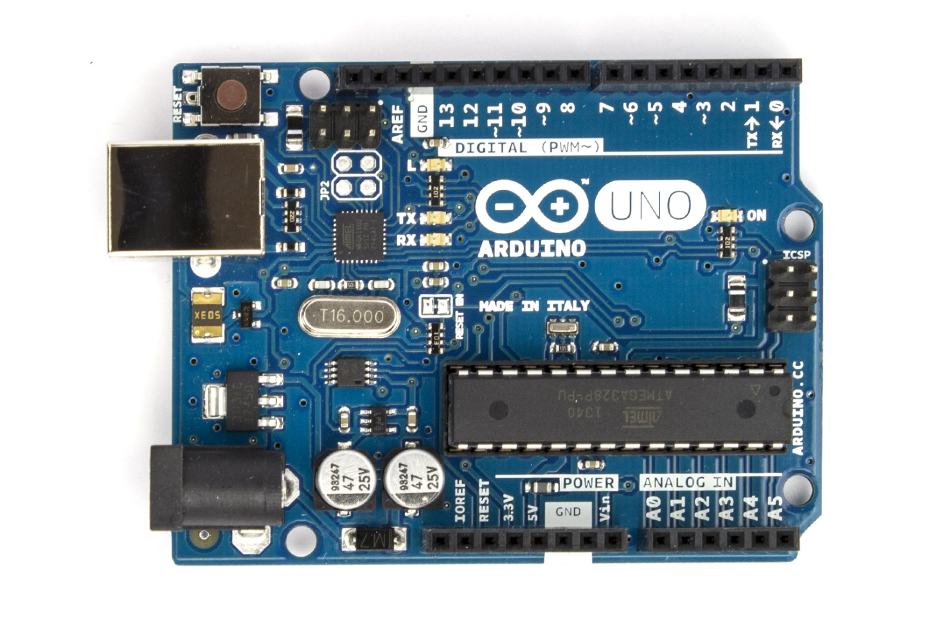
The Arduino development board
Has a microcontroller and USB interface to a PC
Large open source community

Slide 12
Power/Reset
Reset button
USB connector
Power connector

Slide 13
Input/Output pins
Digital I/O
Power/reset pins
Digital I/O pins
Analog input pins
Power/reset pins
Analog inputs

Slide 14
Microcontrollers
ATmega16U2
Main processor
ATmega328 processor programmed by the user
USB com. processor
ATmega16U2 handles USB communication
ATmega328

Slide 15
Microcontroller
Microcontroller | ATmega328
Operating voltage | 5V
Input voltage (recommended) | 7-12V
Input voltage (limits) | 6-20V
Digital I/O pins | 14 (of which 6 provide PWM output)
Analog input pins | 6
DC current per I/O pin | 40mA
DC current for 3.3V pin | 50mA
Flash memory | 32KB (ATmega328) (of which 0.5KB used by bootloader)
SRAM | 2KB (ATmega328)
EEPROM | 1KB (ATmega328)
Clock speed | 16MHz

Slide 16
Firmware
Two types of code executing on a simple microcontroller
Application code
Executes the system’s main functionality
We write this code
Firmware
Low-level code: supports the main function
USB interface, power modes, reset, etc.
The distinction is a matter of perspective
Arduino-firmware is pre-programmed

Slide 17
Direct programming

Slide 18
Bootloader
Firmware on a microcontroller
Allows the Flash and EEPROM to be programmed
Manages USB communication since application programming is via USB

Slide 19
In-Circuit Serial Programming (ICSP)
A special programming method to program the firmware
Needed because the bootloader cannot reprogram itself
One ICSP header for each processor

Slide 20
Arduino schematics

Slide 21
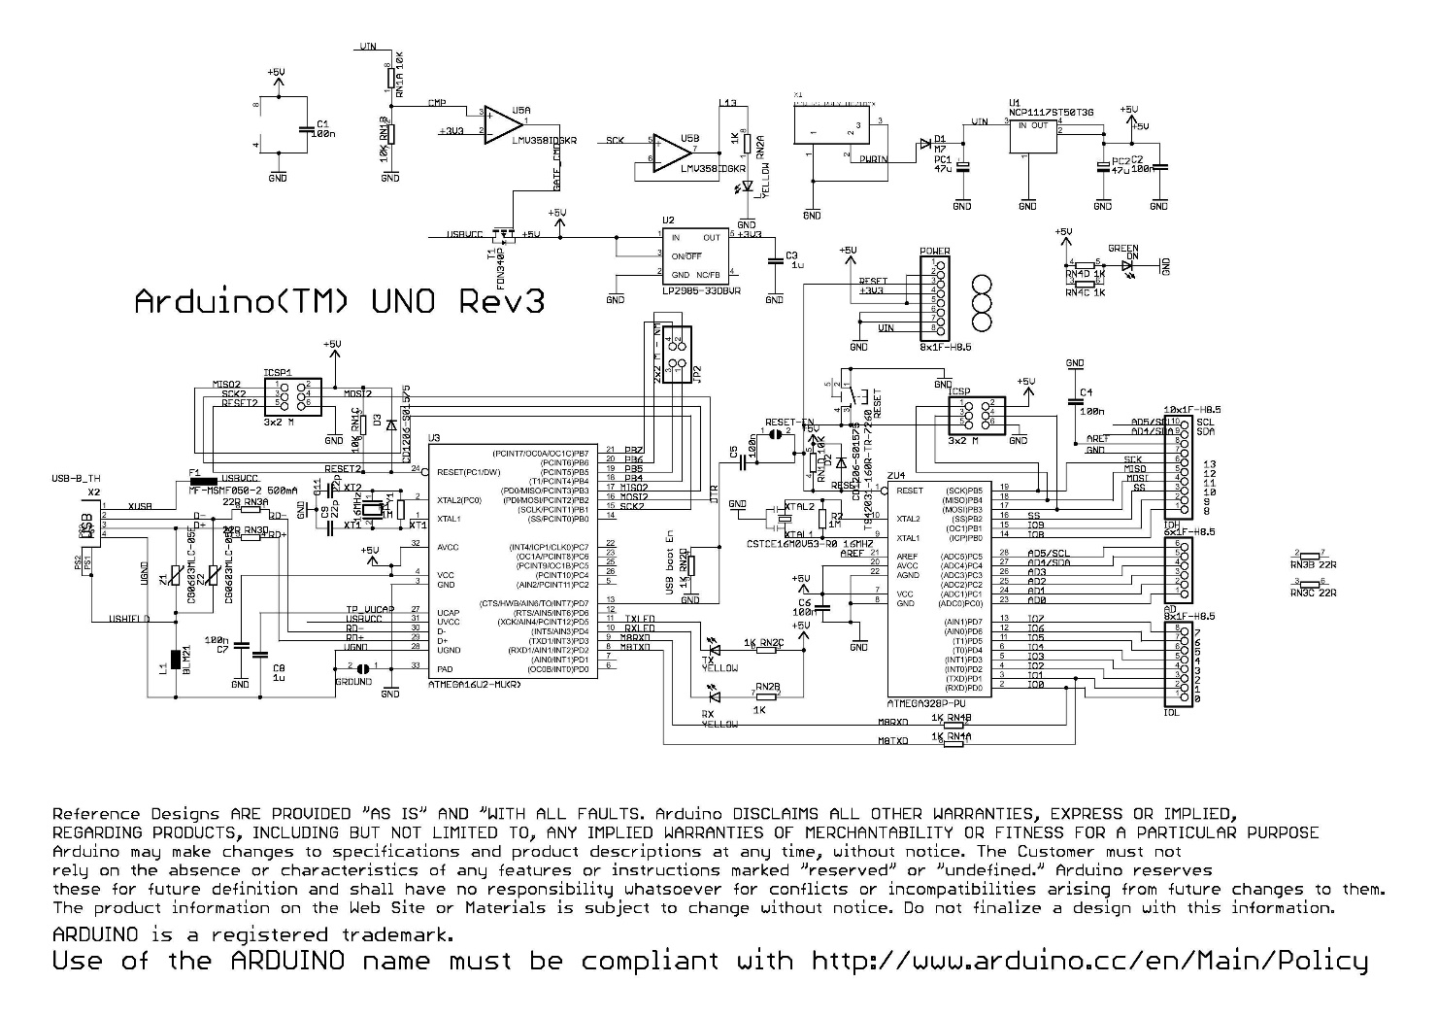
Arduino UNO schematic
Arduino designs are open source
Design is available
You can build your own

Slide 22
Microcontrollers and I/O
Power pins
Analog in
Digital I/O
ATmega16U2
ATmega328

Slide 23
USB, Power, ICSP
Power connector
ICSP2
ICSP 1
USB connector
ATmega16U2
ATmega328

Slide 24
Arduino IDE

Slide 25
Arduino IDE
Menus with all commands
Arduino IDE (Integrated Development Environment)
Buttons with common commands
Text editor for writing code
Message area

Slide 26
Arduino IDE
Button | Function
Verify | Compiles code, checks for errors
Upload | Compiles code, checks for errors, uploads to board
New | Creates a new sketch
Open | Opens an existing sketch
Save | Saves your sketch to a file
Serial Monitor | Opens a window to communicate with the board

Slide 27
Compiling code

Slide 28
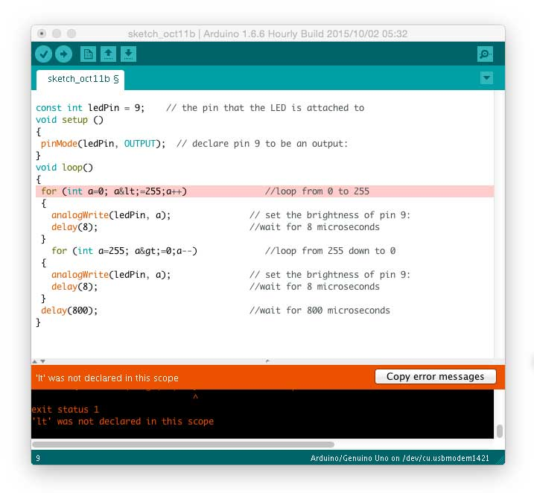
Compiling code
Verify and Upload both compile
Messages window will show either completion message or error messages
Error messages will show line numbers

Slide 29
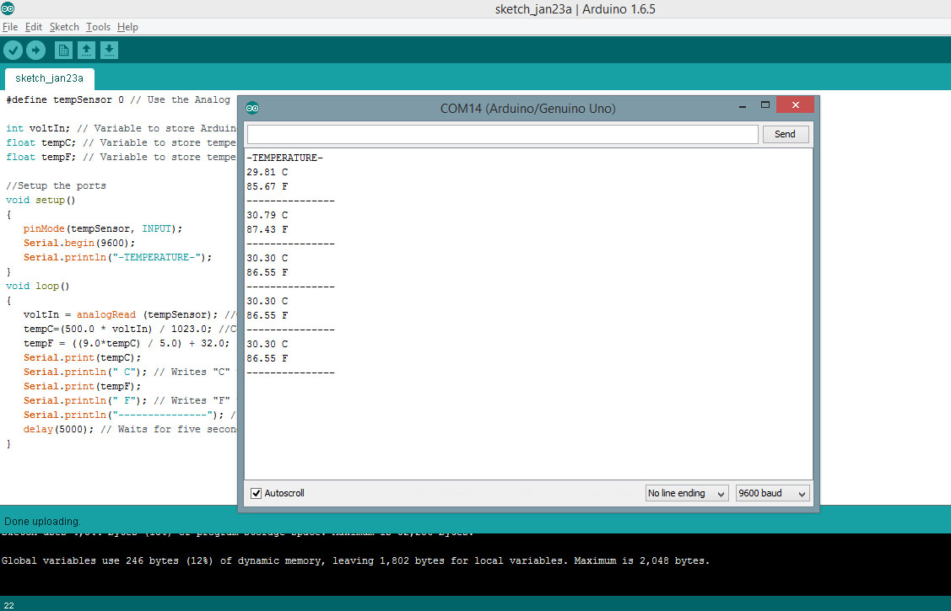
Serial monitor
Displays serial data sent from the Arduino
Allows serial data to be sent to the Arduino from the keyboard
Library functions in the serial library

Slide 30
Arduino shields and libraries

Slide 31
Arduino shields
Add-on boards that interface with another device/IC
Can be stacked directly on top of the Arduino
Libraries exist to make interfacing simple
Open source hardware, but most can be purchased
Large variety of shields available
Big advantage of the Arduino platform
Fairly complete list is at http://shieldlist.org

Slide 32
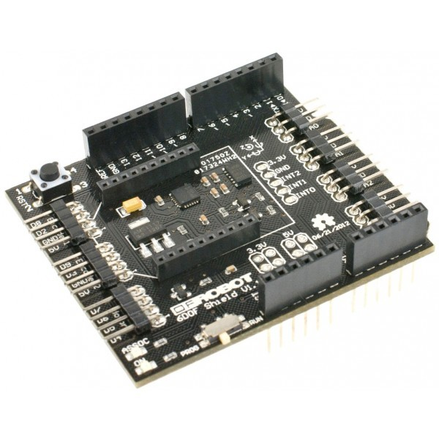
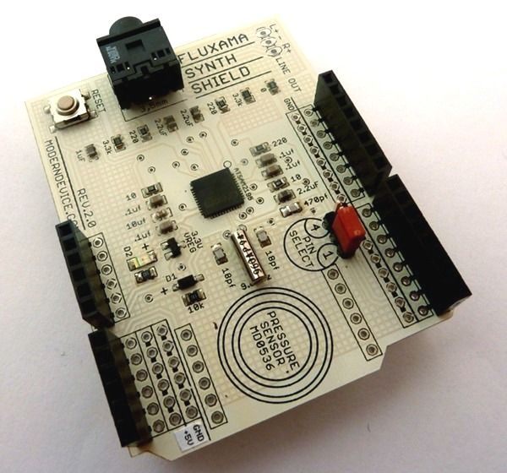
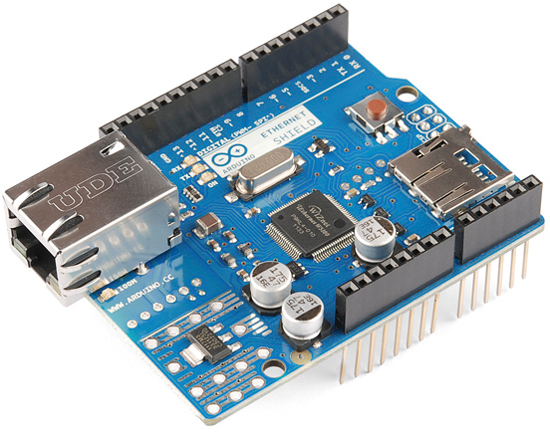
Some Arduino shields
IMU shields:
Measures 6DOF motion
(acceleration and rotation)
Synthesizer shields:
Generates music
Connects to speaker
Ethernet shields:
Interfaces to Ethernet controllers
Builds web servers/clients

Slide 33
Arduino basic setup

Slide 34
Set up the Arduino IDE
Download the IDE
Easiest to run Windows Installer (http://www.arduino.cc)
Also installs USB and other drivers
Connect the board to your computer
Use USB cable
Launch the Arduino application
Starts the IDE

Slide 35
Launch the Arduino IDE
Open the Blink example
File→Examples→Basics→Blink

Slide 36
Run a program
Select your Arduino
Tools→Board menu
Select your serial port
Tools→Port menu
There should be only one selection (COM3, etc.)
Upload the program with the upload button
This writes the program onto the Flash of the Arduino
The LED near pin 13 of the Arduino should blink

Slide 37
Arduino simulators

Slide 38
Tinkercad: Circuits
Tinkercad
http://tinkercad.com
A free online collection of software tools that help people create and make
Simulates Arduino circuits and programs with a bunch of electronic components, sensors and actuators
A good way to test your idea before you actually build

Slide 39
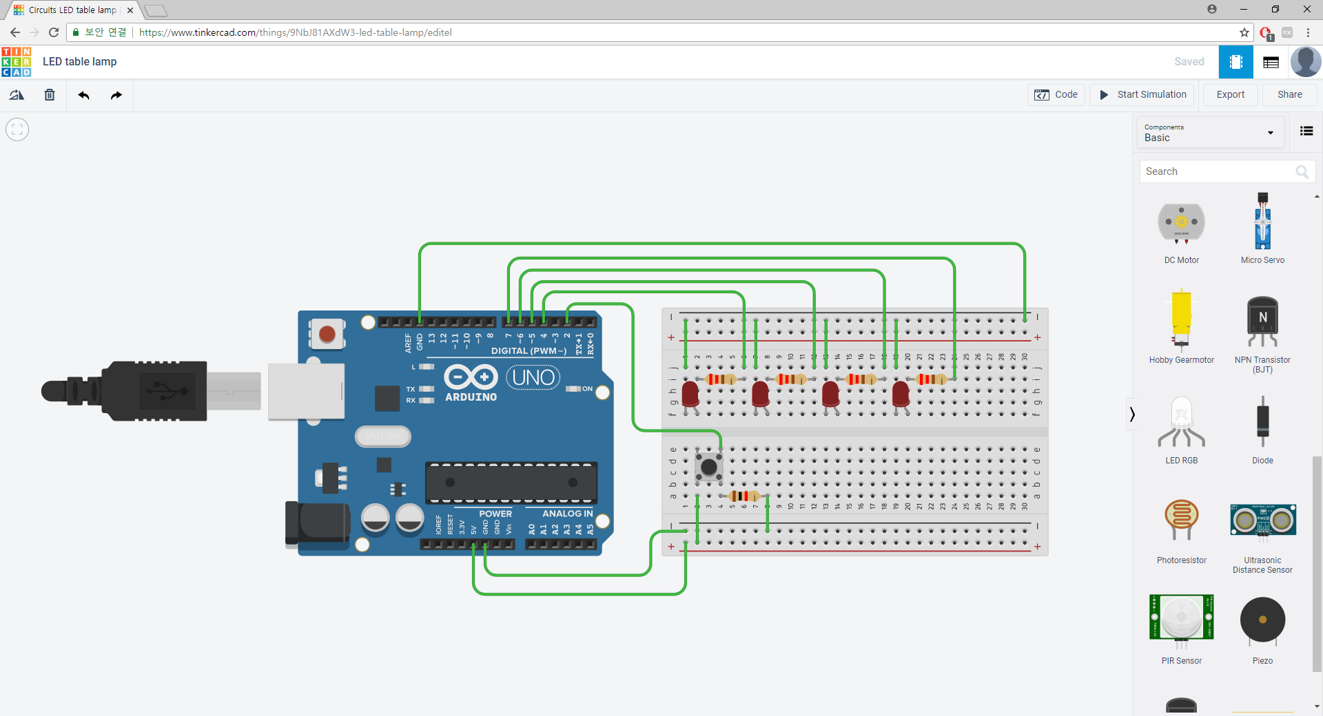
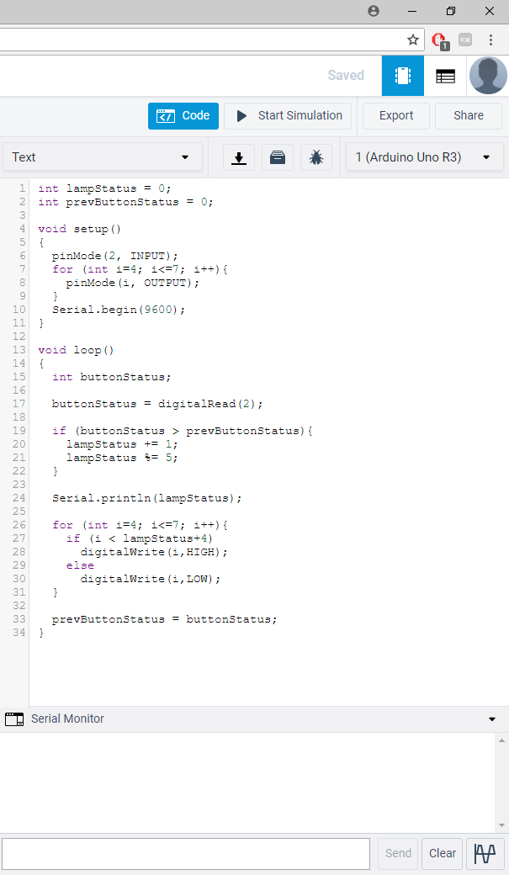
Tinkercad: Circuits

Slide 40
Lab

Slide 41
Blink example
Set up the Arduino development environment
Load the Blink example.
Compile, download, and run.
Modify blink intervals and check if it really works.

Slide 42
Tinkercad
Go to http://tinkercad.com
Register for your own account.
Try several Arduino starter examples.
Modify some codes, and check if it works.

