Slide 1
Basic circuits
Electrical circuits
Electrical properties
Ohm’s law
Electrical components
Diodes
Switches and potentiometers
Wiring

Slide 2
Electrical circuits

Slide 3
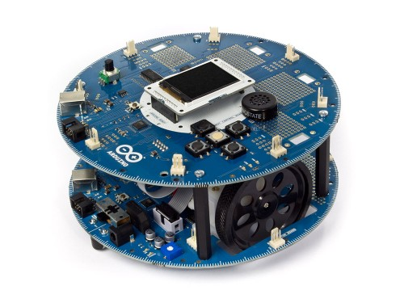
Hardware and software
Electronic devices combine hardware and software
Hardware interacts with the world
Software is the intelligence

Slide 4
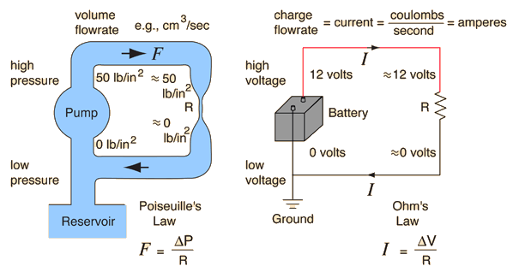
Electrical circuits
Electrical current flowing through wires
Battery/power supply moves current
Water flowing through pipes
Pump moves water

Slide 5
Electrical properties

Slide 6
Voltage
Voltage (V): potential difference between two points in the circuit
Like pressure in a water system
Measured in volts

Slide 7
Current
Current (I): rate of carrier flow
Flows from positive to negative
Electrons flow from negative to positive
Measured in amperes

Slide 8
Resistance
Resistance (R): any obstacle to current flow
For water, might be a rock or narrow pipe
For circuits, might be a bad conductor or narrow conductor
Measured in ohms

Slide 9
Ohm’s law

Slide 10
Ohm’s law
V = I * R
Expresses the relationship between V, I, and R
Used to compute one value given the other two
Some common uses:
What resistor do I need to limit current flow, so that my device is safe?
What voltage can I expect for a given resistance?

Slide 11
Electrical components

Slide 12
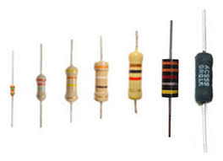
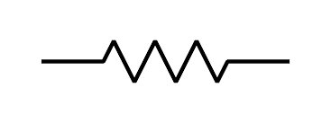
Resistors
Provides resistance to current flow
Two terminals; no difference between them
Band colors indicate resistance
Each color is a digit; scientific notation is used
Resistor

Slide 13
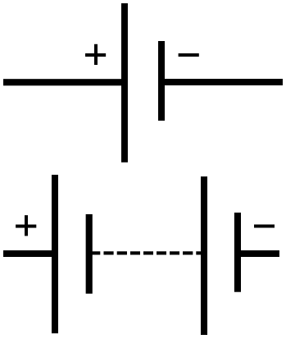
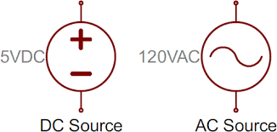
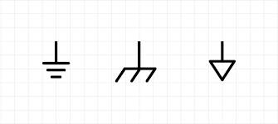
Battery / DC power
Provides voltage via power and ground
Do not create a short circuit
Batteries
Power sources
Ground

Slide 14
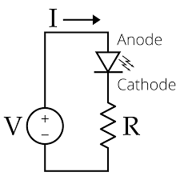
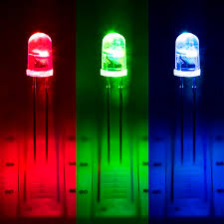
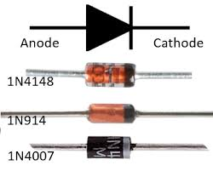
Diodes and LEDs
Two terminals: anode (+) and cathode (-)
Current only flows in one direction, anode to cathode
One-way valve
LEDs light when current flows
Diodes
LEDs

Slide 15
Diode threshold voltage
Anode-cathode voltage must be above threshold
Different thresholds for different diodes
Reverse-biased: when anode is negative with respect to cathode

Slide 16
Diode current limit
Diodes have a maximum current limit
Around 20mA
Do not connect an LED directly across a 5V supply
If without an appropriate resistor, too much current will flow which will probably burn your diode.

Slide 17
Switches and potentiometers

Slide 18
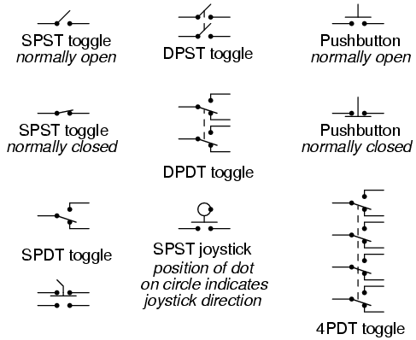
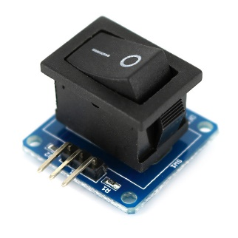
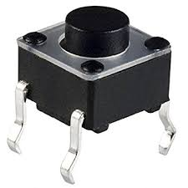
Switches / pushbuttons
Closing the switch completes the circuit
Voltage on both terminals is identical when the switch is closed

Slide 19
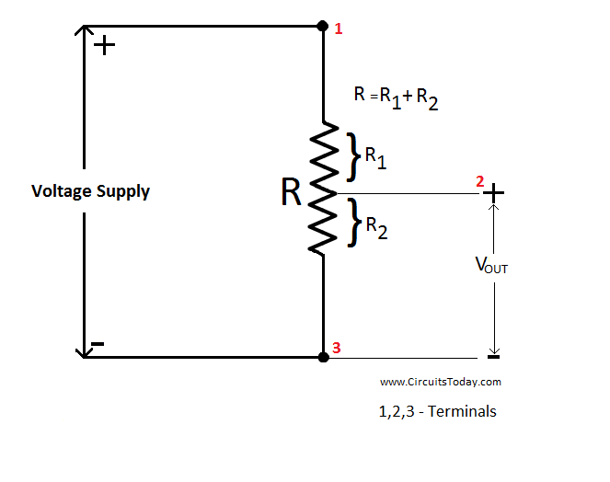
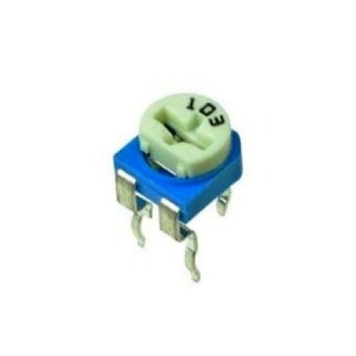
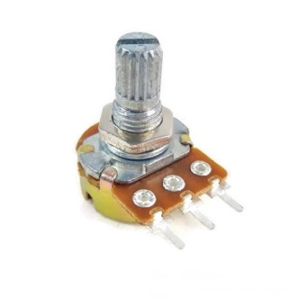
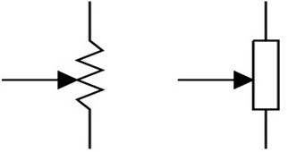
Potentiometers
Three terminals: top, bottom, middle
Resistance between top and bottom terminals is constant
Ratio of resistances changes

Slide 20
Wiring

Slide 21
Interpreting a schematic
Shows how components are connected in a real circuit
You need to be able to build a real circuit from a schematic
You need to be able to draw a schematic to represent your design

Slide 22
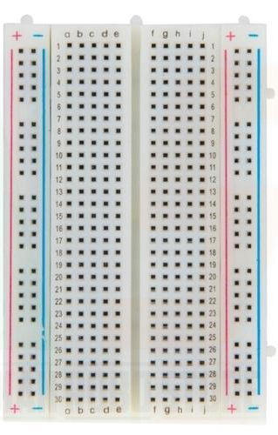
Solderless breadboard
Allows components to be easily connected in a non-permanent way
Great fro prototyping
Holes fit 24 AWG solid wires
Connected in rows of 5 holes and columns along the sides
Connected
Disconnected

Slide 23
Wiring process
Select a hardware component
Select one terminal on the hardware component
Connect the terminal to a row of the breadboard
If the terminal needs to be connected to another terminal already in the breadboard, share the row
Otherwise, use a free row
Go back to step 2 until all terminals are done
Go back to step 1 until all components are done

Slide 24
Lab

Slide 25
Simple LED lights (I)
Get your Arduino ready with three LEDs (R/G/B) with appropriate resistors, a push button, and a breadboard.
Have your Arduino do the following.
Before you begin, you will need to select appropriate resistors.
LEDs should be turned off when your Arduino is powered up.
Turns the three LEDs on simultaneously when the push button is pressed.
Turns the three LEDs off simultaneously when the push button is released.

Slide 26
Simple LED lights (II)
Get ready with the same hardware setting (three LEDs (R/G/B) with appropriate resistors, a push button, and a breadboard).
Now the push button should act as a toggle switch.
Whenever the button’s state changes from “RELEASED” to “PRESSED”, all three LEDs’ states should be inverted.

