Slide 1
Debugging
Debugging
Debug environments
Debug via serial

Slide 2
Debugging

Slide 3
Debug and trace
Controllability and observability are required
Controllability
Ability to control sources of data used by the system
Input pins, input interfaces (serial, Ethernet, etc.)
Registers and internal memory
Observability
Ability to observe intermediate and final results
Output pins, output interfaces
Registers and internal memory

Slide 4
I/O access is insufficient
Observation of I/O is not enough to debug
If Pin2 is incorrect, how do we locate the bug?
main(){
x=f1(pin1,pin2)
foo(x);
}
foo(x){
y=f2(x);
bar(y);
}
bar(y){
pin3=f3(y);
}
Pin1
Pin3
Pin2

Slide 5
Properties of a debugging environment
Run control of the target
Start and stop the program execution
Observe data at stop points
Real-time monitoring of target execution
Non-intrusive in terms of performance
Timing and functional accuracy
Debugged system should ac like the real system

Slide 6
Debug environments

Slide 7
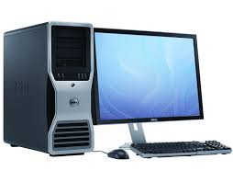
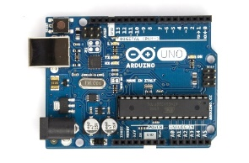
Remote debugger
Frontend running on the host
Debug monitor hidden on target
Typically triggered when debug events occur
Hitting a breakpoint, receiving request from host, etc.
Debug monitor maintains communication link
Communication link
Host
Target

Slide 8
Remote debug tradeoffs
Advantages
Good run control using breakpoints to stop execution
Debug monitor can alter memory and registers
Perfect functional accuracy
Disadvantages
Debug interrupts alter timing so real-time monitoring is not possible
Need a spare communication channel
Need program in RAM to add breakpoints

Slide 9
Embedded debug interfaces
Many modern processors include embedded debug logic
Embedded trace macrocell (ARM)
Background debug mode (Freescale)
Debug logic permanently build into the processor
A few dedicated debug pins are added

Slide 10
Debug and trace features
Breakpoints, stopping points in the code
Watchpoints, memory locations which trigger stop
On-the-fly memory access
Examine/change internal processor values
Single-step through the code
Export softeware-generated data (printf)
Timestamp information for each event
Instruction trace (special purpose HW needed)

Slide 11
Debug via serial

Slide 12
Serial protocols
Data is transmitted serially
Only 1 bit needed (plus common ground)
Parallel data transmitted serially
Original bytes/words regrouped by the receiver
Many protocols are serial to reduce pin usage
Pins are precious

Slide 13
UART
Universal asynchronous receiver/transmitter
Used for serial communication between devices
UART is asynchronous; no shared clock
Asynchronous allows longer distance communication
Clock skew is not a problem

Slide 14
UART applications
Used by modems to communicate with network
Computers used to have an RS232 port, standard
Not well used anymore, outside of embedded systems
Replaced by USB, Ethernet, etc.
Simple, low HW overhead
Build into most microcontrollers

Slide 15
Serial on Arduino

Slide 16
Arduino serial communication
UART protocol used over the USB cable
Initialize by using Serial.begin()
Serial.begin(speed) or Serial.begin(speed,config)
speed is the baud rate
config sets the data bits, parity, and stop bits
Serial.begin(9600)
Serial.begin(9600, SERIAL_8N1)
8 data bits, no parity bit, and 1 stop bit
Usually call Serial.begin() in the setup function

Slide 17
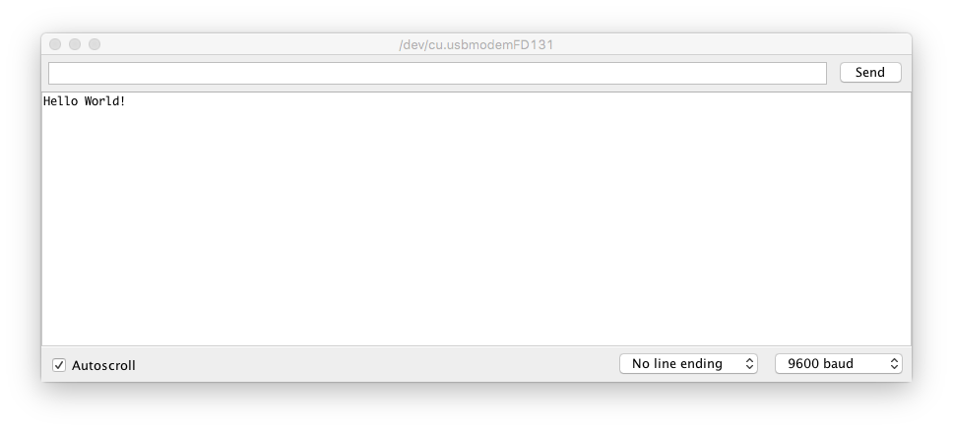
Sending text over serial
Use Serial.print() or Serial.println() to print text in the serial monitor
Strings are converted to ASCII and sent using UART
Serial.println(“Hello World!”);

Slide 18
Reading data over serial
Data can be sent to the Arduino via the serial monitor
When data is sent, it goes into a buffer in the Arduino until it is read
Serial.available() is used to see how many bytes are waiting in the buffer
int byteNum = Serial.available();

Slide 19
Serial.read()
Returns 1 byte from the serial buffer
int bval = Serial.read();
Returns -1 if no data is available
Serial.readBytes() writes several bytes into a buffer
char buff[10];
Serial.readBytes(buff,10);

