Slide 1
Business Analytics (IM561)
Module3. Detecting Labels in Your Own Video Data
Intelligent Video Analytics
with Deep Learning
Jongho Kim
December & Company Inc.
Spring, 2019

Slide 2
Module3. Detecting Labels in Your Own Video Data

Slide 3
Learn Python in 5 Minutes
https://www.stavros.io/tutorials/python/

Slide 4

Features of Python
Code is easy to read
Syntax is concise
Development speed is fast
Programming is fun

Slide 5
Package Installation
Python*
pip install package_name
* Run outside the Python shell

Slide 6
Using Packages
Python
import package_name

Slide 7
List
Python**
abc = [‘a’, ‘b’, ‘c’]
abc.append(‘d’)
print(abc[0])
print(abc[1])
** Also known as "list"

Slide 8
Dictionary
Python
abc = {}
abc[‘a’] = 1
abc[‘b’] = 2
print(abc[‘a’])

Slide 9
List + Dictionary
Python
li = []
li.append({‘a’:1})
print(li[0][‘a’])

Slide 10
String concatenation
Python
abc = [‘a’, ‘b’, ’c’]
‘ ‘.join(abc)

Slide 11
String substitution
Python
‘beat’.replace(‘b’, ‘n’)

Slide 12
Loop
Python
for i in range(1,5):
print(i)

Slide 13
Loop
Python
a = range(1,4)
s = [i**2 for i in a]
print(sum(s))

Slide 14
Function
Python
def jiggle(x):
return x + 1

Slide 15
File Input
Python
import io
f = io.open(‘kaist.mp4’, ‘rb’)
video = f.read()
f.close()

Slide 16
Dictionary + List to Table
Python
import pandas as pd
df = pd.DataFrame([{‘a’:1,’b’:2},
{‘a’:3, ‘b’:4}])

Slide 17
Saving a Table as CSV
Python
import pandas as pd
df = pd.DataFrame([{‘a’:1,’b’:2},
{‘a’:3, ‘b’:4}])
df.to_csv(‘test.csv’)

Slide 18
Google Cloud API

Slide 19
What is an API?
API(Application Programming Interface)
API stands for Application Programming Interface, which refers to an interface that allows application programs to control the functions provided by the operating system or programming language.
Interface
An interface refers to a shared boundary through which computer systems exchange information.
Some computer hardware devices, such as touch screens, can send and receive data through interfaces, while devices like mice and microphones provide interfaces that only transmit data to the system.

Slide 20
REST What is an API?
Client - Server Architecture
1. Request
Resources are represented using URI format
Ex. https://www.google.co.kr/search?q=uri
Actions on resources use HTTP Methods
Ex. GET, POST

Slide 21
REST What is an API?
Client - Server Architecture
1. Request
2. Response
Result

Slide 22
Google Video Intelligence API
The API detects the video labels (objects within the video) as well as shot labels (description of the video events over time)
https://cloud.google.com/video-intelligence/

Slide 23
Hands-on-Labs Google Video Intelligence API

Slide 24


Google Video Intelligence API
KAIST_Video_Analytics.ipynb
URL: https://bit.ly/2IOPeuI

Slide 25
Google Drive Access on Colab
First Step: Upload your data on Google Drive
http://drive.google.com
Second Step: Enter Authentication Code on Google Colab
Go to Url
Type Code

Slide 26
Check Data Available on Google Drive
Type: !ls "/content/gdrive/My Drive/”
This is root directory for Google Drive
For a specific folder, !ls "/content/gdrive/My Drive/{Your Folder Name}”

Slide 27
Conclusion

Slide 28
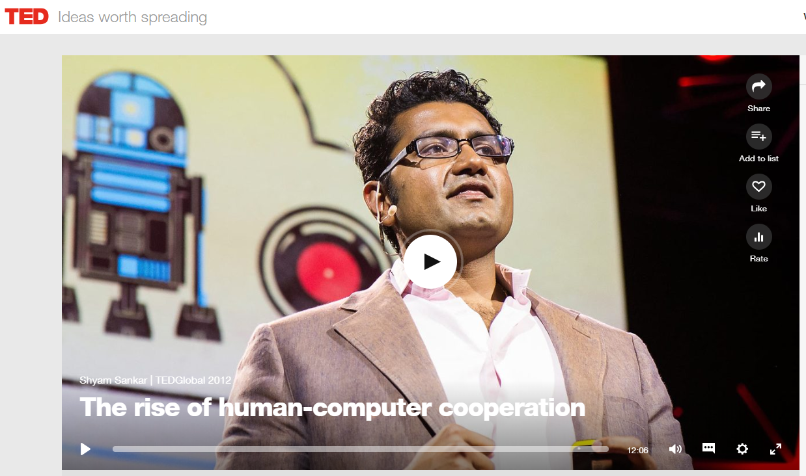
Let’s Cooperate with Deep Learning
Analytic capability consists of human, computer, and human-computer cooperation.
“In a freestyle chess tournament in 2005… The surprise came at the end. Who won? Not a grandmaster with a supercomputer, but actually two American amateurs using three relatively weak laptops …
This is an astonishing result: average men, average machines beating the best man, the best machine. And anyways, isn't it supposed to be man versus machine? Instead, it's about cooperation, and the right type of cooperation.”
https://www.ted.com/talks/shyam_sankar_the_rise_of_human_computer_cooperation
- Shyam Sankar at TEDGlobal 2012

Slide 29
Thank you ☺
Contact Info: quantic.jh@gmail.com
Thank you.

Slide 30
References
Python
Eunjung Park, Introduction to Python (on Windows)
Taehoon Kim, Python in 140 Minutes

