Slide 1
Business Analytics (IM561)
From Zero to Hero: Analyzing Videos using Deep Learning
Intelligent Video Analytics
with Deep Learning
Jongho Kim
December & Company Inc.
Spring, 2019

Slide 2
Intelligent Video Analytics with Deep Learning
(Subtitle) “From Zero to Hero: Analyzing Videos using Deep Learning”
Notes:
Zero base에서 뭔가를 얻어 가는 시간 짧은 시간이지만 직접 어떤 결과물을 얻어 보는게 가장 많은 도움이 될 것 같다.
이미 Technical Background가 있으신 분들에게는 쉬운 내용일 수 있다. 기술적을 아무것도 모르시는 분들을 대상으로 함

Slide 3
Goals of This Session
From Zero to Hero: Analyzing Videos using Deep Learning
There is no prerequisite related with programming skills for this session
Notes:
Zero base에서 뭔가를 얻어 가는 시간 짧은 시간이지만 직접 어떤 결과물을 얻어 보는게 가장 많은 도움이 될 것 같다.
이미 Technical Background가 있으신 분들에게는 쉬운 내용일 수 있다. 기술적을 아무것도 모르시는 분들을 대상으로 함

Slide 4
Goals of This Session
From Zero to Hero: Analyzing Videos using Deep Learning
There is no prerequisite related with programming skills for this session.
Make it possible for you to analyze your own video data

Slide 5



What is Video Analytics?
Video Analytics is really the study of video data
The amount of video data in our world has exploded to a ridiculous degree
82% of all Internet traffic would be video by 2022 (CISCO, 2018)
The majority of bits flying around the Internet are actually video

Slide 6
Why is it Difficult to Analyze Video Data?
However, there’s a problem with video data that it’s really hard to understand
Video has multiple modalities with the usage of audio, visual and (possibly) textual data
A few of Problems: Semantic Gap, Deformation, Illumination, Occlusion, Intra-class Variation, Cocktail Party Effect, etc
References: Stanford CS231n

Slide 7
Why is it Difficult to Analyze Video Data?
Challenges: Deformation
References: Stanford CS231n

Slide 8
Why is it Difficult to Analyze Video Data?
Challenges: Occlusion
References: Stanford CS231n

Slide 9
Why is it Difficult to Analyze Video Data?
Challenges: Intra-class Variation
References: Stanford CS231n

Slide 10

Why is it Difficult to Analyze Video Data?
Challenges: Cocktail Party Effect

Slide 11
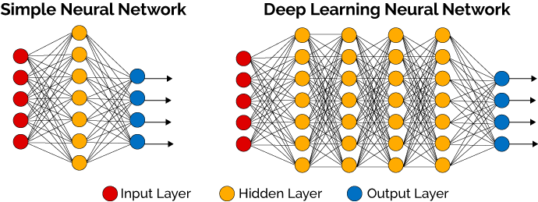
Why is Video Analytics Recently Becoming a Big Player?
Deep Learning has achieved very promising results in a wide range of areas including Computer Vision, Speech Recognition and Natural Language Processing

Slide 12
Key Market Segments of Video Analytics
Video Analytics Market was valued at $2,745 million in 2016, and is estimated to reach $13,381 million by 2023 (Allied Market Research, 2017)
Video Analytics Market Key Segments
By Application | - Activity and Event Recognition - Audio and Speech Processing - Scene Analysis and Interpretation - Visual Feature Extraction - Question Answering
Industry Vertical | - Entertainment - Healthcare - Home Automation - Transportation - Retail - Manufacturing - Energy & Utilities - Critical Infrastructure
https://datafloq.com/read/what-is-video-analytics-why-becoming-big-player/2312
https://www.alliedmarketresearch.com/vieo-analytics-market
* Object Detection; Object Recognition; Privacy, Anonymity, and Security; *
Notes:
Crowd Detection & Management, Incident Detection, Perimeter Intrusion Detection, Traffic & Parking Management
Facial Recognition & Detection, Tracking and Motion in Video, Body Pose, Face, and Gesture Analysis

Slide 13
Intelligent Video Analytics with Deep Learning
Welcome to “Intelligent Video Analytics with Deep Learning”
We mainly focus on 1. social science research and practice applying video analytics and 2. learn how to understand and analyze quantitative video data based on deep learning
Notes:
Zero base에서 뭔가를 얻어 가는 시간 짧은 시간이지만 직접 어떤 결과물을 얻어 보는게 가장 많은 도움이 될 것 같다.
이미 Technical Background가 있으신 분들에게는 쉬운 내용일 수 있다. 기술적을 아무것도 모르시는 분들을 대상으로 함

Slide 14
Three Modules of This Session
Module 1. Video Analytics and Social Science Research
Module 2. Underlying Mechanisms of Deep Learning
Module 3. Detecting Labels in Your Own Video Data

Slide 15
Thank you ☺
Contact Info: quantic.jh@gmail.com
감사합니다.

