Slide 1
Business Analytics (IM561)
Module2. Underlying Mechanisms of Deep Learning
Intelligent Video Analytics
with Deep Learning
Jongho Kim
December & Company Inc.
Spring, 2019
Note. This content mainly refers the summer session of KAIST organized by Jiyong Park(2018)

Slide 2
Module2. Underlying Mechanisms of Deep Learning

Slide 3
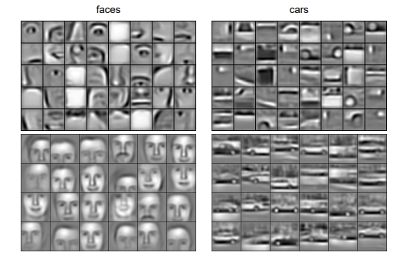
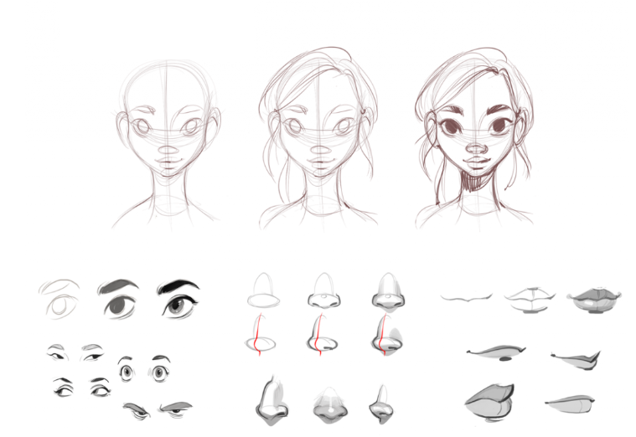
Intuitive Understanding of Deep Learning
What is deep learning?
Deep learning is “Representation Learning” to learn and discover how to represent features of data. (Here, representation means a machine-understandable format)
How to draw faces?
How to represent faces?

Slide 4
Intuitive Understanding of Deep Learning
Why important to well-represent the features of data?
What needs to well-represent the features of data?
Why is deep learning outstanding at representation learning?

Slide 5
Intuitive Understanding of Deep Learning
Why important to well-represent the features of data?
What needs to well-represent the features of data?
Why is deep learning outstanding at representation learning?
Ch1. Representational Learning
Ch2. Artificial Neural Networks
Ch3. Deep Learning Algorithms

Slide 6
Ch1. Representational Learning

Slide 7
What is the meaning of Well-Representation of the Data Feature?
First, let's look at an example of what a Representation is:
How can you distinguish the objects?

Slide 8
What is the meaning of Well-Representation of the Data Feature?
First, let's look at an example of what a Representation is:
If you try to solve the problem of Classify the following shape, the number of corners can be used as a Representation
Square: 4 corner
Triangle: 3 corner
Circle: 0 corner

Slide 9
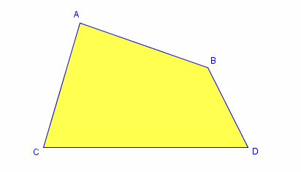
What is the meaning of Well-Representation of the Data Feature?
But how do we cope if this shape comes in?
You need great expertise in good representation, and Deep Learning automatically learns this representation

Slide 10
Why Should We Care about Learning Representation?
The performance of machine learning methods is heavily dependent on the choice of data representation
Conventional machine-learning techniques were limited in their ability to process natural data in their raw form.

Slide 11
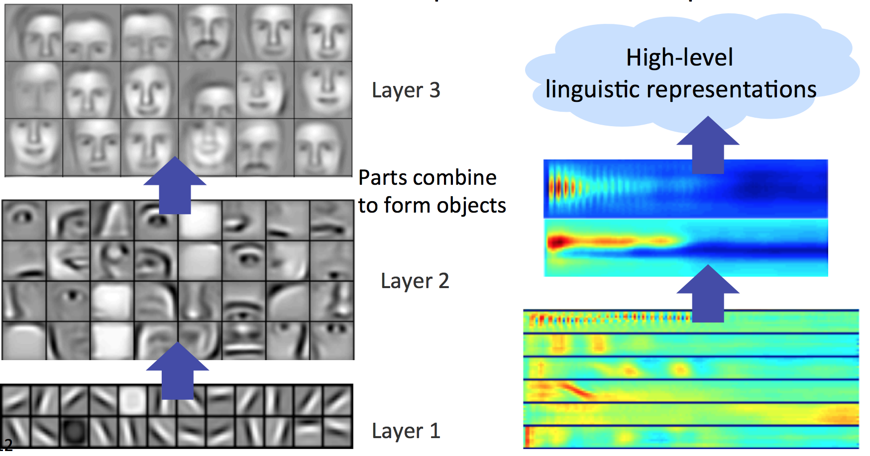
Why Should We Care about Learning Representation?
Deep-learning methods are representation-learning methods with multiple levels of representation from a concrete level to slightly more abstract level.
Very complex functions can be learned by learning representation using Deep-learning

Slide 12
Ch2. Artificial Neural Networks

Slide 13
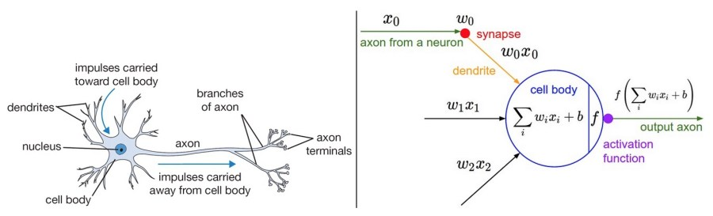
Neural Networks
Artificial neural network mimics the human brain
While neural network-based algorithms for classification or regression may be useful for the purpose of artificial intelligence (AI), neural network itself has nothing to do with.
Single neuron is activated (=1) or not (=0).

Slide 14
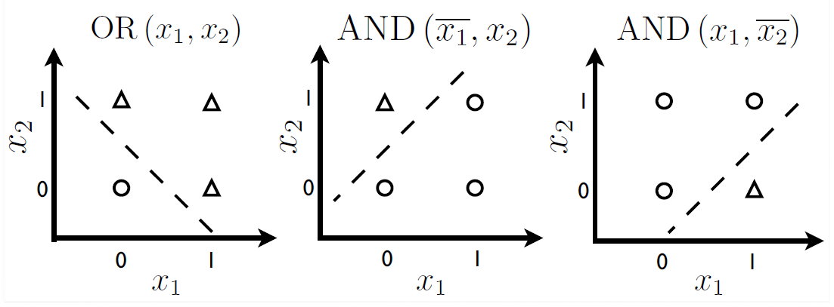
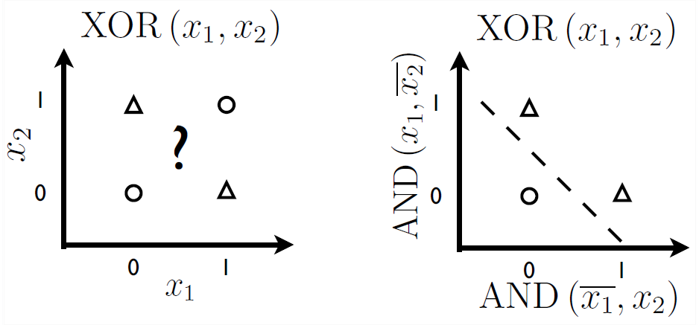
Capacity of Neural Networks
Linearly separable problems
Non-linearly separable problems

Slide 15
Capacity of Neural Networks
Artificial neural networks can solve non-linearly separable problems.
That is, neural networks can represent more complex features!
Linearly separable problems
Non-linearly separable problems
Multi-layer neural networks can solve it by transforming the input in a better representation.

Slide 16
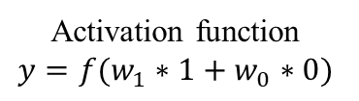

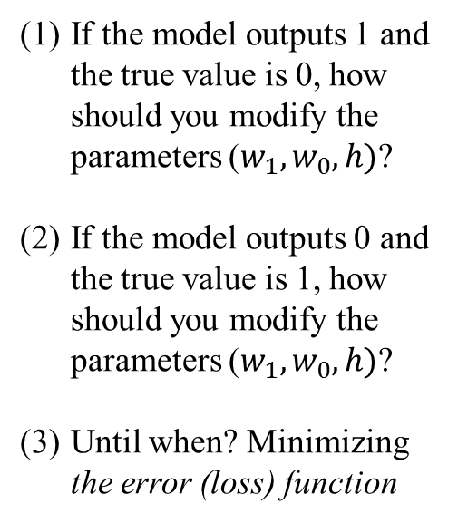

Learning Algorithm of Neural Networks
Back-propagation
= Learning parameters to minimize the error from the true value in the reverse way
1
Direction of updates
If the model outputs 1 and the true value is 0, how should you modify the parameters ($w_{1}, w_{0}, h)$?
If the model outputs 0 and the true value is 1, how should you modify the parameters ($w_{1}, w_{0}, h)$?
Until when? Minimizing the error (loss) function
$$f$$
$$y$$
0
Activation function
$$y=f(w_{1}∗1+w_{0}∗0)$$
1
h

Slide 17
Ch3. Deep Learning Algorithms

Slide 18
Representation Learning + Deep Architecture
“Deep Learning can be considered as special case of representation learning algorithms which learn representations of the data in a Deep Architecture with multiple levels of representations.” (Najafabadi et al. 2015, p. 5)
Recent deep learning algorithms are mostly based on neural networks.
Neural network + Deep architecture
= Feed-forward networks with many hidden layers
= Multi-layer perceptron (MLP)
= Deep neural network (DNN)
More specialized algorithms: CNN, RNN, LSTM, etc.
Najafabadi, M. M., Villanustre, F., Khoshgoftaar, T. M., Seliya, N., Wald, R., & Muharemagic, E. (2015). Deep Learning Applications and Challenges in Big Data Analytics. Journal of Big Data, 2(1), 1.

Slide 19
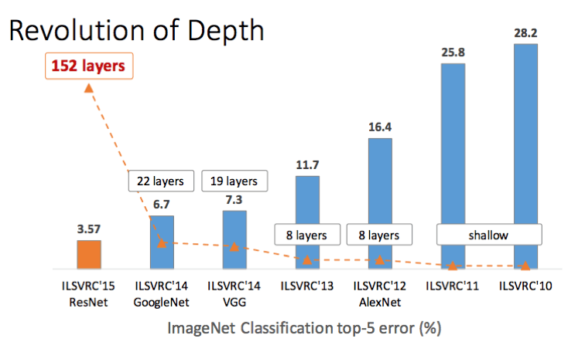
Representation Learning + Deep Architecture
Then, how deep?

Slide 20
Convolutional Neural Network

Slide 21
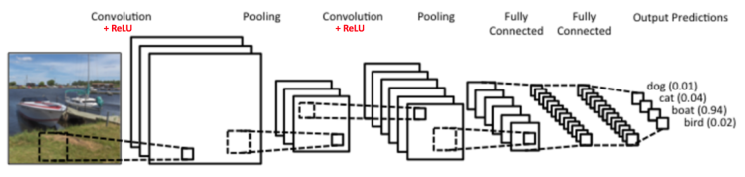
What is Convolutional Neural Network (CNN)?
A typical example of CNN
Inputs (2-dimension ⨯ channels) → [Convolution -> ReLu -> Pooling] → … → [Convolution -> ReLu -> Pooling] → Fully connected layer → Output prediction (Multi-class classification)

Slide 22
Example: 1D Convolution
How can we apply convolution on 1D time series data?
1D Convolution of discrete time signals
Example
Kernel:
Time series data:
-1 | 1
0 | 0 | 0 | 1 | 0 | 1 | 1 | 1

Slide 23
Example: 1D Convolution
Example
N = 0: -1*0 + 1*0 = 0
N = 1: -1*0 + 1*0 = 0
N = 2: -1*0 + 1*1 = 1
-1 | 1
0 | 0 | 0 | 1 | 0 | 1 | 1 | 1
-1 | 1
0 | 0 | 0 | 1 | 0 | 1 | 1 | 1
-1 | 1
0 | 0 | 0 | 1 | 0 | 1 | 1 | 1

Slide 24
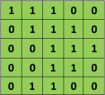

Example: 2D Convolution
Convolution
Image data
Convolution filter

Slide 25
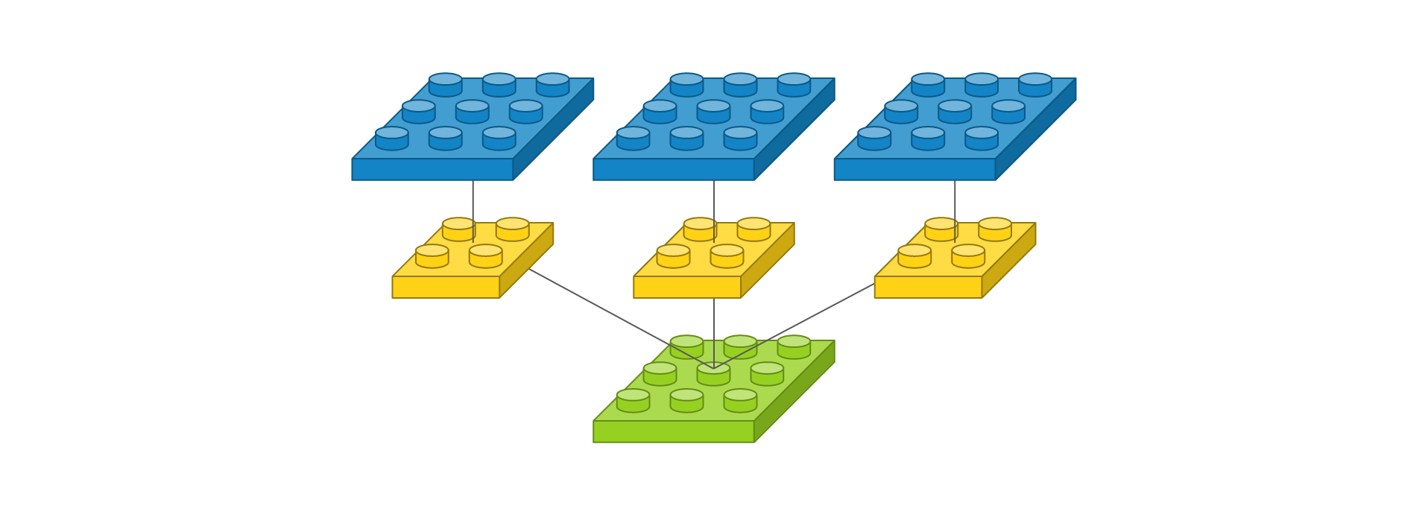
Applying 2D Multiple Kernel

Slide 26
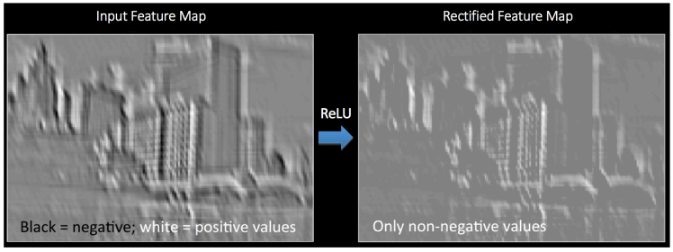
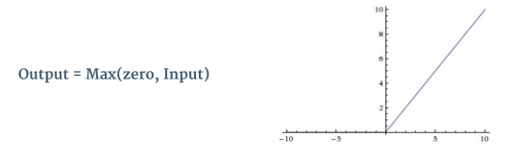
ReLU
Introducing non-linearity (ReLU)
The purpose of ReLU is to introduce non-linearity in CNN.
Other non-linear functions such as tanh or sigmoid can also be used, but ReLU has been found to perform better in most situations.
Source: An Intuitive Explanation of Convolutional Neural Networks (Data Science Blog)
https://ujjwalkarn.me/2016/08/11/intuitive-explanation-convnets/

Slide 27
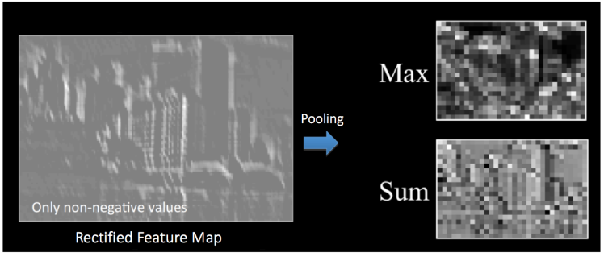
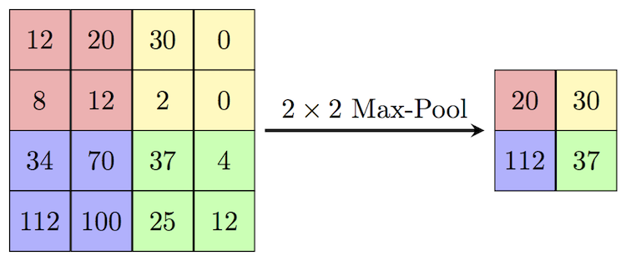
Max Pooling
Reducing the dimensionality of each feature map (Pooling)
The purpose of pooling is to reduce the number of parameters and computations in the network, therefore, controlling overfitting.
Another purpose is to make the network invariant to small transformations, distortions and translations in the input image.
Pooling can be of different types: Max, Average, Sum, etc.
Source: An Intuitive Explanation of Convolutional Neural Networks (Data Science Blog)
https://ujjwalkarn.me/2016/08/11/intuitive-explanation-convnets/

Slide 28
What is Convolutional Neural Network (CNN)?
A typical example of CNN
Inputs (2-dimension ⨯ channels) → [Convolution -> ReLu -> Pooling] → … → [Convolution -> ReLu -> Pooling] → Fully connected layer → Output prediction (Multi-class classification)

Slide 29
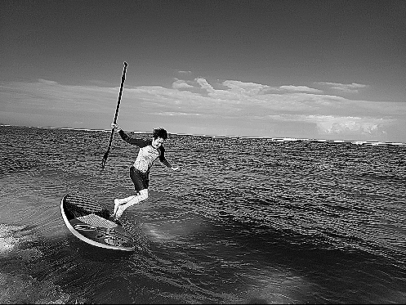
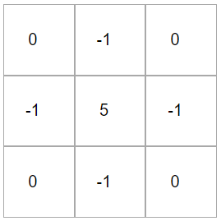

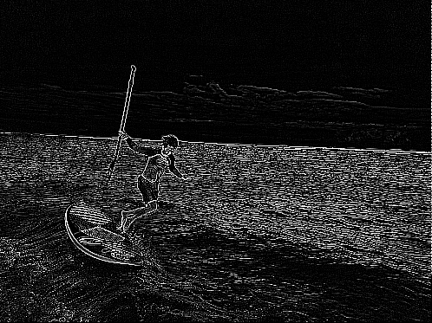
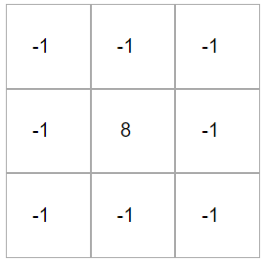
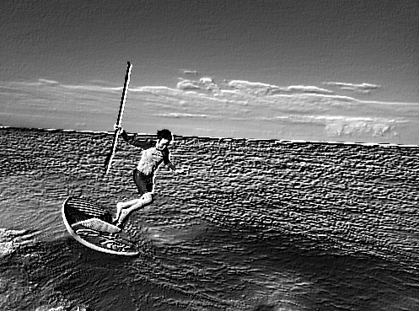
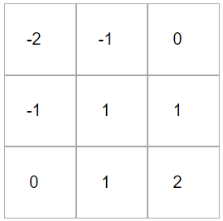
Convolutional Neural Network (CNN)
CNN automatically learns the best filters to extract the feature maps for image classifications through back propagation.
Output layer
Sharpen
Convolution
Filter (kernel)
-> pooling
-> convolution
-> pooling
-> convolution
…
Softmax function
Board
(0.54)
Feature maps
Edge detect
Sea
(0.43)
Cat
(0.02)
Input image
Flower
(0.01)
Emboss
Source: Image Kernels demo, http://setosa.io/ev/image-kernels/

Slide 30
Convolutional Neural Network (CNN)
CNN has been considered as a basic deep learning algorithm. Why is CNN superior at feature representations?
Effectively reducing computational complexity (Convolution filter)
Hierarchical feature representation (multiple convolution layers)
Non-linearity and less overfitting (Rectified Linear Unit (ReLU) and Pooling)

Slide 31
Thank you ☺
Contact Info: quantic.jh@gmail.com
감사합니다.

Slide 32
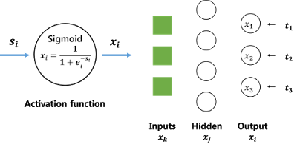
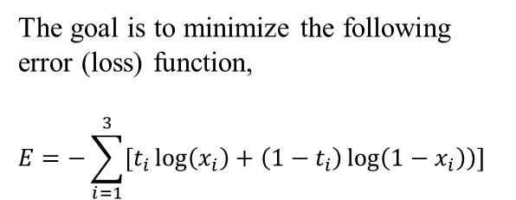
(Appendix) Learning Algorithm of Neural Networks
Gradient descent method (Back-propagation)
= Learning parameters to minimize the error from the true value in the systematic, reverse way even for multiple hidden layers
True values
The goal is to minimize the following error (loss) function,
$$E=−\sum_{i=1}^{3}{\left[t_{i}\log\left(x_{i}\right)+\left(1−t_{i}\right)\log\left(1−x_{i}\right)\right)}]$$
Source: Backpropagation 설명 예제와 함께 완전히 이해하기 (Jaejun Yoo’s Playground) http://jaejunyoo.blogspot.com/2017/01/backpropagation.html

Slide 33
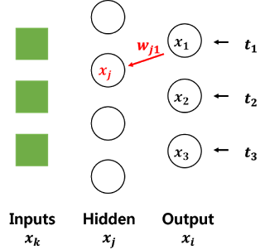
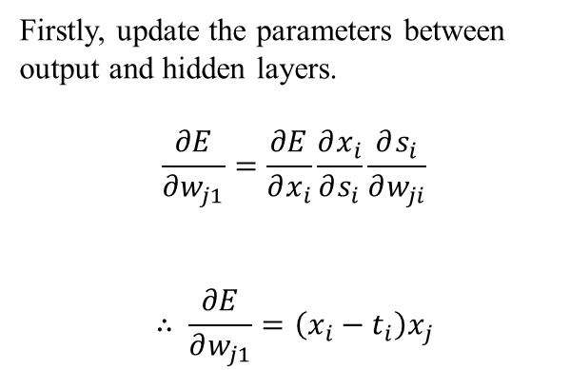
(Appendix) Learning Algorithm of Neural Networks
Gradient descent method (Back-propagation)
= Learning parameters to minimize the error from the true value in the systematic, reverse way even for multiple hidden layers
True values
Firstly, update the parameters between output and hidden layers.
$$\frac{∂E}{∂w_{j1}}=\frac{∂E}{∂x_{i}}\frac{∂x_{i}}{∂s_{i}}\frac{∂s_{i}}{∂w_{ji}}$$
$$∴ \frac{∂E}{∂w_{j1}}=\left(x_{i}−t_{i}\right)x_{j}$$
(Chain rule)
Source: Backpropagation 설명 예제와 함께 완전히 이해하기 (Jaejun Yoo’s Playground) http://jaejunyoo.blogspot.com/2017/01/backpropagation.html

Slide 34
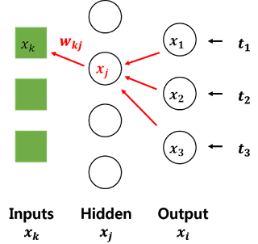
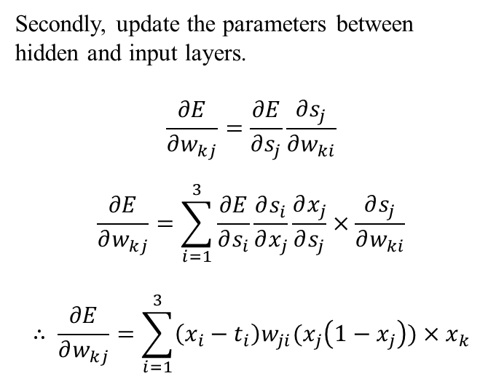
(Appendix) Learning Algorithm of Neural Networks
Gradient descent method (Back-propagation)
= Learning parameters to minimize the error from the true value in the systematic, reverse way even for multiple hidden layers
True values
Secondly, update the parameters between hidden and input layers.
$$\frac{∂E}{∂w_{kj}}=\frac{∂E}{∂s_{j}}\frac{∂s_{j}}{∂w_{ki}}$$
$$\frac{∂E}{∂w_{kj}}=\sum_{i=1}^{3}{\frac{∂E}{∂s_{i}}\frac{∂s_{i}}{∂x_{j}}\frac{∂x_{j}}{∂s_{j}}}×\frac{∂s_{j}}{∂w_{ki}}$$
$$∴ \frac{∂E}{∂w_{kj}}=\sum_{i=1}^{3}{\left(x_{i}−t_{i}\right)w_{ji}(x_{j}\left(1−x_{j}\right))}×x_{k}$$
Source: Backpropagation 설명 예제와 함께 완전히 이해하기 (Jaejun Yoo’s Playground) http://jaejunyoo.blogspot.com/2017/01/backpropagation.html

