Slide 1
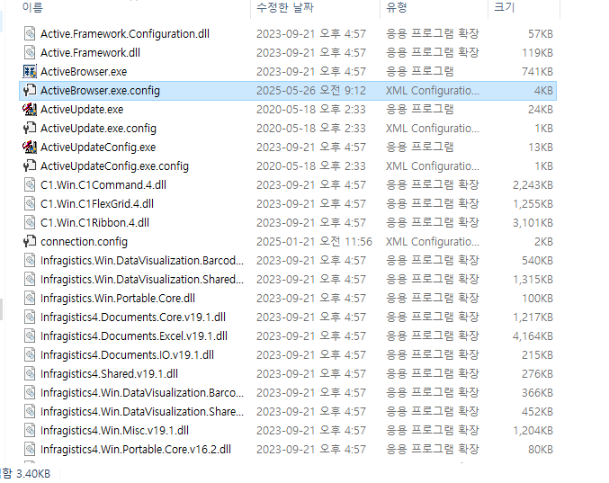
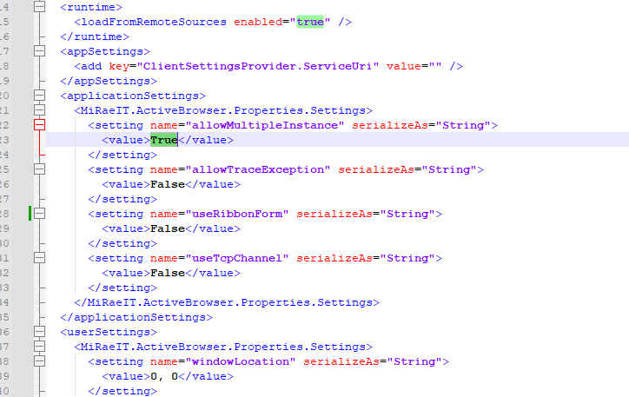
ACTIVE BROWSER 멀티 사용법
C:\Program Files (x86)\MiRaeIT Active Browser 1.1

