Slide 1
Book of 2D Blueprints
Proposed
Maximum
Third Quartile
Median
First Quartile
Minimum

Slide 3
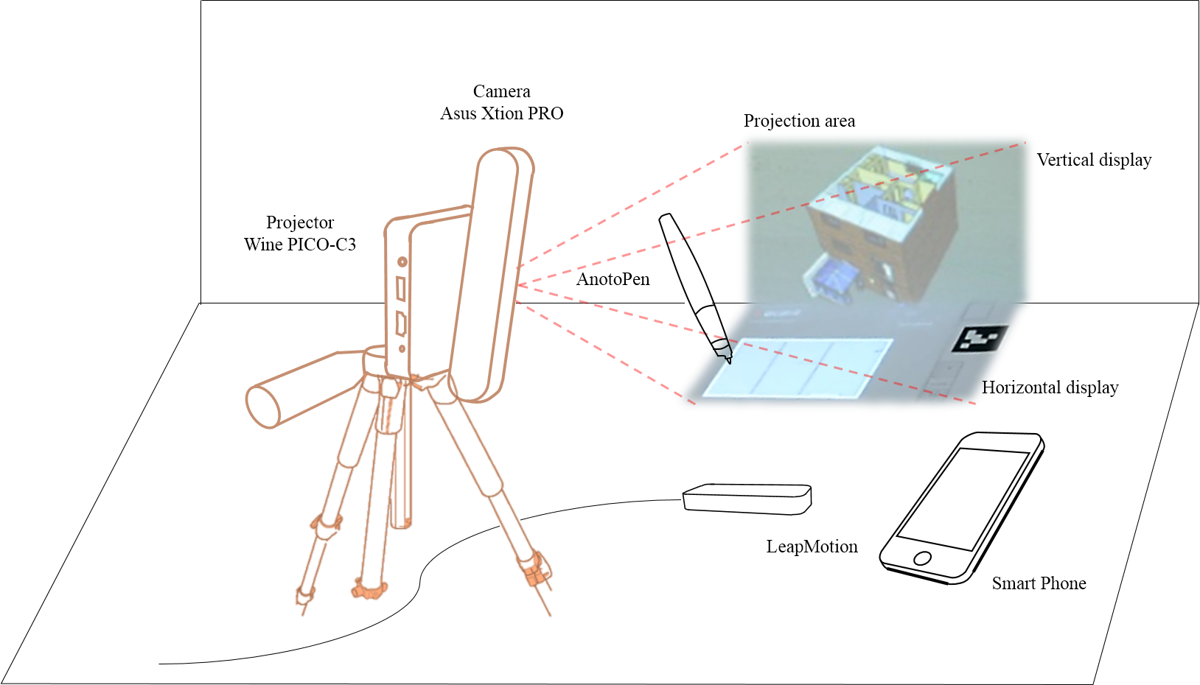

Slide 4
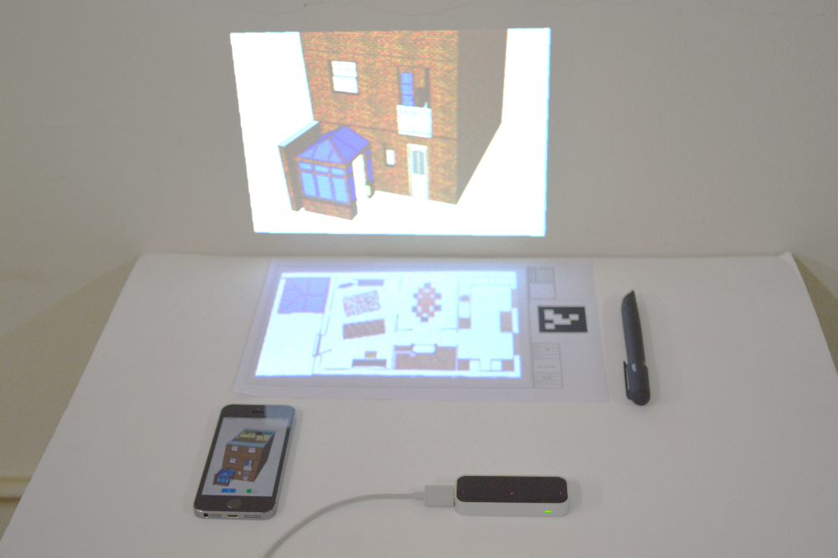
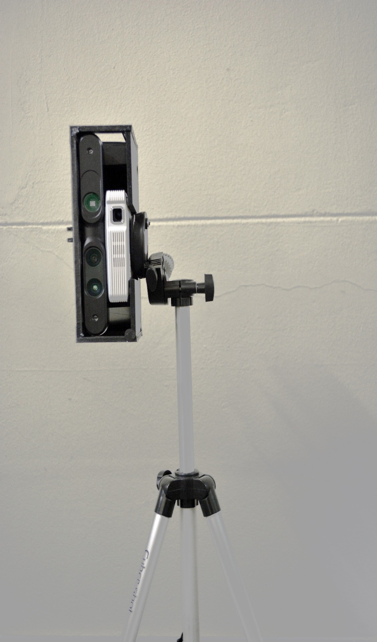
Vertical display
Camera Asus Xtion PRO
Projector
Wine PICO-C3
Horizontal display
AnotoPen
Smart Phone
LeapMotion

