Slide 1
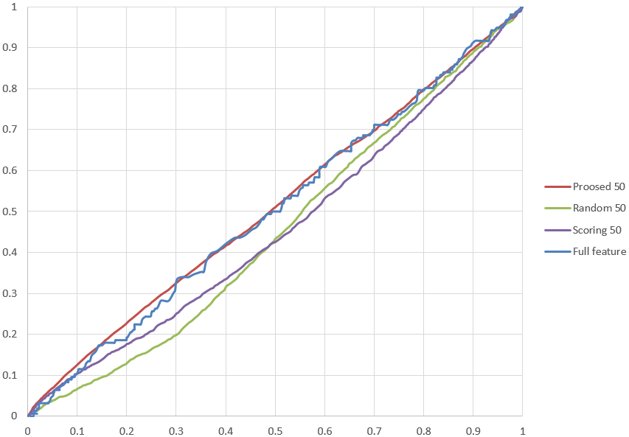
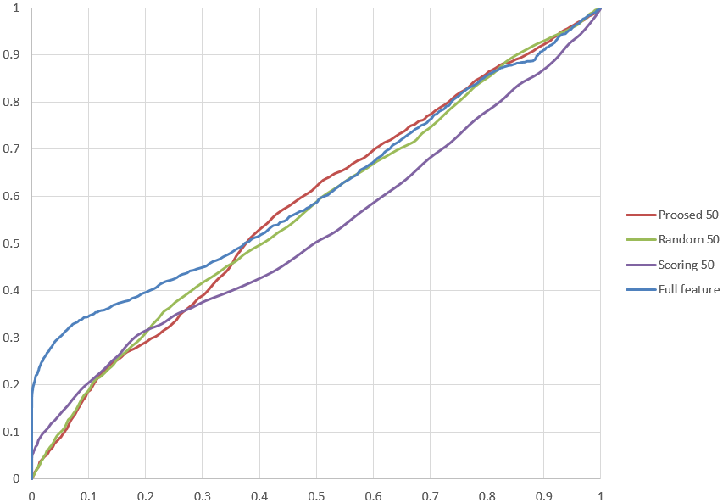
Fast – Brief
Fast – Brisk
Fast - Surf
Fast- Freak

Slide 2
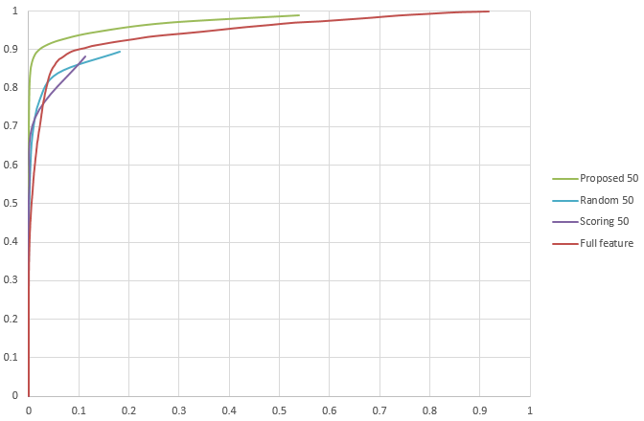
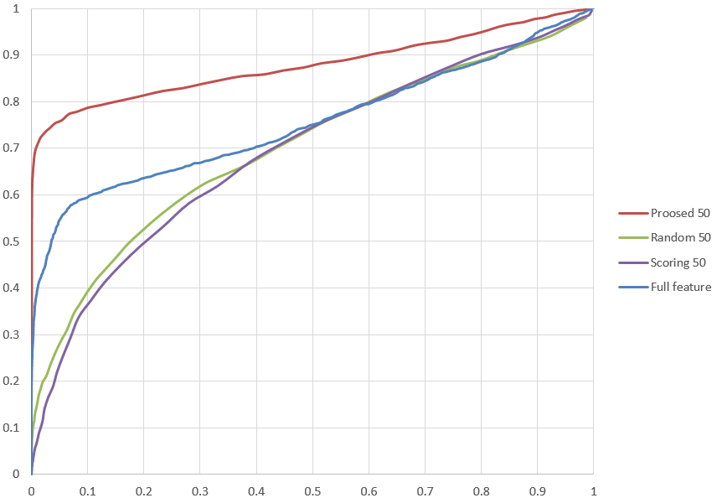
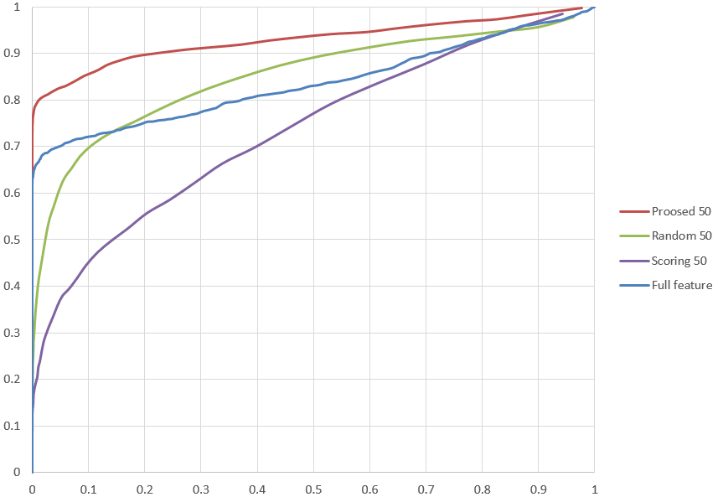
Agast – Brief(데이터 이상)
Agast – Brisk
Agast – Surf
Agast - Freak

Slide 3
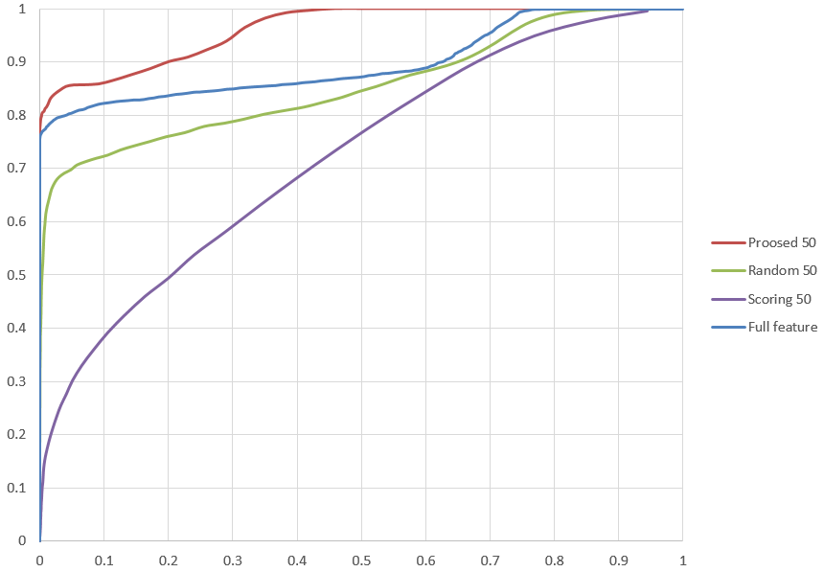
Surf – Brief(지윤 ing)
Surf – Brisk( 승호 ing)
Surf – Surf(윤식 ing)
Surf - Freak

