Slide 1
Optimizing U-Net with TVM
11조 김영곤, 이종현, 이찬우

Slide 2
Task
Medical image segmentation task
Brain MRI based tumor segmentation
Data source: Kaggle, https://www.kaggle.com/mateuszbuda/lgg-mri-segmentation
Model: (simple) U-Net

Slide 3
Training
Pytorch & Keras version models were successfully trained
https://github.com/jonghyunlee1993/AIPlatformOptimization/tree/master/Project_optimizing_U-net
Now we try to optimize our U-Net model with TVM

Slide 4
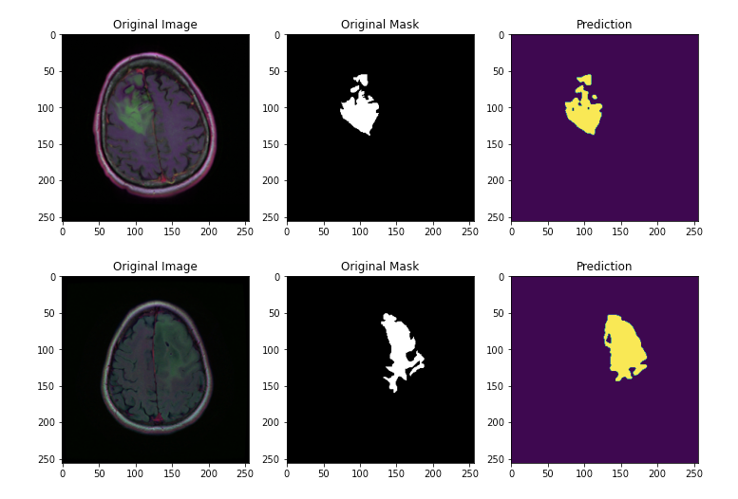

Slide 5
Target HW | Frameworks | Performance Measurement
 |  | Before. Opt |  | After. Opt |  | Difference
 |  | Time | Accuracy | Time | Accuracy | Time | Accuracy
CPU | Pytorch
 | Keras
 | TF-Lite
GPU | Pytorch
 | Keras
 | TF-Lite
Raspberry Pi 3+ | Pytorch
 | Keras
 | TF-Lite

