Slide 1
Identifying Types of Activity
With personal GPS Data from Switzerland
Michael Fehr, Jon Guler, 07.06.24

Slide 2










Context
Background: We have collected GPS data with different types of activity such as hiking, jogging, ski-touring and cycling via Strava.
Goal: This project aims to identify the types of transportation based on their characteristics.
Additional Data: Street Data from SwissTLM3D (streets, hiking paths)
Application Area: Switzerland
Conceptual models: Street Network (Urban movement space) / continuous movement space / unconstrained / uniform Lagrange perspective / 2D
Data structures: Vector data (Shapefiles and GPX)
Notes:
Beginning and end of the tracks are removed (100m)

Slide 3
Research Questions
How accurately can we identify transportation modes based on GPS data features such as speed, elevation change, distance measures and stop frequency?
What are the challenges in distinguishing between similar modes (e.g., jogging & biking)?
How do factors like street data or environmental data influence the accuracy of transportation mode detection models?

Slide 4
Research Plan
Data Load
GPX files, SwissTLM3D, transform to coordinate system, …
Data Exploration
Plots, Visualization, etc.
Data Processing
Outlier removal, Interpolation (Strava Tracks -> 10s)
Function Definition
Speed (cross scale), Average Speed, Elevation Change, Stop Frequency, Distance Measures, Temporal Measures
Classification Model*
Decision Tree
Data Processing
Principal Component Analysis
Evaluation
Predictive validation: Accuracy, Precision, Recall, F1-Score, Confusion Matrix (comparison to Random Forest)
Result Visualization
Classification, Accuracy
*more details on next slide

Slide 5
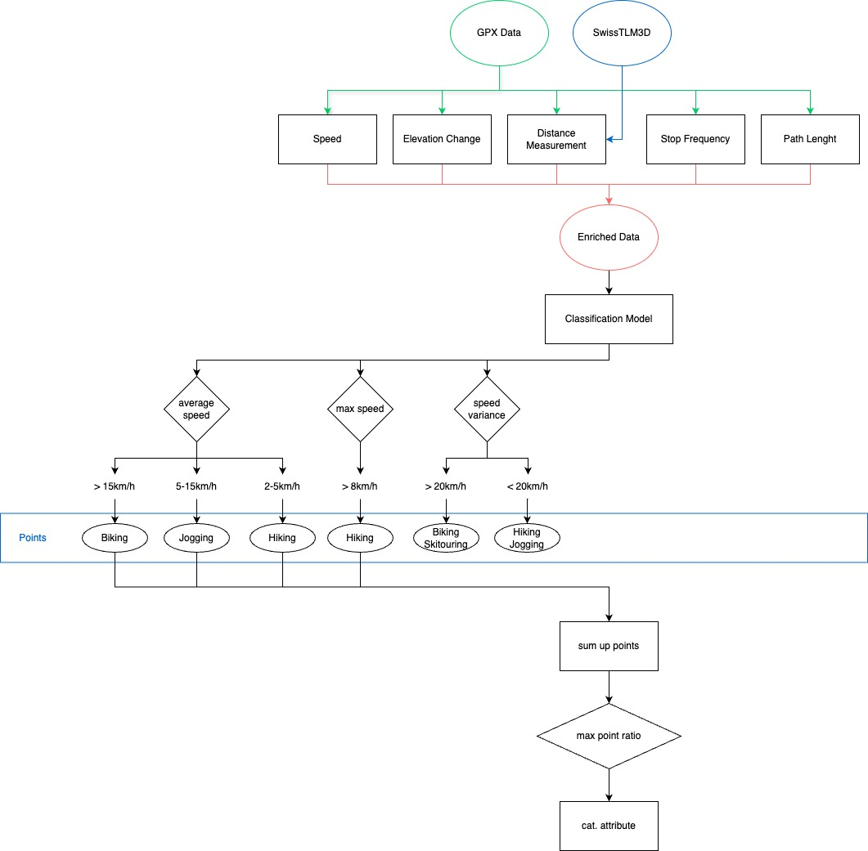
Classification Model
Notes:
visal attribute (eg. size) of uncertainty -> dot size of percentage of points

Slide 6
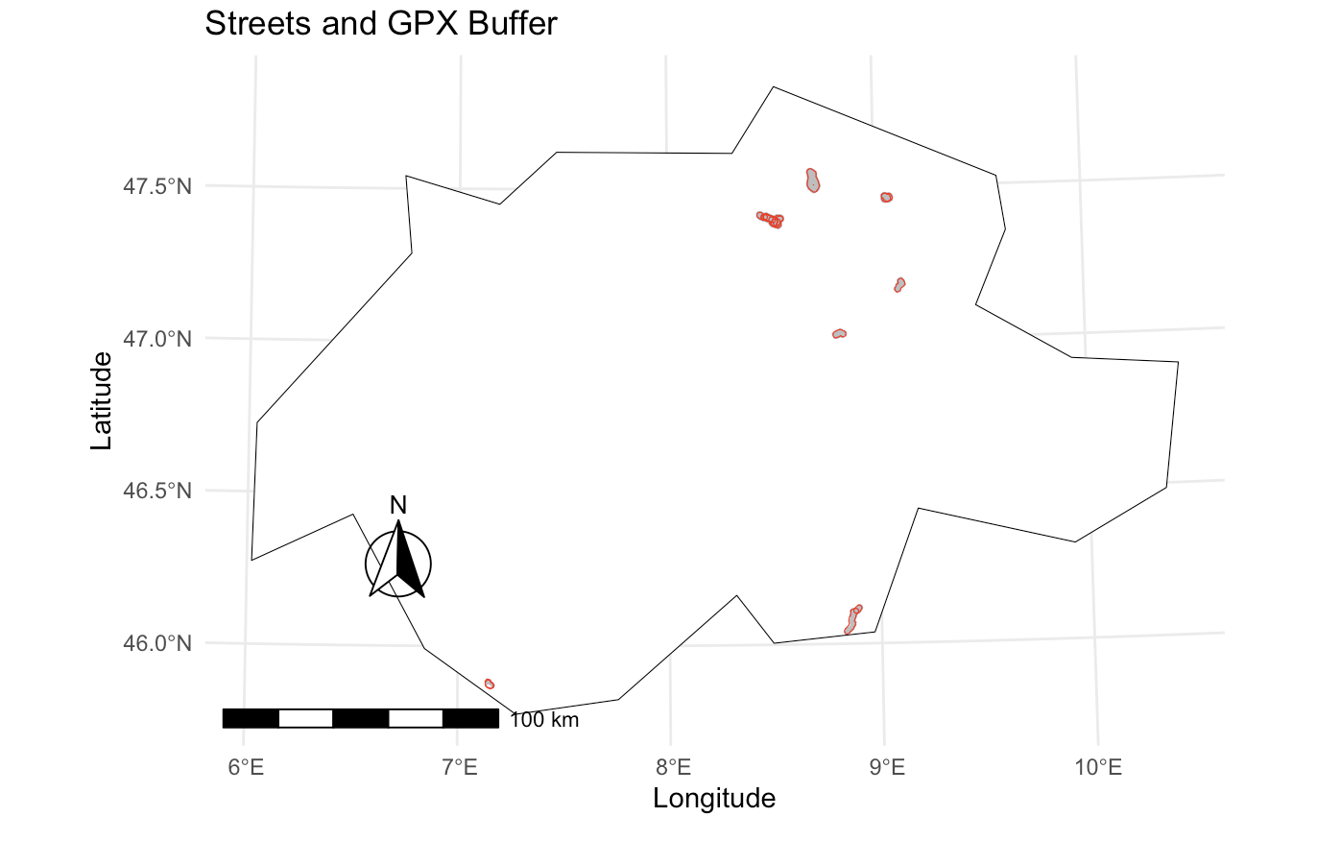
Preliminary Results
Buffered tracks
Intersected Street network

Slide 7
Goals & Challenges
Model Accuracy: Develop a classification model with high accuracy
Key Features: Determine the most critical GPS features for differentiating transportation modes
Appealing result visualization
Challenges Addressed: Identify challenges in distinguishing similar modes (e.g., jogging & biking) and propose solutions.

