Slide 1
new Book();
jsBook
function Book
function Object
__proto__
prototype
prototype
__proto__
__proto__
null
Book Prototype object
Object Prototype object
constructor
constructor
__proto__
__proto__
null
cover
…

Slide 2
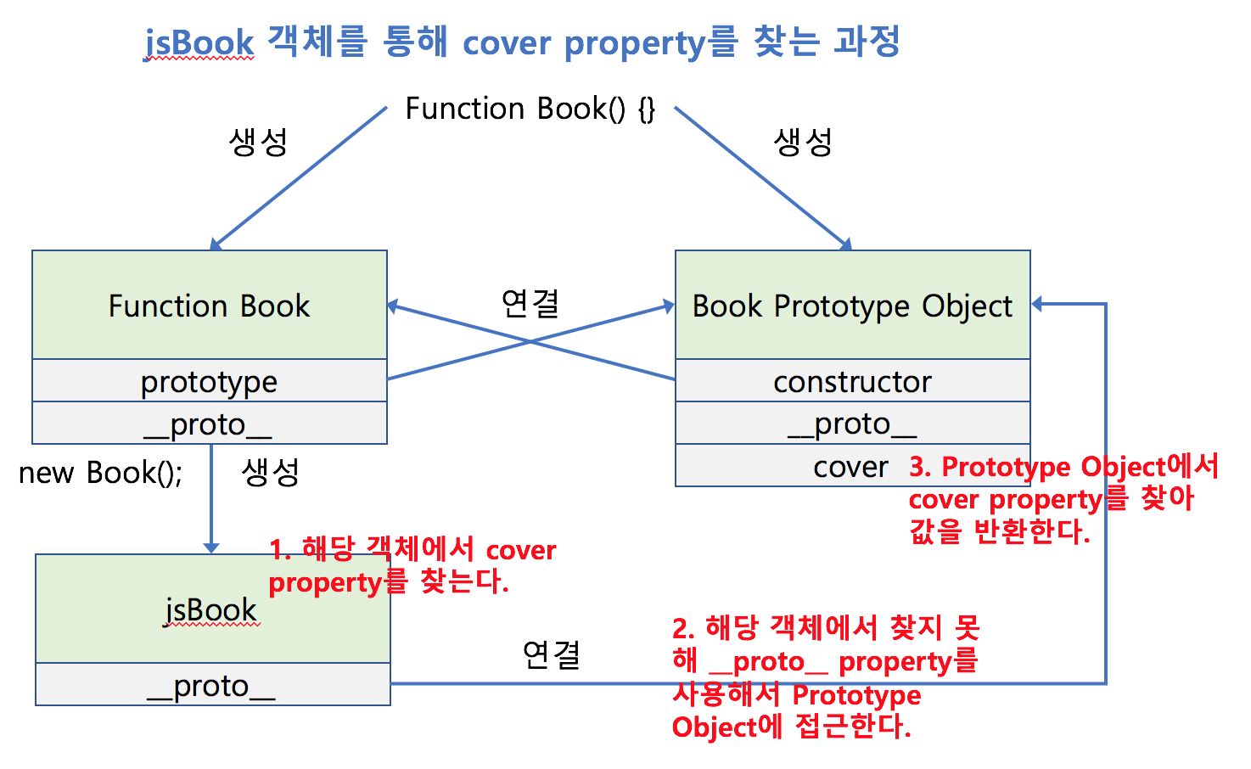
function book() {}
function Book
Book Prototype object

Slide 3
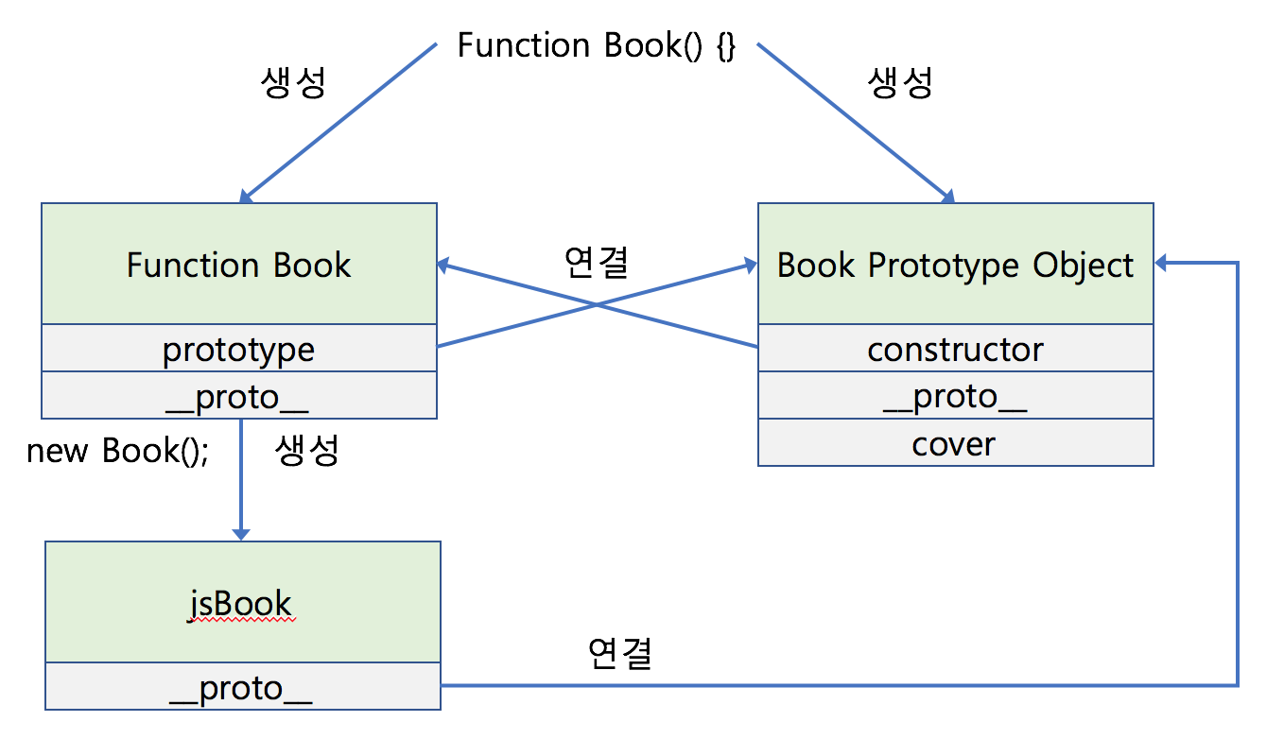
function book() {}
function Book
Book Prototype object

Slide 4
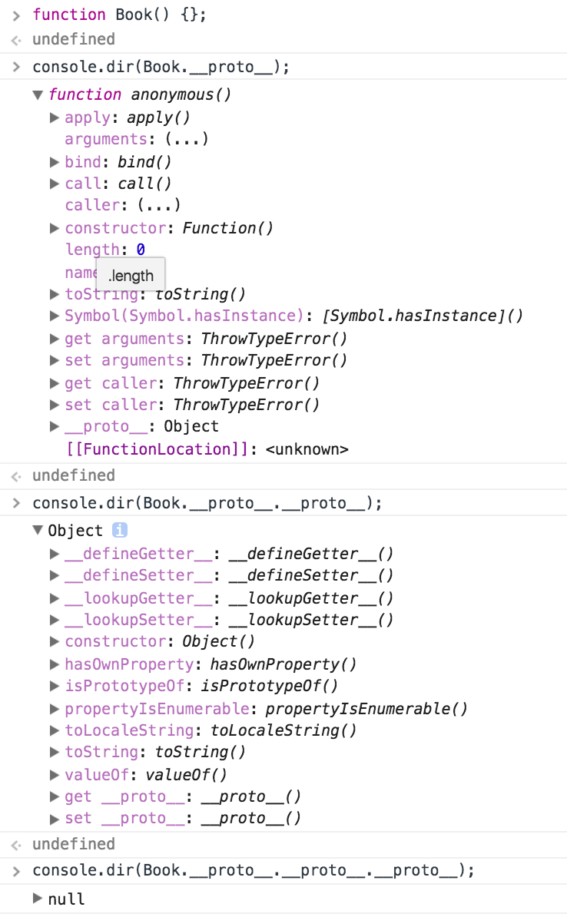

Slide 5
Function Book() {};
function Book
function Function
Function Object
prototype
prototype
prototype
__proto__
__proto__
__proto__
Book.__proto__
Book Prototype object
Object Prototype Object
Object Prototype Object
constructor
constructor
constructor
__proto__
__proto__
__proto__
null
…
Book.__proto__.__proto__.__proto
cover
Book.__proto__.__proto__
…

