Slide 1
피카츄 배구 크랙
박종민

Slide 2
목차
1. 2P 무적 만들기
2. 몬스터 볼 마스터 볼로 바꾸기
3. 네트 넘어가기 (시도 했으나 실패)
Notes:
https://blogs.technet.microsoft.com/tip_of_the_day/2016/06/29/tip-of-the-day-demystifying-software-defined-networking-terms-the-cloud-compass-sdn-data-flows/

Slide 3
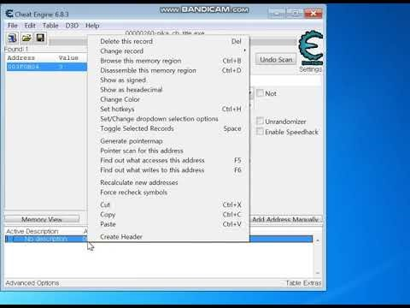
2p 무적 만들기
Notes:
https://blogs.technet.microsoft.com/tip_of_the_day/2016/06/29/tip-of-the-day-demystifying-software-defined-networking-terms-the-cloud-compass-sdn-data-flows/

Slide 4
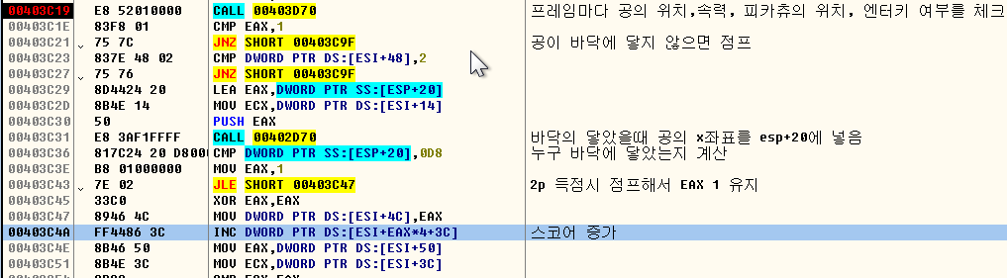
2p 무적 만들기
GO TO 00403C4A
Notes:
https://blogs.technet.microsoft.com/tip_of_the_day/2016/06/29/tip-of-the-day-demystifying-software-defined-networking-terms-the-cloud-compass-sdn-data-flows/

Slide 5

2p 무적 만들기
상황 체크
YES
NO
공이 바닥에 닿음?
YES
공의 X좌표 구함
X<=D8
NO
1P 득점
YES
2P 득점
00
00
X
D8
216
1B0
432
Notes:
https://blogs.technet.microsoft.com/tip_of_the_day/2016/06/29/tip-of-the-day-demystifying-software-defined-networking-terms-the-cloud-compass-sdn-data-flows/

Slide 6

2p 무적 만들기
상황 체크
YES
NO
공이 바닥에 닿음?
YES
공의 X좌표 구함
YES
NO
X<=D8
1P 득점
YES
2P 득점
Notes:
https://blogs.technet.microsoft.com/tip_of_the_day/2016/06/29/tip-of-the-day-demystifying-software-defined-networking-terms-the-cloud-compass-sdn-data-flows/

Slide 7
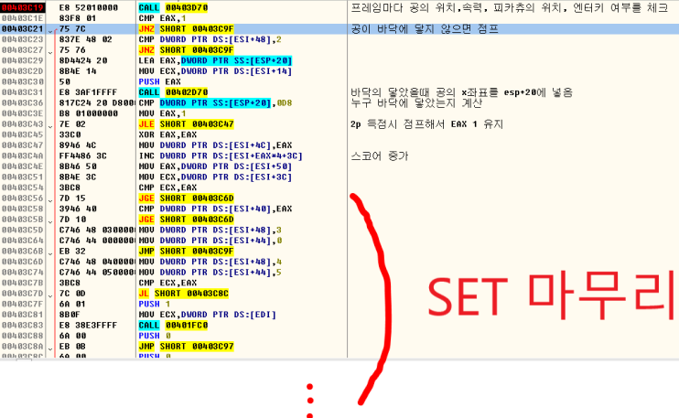
2p 무적 만들기
Notes:
https://blogs.technet.microsoft.com/tip_of_the_day/2016/06/29/tip-of-the-day-demystifying-software-defined-networking-terms-the-cloud-compass-sdn-data-flows/

Slide 8
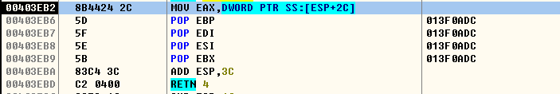
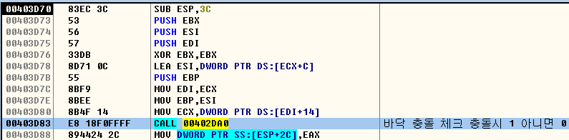
2p 무적 만들기
00403D70 함수 내부
Notes:
https://blogs.technet.microsoft.com/tip_of_the_day/2016/06/29/tip-of-the-day-demystifying-software-defined-networking-terms-the-cloud-compass-sdn-data-flows/

Slide 9
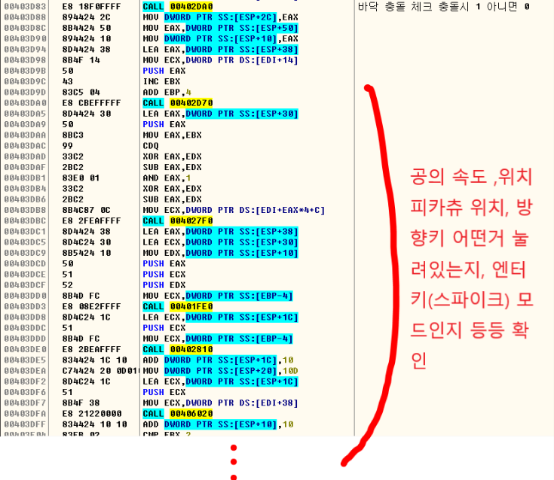
2p 무적 만들기
00403D70 함수 내부
Notes:
https://blogs.technet.microsoft.com/tip_of_the_day/2016/06/29/tip-of-the-day-demystifying-software-defined-networking-terms-the-cloud-compass-sdn-data-flows/

Slide 10
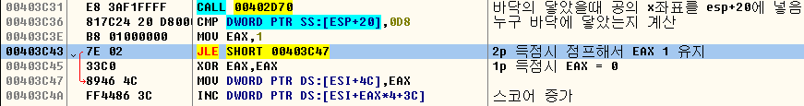
2p 무적 만들기
ESI + 3C
1P 스코어 | 2P 스코어
EAX == 0
EAX == 1

Slide 11
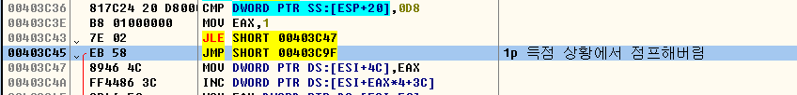
2p 무적 만들기

Slide 12
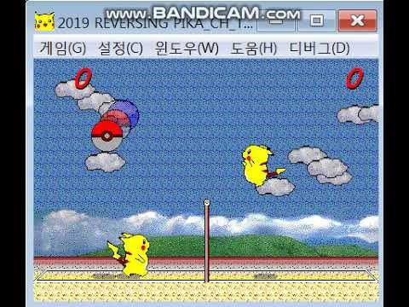
2p 무적 만들기
Notes:
https://blogs.technet.microsoft.com/tip_of_the_day/2016/06/29/tip-of-the-day-demystifying-software-defined-networking-terms-the-cloud-compass-sdn-data-flows/

Slide 13
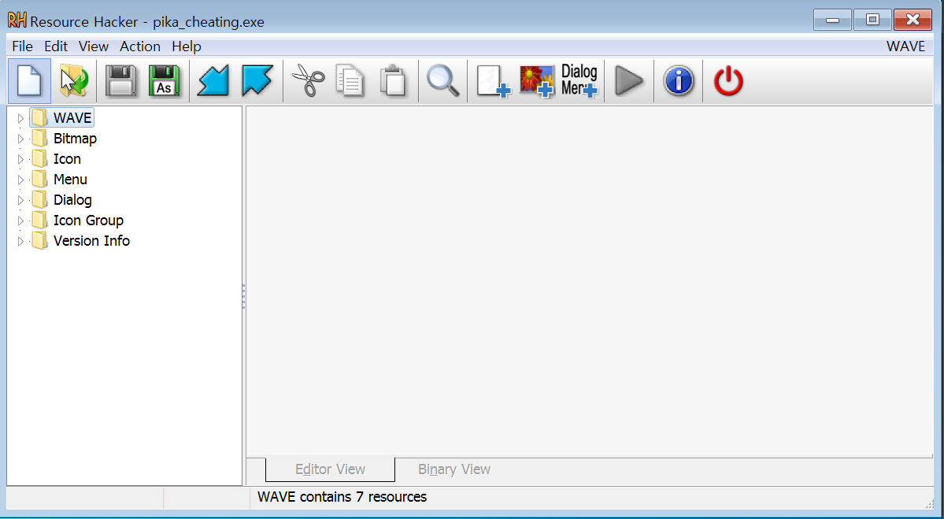
몬스터 볼 마스터 볼로 바꾸기
Notes:
https://blogs.technet.microsoft.com/tip_of_the_day/2016/06/29/tip-of-the-day-demystifying-software-defined-networking-terms-the-cloud-compass-sdn-data-flows/

Slide 14
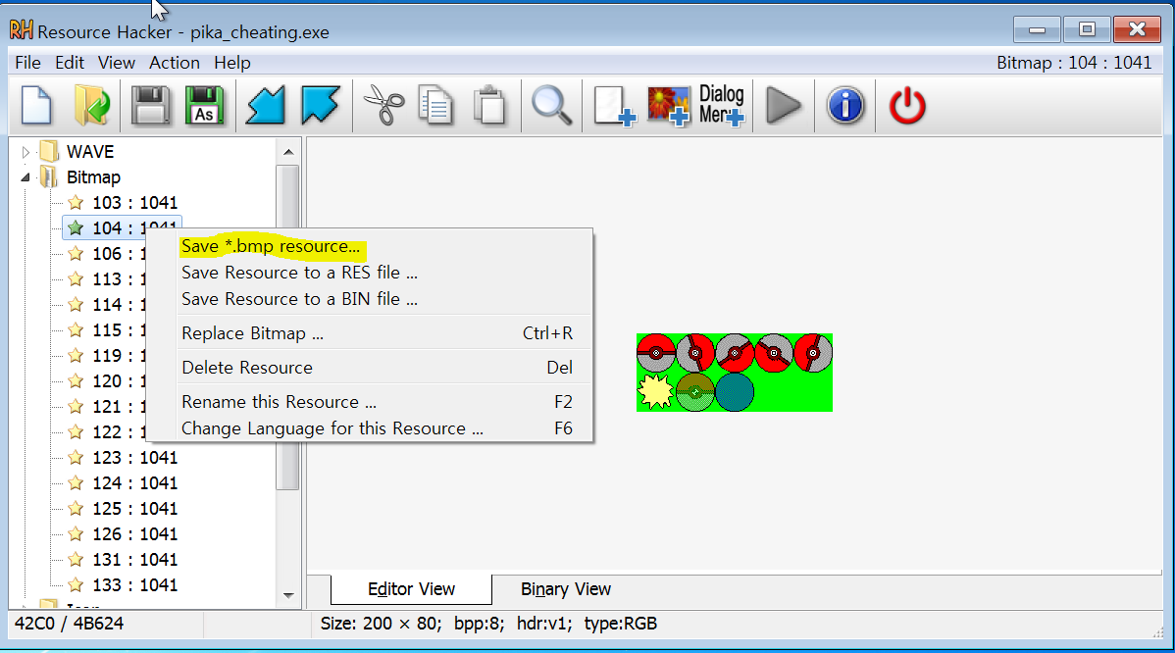
몬스터 볼 마스터 볼로 바꾸기
Notes:
https://blogs.technet.microsoft.com/tip_of_the_day/2016/06/29/tip-of-the-day-demystifying-software-defined-networking-terms-the-cloud-compass-sdn-data-flows/

Slide 15


몬스터 볼 마스터 볼로 바꾸기
Notes:
https://blogs.technet.microsoft.com/tip_of_the_day/2016/06/29/tip-of-the-day-demystifying-software-defined-networking-terms-the-cloud-compass-sdn-data-flows/

Slide 16

몬스터 볼 마스터 볼로 바꾸기
Notes:
https://blogs.technet.microsoft.com/tip_of_the_day/2016/06/29/tip-of-the-day-demystifying-software-defined-networking-terms-the-cloud-compass-sdn-data-flows/

Slide 17
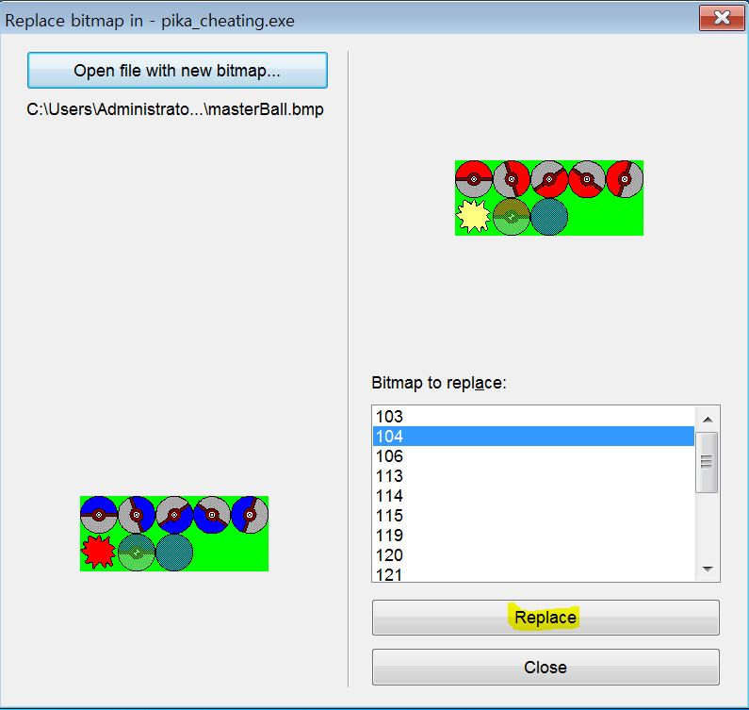
몬스터 볼 마스터 볼로 바꾸기
Notes:
https://blogs.technet.microsoft.com/tip_of_the_day/2016/06/29/tip-of-the-day-demystifying-software-defined-networking-terms-the-cloud-compass-sdn-data-flows/

Slide 18
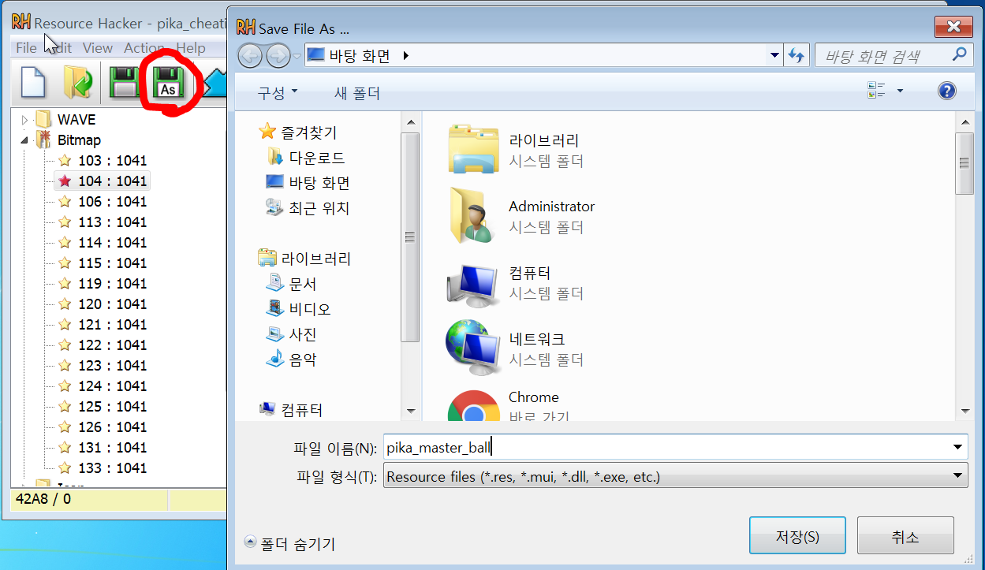
몬스터 볼 마스터 볼로 바꾸기
Notes:
https://blogs.technet.microsoft.com/tip_of_the_day/2016/06/29/tip-of-the-day-demystifying-software-defined-networking-terms-the-cloud-compass-sdn-data-flows/

Slide 19
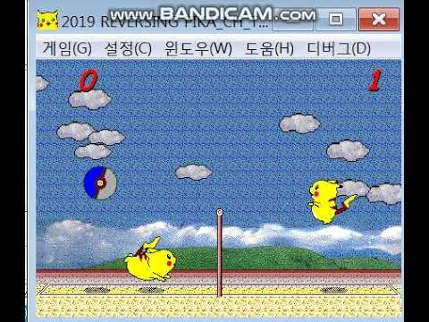
몬스터 볼 마스터 볼로 바꾸기
Notes:
https://blogs.technet.microsoft.com/tip_of_the_day/2016/06/29/tip-of-the-day-demystifying-software-defined-networking-terms-the-cloud-compass-sdn-data-flows/

Slide 20
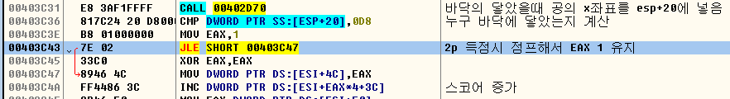

네트 넘어가기(실패)
00
00
D8
216
144
324
1B0
432

Slide 21
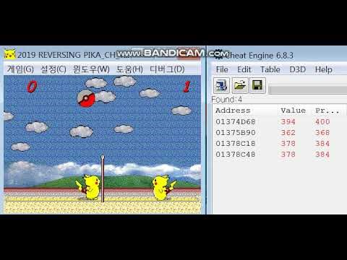
네트 넘어가기(실패)
Notes:
https://blogs.technet.microsoft.com/tip_of_the_day/2016/06/29/tip-of-the-day-demystifying-software-defined-networking-terms-the-cloud-compass-sdn-data-flows/

Slide 22
Q&A

