Slide 1
An Implementation of Collaborative Filtering with Stochastic Gradient Descent Optimization on Spark
Jongse Park
2016.12.13

Slide 2
Questions
What is Collaborative Filtering?
How do we train CF with Stochastic Gradient Descent Optimization?
How can we parallelize the optimization on Spark?

Slide 3


Recommender System
Group of Users
Group of Items

Slide 4
Collaborative Filtering
A method of making automatic predictions (filtering) about the interest of a user by collecting preferences or taste information from many users (collaborating).
Notes:
The assumption of the algorithm is that a (user, item) rating is determined by the match of the latent features between users and items and the goal of algorithm is to calculate the hidden features of each vertex (i.e. user and item).

Slide 5
Project Goal
Develop a parallelized collaborative filtering algorithm using stochastic gradient descent optimization on a state-of-the-art distributed system, Spark.

Slide 6
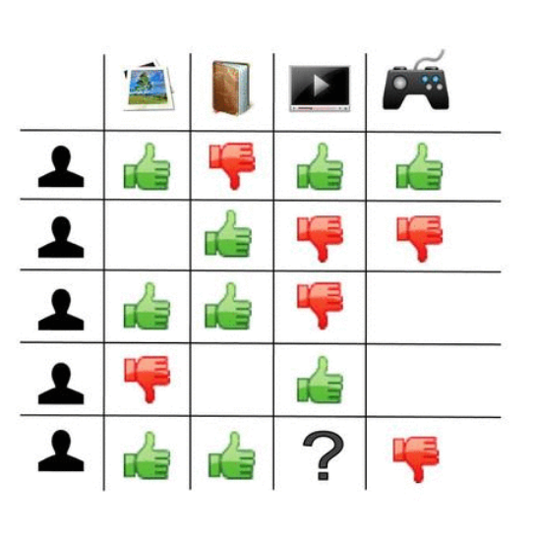
User-Item Matrix

Slide 7
Prediction

Slide 8
Prediction

Slide 9
Matrix Factorization

Slide 10
Matrix Factorization

Slide 11
Matrix Factorization

Slide 12
Training

Slide 13
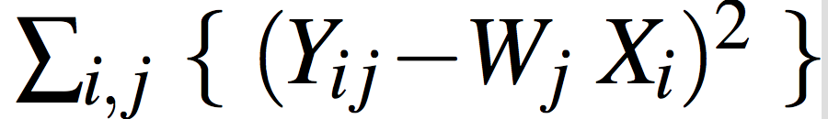
Optimization Problem
Minimize

Slide 14
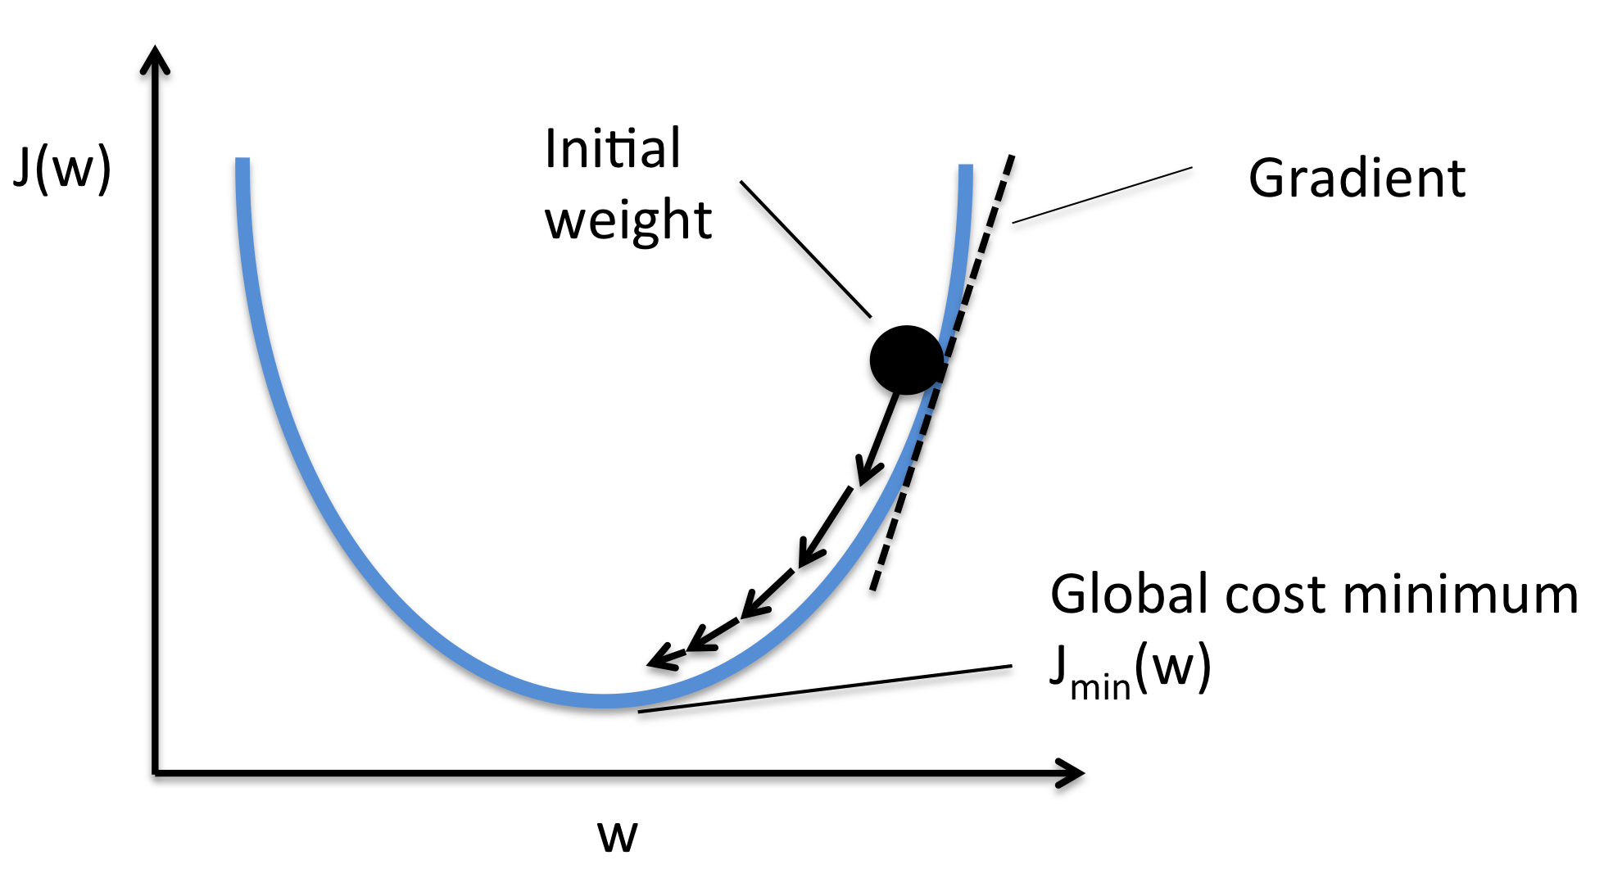
Gradient Descent

Slide 15
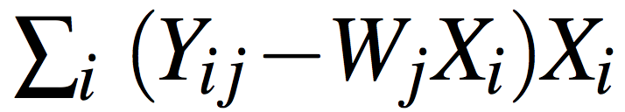

Stochastic Gradient Descent (SGD)
Gradient =
,
Instead of computing gradients for the entire dataset, SGD reads an input data and compute the gradient and update the feature matrices

Slide 16
Parallel SGD
Gradient is a linear operation
Model update can be run in parallel
Workflow
Broadcast the feature matrices
Locally train the model on a subset of input dataset
Aggregate the updates, average, and update the global model
Repeat step 1 - 3

Slide 17
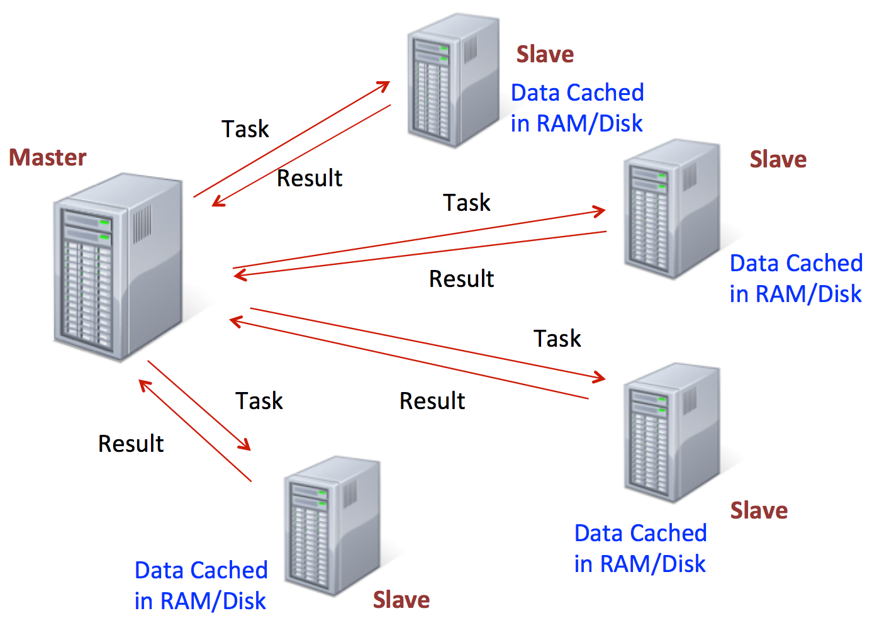
Spark

Slide 18
Evaluation
Three machines
Intel Skylake Core i7 6700K Quad-core Processors
32G memory
Hadoop Distributed File System
1Gbps interconnection network
Movielens and NetFlix datasets

Slide 19
Performance Scaling
Speedup
xMyT: x machines + y threads
1M32T is 7.0x faster than 1M1T
3M32T is 2.4x faster than 1M32T

Slide 20
Conclusion
Developed collaborative filtering algorithm using parallel stochastic gradient descent optimization method on Spark
The experiment demonstrates that the implemented version of collaborative filtering algorithm is scalable

Slide 21
Thank you! Questions?

