Slide 1


NELSSA: A GPU-PNM Heterogeneous System for Mixed-Length LLM Serving via Length-based Request Placement
Sookyung Choi Seungyong Lee Kangkyu Park Yunseo Chun
Junseok Lee Hyeongseok Gwak Myunghyun Rhee
Euiseok Kim Donguk Moon Kwangsik Shin Guseul Heo†
Youngpyo Joo Hoshik Kim Jongse Park†
SK hynix Memory Systems Research
† KAIST CASYS Lab
Notes:
Great to be here. I'm Sookyung Choi, part of the Memory Systems Research Group where we work on emerging memory technologies, system architectures, and infrastructures.
And I'm so excited to share some of the work with you here in MICRO,
This work was also done in collaboration with Professor Jongse Park at KAIST,
For today's talk, I'm going to talk about NELSSA, a GPU–PNM heterogeneous system for efficient mixed-length LLM serving.

Slide 2




Background: Mixed-Length Workloads
Conversational
Reasoning
Multi-agent
Coding
A wide and dynamic mix of short and long requests
10²
10³
10⁴
10⁵+
Application A
LLM
Request-length
Spectrum
Application B
Application C
1
Notes:
We all know that LLM applications are becoming increasingly diverse.
And as applications become more diverse, we are also seeing / a much wider range of request lengths.
So, short and very long requests coexist within the same workload, and their length distribution can also change over time.
As a result, handling dynamic mixed-length workloads has become an important challenge for LLM serving.

Slide 3
Motivation: Long-Context Interference
Waiting
Queue
L
S
S
S
Admission
S
GPU
HBM
S
S
S
S
S
S
S
S
S
S
S
S
Running
Batch
S
S
S
S
S
S
S
S
…
[Running Batch Size: 12]
2
Notes:
So, what happens when we serve requests of different lengths together?
On the left side, we have incoming requests waiting in a queue. And the GPU stores the KV caches of running requests in HBM.

Slide 4
Motivation: Long-Context Interference
Waiting
Queue
L
S
S
S
Admission
S
GPU
HBM
S
S
S
S
S
S
S
S
S
S
S
S
Running
Batch
S
S
S
S
S
S
S
S
…
[Running Batch Size: 12]
2
Notes:
Now, when a long request is admitted, ➔

Slide 5
Motivation: Long-Context Interference
Waiting
Queue
L
S
S
S
Admission
S
GPU
HBM
S
S
S
S
S
S
S
S
S
S
S
S
Running
Batch
S
S
S
S
S
S
S
S
…
[Running Batch Size: 12]
2
Notes:
Now, when a long request is admitted,

Slide 6
Motivation: Long-Context Interference
Waiting
Queue
L
S
S
S
Admission
GPU
HBM
L
S
S
Running
Batch
L
S
S
[Running Batch Size: 3]
2
Notes:
its large KV cache can occupy a significant portion of GPU memory.

Slide 7
Motivation: Long-Context Interference
Waiting
Queue
S
S
S
S
S
S
Admission
GPU
HBM
L
Running
Batch
L
[Running Batch Size: 1]
2
Notes:
As a result, the running batch size can drop,

Slide 8
Motivation: Long-Context Interference
Waiting
Queue
S
S
S
S
S
S
S
S
Admission
GPU
HBM
L
Running
Batch
L
[Running Batch Size: 1]
2
Notes:
and short requests may have to wait

Slide 9
Motivation: Long-Context Interference
Waiting
Queue
S
S
S
S
S
S
S
S
Admission
GPU
HBM
L
Running
Batch
L
[Running Batch Size: 1]
2
Notes:
because there is not enough space in GPU HBM to admit them.

Slide 10
Motivation: Long-Context Interference
Pending Requests
Waiting
Queue
S
S
S
S
S
S
S
S
Admission
Cannot be
admitted
GPU
HBM
L
Running
Batch
L
[Running Batch Size: 1]
2
Notes:
This leads to Head-of-Line blocking.

Slide 11
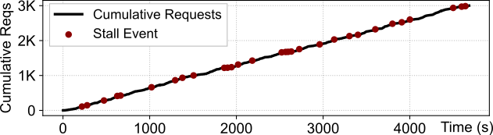
Motivation: Long-Context Interference
Pending Requests
Waiting
Queue
S
S
S
S
S
S
S
S
Admission
Cannot be
admitted
GPU
HBM
L
Running
Batch
L
[Running Batch Size: 1]
2
Notes:
On the right side, we have experimental results from a real conversation trace. The red dots indicate throughput stall events.

Slide 12
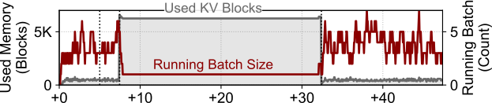
Motivation: Long-Context Interference
Pending Requests
Waiting
Queue
S
S
S
S
S
S
S
S
Admission
Cannot be
admitted
GPU
HBM
L
Running
Batch
L
[Running Batch Size: 1]
2
Notes:
And if we zoom in on one of these events, we can see that GPU memory becomes saturated,
the running batch size drops sharply,

Slide 13
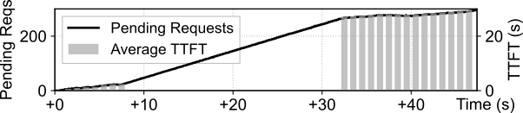
Motivation: Long-Context Interference
Pending Requests
Waiting
Queue
S
S
S
S
S
S
S
S
Admission
Cannot be
admitted
GPU
HBM
L
Running
Batch
L
[Running Batch Size: 1]
2
Notes:
and pending requests start to accumulate.

Slide 14
Motivation: Long-Context Interference
Pending Requests
Waiting
Queue
S
S
S
S
S
S
S
S
Admission
Cannot be
admitted
GPU
HBM
L
Running
Batch
L
[Running Batch Size: 1]
Need to handle large KV state efficiently
2
Notes:
And this is where we want to focus: how to handle large KV caches efficiently.

Slide 15
Motivation: Existing Approaches
GPU Sparse Attention
KV Offloading
PNM Sparse Attention
Large KV
GPU
HBM
Access only selected KV
Quest ‘24
DeepSeek Sparse Attention (DSA) ‘25
Native Sparse Attention (NSA) ‘25
RocketKV ‘25
+ Reduced KV access
- KV remains in GPU HBM
3
Notes:
So, let's look at how existing approaches handle large KV caches.
Some approaches reduce the KV cache size using eviction or compression during prefill, but this often comes at the cost of accuracy, particularly with aggressive reduction.
So, let's focus on approaches that "keep the full kv caches."

Slide 16
Motivation: Existing Approaches
GPU Sparse Attention
KV Offloading
PNM Sparse Attention
Large KV
GPU
HBM
Access only selected KV
Quest ‘24
DeepSeek Sparse Attention (DSA) ‘25
Native Sparse Attention (NSA) ‘25
RocketKV ‘25
+ Reduced KV access
- KV remains in GPU HBM
3
Notes:
Another direction is to apply sparse attention on the GPU, accessing only selected KV entries.
This reduces memory access and computation.
But the full KV cache still needs to stay in GPU HBM, so the memory capacity problem remains.

Slide 17
Motivation: Existing Approaches
GPU Sparse Attention
KV Offloading
PNM Sparse Attention
Large KV
GPU
HBM
Move KV out of GPU HBM
InfiniGen (OSDI ‘24)
ArkVale (NeurIPS ’24)
RetrievalAttention (NeurIPS ‘25)
RetroInfer (PVLDB ‘26)
HiSparse (’26)
CPU
DRAM
+ Relieves HBM capacity pressure
- Per-step KV transfer to GPU
4
Notes:
Another approach is to

Slide 18
Motivation: Existing Approaches
GPU Sparse Attention
KV Offloading
PNM Sparse Attention
GPU
HBM
Move KV out of GPU HBM
InfiniGen (OSDI ‘24)
ArkVale (NeurIPS ’24)
RetrievalAttention (NeurIPS ‘25)
RetroInfer (PVLDB ‘26)
HiSparse (’26)
Offload KV
Large KV
CPU
DRAM
+ Relieves HBM capacity pressure
- Per-step KV transfer to GPU
4
Notes:
offload the KV cache from HBM to host memory.
This reduces GPU memory capacity pressure, and

Slide 19
Motivation: Existing Approaches
GPU Sparse Attention
KV Offloading
PNM Sparse Attention
GPU
HBM
Move KV out of GPU HBM
InfiniGen (OSDI ‘24)
ArkVale (NeurIPS ’24)
RetrievalAttention (NeurIPS ‘25)
RetroInfer (PVLDB ‘26)
HiSparse (’26)
Large KV
CPU
DRAM
+ Relieves HBM capacity pressure
- Per-step KV transfer to GPU
4
Notes:
with sparse attention,

Slide 20
Motivation: Existing Approaches
GPU Sparse Attention
KV Offloading
PNM Sparse Attention
Selected
KV
GPU
HBM
Move KV out of GPU HBM
InfiniGen (OSDI ‘24)
ArkVale (NeurIPS ’24)
RetrievalAttention (NeurIPS ‘25)
RetroInfer (PVLDB ‘26)
HiSparse (’26)
Fetch Selected KV
Large KV
CPU
DRAM
+ Relieves HBM capacity pressure
- Per-step KV transfer to GPU
4
Notes:
only selected KV entries are transferred back to the GPU.

Slide 21
Motivation: Existing Approaches
GPU Sparse Attention
KV Offloading
PNM Sparse Attention
Selected
KV
GPU
HBM
Move KV out of GPU HBM
InfiniGen (OSDI ‘24)
ArkVale (NeurIPS ’24)
RetrievalAttention (NeurIPS ‘25)
RetroInfer (PVLDB ‘26)
HiSparse (’26)
Fetch Selected KV
Large KV
CPU
DRAM
+ Relieves HBM capacity pressure
- Per-step KV transfer to GPU
4
Notes:
But even with prefetching, PCIe can become a bottleneck as context lengths or batch sizes grow, / because the attention still runs on the GPU.

Slide 22

Motivation: Existing Approaches
GPU Sparse Attention
KV Offloading
PNM Sparse Attention
Large KV
GPU
HBM
Execute attention where KV resides
LongSight (MICRO ‘25)
ScalablePNM (PACT ‘25)
PNM Meets Sparse Attention (CAL ‘25)
PNM
Good fit for long-context decode attention
Memory-bound ∙ Large capacity ∙ Sparse execution
5
Notes:
So, another direction is to use

Slide 23
Motivation: Existing Approaches
GPU Sparse Attention
KV Offloading
PNM Sparse Attention
GPU
HBM
Execute attention where KV resides
LongSight (MICRO ‘25)
ScalablePNM (PACT ‘25)
PNM Meets Sparse Attention (CAL ‘25)
Offload KV
Large KV
PNM
Good fit for long-context decode attention
Memory-bound ∙ Large capacity ∙ Sparse execution
5
Notes:
Processing-Near-Memory, or PNM,

Slide 24
Motivation: Existing Approaches
GPU Sparse Attention
KV Offloading
PNM Sparse Attention
GPU
HBM
Execute attention where KV resides
LongSight (MICRO ‘25)
ScalablePNM (PACT ‘25)
PNM Meets Sparse Attention (CAL ‘25)
Large KV
PNM
Good fit for long-context decode attention
Memory-bound ∙ Large capacity ∙ Sparse execution
5
Notes:
to execute attention where the KV cache resides.

Slide 25
Motivation: Existing Approaches
GPU Sparse Attention
KV Offloading
PNM Sparse Attention
GPU
HBM
Execute attention where KV resides
LongSight (MICRO ‘25)
ScalablePNM (PACT ‘25)
PNM Meets Sparse Attention (CAL ‘25)
Large KV
PNM
Good fit for long-context decode attention
Memory-bound ∙ Large capacity ∙ Sparse execution
5
Notes:
PNM provides large memory capacity,

Slide 26
Motivation: Existing Approaches
GPU Sparse Attention
KV Offloading
PNM Sparse Attention
GPU
HBM
Execute attention where KV resides
LongSight (MICRO ‘25)
ScalablePNM (PACT ‘25)
PNM Meets Sparse Attention (CAL ‘25)
O
Return
attention output
Large KV
PNM
Good fit for long-context decode attention
Memory-bound ∙ Large capacity ∙ Sparse execution
5
Notes:
and only the attention output needs to be sent back to the GPU.
As we all know that…This works well for decode attention because of its low operational intensity.
And by combining PNM with sparse attention, we can further reduce memory bandwidth requirements.
So(↗), sparse PNM is a good option for long-context decode attention.

Slide 27
Motivation: Existing Approaches
GPU Sparse Attention
KV Offloading
PNM Sparse Attention
GPU
HBM
Execute attention where KV resides
LongSight (MICRO ‘25)
ScalablePNM (PACT ‘25)
PNM Meets Sparse Attention (CAL ‘25)
O
Return
attention output
Large KV
PNM
Good fit for long-context decode attention
Memory-bound ∙ Large capacity ∙ Sparse execution
But what about mixed-length workload?
5
Notes:
But my question is… what about mixed-length workloads, where short and long requests coexist?

Slide 28
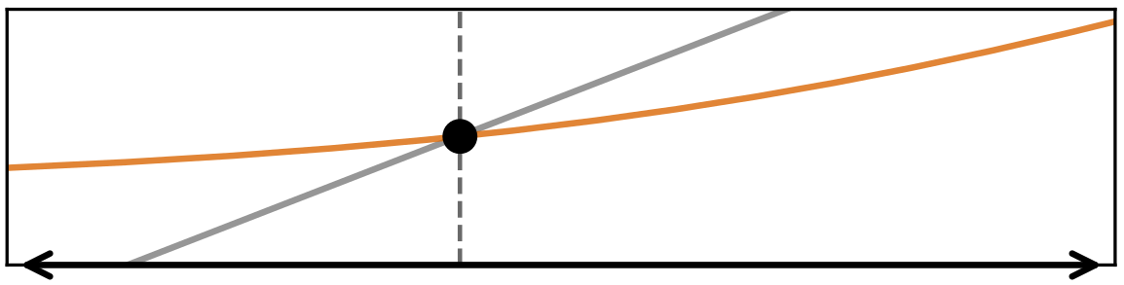
Motivation: Different Lengths, Different Strengths
Observation: GPU and PNM favor different request-length regimes
GPU Attention
PNM Attention
Decode Attention
Latency
Tinput
Context Length
SHORT
LONG
6
Notes:
Now, from the perspective of our work, let's take a closer look at the relative strengths of GPU and PNM.
This figure compares the attention latency of GPU and PNM across different request lengths.

Slide 29
Motivation: Different Lengths, Different Strengths
Observation: GPU and PNM favor different request-length regimes
GPU Attention
PNM Attention
Decode Attention
Latency
Tinput
Context Length
SHORT
LONG
GPU Advantage
High HBM bandwidth
No PNM dispatch overhead
6
Notes:
On the left side, for short requests, the GPU is faster.
This is because the GPU provides high bandwidth, without the additional overhead of PNM dispatch.

Slide 30
Motivation: Different Lengths, Different Strengths
Observation: GPU and PNM favor different request-length regimes
GPU Attention
PNM Attention
Decode Attention
Latency
Tinput
Context Length
SHORT
LONG
GPU Advantage
PNM Advantage
High HBM bandwidth
No PNM dispatch overhead
Large KV capacity
(Sparse) Attention where KV resides
6
Notes:
On the right side, for long requests, PNM becomes more advantageous.
This is because PNM provides large capacity and supports sparse attention near memory.
So, as we can see, there is a crossover point where the relative performance of GPU and PNM, changes with request length.

Slide 31
Motivation: Different Lengths, Different Strengths
Observation: GPU and PNM favor different request-length regimes
GPU Attention
PNM Attention
Decode Attention
Latency
Tinput
Context Length
SHORT
LONG
GPU Advantage
PNM Advantage
High HBM bandwidth
No PNM dispatch overhead
Large KV capacity
(Sparse) Attention where KV resides
No single hardware tier is universally superior
6
Notes:
And the key observation here is, / no single hardware tier is universally superior.

Slide 32
NELSSA: Overview
Request
Queue
S
L
S
S
S
L
L
S
S
S
Threshold (Tinput)
Short
Long
GPU Node
PNM Node
7
Notes:
Based on this observation, we propose NELSSA.
The key idea / is to use GPU and PNM where each performs best, depending on the request length.

Slide 33
NELSSA: Overview
Request
Queue
S
L
S
S
S
L
L
S
S
S
S
Threshold (Tinput)
Short
Long
S
GPU Node
PNM Node
Leverage GPU Strengths
7
Notes:
So, for instance, short requests are handled entirely on the GPU.

Slide 34
NELSSA: Overview
Request
Queue
L
S
S
S
L
L
S
S
S
L
Threshold (Tinput)
Short
Long
S
L
L
GPU Node
PNM Node
Leverage PNM Strengths
7
Notes:
For long requests, we use both GPU and PNM, with the historical KV cache stored on PNM.

Slide 35
NELSSA: Overview
Request
Queue
L
S
S
S
L
L
S
S
S
L
Placement
How do we determine the routing threshold?
Threshold (Tinput)
?
Short
Long
S
L
L
GPU Node
PNM Node
7
Notes:
But this also brings a challenge in terms of request placement: How do we determine the routing threshold?

Slide 36
NELSSA: Overview
Request
Queue
S
S
S
L
L
S
S
S
S
Placement
How do we determine the routing threshold?
Threshold (Tinput)
Short
Long
S
L
S
L
GPU Node
PNM Node
7
Notes:
The next challenge comes from the fact that context length keeps growing during inference.

Slide 37
NELSSA: Overview
Request
Queue
S
S
S
L
L
S
S
S
S
Placement
How do we determine the routing threshold?
Threshold (Tinput)
Iterative
Decoding
Short
Long
S
L
S
L
GPU Node
PNM Node
7
Notes:
If you think of a short request running on the GPU, its context can gradually grow as more tokens are generated.

Slide 38
NELSSA: Overview
Request
Queue
S
S
S
L
L
S
S
S
L
S → L ?
Placement
How do we determine the routing threshold?
Migration
What if the context grows during decoding?
Threshold (Tinput)
Iterative
Decoding
Short
Long
S
L
S
L
GPU Node
PNM Node
7
Notes:
So, the next question is, what happens when a short request becomes long during inference?

Slide 39
NELSSA: Overview
Request
Queue
S
S
S
L
L
S
S
S
L
Placement
How do we determine the routing threshold?
Migration
What if the context grows during decoding?
Threshold (Tinput)
Short
Long
GPU
GPU
PNM
PNM
GPU
GPU
CPU
CPU
PNM
PNM
GPU
GPU
PNM
PNM
GPU Node
PNM Node
7
Notes:
And finally, it's also important to consider the challenge of building a real heterogeneous system.

Slide 40
NELSSA: Overview
Request
Queue
S
S
S
L
L
S
S
S
L
Placement
How do we determine the routing threshold?
Migration
What if the context grows during decoding?
Integration
How do we build the end-to-end GPU-PNM system?
SW
Threshold (Tinput)
Short
Long
GPU
GPU
PNM
PNM
HW
GPU
GPU
CPU
CPU
PNM
PNM
GPU
GPU
PNM
PNM
GPU Node
PNM Node
7
Notes:
Integrating a new PNM device into an existing GPU-based LLM serving system is not straightforward.
And for example, to support scalability through disaggregation, we also need to design and implement the interconnect between GPU and PNM.
So, we need to consider how we bring all these components together into a real system.

Slide 41
NELSSA: Hardware-Aware Routing
Challenge 1
How do we determine the routing threshold?
Estimate GPU and PNM attention latency from device-level performance characteristics.
Derive Tinput as the hardware-specific crossover between the two execution paths.
HBM bandwidth, Compute capability…
GPU attention
latency model
TGPU(L)
Latency
PNM attention
latency model
TPNM(L)
Tinput
Context
Length(L)
PNM bandwidth, Parallelism(n_PNM), Communication…
8
Notes:
So, for the first challenge, we model the attention latency of GPU and PNM based on their hardware characteristics and LLM model configuration.
And we use the crossover point between the two latency curves / as our routing threshold.

Slide 42
NELSSA: Hardware-Aware Routing
Challenge 1
How do we determine the routing threshold?
Estimate GPU and PNM attention latency from device-level performance characteristics.
Derive Tinput as the hardware-specific crossover between the two execution paths.
Batched QKV
HBM bandwidth, Compute capability…
GPU attention
latency model
TGPU(L)
Short
< Tinput ?
Long
Latency
GPU dense attention
(FlashAttn)
GPU + PNM sparse attention
Sink-local
Attn
Top-K Search (on GPU)
PNM attention
latency model
TPNM(L)
Sparse Attn (on PNM)
Tinput
Context
Length(L)
Aggregation (on GPU)
PNM bandwidth, Parallelism(n_PNM), Communication…
Batched MLP
8
Notes:
With this threshold, short requests / use dense attention on the GPU.
For long requests, we store the historical KV cache on PNM, and use GPU local attention together with PNM sparse attention.

Slide 43
NELSSA: Background Migration
Challenge 2
What if the context grows during decoding?
Migrate growing requests from GPU to PNM without interrupting generation.
One-way handoff preserves the KV cache and avoids recomputation.
N-2
N-1
N
N+1
…
N+k
N+k+1
N+k+2
GPU
HBM
KV
KV
PNM
Time (decode steps)
9
Notes:
Next, we introduce background migration to handle context growth.

Slide 44
NELSSA: Background Migration
Challenge 2
What if the context grows during decoding?
Migrate growing requests from GPU to PNM without interrupting generation.
One-way handoff preserves the KV cache and avoids recomputation.
length > Tinput or
under memory pressure
N-2
N-1
N
N+1
…
N+k
N+k+1
N+k+2
GPU
HBM
KV
KV
PNM
Time (decode steps)
Start Migration
9
Notes:
If you think of a short request getting longer,

Slide 45
NELSSA: Background Migration
Challenge 2
What if the context grows during decoding?
Migrate growing requests from GPU to PNM without interrupting generation.
One-way handoff preserves the KV cache and avoids recomputation.
N-2
N-1
N
N+1
…
N+k
N+k+1
N+k+2
GPU
HBM
KV
KV
KV
PNM
Time (decode steps)
Start Migration
9

Slide 46
NELSSA: Background Migration
Challenge 2
What if the context grows during decoding?
Migrate growing requests from GPU to PNM without interrupting generation.
One-way handoff preserves the KV cache and avoids recomputation.
Generation Continues on GPU
N-2
N-1
N
N+1
…
N+k
N+k+1
N+k+2
GPU
HBM
KV
KV
KV
PNM
KV
Time (decode steps)
Start Migration
9
Notes:
we migrate its historical KV cache to PNM in the background, while generation continues on the GPU.

Slide 47
NELSSA: Background Migration
Challenge 2
What if the context grows during decoding?
Migrate growing requests from GPU to PNM without interrupting generation.
One-way handoff preserves the KV cache and avoids recomputation.
GPU-PNM (NELSSA)
N-2
N-1
N
N+1
…
N+k
N+k+1
N+k+2
GPU
HBM
KV
KV
KV
Output Aggregation
PNM
KV
KV
KV
Time (decode steps)
Start Migration
After Migration
9
Notes:
After the migration is complete, GPU and PNM work together to execute attention.
As a result of this, we can avoid preemption and reuse the existing KV cache without recomputation.

Slide 48
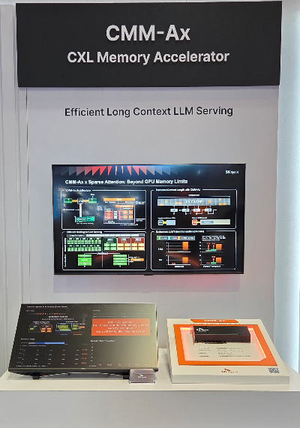
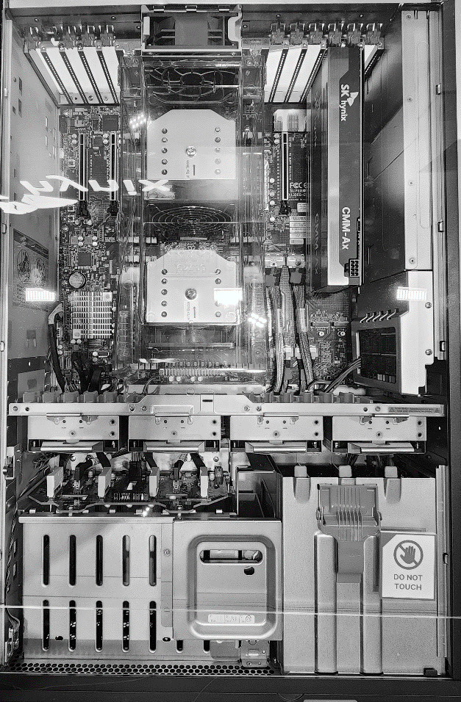
NELSSA: End-to-End System
Challenge 3
How do we build the end-to-end GPU-PNM system?
NELSSA implements an end-to-end GPU-PNM heterogeneous serving system on real HW
  Real HW Prototype: built on real CXL-PNM HW
[ CMM-Ax Server Integration]
[ FMS 2026 Tech Session ]
10
Notes:
Finally, for system implementation,

Slide 49
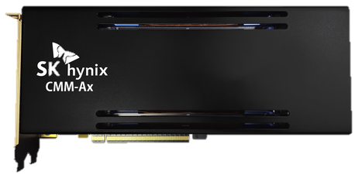
NELSSA: End-to-End System
Challenge 3
How do we build the end-to-end GPU-PNM system?
NELSSA implements an end-to-end GPU-PNM heterogeneous serving system on real HW
  Real HW Prototype: built on real CXL-PNM HW
[ SK hynix CMM-Ax ]
CXL 2.0, DDR5-based PNM (32 GB)
ARM Neoverse V2
Ongoing: Custom board development (512 GB)
[ CMM-Ax Server Integration]
[ FMS 2026 Tech Session ]
10
Notes:
we integrated a real PNM hardware prototype, called CMM-AX, into our system.
This is a photo of our PNM node, and the red box highlights where the CMM-Ax device is installed.

Slide 50
NELSSA: End-to-End System
Challenge 3
How do we build the end-to-end GPU-PNM system?
NELSSA implements an end-to-end GPU-PNM heterogeneous serving system on real HW
  Real HW Prototype: built on real CXL-PNM HW
  End-to-End SW: integrates GPU and PNM execution through a complete serving SW stack
Conventional P-D System
PyTorch Frontend
PREFILL
DECODE
LLM Model
NelssaPNM
Sparse Attention Kernel
Hybrid Router
GPU
GPU
GPU
GPU
GPU
GPU
GPU
GPU
NelssaClient
NelssaHost
gRPC service
PNM Distribution, Aggregation
NELSSA
init
()
send_kv()
PREFILL
DECODE
execute_decode()
GPU
GPU
GPU
GPU
gRPC Client
OS Kernel
OS Kernel
gRPC Server
GPU
GPU
GPU
GPU
RDMA Engine
Ethernet
Switch
RDMA Poller &
Dispatcher
GPU Node
PNM Node
10
Notes:
At the infrastructure level,

Slide 51
NELSSA: End-to-End System
Challenge 3
How do we build the end-to-end GPU-PNM system?
NELSSA implements an end-to-end GPU-PNM heterogeneous serving system on real HW
  Real HW Prototype: built on real CXL-PNM HW
  End-to-End SW: integrates GPU and PNM execution through a complete serving SW stack
Conventional P-D System
PyTorch Frontend
PREFILL
DECODE
LLM Model
NelssaPNM
Sparse Attention Kernel
Hybrid Router
GPU
GPU
GPU
GPU
GPU
GPU
GPU
GPU
NelssaClient
NelssaHost
gRPC service
PNM Distribution, Aggregation
NELSSA
init
()
send_kv()
PREFILL
DECODE
DECODE
execute_decode()
GPU
GPU
GPU
GPU
PNM
PNM
gRPC Client
OS Kernel
OS Kernel
gRPC Server
GPU
GPU
GPU
GPU
PNM
PNM
RDMA Engine
Ethernet
Switch
RDMA Poller &
Dispatcher
SHORT
Decode
LONG
Decode
GPU Node
PNM Node
10
Notes:
NELSSA adds a dedicated PNM attention node to a conventional prefill-decode disaggregated system.

Slide 52
NELSSA: End-to-End System
Challenge 3
How do we build the end-to-end GPU-PNM system?
NELSSA implements an end-to-end GPU-PNM heterogeneous serving system on real HW
  Real HW Prototype: built on real CXL-PNM HW
  End-to-End SW: integrates GPU and PNM execution through a complete serving SW stack
Conventional P-D System
PyTorch Frontend
PREFILL
DECODE
LLM Model
NelssaPNM
Sparse Attention Kernel
Hybrid Router
GPU
GPU
GPU
GPU
GPU
GPU
GPU
GPU
NelssaClient
NelssaHost
gRPC service
PNM Distribution, Aggregation
NELSSA
init
()
send_kv()
PREFILL
DECODE
DECODE
execute_decode()
GPU
GPU
GPU
GPU
PNM
PNM
gRPC Client
OS Kernel
OS Kernel
gRPC Server
GPU
GPU
GPU
GPU
PNM
PNM
RDMA Engine
Ethernet
Switch
RDMA Poller &
Dispatcher
SHORT
Decode
LONG
Decode
GPU Node
PNM Node
10
Notes:
On the software side, we implemented a PyTorch-based frontend and a host application.

Slide 53
NELSSA: End-to-End System
Challenge 3
How do we build the end-to-end GPU-PNM system?
NELSSA implements an end-to-end GPU-PNM heterogeneous serving system on real HW
  Real HW Prototype: built on real CXL-PNM HW
  End-to-End SW: integrates GPU and PNM execution through a complete serving SW stack
Conventional P-D System
PyTorch Frontend
PREFILL
DECODE
LLM Model
NelssaPNM
Sparse Attention Kernel
Hybrid Router
GPU
GPU
GPU
GPU
GPU
GPU
GPU
GPU
NelssaClient
NelssaHost
gRPC service
PNM Distribution, Aggregation
NELSSA
init
()
send_kv()
PREFILL
DECODE
DECODE
execute_decode()
GPU
GPU
GPU
GPU
PNM
PNM
gRPC Client
OS Kernel
OS Kernel
gRPC Server
GPU
GPU
GPU
GPU
PNM
PNM
RDMA Engine
Ethernet
Switch
RDMA Poller &
Dispatcher
SHORT
Decode
LONG
Decode
GPU Node
PNM Node
10
Notes:
We also built a communication layer over standard Ethernet to connect the GPU and PNM nodes.
And on the PNM side, we developed a separate software stack and libraries.

Slide 54
Evaluation: Experimental Methodology
Hardware / System
  1x H100 NVL + 4x CXL-PNM devices
  PNM: 32 GB/device measured, 512 GB/device projected
Model / Workload
  Llama3-8B-1048K, 128K-1M context
  RULER for accuracy, Mooncake trace for mixed-length workloads
Baselines
  1x GPU: H100 NVL, FlashAttention
  2x GPU: 2x H100 NVL, FlashAttention
  RetroInfer: CPU-offloaded sparse attention
Projection
  Scale PNM capacity: 32 GB → 512 GB/device
  Project from measured component-level latency
  PNM-attention model validated within ±5.6%
11
Notes:
For our evaluation, we used one H100 GPU and four PNM devices.
We measured the prototype with 32 GB per PNM device, and projected results for a 512 GB configuration based on these measurements.

Slide 55
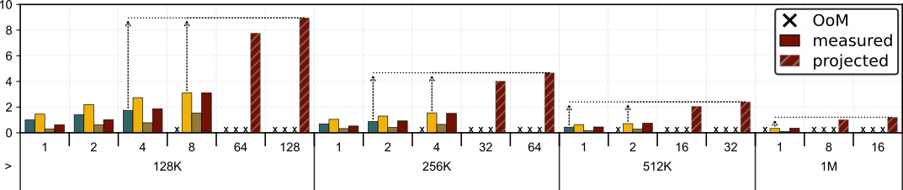
Evaluation: Throughput Results
GPU only (1x GPU) GPU only (2x GPU) RetroInfer NELSSA
Throughput
Improvement
(tokens/sec)
5.1x
2.9x
5.3x
3.0x
3.6x
5.5x
3.4x
Batch
Sequence
Length
1
2
4
8
64
128
1
2
4
32
64
1
2
16
32
1
2
16
>
>
128K
256K
512K
1M
NELSSA efficiently serves large-KV configurations beyond GPU memory capacity.
It improves throughput by up to 5.5× vs. 1× GPU and 3.6× vs. 2× GPU.
12
Notes:
Here is the main result.
This graph shows throughput across different batch sizes and context lengths.
NELSSA efficiently handles large KV caches,

Slide 56
Evaluation: Throughput Results
GPU only (1x GPU) GPU only (2x GPU) RetroInfer NELSSA
Throughput
Improvement
(tokens/sec)
5.1x
2.9x
5.3x
3.0x
3.6x
5.5x
3.4x
Batch
Sequence
Length
1
2
4
8
64
128
1
2
4
32
64
1
2
16
32
1
2
16
>
>
128K
256K
512K
1M
NELSSA efficiently serves large-KV configurations beyond GPU memory capacity.
It improves throughput by up to 5.5× vs. 1× GPU and 3.6× vs. 2× GPU.
12
Notes:
Specifically, achieving up to 5.5 times higher throughput than a single GPU,

Slide 57
Evaluation: Throughput Results
GPU only (1x GPU) GPU only (2x GPU) RetroInfer NELSSA
Throughput
Improvement
(tokens/sec)
5.1x
2.9x
5.3x
3.0x
3.6x
5.5x
3.4x
Batch
Sequence
Length
1
2
4
8
64
128
1
2
4
32
64
1
2
16
32
1
2
16
>
>
128K
256K
512K
1M
NELSSA efficiently serves large-KV configurations beyond GPU memory capacity.
It improves throughput by up to 5.5× vs. 1× GPU and 3.6× vs. 2× GPU.
12
Notes:
and 3.6 times higher than two GPUs.

Slide 58
Evaluation: More Results in the Paper
Accuracy-Throughput Trade-off
  Stable accuracy at ≥ 4% Selection (RULER benchmark)
Mixed-Length Serving
  Up to 15x lower P99 latency
Long-Request Sensitivity
  Robust across varying workload mixes
Dynamic Context Growth
  29% higher throughput with background migration
System Overheads
  Low communication and migration overhead
13
Notes:
We also achieved / up to 15 times lower P99 latency in mixed-length serving.
And you can also see more results in the paper, including the accuracy, robustness across different workload mixes, background migration, and system overheads.

Slide 59
Implication: NELSSA Scaling
GPU-PNM disaggregation enables compute and memory-centric to scale independently.
Resource provisioning can follow workload composition instead of scaling GPUs together.
Target Throughput
RoCEv2 Ethernet
GPU-only
CPU
CPU
CPU
NELSSA
GPU
GPU
GPU
Node
PNM
Node
GPU
GPU
GPU
GPU
PNM
PNM
GPU
GPU
PNM
PNM
Tightly coupled compute-memory
Decoupled compute and memory-centric scaling
Illustrative capacity-based scaling example (llama-3-8B)
GPU-only: 4x H100, NELSSA: 4x H100 + 4x PNM (█=1.15M)
14
Notes:
Finally, / we can imagine scaling up this system.

Slide 60
Implication: NELSSA Scaling
GPU-PNM disaggregation enables compute and memory-centric to scale independently.
Resource provisioning can follow workload composition instead of scaling GPUs together.
Target Throughput
RoCEv2 Ethernet
GPU-only
CPU
CPU
CPU
CPU
NELSSA
GPU
GPU
GPU
GPU
GPU
Node
PNM
Node
GPU
GPU
GPU
GPU
GPU
GPU
PNM
PNM
GPU
GPU
PNM
PNM
Tightly coupled compute-memory
Decoupled compute and memory-centric scaling
Illustrative capacity-based scaling example (llama-3-8B)
GPU-only: 4x H100, NELSSA: 4x H100 + 4x PNM (█=1.15M)
14
Notes:
To achieve the same target throughput,

Slide 61
Implication: NELSSA Scaling
GPU-PNM disaggregation enables compute and memory-centric to scale independently.
Resource provisioning can follow workload composition instead of scaling GPUs together.
Target Throughput
CPU
CPU
CPU
CPU
RoCEv2 Ethernet
GPU
GPU
GPU
GPU
GPU
GPU
GPU
GPU
GPU-only
GPU
GPU
GPU
GPU
GPU
GPU
GPU
GPU
CPU
CPU
NELSSA
GPU
Node
PNM
Node
CPU
CPU
CPU
GPU
GPU
PNM
PNM
GPU
GPU
GPU
GPU
GPU
GPU
GPU
GPU
PNM
PNM
GPU
GPU
GPU
GPU
GPU
GPU
Tightly coupled compute-memory
Decoupled compute and memory-centric scaling
Illustrative capacity-based scaling example (llama-3-8B)
GPU-only: 4x H100, NELSSA: 4x H100 + 4x PNM (█=1.15M)
14
Notes:
GPU-only systems need to scale up GPUs as memory demand grows,

Slide 62
Implication: NELSSA Scaling
GPU-PNM disaggregation enables compute and memory-centric to scale independently.
Resource provisioning can follow workload composition instead of scaling GPUs together.
Target Throughput
CPU
CPU
CPU
CPU
CPU
GPU
GPU
GPU
GPU
GPU
GPU
GPU
GPU
GPU
GPU
GPU-only
GPU
GPU
GPU
GPU
GPU
GPU
GPU
GPU
GPU
GPU
NELSSA
CPU
CPU
CPU
CPU
CPU
GPU
GPU
GPU
GPU
GPU
GPU
GPU
GPU
GPU
GPU
GPU
GPU
GPU
GPU
GPU
GPU
GPU
GPU
GPU
GPU
Tightly coupled compute-memory
Decoupled compute and memory-centric scaling
Illustrative capacity-based scaling example (llama-3-8B)
GPU-only: 4x H100, NELSSA: 4x H100 + 4x PNM (█=1.15M)
14
Notes:
because compute and memory are tightly coupled.

Slide 63
Implication: NELSSA Scaling
GPU-PNM disaggregation enables compute and memory-centric to scale independently.
Resource provisioning can follow workload composition instead of scaling GPUs together.
Target Throughput
CPU
CPU
CPU
CPU
CPU
GPU
GPU
GPU
GPU
GPU
GPU
GPU
GPU
GPU
GPU
CPU
CPU
CPU
GPU-only
GPU
GPU
GPU
GPU
GPU
GPU
GPU
GPU
GPU
GPU
GPU
Node
PNM
Node
NELSSA
GPU
GPU
PNM
PNM
PNM
PNM
CPU
CPU
CPU
CPU
CPU
GPU
GPU
PNM
PNM
PNM
PNM
GPU
GPU
GPU
GPU
GPU
GPU
GPU
GPU
GPU
GPU
GPU
GPU
GPU
GPU
GPU
GPU
GPU
GPU
GPU
GPU
Tightly coupled compute-memory
Decoupled compute and memory-centric scaling
Illustrative capacity-based scaling example (llama-3-8B)
GPU-only: 4x H100, NELSSA: 4x H100 + 4x PNM (█=1.15M)
14
Notes:
In contrast, NELSSA's length-aware design / allows us to scale compute and memory resources independently.

Slide 64
Conclusion
NELSSA
  A GPU-PNM heterogeneous system for efficient mixed-length LLM serving
Problem
  Long requests cause GPU memory pressure and short-request interference, exposing the efficiency limitations of single-tier serving
Contributions
  Length-aware Placement: Matches request lengths to GPU and PNM strengths
  Background Migration: Handles dynamic context growth without interrupting token gen
  E2E GPU-PNM System: Demonstrates practical heterogeneous execution on real PNM HW
15
Notes:
So, what are the key takeaways from this talk?
NELSSA is a GPU–PNM heterogeneous system / designed to address GPU memory capacity pressure and interference caused by long requests.
By placing requests based on their lengths, NELSSA takes advantage of GPU and PNM in a complementary way.
I also wanna highlight that we built and evaluated an end-to-end system using real PNM hardware.

Slide 65
Conclusion
NELSSA
  A GPU-PNM heterogeneous system for efficient mixed-length LLM serving
Problem
  Long requests cause GPU memory pressure and short-request interference, exposing the efficiency limitations of single-tier serving
Contributions
  Length-aware Placement: Matches request lengths to GPU and PNM strengths
  Background Migration: Handles dynamic context growth without interrupting token gen
  E2E GPU-PNM System: Demonstrates practical heterogeneous execution on real PNM HW
Toward LLM infrastructure that combines compute- and memory-centric resources
15
Notes:
And finally, I'd like to emphasize that NELSSA shows the potential of combining GPU compute, with memory-centric resources for more efficient LLM serving.

Slide 66
Notes:
If you’re interested in PNM or other emerging memory technologies, please feel free to reach out.
We’d be happy to explore potential collaborations. Thank you.
It might take a while to explain, so I’d be happy to discuss it with you after the session.
* Currently, we use a static threshold based on hardware and model characteristics.
But we agree that it should be adjusted dynamically depending on the system load and workload patterns.
We’re considering this as part of our future work.
** As a future direction, we’re looking into PNM pooling and sharing across multiple GPU nodes. We’re also working on the software needed to support this.
*** So, I believe long-context demand will keep increasing, and NELSSA will become more beneficial as context length growth.
** the compute-to-bandwidth ratio is 8 FLOPS per bytes, so GQA remain memory-bound.
**This is currently working on a custom DIMM-based PNM board.

