Slide 1

Towards Statistical Guarantees in Controlling Quality Tradeoffs for Approximate Acceleration
Divya Mahajan
Amir Yazdanbakhsh
Jongse Park
Bradley Thwaites
Hadi Esmaeilzadeh
Alternative Computing Technologies (ACT) Lab
Georgia Institute of Technology

Slide 2
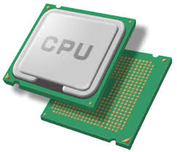
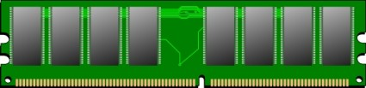


Approximate Computing
Relax the abstraction of “near perfect” accuracy in
Data Processing
Storage
Communication
Accept imprecision to improve
performance
energy efficiency
Notes:
Approximate computing relaxes the abstraction of near perfect precision in processing, storage, and communication
By accepting this imprecision, we can achieve benefits in performance and energy efficiency

Slide 3
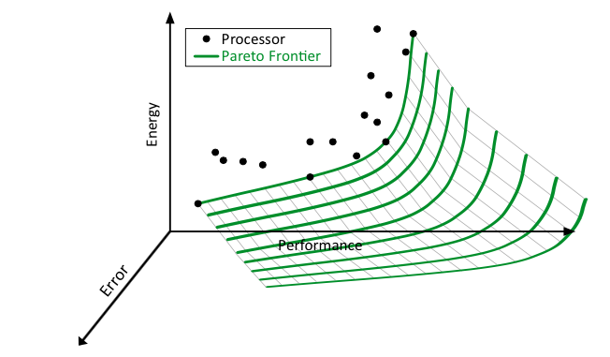
Approximate Acceleration
Notes:
Approximate computing relaxes the abstraction of near perfect precision in processing, storage, and communication
By accepting this imprecision, we can achieve benefits in performance and energy efficiency

Slide 4
Approximate Acceleration
Approximate
Accelerator
Approximate
Accelerator
Application
Notes:
The common practice in approximate acceleration is to always invoke the accelerator in lieu of a frequently-executed safe-to-approximate region of
code, e.g., a function in a loop. Always invoking the accelerator provides maximum gains from approximation.

Slide 5
Fixed Error
Lack of Error Control
Lack of Guarantees
Notes:
However this common practice of always invoking the accelerator leads to a fixed errors. Furthermore, the programmer who seems to believe that they can control where to add this error does not have nay control as to how much error or error range will be seen by the final output. Finally, some techniques out there which aim to control this error, however, do not provide any statistical gaurentees

Slide 6

Fixed Error
Lack of Error Control
Lack of Guarantees
Notes:
These all drawbacks of the technique lead to a fixed tradeoff between benefits and error. However, ideally we would like something like this. While, it is also important to maximize the benefit from approximation.

Slide 7
Fixed Error
Lack of Error Control
Lack of Guarantees
Notes:
These all drawbacks of the technique lead to a fixed tradeoff between benefits and error. However, ideally we would like something like this. While, it is also important to maximize the benefit from approximation.

Slide 8
Fixed Error
Lack of Error Control
To tackle these shortcomings we devise MITHRA
Lack of Guarantees
Notes:
These all drawbacks of the technique lead to a fixed tradeoff between benefits and error. However, ideally we would like something like this. While, it is also important to maximize the benefit from approximation.

Slide 9
Overview
Motivation
Challenges in devising MITHRA
A hardware software solution
Detailing the components of MITHRA

Slide 10
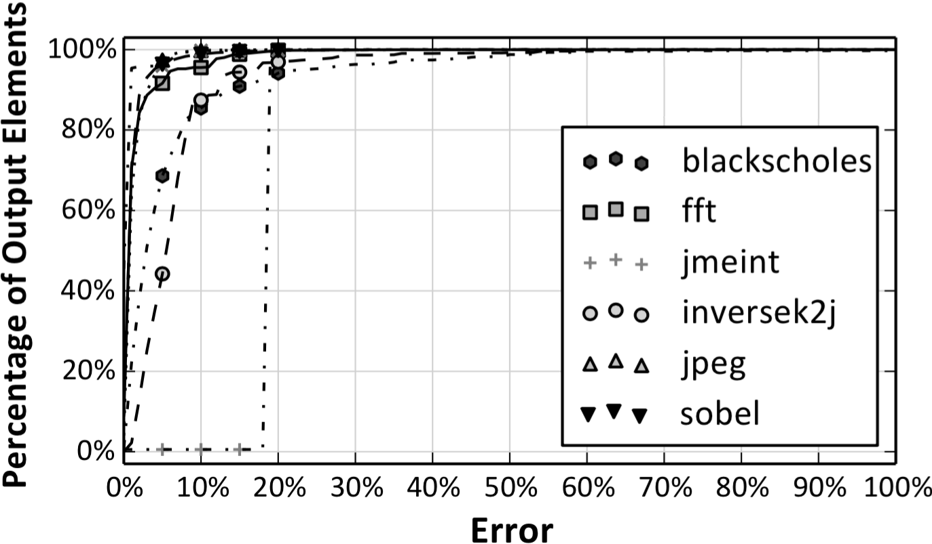
Exploiting Accelerator Characteristics
Approximate
Accelerator
Application
Notes:
As mentioned before, the approximate accelerator execution replaces the frequently executed function. Obviously it is an approximate accelerator, the output is an approximation of the precise CPU code. This is represented by the local error in this figure. Obviously, to get more benefits this local part of code is run multiple times. Couple of thousands generally. This local error then leads to some error in the final application output and is called the final output quality loss.
We ran some experiments on an established approximate accelerator technique of neural networks and saw that the only a very few fraction of these approximate accelerator techniques gave a large error. Hence, this shows that we have an opportunity to reduce the final error drastically by eliminating a few of the approximate accelerator invocations. Therefore, we are reducing the quality loss by trying to maximize the benefits from approximation.

Slide 11
Challenges
Approximate
Accelerator
Final Quality
loss
Local Error
How to eliminate anomalous invocations?
Application

Slide 12
Factors Influencing Error
Accelerator Inputs
Accelerator Configuration
Output_{accelerator}
Accelerator Error = | Output_{accelerator} - Output_{original}|
Output_{accelerator} = ƒ (accelerator inputs, accelerator configuration)
Notes:
The accelerator outputs are essentially a function of accelerator configuration and accelerator inputs. However, for a given application the accelerator configuration remains the same. Hence, the accelerator output and in-turn the error is only dependent on the accelerator inputs.
Now we know the proprieties that need to be possessed by Mithra.
It is a microarchitectural mechanism that navigates quality control tradeoffs to deliver high performance and efficiency with low quality loss.
It requires the accelerator inputs to decide whether the accelerator might yield a large undesirable error.

Slide 13
Factors Influencing Error
Accelerator Inputs
Accelerator Configuration
Output_{accelerator}
Accelerator Error = | Output_{accelerator} - Output_{original}|
Output_{accelerator} = ƒ (accelerator inputs, accelerator configuration)
Constant
Notes:
The accelerator outputs are essentially a function of accelerator configuration and accelerator inputs. However, for a given application the accelerator configuration remains the same. Hence, the accelerator output and in-turn the error is only dependent on the accelerator inputs.
Now we know the proprieties that need to be possessed by Mithra.
It is a microarchitectural mechanism that navigates quality control tradeoffs to deliver high performance and efficiency with low quality loss.
It requires the accelerator inputs to decide whether the accelerator might yield a large undesirable error.

Slide 14
Factors Influencing Error
Accelerator Inputs
Accelerator Configuration
Output_{accelerator}
Accelerator Error = | Output_{accelerator} - Output_{original}|
Output_{accelerator} = ƒ (accelerator inputs, accelerator configuration)
Constant
Output_{accelerator} = ƒ (accelerator inputs)
Notes:
The accelerator outputs are essentially a function of accelerator configuration and accelerator inputs. However, for a given application the accelerator configuration remains the same. Hence, the accelerator output and in-turn the error is only dependent on the accelerator inputs.
Now we know the proprieties that need to be possessed by Mithra.
It is a microarchitectural mechanism that navigates quality control tradeoffs to deliver high performance and efficiency with low quality loss.
It requires the accelerator inputs to decide whether the accelerator might yield a large undesirable error.

Slide 15
Challenges
How to eliminate anomalous invocations?
Look at the accelerator inputs

Slide 16
Challenges
Approximate
Accelerator
Local
Error
Final Quality
loss
Final Quality loss → Local Error ?
Application
Notes:
Lets look at the challenges we face when we try to optimize both for accuracy and benefits with an approximate accelerator.
The first challenge here is

Slide 17
Challenges
How to eliminate anomalous invocations?
Look at the accelerator inputs
Final Quality loss → Local Error ?
Threshold the local error

Slide 18
Challenges
How to eliminate anomalous invocations?
Look at the accelerator inputs
Final Quality loss → Local Error ?
Threshold the local error
What guarantees?

Slide 19
Challenges
How to eliminate anomalous invocations?
Look at the accelerator inputs
Final Quality loss → Local Error ?
Threshold the local error
What guarantees?
Statistical Guarantees

Slide 20
Challenges
How to eliminate anomalous invocations?
Look at the accelerator inputs
Final Quality loss → Local Error ?
Threshold the local error
What guarantees?
Statistical Guarantees
What algorithm at runtime?

Slide 21
Challenges
How to eliminate anomalous invocations?
Look at the accelerator inputs
Final Quality loss → Local Error ?
Threshold the local error
What guarantees?
Statistical Guarantees
What algorithm at runtime?
Classification in Hardware

Slide 22
MITHRA: A Hardware/Software Solution
Desired quality requirements
Generate the threshold for the local error such that the final quality loss meets the requirements
Approximate
Accelerator
Statistical Optimizer
Input Datasets
Application

Slide 23
MITHRA: A Hardware/Software Solution
Desired quality requirements
Approximate
Accelerator
Statistical Optimizer
(th)
Classifier Trainer
Generate training data that segregates inputs that give > and < (th)
Input Datasets
Application

Slide 24
MITHRA: A Hardware/Software Solution
Desired quality requirements
Approximate
Accelerator
Statistical Optimizer
(th)
Classifier Trainer
Hardware Classifier Topology
Input Datasets
Application

Slide 25
MITHRA: A Hardware/Software Solution
Desired quality requirements
Approximate
Accelerator
Statistical Optimizer
(th)
Classifier Trainer
Hardware Classifier Topology
Input Datasets
Application

Slide 26
Statistical Optimizer
Approximate
Accelerator
Input Datasets
Application

Slide 27
Statistical Optimizer
Approximate
Accelerator
Input Datasets
Precise Result
Application

Slide 28
Statistical Optimizer
Approximate
Accelerator
Input Datasets
Approximate Result
Application

Slide 29
Statistical Optimizer
Local error
Approximate
Accelerator
Input Datasets
Application

Slide 30
Statistical Optimizer
Local error
><
Approximate
Accelerator
Input Datasets
th
Threshold
Application

Slide 31
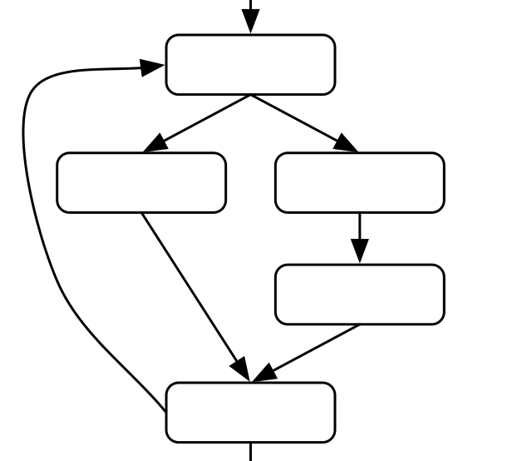
>
th
Local error
Application

Slide 32
<
th
Approximate
Accelerator
Local error
Application

Slide 33
Desired Quality Loss by the programmer
Approximate
Accelerator
Final Quality
loss
><
Input Datasets
Application

Slide 34
Binomial Proportion Confidence Interval
Less than the desired programmer quality loss ➔ nsuccess
Greater than the desired programmer quality loss
Input Datasets

Slide 35
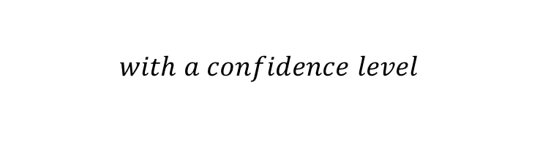
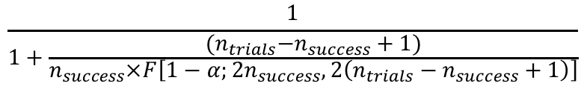

Binomial Proportion Confidence Interval
Less than the desired programmer quality loss ➔ nsuccess
Greater than the desired programmer quality loss
Input Datasets
$$\frac{1}{1+\frac{{(n}_{trials}−n_{success}+1)}{n_{success}×F\left[1−α;2n_{success},2\left(n_{trials}−n_{success}+1\right)\right]}}$$
$$<SuccessRate$$
$$with a confidence level$$

Slide 36


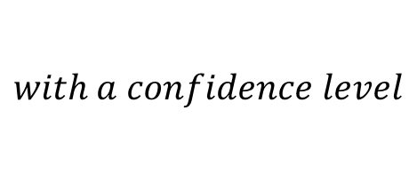
Example
$$(n_{trials}, n_{success})$$
$$r<SuccessRate$$
$$with a confidence level$$
E.g., (100, 80)
72% < SuccessRate
with 95% confidence level
Notes:
Let me give me a concrete example
Let’s say you tried a binary event 100 times and you succeeded 80 times.
You success rate for the future binary event is going to be higher than 72.28% with 95% confidence level

Slide 37
Example
$$(n_{trials}, n_{success})$$
$$r<SuccessRate$$
$$with a confidence level$$
E.g., (100, 80)
72% < SuccessRate
with 95% confidence level
Final Quality Level, Success Rate and Confidence Interval programmer specified

Slide 38
Statistical Optimization
if desired metrics are not met:
tht+1 = tht - ∆
else if desired metrics are met:
tht+1= tht + ∆
Reiterate; till the tht meets the metrics but tht+1 doesn't

Slide 39
Statistical Optimization
if desired metrics are not met:
tht+1 = tht - ∆
else if desired metrics are met:
tht+1= tht + ∆
Reiterate; till the tht meets the metrics but tht+1 doesn't
Tighter threshold better Final Quality Loss Level, Success Rate and Confidence Interval but lower benefits from approximation

Slide 40
Training the Classifiers
Local error
><
Approximate
Accelerator
Input Datasets
thfinal
The training data used to generate classifier topology

Slide 41
Hardware Classifiers
Simple algorithm that can be easily implemented in hardware.
We use two techniques for this work:
Table Based
Neural Network Based

Slide 42
Table-based Classifiers
Classifier

Slide 43
Table-based Classifiers
A small ensemble of table-based classifiers achieve better accuracy and performance

Slide 44
Neural Network Based Classifiers

Slide 45
Benchmarks
Accelerator
Topology
Baseline
Error
Neural Classifier
Topology
Blackscholes
6 ➔ 8 ➔ 8➔1
6.02%
6 ➔ 4 ➔ 2
FFT
1➔ 4 ➔ 4➔2
7.22%
1➔ 4 ➔ 2
Inversek2j
2 ➔ 8 ➔ 2
7.50%
2 ➔ 4 ➔ 2
JMEINT
18 ➔ 32 ➔ 8➔2
17.69%
18 ➔ 16 ➔2
JPEG Encoding
64 ➔ 16 ➔ 64
7.00%
64 ➔ 2 ➔ 2
Sobel
9 ➔ 8 ➔1
9.96%
9 ➔ 4 ➔2
Table Classifier Topology
8 tables each of size 0.5 KB

Slide 46
Energy and Performance Benefits

Slide 47
Invocation Rate

Slide 48
Varying Success Rate

Slide 49
Conclusion
Hardware software co-design works well
MITHRA
Aims to make statistical guarantees a norm

Slide 50
Thank you

Slide 51
Thank you

Slide 52
False Positive and False Negative Results

Slide 53
Binomial Proportion Confidence Interval
$$(n_{trials}, n_{success})$$
$$r<SuccessRate$$
$$with a confidence level$$
Notes:
To do that, we borrowed an old statistic analysis methodology for binomial proportion confidence interval, called clopper-pearson exact method.
This method is for a binary event that only has two possible outputs, success and failure
Let me give you the abstract intuition of this analysis
Let’s say you have a binary event and you tried n_trial times and you succeeded n_success times
Your success rate for a future, arbitrary, unknown event is going to be higher than the rate, r, with a certain confidence level

Slide 54
Evaluation of MITHRA
Comparing geometric mean - speedup, energy reduction and invocation rate across varied set of benchmarks.
Notes:
Before getting into the evaluation of Mithra we first need to find a mechanism to compare our designs to. Hence, we define an oracle Mithra that gives the maximum number of accelerator invocations for a particular final output quality loss. In other words, the oracle leads to minimum number of fallbacks to the core. This is what we aim for our designs to be close to the oracle and do not do any unnecessary fallbacks.
From the graphs we see that oracle has highest benefits closely followed by neural and then table. As the final quality loss requirements increase the benefits tend to decrease.
This can be further explained by looking at the invocation rate graph. Higher the invocation rate higher are the benefits from approximate acceleration. However neural is higher in invocation rate speedup is the same as neural is more compute intensive.
1. We use an oracle predictor, an ideal predictor to measure the predictor accuracy. The oracle predictor is an all-knowing predictor has a global view of the application that is not available while the program executes.
2. To meet the quality requirements, the predictor conservatively runs the original function more frequently.
3. As the results show, the table-based predictor provides comparable accuracy to the more sophisticated neural predictor.

Slide 55
False Positive and False Negatives
Notes:
Finally we get into the average false positive and negatives for the table-based and neuralbased. We don’t have oracle here because it is what we compare with.
The false negatives and positives lead to reduction in invocation rate.
The false positives comprise the input cases that should have been run on the accelerator according to the oracle, but are identified as potential high-error cases by MITHRA and are executed using the original precise function.
Conversely, the false negatives comprise those input cases, which should have been run using the original function according to the oracle but are missed by MITHRA and are run on the accelerator.
The false negatives are significantly lower than the false positives with both designs because MITHRA adopts a conservative approach towards controlling quality tradeoffs and hence prioritizes quality over benefits from approximation.

Slide 56
Multi-Input Hashing and Input Signature Generation
Notes:
We used MISRs to combine the accelerator inputs into a Hash function which can be used to index into the predictor table. The mutiple input signature registers allows the table based mechanism to combine any number of inputs.
MISR takes in a bit-vector and uses a set of XOR gates to combine the incoming bit-vector with the content of a shift register.
As the next input comes in, the MISR repeats the previous step of combining the inputs together.
After all the inputs are processed, the value that remains in the register is the index.

Slide 57
Multiple Tables for Improved Performance
A small ensemble of table-based Classifiers achieve better accuracy and performance
Notes:
A single-table MITHRA requires a large size to maximize the benefits of approximate acceleration while reducing quality loss.
The main reason is that only a small fraction of the input combinations need to be filtered out from accelerator invocation.
This characteristic makes it harder for only one small table to segregate inputs that cause relatively large errors because of destructive aliasing.
When aliasing occurs and multiple inputs collide on the same entry, the bias is always toward invoking the accelerator.
2. Therefore we use multiple tables and to reduce the bias MITHRA directs the core to run the original function even if a single table
3. This figure illustrates the general architecture of our multi-table MITHRA.
4. The consists of multiple equally-sized tables. The entries in the tables are all single-bit values.
5. The hash function for each table is a different MISR. Using different hash functions for different tables lowers the probability of destructive aliasing in all of the tables.

Slide 58
Neural Network Based Mechanism
Notes:
We use neural networks as an alternative mechanism for quality control.
For our task, we use multilayer perceptrons. Multilayer perceptrons shown in the figure here comprises of a fully- connected set of neurons organized into layers: the input layer, hidden layers, and the output layer

Slide 59
Compiler Support for MITHRA
Programmer provides:
Application specific quality requirement
Quality Metric
Set of representative application inputs
Algorithm maps final output requirement to a threshold (th) on accelerator error.
Accelerator error < th : learn to invoke the accelerator
Accelerator error > th : learn to fall back to the original function
Notes:
For each invocation of this target function, MITHRA decides whether to use the accelerator or run the original precise function.
But how are these designs initially filled with? What do the tables have and what is the neural Mithra trained with?
We know that Mithra makes its decision based only on the accelerator inputs without knowing about how this decision will affect the application’s final output quality.
Hence we need to convert the final application quality loss to a local error which implies that
The objective is to find a threshold that reduces the final application quality loss by a certain factor while preserving maximum possible benefits
Threshold essentially is the maximum local error that the target function can see on accelerator error for a given final application quality loss.
Hence we first find this threshold and then we use it generate training data to that can give accelerator inputs and the corresponding decision to be invoking the accelerator or the core.

Slide 60
Quality vs Benefits Tradeoffs
Approximation Benefits
Output Quality

