Slide 1


Common Counters:
Compressed Encryption Counters for Secure GPU Memory
Seonjin Na, Sunho Lee, Yeonjae Kim, Jongse Park, Jaehyuk Huh
KAIST, School of Computing
Notes:
Hi, my name is seonjin na from KAIST.
I'will present our work, common counter - .

Slide 2









Need for Secure GPU Computing
Privileged SW Attack
Training Data
& DNN Model
Untrusted
Device Driver
We need to consider Secure GPU computing !
PCIe bus
Physical Attack
Trained DNN Parameters
Notes:
Let’s begin with the need for secure GPU computing
Recently GPU hardware is widely used for accelerating many applications.
A good example is DNN training.
To use GPU for DNN training , [Click] we need to send the training data and DNN model to the GPU.
After data transmission, [Click] DNN training is executed on GPU and trained parameters are stored in GPU memory.
However, current GPU computing is not safe from potential attacks.
[Click] First, when an attacker can control the operating system, then the input data and training model information can be stolen or illegally modified.
[Click] Direct physical attacks by probing memory can also leak or change the data in GPU memory.
Therefore, [Click] it is important to support secruity in GPU Computing because many critical workloads are running on GPUs nowadays.

Slide 3


Trusted GPU Computing
Trusted Execution Environment (TEE)
Intel SGX, ARM TrustZone
Existing TEEs does not provide TEE on GPUs
Enclave
Device Driver
PCIe-bus
GPU
GPU
Memory
Data
Code
Protected by Hardware
Attack Surface
Notes:
Hardware-based trusted execution. is a promising technique for securing computing environments.
For example, Intel SGX or ARM TrustZone, provides protected execution from malicious privileged software or even physical attacks.
[Click] In SGX, A user can create an enclave. The user data and code in the enclave can be protected by hardware.
[Click] However, Existing techniques does not provide TEE on GPUs
If a attacker can control the operating system, the computation in the GPU is compromised through the device driver
[Click] So Computing in GPUs is stll vulnerable to potential attacks, even if CPU supports TEEs.

Slide 4
Prior Work : HIX
HIX [ASPLOS ‘19]: Securing I/O Path from CPU to GPU
All device I/O accesses to GPU are controlled by trusted device driver
Secure Channel
No GPU HW Modification
Protected
PCIe-path
User
Enclave
Data
CMD
Trusted
Device Driver
GPU
Untrusted
OS
GPU Enclave
Notes:
There are two recent prior works for providing TEE on GPUs : HIX and Graviton
[Click] HIX provides TEE on GPUs, by securing I/O path from CPU to GPU.
HIX execute the GPU driver in a special enclave to isolate the device driver from the untrusted OS.
In addition, I/O path between the GPU driver and GPU is secured from the operating system.
[Click] Without any directly access permission to the GPU, even the operating system cannot compromise the GPU.
By securing the I/O path, One of the key advantages of HIX is [Click] that it does not require any modification to GPU Hardware.

Slide 5
Prior Work : Graviton
Graviton [OSDI ‘18]: Trusted GPU by changing GPU HW
Trusted Command Processor handles critical GPU operations instead of driver
Accesses from device driver are not allowed
Data
CMD
Trusted
Command Processor
Protected
Memory Region
Untrusted Device Driver
Secure Channel
Unprotected
Memory Region
Stacked GPU Memory
GPU
Notes:
The other prior work is graviton
Unlike HIX , by changing GPU HW, graviton directly add TEE on the GPU.
In graviton, the trusted command processor handles critical operations, which are isolated from the operating system.
They divide the GPU memory into protected memory region and unprotected region.
All critical meta-data for gpu context are stored in the protected memory region.
[Click] In this protected region, any I/O accesses from the untrusted GPU driver is not allowed.

Slide 6
Limitations of Prior Work
HIX [ASPLOS ‘19]: Securing I/O Path from CPU to GPU
Graviton [OSDI ‘18]: Trusted GPU by changing GPU HW
No GPU HW Modification
Secure Channel
Monitor
PCIe-packet
Out-of-scope
: GPU Physical Attack
User
Enclave
Data
CMD
Trusted
Device Driver
GPU
Untrusted
OS
Accesses from device driver are not allowed
Assumption : Stacked GPU Memory
Data
CMD
Trusted
Command Processor
Protected
Memory Region
Untrusted Device Driver
Secure Channel
Unprotected
Memory Region
Stacked GPU Memory
GPU
Notes:
The two prior studies provide TEEs with GPU. however, they have limitations with respect to physical attacks on systems.
In HIX, [Click] physical attacks on systems are out of scope in their work.
[Click] In graviton, they assume that the GPU uses 3D stacked memory and the memory is in the GPU Package
The GPU memory is assumed to be safe from physical attacks.
However, many GPU systems still use GDDRx memory and Recently released GPUs also use GDDR6 memory.
[아래의 표현이 좀 어색하네요.]
In summary, the prior studies did not address the protection of non-stacked GPU memory from physical attacks.

Slide 7
Goal: Secure GPU Memory
Main Contributions
Provide secure GPU memory with low performance overheads
Exploit unique memory update behavior of common GPU applications
Reduce the average performance overhead to 2.9 %
Our Focus
Protected by prior work
GPU
GDDRx GPU Memory
CPU
Crypto
Engine
Security
Meta-data
Enclave
PCIe
User
App
Trusted
Device Driver
Encryption
& Integrity verification
Encrypted Data
Integrity
Engine
Notes:
[Click] While the prior studies addressed the TEE mechanism itself for GPUs , [Click] we focus on the hardware-based memory protection for GPUs.
In this study. we assume that GPU hardware use commodity GDDRx memory, which is vulnerable from physical attacks.
The main contributions of this work are as follows.
This study significantly reduces the performance overheads of secure GPU memory.
To reduce the overheads, We exploit a unique memory update behavior of common GPU applications
Our mechanism reduces the average performance degradation to 2.9%, compared to the unprotected GPU memory.

Slide 8
Threat Model & Assumptions
Threat Model
Attackers can fully control operating system/hypervisor
Attackers can physically access the whole system
Trusted Computing Base (TCB)
GPU processor & GPU software running on the GPU
CPU chip & user application in an CPU Enclave
Out of Scope
Denial of Service(DoS) attacks
Side-channel attacks
Notes:
This is our threat model and assumptions
In our work, an attacker can fully control the privileged software. In addition, the attacker can physically access the whole system.
The GPU processor and software running on the GPU are in trusted computing base.
CPU and the GPU host codes on CPU is also part of TCB.
However, we does not consider denial of service and side channel attacks.

Slide 9
Outline
Introduction
Background & Motivation
Common Counter
Main Idea
Additional Metadata
Common Counter Mechanism
Evaluation
Notes:
And now Let’s move on the background and motivation of our work.

Slide 10
Background : Securing Memory
Memory Encryption
Counter mode encryption
Split Counter scheme
Incremented after data update
Address
Counter
Data
Key
AES-CTR
OTP
Encrypted Data
Counter = Major | Minor
Minor Counters(7-bit for each)
64-bit
Major
Ctr
...
Cache block :128B
128 minor counters
Notes:
Before discussing the memory encryption for GPUs, I will briefly talk about the secure memory techniques developed for CPUs.
The confidentiality and integrity of data need to be provided in secure memory.
Memory encryption provides the confidentiality of data.
For encryption, [click] counter mode encryption is widely used because of its fast decryption .
In counter mode encryption, an OTP is created with a block cipher such as AES from a secret key, address, and counter.
A data block is encrypted by xoring with the generated OTP.
Since the OTP need to be used only once, counter is incremented after each data update for freshness support,
For memory decryption, the OTP can be generated while the data is fetched from the memory,
if the counter value for the block is in the on-chip counter cache.
Therefore, to reduce the decryption latency, the counter cache efficiency is critical.
[Click] When using counter mode encryption, split counter scheme was commonly used to pack more counters in 1 cache block.
As more counters can be packed in a cache block, the counter cache efficiency is improved.
A split count consists of major and minor counters. Counter value are obtained by concatenating these two counters.
Each minor counter is used for the corresponding data block and major counters are shared for the minor counters in the same counter block.
[Click] Since our GPU cache block size is 128B and we assume each minor counter is 7-bit , there are 128 minor encryption counters in one counter block.

Slide 11

Background : Securing Memory
Memory Integrity Verification
Message Authentication Code (MAC)
Counter Integrity Tree
Data
Cryptographic
Hash
Data MAC
Replay Attack
{Data1,MAC1, Ctr1}
On-chip secured
Processor
DRAM
Counter
Integrity Tree
Sniff
{Data0, MAC0, Ctr0}
Data Blocks
Counters
(older copy)
Our baseline : SC-128
128-ary (Split Counter + Counter integrity tree)
Notes:
To provide the integrity of data in memory, we need message authentication code for each cache block, and use a counter integrity tree.
Data MAC is need to detect any data modification from attackers.
[Click] we apply a cryptographic hash function to generate DATA MAC.
However, [Click] When an attacker replace Data, MAC, counter with an older copy, we can’t detect data modification
This type of attack is called a replay attack,
[Click] To protect from a replay attack, secure memories commonly use a counter integrity tree.
The counter integrity tree verifies counter values stored in off-chip memory, and its root never leaves the processor.
By verifying the counter value for data blocks, secure memory can detect a potential replay attack.
In this work, we use 128-arity split counter and counter integrity tree as a base memory protection mechanism
and we call it SC-128

Slide 12
Problem : Performance Overhead
Secure memory require additional meta-data requests
Last-Level Cache
(LLC)
Counter
Cache
Hash Cache
1. Data Request
5. Decryption
& Data MAC check
3. Counter
Request
4. Counter Tree Requests
On-chip
Boundary
OTP
Trusted
2. Data MAC Request
Untrusted
Encrypted
Data
Data
MAC
Encryption Counters
Tree Nodes
Secure memory adds decryption latency
and increases memory bandwidth
Untrusted GPU Memory
Notes:
we can provide the confidentiality and integrity of data by using secure memory
However, the problem of secure memory is performance degradation by additional meta-data accesses.
I’ll explain a detailed procedure of LLC miss handling in secure memory.
[Click] This dashed line is the on-chip boundary, and the below the boundary, memory resident data are untrusted.
When the LLC miss occurs, [Click] a data request and [click] the corresponding counter access in the counter cache are generated.
[Click] And a Data mac request is sent.
[click] If a counter cache miss occurs, then that counter request to the memory is initiated.
When the counter is fetched from memory , OTP generation is started, and [Click] the verification of the counter need to be done by traversing the counter integrity tree.
Hash cache is used for caching the intermediate tree nodes.
During the verification, additional tree node requests can be generated.
[Click] After OTP is made , decryption can be done for the encrypted data block from the memory and its integrity will be checked by using data MAC
Therefore, [Click] using secure memory adds a significant decryption latency when a counter cache miss occur, and
increases memory bandwidth consumption for additional security meta-data.

Slide 13
Performance Breakdown Analysis
GPU memory protection overhead result for GPU benchmark suites
For data MAC overhead
Data
Data MAC
+ 22.4%
+ 11.8%
+ 2.4%
With ECC memory,
Data & MAC can be provided by
1 memory access using Synergy[1]
SC_128
SC_128+
Ideal MAC
SC_128+
Ideal Ctr
SC_128+
Ideal (Ctr+ MAC)
Counter mode encryption is one of the key bottlenecks
[1] :SYNERGY: Rethinking Secure-Memory Design for Error-Correcting Memories, HPCA’18
Notes:
We first apply the baseline encryption scheme to a GPU, and this slide shows the performance break down analysis to see where is the main performance bottleneck for secure GPU Memory,
[Click] This graph shows geomean results for all GPU benchmark suites we evaluated and the baseline is SC-128
The prefix ,ideal, represents the idealized configuration.
For instance, ideal counter means counter requests to the counter cache are always hits.
In baseline, the performance degradation is about 23%
[Click] As you can see this graph, [Click] when we only idealize MAC, we improve performance by 2.4% compared to baseline,
[click] and the performance is improved by 11.8% when we only idealize counter.
Only when we idealize both, we can eliminate the performance cost of memory protection.
Therefore, we can conclude [Click] that counter mode encryption for GPU memory can cause a significant performance degradation.
[Click] And we should remove the overhead by counter encryption and data mac to improve the performance.
To reduce the overhead by data mac , we employ a technique called synergy which was published in HPCA 18.
By using synergy, data and its mac can be fetched with a single memory access, as it stores MAC in ECC memory.
Later, we’ll report the performance result of both schemes, using synergy and conventional MACs in normal memory.
[Click] Based on this analysis, we focus on reducing counter cache misses for GPU memory by exploiting common memory behaviors of GPU applications.

Slide 14
Uniformly Updated Segments
Memory segment: Contiguous memory region
Uniformly updated segment: Read-only + uniformly written
Example granularity: 32KB
32KB/ 128B = 256 Data cache blocks
Data
Blocks
...
Block
Block
Block
256 cache blocks
256 cache blocks
Data
Blocks
Data
Blocks
Block
Block
...
Block
Block
Block
...
Block
Counters
0
0
...
0
Counters
0
0
...
0
2
2
2
1. Read-only
2. Uniformly written
Notes:
Before discussing GPU memory update behavior, I’ll define basic terminology in used our work.
[Click] The first term is memory segment. We define memory segment as contagious memory region.
[Click] For example, if the memory segment size is 32KB, [Click] there are 256 data cache blocks in a segment.
[Click] Uniformly updated segments are either Read-only or uniform written segments.
If all the data in a segment has never been updated, then all counter values are zero. [Click] We call this case as read-only segment.
In our technique, when a GPU application starts, counter values for its memory are reset.
Each application context is required to use a different encryption key.
[Click] On the other hands, the data can be updated during execution
If all the data have the same number of updates within a segment, then counter values are equal.
We call this kind of segments as uniformly written segments.

Slide 15
Observation : GPU SW Write Patterns
Analyze memory read/write behavior by using NVBit [MICRO ‘19]
Result of GPU Benchmark Suite
We choose 128KB granularity for evaluation
32KB
128KB
512KB
2MB
Observation 1: GPU programs tend to uniformly update memory
Observation 2: The number of distinct counter values is small
Notes:
Key observation of our work is about common memory update behavior of GPU Software.
To analyze the memory write pattern of GPU Programs, we use real GPU Hardware for this analysis
we collected memory load/store instruction traces for GPU benchmark suites by using NVBit
[Click] This graphs shows the result.
We increased memory segment sizes from 32KB to 2MB.
Each bar shows the average ratio of uniformly updated segments in all GPU benchmark sites for a different segment size.
As you can see in the graph, [Click]
on average, 56% of the total memory segment was uniformly updated segment when the segment size is 128KB.
We will use this segment size for our performance evaluation.
The other key observation is that the number of distinct counter values for the uniformly updated segment is small enough to be stored on a few on-chip registers.
You can refer to our paper for the related analysis result.
[Click] So there are two key observations in our work.
First, common GPU programs tend to uniformly update memory in the majority of their memory.
Second, the distinct number of unique counter values is small.

Slide 16
Outline
Introduction
Background & Motivation
Common Counter
Main Idea
Additional Metadata
Common Counter Mechanism
Evaluation
Notes:
Now, I will present our common counter technique.

Slide 17
Common Counter : Main Idea
Use coarse-grained counters for uniformly updated segments
Data
Blocks
...
Block
Block
...
Block
Block
Block
Block
Per-block Ctr Blocks
...
...
2
2
2
1
3
6
Use a common counter
Use per-block counters
Uniformly Updated Segment
Non-uniform Segment
Data
Blocks
Block
Block
...
Block
Block
Block
Block
...
Common Counter
1
3
6
Notes:
The main idea of common counter is that we use coarse-grained counters for uniformly updated segments.
For example, there are two memory segments and corresponding counter values are shown in the figure.
[Click] for a uniformly updated segment, we use a common counter, so the per-block counters do not need to be stored in the counter cache.
For handling misses in a uniformly updated segment, a common counter register provides the counter value.
[click] However, for non-uniform segment, we use conventional per-block counters stored in the counter cache.

Slide 18
Finding Uniformly Updated Segments
Common Counter Status Map (CCSM)
Check whether a memory segment uses a common counter or not
Can be cached in CCSM cache
15 Registers
CCSM Table
Segment 1
Common ctr set
Segment | Value
1 | 2
2 | Invalid
3 | 1
4 | 15
Segment 2
Common Ctr 1
Common Ctr 2
Segment 3
…
Common Ctr 15
Segment 4
Index of common counter
Invalid : not uniformly updated segment
Notes:
Then one important questions is how to identify uniformly updated segments.
To determine this,
we introduce common counter status map or CCSM
CCSM is the mapping table to determine the segment for a missed address can use a common counter or not.
[Click] In the figure, there are 4 memory segments and the mapping between memory segment and common counters are like this.
[Click] In the CCSM table, we store the mapping information about which segment can use a common counter
[Click] we use 15 registers for common counters in this work
[Click] The value of CCSM table entry is an index of common counter. If it is invalid, the segment is not a uniformly updated segment.
CCSM table is stored in the memory, and for fast accesses, [Click] we use a 1KB cache for storing recently used CCSM table entries.

Slide 19
Updating CCSM Table
Initialized at application launch
Scanning Procedure
When? After a kernel is completed
Segment 1
Segment 2
. . .
CCSM Table
...
...
Segment | Value
1
2 | 0
Invalid
Counter 1
Counter 2
1
. . .
1
1
1
...
1
1
1
...
1
...
...
2MB
Region Scan
Uniformly updated!
Updated Memory Region Map
1
0
...
0
Bit vector for recording memory update status at 2MB granularity
Notes:
The CCSM table has the status information, but the status must be updated during the execution of a GPU application.
A GPU application commonly consists of a sequence of kernel invocation.
When a kernel execution is finished, the CCSM table is updated by a scanning procedure.
[Click] To avoid scanning the entire memory, we maintain the updated memory region map.
It is a bit vector to record which memory regions are updated during the last kernel execution.
To reduce the storage overheads of the bit vector, each bit covers a 2MB memory region.
If the corresponding bit is one, the memory region was updated, and scanning is only required [Click] for the regions marked with 1.
If all counter values are same within each segment in a memory region, then
we update [Click ]the corresponding entry of CCSM table.

Slide 20
LLC Miss Handling with Common Counters
LLC
Miss
Last Level Cache
(L2 cache)
Common ctr can reduce counter cache access.
Data
Request
1. CCSM cache access
3. Invalid
Segment
1. Hit: Use Common ctr
CCSM Cache
Counter Cache
On-chip
Boundary
2. Miss :
CCSM request
4. Use
per-block ctrs
Trusted
Untrusted
GPU Memory
Notes:
Lastly I’ll explain how we can use the common counter during kernel execution.
[Click] I’ll describe the LLC miss handling procedure in our mechanism
[Click] When an LLC miss occurs, Data request is generated.
[Click] Instead of accessing the counter cache, the CCSM cache is accessed to identify the current segment is uniform or not.
[Click] If it can use a common counter, the counter value is fetched from a common counter for this request.
[Click] However if a CCSM cache miss occurs, then CCSM request need to be generated.
[Click] When the corresponding CCSM entry is marked as invalid, then we need to access the counter cache and use per-block counters.
[Click] By using common counter, we can bypass counter cache accesses, but still can retrieve counter values for uniformly updated segments.

Slide 21

GPU Execution with Common Counter
GPU Context
Initialization
Kernel Execution
Scanning Procedure
Kernel Launch
1. Meta-data Initialization
2. Meta-data Update
3. Scan updated memory region
Common Ctr set
Enc key
Ctr 1
...
Ctr 15
Segment
Ctr blocks
CCSM Table
...
0
0
...
0
Segment | Value
1 | 0
2 | 0
Updated Memory Region Map
0
0
...
0
...
...
Notes:
With common counter mechanism, the flow of GPU Execution consists of three main steps.
Firstly, when a GPU context is created and initialized, [Click] meta-data such as CCSM table and counter are initialized.
Each context uses a different encryption key.
After initialization, GPU kernel will be executed.
[Click ] During kernel execution, [Click] the CCSM table and related meta-data need to be updated.
[Click] After a kernel is finished, scanning procedure is done to update the segment information.

Slide 22
Outline
Introduction
Background & Motivation
Common Counter
Main Idea
Additional Metadata
Common Counter Mechanism
Evaluation
Notes:
And Let’s look at evaluation of our work.

Slide 23
Methodology
Simulator: GPGPU-Sim
Workloads: ISPASS, Rodinia, Polybench, Pannotia
System configuration: Models NVIDIA TITAN X Pascal GPU
GPU Core Configuration
System overview | 28 SMs, 64 warps per SM
Shader core | 1,417 MHz, GTO Scheduler
Cache & Memory Configuration
L1 cache | 48 KB
L2 cache | 3 MB
DRAM | GDDR5X 1,251 MHz, 12 GB
Counter cache, Hash cache | 16 KB
CCSM cache | 1 KB
Segment size | 128 KB
Number of common ctrs | 15
Notes:
To evaluate the performance of common counter, we extended the gpgpu-sim simulator to model memory protection mechanism .
We selected workloads from various GPU benchmark suite to analyze the secure memory performance.
GPU configuration used in this work are described in this table.
We models the NVIDIA TITAN X Pascal GPU.
In our experiment, we use 16KB cache for each counter cache and hash cache (설명없이 나옴) and 1KB CCSM cache.
We use 128KB segment size and we use 15 common counters for each GPU context.

Slide 24
Performance: Separate MACs
Performance overhead analysis (Baseline: Non-secure GPU)
SC-128: 128-arity split counter
Morphable Counter [MICRO ‘18]: 256-arity split counter
Common_Ctr: Implemented on top of SC-128 (128-arity)
13.9%
With Separate MACs
Notes:
we’ll show the performance result for two cases when we does not use sysergy and when we employ synergy .
we compare common counter mechanism with two techniques, SC-128 and morphable counter proposed for CPUs.
Morphable counter is a state-of-the art technique, and when it is applied to 128B cache block, the arity of this mechanism is 256, which is twice of SC-128.
Common counters are applied to SC-128 in the evaluation.
[Click] This graph shows the performance result with separate MACs, when the in-line MAC of synergy is not used.
The x axis of graph represents workloads and y axis is the instruction per cycle normalized to the result of non-secure GPU.
So the higher is better.
[Click] When we does not use synergy, we can reduce the performance degradations to 13.9%
This is close to the performance when we idealize counter only.

Slide 25
Performance: Synergy In-line MACs
Common counter reduces the performance degradation to 2.9%
color, mis,lib,bfs : As kernel runs, # of requests served by common counters decreases.
2.9%
With Synergy[1] in-line MACs
[1] :SYNERGY: Rethinking Secure-Memory Design for Error-Correcting Memories, HPCA’18
Notes:
This is the performance result when we use synergy technique
In this case, we observe that [Click] common counter reduce the performance degradation to 2.9%
Overall performance is better than morphable counter,
But [Click] in the case of color, mis, bfs and lib, the performance degradation is greater than that of morphable counter.
This is because as the kernel runs, the number of requetss served by commpn counters decreases .
For such workloads, the 256-arity of morphable counter incur less counter cache misses than common counters.
However, on average, the common counter provide better performance than morphable counters.
Integrating common counters with morphable counter will further improve the performance, and it will be our future work.

Slide 26
More Results in the Paper
Uniformly updated ratios of real-world GPU Applications
Hardware area/energy cost for common counter mechanism
Ratios of LLC misses served by common counters
Scanning Overheads
Counter cache sensitivity experiments
Please Refer to our paper for more details!
Notes:
For more detailed results, please refer to our paper !

Slide 27
Conclusion
Result
Common Counter reduces the performance degradation to 2.9%
Problem
Memory encryption is one of the critical bottlenecks for secure GPU memory
Key Observation
GPU programs tend to uniformly update memory
The number of distinct common counters is small
Our Approach
Common Counter provides compressed representation of per-block counters
Notes:
In conclusion, By using common counter, we can reduce the performance degradation to 2.9 %
we find the memory encryption is one of the critical performance bottleneck when we apply Secure GPU Memory.
By analyzing the characteristics GPU program, we identify the GPU memory update behavior that GPU Program tend to uniformly update memory.
To exploit this unique behavior, we propose common counter mechanism, which can signifanctly reduce counter cache misses for common GPU applications.
Thank you.

Slide 28
Backup Slides

Slide 29
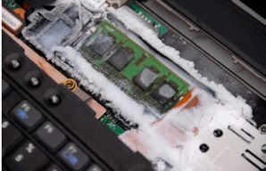
Type of Physical Attacks
Unauthorized
Data Leak
Unauthorized
Data Modification
Replay Attack
Processor
DRAM
Data A
Reuse old pair
Data B
Data 0
Data 1
MAC 0
MAC 1
Cold Boot Attack
DMA Attack
Man in the middle attack
Secure memory needs to protect against these attacks !

Slide 30
GPU SW Memory Write Patterns
Analyze memory read/write behavior by using NVBit [1]
Collect traces for load/store instructions
Result of Real-World GPU Applications
Result of GPU Benchmark Suite
[1] : NVBit: A Dynamic Binary Instrumentation Framework for NVIDIA GPUs, MICRO’19

Slide 31

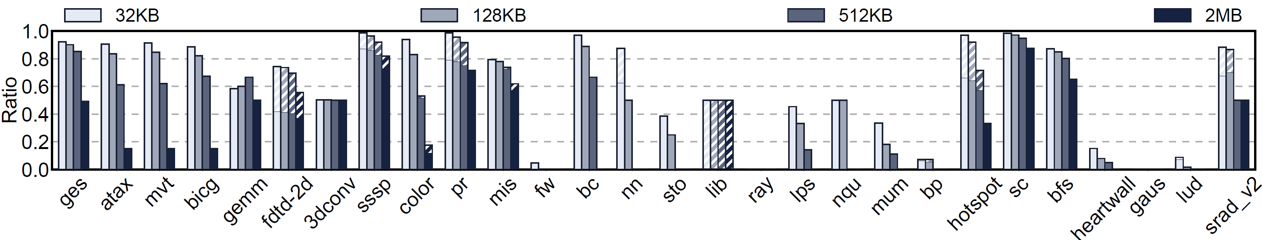
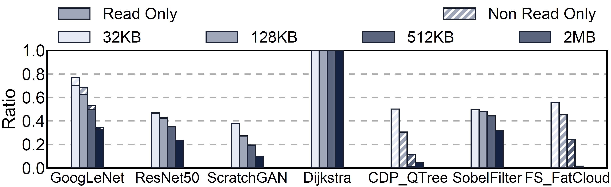
GPU SW Memory Write Patterns
Analyze
Result for GPU Benchmark Suite
Result for Real-World GPU Applications

Slide 32
GPU SW Memory Write Analysis
Result for GPU Benchmark Suite
Result for Real-World GPU Applications

Slide 33
Coverage
Coverage comparison
Scheme | Granularity | Per-block Coverage
split counter | 128B data block | 128 * 16KB = 16KB data
Common counter | 128 KB data block | 256 * 128KB = 32MB data
2048x efficient coverage

Slide 34
Performance Result & Counter Coverage
With Synergy in-line MACs

Slide 35
Counter Cache Miss ratio

Slide 36
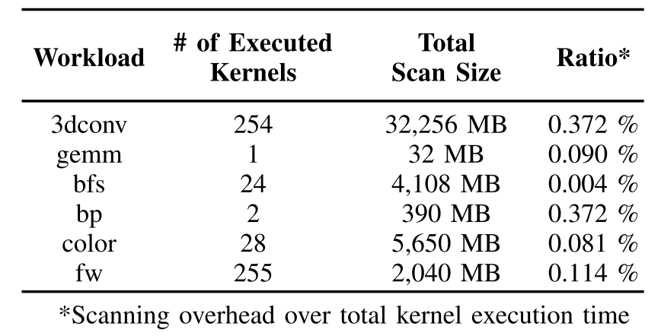
Scanning Overhead
Evaluate scanning procedure
Neglig

