Slide 1

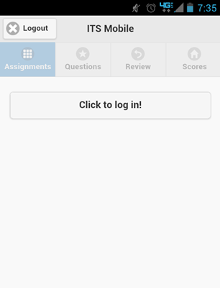
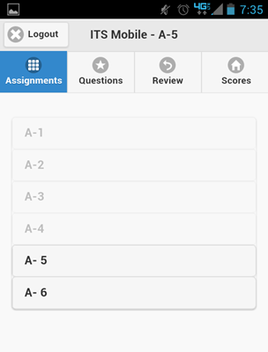
ITS Mobile App
1. GT Login
2. Assignment List

Slide 2
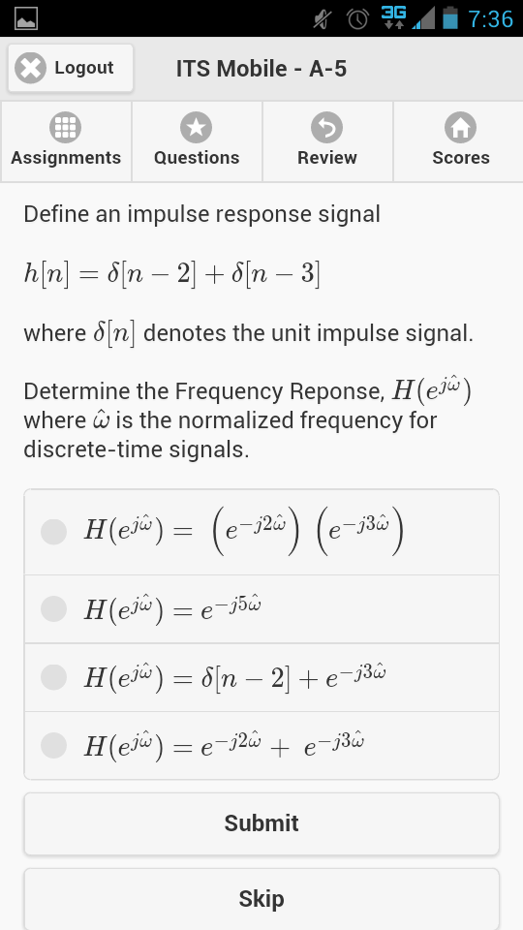
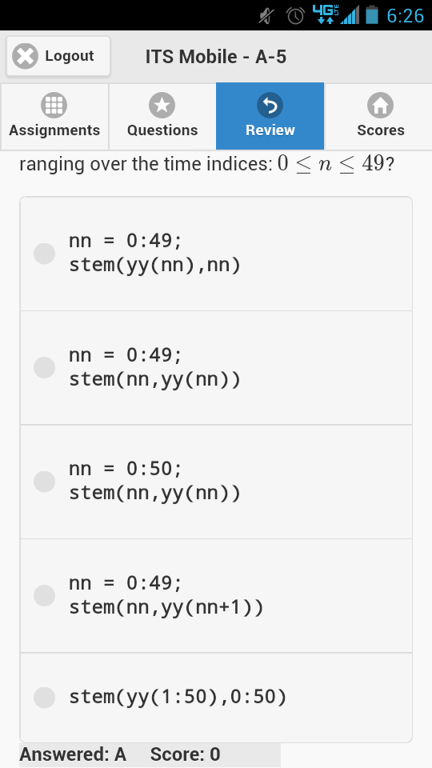
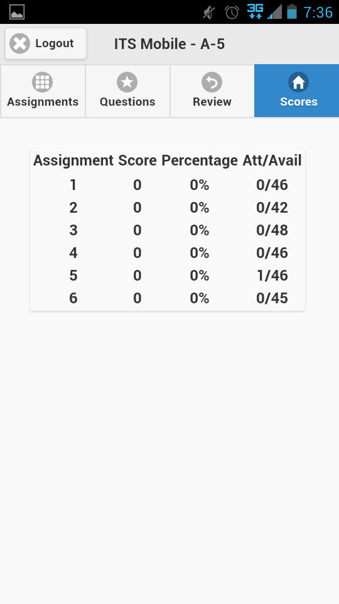
3. Questions
4. Review
5. Scores

Slide 3
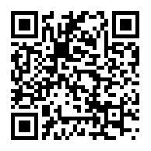
Need TESTERS !!!
Sneak peak A.6-7 questions
ITS Mobile is not scored
Testing period: Nov. 7-14
Android only - Android App Store:
play.google.com/store/apps/details?id=com.gatech.itsvip
ITS Mobile FAQ: quid.gatech.edu/mobile
Scan it to download
the app!

