Slide 1
Mastering JavaFX 10
JONGWOOK-SI
Kumoh National Institute of Technology, Korea
Dept. Of Computer Engineering

Slide 2
Chapter 6. Styling Applications with CSS

Slide 3
Styling Applications with CSS
What is CSS?
Cascading Style Sheets
Stylesheet Language Standardized in Web Development
Simplify design, unified style
Font, color, heading style, margins, padding, and other layouts

Slide 4
Styling Applications with CSS
Why use CSS?
Dividing responsibilities( logic – java, stylesheet – style)
Avoiding duplicated code
Simplifying changes
Changing styles

Slide 5
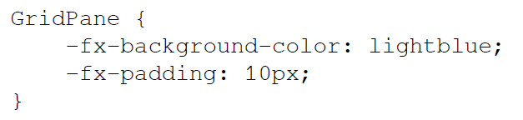
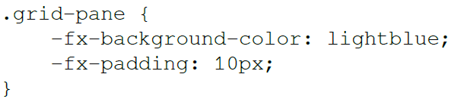
Styling Applications with CSS
CSS in JavaFX

Slide 6
Styling Applications with CSS
CSS in JavaFX
(1)
(2)
(3)

Slide 7
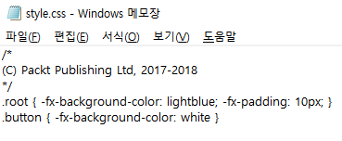
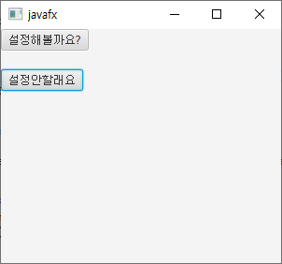
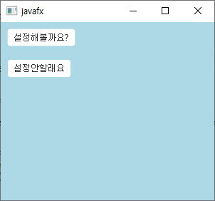
Styling Applications with CSS
(1) Style

Slide 8
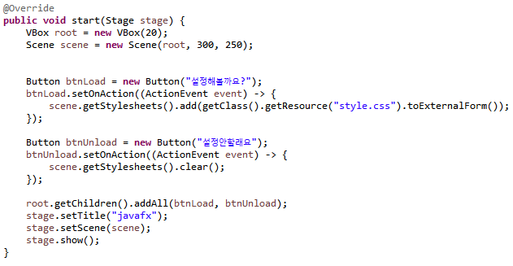
Styling Applications with CSS
(1) Style

Slide 9
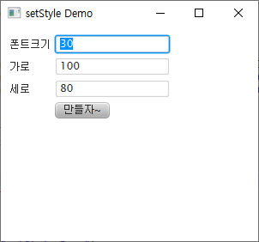
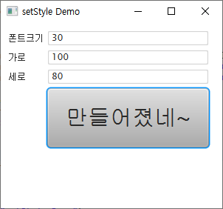
Styling Applications with CSS
(2) Demo

Slide 10
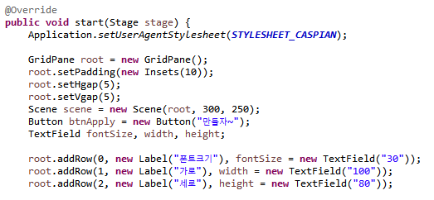
Styling Applications with CSS
(2) Demo

Slide 11
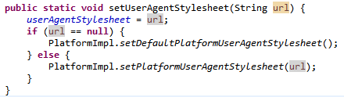
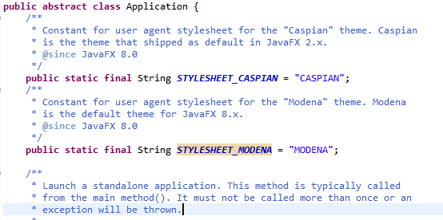
Styling Applications with CSS
(2) Demo

Slide 12
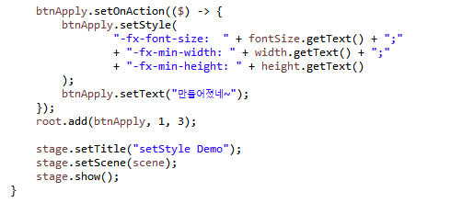
Styling Applications with CSS
(2) Demo

Slide 13
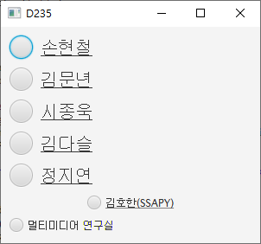
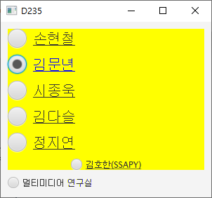
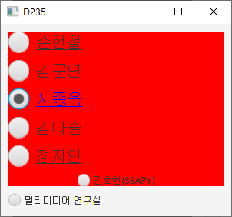
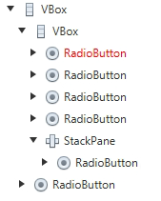
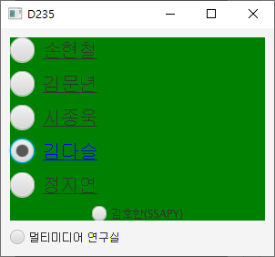
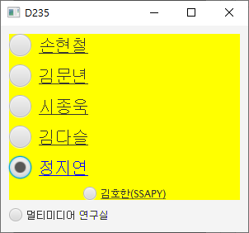
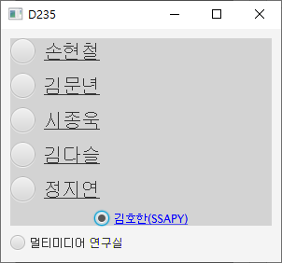
Styling Applications with CSS
(3) Syntax (font color : blue, background color: random)

Slide 14
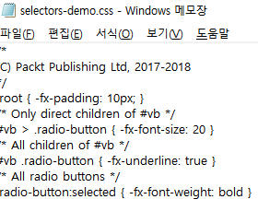
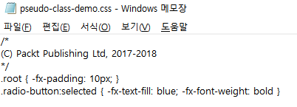
Styling Applications with CSS
(3) Syntax

Slide 15
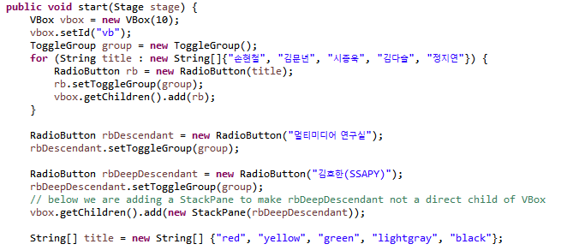
Styling Applications with CSS
(3) Syntax

Slide 16
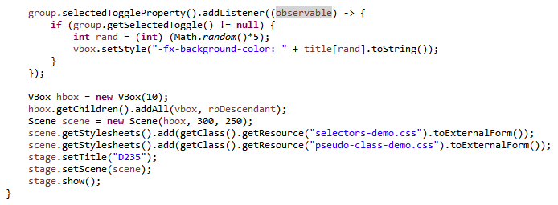
Styling Applications with CSS
(3) Syntax

Slide 17
Chapter 10. Advanced Controls and Charts

Slide 18
Advanced Controls and Charts
Features that Javafx can use to handle data
ListView
TableView
Charts

Slide 19
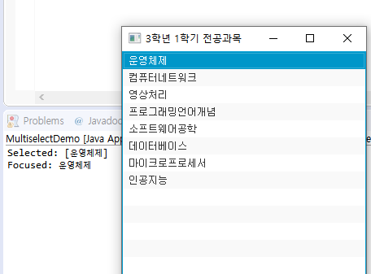
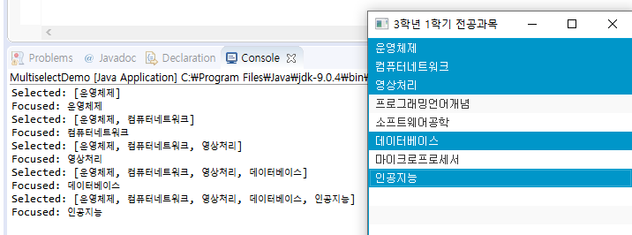
Advanced Controls and Charts
(1) ListView(Multiple)

Slide 20
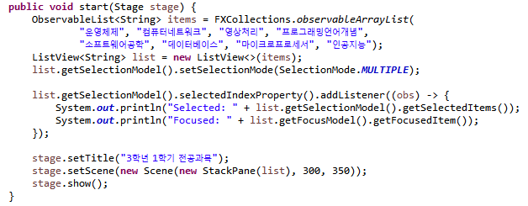
Advanced Controls and Charts
(1) ListView(Multiple)

Slide 21

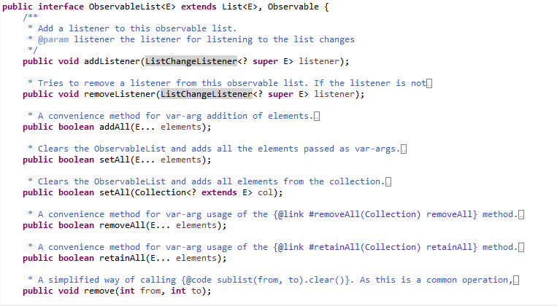
Advanced Controls and Charts
(1) ListView(Multiple)

Slide 22
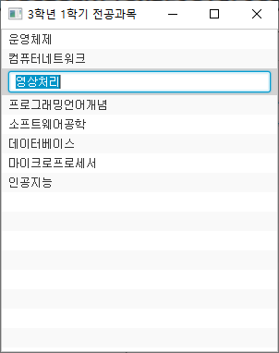
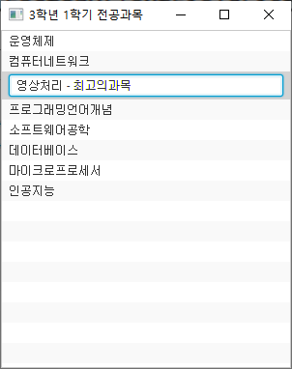
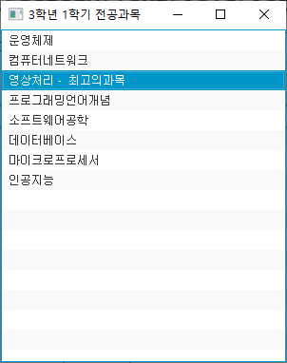
Advanced Controls and Charts
(2) ListView(Editable)

Slide 23
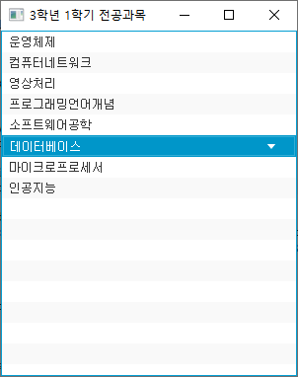
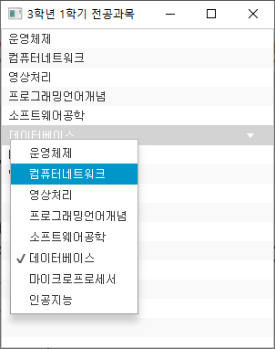
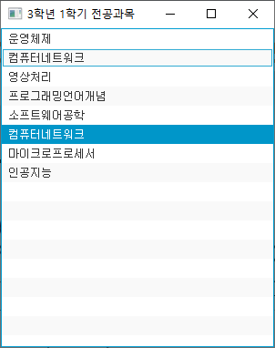
Advanced Controls and Charts
(3) ListView(choicebox)

Slide 24
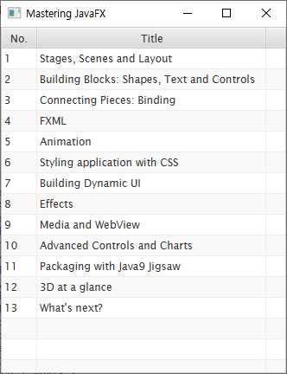
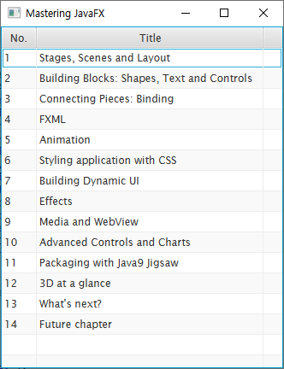
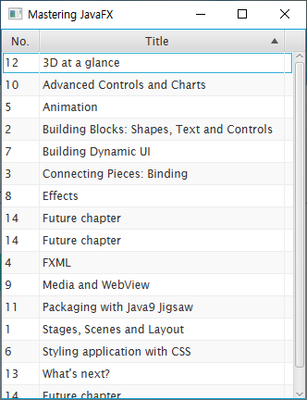
Advanced Controls and Charts
(4) TableView(choicebox)

Slide 25
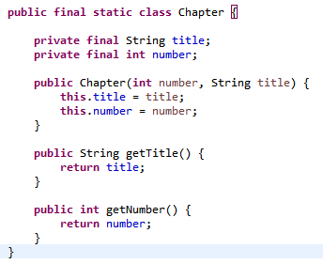
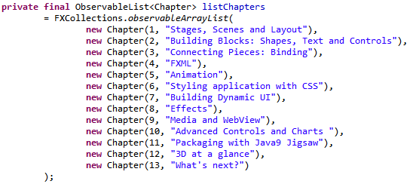
Advanced Controls and Charts
(4) TableView

Slide 26
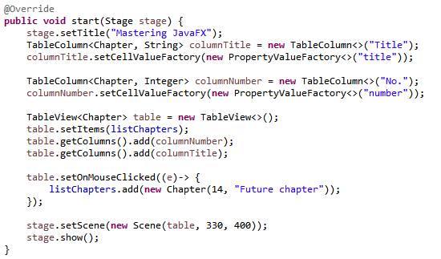
Advanced Controls and Charts
(4) TableView

Slide 27
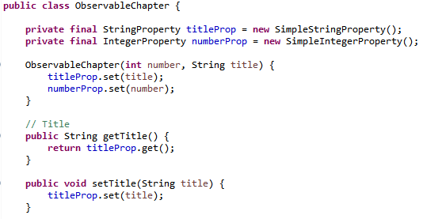
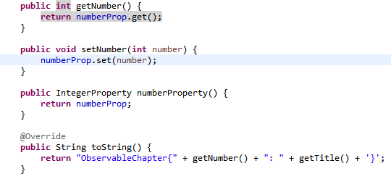
Advanced Controls and Charts
(5) TableView(Editable)

Slide 28
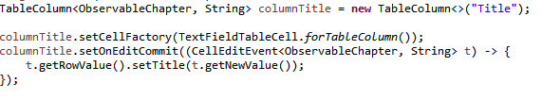
Advanced Controls and Charts
(5) TableView(Editable)

Slide 29
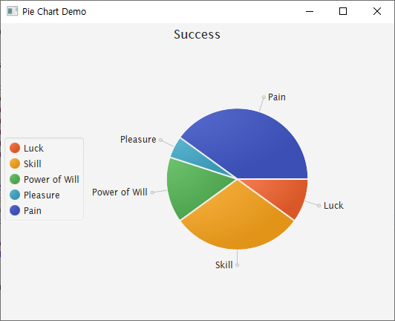
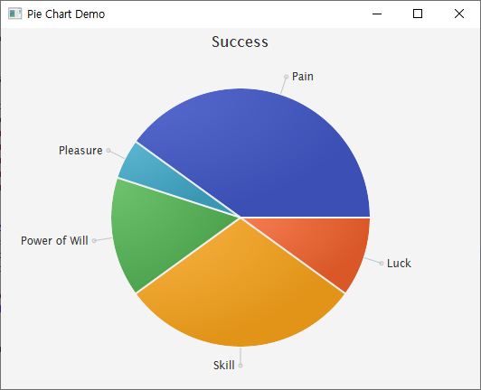
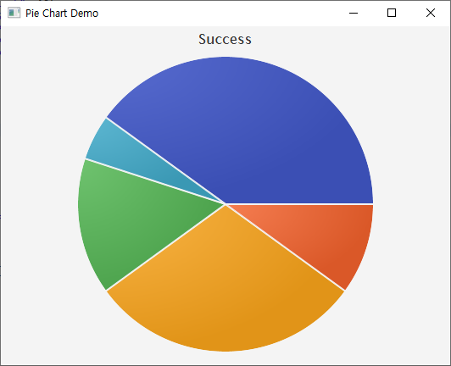
Advanced Controls and Charts
(6) PieChart

Slide 30
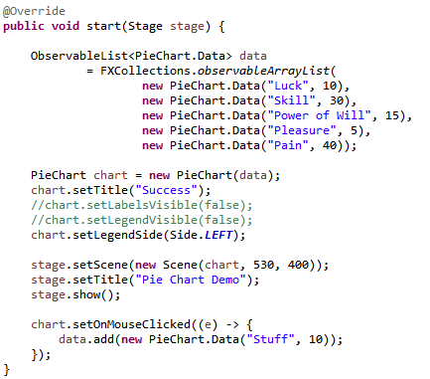
Advanced Controls and Charts
(6) PieChart

Slide 31
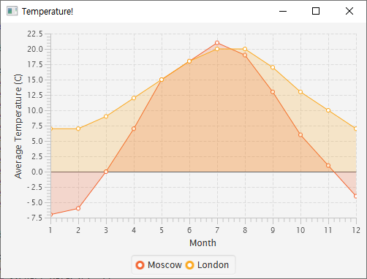
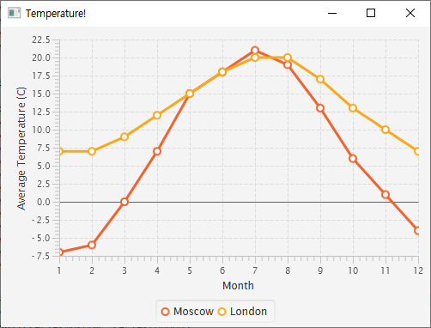
Advanced Controls and Charts
(7) AreaChart, LineChart
Area Chart
Line Chart

Slide 32
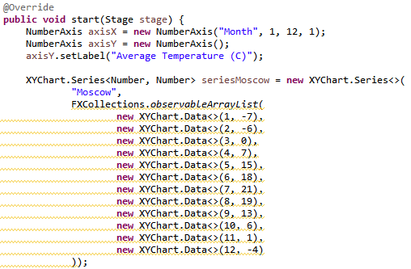
Advanced Controls and Charts
(7) AreaChart, LineChart

Slide 33
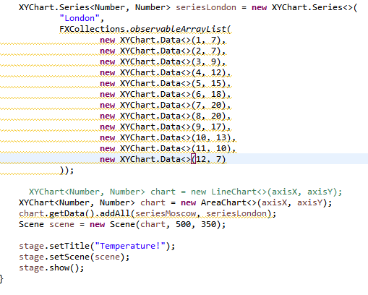
Advanced Controls and Charts
(7) AreaChart, LineChart

Slide 34

Advanced Controls and Charts
(8) Chart etc..

Slide 35
The end

