Slide 1
Anomaly Detection in Traffic Surveillance Videos with GAN-based Future Frame Prediction
JONGWOOK-SI

Slide 2
Abstract
This motivates us to propose a novel method to detect traffic accidents in traffic videos.
We propose a method using Generative Adversarial Network trained on regular sequences to predict future frames.
We also propose a new idea of encoding motion descriptors and scaled intensity loss function to optimize GAN for fast-moving objects.

Slide 3
Introduction
This motivates our proposal of a novel method to detect car accident right when the event begins.
We propose a new way of encoding the stacked motion descriptors into blended motion descriptor using an average image.
Experiments on the Traffic Anomaly Detection dataset in AI City Challenge at CVPR 2019.

Slide 4
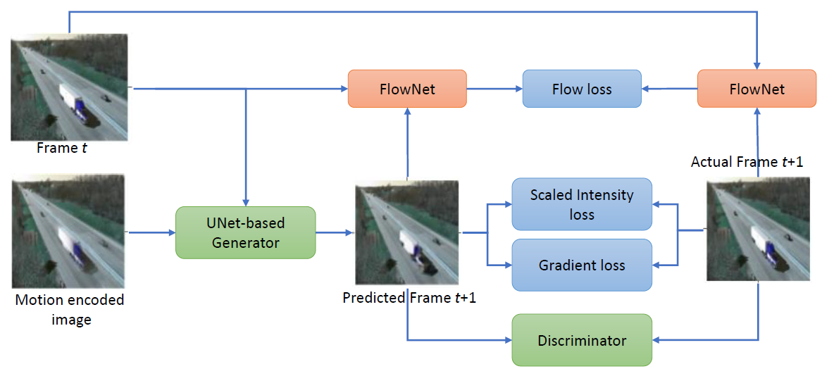
Proposed Method
Network Architecture

Slide 5
Proposed Method
Future Frame Prediction
Our proposed method to predict the next frame from a video sequence is inspired by the method of Wen Liu et al
This input strategy is appropriate with objects having slow, stable motions in normal scenarios.
Our goal is to deal with traffic videos which contain high-velocity objects.
This motivates us to propose new techniques to adapt the network to encode the input motion descriptor with average images.

Slide 6
Proposed Method
Future Frame Prediction (Generative Model Training)
Generator Model : U-Net
Learning rate : 0.0005 -> 0.00005
Batch Size : 4 or 8
Input Size : 512 x 512 x c
Convolution Layer, Deconvolution Layer : 5

Slide 7
Proposed Method
Future Frame Prediction (Adversarial Model Training)
Discriminator Model : Fully connected Layer와 non padded Convolution
Learning rate : 0.0005

Slide 8
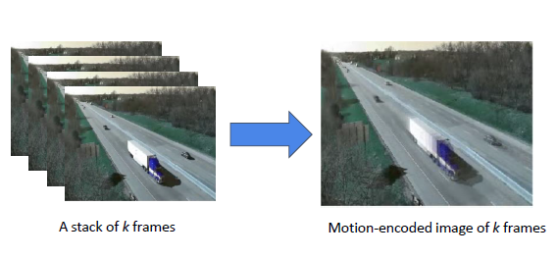
Proposed Method
Future Frame Prediction (Encoded Motion Descriptor)

Slide 9
Proposed Method
Future Frame Prediction (Encoded Motion Descriptor)
This information allows GAN models to estimate, predict and generate the positions of moving objects in the next frame at pixel-level.
Instead of stacking the frames to show the motion trajectories, we propose the encoded motion descriptor by using average images.

Slide 10
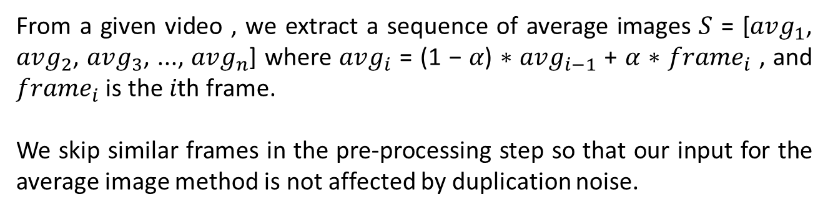
Proposed Method
Future Frame Prediction (Encoded Motion Descriptor)
From a given video , we extract a sequence of average images 𝑆 = [$avg_{1}$, $avg_{2}$, $avg_{3}$, ..., $avg_{n}$] where $avg_{i}$ = (1 − 𝛼) ∗ $avg_{i−1}$ + 𝛼 ∗ $frame_{i}$ , and $frame_{i}$ is the 𝑖th frame.
We skip similar frames in the pre-processing step so that our input for the average image method is not affected by duplication noise.

Slide 11
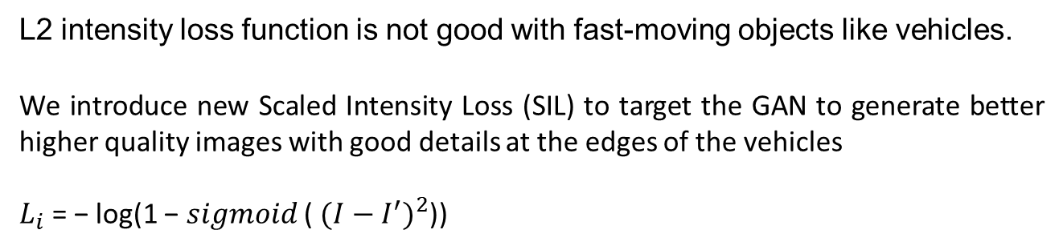
Proposed Method
Future Frame Prediction (Scaled Intensity Loss Function)
L2 intensity loss function is not good with fast-moving objects like vehicles.
We introduce new Scaled Intensity Loss (SIL) to target the GAN to generate better higher quality images with good details at the edges of the vehicles
$L_{i}$ = − log(1 − 𝑠𝑖𝑔𝑚𝑜𝑖𝑑 ( ${(I−I^{′})}^{2}$))

Slide 12
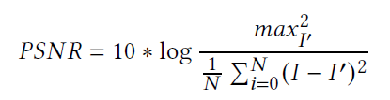
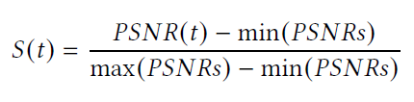
Proposed Method
Scoring the Abnormal Event based on Frame Prediction

Slide 13
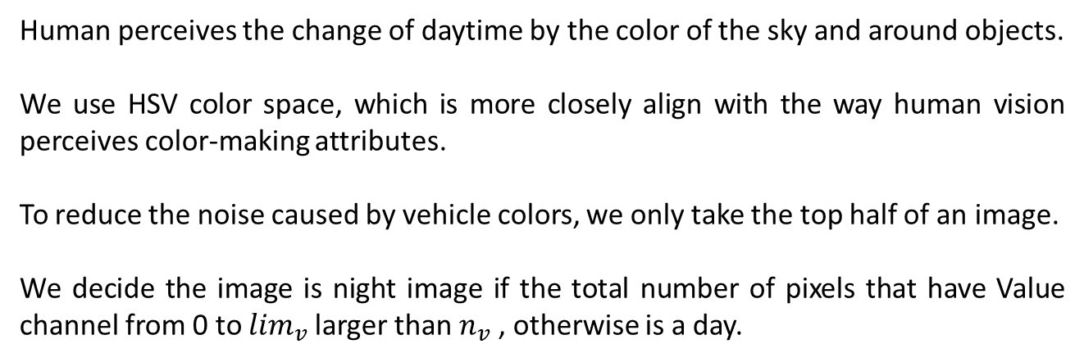
Proposed Method
Day-Night Detection
Human perceives the change of daytime by the color of the sky and around objects.
We use HSV color space, which is more closely align with the way human vision perceives color-making attributes.
To reduce the noise caused by vehicle colors, we only take the top half of an image.
We decide the image is night image if the total number of pixels that have Value channel from 0 to $\lim_{v}$larger than $n_{v}$ , otherwise is a day.

Slide 14
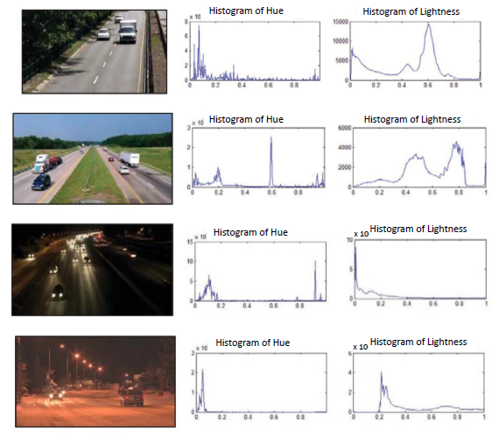
Proposed Method
Day-Night Detection

Slide 15

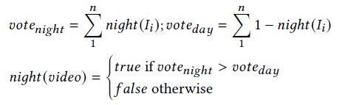
Proposed Method
Day-Night Detection

Slide 16
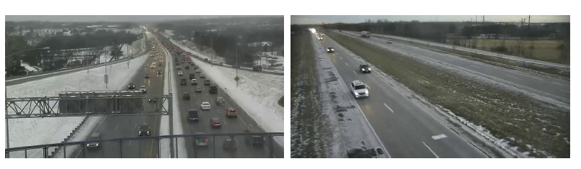
Proposed Method
Day-Night Detection

Slide 17
Experiments
Dataset and Evaluation Metric
AI City Challenge 2019 Traffic Anomaly Detection Datasets
Train 100, Test 100, Each 15min, Total 50 hours
The output of our system for one video is the list of detected anomaly represent by 4 factors: detected bounding boxes, starting time of anomaly, ending time of anomaly, and confident score.
The evaluation for this task is based on model anomaly detection performance, measured by the 𝐹1-score, and detection time error, measured by 𝑅𝑀𝑆𝐸.

Slide 18

Experiments
Dataset and Evaluation Metric
𝑁𝑅𝑀𝑆𝐸 is the normalized root mean square error (𝑅𝑀𝑆𝐸).
The score ranges between 0 and 1, the higher scores are better.
To compute 𝐹1-score, 𝑇𝑃 detection is considered as the predicted anomaly within 10 seconds of the actual anomaly that has the highest confidence score.

Slide 19
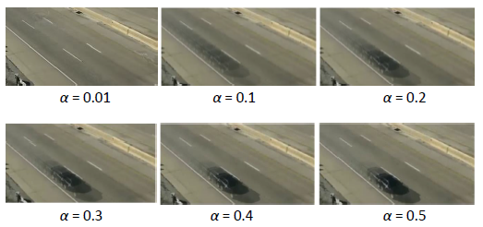
Experiments
Choosing alpha to Encode Descriptor with Average Images

Slide 20
Experiments
Day-Night Detection Experiments
To train the classifier, we pick random 10 images of each traffic video in the total 100 training videos.
We consider when the 𝑙𝑖𝑚𝑣 reaches over 124, colors become brighter; otherwise, colors become darker.

Slide 21
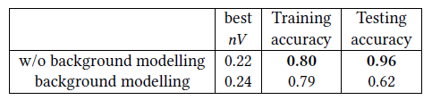
Experiments
Day-Night Detection Experiments
Background modeling is to remove all moving objects while keeping stalled vehicles stay in the background.
The daytime period detector with background modeling gives the worse result because the background modeling aggregates all frames by blending, so it increases noise.

Slide 22
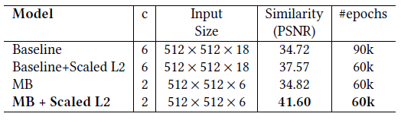
Experiments
Qualitative evaluation

Slide 23
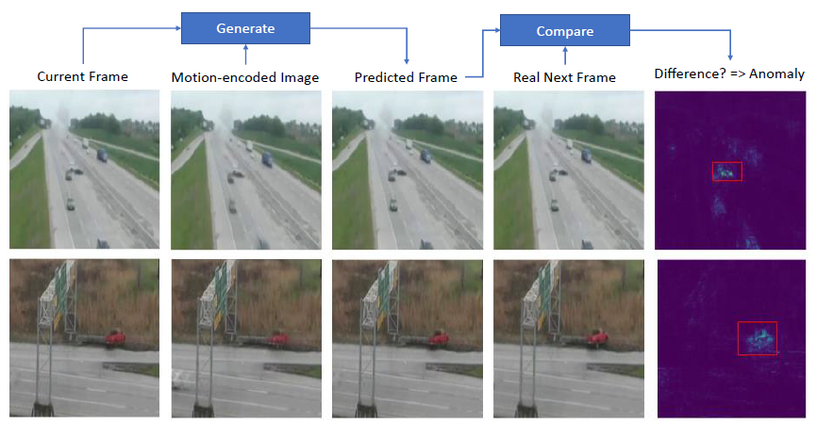
Experiments
Qualitative evaluation

Slide 24
Experiments
Traffic Anomaly Event Detection Evaluation
Our proposed method has both the high detection score for anomaly event detection (F1 = 0.9412) and the high detection time accuracy (RMSE = 4.8088).
Consequently, our method achieves the final score of 0.9261

Slide 25
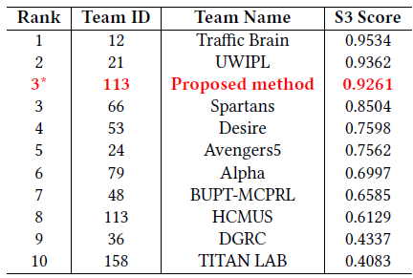
Experiments
Traffic Anomaly Event Detection Evaluation

Slide 26


