Slide 1
Traffic accident detection using P- GAN
- Proposed system
JONGWOOK-SI

Slide 2
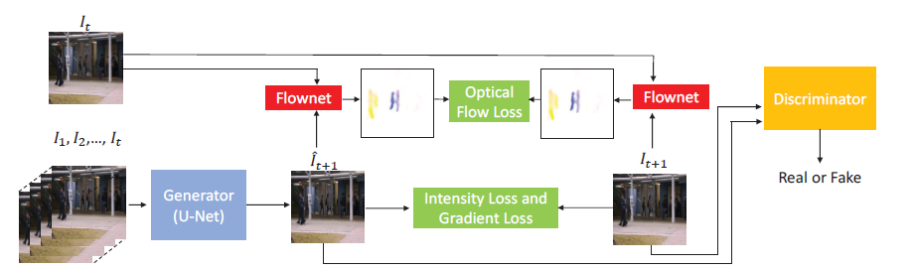
Baseline
고정카메라 환경

Slide 3
Baseline
Train : 254 videos (81417 frames) – normal frame
방향전환, 정거, 차 깜짝출연 등의 상황이 포함됨
Test : 54 videos (6429 frames) – normal(0) + abnormal(1)
Normal data에 대해 학습한 후, abnormal을 판별해보자!

Slide 4
Baseline
Input Size = 256x256 -> 128x128 (256으로 하면 컴퓨터가 다운됨)
Frame length = 4
Train data에 방향전환, 정거, 차 깜짝출연 등의 상황이 포함되지 않았을 때
F1score : 41.3%, Auc : 74%
Train data에 방향전환, 정거, 차 깜짝출연 등의 상황이 포함되었을 때
F1score : 50.7%, Auc : 75.9%

Slide 5
Proposed System

Slide 6
Proposed System
F1score : 58.4%
Auc : 81%
Threshold : adaptive
Input Size = 128x128
Frame length = 8

Slide 7
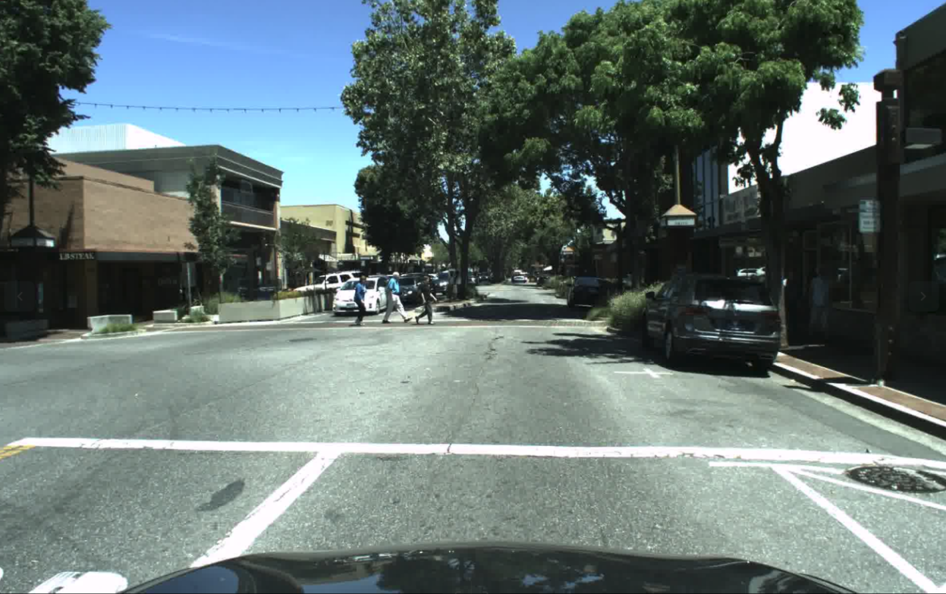
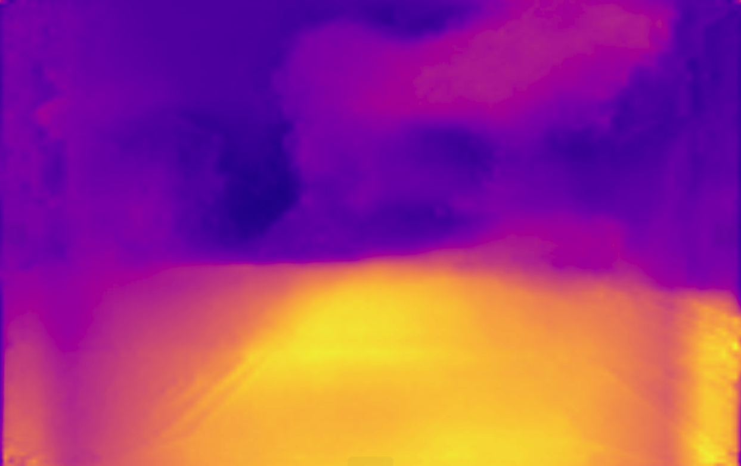
Proposed System
깊이 영상 (mono depth)
영상에 깊이를 추가함으로써 성능 향상을 기대

Slide 8
Proposed System
monodepth
Depth Loss
monodepth

Slide 9




Proposed System
$${\hat{I}}_{t+δ+1}$$
$$I_{t+δ+1}$$
Real or Fake
Discriminator
Intensity Loss
Gradient Loss
Mono Depth
Background Motion Loss
Mono Depth
Generator
$$I_{t+δ}$$
Depth Loss
$I_{t+1}, I_{t+2},…$,$I_{t+δ}$

Slide 10


Proposed System
$${\hat{I}}_{t+δ+1}$$
$$I_{t+δ+1}$$
Flownet
Background Motion Loss
Flownet
$$I_{t+δ}$$

Slide 11
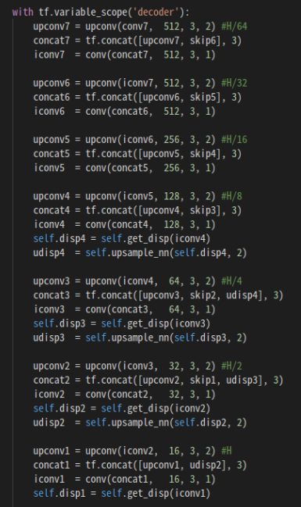
Proposed System
Loss 정의 (upsampling의 말단에서 4개의 합)
Pretrained model (vgg19)
S
U
M

Slide 12


Proposed System
$${\hat{I}}_{t+9δ}$$
$$I_{t+9δ}$$
⊕
⊙
⊝
⊙
⊕
Upconv
UpSampling
UpSampling
Upconv
Conv
⊕
⊙
⊝
⊙
⊕
Conv
Upconv
UpSampling
UpSampling
Upconv
Max pooling
⊕
⊙
⊝
⊙
⊕
Max pooling
Upconv
UpSampling
UpSampling
Upconv
Residual Block
⊕
⊙
⊝
⊙
⊕
Residual Block
Upconv
UpSampling
Upconv
Residual Block
⊕
⊕
Residual Block
Upconv
Upconv
Residual Block
⊕
SUM : Depth Loss
⊕
Residual Block
⊕ : Concat + Conv
⊙ : Conv 1x1
⊝ : Subtract
Residual Block
Upconv
Upconv
Residual Block

Slide 13
Proposed System
F1score : 59.3%
Auc : 82%
Threshold : adaptive
Input Size = 128x128
Frame length = 8

Slide 14
Proposed System
Depth Loss
monodepth
monodepth

Slide 15
Proposed System
F1score : 51.4%
Auc : 75.7%
Threshold : adaptive
Input Size = 128x128
Frame length = 8

Slide 16
Proposed System
monodepth
Depth Loss
monodepth

Slide 17
Proposed System
기존 PSNR을 정규화 방식 (무조건 0 혹은 1이 존재)
앞쪽 프레임의 예측 성능이 대부분 낮다가 중간쯤 되면 안정화
전체 프레임의 절반(half length)에 대하여 linspace 식으로 weight noise 부여
Score -= np.linspace(0.5, 0, half length)
Score[Score <0] = 0
F1score : 67.3%
Auc : 88%
Threshold : adaptive

Slide 18
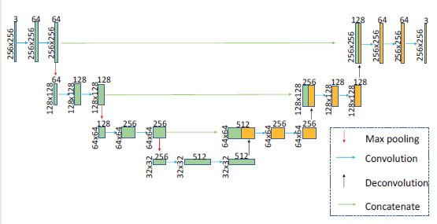
Proposed System
Baseline U-net architecture (generator)

Slide 19
Proposed System
U-net 구조 (종욱이 버전)
128x128x3
128x1282x32
128x1282x32
128x128x64
128x128x32
128x128x32
128x128x3
64x64x32
64x64x64
64x64x64
64x64x128
64x64x64
64x64x64
32x32x64
32x32x128
32x32x128
32x32x256
32x32x128
32x32x128
16x16x128
16x16x256
16x16x256
16x16x512
16x16x256
16x16x256
8x8x256
8x8x512
8x8x512

Slide 20
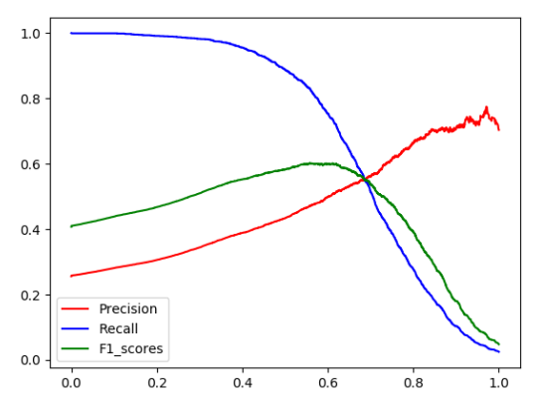
Proposed System
Weight noise 없을 때
F1score : 60.5%
Auc : 82.3 %
Threshold : adaptive

Slide 21
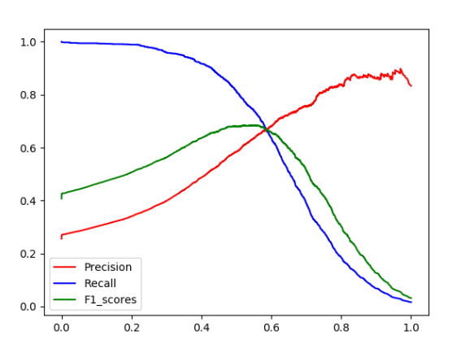
Proposed System
Weight noise 있을 때
F1score : 68.9%
Auc : 88.1%
Threshold : adaptive

Slide 22
Proposed System
 | Baseline | -Optical flow | +depth +optical | +depth | +depth +noise | +depth +종욱unet | +depth +종욱unet +noise
F1score | 41.3 50.7 | 51.8 58.4 | 51.4 | 59.3 | 67.3 | 60.5 | 68.9
AUC | 74.0 75.9 | 76.3 81.0 | 75.7 | 82.0 | 88.0 | 82.3 | 88.1

Slide 23
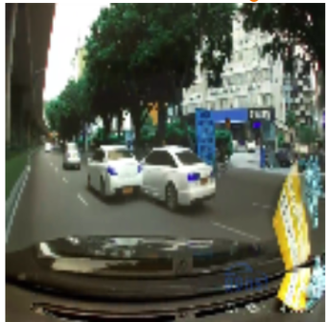
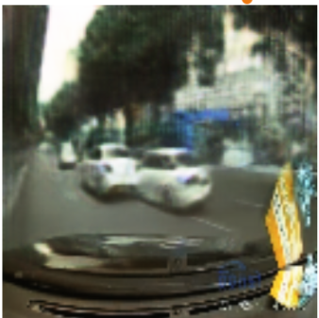
Proposed System
Ground Truth
Prediction

Slide 24
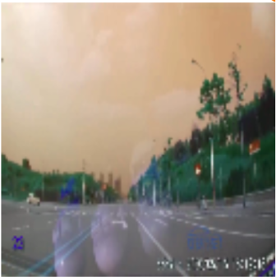
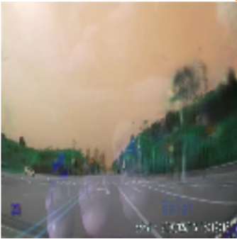
Proposed System
Ground Truth
Prediction

Slide 25
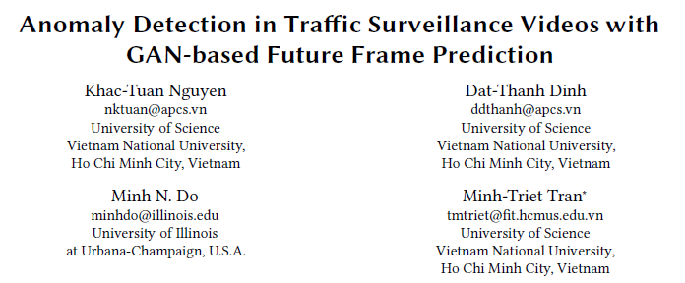
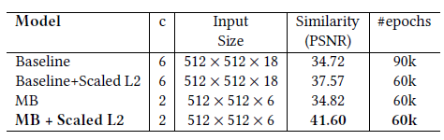
Possible System
P-GAN : 256x256
<- 512x512
But,. 128x128

Slide 26
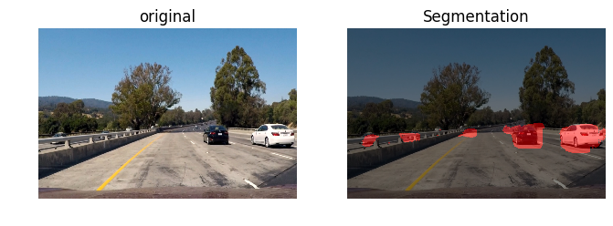
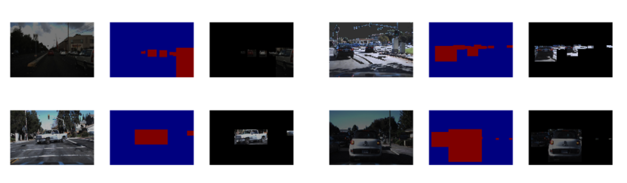
Possible System
Vehicle Extract
Background removal

