Slide 1
Identity-Preserving Face Recovery from Portraits (2018 IEEE WACV)
Jongwook Si (M. S Course)

Slide 2
Abstract
overview
Recovering the latent photorealistic faces from artistic portrait aids human perception and facial analysis
However, a recovery process that can preserve identity is challenging because the fine details of real faces can be distorted or lost in stylized images
In this paper, we present a new Identity-preserving Face Recovery from Portraits (IFRP) to recover latent photorealistic faces from unaligned stylized portraits.

Slide 3
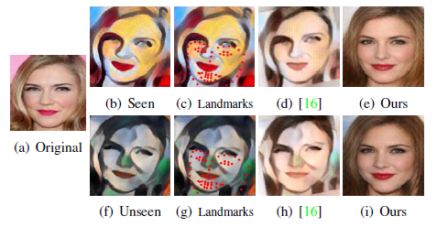
Introduction
overview
Stylized face
Various facial expression
Facial component distortion
Facial component misalignment
Landmark detector often fail to localize facial landmarks accurately
Restoring identity-consistent photorealistic face images from unaligned stylized ones is challenging

Slide 4
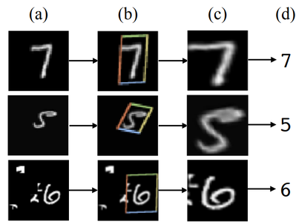
Introduction
overview
This Network
Generative subnetwork
Dubbed Style Removal Network (SRN)
Discriminative Network (DN)
SRN
AutoEncoder : extract facial components, transfer the extracted feature maps
Spatial Transformer Network (STN)
: be used by the encoder and decoder to align stylized faces

Slide 5
Introduction
overview
DN
Forces SRN to generate destylized faces to be similar to authentic GT faces
To train network
Require pairs of Stylized Face (SF) and ground-truth Real Face (RF)
So, They synthesized a large-scale dataset of SF/RF pairs

Slide 6


Introduction
overview
CNN filters learned on images of seen styles (used for training) can extract meaningful features from images in unseen styles

Slide 7
Introduction
overview
The main contribution of work are fourfold
Proposed IFRP : recover photorealistic faces from unaligned stylized portraits
Used STNs as intermediate layers : not require the use of facial landmark
Fused an identity-preserving loss
Pixel-wise similarity loss + adversarial loss
Remove seen/unseen styles from portraits and recover the underlying identity
Synthesized a large dataset of pairs stylized and photorealistic faces

Slide 8
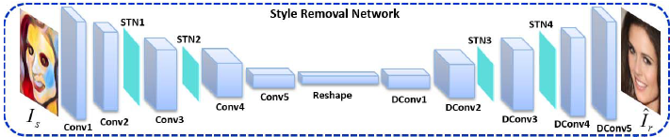
Proposed Method
Style Removal Network
The goal of face recovery
To generate a photorealistic destylized image
Generative network should be able to remove various styles of portraits without losing the identity-preserving information

Slide 9
Proposed Method
Style Removal Network
AutoEncoder
Use of Encoder: learn a deterministic mapping from a portrait space into latent space
Use of Decoder: mapping from the latent space to the real face space
STN Layer
Incorporate 4 STN layers to perform face

Slide 10
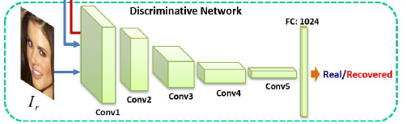
Proposed Method
Discriminative Network
Using only a pixel-wise distance between the recovered faces and their ground-truth real counterparts leads to over smoothed results
Discriminative loss(=adversarial loss)
Penalizes the discrepancy between distributions of recovered and real faces
Used to update the parameters of the SRN unit

Slide 11
Proposed Method
Identity Preservation
Be able to generate high-frequency facial contents (by using adversarial loss)
What is Problem?
The results often lack details of identities such as beard or wrinkles
What is solution?
To constrain the recovered faces to share as many features with the GT faces
Define Euclidean distance between the feature representation of recovered and the GT (from the ReLU activations of the VGG-19 Network)

Slide 12
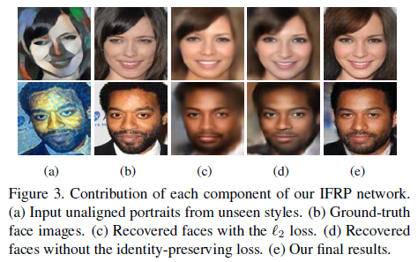
Proposed Method
Identity Preservation

Slide 13
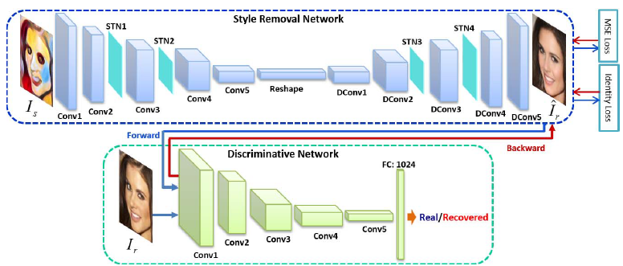
Proposed Method
Overall Network Architecture

Slide 14
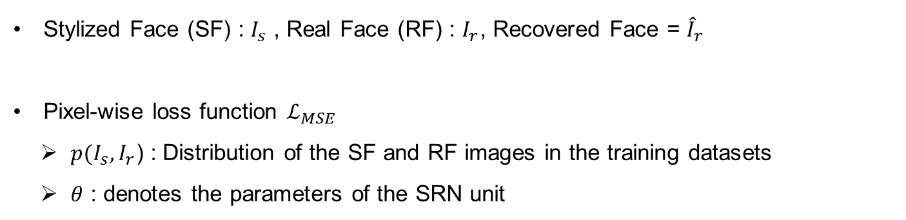
Training Details
Loss
Stylized Face (SF) : $I_{s}$ , Real Face (RF) : $I_{r}$, Recovered Face = ${\hat{I}}_{r}$
Pixel-wise loss function $ℒ_{MSE}$
$p(I_{s}, I_{r}$) : Distribution of the SF and RF images in the training datasets
$θ$ : denotes the parameters of the SRN unit

Slide 15
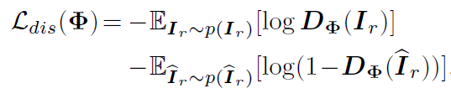
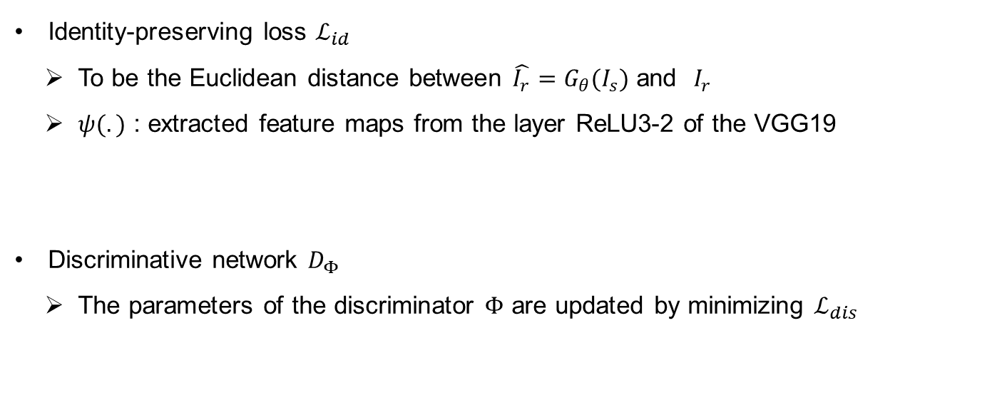
Training Details
Loss
Identity-preserving loss $ℒ_{id}$
To be the Euclidean distance between $\hat{I_{r}}=G_{θ}(I_{s})$ and $I_{r}$
$ψ(.)$ : extracted feature maps from the layer ReLU3-2 of the VGG19
Discriminative network $D_{Φ}$
The parameters of the discriminator $Φ$ are updated by minimizing $ℒ_{dis}$

Slide 16
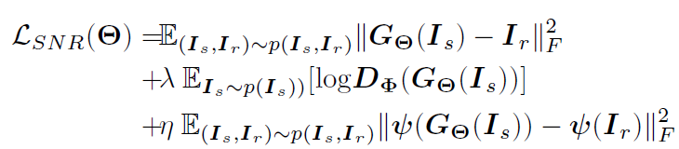
Training Details
Loss
SNR loss

Slide 17
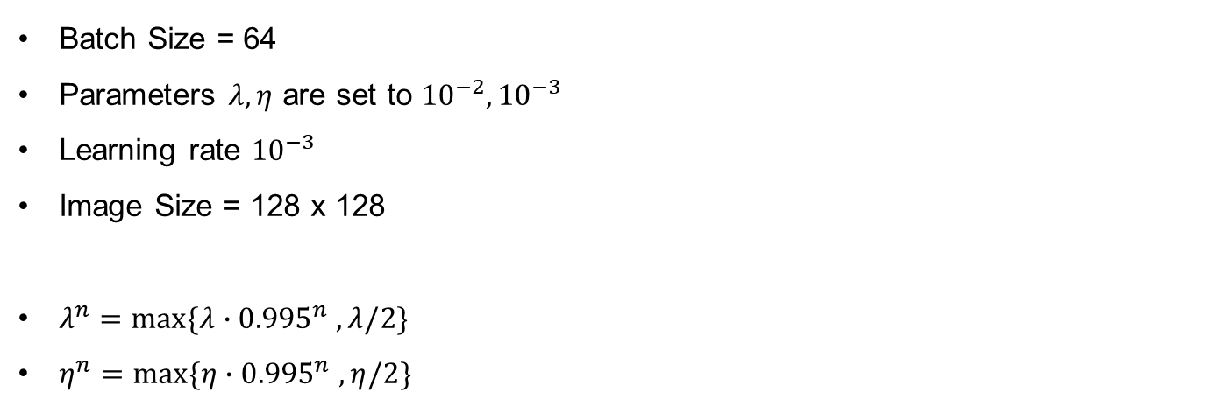
Implementation Details
Implementation Details
Batch Size = 64
Parameters $λ, η$ are set to ${10}^{−2}, {10}^{−3}$
Learning rate ${10}^{−3}$
Image Size = 128 x 128
$λ^{n}=max⁡\{λ∙{0.995}^{n} ,λ/2\}$
$η^{n}=max⁡\{η∙{0.995}^{n} ,η/2\}$

Slide 18
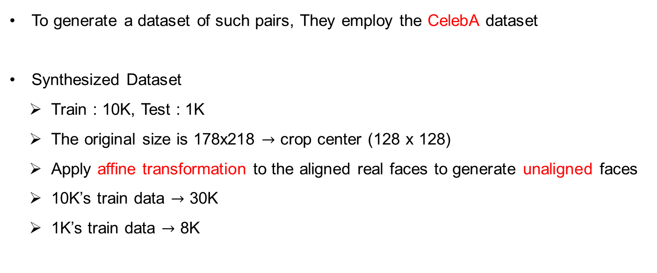
Synthesized Dataset and Preprocessing
Dataset
To generate a dataset of such pairs, They employ the CelebA dataset
Synthesized Dataset
Train : 10K, Test : 1K
The original size is 178x218 $→$ crop center (128 x 128)
Apply affine transformation to the aligned real faces to generate unaligned faces
10K’s train data $→$ 30K
1K’s train data $→$ 8K

Slide 19
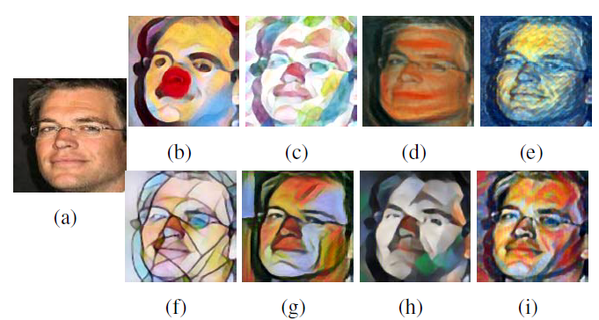
Synthesized Dataset and Preprocessing
Dataset
(b)~(d) : Scream, Candy and Feathers
(e)~(i) : Starry, Mosaic, la Muse, Udnie and Composition VII

Slide 20
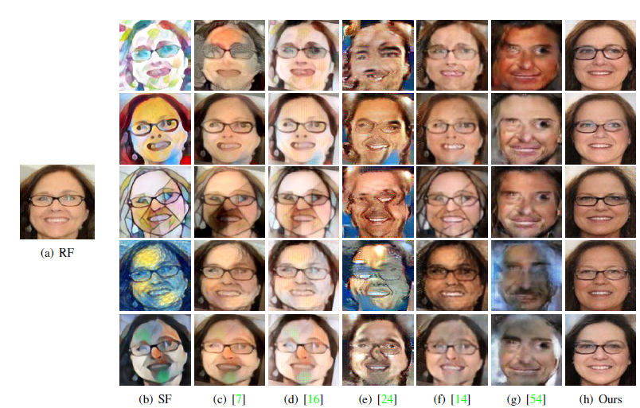
Experiments
Qualitative Evaluation
(c) : Gatys et al.
(d) : Johnson et al.
(e) : MGAN
(f) : Pix2Pix
(g) : CycleGAN

Slide 21
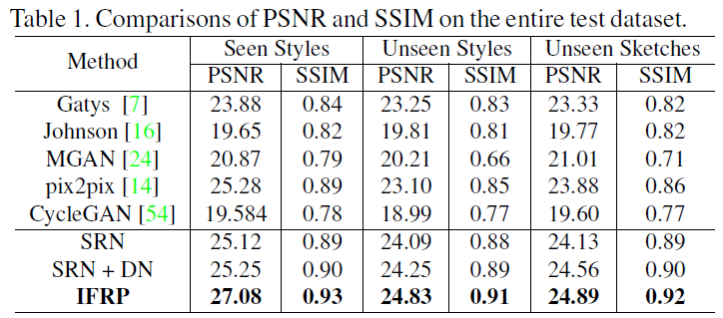
Experiments
Quantitative Evaluation

Slide 22
Experiments
Face Retrieval Analysis
Demonstrate that faces recovered by method are highly consistent with GT
Run a face recognition algorithm on test dataset
1K recovered faces from one style and 1K GT faces
Apply to face recognition algorithm quantify whether the correct person is retrieved within the top-5 matched images -> average retrieval score
FRR(Face Retrieval Ratio)
Be better compared to results on other style
Repeat procedure for every style

Slide 23
Experiments
Consistency Analysis w.r.t. Style
FCR (Face Consistency Ratio)
It indicates that network is robust to different styles
They search its top-5 most similar faces in another group of destylized faces
If the same person is retrieved within the top-5 candidates, They record it as hit
Then an average hit number of one style is obtained

Slide 24
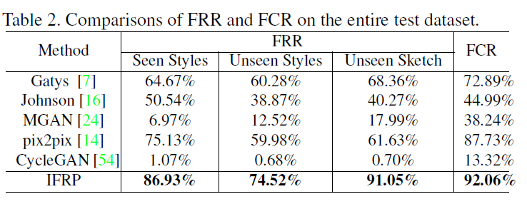
Experiments
Consistency Analysis w.r.t. Style

Slide 25
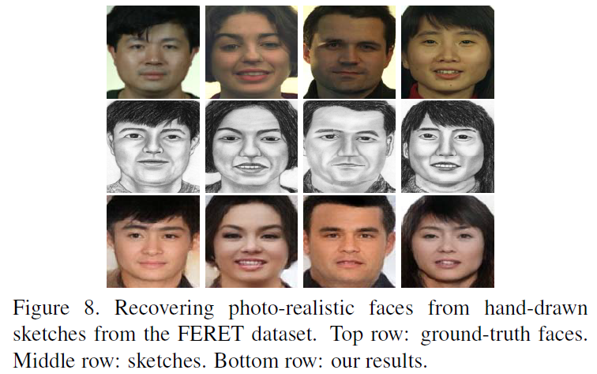
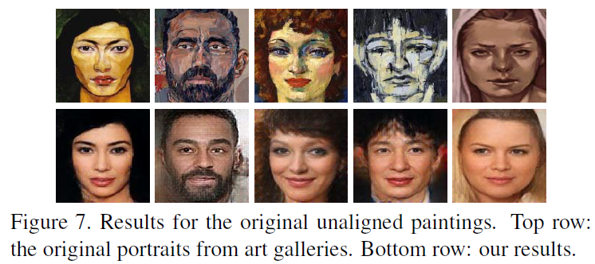
Experiments
Destylizing Original Paintings and Sketches

Slide 26
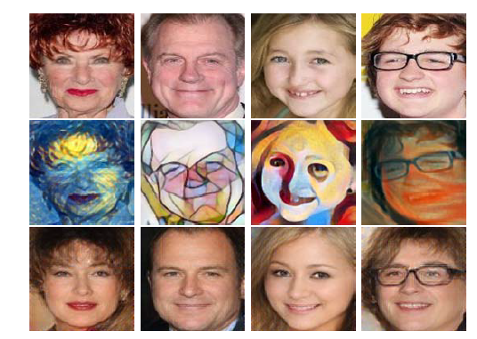
Experiments
Limitation
CelebA dataset
Age area are unbalanced
Children + old people < young adult
In Future
The intent to embed semantic information into network
Then, generate more consistent face images in terms of the skin and hair color

