Slide 1
LI-Net: Large-Pose Identity-Preserving Face Reenactment Network (arXiv.2104.02850v1)
Jongwook Si (M. S Course)

Slide 2
Abstract
overview
Landmark Transformer is adopted to adjust driving landmark images, which aims to narrow the identity gap between driving and source landmark images
Then, the Face Rotation Module and the Expression Enhancing Generator
Decouple the transformed landmark image into pose and expression features
Reenact those attributes separately to generate identity-preserving faces with accurate expressions and poses

Slide 3
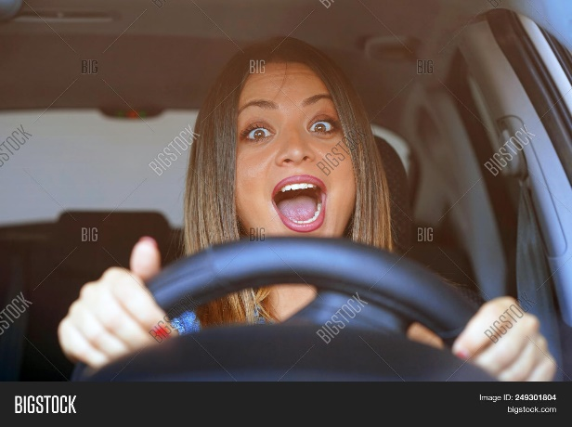
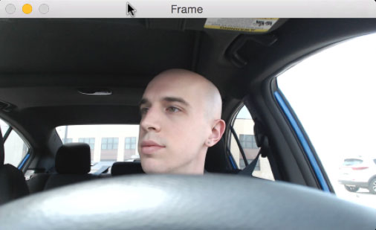
Introduction
overview
Given a source face and driving face
Face reenactment aims to generate a reenacted face
Expression and pose of the driving face
Preserving the identity of the source face

Slide 4
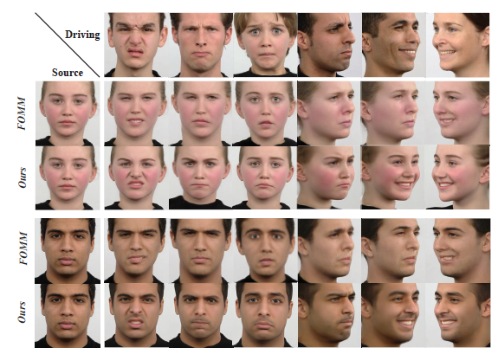
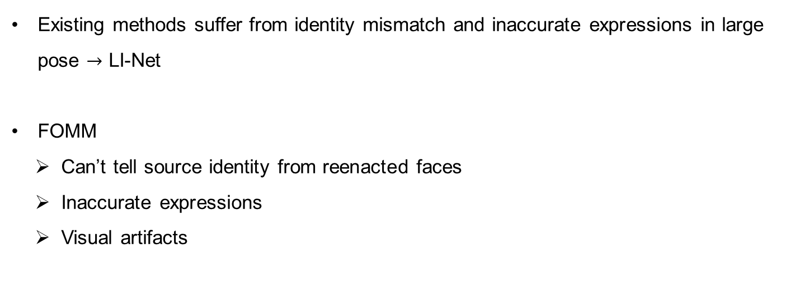
Introduction
The results of LI-Net and current SOTA method FOMM
Existing methods suffer from identity mismatch and inaccurate expressions in large pose $→$ LI-Net
FOMM
Can’t tell source identity from reenacted faces
Inaccurate expressions
Visual artifacts

Slide 5
Introduction
overview
Their Contributions
To solve identity mismatch
Landmark transformer (with explicit identity restrictions)
Adopt the Face Rotation Module with a novel data augmentation method
Adopt the Expression Enhancing Generator to impose fined pose and grained expression

Slide 6
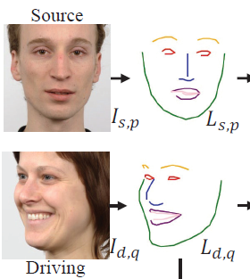
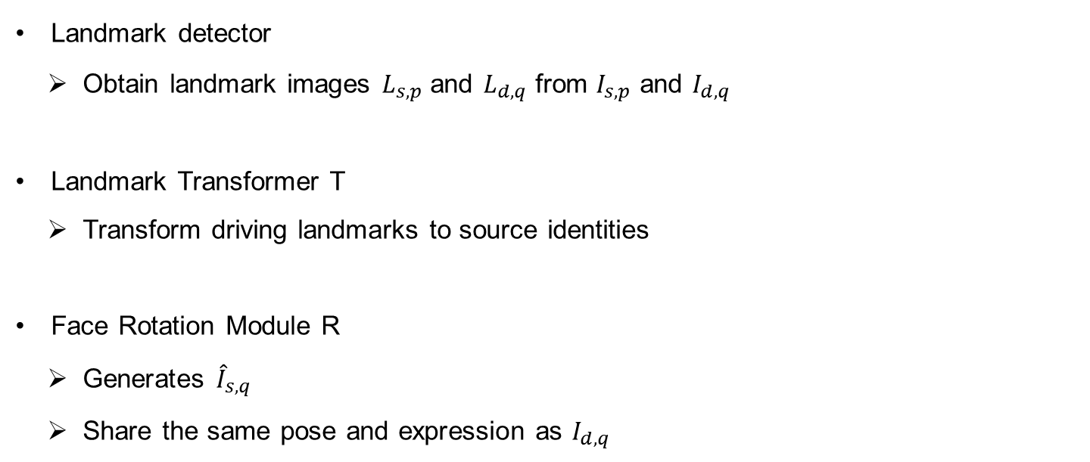
Methodology
overview
Landmark detector
Obtain landmark images $L_{s,p}$ and $L_{d,q}$ from $I_{s,p}$ and $I_{d,q}$
Landmark Transformer T
Transform driving landmarks to source identities
Face Rotation Module R
Generates ${\hat{I}}_{s,q}$
Share the same pose and expression as $I_{d,q}$

Slide 7
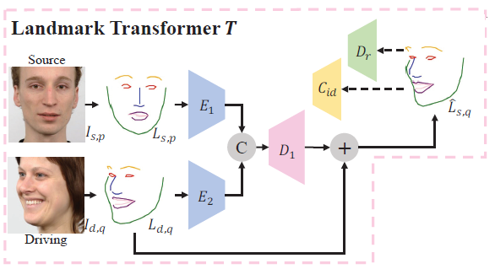
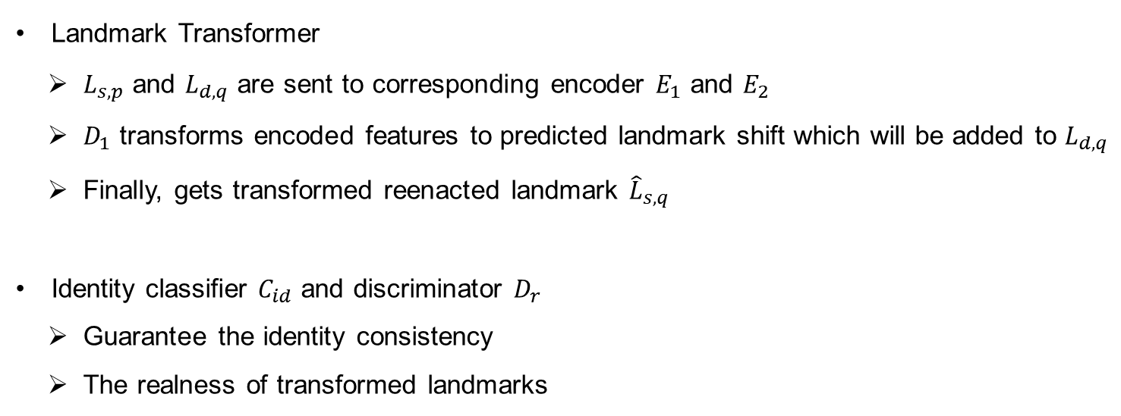

Methodology
Landmark Transformer
Landmark Transformer
$L_{s,p}$ and $L_{d,q}$ are sent to corresponding encoder $E_{1}$ and $E_{2}$
$D_{1}$ transforms encoded features to predicted landmark shift which will be added to $L_{d,q}$
Finally, gets transformed reenacted landmark ${\hat{L}}_{s,q}$
Identity classifier $C_{id}$ and discriminator $D_{r}$
Guarantee the identity consistency
The realness of transformed landmarks
${\hat{L}}_{s,q}=T(L_{s,p}, L_{d,q})$

Slide 8
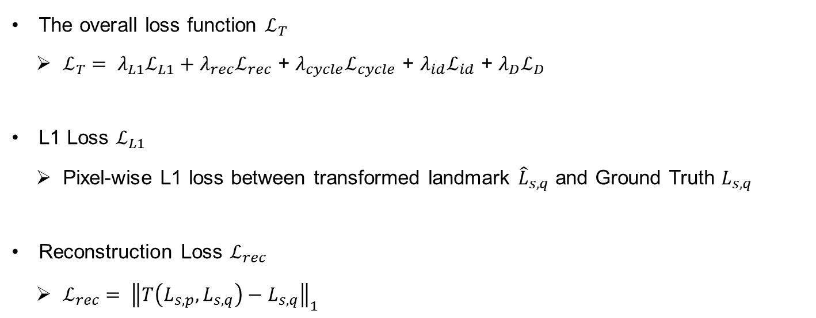
Methodology
Landmark Transformer
The overall loss function $ℒ_{T}$
$ℒ_{T}= λ_{L1}ℒ_{L1}+λ_{rec}ℒ_{rec}$ + $λ_{cycle}ℒ_{cycle}$ + $λ_{id}ℒ_{id}$ + $λ_{D}ℒ_{D}$
L1 Loss $ℒ_{L1}$
Pixel-wise L1 loss between transformed landmark ${\hat{L}}_{s,q}$ and Ground Truth $L_{s,q}$
Reconstruction Loss $ℒ_{rec}$
$ℒ_{rec}= {\left\|T\left(L_{s,p}, L_{s,q}\right)−L_{s,q}\right\|}_{1}$

Slide 9
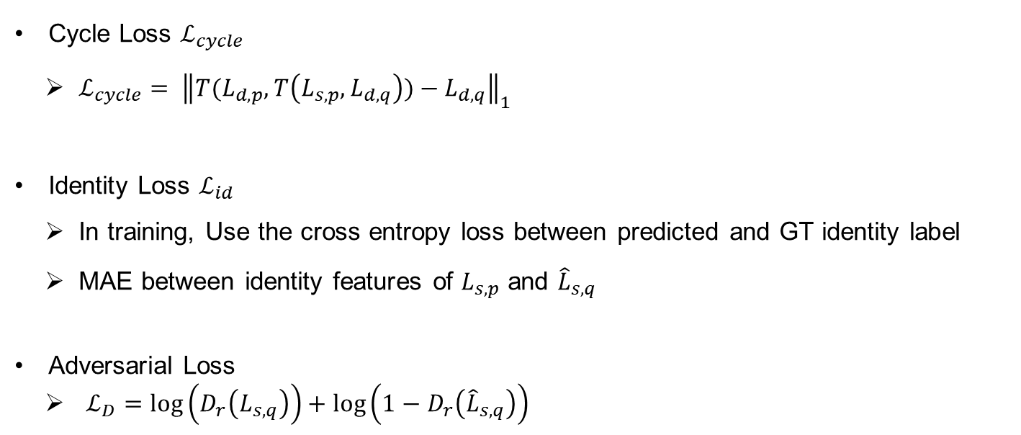
Methodology
Landmark Transformer
Cycle Loss $ℒ_{cycle}$
$ℒ_{cycle}= {\left\|T(L_{d,p},T\left(L_{s,p}, L_{d,q}\right))−L_{d,q}\right\|}_{1}$
Identity Loss $ℒ_{id}$
In training, Use the cross entropy loss between predicted and GT identity label
MAE between identity features of $L_{s,p}$ and ${\hat{L}}_{s,q}$
Adversarial Loss
$ℒ_{D}=\log\left(D_{r}\left(L_{s,q}\right)\right)+\log\left(1−D_{r}\left({\hat{L}}_{s,q}\right)\right)$

Slide 10
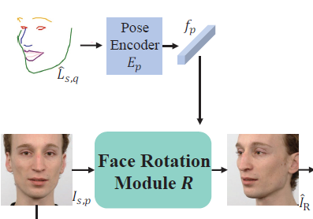
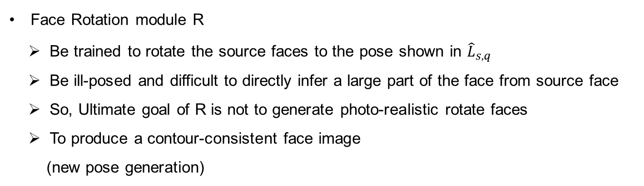
Methodology
Face Rotation Module
Face Rotation module R
Be trained to rotate the source faces to the pose shown in ${\hat{L}}_{s,q}$
Be ill-posed and difficult to directly infer a large part of the face from source face
So, Ultimate goal of R is not to generate photo-realistic rotate faces
To produce a contour-consistent face image
(new pose generation)

Slide 11
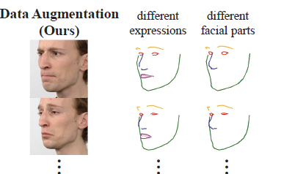
Methodology
Face Rotation Module
Data Augmentation
Choose landmark images with driving pose and source identity
But with different expressions and facial parts
Randomly choose one from driving pose landmark

Slide 12
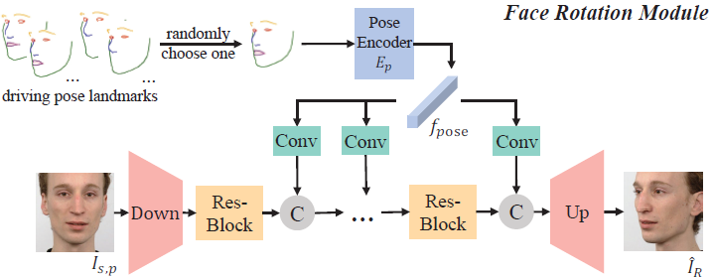
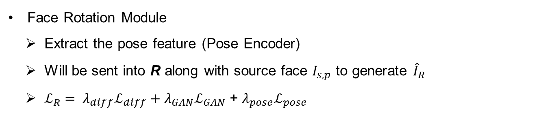
Methodology
Face Rotation Module
Face Rotation Module
Extract the pose feature (Pose Encoder)
Will be sent into R along with source face $I_{s,p}$ to generate ${\hat{I}}_{R}$
$ℒ_{R}= λ_{diff}ℒ_{diff}+λ_{GAN}ℒ_{GAN}$ + $λ_{pose}ℒ_{pose}$

Slide 13
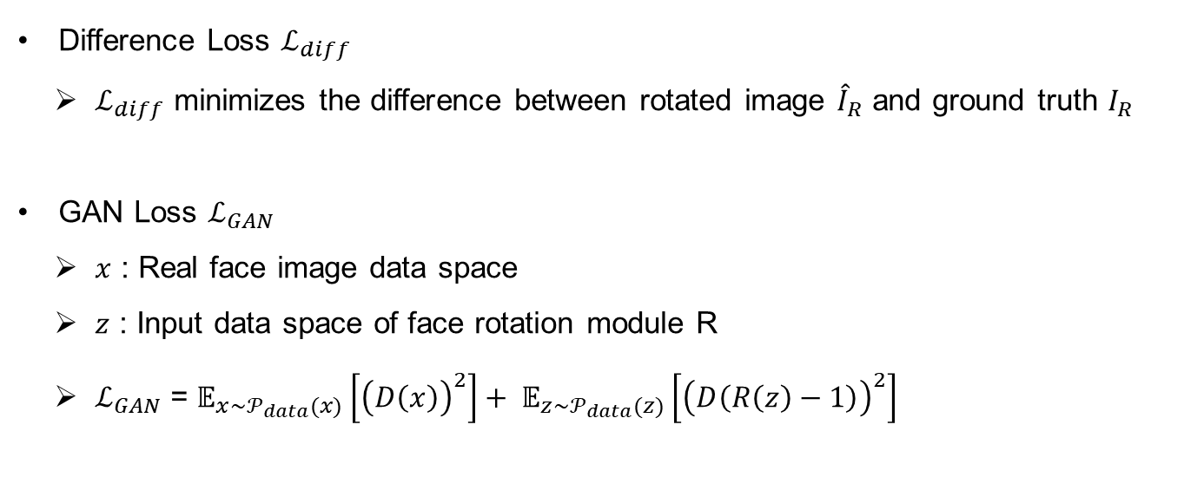
Methodology
Face Rotation Module
Difference Loss $ℒ_{diff}$
$ℒ_{diff}$ minimizes the difference between rotated image ${\hat{I}}_{R}$ and ground truth $I_{R}$
GAN Loss $ℒ_{GAN}$
$x$ : Real face image data space
$z$ : Input data space of face rotation module R
$ℒ_{GAN}$ = $𝔼_{x\sim 𝒫_{data}(x)}\left[{\left(D\left(x\right)\right)}^{2}\right]+ 𝔼_{z\sim 𝒫_{data}(z)}\left[{\left(D\left(R\left(z\right)−1\right)\right)}^{2}\right]$

Slide 14
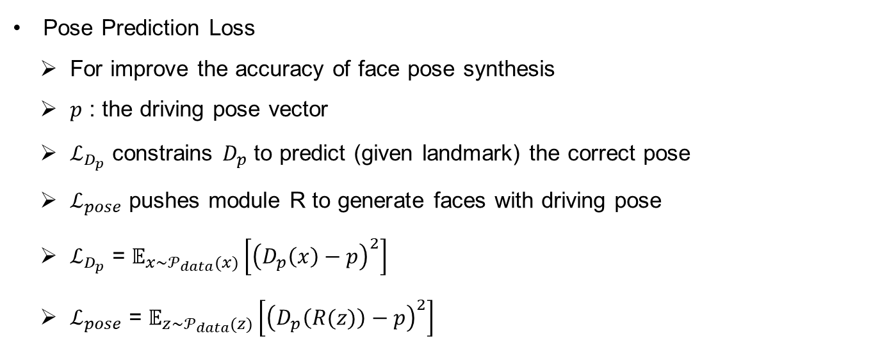
Methodology
Face Rotation Module
Pose Prediction Loss
For improve the accuracy of face pose synthesis
$p$ : the driving pose vector
$ℒ_{D_{p}}$ constrains $D_{p}$ to predict (given landmark) the correct pose
$ℒ_{pose}$ pushes module R to generate faces with driving pose
$ℒ_{D_{p}}$ = $𝔼_{x\sim 𝒫_{data}(x)}\left[{\left(D_{p}\left(x\right)−p\right)}^{2}\right]$
$ℒ_{pose}$ = $𝔼_{z\sim 𝒫_{data}(z)}\left[{\left(D_{p}\left(R(z)\right)−p\right)}^{2}\right]$

Slide 15
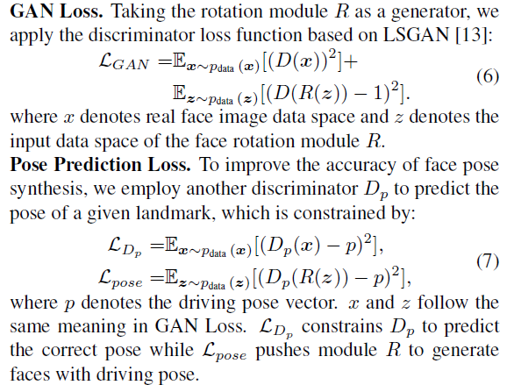

Methodology
Face Rotation Module
$ℒ_{GAN}$ = $𝔼_{x\sim 𝒫_{data}(x)}\left[{\left(D\left(x\right)\right)}^{2}\right]$
$+ 𝔼_{z\sim 𝒫_{data}(z)}\left[{\left(D\left(R\left(z\right)−1\right)\right)}^{2}\right]$
$ℒ_{pose}$ = $𝔼_{z\sim 𝒫_{data}(z)}\left[{\left(D_{p}\left(R(z)\right)−p\right)}^{2}\right]$
$D$ : To distinguish between $x$ and $R(z)$
$D_{p}$: Whether $x$ and $R(z)$ are created close to $p$

Slide 16
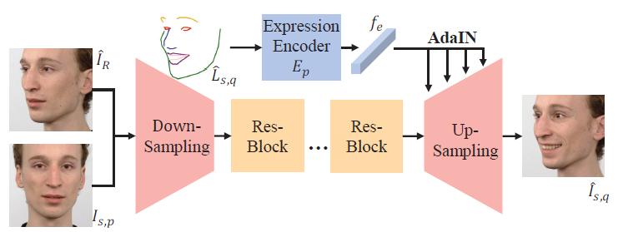
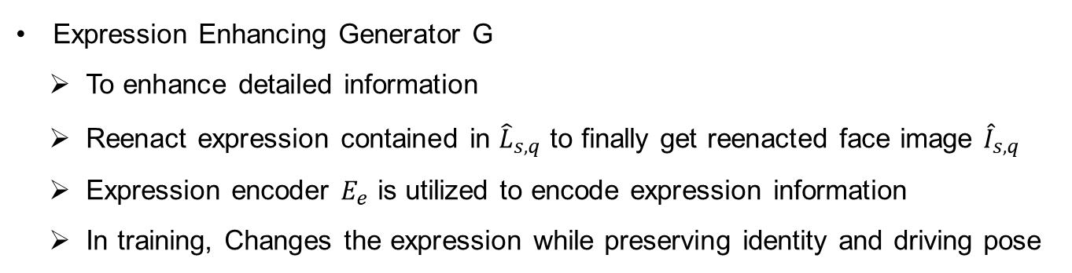
Methodology
Expression Enhancing Generator
Expression Enhancing Generator G
To enhance detailed information
Reenact expression contained in ${\hat{L}}_{s,q}$ to finally get reenacted face image ${\hat{I}}_{s,q}$
Expression encoder $E_{e}$ is utilized to encode expression information
In training, Changes the expression while preserving identity and driving pose

Slide 17
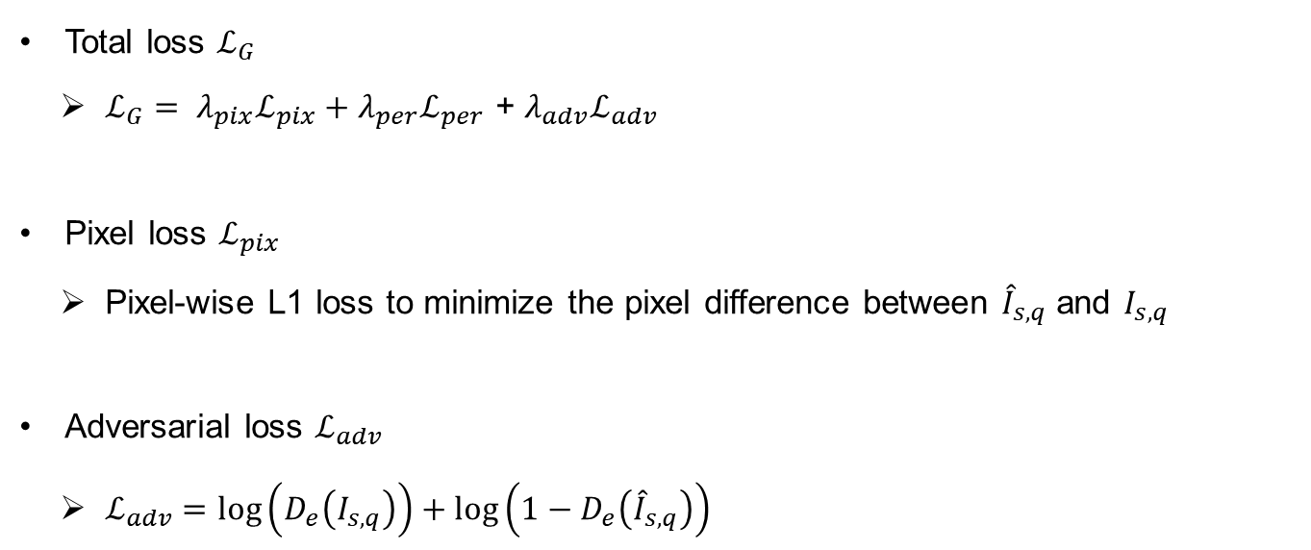
Methodology
Expression Enhancing Generator
Total loss $ℒ_{G}$
$ℒ_{G}= λ_{pix}ℒ_{pix}+λ_{per}ℒ_{per}$ + $λ_{adv}ℒ_{adv}$
Pixel loss $ℒ_{pix}$
Pixel-wise L1 loss to minimize the pixel difference between ${\hat{I}}_{s,q}$ and $I_{s,q}$
Adversarial loss $ℒ_{adv}$
$ℒ_{adv}=\log\left(D_{e}\left(I_{s,q}\right)\right)+\log\left(1−D_{e}\left({\hat{I}}_{s,q}\right)\right)$

Slide 18
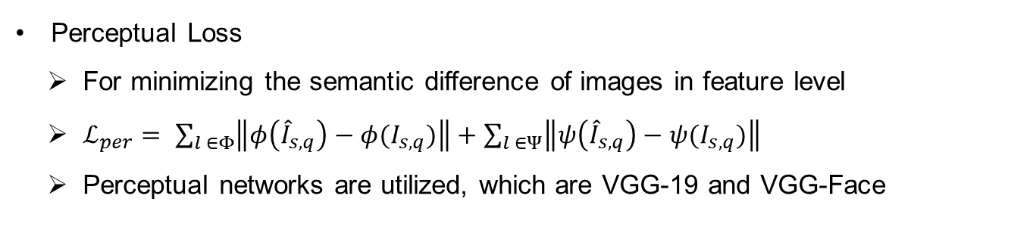
Methodology
Expression Enhancing Generator
Perceptual Loss
For minimizing the semantic difference of images in feature level
$ℒ_{per}= \sum_{l ∈Φ}{\left\|φ\left({\hat{I}}_{s,q}\right)−φ(I_{s,q})\right\|}+\sum_{l ∈Ψ}{\left\|ψ\left({\hat{I}}_{s,q}\right)−ψ(I_{s,q})\right\|}$
Perceptual networks are utilized, which are VGG-19 and VGG-Face

Slide 19
Experiments
Experimental Settings
Datasets
Radboud Faces Database (RaFD)
8040 Images of 67 persons displaying 8 emotional expressions, five different angles
Multi-PIE Database
It contains more then 750,000 images of 337 subject but They use 75,000 images

Slide 20
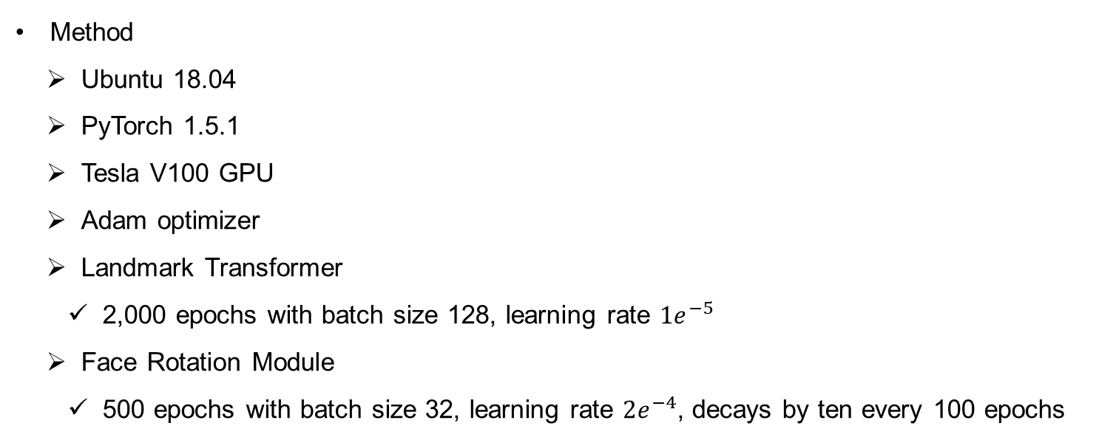
Experiments
Implementation Details
Method
Ubuntu 18.04
PyTorch 1.5.1
Tesla V100 GPU
Adam optimizer
Landmark Transformer
2,000 epochs with batch size 128, learning rate $1e^{−5}$
Face Rotation Module
500 epochs with batch size 32, learning rate $2e^{−4}$, decays by ten every 100 epochs

Slide 21
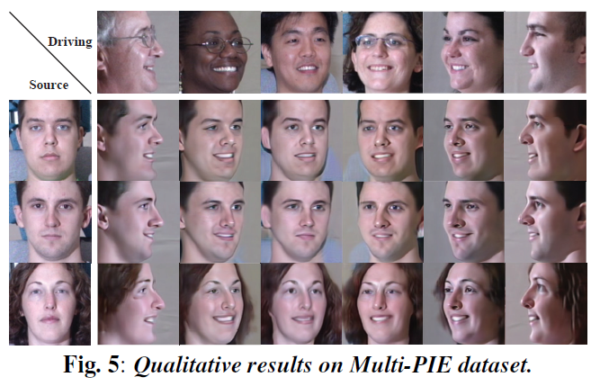
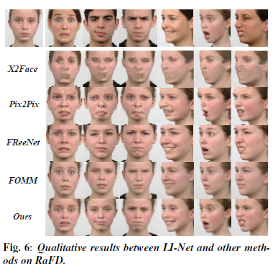
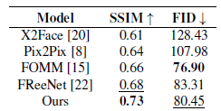
Experiments
Experimental Results

Slide 22

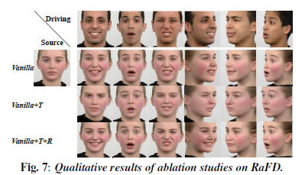
Experiments
Experimental Results
Vanilla
It treat the entire process as image to image translation task
Only utilize the expression enhancing generator G
Vanilla + T
Based on Vanilla, add the landmark transformer
Vanilla + T + R
Their full proposed method (LI-Net)

