Slide 1
Style Separation and Synthesis via Generative Adversarial Networks (ACM 2018)
Jongwook Si (M. S Course)
2021.05.27

Slide 2
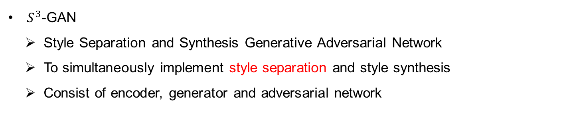
Abstract
overview
$S^{3}$-GAN
Style Separation and Synthesis Generative Adversarial Network
To simultaneously implement style separation and style synthesis
Consist of encoder, generator and adversarial network

Slide 3
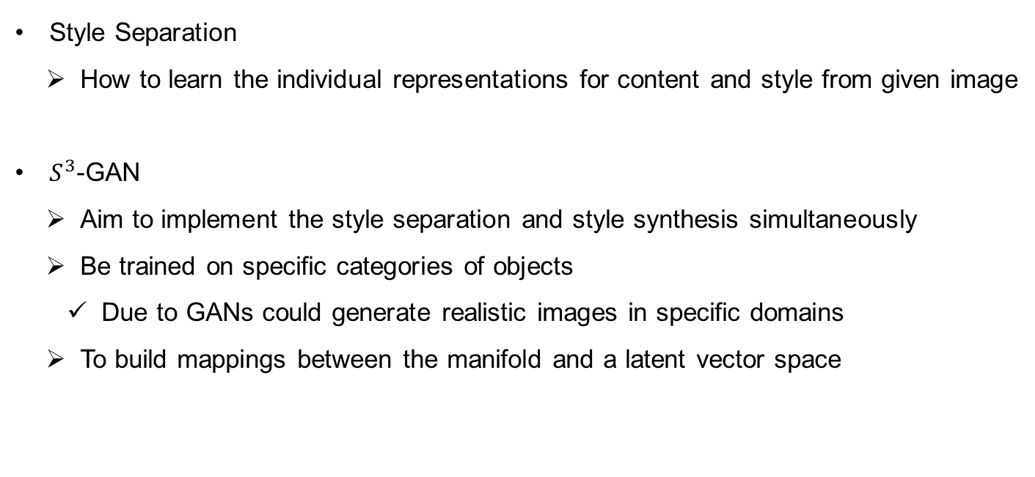
Introduction
overview
Style Separation
How to learn the individual representations for content and style from given image
$S^{3}$-GAN
Aim to implement the style separation and style synthesis simultaneously
Be trained on specific categories of objects
Due to GANs could generate realistic images in specific domains
To build mappings between the manifold and a latent vector space

Slide 4
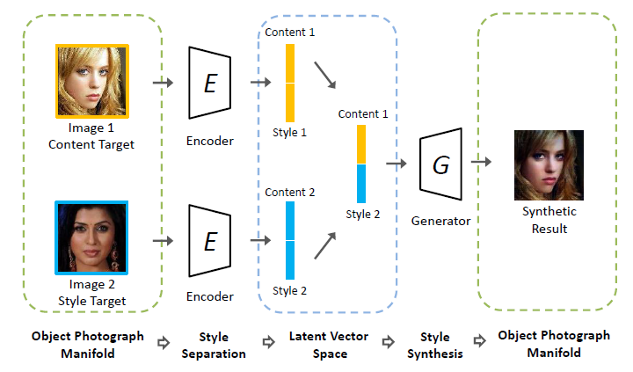
Introduction
overview
Latent Vector Space
Half of the latent vector : Style
Other latent vector : Content
Generate from the concatenated vector has the similar style to the style target image while preserving the content of the content target image

Slide 5
Introduction
overview
The main contributions
Propose a novel framework for style separation and synthesis
Extensive experiment on photographs demonstrate the effectiveness
Faces and shoes
Perform style separation with an encoder
Perform style synthesis with a generator

Slide 6
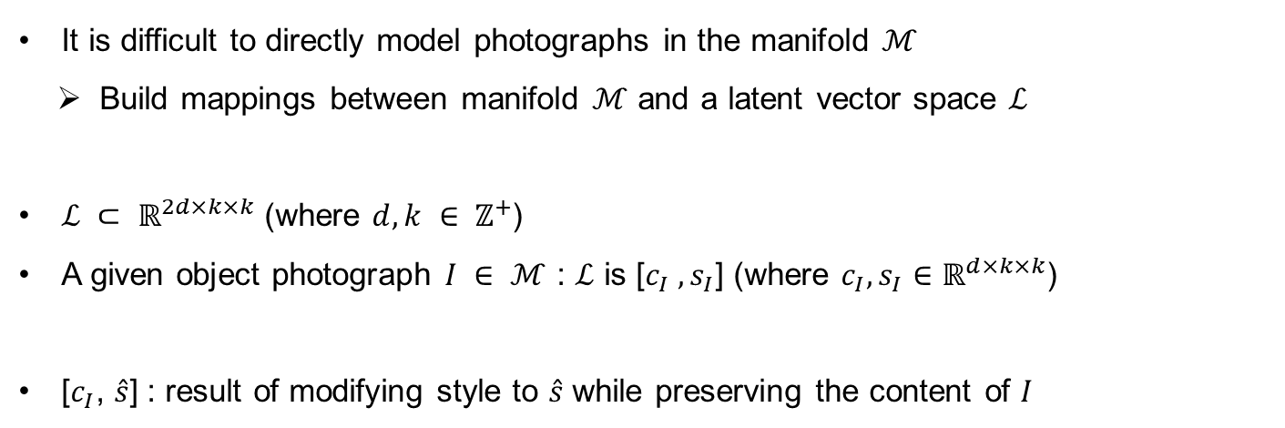
Proposed Approaches
Formulation
It is difficult to directly model photographs in the manifold $ℳ$
Build mappings between manifold $ℳ$ and a latent vector space $ℒ$
$ℒ ⊂ ℝ^{2d×k×k}$ (where $d, k ∈ ℤ^{+}$)
A given object photograph $I ∈ ℳ$ : $ℒ$ is [$c_{I} , s_{I}$] (where $c_{I}, s_{I}∈ℝ^{d×k×k}$)
[$c_{I}$, $\hat{s}$] : result of modifying style to $\hat{s}$ while preserving the content of $I$

Slide 7
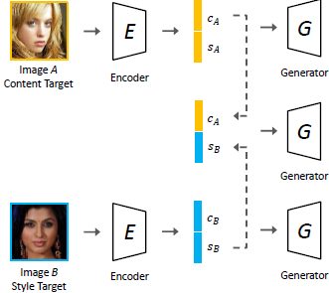
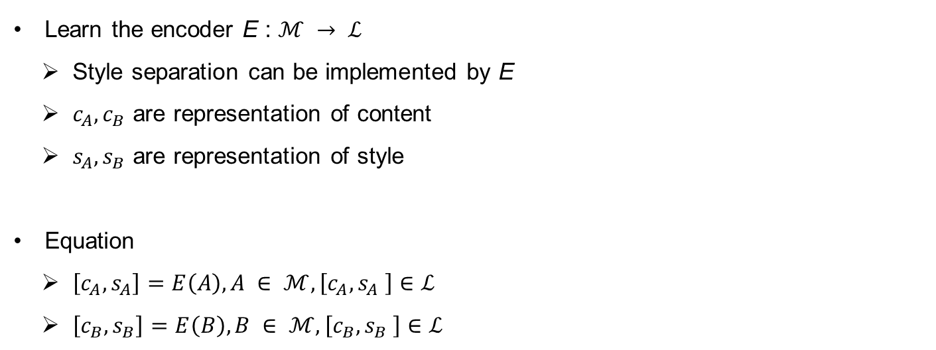
Proposed Approaches
Architecture
Learn the encoder E : $ℳ → ℒ$
Style separation can be implemented by E
$c_{A}, c_{B}$ are representation of content
$s_{A}, s_{B}$ are representation of style
Equation
$\left[c_{A}, s_{A}\right]=E\left(A\right), A ∈ ℳ, \left[c_{A}, s_{A} \right]∈ℒ$
$\left[c_{B}, s_{B}\right]=E\left(B\right), B ∈ ℳ, \left[c_{B}, s_{B} \right]∈ℒ$

Slide 8
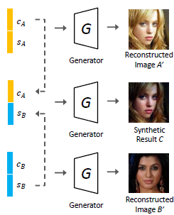
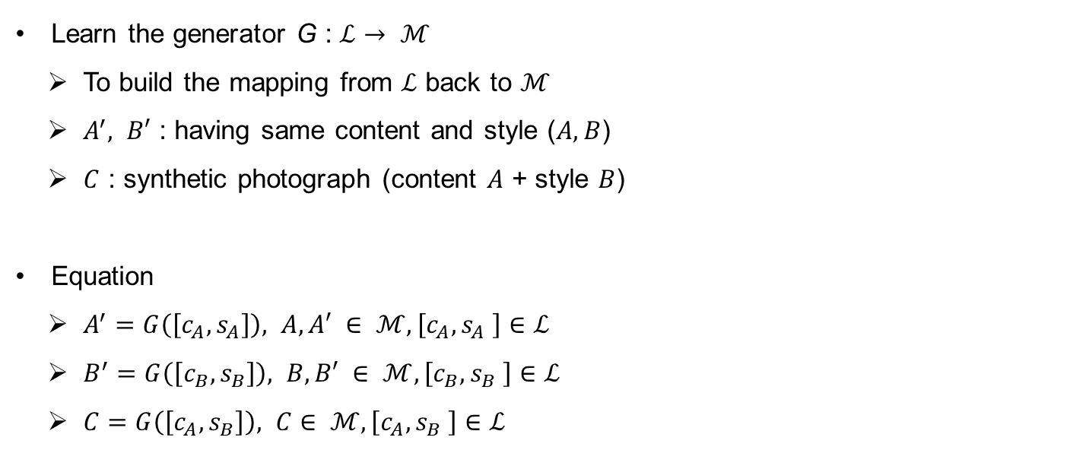
Proposed Approaches
Architecture
Learn the generator G : $ℒ→ ℳ$
To build the mapping from $ℒ$ back to $ℳ$
$A^{′}, B′$ : having same content and style ($A, B$)
$C$ : synthetic photograph (content $A$ + style $B$)
Equation
$A^{′}=G\left(\left[c_{A}, s_{A}\right]\right), A,A′ ∈ ℳ, \left[c_{A}, s_{A} \right]∈ℒ$
$B^{′}=G\left(\left[c_{B}, s_{B}\right]\right), B,B′ ∈ ℳ, \left[c_{B}, s_{B} \right]∈ℒ$
$C=G\left(\left[c_{A}, s_{B}\right]\right), C∈ ℳ, \left[c_{A}, s_{B} \right]∈ℒ$

Slide 9
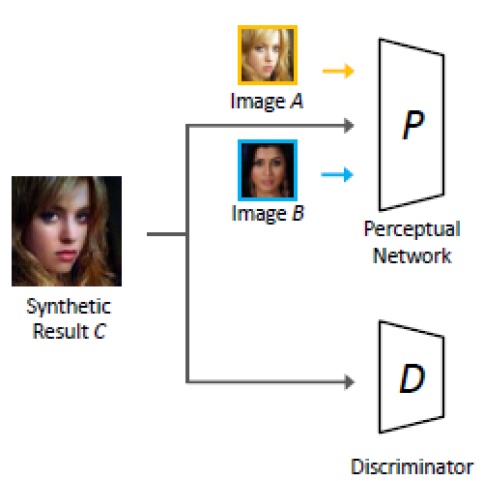
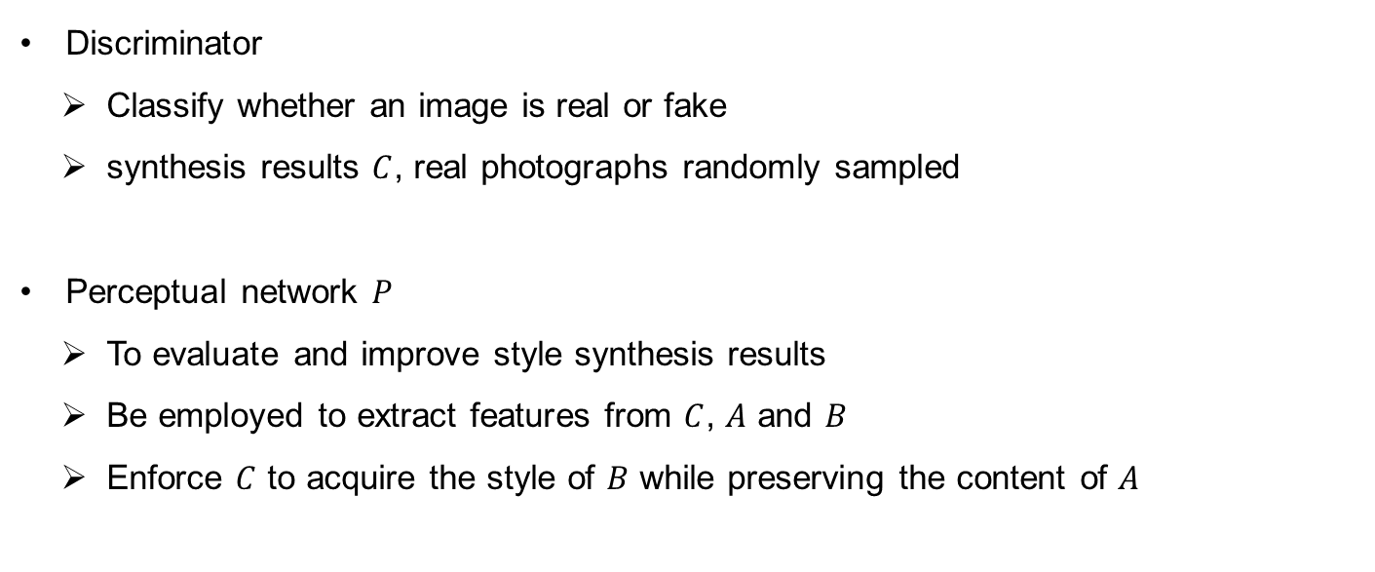
Proposed Approaches
Architecture
Discriminator
Classify whether an image is real or fake
synthesis results $C$, real photographs randomly sampled
Perceptual network $P$
To evaluate and improve style synthesis results
Be employed to extract features from $C$, $A$ and $B$
Enforce $C$ to acquire the style of $B$ while preserving the content of $A$

Slide 10
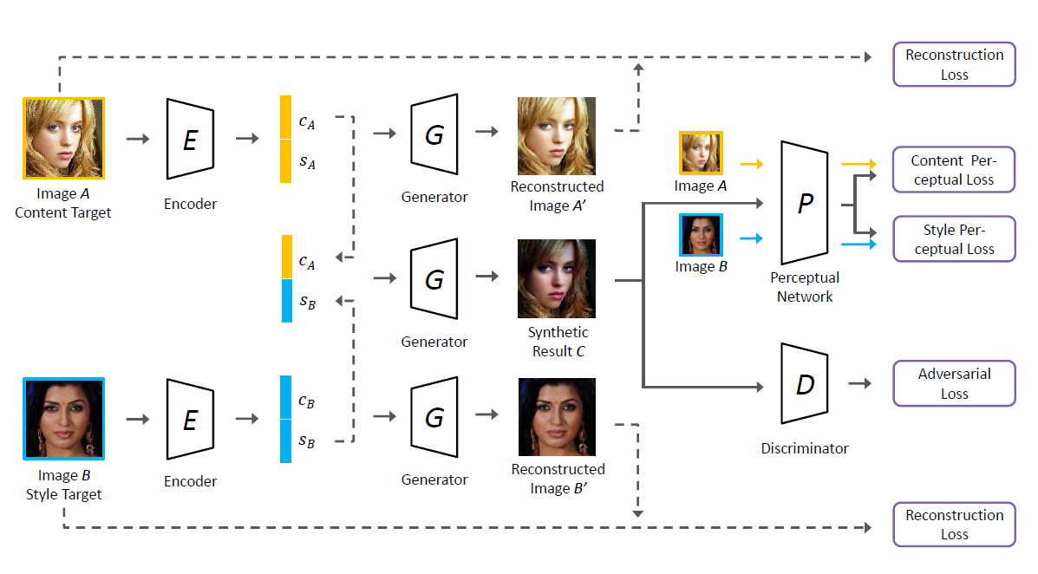
Proposed Approaches
Architecture

Slide 11
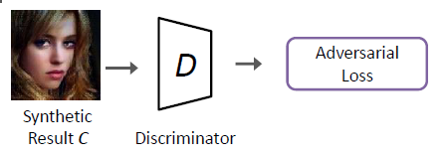
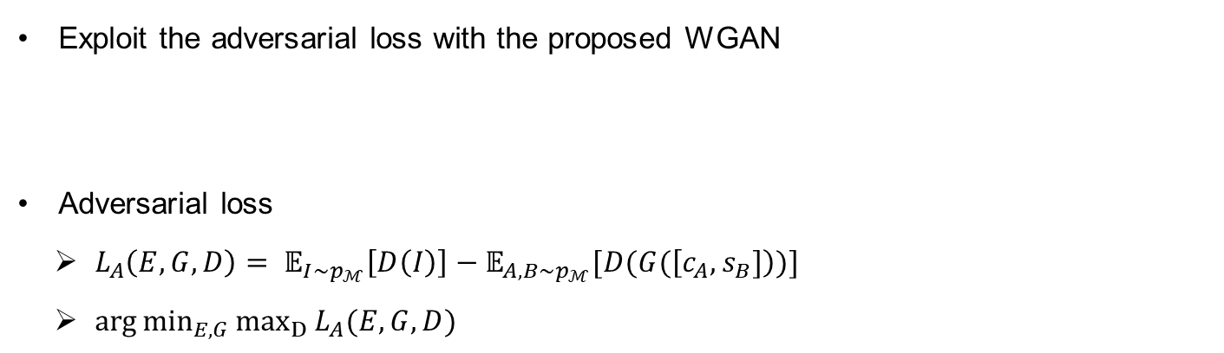
Loss function
Adversarial Loss
Exploit the adversarial loss with the proposed WGAN
Adversarial loss
$L_{A}\left(E,G,D\right)= 𝔼_{I\sim p_{ℳ}}\left[D\left(I\right)\right]−𝔼_{A,B\sim p_{ℳ}}[D(G(\left[c_{A}, s_{B}]\right))]$
$\arg{\min_{E,G}{\max_{D}{L_{A}(E, G, D)}}}$

Slide 12
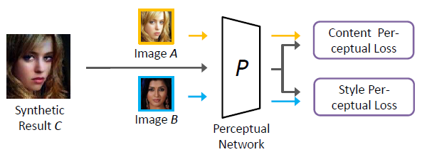
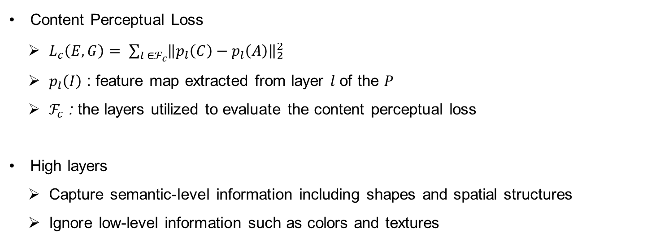
Loss function
Content Perceptual Loss
Content Perceptual Loss
$L_{c}\left(E, G\right)= \sum_{l ∈ℱ_{c}}{{\left\|p_{l}\left(C\right)−p_{l}\left(A\right)\right\|}_{2}^{2}}$
$p_{l}\left(I\right)$ : feature map extracted from layer $l$ of the $P$
$ℱ_{c}$ : the layers utilized to evaluate the content perceptual loss
High layers
Capture semantic-level information including shapes and spatial structures
Ignore low-level information such as colors and textures

Slide 13
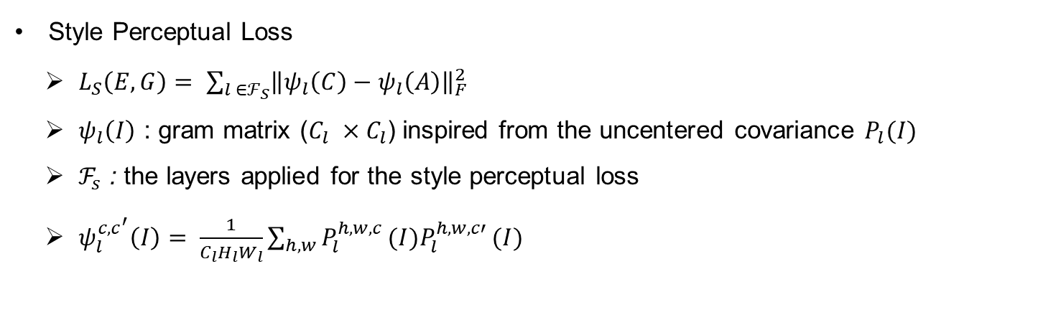
Loss function
Style Perceptual Loss
Style Perceptual Loss
$L_{S}\left(E, G\right)= \sum_{l ∈ℱ_{S}}{{\left\|ψ_{l}\left(C\right)−ψ_{l}\left(A\right)\right\|}_{F}^{2}}$
$ψ_{l}\left(I\right)$ : gram matrix ($C_{l} ×C_{l}$) inspired from the uncentered covariance $P_{l}(I)$
$ℱ_{s}$ : the layers applied for the style perceptual loss
$ψ_{l}^{c,c^{′}}\left(I\right)= \frac{1}{C_{l}H_{l}W_{l}}\sum_{h,w}{P_{l}^{h, w, c }(I)P_{l}^{h, w, c′ }(I)}$

Slide 14
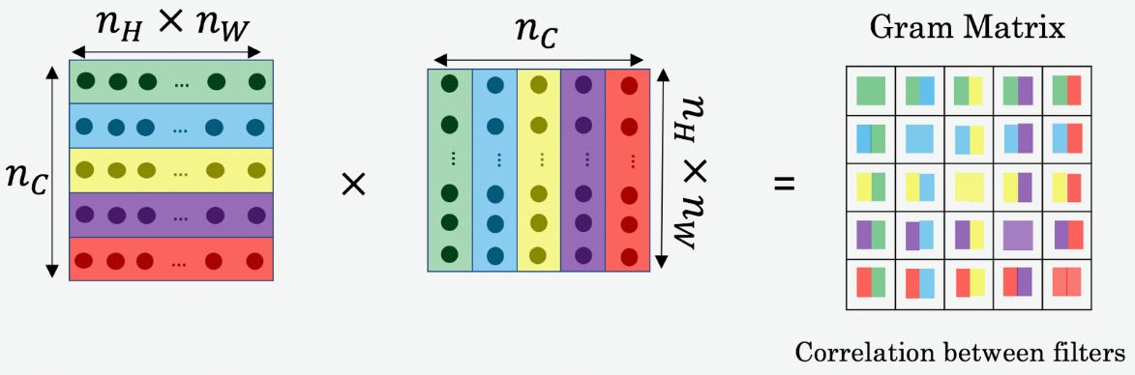
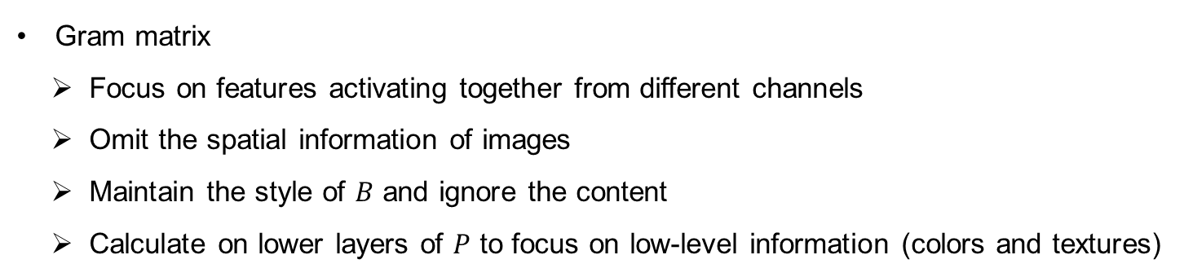
Loss function
Style Perceptual Loss
Gram matrix
Focus on features activating together from different channels
Omit the spatial information of images
Maintain the style of $B$ and ignore the content
Calculate on lower layers of $P$ to focus on low-level information (colors and textures)

Slide 15
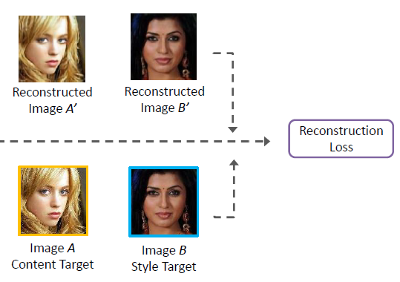
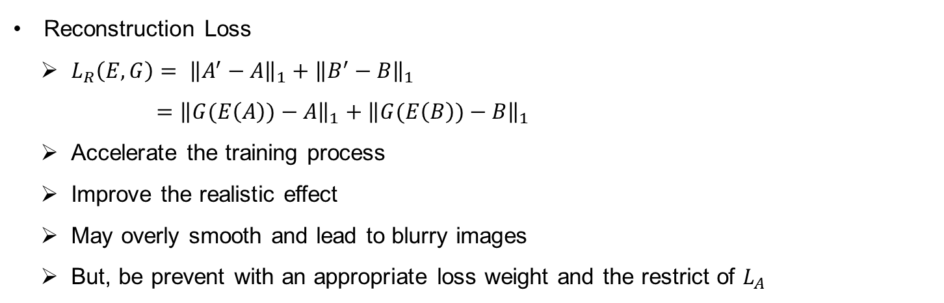
Loss function
Style Perceptual Loss
Reconstruction Loss
$L_{R}\left(E, G\right)= {\left\|A^{′}−A\right\|}_{1}+{\left\|B^{′}−B\right\|}_{1}$
$={\left\|G(E\left(A\right))−A\right\|}_{1}+{\left\|G(E\left(B\right))−B\right\|}_{1}$
Accelerate the training process
Improve the realistic effect
May overly smooth and lead to blurry images
But, be prevent with an appropriate loss weight and the restrict of $L_{A}$

Slide 16
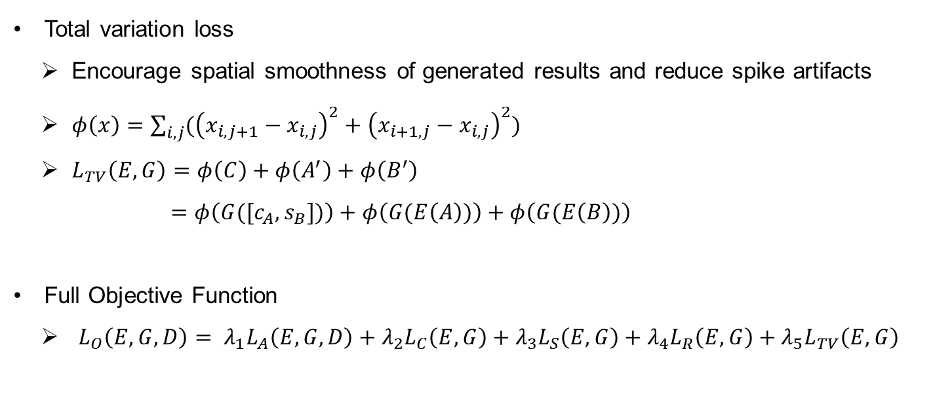
Loss function
Total Variation Loss and Full Objective Function
Total variation loss
Encourage spatial smoothness of generated results and reduce spike artifacts
$φ\left(x\right)=\sum_{i,j}{({\left(x_{i,j+1}−x_{i,j}\right)}^{2}+{\left(x_{i+1,j}−x_{i,j}\right)}^{2})}$
$L_{TV}\left(E,G\right)=φ\left(C\right)+φ\left(A^{′}\right)+φ\left(B^{′}\right)$
$=φ\left(G([c_{A},s_{B}])\right)+φ\left(G(E\left(A\right))\right)+φ\left(G(E\left(B\right))\right)$
Full Objective Function
$L_{O}\left(E,G,D\right)= λ_{1}L_{A}\left(E,G,D\right)+λ_{2}L_{C}\left(E,G\right)+λ_{3}L_{S}\left(E,G\right)+λ_{4}L_{R}\left(E,G\right)+λ_{5}L_{TV}\left(E,G\right)$

Slide 17
Experiments
Experimental Settings
Perform experiments on object photographs of two specific categories
Faces : from CelebA datatset
Shoes : from UT Zappos50K dataset
CelebA dataset
Consists of more than 200K celebrity images of 10K identities
Crop 128x128
Randomly select 2K images : testing / the rest images : training samples

Slide 18
Experiments
Experimental Settings
UT Zappos50K Dataset
Be collected from the online shopping website Zappos.com
Contain 50K catalog shoe images, blank background
The images are scaled to 128x128
48K training / 2K testing

Slide 19
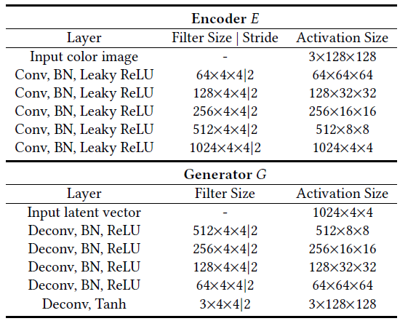
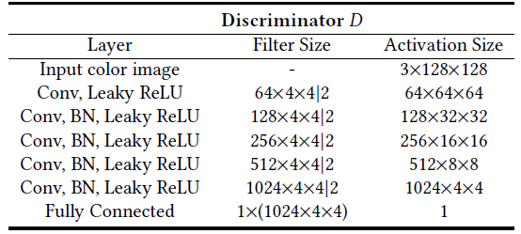
Experiments
Implementation Details

Slide 20
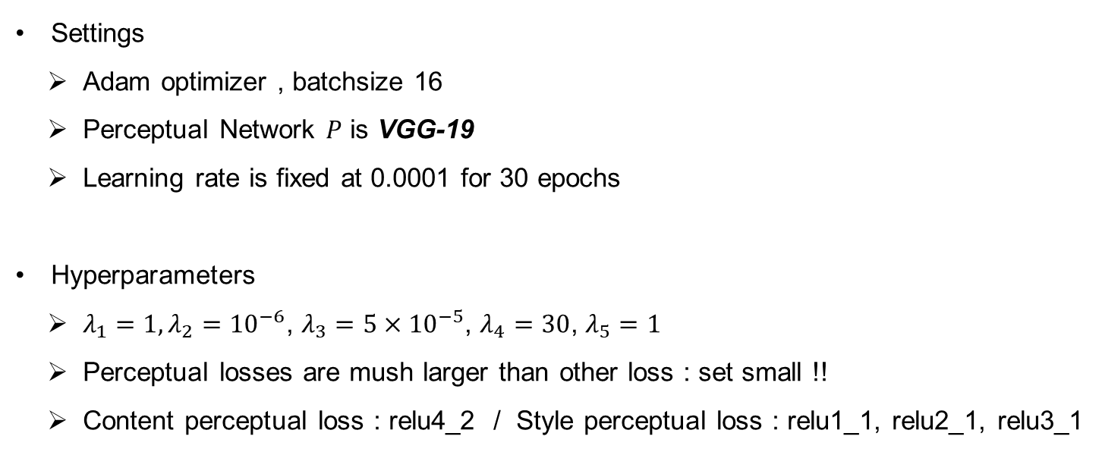
Experiments
Implementation Details
Settings
Adam optimizer , batchsize 16
Perceptual Network $P$ is VGG-19
Learning rate is fixed at 0.0001 for 30 epochs
Hyperparameters
$λ_{1}=1, λ_{2}={10}^{−6}$, $λ_{3}=5×{10}^{−5}$, $λ_{4}=30$, $λ_{5}=1$
Perceptual losses are mush larger than other loss : set small !!
Content perceptual loss : relu4_2 / Style perceptual loss : relu1_1, relu2_1, relu3_1

Slide 21
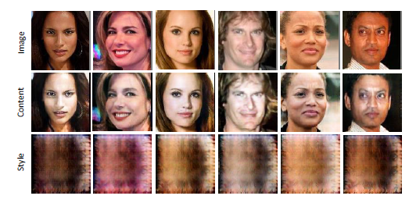
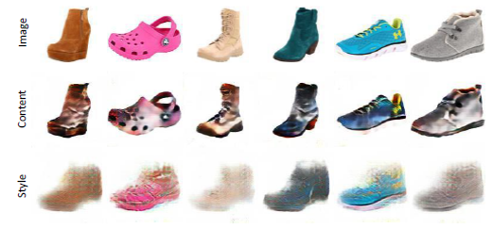
Experiments
Results and Comparisons
Visualization
Preserve the half vector of content or style
Simply fill the other half vector with zero
Content: Preserve the structure, Abandon color
Style: Maintain the color, Ignore structure

Slide 22
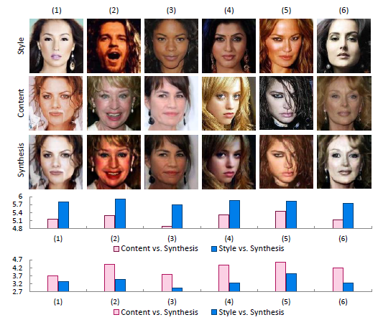
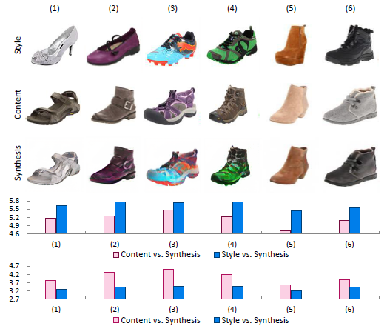
Experiments
Results and Comparisons

Slide 23
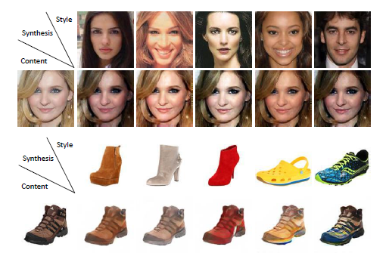
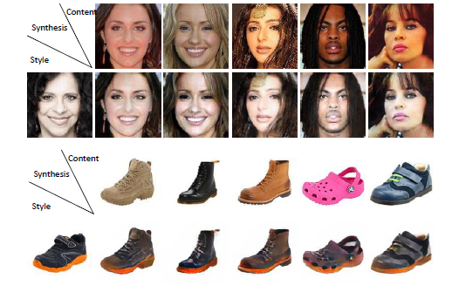
Experiments
Results and Comparisons

Slide 24
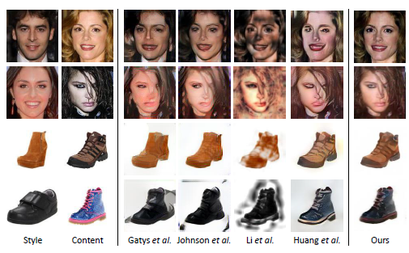
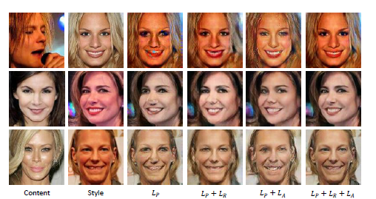
Experiments
Results and Comparisons

Slide 25
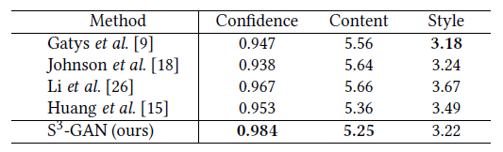
Experiments
Results and Comparisons
Comparison
Confidence : average confidence core of face detection (MTCNN)
Content: average logarithms of content perceptual distances
Style: average logarithms of style perceptual distances

