Slide 1
Detail-Preserving Arbitrary Style Transfer
(IEEE ICME 2020)
Ting Zhu, Shiguang Liu
Jongwook Si (M.S Course)
2021.06.18

Slide 2
Abstract
overview
Present Detail-preserving arbitrary style transfer network
Can suppress structural distortion and preserve semantic content
Propose Refine network
Spatially match the hierarchical structure
Preserve style pattern
Introduce global, local, style loss

Slide 3
Introduction
Approach and Model
To solve the problem, propose effective arbitrary style transfer approach
Limited flexibility
Over-dependence on a deep map
Imbalanced of the global and local content structure
Model
Preserve more details of the content image
Make the stylized image strong hierarchical effect (to avoid distortion)

Slide 4
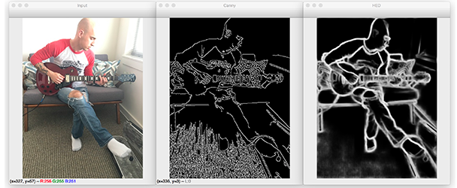
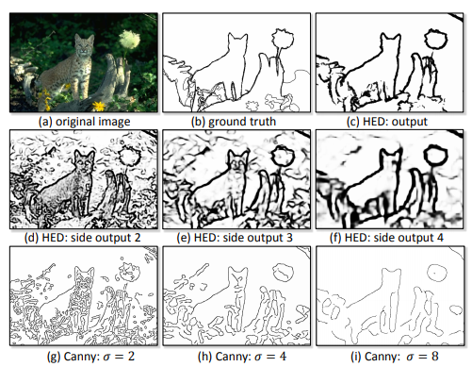
Introduction
HED
Holistically-nested edge detection (HED)
Solve the problem
Holistic image training
Multi-scale feature learning
Improve the style transfer (high-quality)
More edge
Boundary information
Call it refine network (optimized network)

Slide 5
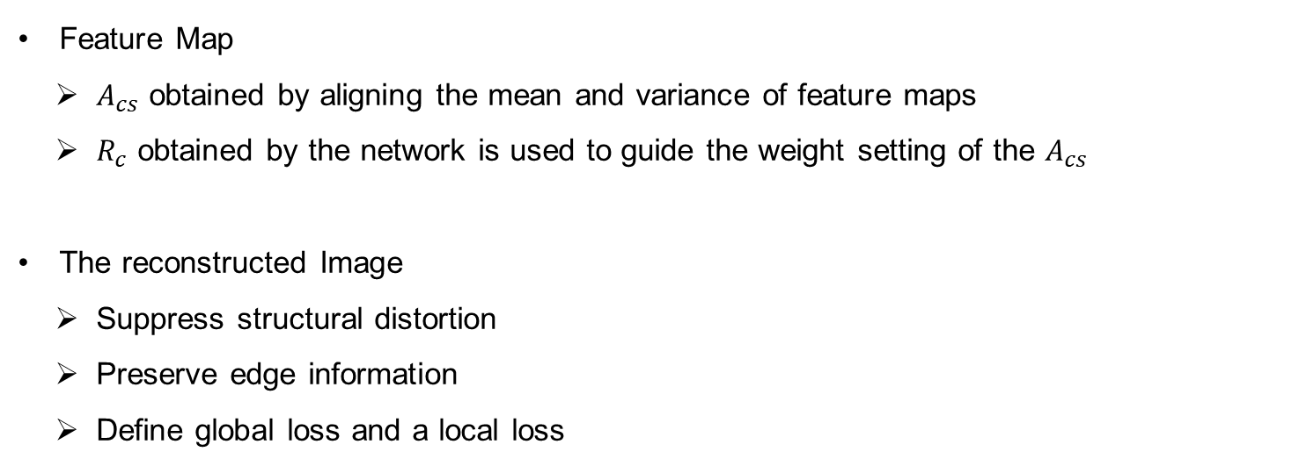
Introduction
Feature Map and Reconstructed Image
Feature Map
$A_{cs}$ obtained by aligning the mean and variance of feature maps
$R_{c}$ obtained by the network is used to guide the weight setting of the $A_{cs}$
The reconstructed Image
Suppress structural distortion
Preserve edge information
Define global loss and a local loss

Slide 6
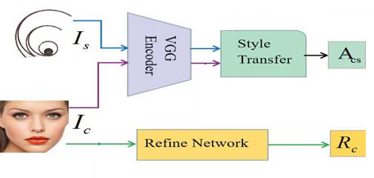
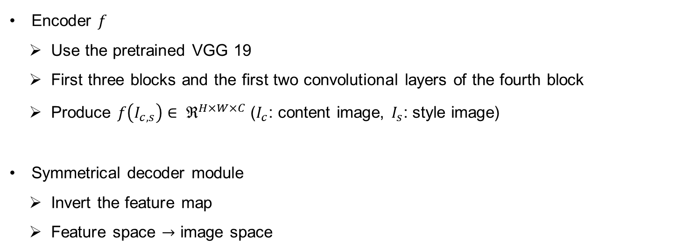
Proposed Method
Transform network
Encoder $f$
Use the pretrained VGG 19
First three blocks and the first two convolutional layers of the fourth block
Produce $f\left(I_{c,s}\right)∈ ℜ^{H×W×C}$ ($I_{c}$: content image, $I_{s}$: style image)
Symmetrical decoder module
Invert the feature map
Feature space $→$ image space

Slide 7
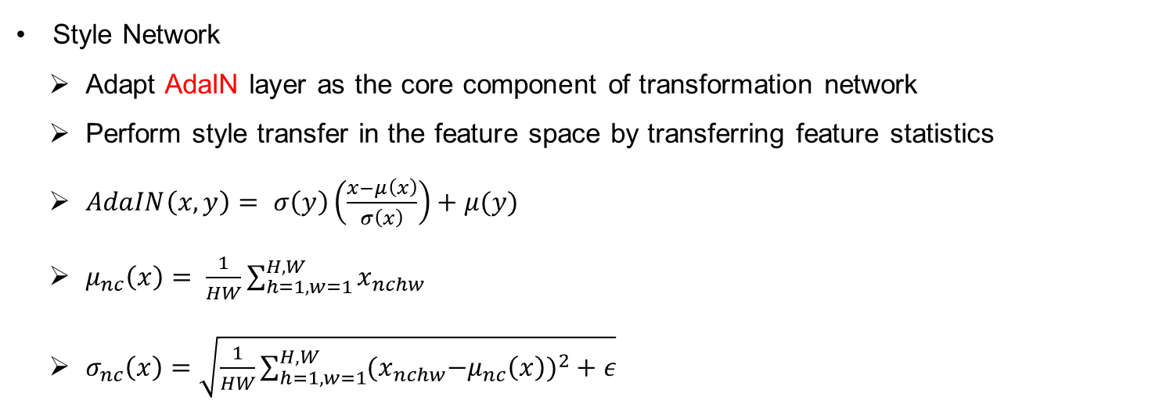
Proposed Method
Style Network
Style Network
Adapt AdaIN layer as the core component of transformation network
Perform style transfer in the feature space by transferring feature statistics
$AdaIN\left(x,y\right)= σ\left(y\right)\left(\frac{x−μ\left(x\right)}{σ\left(x\right)}\right)+μ(y)$
$μ_{nc}\left(x\right)= \frac{1}{HW}\sum_{h=1,w=1}^{H,W}{x_{nchw}}$
$σ_{nc}\left(x\right)=\sqrt{\frac{1}{HW}\sum_{h=1,w=1}^{H,W}{{(x}_{nchw}−μ_{nc}{\left(x\right))}^{2}+ε}}$

Slide 8
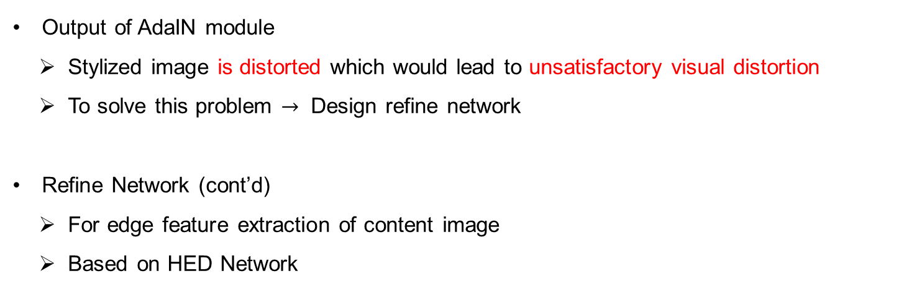
Proposed Method
Refine Network
Output of AdaIN module
Stylized image is distorted which would lead to unsatisfactory visual distortion
To solve this problem $→$ Design refine network
Refine Network (cont’d)
For edge feature extraction of content image
Based on HED Network

Slide 9
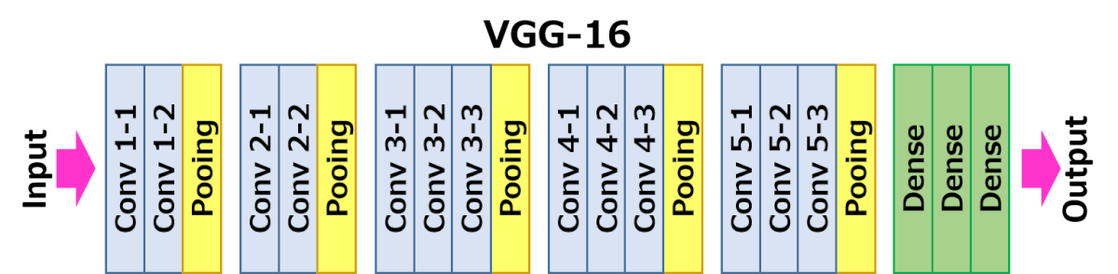
Proposed Method
Refine Network
Refine Network (cont’d)
Be modified to VGG-16
The last stage of VGG-16 is removed
5th pooling layer
All the fully connected layer
Because of long computation time
Removed 3~4th pooling layer

Slide 10
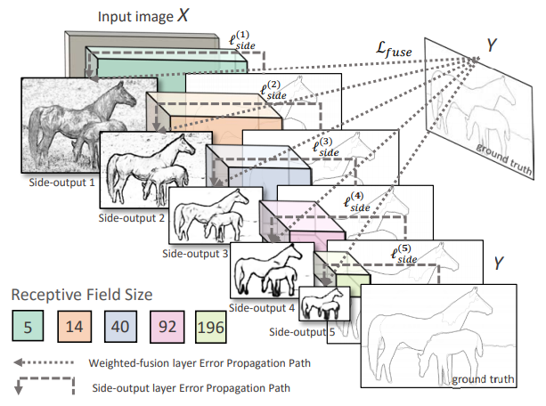
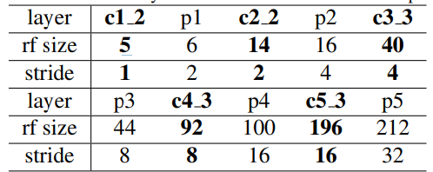
Proposed Method
Refine Network
Refine Network
Connect side output layer to last conv. Layer
in each stage
Size of each Conv. Layer is identical

Slide 11
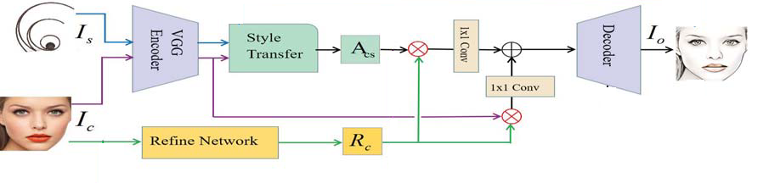
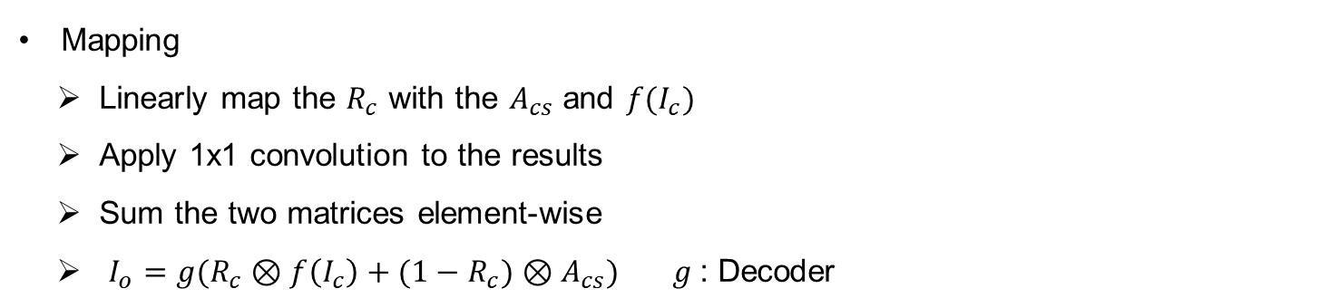
Proposed Method
Mapping
Mapping
Linearly map the $R_{c}$ with the $A_{cs}$ and $f(I_{c})$
Apply 1x1 convolution to the results
Sum the two matrices element-wise
$I_{o}=g(R_{c}⊗f\left(I_{c}\right)+(1−R_{c})⊗A_{cs})$ $g$: Decoder

Slide 12
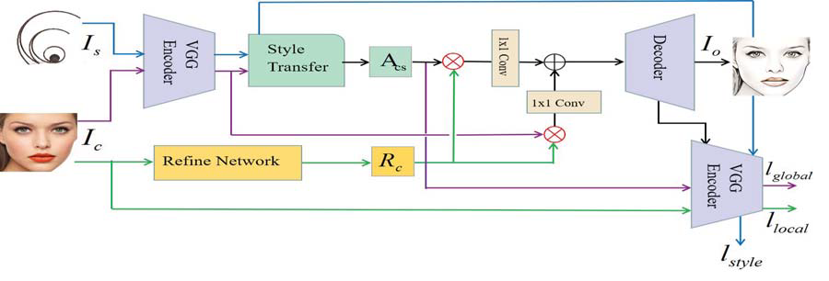
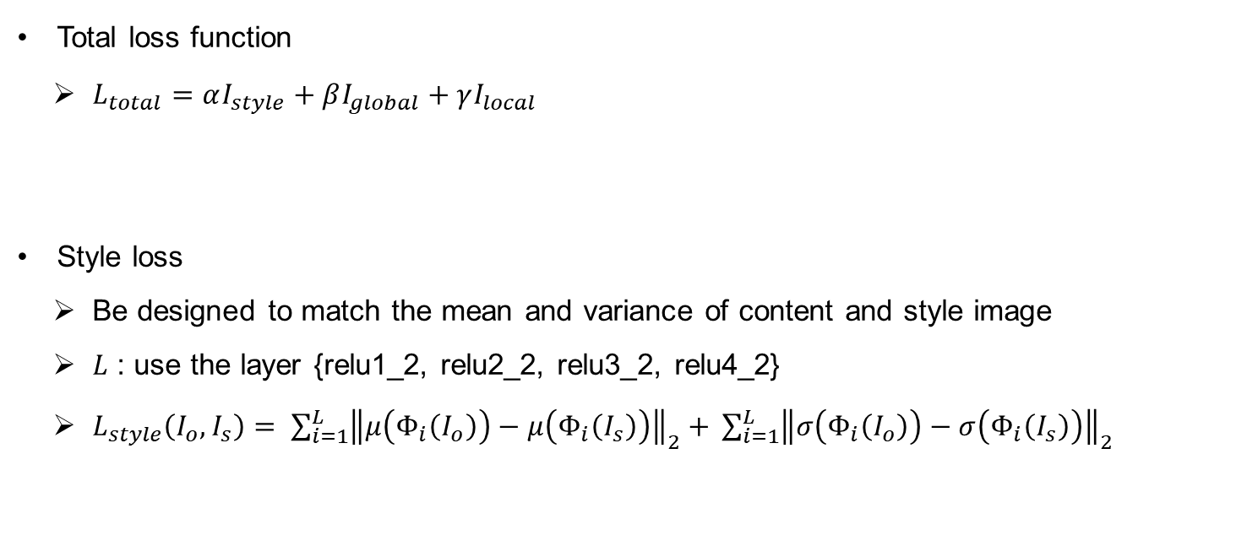
Proposed Method
Loss function
Total loss function
$L_{total}=αI_{style}+βI_{global}+γI_{local}$
Style loss
Be designed to match the mean and variance of content and style image
$L$ : use the layer {relu1_2, relu2_2, relu3_2, relu4_2}
$L_{style}\left(I_{o},I_{s}\right)= \sum_{i=1}^{L}{{\left\|μ\left(Φ_{i}\left(I_{o}\right)\right)−μ\left(Φ_{i}\left(I_{s}\right)\right)\right\|}_{2}+ }\sum_{i=1}^{L}{{\left\|σ\left(Φ_{i}\left(I_{o}\right)\right)−σ\left(Φ_{i}\left(I_{s}\right)\right)\right\|}_{2}}$

Slide 13
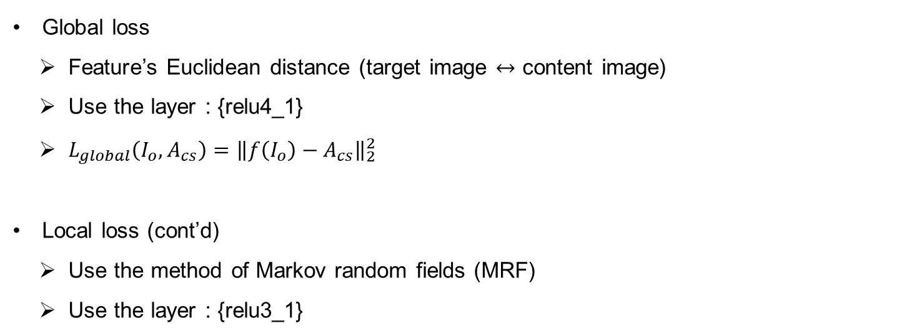
Proposed Method
Loss function
Global loss
Feature’s Euclidean distance (target image $↔$ content image)
Use the layer : {relu4_1}
$L_{global}\left(I_{o},A_{cs}\right)={\left\|f\left(I_{o}\right)−A_{cs}\right\|}_{2}^{2}$
Local loss (cont’d)
Use the method of Markov random fields (MRF)
Use the layer : {relu3_1}

Slide 14
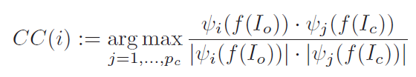
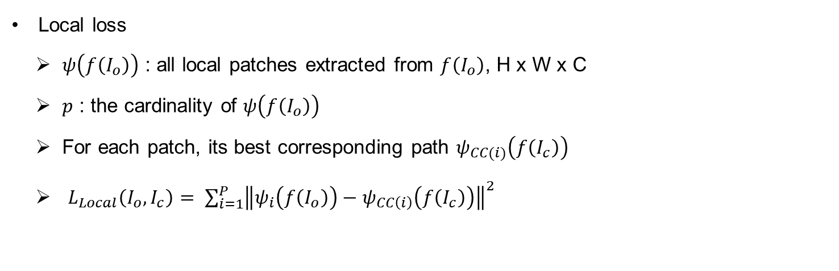
Proposed Method
Loss function
Local loss
$ψ\left(f\left(I_{o}\right)\right)$ : all local patches extracted from $f\left(I_{o}\right)$, H x W x C
$p$ : the cardinality of $ψ\left(f\left(I_{o}\right)\right)$
For each patch, its best corresponding path $ψ_{CC(i)}\left(f\left(I_{c}\right)\right)$
$L_{Local}\left(I_{o},I_{c}\right)= \sum_{i=1}^{P}{{{\left\|ψ_{i}\left(f\left(I_{o}\right)\right)−ψ_{CC\left(i\right)}\left(f\left(I_{c}\right)\right)\right\|}^{2}}_{ }}$

Slide 15
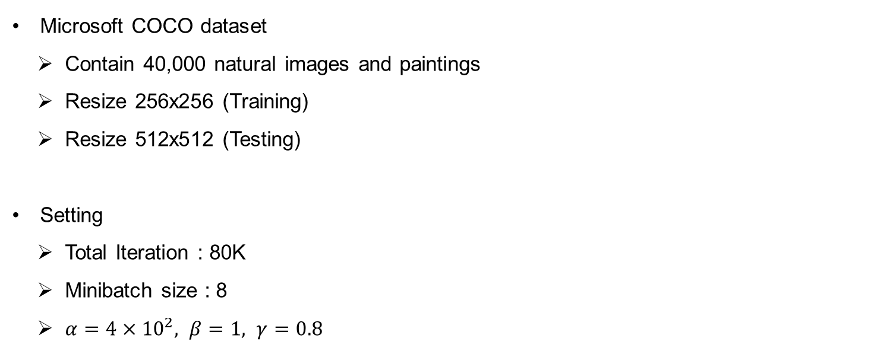
Experiments
Implementation details
Microsoft COCO dataset
Contain 40,000 natural images and paintings
Resize 256x256 (Training)
Resize 512x512 (Testing)
Setting
Total Iteration : 80K
Minibatch size : 8
$α=4×{10}^{2}, β=1, γ=0.8$

Slide 16
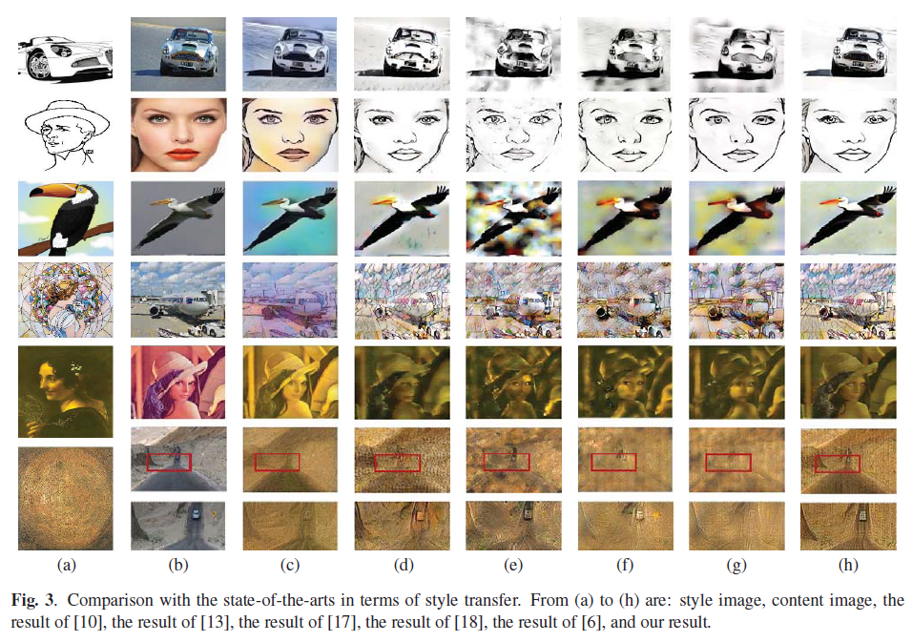
Experiments
Performance analysis – Qualitative comparison
Qualitative comparison
Style Image (a)
Content Image (b)
Previous Research
(c ~ g), [10,13,17,18,6]
Proposed Method (h)

Slide 17
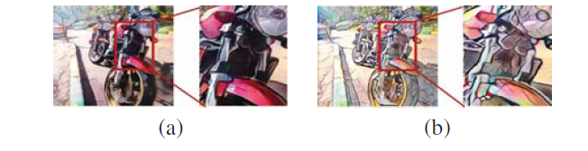
Experiments
Performance analysis – Qualitative comparison
Comparison with the method of depth-preserving
Previous Research (a) : [4]
Proposed method (b)

Slide 18
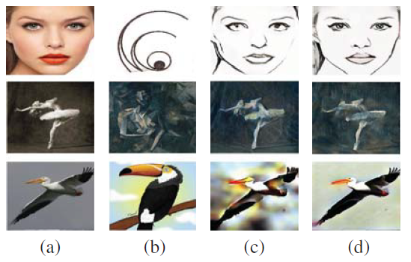
Experiments
Performance analysis – Qualitative comparison
Comparison with the GAN-based method
Style Image (a)
Content Image (b)
Previous Seminar (c)_20210618
Proposed Method (d)

Slide 19
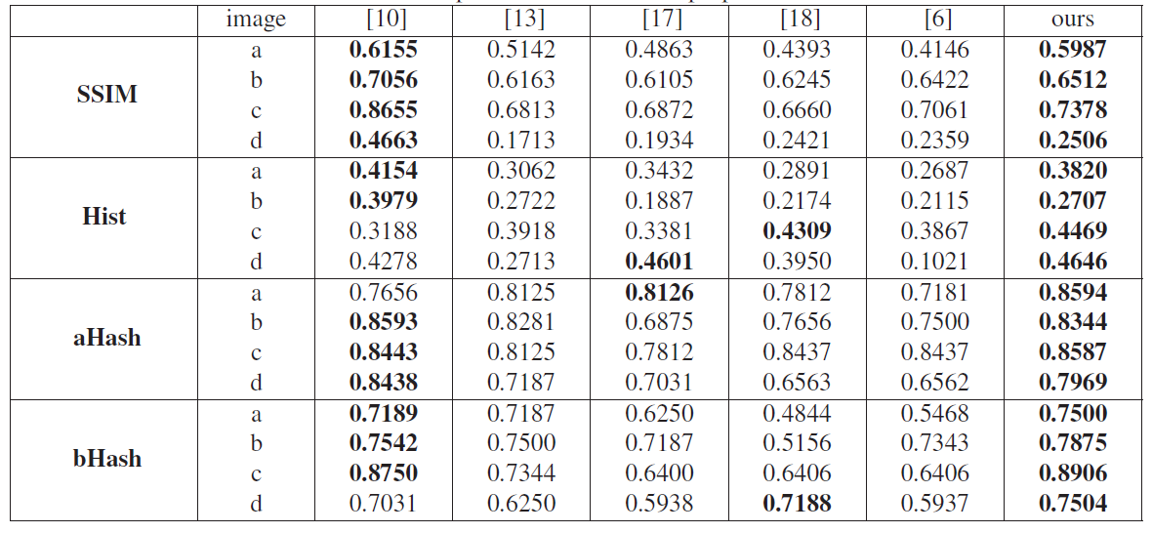
Experiments
Performance analysis – Quantitative comparison
Evaluation results of the compared method and proposed method
Structural similarity (SSIM)
Correlation of hist (Hist)
Average hash (aHash)
Difference hash (dHash)
Image (pp.16 Figure)
a ~ c : First three row
d : Last row
Nearly preserve the structure consistency, values are close to 1

Slide 20
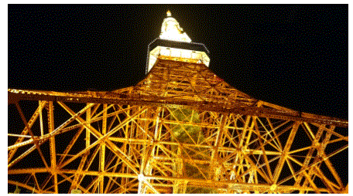
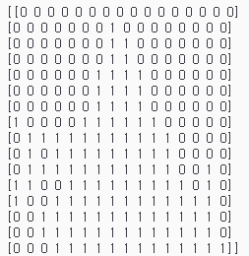
Experiments
Performance analysis – Quantitative comparison
Average Hash
Reduce the image size to 8 x 8 (or 16x16)
Convert color to grayscale
Calculate the average of each pixel in the image
If each pixel is higher than average : 1
Else : 0

