Slide 1
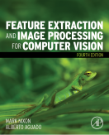
Lecture 3 Image Sampling
COMP3204 Computer Vision
How is an image sampled and what does it imply?
 | Book pp 36-56

Slide 2
Content
How does the discrete Fourier transform work, and help?
What can go wrong with sampling?

Slide 3


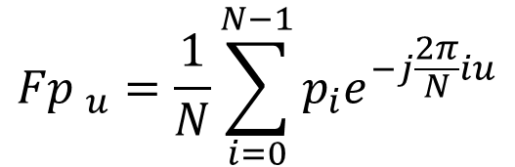
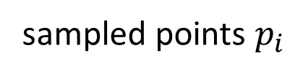

1D Discrete Fourier transfrom
$\text{Discrete} \text{Fourier} \text{calculates} \text{frequency}$ from data points
$${Fp }_{u}=\frac{1}{N}\sum_{i=0}^{N−1}{p_{i}e^{−j\frac{2π}{N}iu}}$$
Comparison
$$\text{sampled} \text{frequency} {Fp}_{u}$$
sampled points $p_{i}$
N points
$$e^{−jθ}=\cos{θ}−j\sin{θ}$$

Slide 4

Transform Pair for Sampled Pulse
Discrete Fourier transform
(a) sampled pulse | (b) DFT of sampled pulse
Inverse Discrete Fourier transform

Slide 5
(a) original sampled signal
(d) adding Fp₁ and Fp₀
(b) first coefficient Fp₀
(e) adding Fp₀, Fp₁ , Fp₂ and Fp₃
(c) second coefficient Fp₁
(f) adding all six frequency components
signal reconstruction from its transform components

Slide 6
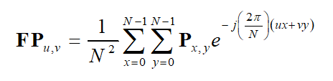

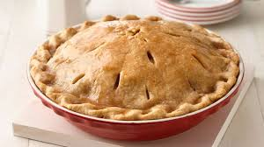
2D Fourier transform
Forward transform
where two dimensions of space, x and y
two dimensions of frequency, u and v
image NxN pixels P_{x,y}
Inverse transform
π??

Slide 7
Reconstruction

Slide 8
Implementation is via (Fast) FFT
while L<cols %iterate until log2(cols)-1 levels have been performed
for j=1:2*L:cols %do all the points in L/2 batches
for i=1:L %now do L butterflies
upp(((j+1)/2)+i-1)= Fp(j+i-1)+Fp(j+L+i-1)*exp(-1j*2*pi*(i-1)/(L*2));
low(((j+1)/2)+i-1)= Fp(j+i-1)-Fp(j+L+i-1)*exp(-1j*2*pi*(i-1)/(L*2));
end
end
for j=1:2*L:cols %copy the components across, to the right places
for i=1:L
Fp(j+i-1)=upp(((j+1)/2)+i-1);
Fp(j+L+i-1)=low(((j+1)/2)+i-1);
end
end
L=L*2; %and go and do the next level (up)
end
(this is a 1-D FFT)

Slide 9
Shift invariance

Slide 10
Rotation

Slide 11
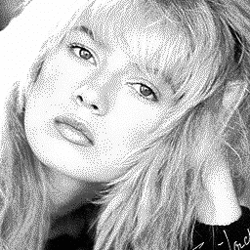
Filtering
Fourier gives access to frequency components

Slide 12
Applications of 2D FT
Understanding and analysis
Speeding up algorithms
Representation (invariance)
Coding
Recognition/ understanding (e.g. texture)

Slide 13
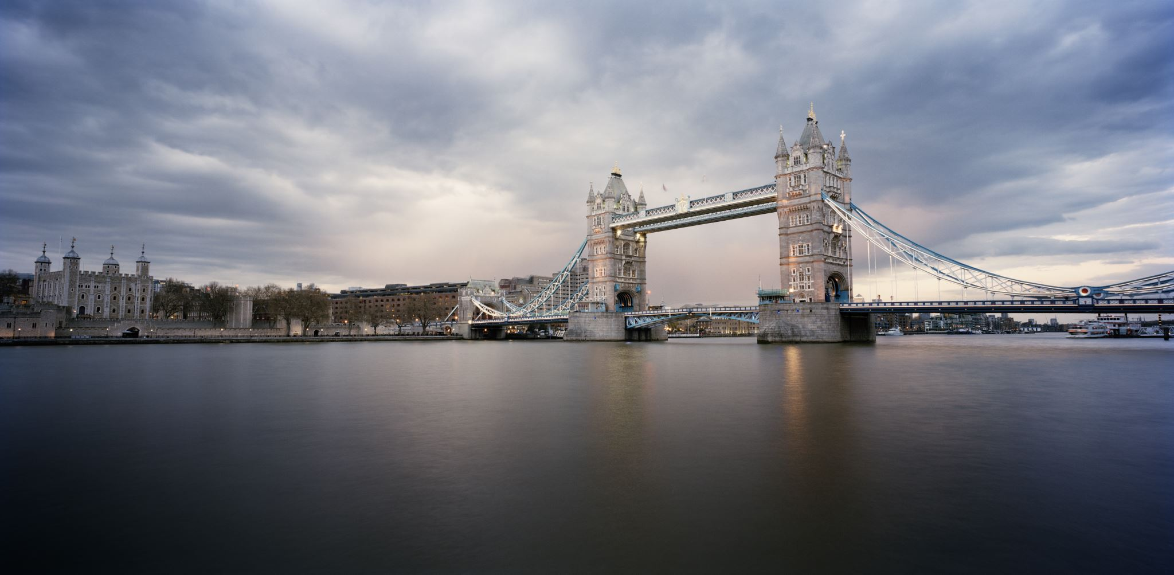
Sampling Signals
original continuous signal
good bad
sampling sampling
(aliased)

Slide 14
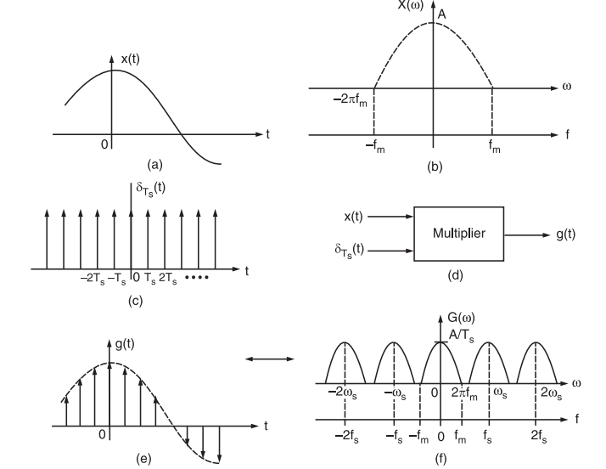
https://electronicspost.com/sampling-theorem/

Slide 15
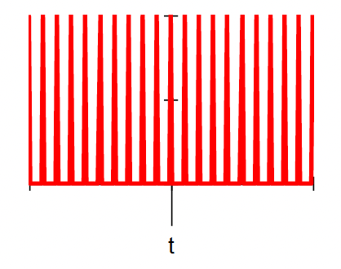
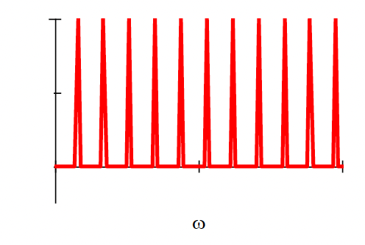
Sampling function
Sampling function in
time domain
Sampling function in
frequency domain - fft

Slide 16
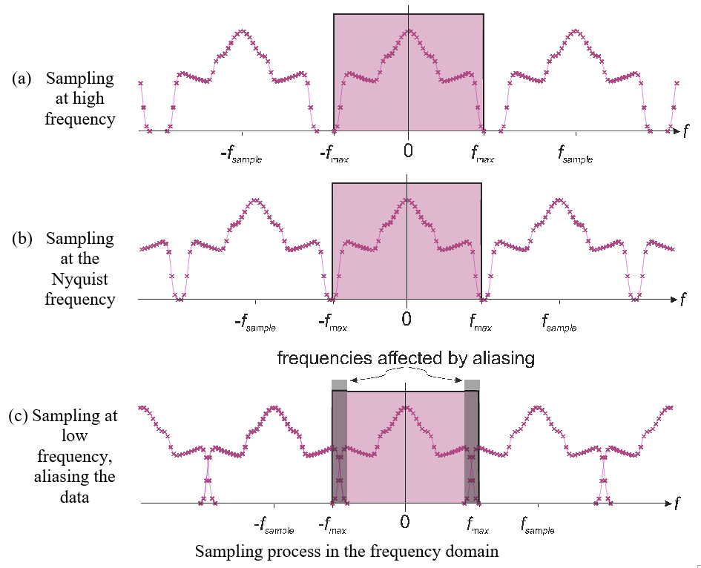

In the frequency domain
Spectra repeat
If sampling is just right, spectra just touch
Minimum sampling frequency = 2 × max
Notes:
Why the Spectra repeat: fft(f.*g) = fft(f)*fft(g), where g is the sampling function.
The spectrum of a signal is the range of frequencies contained in the signal.
The bandwidth is the difference between the lowest and highest frequency in the spectrum.
It is therefore the width of the spectrum and is a measure of the information carrying capacity of the signal.

Slide 17
Sampling theory
Nyquist’s sampling theorem
In order to be able to reconstruct a signal from its samples we must sample at minimum at twice the maximum frequency in the original signal
E.g. speech 6kHz, sample at 12 kHz
Video bandwidth (CCIR) is 5MHz
Sampling at 10MHz gave 576×576 images
Guideline: “two pixels for every pixel of interest”

Slide 18
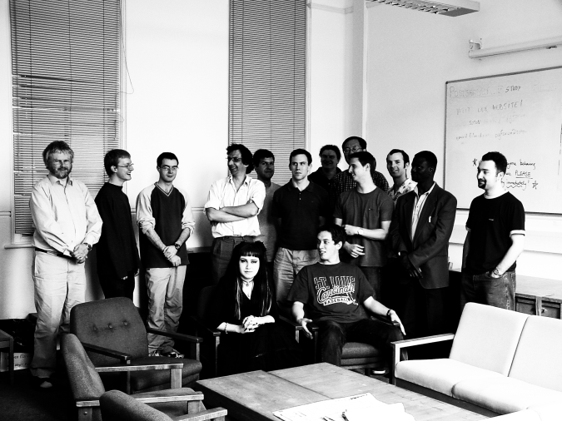
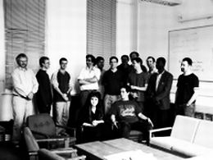
Aliasing in Sampled Imagery
(a) high resolution | (c) low resolution – aliased

Slide 19
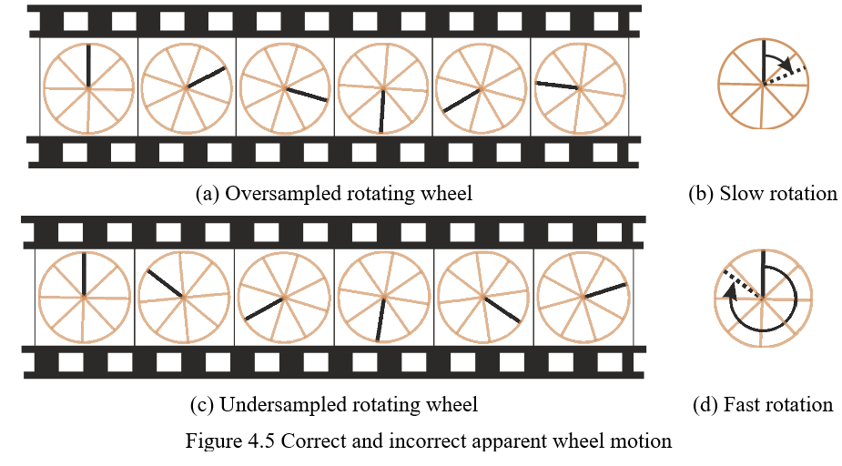
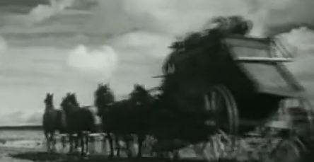
Correct and Incorrect Apparent Wheel Motion
https://www.youtube.com/watch?v=e1EqXE06xr8

Slide 20
Main points so far
1 – need to sample at a high enough frequency
2 – aliasing corrupts image information
3 – discrete Fourier allows analysis and understanding
4 – Fourier has many properties and advantages
…. but it’s complex. So we’ll move on to processing images
Notes:
Kohinoor Kerala

Slide 21
More sampling theories
Compressed sensing
Many signals are sparse…
Regularisation

