Slide 1
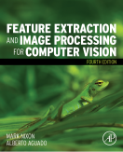
Lecture 4 Point Operators
COMP3204 Computer Vision
How many different operators are there which operate on image points?
 | Book pp 72-83

Slide 2
Content
How do we best display images?
What operators are available which work solely on image points?

Slide 3

An image and its histogram
The histogram shows contrast

Slide 4

Brightening an image
new image N; old image O; gain k; level l; co-ordinates x, y
Then choose values for k and l

Slide 5
Intensity mappings

Slide 6


Applying exponential and logarithmic point operators
Brightness compression
Brightness expansion

Slide 7
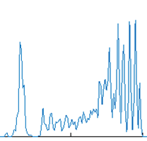
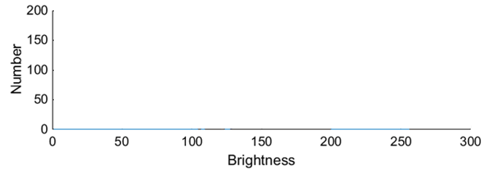
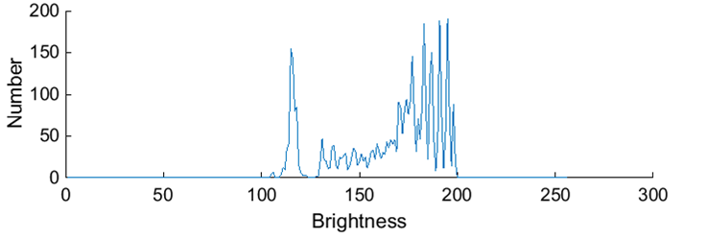
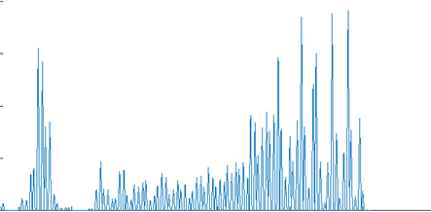
Intensity normalisation - function
Aim is to use all available grey levels for display
Original histogram
Shift origin to zero
Scale brightness to use whole range

Slide 8
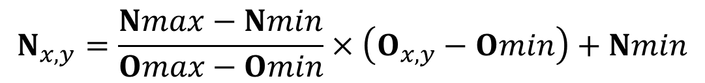
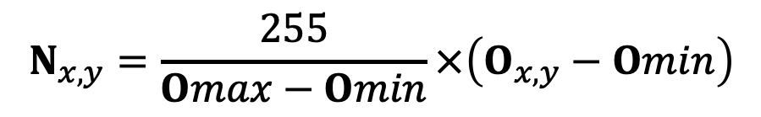
Intensity normalisation
$$N_{x,y}=\frac{Nmax−Nmin}{Omax−Omin}×\left(O_{x,y}−Omin\right)+Nmin$$
new image N; old image O; co-ordinates x, y
minimum new Nmin
maximum new Nmax
minimum original Omin
maximum original Omax
$$N_{x,y}=\frac{255}{Omax−Omin}×\left(O_{x,y}−Omin\right)$$
Avoids need for parameter choice

Slide 9
Intensity normalisation and histogram equalisation
Grey levels all ‘weigh’ the same
Used in Matlab’s imagesc
Grey levels have different weights
Aimed for human vision

Slide 10





Histogram Equalisation – aim is a flat histogram
N² points in the image; the sum of points per level is equal in equalised and original image
cumulative histogram up to level p should be transformed to cover up to the level q
Target histogram
number of points per level in the output picture
cumulative histogram of the output picture
mapping for the output pixels at level q
Often used in medical image analysis
Effective … but … nonlinear and major problems with noise

Slide 11
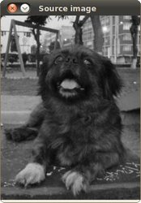
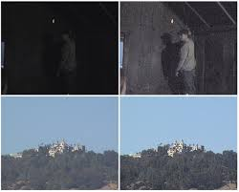
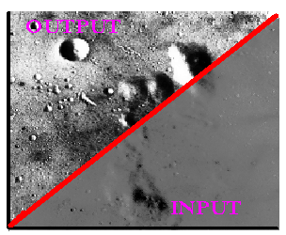
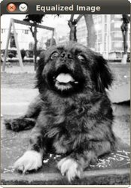
Applying intensity normalisation and histogram equalisation
http://homepages.inf.ed.ac.uk/rbf/HIPR2/histeq.htm; http://docs.opencv.org/doc/tutorials/imgproc/histograms/histogram_equalization/histogram_equalization.html ; http://www.softpedia.com/get/Multimedia/Video/Other-VIDEO-Tools/Easy-Histogram-Equalization.shtml

Slide 12

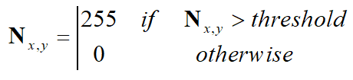
Thresholding an eye image
Thresholding selects points that exceed a chosen threshold

Slide 13
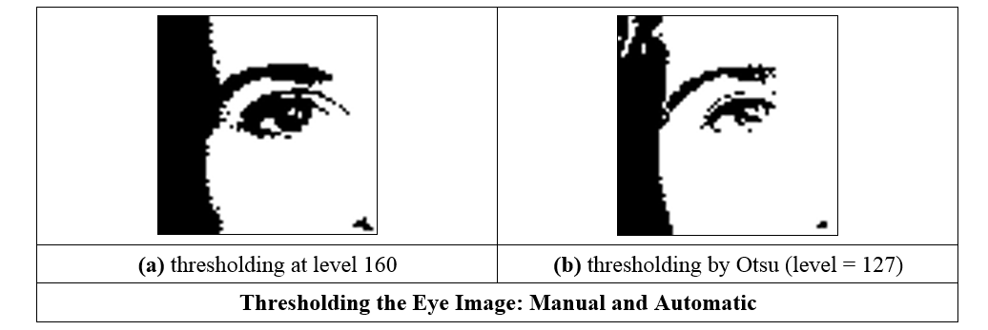
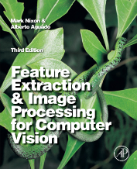
Thresholding an eye image: manual vs automatic
Is optimal thresholding a myth??
Notes:
Otsu's method is equivalent to a globally optimal k-means

Slide 14
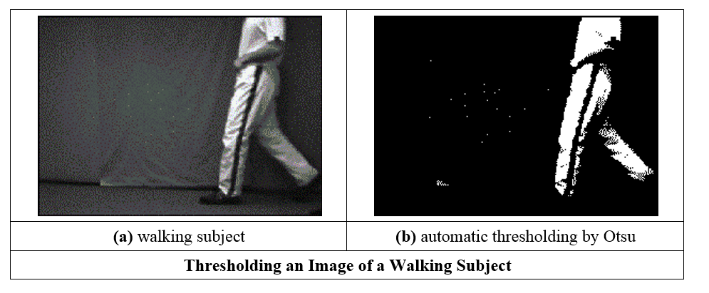
Thresholding an image of a walking subject
Many consider that shape concerns a higher level

Slide 15
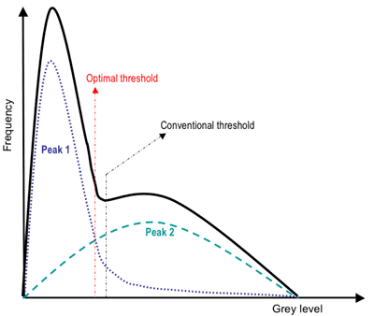
Advanced thresholding
https://www.cs.auckland.ac.nz/courses/compsci773s1c/lectures/ImageProcessing-html/topic3.htm
Notes:
Also talk about the adaptive thresholding

Slide 16
Main points so far
point operators are largely about image display
concern histogram manipulation
thresholding used a lot
intensity normalisation used for display
Need sets of points. That’s group operators, coming next.
Notes:
Bitter virtue

Slide 17
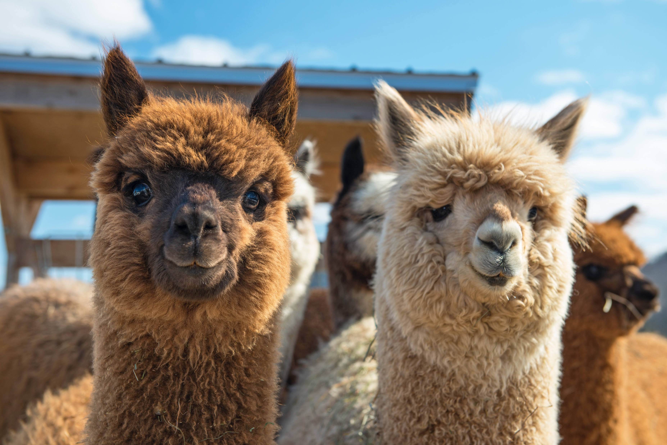
Other thresholding techniques…
Notes:
Talk about using K-means to select thresholding, i.e., using classification.
Also talk about how to do thresholding for colour images…

