Slide 1

Lecture 6 Edge Detection
COMP3204 Computer Vision
What are edges and how do we find them?
 | Book pp 118 - 130

Slide 2
Content
Differentiation/ differencing can be used to find edges of features
How can we improve the differencing process?

Slide 3
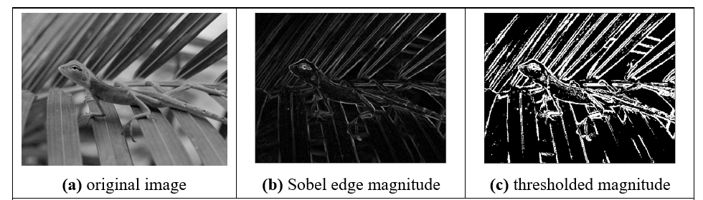

Edge detection
What is an edge? It’s contrast

Slide 4
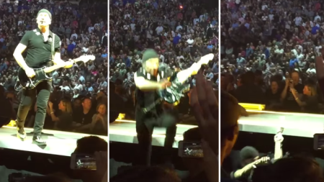
U2’s Edge can’t detect edges
http://metro.co.uk/2015/05/15/the-edge-falls-off-the-edge-of-the-stage-in-spectacular-style-during-u2s-world-tour-5199503/

Slide 5


Horizontal differencing
difference
result
Horizontal differencing detects vertical edges

Slide 6

Vertical differencing
difference
Vertical differencing detects horizontal edges
result

Slide 7
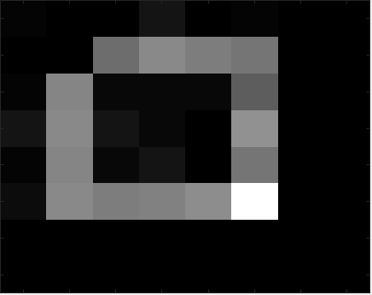
First order edge detection
Addition of horizontal and vertical

Slide 8



First order edge detection
vertical edges, Ex
horizontal edges, Ey
vertical and horizontal edges

Slide 9

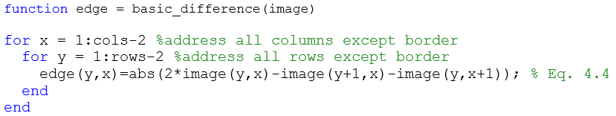
First order edge detection
Template
Code
How can we improve it?

Slide 10
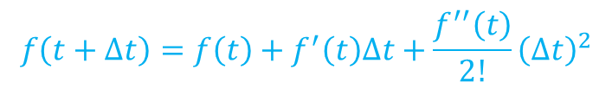



Taylor series – evaluate $f\left(t+∆t\right)$
First approximation, original value
$$f\left(t+∆t\right)=f\left(t\right)$$
Second approximation, add gradient
$$f\left(t+∆t\right)=f\left(t\right)+f^{′}\left(t\right)∆t$$
Third approximation, add f’’
$$f\left(t+∆t\right)=f\left(t\right)+f^{′}\left(t\right)∆t+\frac{f^{′′}\left(t\right)}{2!}{\left(∆t\right)}^{2}$$
Taylor series
$$f\left(t+∆t\right)=f\left(t\right)+f^{′}\left(t\right)∆t+\frac{f^{′′}\left(t\right)}{2!}{\left(∆t\right)}^{2}+\frac{f^{′′′}\left(t\right)}{3!}{\left(∆t\right)}^{3}+…+\frac{f^{n}\left(t\right)}{n!}{\left(∆t\right)}^{n}$$

Slide 11
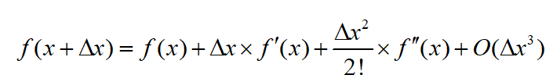

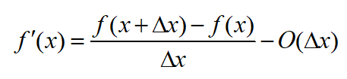







Edge detection maths
A
1 | -1
B
A − B
1 | 0 | -1

Slide 12
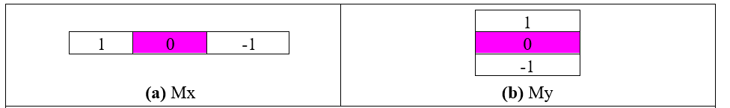
Templates for improved first order difference

Slide 13
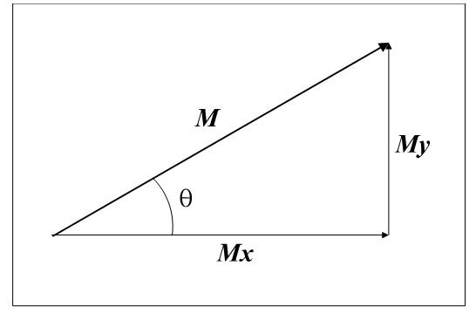

Edge Detection in Vector Format
Vectors have magnitude (strength) and direction
M = magnitude = $\sqrt{M_{x}^{2}\text{+}M_{y}^{2}}$
θ = $direction$ = $\tan^{−1}\left(\frac{M_{y}}{M_{x}}\right)$

Slide 14
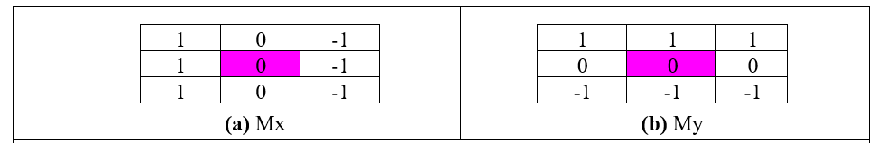
Templates for 3×3 Prewitt operator
Average improved horizontal and vertical operators over 3 rows/ columns to give Prewitt templates
Edge magnitude and direction calculated for centre point

Slide 15
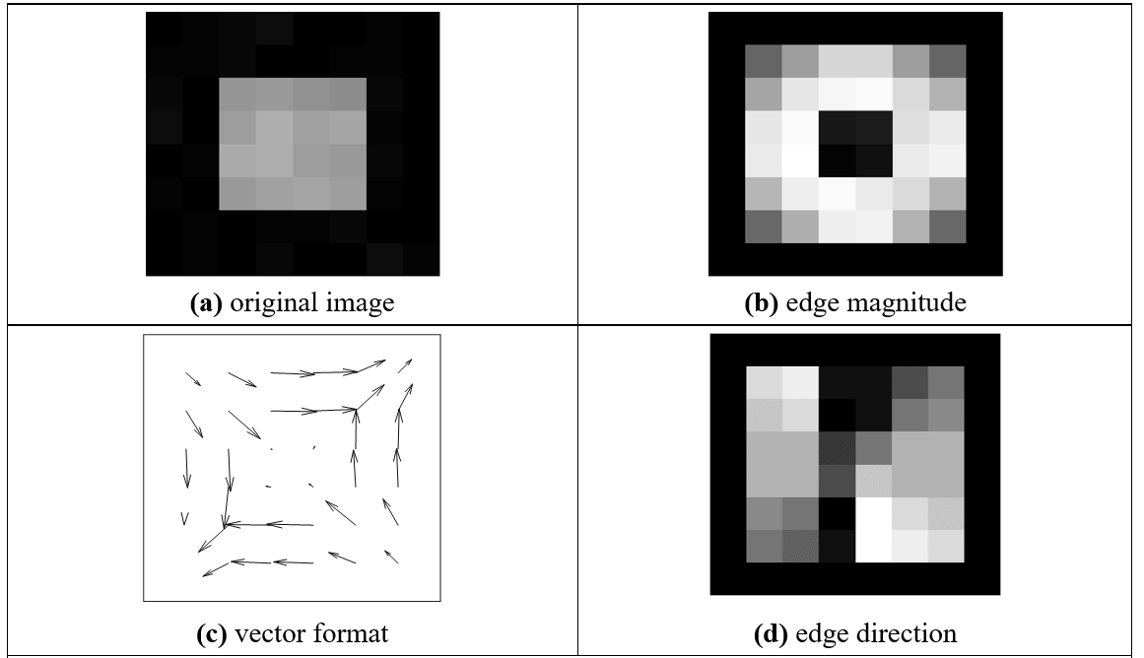
Applying the Prewitt Operator
No missing points

Slide 16
Applying the Prewitt Operator
Blurred edges

Slide 17
Applying the Prewitt Operator
No double points

Slide 18
Applying the Prewitt Operator
Displaying gradients as an image communicates nothing
So use vectors

Slide 19
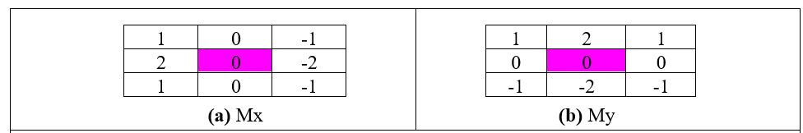
Templates for Sobel operator
Sobel is most popular basic operator
Double the centre coefficients of Prewitt
WHY?

Slide 20
Applying Sobel operator

Slide 21
Generalising Sobel - use Pascal’s triangle
1. Averaging Window size
2 1 1
3 1 2 1
4 1 3 3 1
5 1 4 6 4 1
2. Differencing Window size
2 1 -1
3 1 0 -1
4 1 1 -1 -1
5 1 2 0 -2 -1
Sobel 3×3
Sobel 5×5
Sobel 3×3
Sobel 5×5

Slide 22
Generalised Sobel
Generated by: averaging^{T} *(differencing)
>> s=Sobel_templates(5)
s(:,:,1) =
1 2 0 -2 -1
4 8 0 -8 -4
6 12 0 -12 -6
4 8 0 -8 -4
1 2 0 -2 -1

Slide 23
Main points so far
1 – differencing detects contrast and thus edges
2 - can improve the differencing process (by maths!!)
3 – Sobel is a good general purpose operator
We shall go to more sophisticated methods, coming up next.
Notes:
Hoxton bakehouse, excellent bread

Slide 24
Filters for edge detection
Notes:
Talk about the low-pass and high-pass filter;
Then initiate the thoughts of doing smoothing first (use low-pass filter) and then
high-pass filter.
Also mentioned the caveat that the longer the filter, the wider the edge info.
Mention Gaussian difference.

