Slide 1
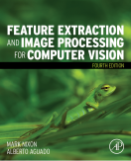
Lecture 7 Further Edge Detection
COMP3204 Computer Vision
What better ways are there to detect edges?
 | Book pp 131 - 177

Slide 2
Content
How can we improve first-order edge detection?
How can we detect edges using second order differentiation/ differencing

Slide 3
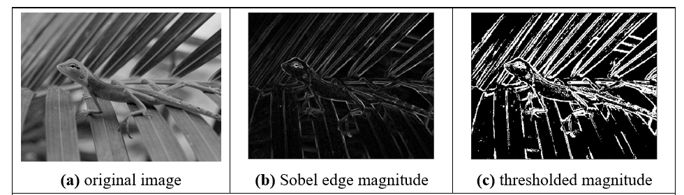

Applying Sobel operator
Sobel is a good basic operator
Blurred edges
Noisy edges

Slide 4
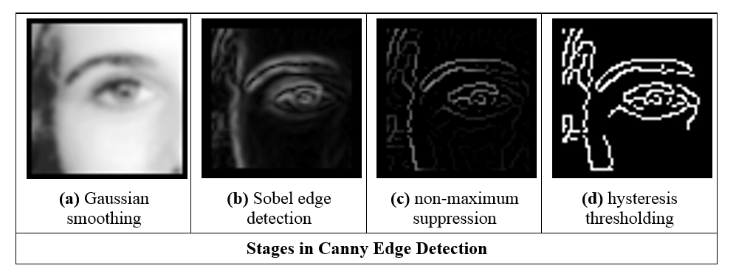
Stages in Canny edge detection operator
Canny gives thin edges in the right place, but is more complex

Slide 5
Canny edge detection operator
Formulated with three main objectives:
optimal detection with no spurious responses;
good localisation with minimal distance between detected and true edge position; and
single response to eliminate multiple responses to a single edge.
Approximation
use Gaussian smoothing;
use the Sobel operator;
use non-maximal suppression; and
threshold with hysteresis to connect edge points.
) combine?

Slide 6
Interpolation in non-maximum suppression
Need to use points which are not on the image grid
Uses linear interpolation

Slide 7
Hysteresis thresholding transfer function
Lower threshold = average noise
Upper threshold = average feature boundary

Slide 8
Action of non-maximum suppression and hysteresis thresholding
Walk along top of ridge
Gives thin edges in the right place

Slide 9
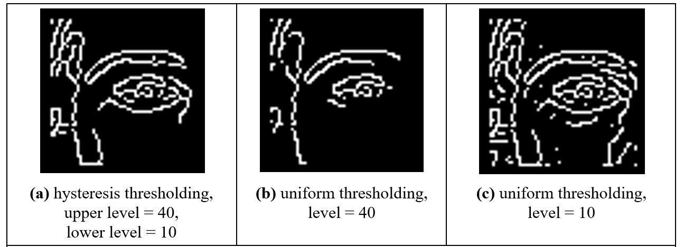
Comparing hysteresis thresholding with uniform thresholding
Hysteresis thresholding gives all points > upper threshold
plus any connected points > lower threshold

Slide 10
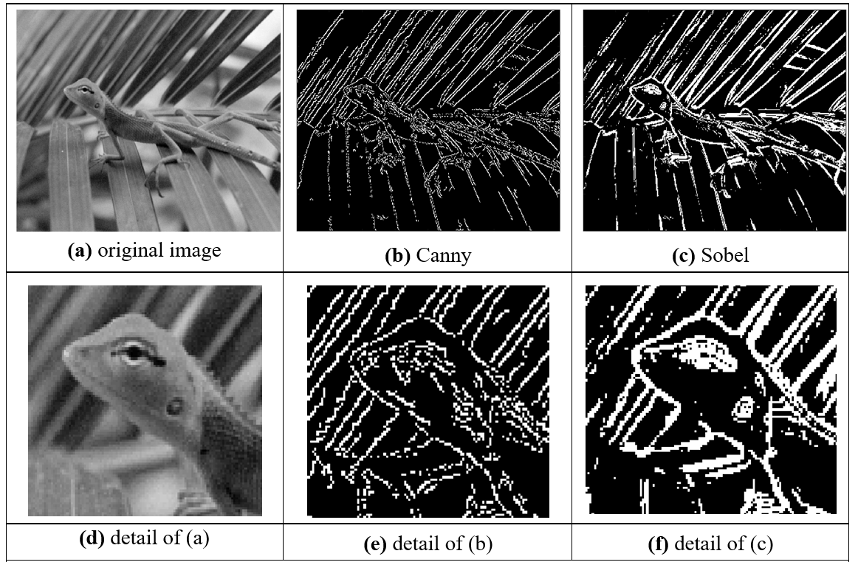
Comparing Canny with Sobel
The lines are thinner here, making Sobel look better!

Slide 11
Comparing Canny with Sobel
The lines are indeed thinner

Slide 12
Comparing Canny with Sobel
The noise is less

Slide 13
First and second order edge detection
First order = single differentiation with thresholding
Second order = twice differentiation with zero-crossing detection

Slide 14

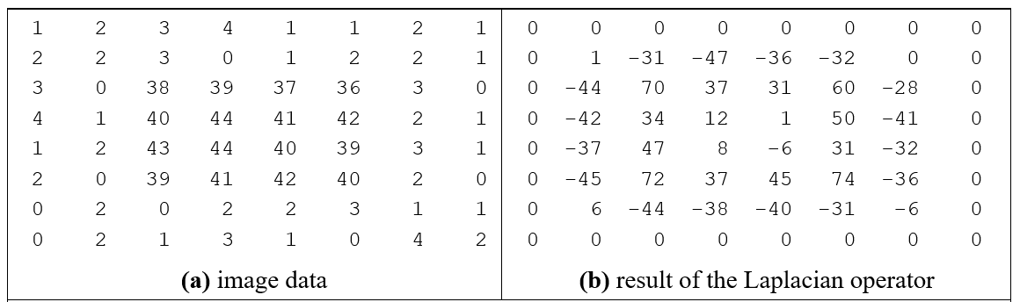
Edge detection via the Laplacian operator
Simple, but unused!

Slide 15
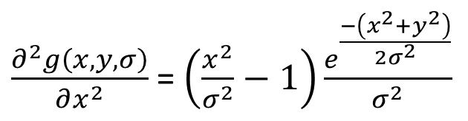
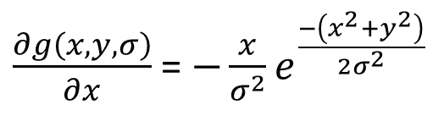
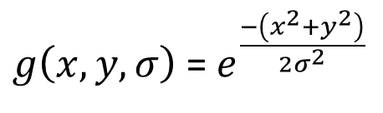
Edge detection is about differentiation
$g\left(x,y,σ\right)$ = $e^{\frac{−\left(x^{2}+y^{2}\right)}{{2σ}^{2}}}$
Take a Gaussian function
Differentiate once
And again
$\frac{∂g\left(x,y,σ\right)}{∂x}$ = ${−\frac{x}{σ^{2}}e}^{\frac{−\left(x^{2}+y^{2}\right)}{{2σ}^{2}}}$
$\frac{∂^{2}g\left(x,y,σ\right)}{∂x^{2}}$ = $\left(\frac{x^{2}}{σ^{2}}−1\right)\frac{e^{\frac{−\left(x^{2}+y^{2}\right)}{{2σ}^{2}}}}{σ^{2}}$

Slide 16
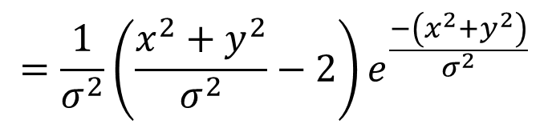
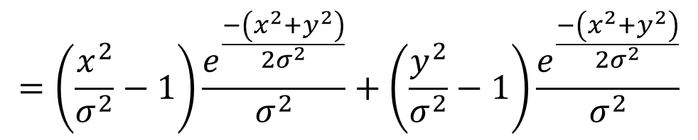
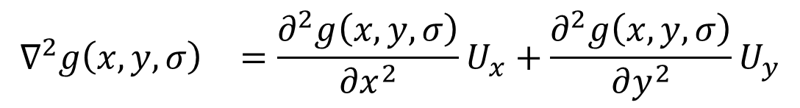
Mathbelts on…
$$\begin{matrix}∇^{2}g\left(x,y,σ\right) & =\frac{∂^{2}g\left(x,y,σ\right)}{∂x^{2}}U_{x}+\frac{∂^{2}g\left(x,y,σ\right)}{∂y^{2}}U_{y}\end{matrix}$$
Second order in x and y is
$$=\left(\frac{x^{2}}{σ^{2}}−1\right)\frac{e^{\frac{−\left(x^{2}+y^{2}\right)}{2σ^{2}}}}{σ^{2}}+\left(\frac{y^{2}}{σ^{2}}−1\right)\frac{e^{\frac{−\left(x^{2}+y^{2}\right)}{{2σ}^{2}}}}{σ^{2}}$$
By substitution
$$=\frac{1}{σ^{2}}\left(\frac{x^{2}+y^{2}}{σ^{2}}−2\right)e^{\frac{−\left(x^{2}+y^{2}\right)}{σ^{2}}}$$
So we get
Second order = Laplacian of Gaussian = Marr Hildreth

Slide 17

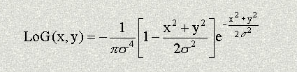
Google: “Laplacian of Gaussian”
http://homepages.inf.ed.ac.uk/rbf/HIPR2/log.htm;
http://fourier.eng.hmc.edu/e161/lectures/gradient/node8.html ; http://academic.mu.edu/phys/matthysd/web226/Lab02.htm

Slide 18
Shape of Laplacian of Gaussian operator
It’s called the ‘Mexican hat operator’

Slide 19
Zero crossing detection
Need to find zero-crossings in 2D
Basic – straight comparison
Advanced
3
1
2
4
Notes:
Ways to find the zero crossing:
threshoulding’
perform some kind of interpolation (more accurate)

Slide 20
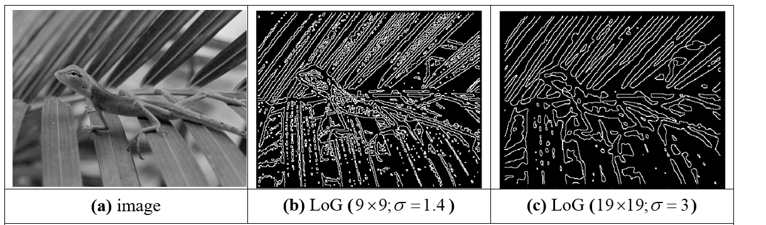
Marr-Hildreth edge detection
Small template, small σ for local features
Large template, large σ for global features

Slide 21
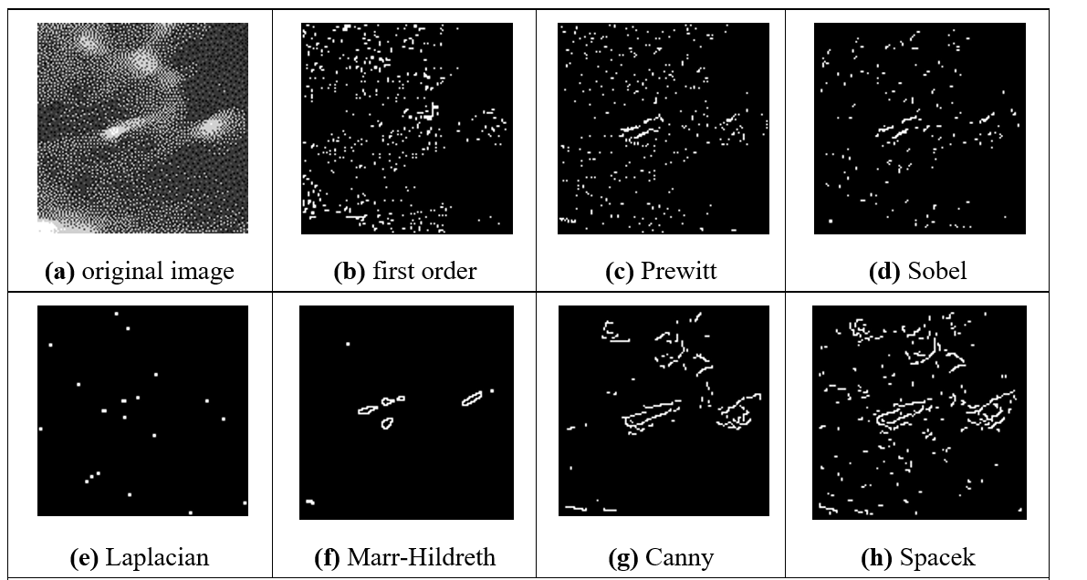
Comparison of edge detection operators

Slide 22
Main points so far
1 – Canny provides thin edges in the right place
2 – second order (Marr-Hildreth) requires zero-crossing detection
3 – the results by Marr-Hildreth and Canny are well worth the extra computation
Now we need to collect the edges to find shape. Coming next…
Notes:
Uptons of Bassett

Slide 23
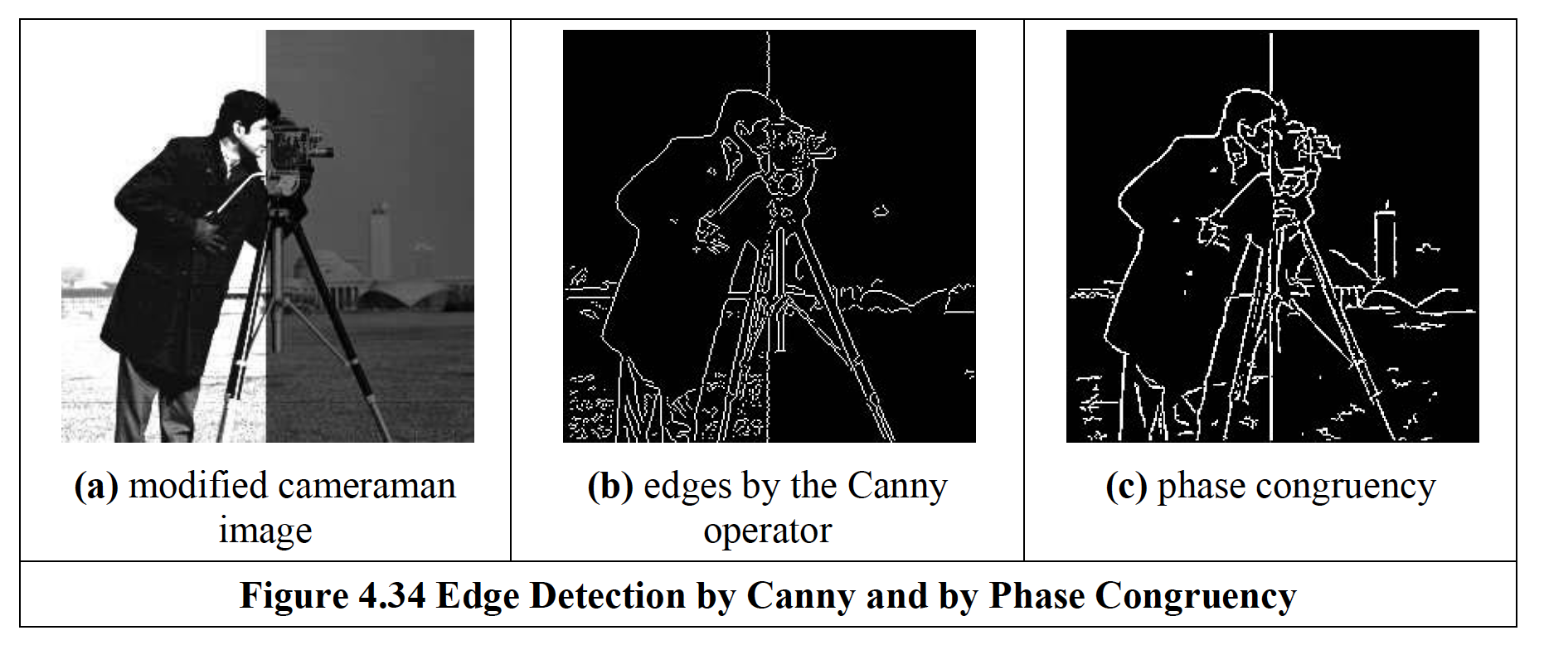
Advanced: Phase Congruency

Slide 24
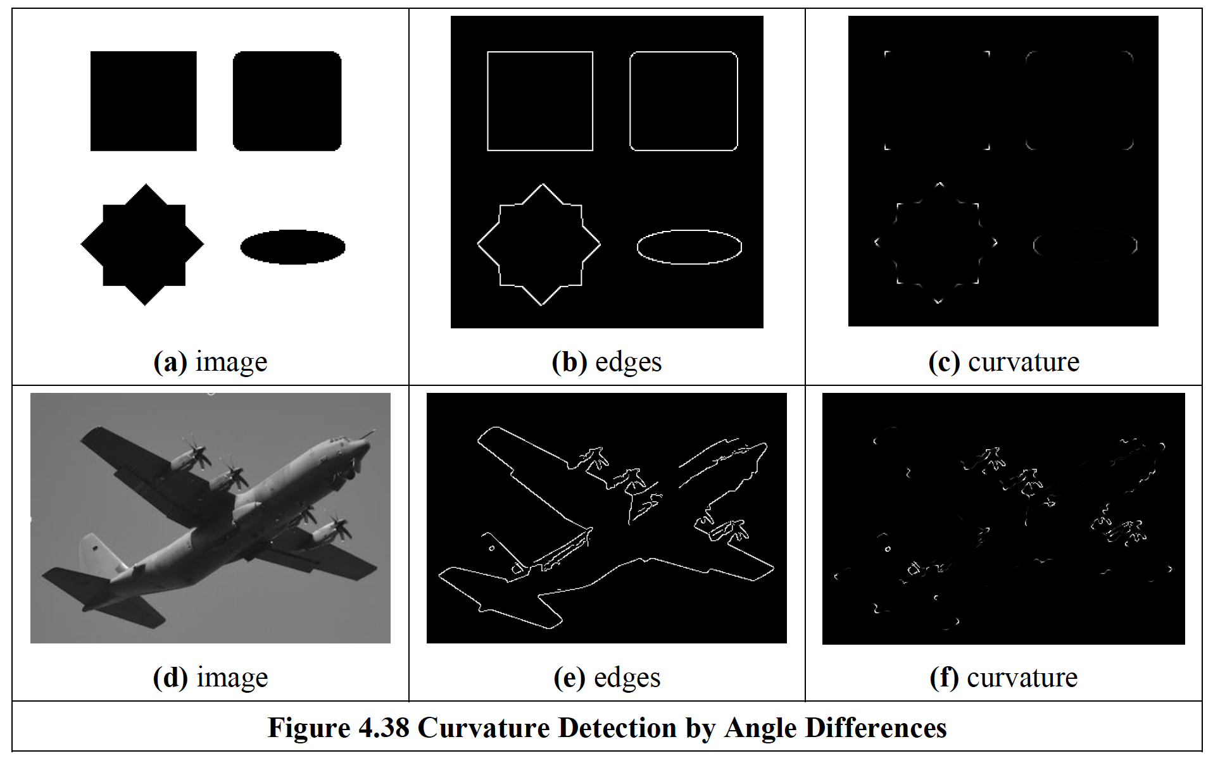
Advanced: localised feature extraction

Slide 25
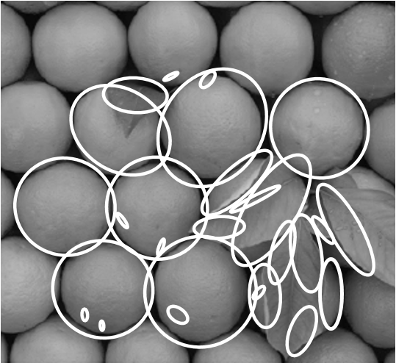
Advanced: localised feature extraction
feature points regions
SIFT (mega famous) brightness clustering
Others: SURF, FAST, ORB, FREAK, LOCKY, etc.
Lomeli-R. and Nixon and Carter, Mach Vis Apps 2016

Slide 26
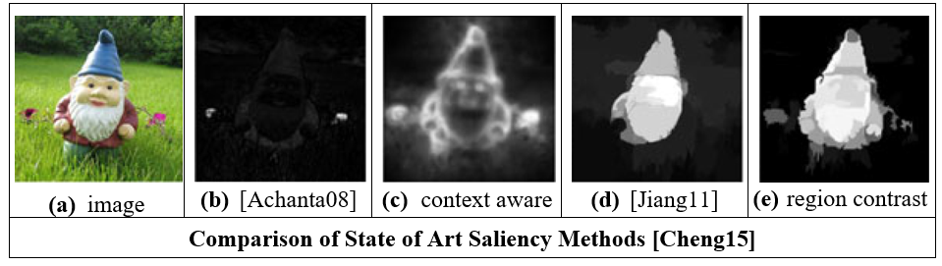
Advanced – saliency

