Slide 1

Lecture 9 Finding More Shapes
COMP3204 Computer Vision
How can we go from conic sections to general shapes?
 | Book pp 215-246

Slide 2
Content
What more versions of the Hough transform are possible?
What are its limits?
Can it be used to detect shapes that are not given by an equation?

Slide 3







Hough Transform for Circles
Again, it’s duality:
$$x,y$$
$x_{0},$ $y_{0}$
$$r$$
Points: centre: radius:
$x_{0},$ $y_{0}$
$$x,y$$
$$r$$
“ “ “

Slide 4
Circle Voting and Accumulator Space

Slide 5
Pseudocode
accum=0
for all x,y !look at all points
if edge(y,x)>threshold !check significance
for r=min_r, max_r !do values of radius
for theta = 0,2*pi !go around a circle
x0=x+r*cos(theta) !generate x
y0=y+r*sin(theta) !generate y
accum(y0, x0 ) PLUS 1 !vote in accumulator
y0, x0 = argmax(accum) !peak gives parameters
, r
, r

Slide 6
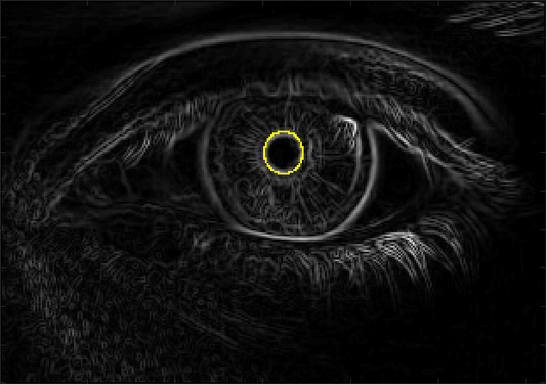
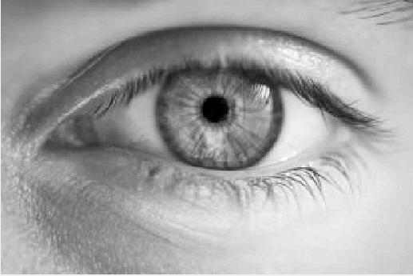
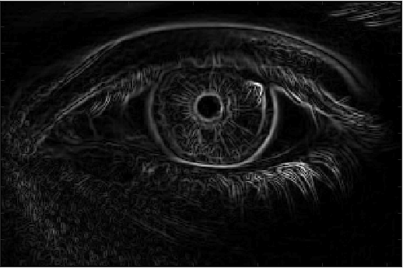
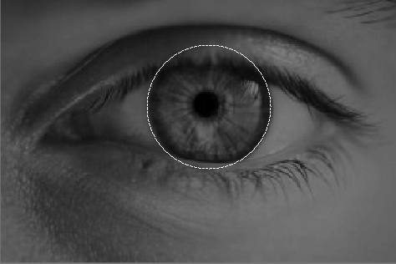
Applying the HT for circles
image
(Sobel) edges
accumulator
small and large circles

Slide 7
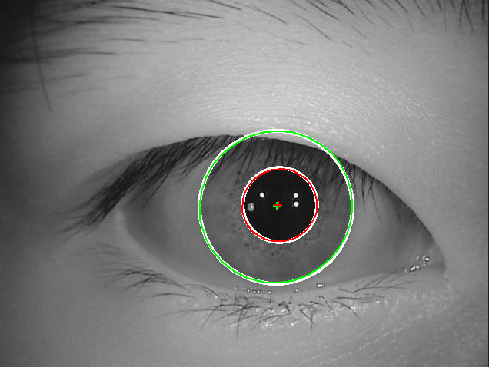

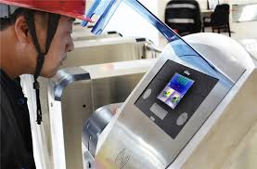
Integrodifferential operator?
https://stackoverflow.com/questions/27058057/comparing-irises-images-with-opencv

Slide 8
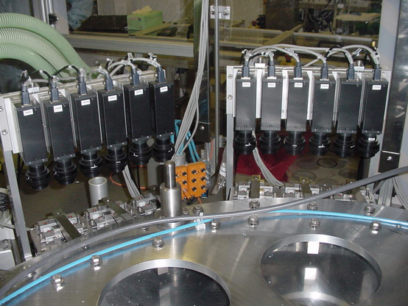
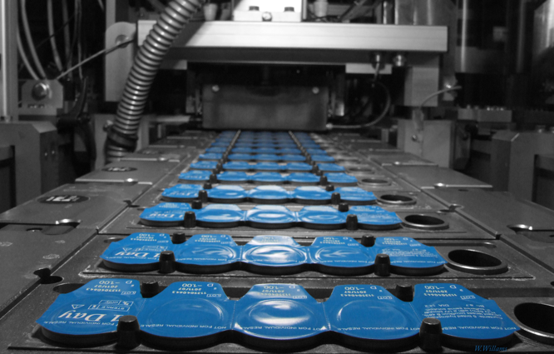
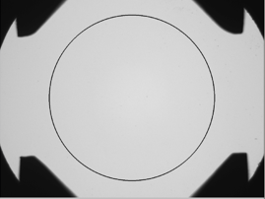
Contact lenses

Slide 9
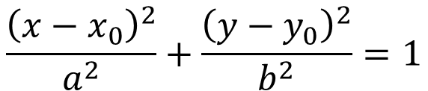
Extensions to conic sections
Ellipse
$$\frac{{\left(x−x_{0}\right)}^{2}}{a^{2}}+\frac{{\left(y−y_{0}\right)}^{2}}{b^{2}}=1$$
Described by 4 parameters. If each has 100 values,
accumulator size = 10² ×10² ×10² ×10²= 10⁸=0.1GB
Add rotation, that’s 10GB …. Ouch!
Motivates approaches to save memory and improve speed (since result is optimal)
Notes:
Curse of dimensionality

Slide 10


Speeding it up…..
Now it’s a 3D accumulator, fast algorithms are available
E.g. by differentiation
Differentiating gives
$$\frac{dy}{dx}=−\frac{\left(x−x_{0}\right)}{\left(y−y_{0}\right)}$$
Substitute back into Eqn. for circle
2D accumulator
$$y−y_{0}=\frac{r}{\sqrt{1+{\left(\frac{dy}{dx}\right)}^{2}}}$$
This is the edge direction

Slide 11
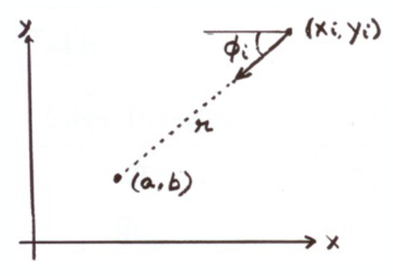
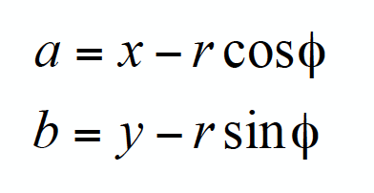
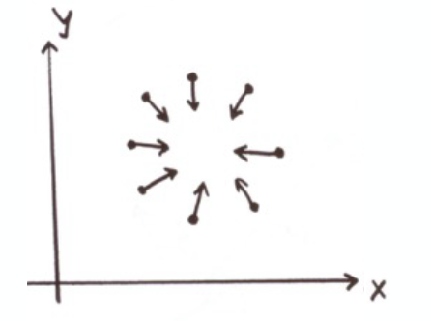
Fireside
Circle
Line
Notes:
Talking how to speed up, using the gradient/angle

Slide 12
Arbitrary Shapes
Use Generalised HT
Form (discrete) look-up-table (R-table)
Vote via look-up-table

Slide 13
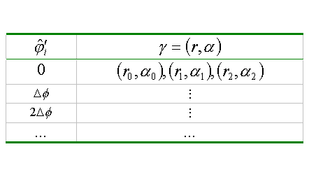
R-table Construction

Slide 14
R-table Construction
Need to start somewhere

Slide 15
R-table Construction
Measure edge direction

Slide 16
R-table Construction
Determine length and direction to reference point

Slide 17
R-table Construction
Store length and direction indexed by edge direction

Slide 18
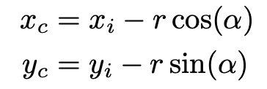
R-table Construction
Edge direction is not a unique description
Gives noise in accumulator

Slide 19
Procedure for GHT
Preparation
Determine centre of template shape
Form R-table from template shape
Application
Use R-table to vote for points in the real image
For edge points > threshold
Get edge direction(x,y)
For all R-table entries with direction(x,y)
Vote in accumulator (@distance, @direction)
Argmax(accumulator) gives centre co-ordinates of shape

Slide 20
Arbitrary Shapes
Use Generalised HT
Form (discrete) look-up-table (R-table)
Vote via look-up-table
Scale? scale R-table voting
Orientation? Rotate R-table voting
Inherent problems with discretisation

Slide 21
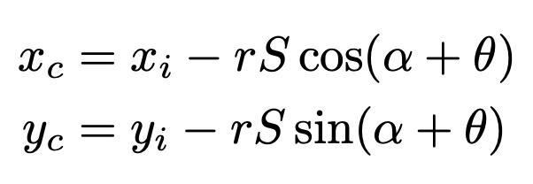
R-table Construction
Scale
Orientation
Notes:
Add S and \theta for scale and dilation

Slide 22
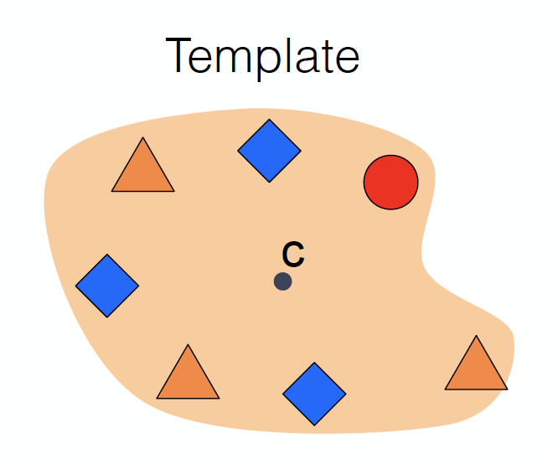
Fireside
Notes:
Talk about using the local features (small patches) to vote center location.

Slide 23
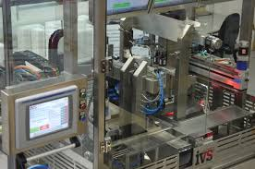
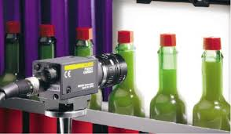
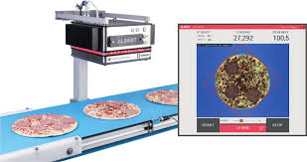
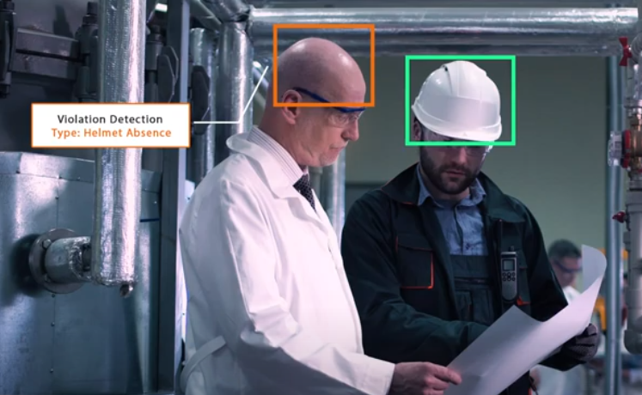
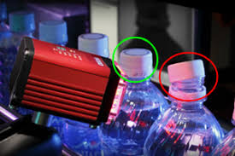
Visual inspection

Slide 24




Active Contours
For unknown arbitrary shapes: extract by evolution
Elastic band analogy
Balloon analogy
Discrete vs. continuous
Volcanoes?

Slide 25
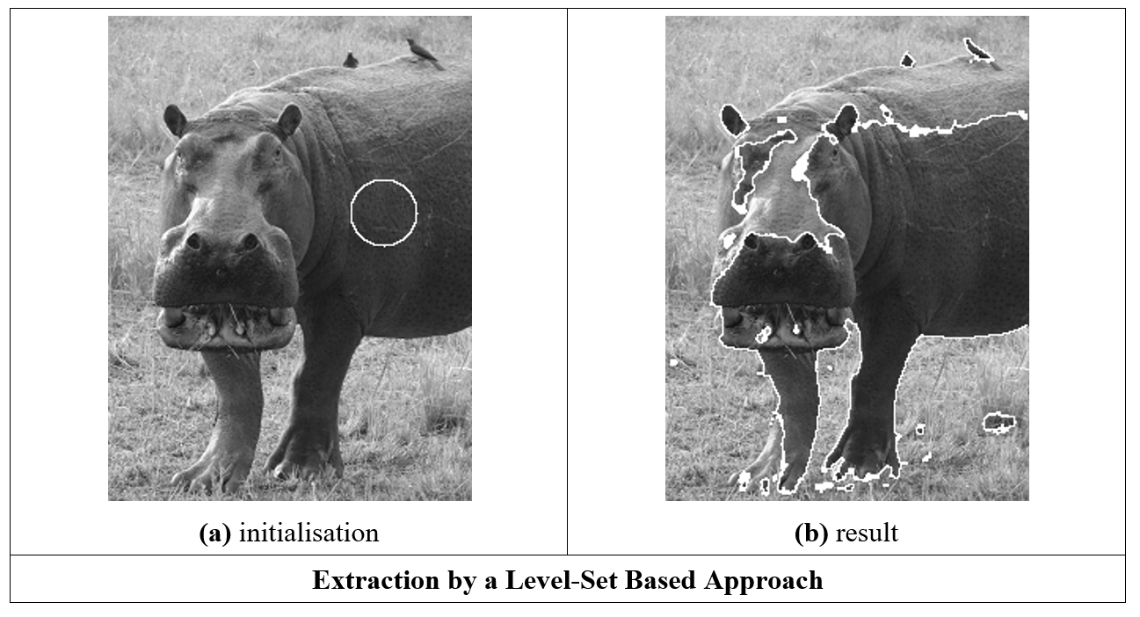
Geometric active contours

Slide 26
Main points so far
1 – conic sections become more complex and take more time
2 – can use Generalised Hough Transform for complex shapes
3 – shape detection IS computer vision. Many more approaches
Let’s see how computer vision can work
Notes:
Old fashioned Sweetie shop, winchester

