Slide 1

Lecture 1 Eye and Human Vision
COMP3204 Computer Vision
Is human vision a good model for computer vision?
 | Book pp 1-28

Slide 2
Content
Is human vision a good model for computer vision?
How does human vision work (and how does it fail)?
Software languages & associated literature

Slide 3
Modelling the eye in three parts
Physical model
(the eye)
Experimental model
(the signals)
Psychological model
(the brain)
Each is not fully understood, especially the brain ……

Slide 4
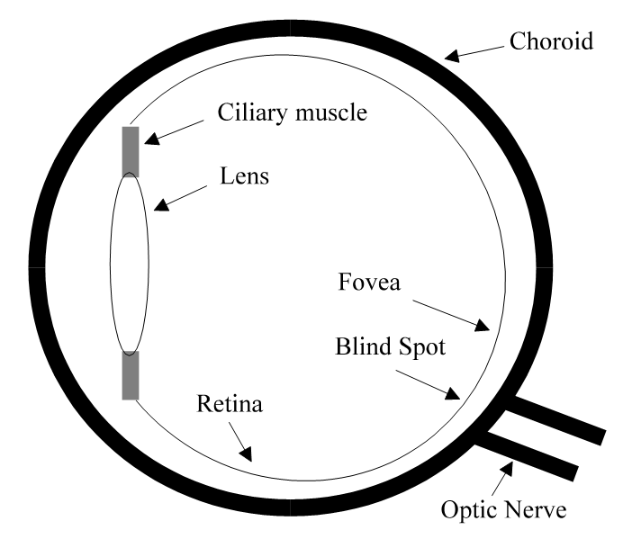

Human eye
Evolved for survival
Function of the eye is to form an image on the retina (on fovea)
The lens is shaped, rather than moved
Image is transmitted via optic nerve

Slide 5
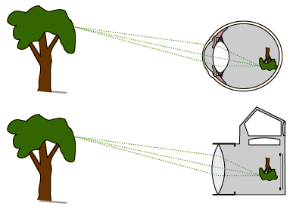
Optics
Your brain must invert the image
http://hyperphysics.phy-astr.gsu.edu/hbase/vision/rfreye.html

Slide 6

Sensors
There must be a lot!
Cones (10⁷) and rods (10⁸)
Cones – colour; rods – greylevel
photopic scotopic
Cones come in three types
S – short wavelength (blue)
M – medium wavelength (green)
L – long wavelength (red)
Insufficient bandwidth of optic nerve implies coding

Slide 7
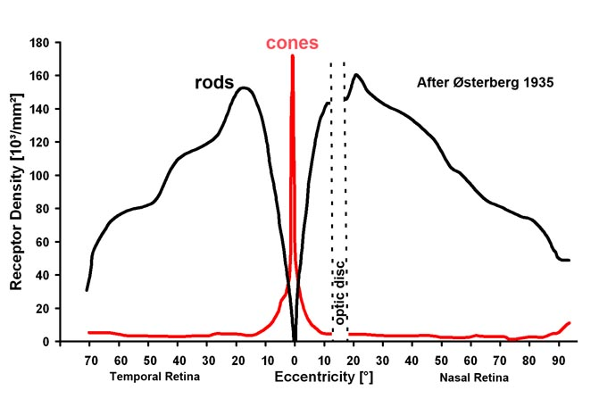
Rod and cone densities
No sensors on blind spot
Most cones on fovea
Rods elsewhere
http://webvision.med.utah.edu/imageswv/Ostergr.jpeg

Slide 8
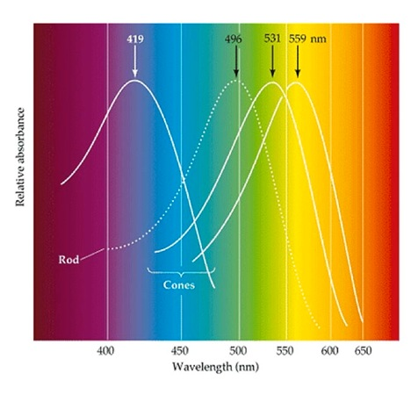
http://webvision.med.utah.edu/wp-content/uploads/2011/03/Spectrum.jpeg

Slide 9
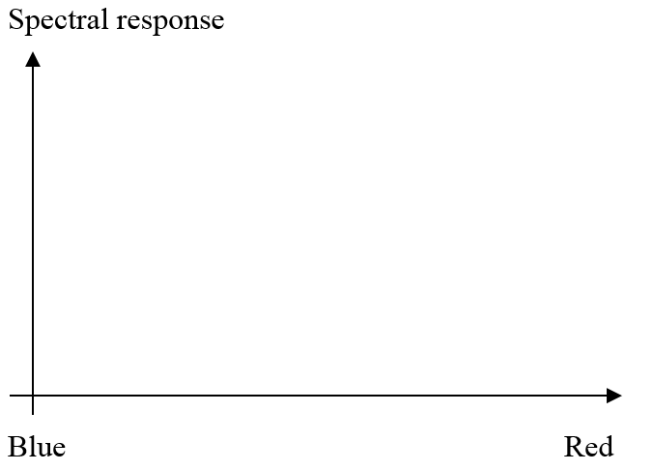
Spectral responses
Blue response (S sensors) is poor

Slide 10
Spectral responses
Blue response (S sensors) is poor
Green response (M sensors) dominates

Slide 11
Spectral responses
Blue response (S sensors) is poor
Green response (M sensors) dominates
Red response (L sensors) close to heat

Slide 12
Spectral responses
Blue response (S sensors) is poor
Green response (M sensors) dominates
Red response (L sensors) closer to heat
Overall response from S, M and L
Human vision must compensate for the poor blue sensors
(Just like a camera)

Slide 13
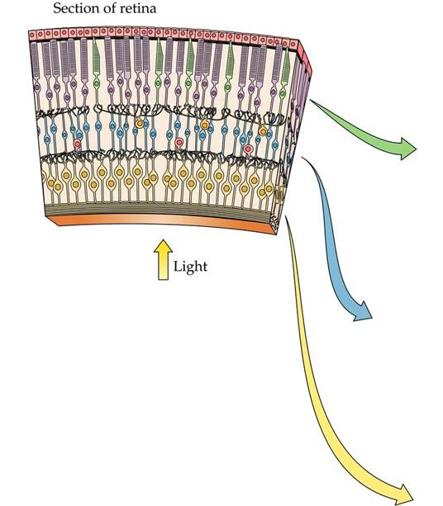
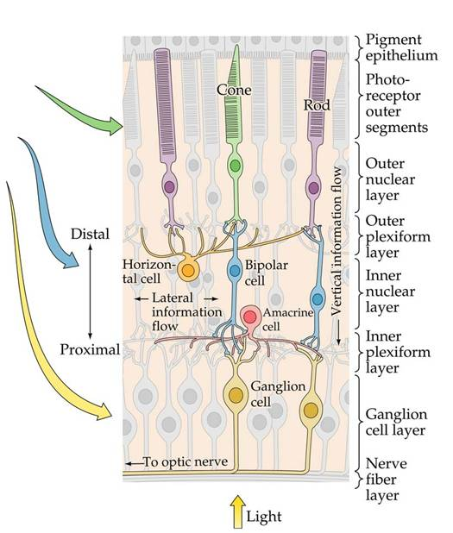
http://www.rci.rutgers.edu/~uzwiak/NBSummer15/NBSummerLect4.html

Slide 14
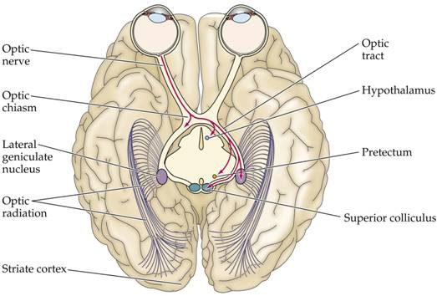
Cortices
http://www.rci.rutgers.edu/~uzwiak/NBSummer15/NBSummerLect4.html

Slide 15
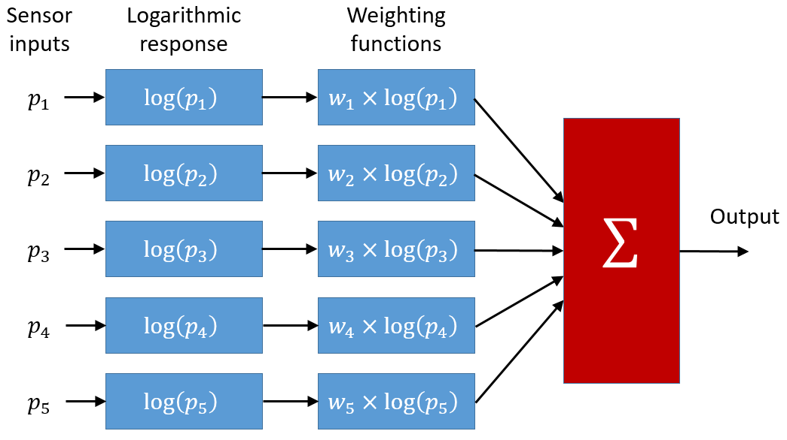
Neural processing
Sensor information must be combined
Note Weber’s law
Notes:
Weber states that, "the minimum increase of stimulus which will produce a perceptible increase of sensation is proportional to the pre-existent stimulus," while Fechner's law is an inference from Weber's law (with additional assumptions) which states that the intensity of our sensation increases as the logarithm of an increase in energy rather than as rapidly as the increase.

Slide 16
Where are we?
links
patterns

Slide 17
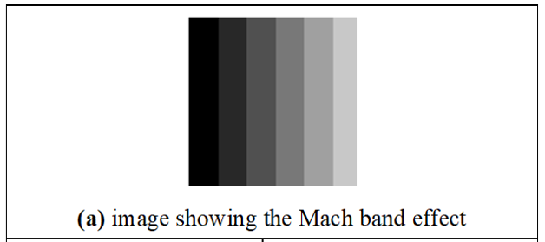
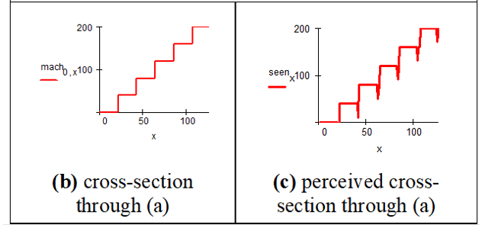
Mach bands
Mach bands are not in the image: your vision introduces them
Result of brightness adaption

Slide 18
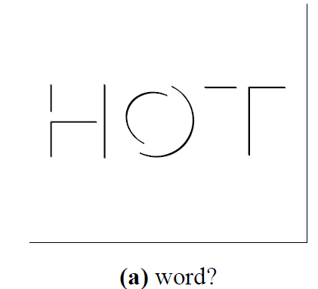
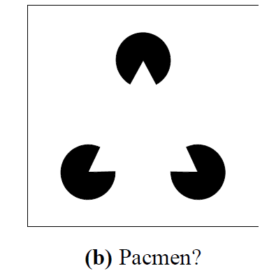
How human vision uses edges
The human eye needs training and can be deceived

Slide 19
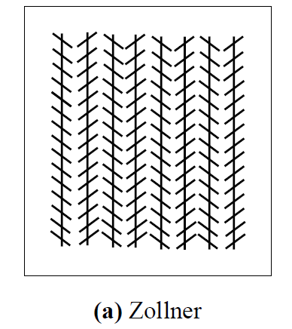
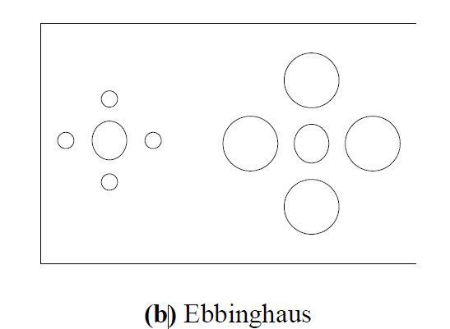
Static illusions
Measurement needs comparison

Slide 20
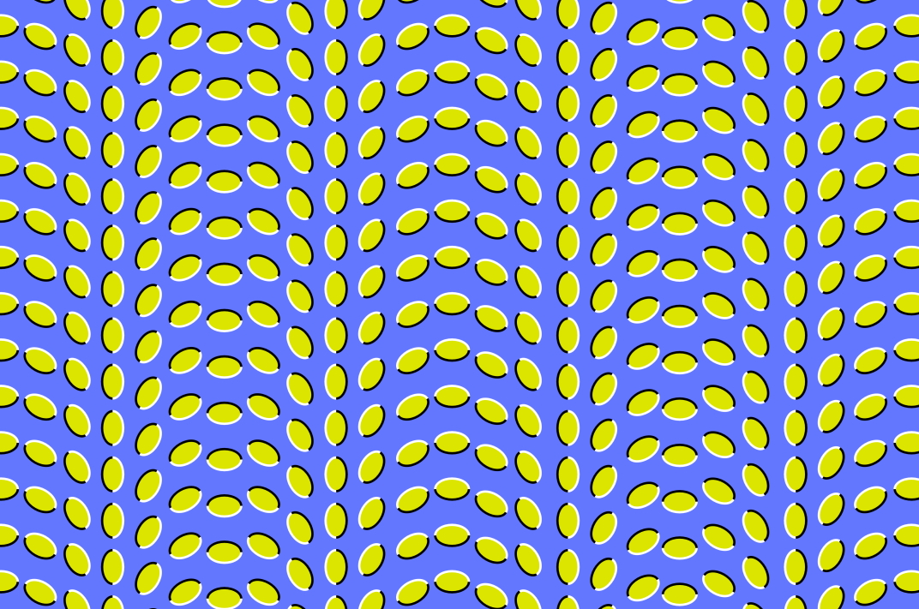

Slide 21
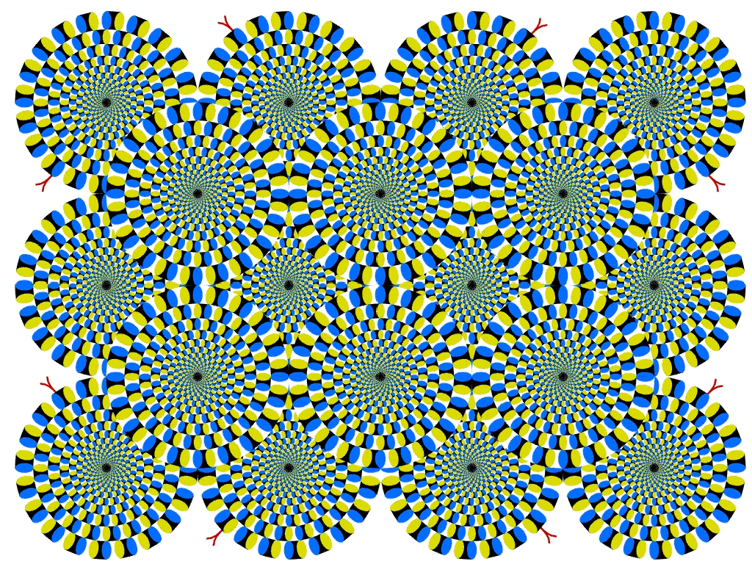

Slide 23

Benham’s disk
Illusions are a consequence of complex function

Slide 24
Main points so far
1 – human eye can be modelled in three sections
2 – it works very well
3 – …… but it can be deceived
4 – is it a good model for computer vision?
Next up, how images are formed
Notes:
Baboo ji in portswood, yum yum

Slide 25




Human to Computer Vision

Slide 26



Software languages
Matlab
Python

Slide 27
Associated literatures
Other books:
CVOnline: homepages.inf.ed.ac.uk/rbf/CVonline/books.htm
Digital Signal Processing: dspguide.com
Journals, magazines and conferences:
IEEE, SIAM, Springer, Elsevier, IET
CVPR, ICCV, ECCV, etc.
References of each Chapter
Computer Vision News: https://www.rsipvision.com/computer-vision-news/

