Slide 1
Project report – Group 22

Slide 2
Contents
Modeling and simulation of the plant
Evaluation of Simulink model
C-code implementation
Demonstration

Slide 3
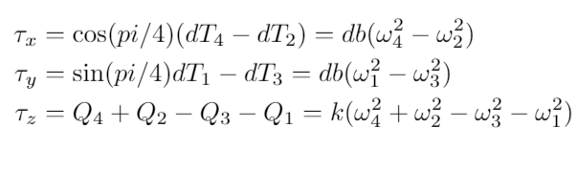
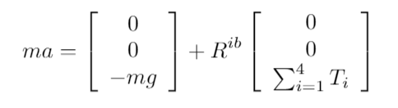



Modeling of the plant

Slide 4
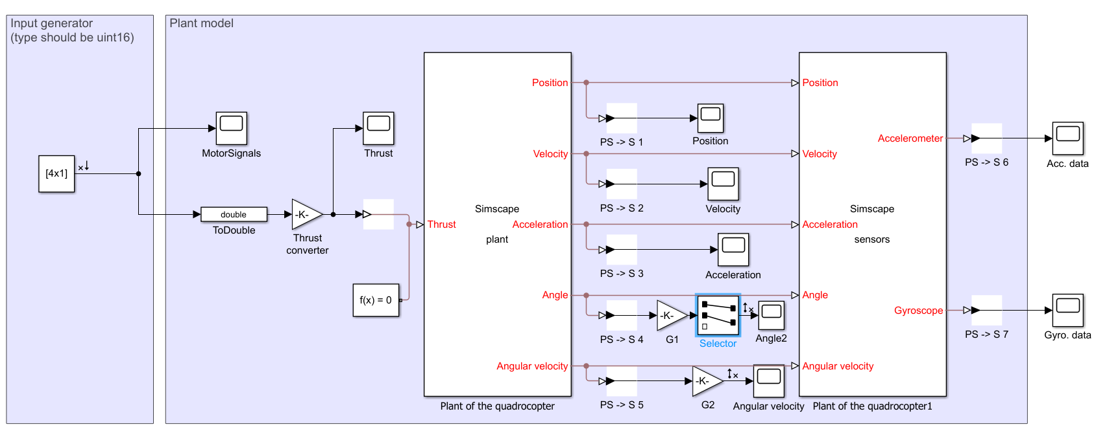
Linear analysis toolbox

Slide 5

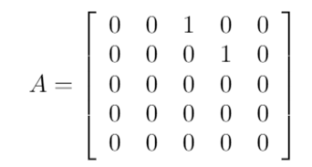
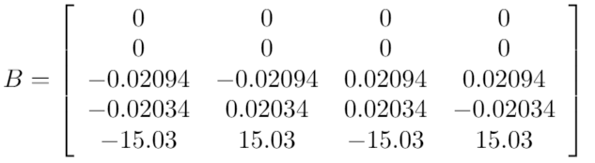
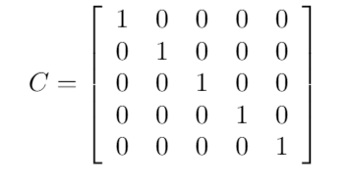
Linearization

Slide 6
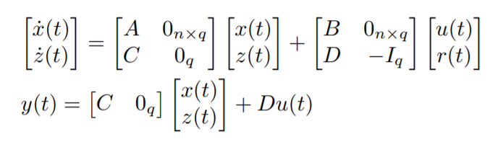


Integral action
What is integral action?
Why did we add it?
Why did we remove it?

Slide 7
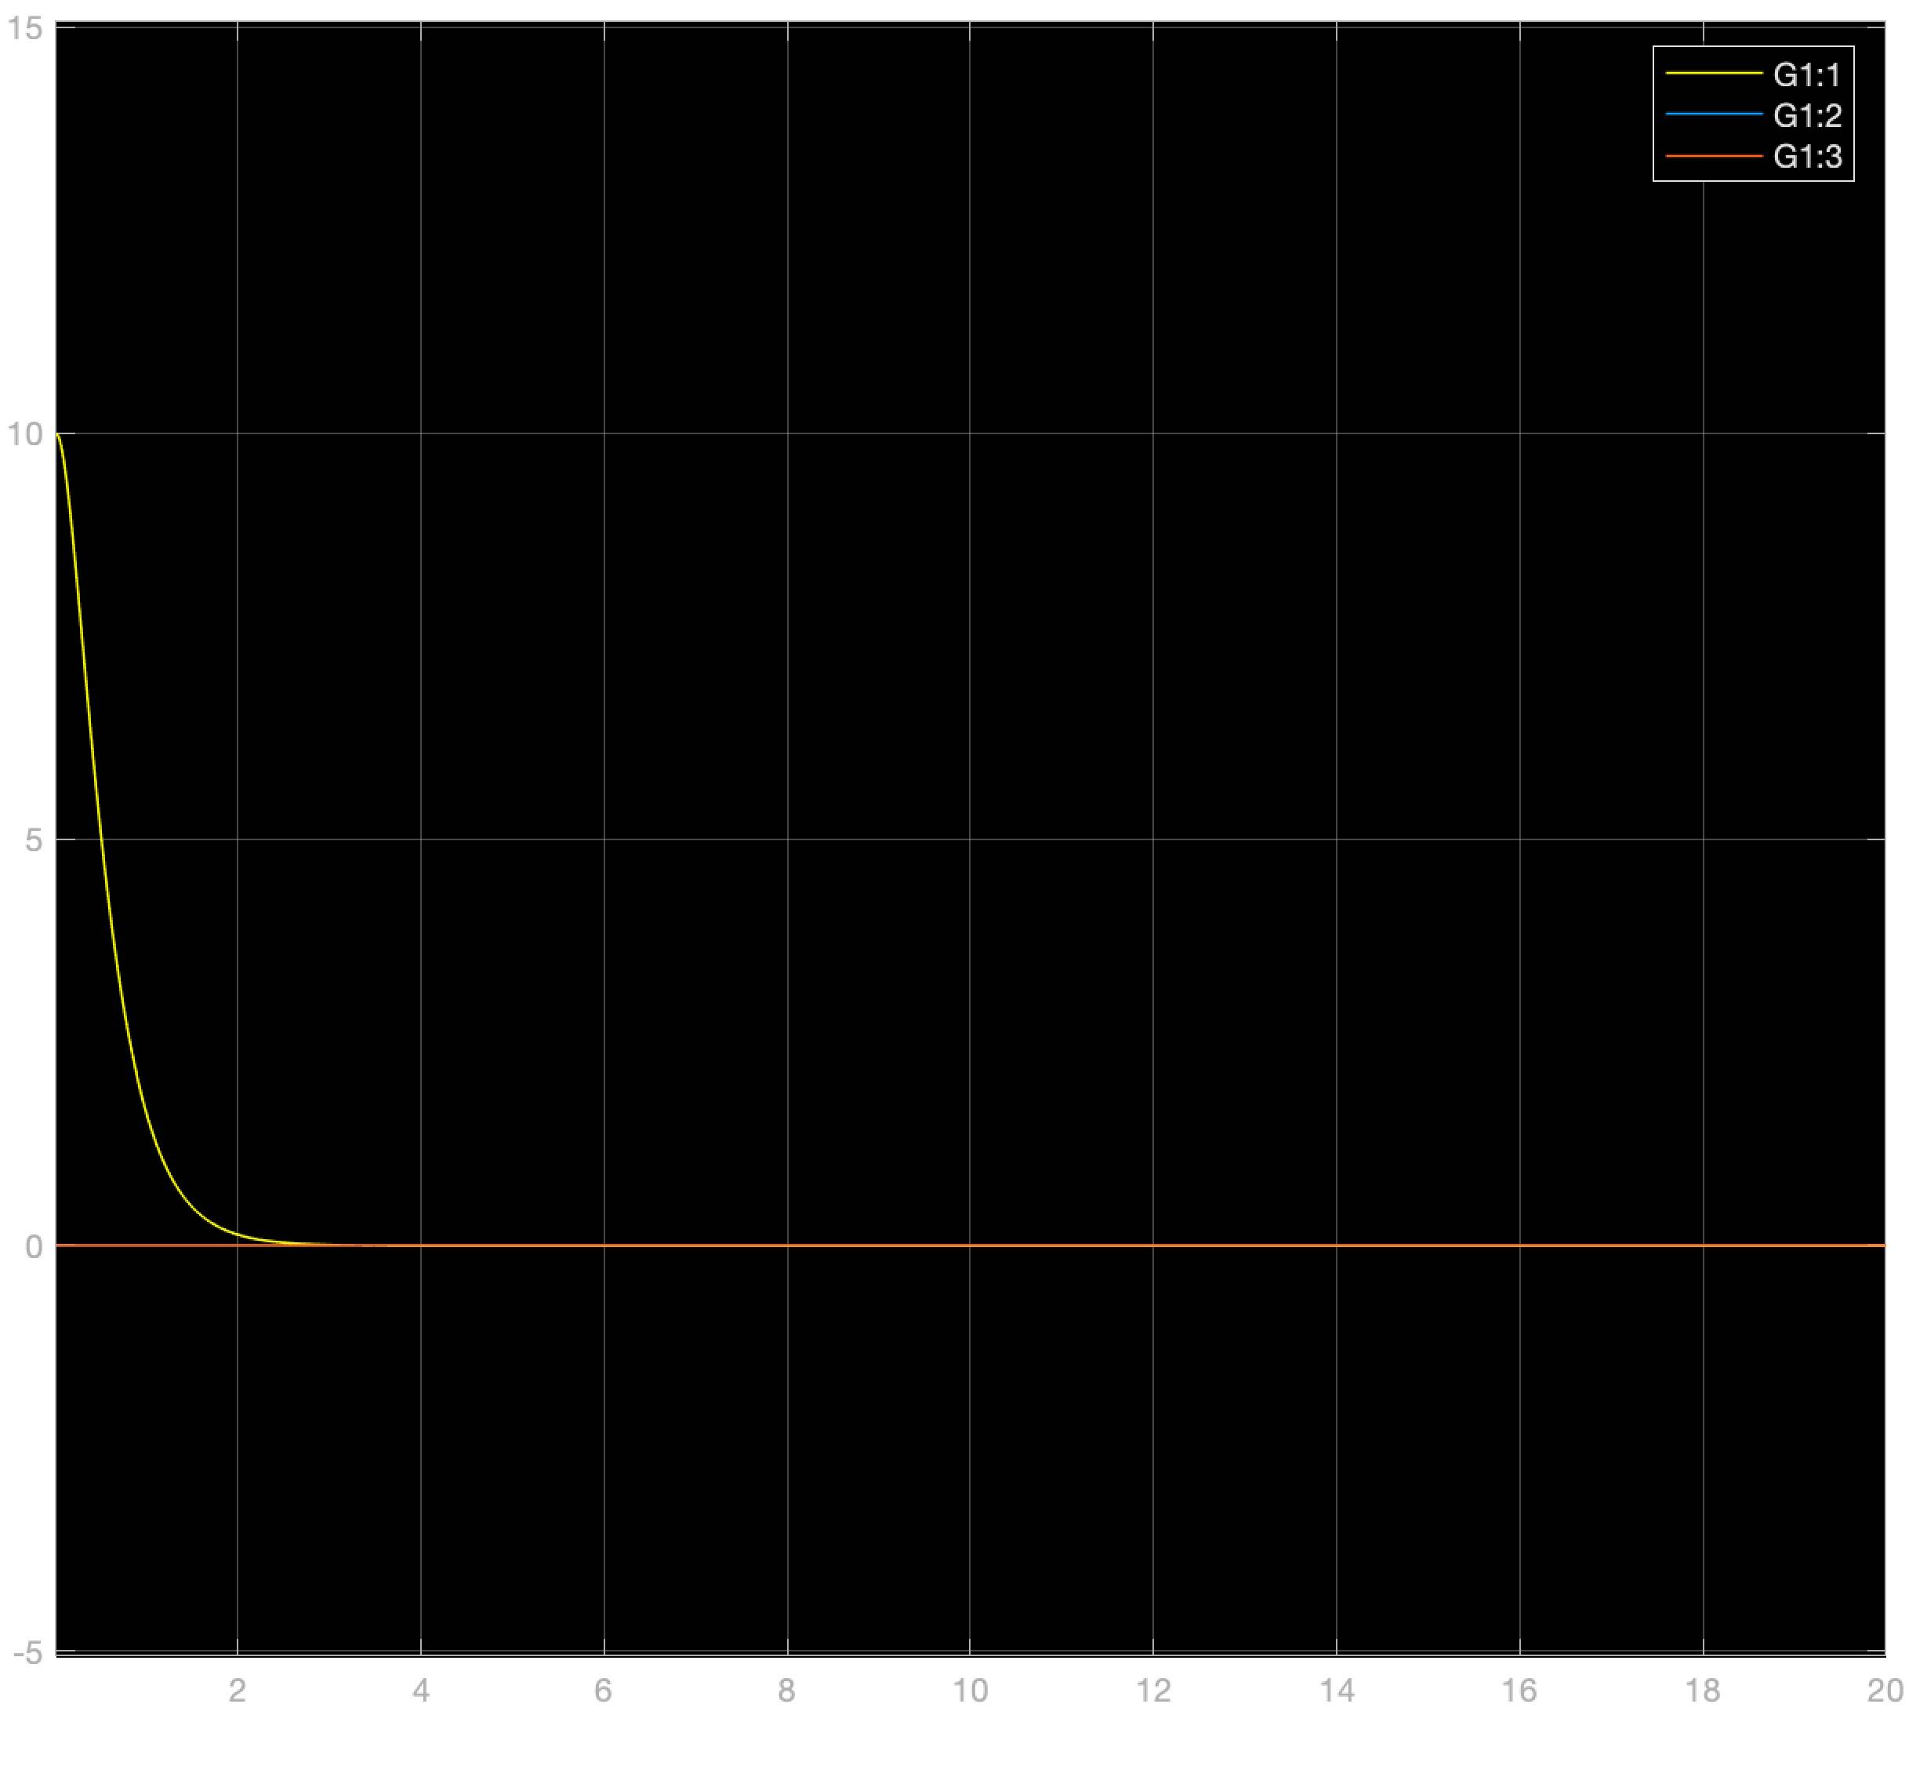
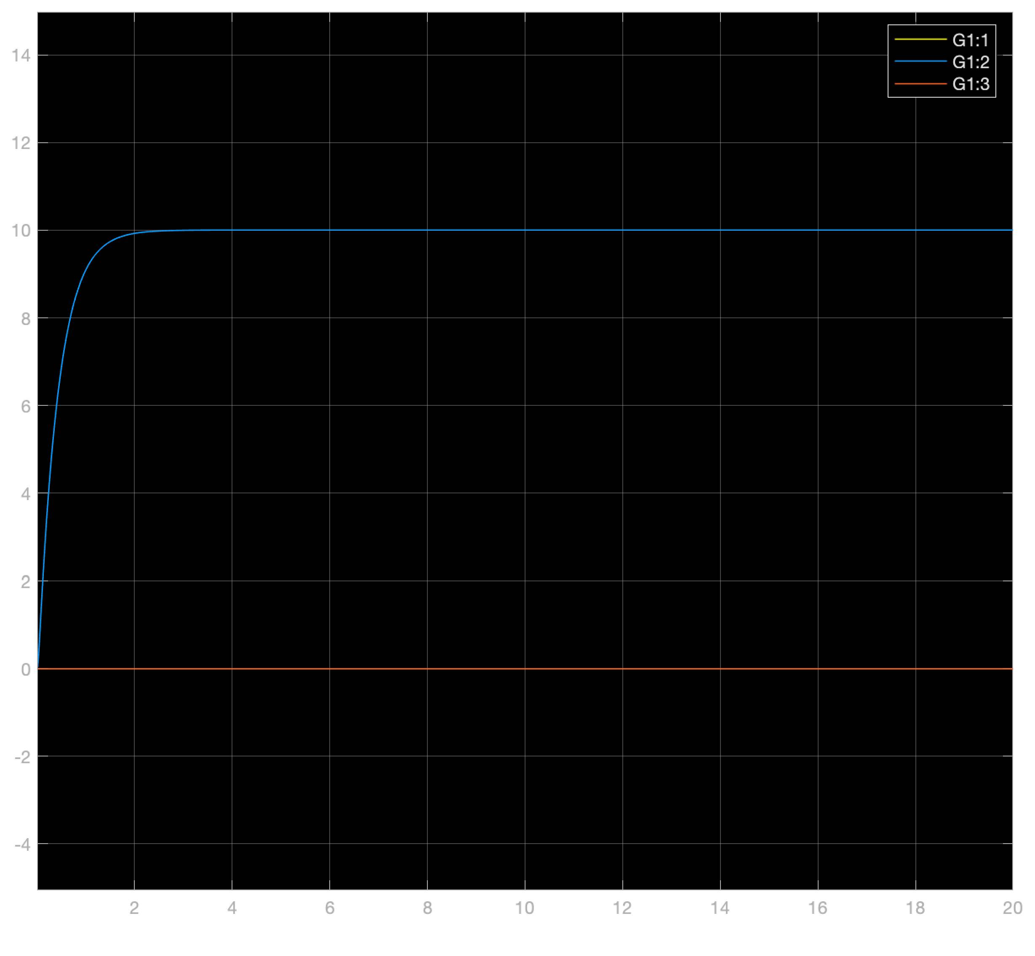
Evaluation of Simulink model using fishingline
Stable behavior
~2s to stabilize
Simplified as acceleration is set to zero
Roll from 10° → 0°
Pitch from 0° → 10°

Slide 8
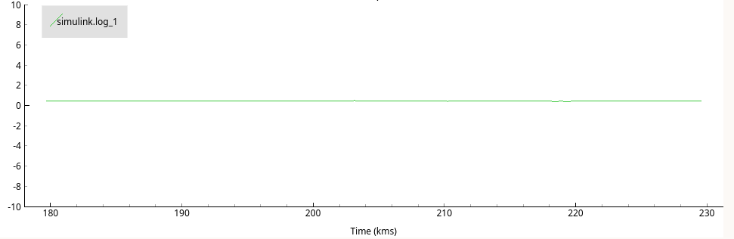
Evaluation of complemetary filter
Stable in stationary conditions
Gamma = 0.98
Unstable when flying
Pitch when laying flat at 0°

Slide 9
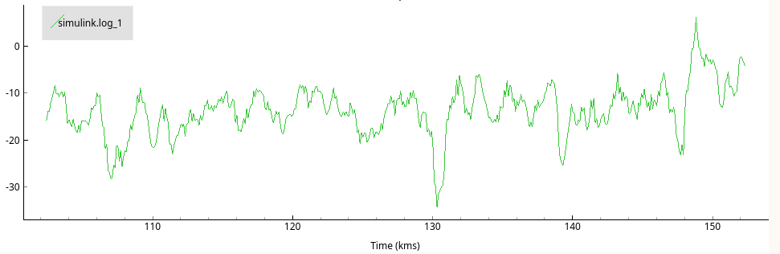
Evaluation of Simulink model using fishingline
Simulink simulations does not reflect real world
Oscillating pitch-angle around 0°/10°
Wobbly roll-angle behavior
Possible reasons - Plant model simplified - Fishing line not influence
Pitch angle stabalizing at 10°

Slide 10
Flying freely in the world
Controllable and stable
Difficulties to correct small angles bias to zero
A pitch bias present
Long oscillations trying to stabilize
Robust. Recovers hitting walls/ceilings
Further stability could be solved using integral states

Slide 11
C-code implementation - State vector -
volatile struct {
// angles - degree
float roll;
float pitch;
// angular velocity - degree / sec
float rateRoll;
float ratePitch;
float rateYaw;
} state;

Slide 12
C-code implementation - Main function-
void yourCodeInit(void)
{
tick = 1;
state.roll = 0.0f;
state.pitch = 0.0f;
filtsema = xSemaphoreCreateMutex();
setsema = xSemaphoreCreateMutex();
xTaskCreate(comp_filter, "FILTER",
(3 * configMINIMAL_STACK_SIZE), NULL, 3, NULL);
xTaskCreate(setPointtrack, "SETPOINT",
(3 * configMINIMAL_STACK_SIZE), NULL, 1, NULL);
xTaskCreate(controller, "CONTROL",
(3 * configMINIMAL_STACK_SIZE), NULL, 2, NULL);
}

Slide 13
C-code implementation - Filter function semaphores -
xSemaphoreTake(filtsema,portMAX_DELAY);
state.pitch= (1-gamma)*thetaacc + gamma*(state.pitch + h*sensorData.gyro.y);
state.roll= (1-gamma)*phiacc + gamma*(state.roll + h*sensorData.gyro.x);
state.rateRoll= sensorData.gyro.x;
state.ratePitch= sensorData.gyro.y;
state.rateYaw= sensorData.gyro.z;
tick++;
xSemaphoreGive(filtsema);

Slide 14
C-code implementation - setpoint function semaphores -
xSemaphoreTake(setsema,portMAX_DELAY);
commanderGetSetpoint(&setpoint, tick);
tick++;
xSemaphoreGive(setsema);

Slide 15
C-code implementation - Control function -
xSemaphoreTake(setsema,portMAX_DELAY);
xSemaphoreTake(filtsema,portMAX_DELAY);
„Calculate difference of setpoint and state“;
xSemaphoreGive(filtsema);
„Multiply LQR gain matrix with the calculated state/setpoint difference“;
„Add base thrust to values“;
xSemaphoreGive(setsema);
„Conversion to uint16_t“;

Slide 16
Demonstration

Slide 17
Thank you for your attention

