Slide 1
Project report – Group 22

Slide 2
Contents
Modeling and simulation of the plant
Evaluation of Simulink model
C-code implementation
Demonstration

Slide 3
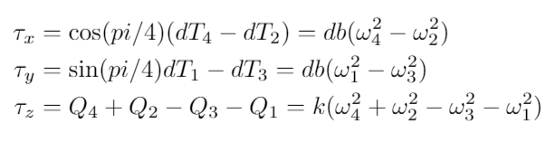
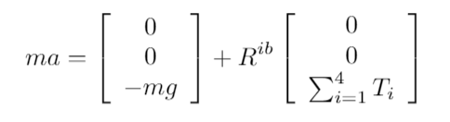



Modeling of the plant

Slide 4
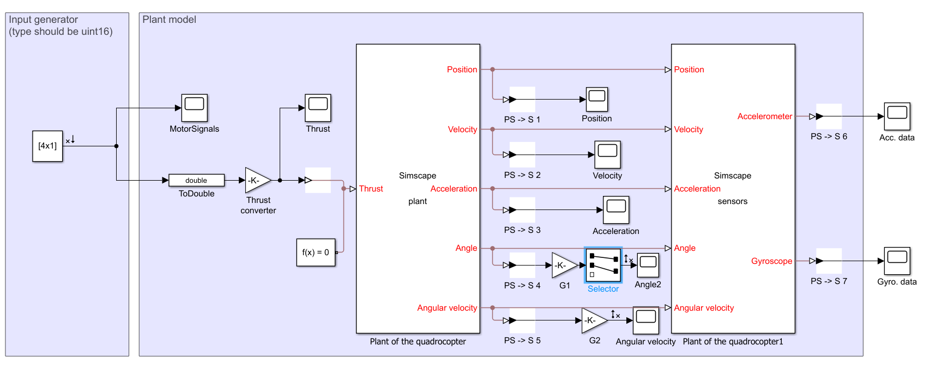
Linear analysis toolbox

Slide 5

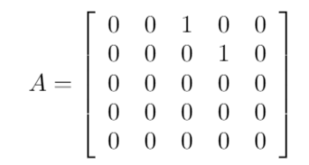
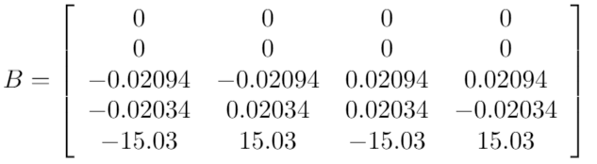
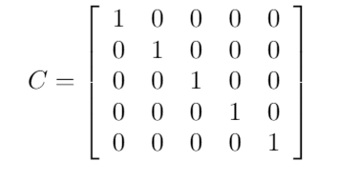
Linearization

Slide 6
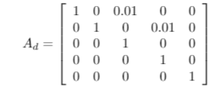
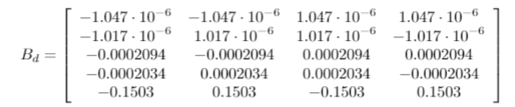
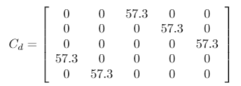
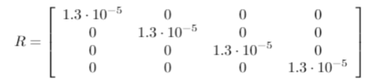
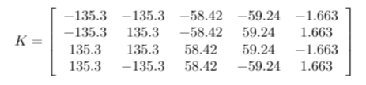
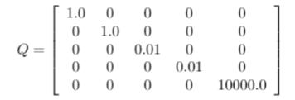
Discretization, LQR Design

Slide 7
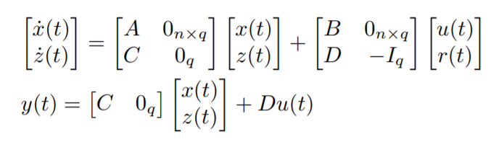


Integral action
What is integral action?
Why did we add it?
Why did we remove it?

Slide 8
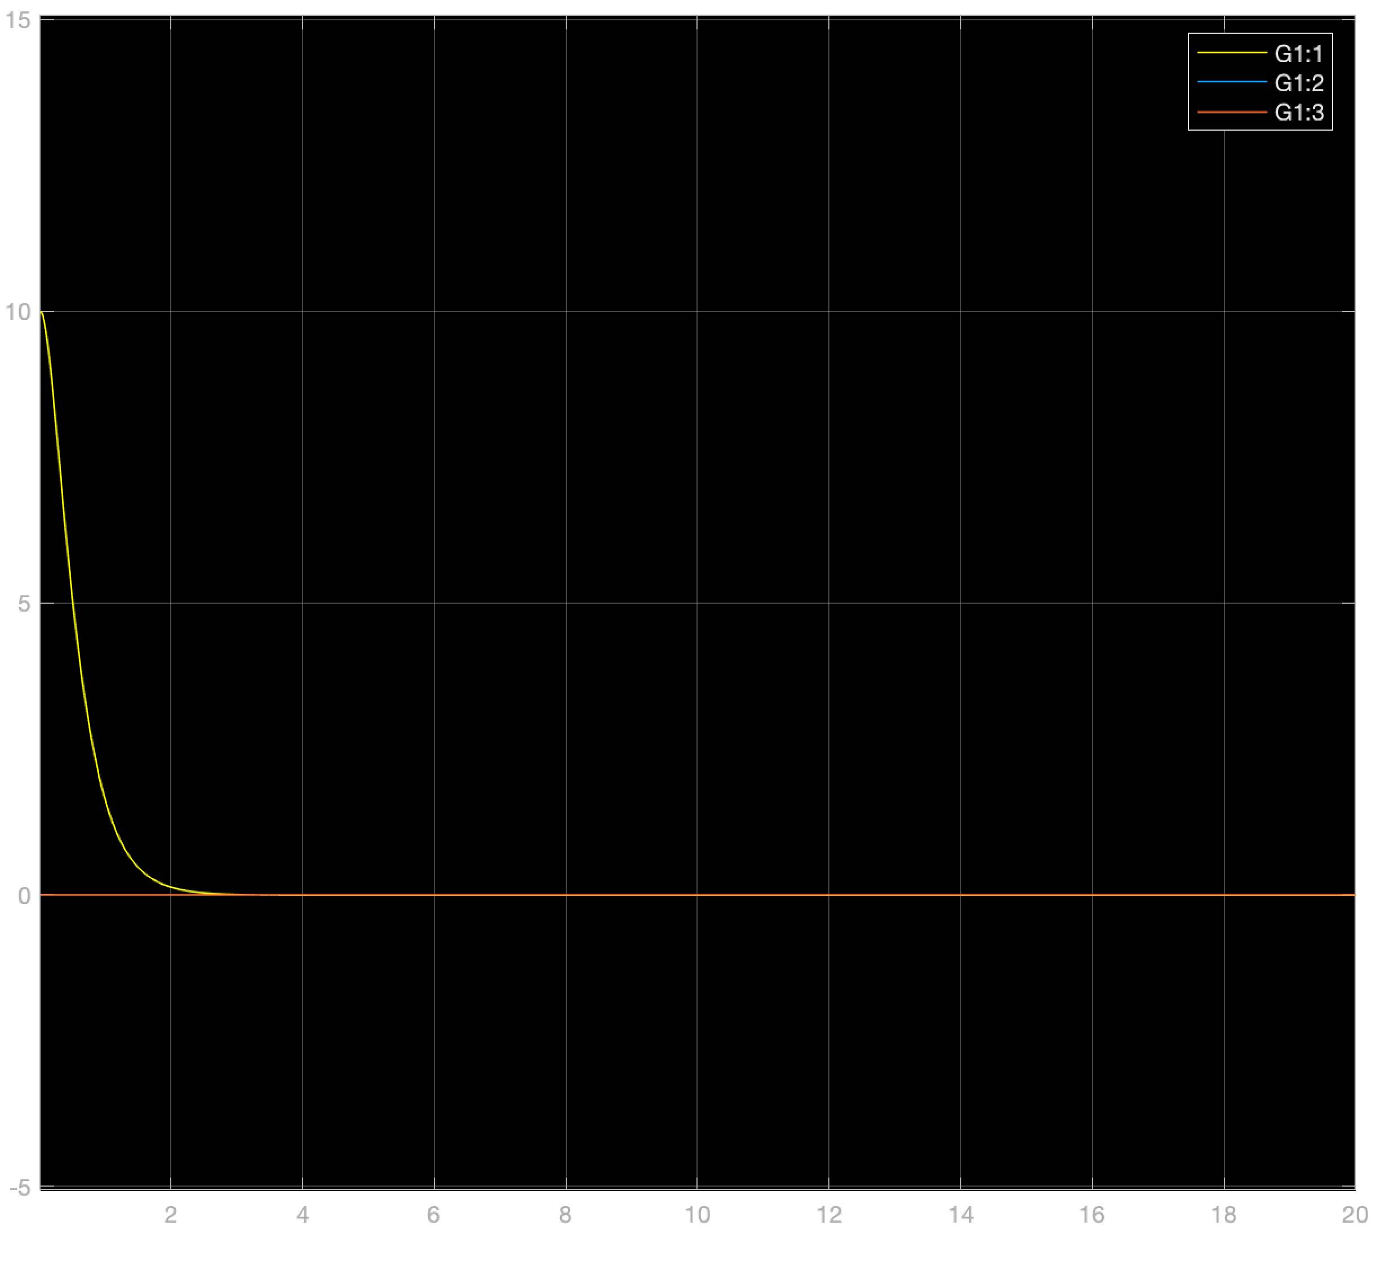
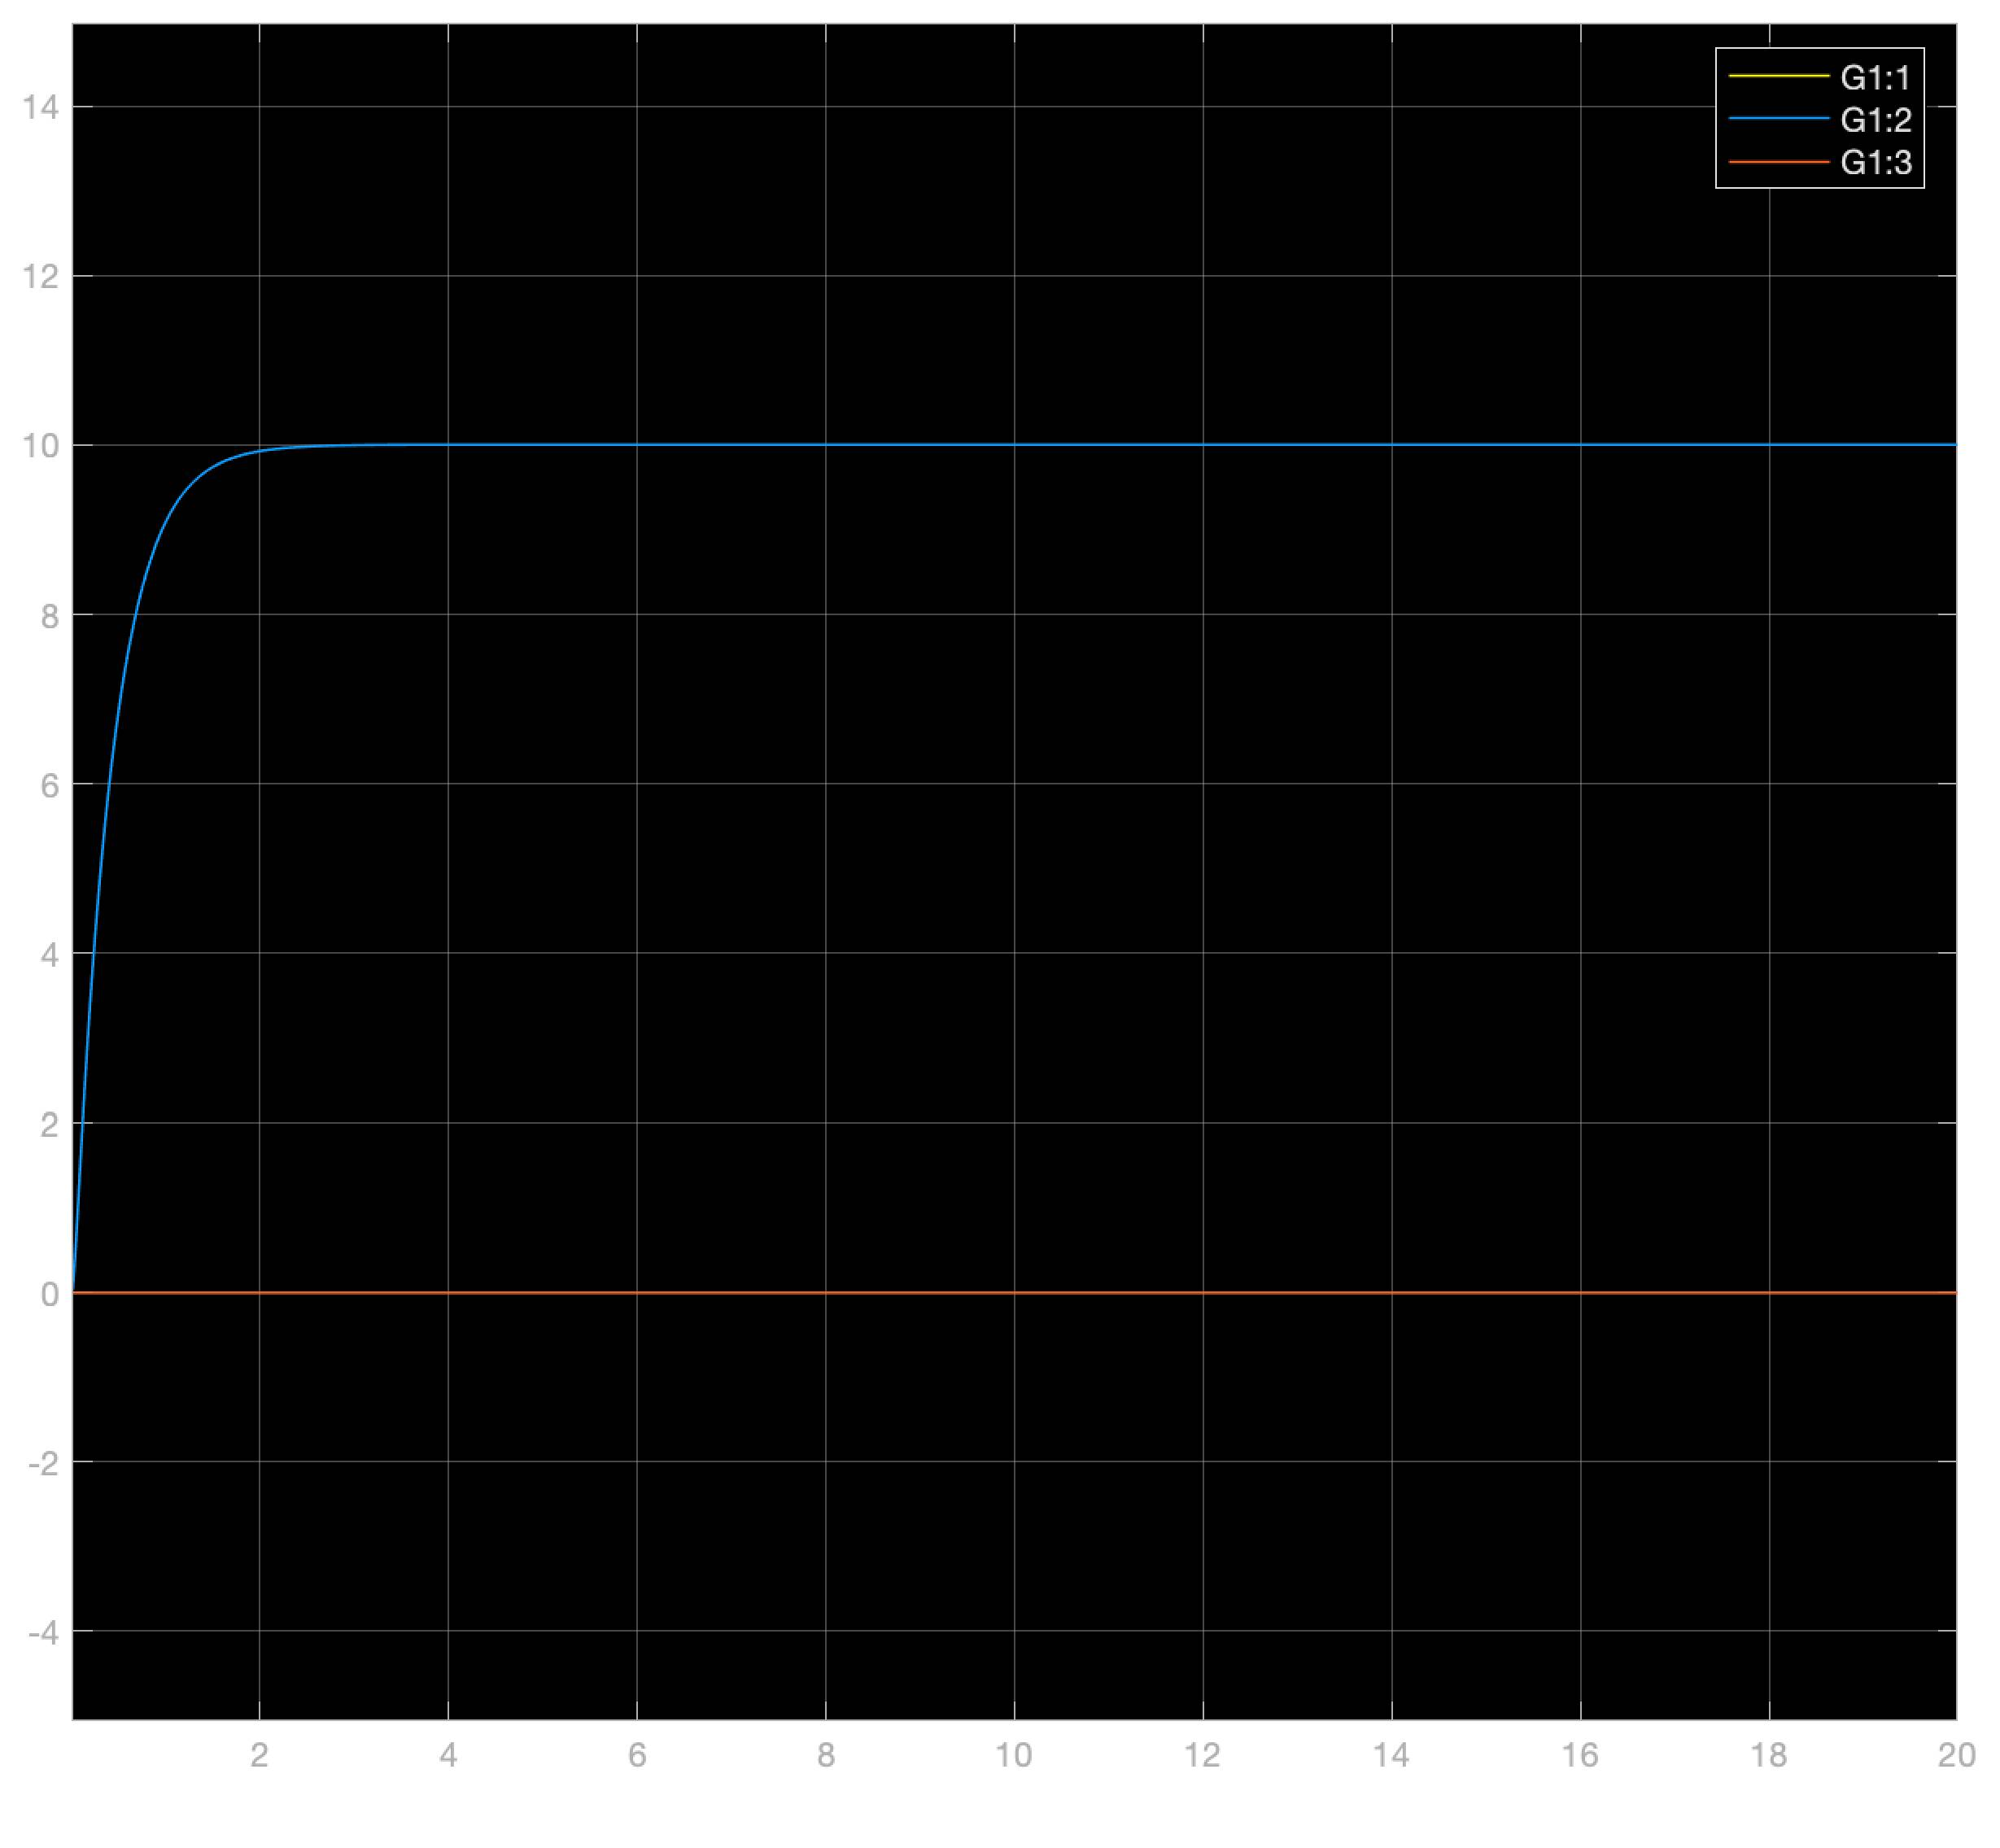
Evaluation of Simulink model using fishingline
Flawl3sss
Superb
No problems
A=0
Why u gay
Wheres the my plate

Slide 9
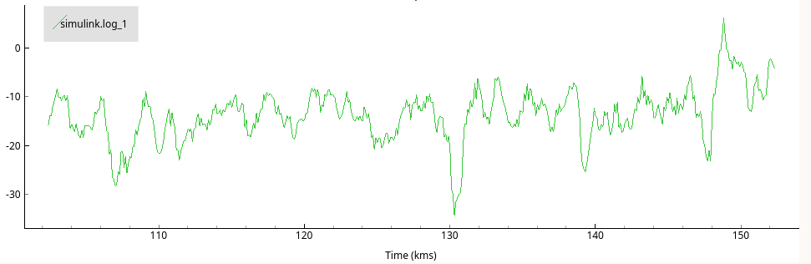
Evaluation of Simulink model using fishingline
Wobbly af
Kinda stabilizes around 10 or 0
Not like simulations
Simulink simple, real world has wind and air restiance, also a fishing line is not nice?
Finish line holder must be strong

Slide 10
Flying freely in the world
Very nice, w8 for the demo bruh
Can hit walls, and recover strongly
Sometimes roll bias
Long oscillations
Diffuculties to correct small angles biases
Further stability could be solved using intergration states

Slide 11
C-code implementation - State vector -
volatile struct {
// angles - degree
float roll;
float pitch;
// angular velocity - degree / sec
float rateRoll;
float ratePitch;
float rateYaw;
} state;

Slide 12
C-code implementation - Main function-
void yourCodeInit(void)
{
tick = 1;
state.roll = 0.0f;
state.pitch = 0.0f;
filtsema = xSemaphoreCreateMutex();
setsema = xSemaphoreCreateMutex();
xTaskCreate(comp_filter, "FILTER",
(3 * configMINIMAL_STACK_SIZE), NULL, 3, NULL);
xTaskCreate(setPointtrack, "SETPOINT",
(3 * configMINIMAL_STACK_SIZE), NULL, 1, NULL);
xTaskCreate(controller, "CONTROL",
(3 * configMINIMAL_STACK_SIZE), NULL, 2, NULL);
}

Slide 13
C-code implementation - Filter function semaphores -
xSemaphoreTake(filtsema,portMAX_DELAY);
state.pitch= (1-gamma)*thetaacc + gamma*(state.pitch + h*sensorData.gyro.y);
state.roll= (1-gamma)*phiacc + gamma*(state.roll + h*sensorData.gyro.x);
state.rateRoll= sensorData.gyro.x;
state.ratePitch= sensorData.gyro.y;
state.rateYaw= sensorData.gyro.z;
tick++;
xSemaphoreGive(filtsema);

Slide 14
C-code implementation - setpoint function semaphores -
xSemaphoreTake(setsema,portMAX_DELAY);
commanderGetSetpoint(&setpoint, tick);
tick++;
xSemaphoreGive(setsema);

Slide 15
C-code implementation - Control function -
xSemaphoreTake(setsema,portMAX_DELAY);
xSemaphoreTake(filtsema,portMAX_DELAY);
„Calculate difference of setpoint and state“;
xSemaphoreGive(filtsema);
„Multiply LQR gain matrix with the calculated state/setpoint difference“;
„Add base thrust to values“;
xSemaphoreGive(setsema);
„Conversion to uint16_t“;

Slide 16
Demonstration

Slide 17
Thank you for your attention

