Slide 1
Project report – Group 22
Notes:
Welcome everyone! we are project group 22, my name is Gustav and this is ..., ..., ...

Slide 2
Contents
Modeling and simulation of the plant
Evaluation of Simulink model
C-code implementation
Demonstration
Notes:
Our drone project can be sumarized into these different points: (Read points). And we will start with by briefly go over how the plant model was derived.

Slide 3
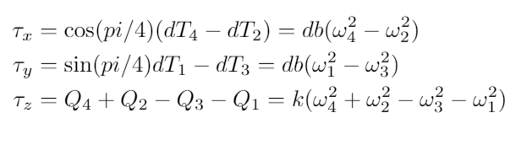
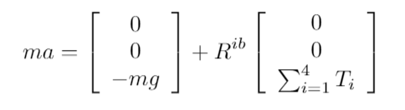



Modeling of the plant
Notes:
So, in order to model the drone we used Simscape to implement these equations that describe the simplified dynamics of the drone. I will not go into much detail about these equations since you all probably did the same thing here. I will just mentioned that when we had implement these equations we were given 2 different cases with given intputs that were supposed to give some outputs. This was just done in order to check if the implementation had been done correctly, which in our case it was. The next step was to implement a LQR controller, but before we could do that we had to linearize the model.

Slide 4
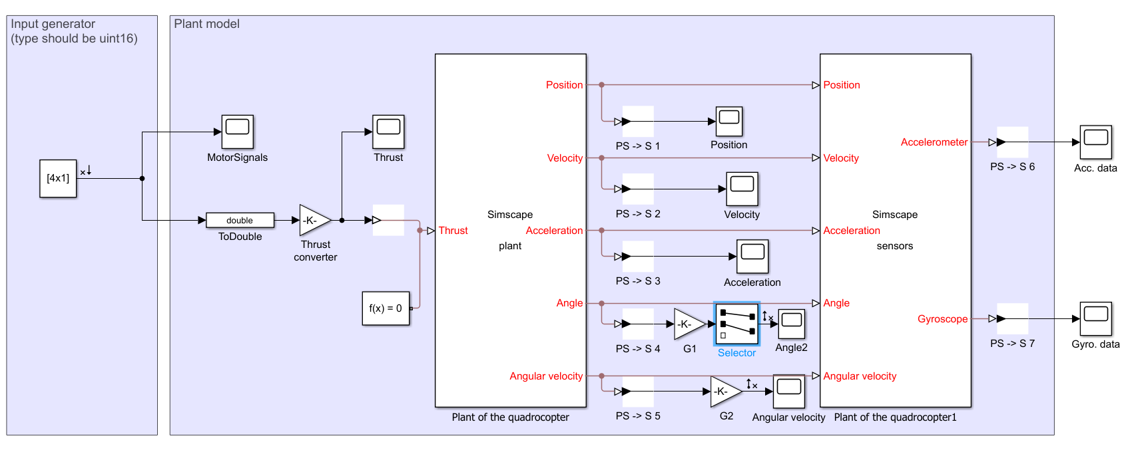
Linear analysis toolbox
Notes:
In order to perform the linearization, we used the Mathlab tool "Linear analysis toolbox". This tool is very easy to use since you just define the input and the output between what you want to linearize (Show the open loop simulink). Our linearization point were then choosen as the point when the drone is just hovering without doing anything else. The reason we choose this point is that this point is were the drone will mainly operate around.With this point we then performed the linearization to get our A and B matrices. Now our state matrix, A contained 15 states which were the position, velocity, acceleration, angles and angular velocity for directions x,y and z. However since the goal of the project is to fly the drone using small angular changes, the state vector were simplified to only contain the pitch and roll angle and also the angular velocities.

Slide 5

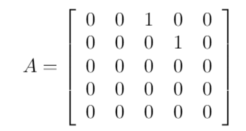
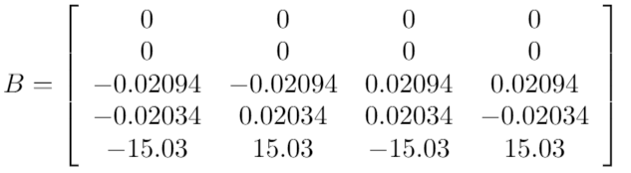
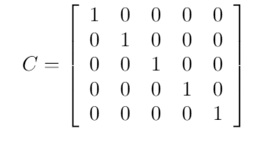
Linearization
Notes:
The final A and B matrices then looked like this (Show matrices). In order to control the drone, the pitch and roll angle need to be controlled, however by checking the B matrix, you can see that the inputs doesn't directly affect the angles,only the angular velocites. This shows that in order to change the angles, we need to include the angular velocities in our state vector.

Slide 6
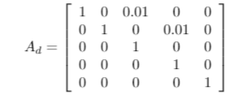
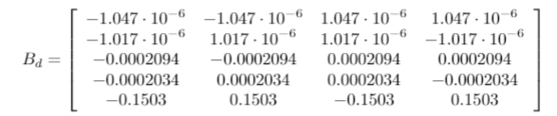
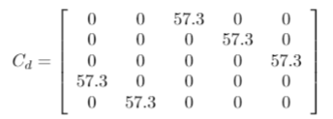
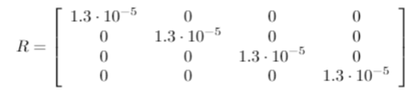
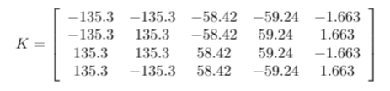
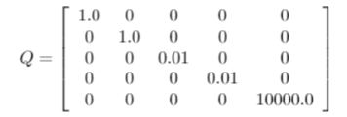
Discretization, LQR Design

Slide 7
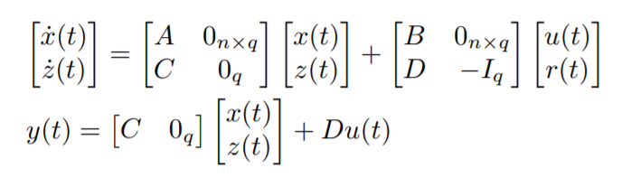


Integral action
What is integral action?
Why did we add it?
Why did we remove it?
Notes:
At first we also included three additional states, namely integral states for the roll and pitch angle and also for the yaw rate.Firstly what is integral action? Essentially what it means is that the system is augmented to something that looks like this (Show augmented). Now the state z is the integral between the reference and the output. In order to implement integral action, an additional gain is placed on the input signal. This gain is calculated by this formula (Show) and with the use of the new augmented state space model.The reason to why we added integral action is that in order to achieve an error that is zero, the input signal needs to be perfectly computed and this requires the plant model to be exact. This is not the case in this project so by adding these integral states, this will result in the error eventually being "pushed" down to zero. These states were later removed however. The reason for this was the number of problems that we encountered with the control design and to minimize the number of possible errors, the integral states were removed since they added another uncertainty to the project. We basically wanted to keep things simple in order to not make any unnecessary mistakes.

Slide 8
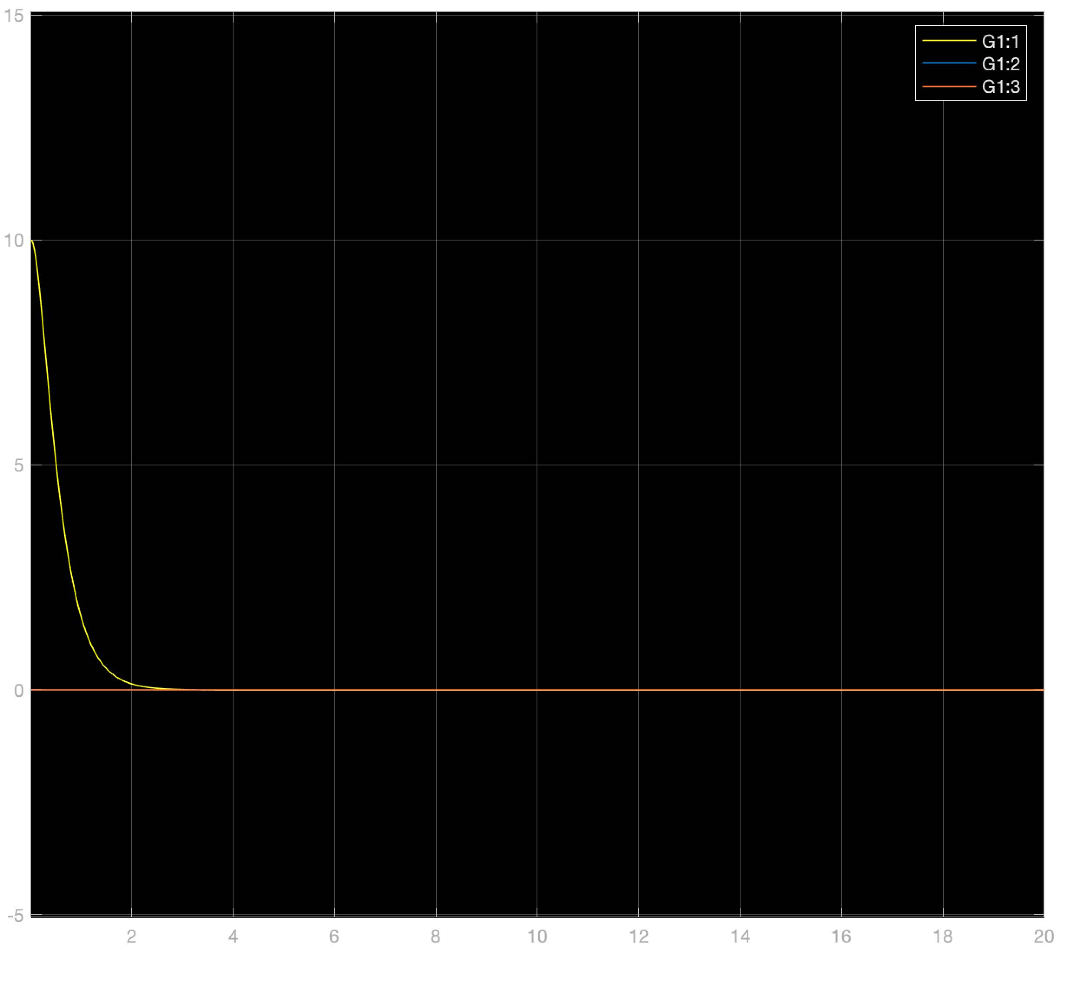
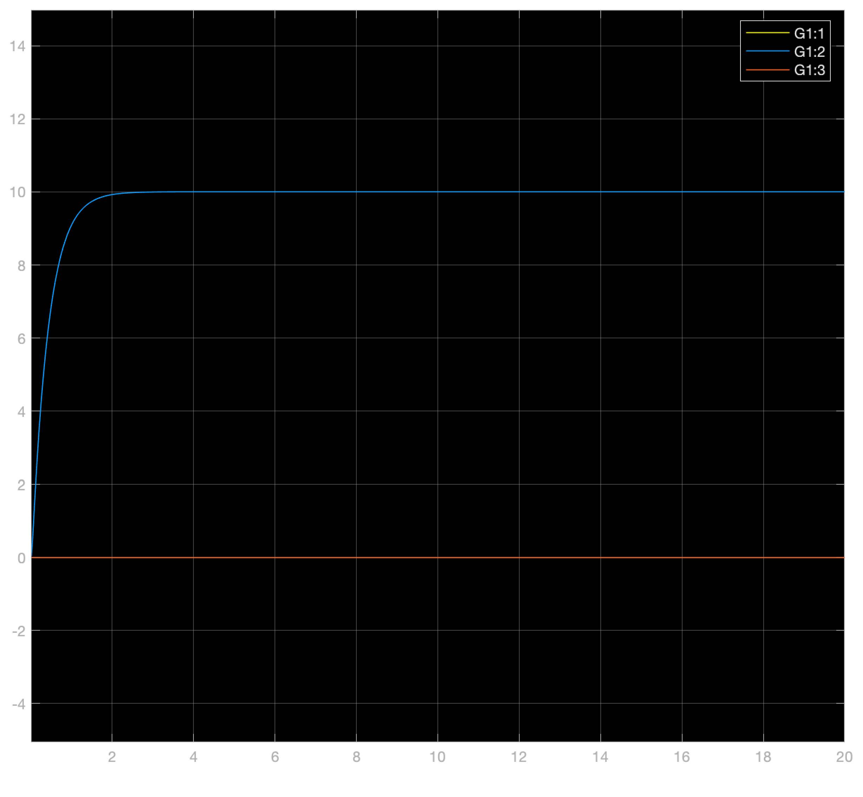
Evaluation of Simulink model using fishingline
Flawl3sss
Superb
No problems
A=0
Why u gay
Wheres the my plate

Slide 9
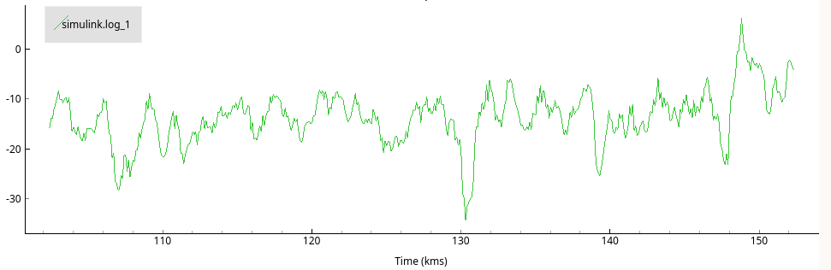
Evaluation of Simulink model using fishingline
Wobbly af
Kinda stabilizes around 10 or 0
Not like simulations
Simulink simple, real world has wind and air restiance, also a fishing line is not nice?
Finish line holder must be strong

Slide 10
Flying freely in the world
Very nice, w8 for the demo bruh
Can hit walls, and recover strongly
Sometimes roll bias
Long oscillations
Diffuculties to correct small angles biases
Further stability could be solved using intergration states

Slide 11
C-code implementation - State vector -
volatile struct {
// angles - degree
float roll;
float pitch;
// angular velocity - degree / sec
float rateRoll;
float ratePitch;
float rateYaw;
} state;

Slide 12
C-code implementation - Main function-
void yourCodeInit(void)
{
tick = 1;
state.roll = 0.0f;
state.pitch = 0.0f;
filtsema = xSemaphoreCreateMutex();
setsema = xSemaphoreCreateMutex();
xTaskCreate(comp_filter, "FILTER",
(3 * configMINIMAL_STACK_SIZE), NULL, 3, NULL);
xTaskCreate(setPointtrack, "SETPOINT",
(3 * configMINIMAL_STACK_SIZE), NULL, 1, NULL);
xTaskCreate(controller, "CONTROL",
(3 * configMINIMAL_STACK_SIZE), NULL, 2, NULL);
}

Slide 13
C-code implementation - Filter function semaphores -
xSemaphoreTake(filtsema,portMAX_DELAY);
state.pitch= (1-gamma)*thetaacc + gamma*(state.pitch + h*sensorData.gyro.y);
state.roll= (1-gamma)*phiacc + gamma*(state.roll + h*sensorData.gyro.x);
state.rateRoll= sensorData.gyro.x;
state.ratePitch= sensorData.gyro.y;
state.rateYaw= sensorData.gyro.z;
tick++;
xSemaphoreGive(filtsema);

Slide 14
C-code implementation - setpoint function semaphores -
xSemaphoreTake(setsema,portMAX_DELAY);
commanderGetSetpoint(&setpoint, tick);
tick++;
xSemaphoreGive(setsema);

Slide 15
C-code implementation - Control function -
xSemaphoreTake(setsema,portMAX_DELAY);
xSemaphoreTake(filtsema,portMAX_DELAY);
„Calculate difference of setpoint and state“;
xSemaphoreGive(filtsema);
„Multiply LQR gain matrix with the calculated state/setpoint difference“;
„Add base thrust to values“;
xSemaphoreGive(setsema);
„Conversion to uint16_t“;

Slide 16
Demonstration

Slide 17
Thank you for your attention

