Slide 1
Calambra Olive Oil
Section 2, Team 2:
Vishal Bajaj, Neal Doshi, Jonathan Hudgins, Joshua Jenkins, Lora Neel, Matt Simmons

Slide 2
Calambra Olive Oil
Table of Contents
Case Overview
Timeline and Business Challenge
Recommendation
Influence Diagram
Monte Carlo Setup
Risks
Detailed Results
Summary Comparison

Slide 3
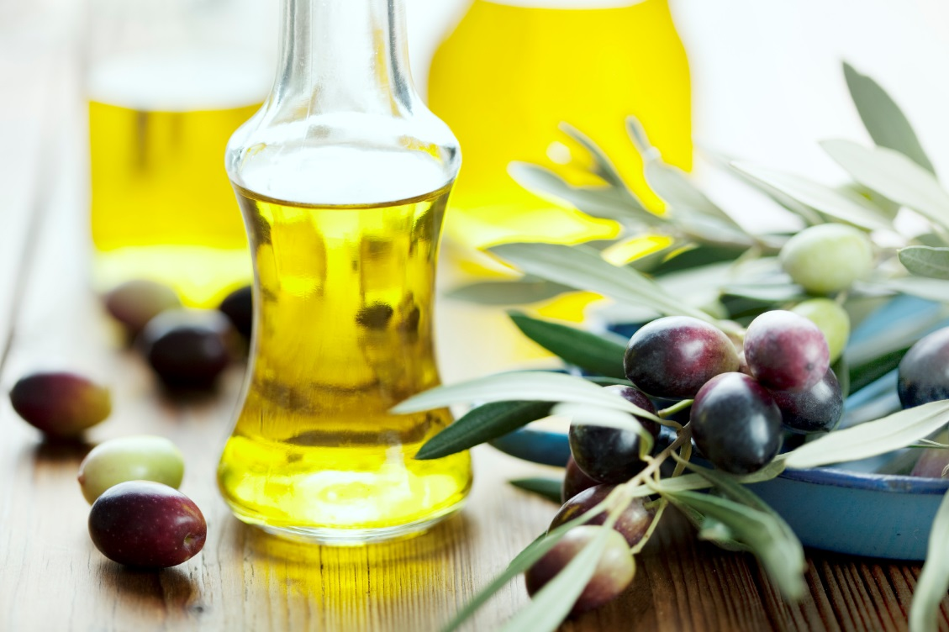
Calambra Olive Oil
Case Overview
Problem: Determine the appropriate order quantity for the
Year 1994 given expected 1993 demand with a number of uncertainties
Overview: Monte Carlo simulation and risk analysis to provide
Calambra an informed recommendation for 1994
Notes:
Frank is faced with the problem of demand uncertainty. Specifically, he asked been asked by his supplier to “reserve” his olives for the 1994 calendar year. However, he just launched his new venture in 1993 and doesn’t have any historical data to base his decision on. He has some information regarding potential 1993 demand based on a number of business development and marketing activities. The objective of this Monte Carlo simulation is to utilize this uncertain data to still form an informed opinion on 1994 demand and then make a decision on the amount to order in 1994. As the tornado chart indicates, Demand in 1994 is critical to the cash flow of the company.

Slide 4
Calambra Olive Oil
Timeline and Business Challenge
We are here
Bottled first crop of oil
Ambrano requested decision
Ambrano would harvest and deliver the olives
April
1993
August
1993
April
1994
Various uncertain events that impact 1993 Demand and therefore the order decision
(Shipped 24 cases)
Lots of uncertainties and complexity:
Neiman Marcus Order
Williams Sonoma Order
Awareness boost from Neiman Marcus catalog
Awareness boost from Williams Sonoma catalog
Sellout in 1993 (influenced by Price and catalog contracts)
Price per case in 1993 (positively correlated with demand and negatively correlated with 1994 Broker Fee)
Broker take in 1994

Slide 5
Calambra Olive Oil
Recommendation and Cash at the End of Year 2
Recommended Quantity to order for 1994
1,100 gallons
Mean | Median | Standard Deviation | Variance | Coeff. of Variation | Minimum | Maximum | Mean Std. Error
$8,164 | $16,656 | $25,311 | $640,650,856 | 3.11 | ($44,577) | $50,898 | $253
Notes:
The highest mean expected value at the end of year 2 is with an order of 1100 gallons.
The statistics give the range of the risk – a potential loss of $44,577 or a potential gain of $50,898.

Slide 6
Calambra Olive Oil
Influence Diagram
Key
Decision
Uncertainty
Result
Influence
Neiman Marcus Order
Catalog awareness boost
1994 Demand
Williams-Sonoma Order
1993 Total Demand
Price Per Case
0.5
-0.25
Cash Flows
1994 Broker Fees
1993 Retail Demand
-0.5
1994 Ordering Decision
Bottling & Other Costs

Slide 7






Calambra Olive Oil
Monte Carlo Setup
High Level Structure
Assumptions
1994 Order Qty
Custom 10-50-90 Distribution
Cash by End of Year 2
Retail Demand
Sellout in 1993 – Higher Demand Parameters
Don’t Sellout in 1993 – Multiplier of 1993 Sales
Awareness Boost: Neiman Marcus Catalog
Awareness Boost: Williams-Sonoma Catalog
1994 Demand
Range
Multiplier
Sellout in 1993
Don’t Sellout in 1993
Yes-No Distribution
Neiman Marcus Order
Williams-Sonoma Order
Number Ordered in 1993
≤
1993 Demand
Number Ordered in 1993
>
1993 Demand
Fixed
Fixed
Uncertainty:
Retail Demand
NM Order
WS Order
2 Separate Catalog Boosts
Price
Broker Fee 1994
Uncertainty:
Retail Demand
NM Order
WS Order
2 Separate Catalog Boosts
Price
Broker Fee 1994
Triangle 10-50-90 Distribution
Wholesale price per case

Slide 8
Calambra Olive Oil
Risks
Risks involved with ordering oil that exceeds demand:
High inventory costs
Increased warehousing costs
Scrap rate as olive oil loses it life cycle
Most importantly – excess costs cause Frank to shut down and go out of business
Not meeting demand by not ordering enough oil
Loss of potential customer base to either consumer base
Loss in startup revenue needed to succeed
May lose “first strike” chance to become preeminent retailer
As Frank’s consultant you lose credibility
Other factors
High uncertain and variable demand
Low margin business
Potential capacity issues
Lack of 1993 catalog sales leading to “gloom and doom” for 1994
Low probability of selling to Nordstrom and Williams Sonoma further increases risk
Lack of brand recognition as a startup
Expensive business location - increasing costs
Maximizing Profit
Preventing Business Failure

Slide 9
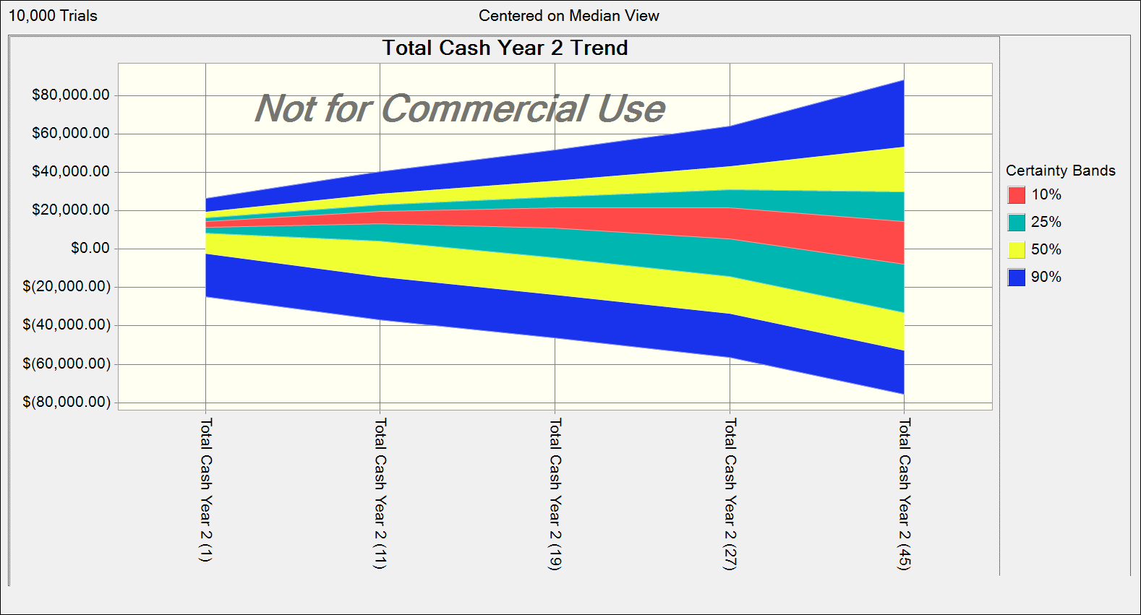
Calambra Olive Oil
Risks
550
1,100
1,540
2,035
3,025
< 990
990-1210
>1210
Not Meeting Forecasted Demand
Acceptable Forecasted Range
Exceeding Forecasted Demand
Notes:
Range based on 2 order sizes (110 gallons) on either side of the optimal demand. With all the uncertainties involving demand, we kept our range a little wider to accommodate the uncertainties.
Appears to be a capacity issue as profit decreases as number of gallons increase, bottling costs skyrocket with increase in gallons. Additionally, cost of oil indicates that new costs structure needs to be addressed.
Need to address process improvement for long-term success of company
Demand range is highly variable due to Frank’s current demand uncertainties
As order quantity increase certainty of losing money increases
Additionally, the ranges provide a guide to the profit maximizing order size. There are uncertainties but there are also limitations to the model. If Frank sells just under the 1993 Quantity, then the model is pulling in a lower demand function. However, it might be reasonable to use the “sellout” demand function if Frank is close to selling out. The ranges can help by adding an acceptable forecast range.

Slide 10
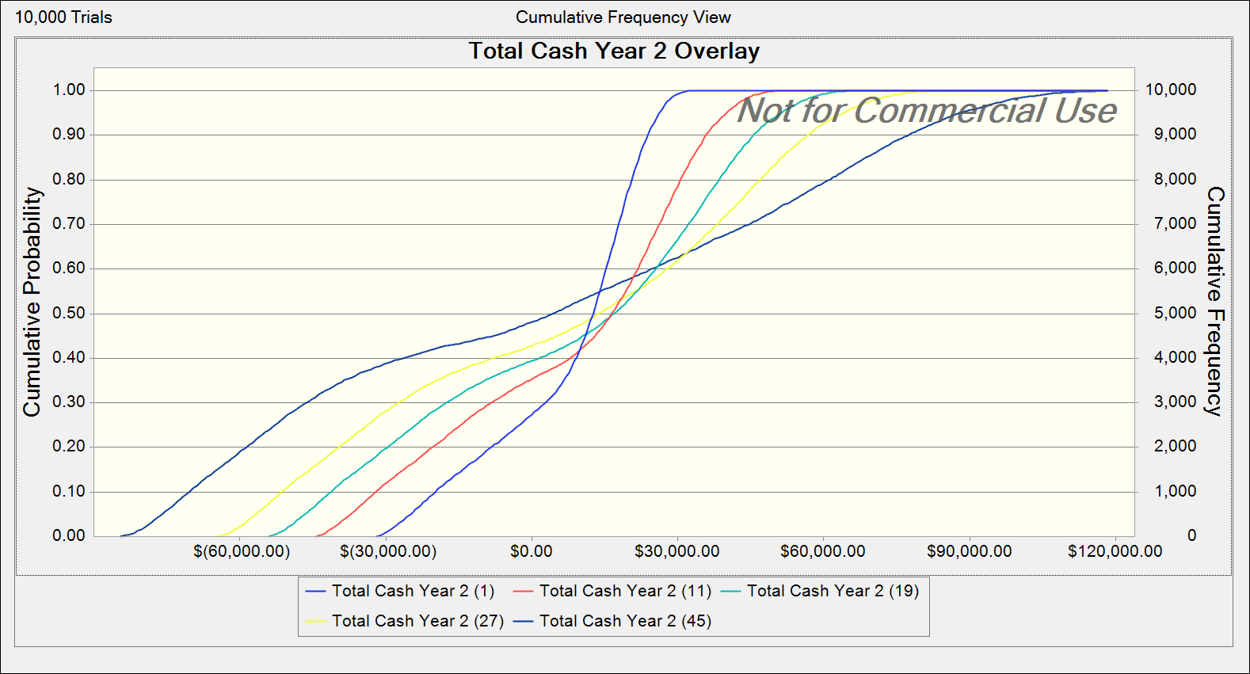
Calambra Olive Oil
Understanding Level of Risk at Various Quantities
The least risk for total cash at the end of year two is with an order of only 550 gallons.
The risk increases as the order quantity gets larger.
The reward (expected value) is highest at 1,100 gallons and drops lower with a bigger or smaller order, with a significant drop in mean value closer to 2975 gallons.
2975 gallons
2,035 gallons
1,540 gallons
1,100 gallons
550 gallons
Notes:
The least risk for total cash at the end of year two is with an order of only 550 gallons.
The risk increases as the order quantity gets larger.
The reward (expected value) is highest at 1100 gallons and drops lower with a bigger or smaller order, with a significant drop in mean value closer to 3000 gallons.

Slide 11
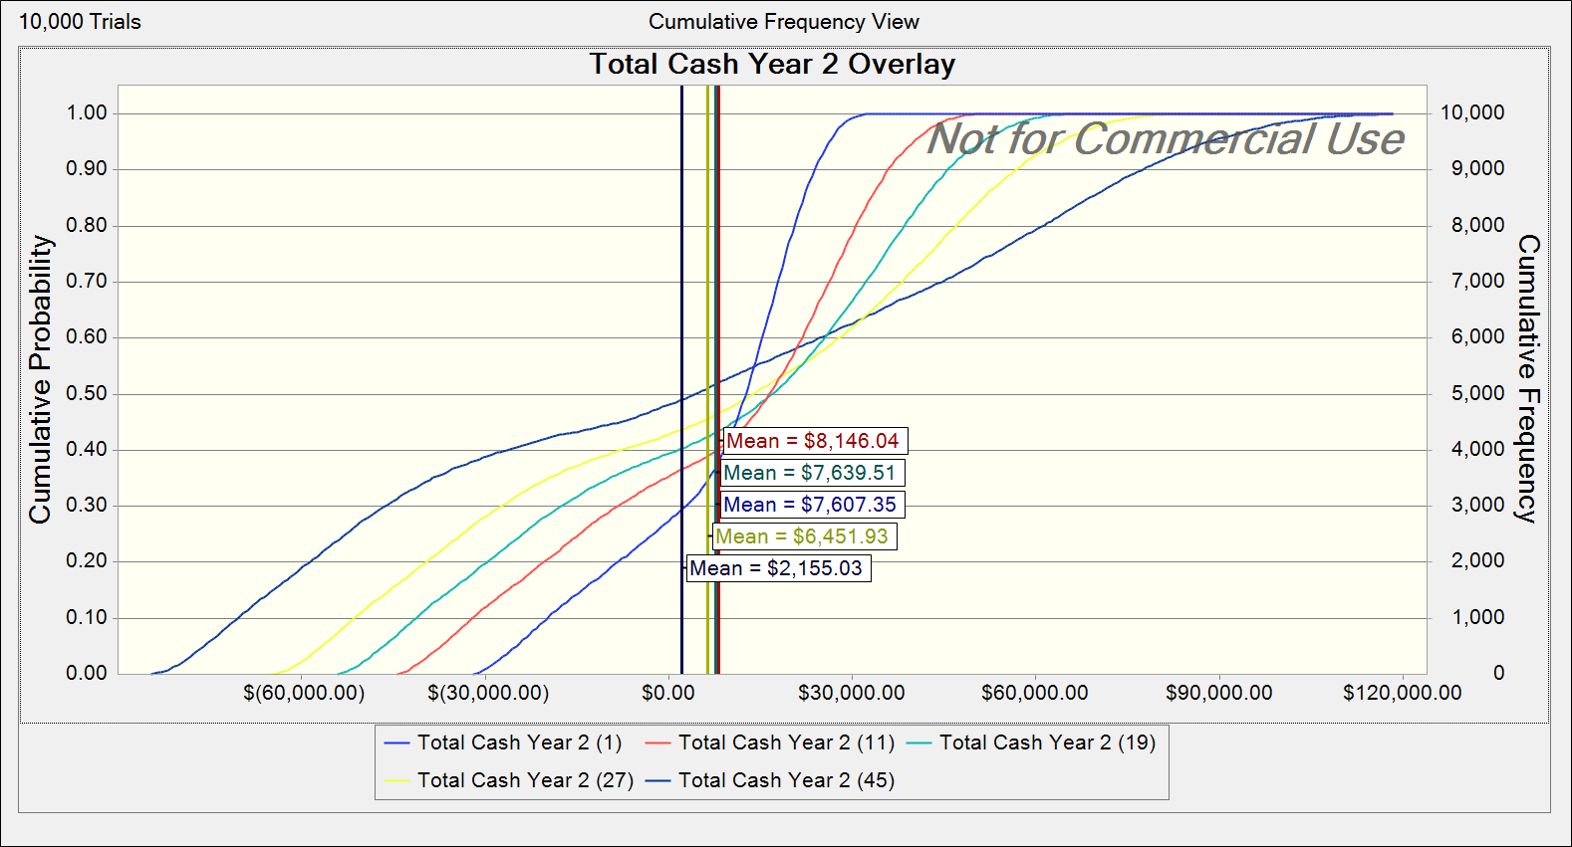
Calambra Olive Oil
Risk Tolerance
Statistic | Total Cash Year 2 (1) 550 Gallons | Total Cash Year 2 (19) 1,540 Gallons
Mean | $7,607 | $7,640
Median | $12,909 | $17,056
Standard Deviation | $15,905 | $32,821
Variance | $252,979,802 | $1,077,244,713
Minimum | ($31,880) | ($54,335)
Maximum | $32,723 | $65,839
Mean Std. Error | $159 | $328
At 550 and 1,540 gallons, the mean expected cash is very similar.
However, the variance is much higher with 1,540, making it riskier.
Notes:
Depending on Franks’s risk tolerance, he could change his order up or down within a range of approximately 500 gallons with less than a 10% impact on mean expected value but take on more or less risk.

Slide 12
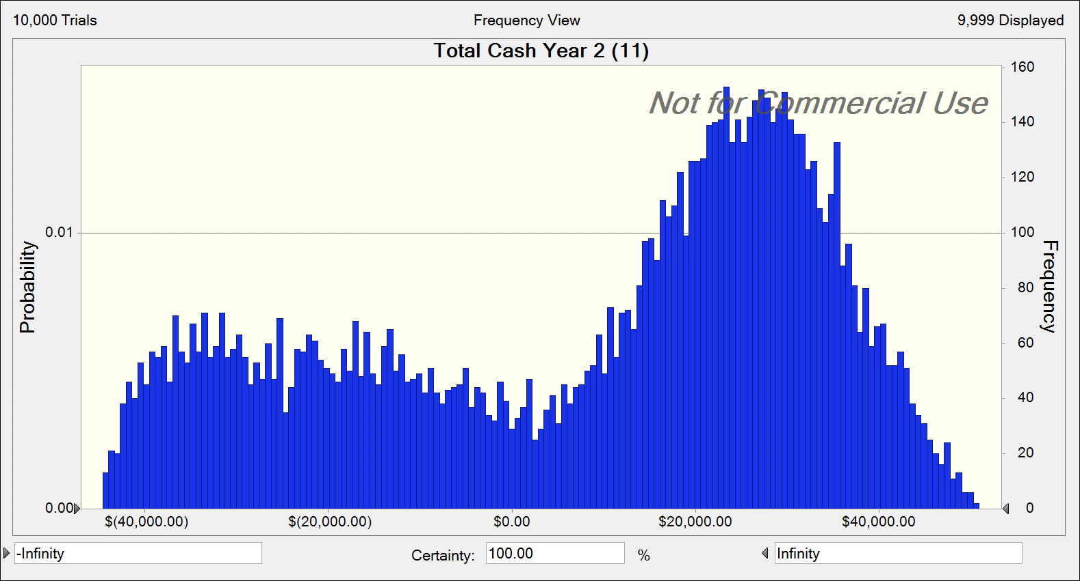
Calambra Olive Oil
Expected Cash Flows at 1,100 Gallons
1993 performance has significant impact on 1994 performance
Leads to the two peak distribution of results
Notes:
Like the idea of the “random walk”, the sales in year 1 have a significant impact on the sales in year 2, leading to a dichotomy in the results.

Slide 13
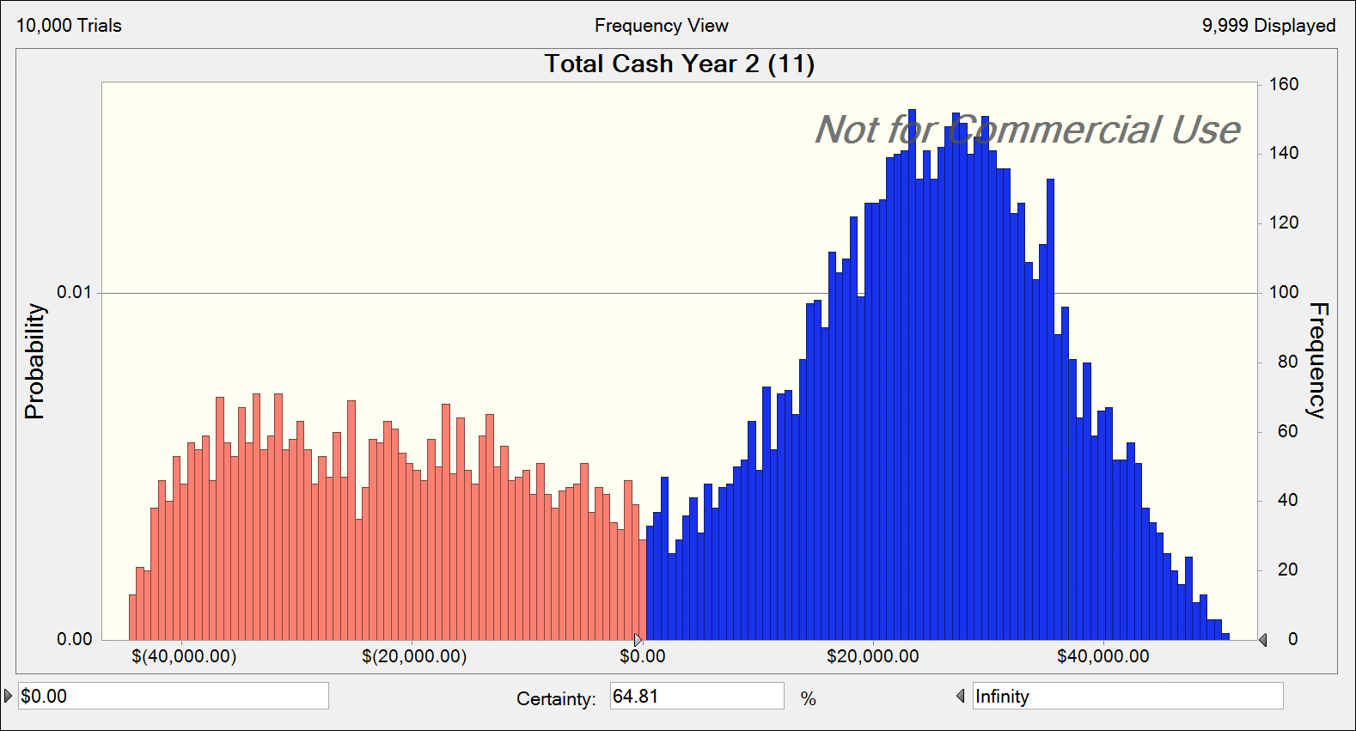
Calambra Olive Oil
Probability of Achieving a Profit in First 2 Years at 1,100 Gallons
65% probability of being Cash Flow positive in the first 2 years.

Slide 14
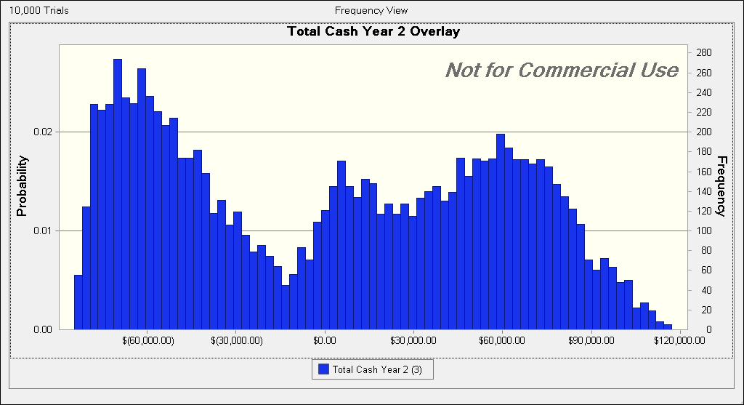
Calambra Olive Oil
Summary at Initial Plan of 3,000 Gallons
Statistic | Value
Mean | $2,311
Median | $5,495
Standard Deviation | $55,736
Variance | $3,106,514,849
Minimum | $(84,584)
Maximum | $117,185
Mean Std. Error | $557

Slide 15
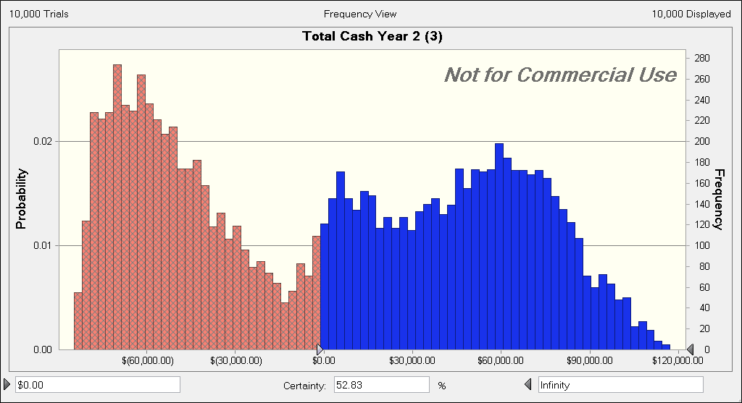
Calambra Olive Oil
Summary at Initial Plan of 3,000 Gallons
53% probability of being Cash Flow positive in the first 2 years.

Slide 16
Calambra Olive Oil
Summary Comparison
Original Plan: 3,000 Gallons
Recommendation: 1,100 Gallons
Increased mean expected cash after 2 years
Decreased risk
Limit downside losses
However, also reduce upside maximum expected revenue
38% increase on 1993 order, rather than 275% as originally planned.
Mean Cash After 2 Years
$2,311
$8,164
Standard Deviation
$55,736
$25,311
Variance
$3,106,514,849
$640,650,856
Minimum
$(84,584)
($44,577)
Maximum
$117,185
$50,898

