Slide 1
MVL Gates Using Verilog HDL
Presentation Subtitle

Slide 2
Quaternary algebra
In this work, Quaternary Algebra was chosen as Multi-Valued Logic. Quaternary is the base-4 numeral system, thus quaternary logic uses 0, 1, 2 and 3 as its truth levels, where 0 is “absolute false” and 3 is “absolute true”.

Slide 3
How quaternary logic is implemented in HDL?
For any of the gates, the separate digits of input binary values should be considered. For example, if we have inputs of 2 and 3 (10 and 11), we obtain the output of <FUNCTION(1, 1), FUNCTION(0, 1)>.

Slide 4
Main MAX, MIN, Sum Of Functions
MIN - A.B = MIN[A, B]
MAX - A + B = MAX[A, B]
Sum Of - A ⊕ B = A + B (Mod 4), where A and B serve as inputs.

Slide 5
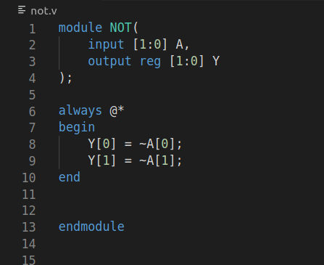
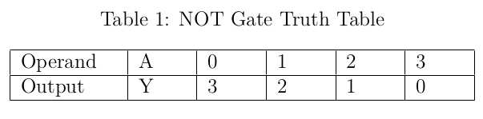
NOT Gate
The design of quaternary NOT Gate is very similar to binary NOT, having only one input and one output.

Slide 6
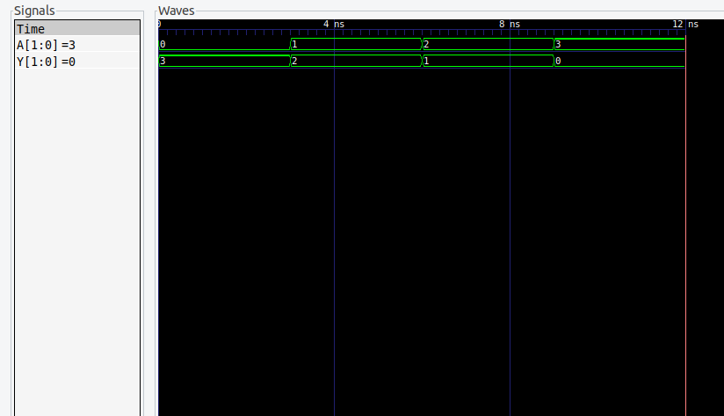
NOT GATE SIMULATION

Slide 7
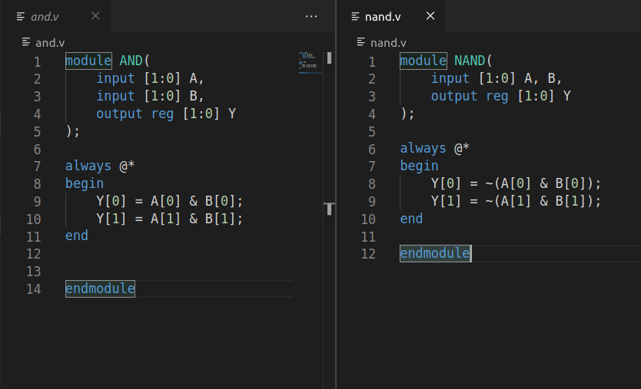
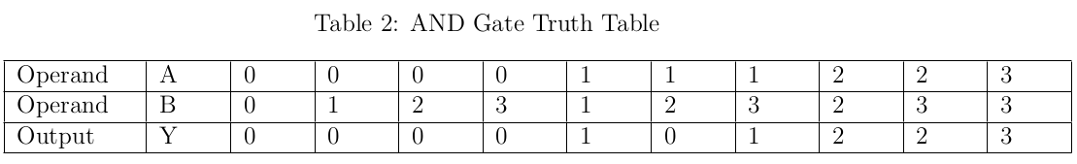
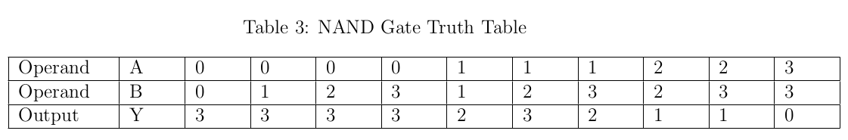
AND and NAND Gates
AND and NAND Gates have two inputs and produce one output in quaternary algebra.

Slide 8
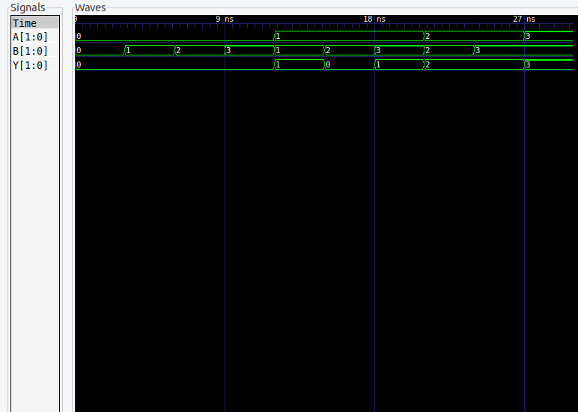
AND GATE SIMULATION

Slide 9
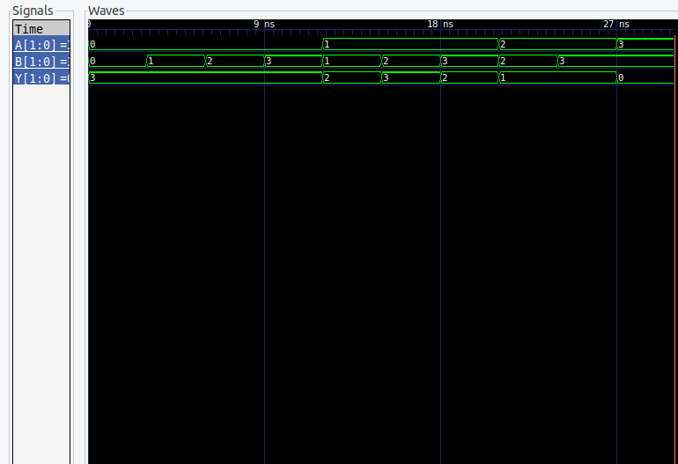
NAND GATE SIMULATION
AND GATE SIMULATION

Slide 10
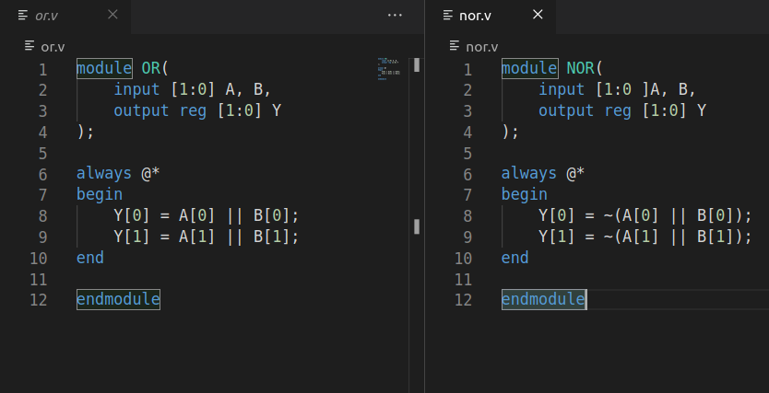
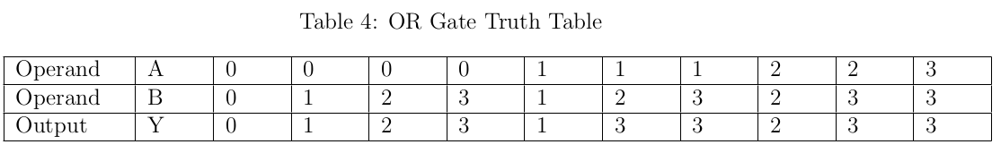
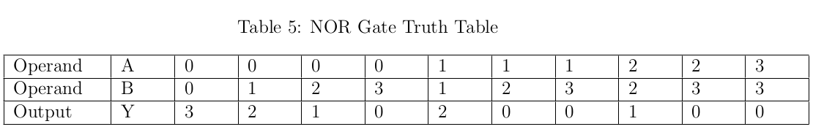
OR and NOR Gates
OR and NOR Gates have two inputs and produce one output in quaternary algebra.

Slide 11
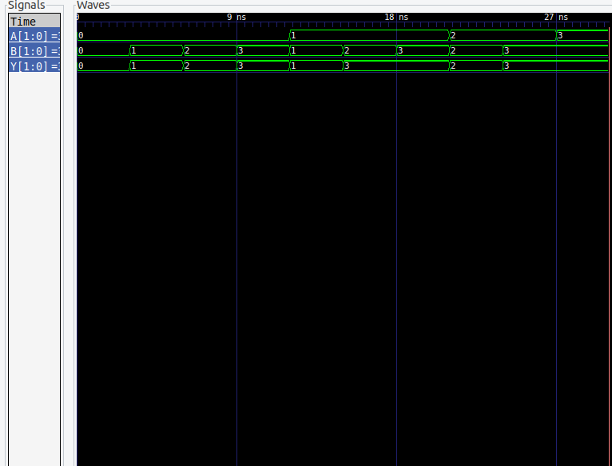
OR GATE SIMULATION
AND GATE SIMULATION

Slide 12
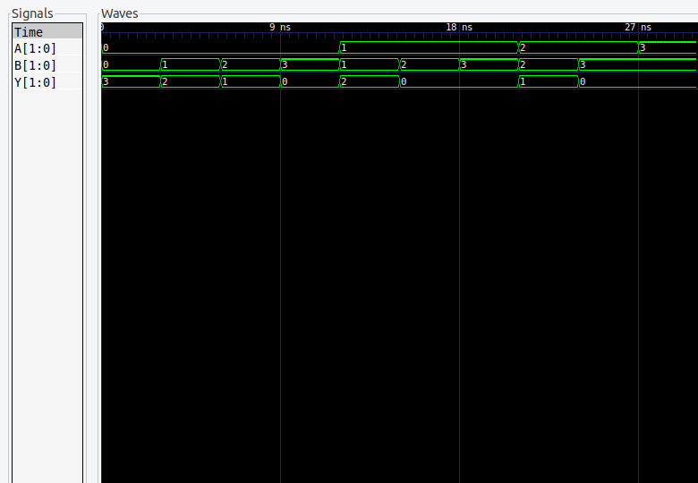
NOR GATE SIMULATION
NOR GATE SIMULATION
AND GATE SIMULATION

Slide 13
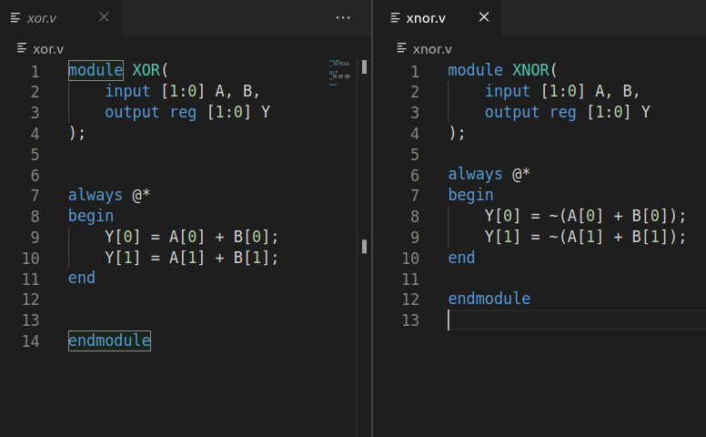
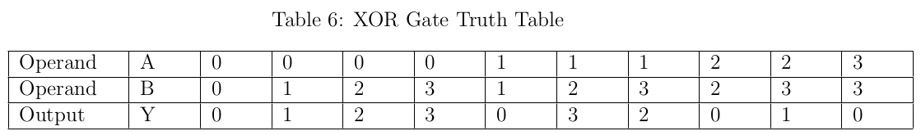
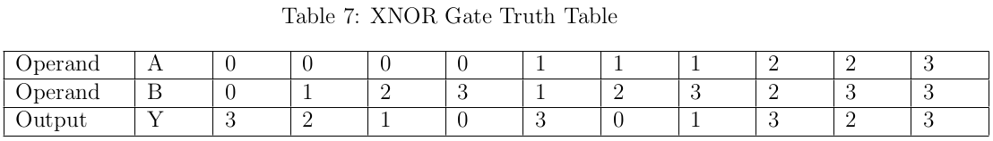
XOR and XNOR Gates
XOR and XNOR Gates have two inputs and produce one output in quaternary algebra.

Slide 14
XOR and XNOR Gates
XOR and XNOR Gates have two inputs and produce one output in quaternary algebra.

Slide 15
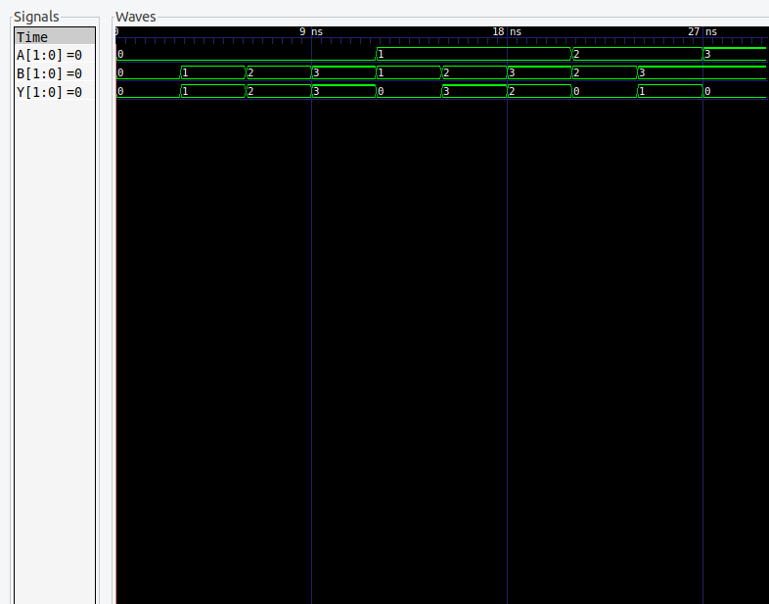
XOR GATE SIMULATION
OR GATE SIMULATION
AND GATE SIMULATION

Slide 16
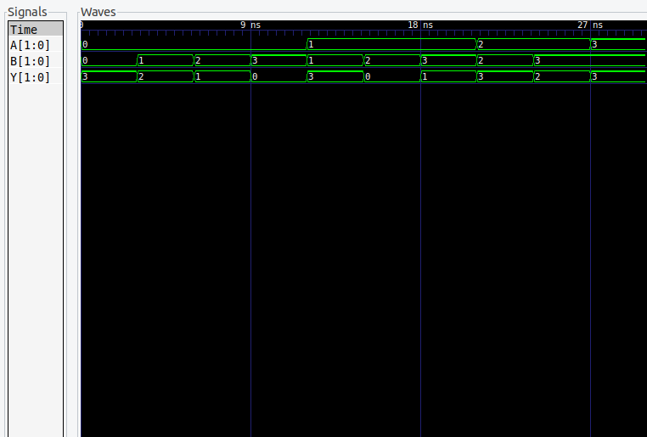
XNOR GATE SIMULATION
XOR GATE SIMULATION
OR GATE SIMULATION
AND GATE SIMULATION

Slide 17
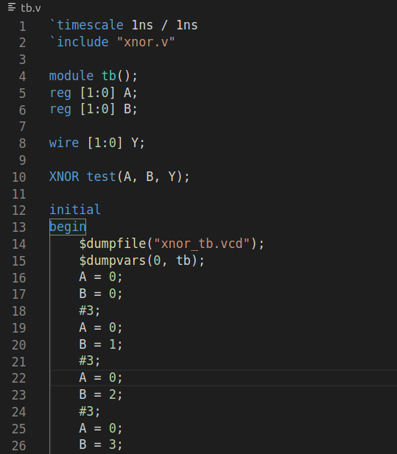
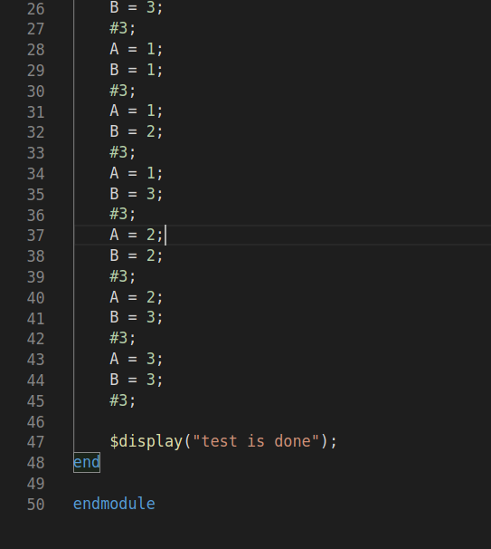
The testbench code used for each logic gate in Verilog HDL

