Slide 1
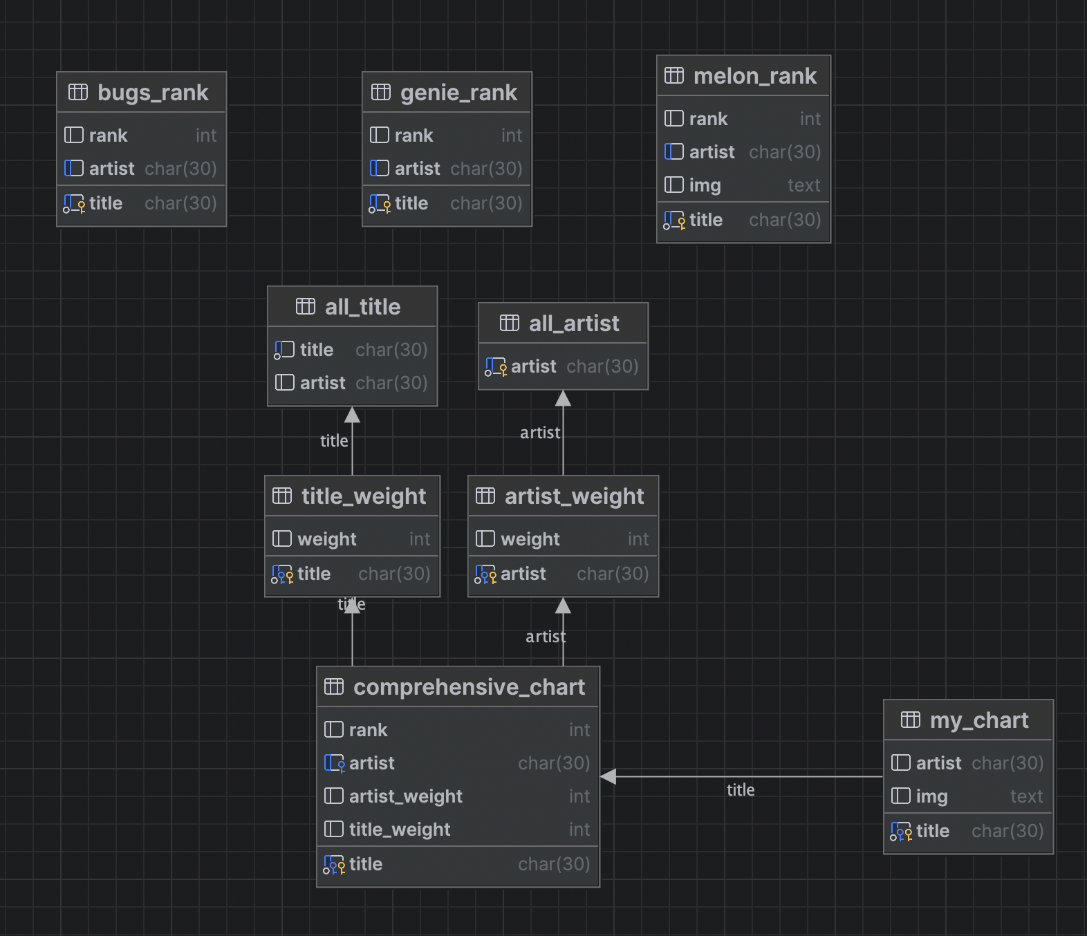

Slide 2
CREATE TABLE all_title AS
SELECT title,artist FROM genie_rank
UNION
SELECT title,artist FROM melon_rank
UNION
SELECT title,artist FROM bugs_rank

Slide 3
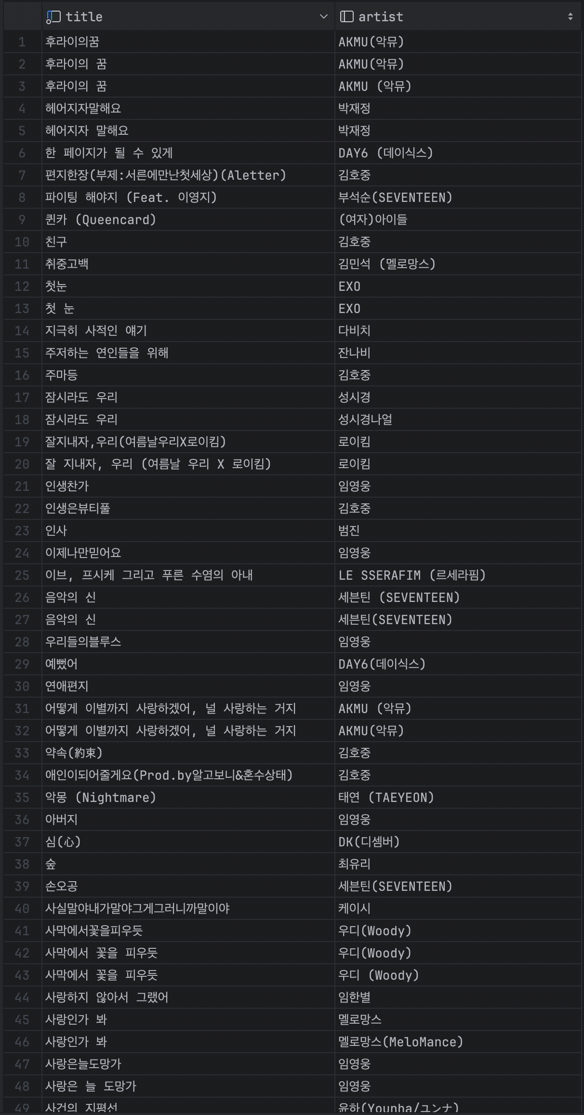
all_title

Slide 4
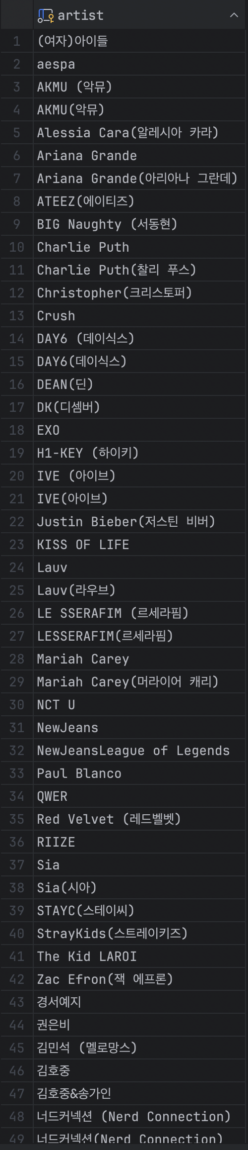
all_artist

