Slide 1
Brain Tumor Multimodal Image Classification
Final Practicum Project | MSDS692
Regis University
Submitted by: Jonish Bishwakarma
jbishwakarma@regis.edu
Notes:
Welcome everyone and thank you for joining my final practicum presentation.
My name is Jonish Bishwakarma, and today I'll be presenting my work on classifying brain tumors using multimodal medical images
specifically, CT and MRI scans through deep learning techniques.

Slide 2
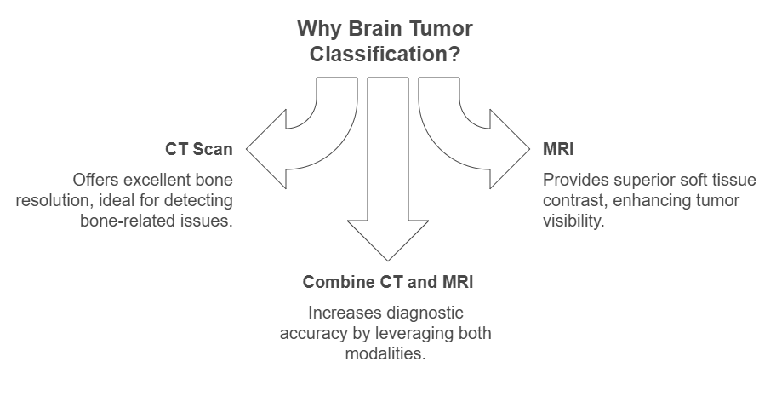
Notes:
Brain tumors are life-threatening conditions, and
early detection significantly improves treatment outcomes.
CT scans offer excellent bone resolution, while MRI provides superior soft tissue contrast.
By combining both, we aim to build a more robust model for brain tumor classification.

Slide 3
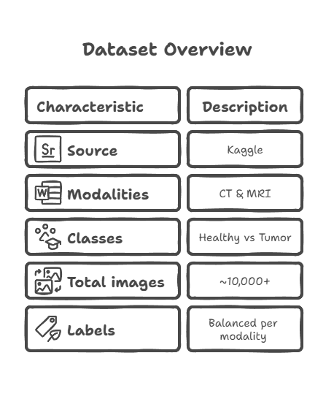
Dataset Description
Notes:
The dataset was sourced from Kaggle and includes thousands of labeled CT and MRI images.
Each image is classified as either "Healthy" or "Tumor."
The dataset is reasonably balanced, which helps with training fairness.

Slide 4
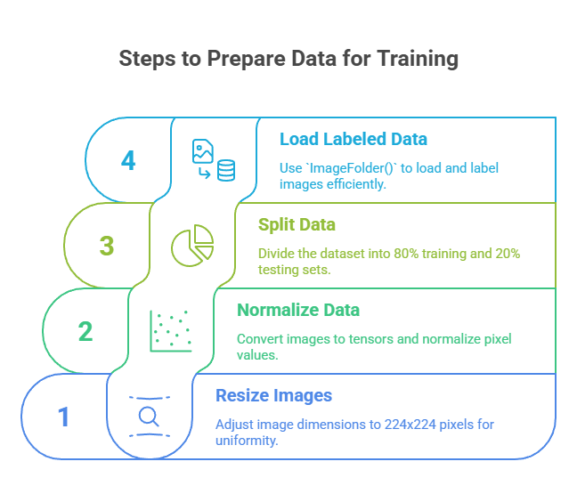
Notes:
All images were resized to 224x224 for consistency and converted to tensors for PyTorch processing.
I split the data into 80% for training and 20% for testing.
Labels were automatically handled using the folder structure and PyTorch's ImageFolder.

Slide 5
Exploratory Data Analysis (EDA)
Content:
Sample grids from CT & MRI
Image count by class and modality
RGB vs Grayscale mode analysis
Data augmentation visualization
Notes:
EDA involved visualizing sample images, checking class distribution across modalities, and
understanding image formats. Most images were RGB.
I also applied data augmentation to simulate real-world variations and improve model robustness.

Slide 6
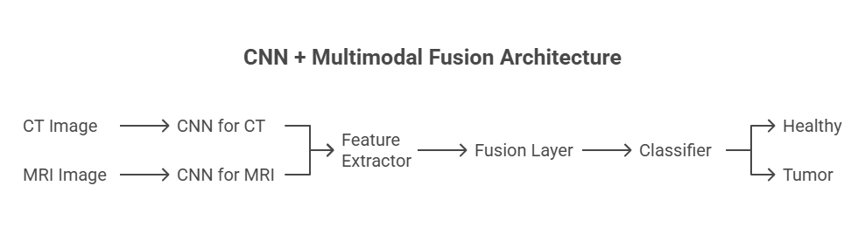
Model Architecture
Notes:
Each image modality is passed through its dedicated CNN.
The final layer embeddings from each are concatenated and passed through a fusion layer.
This allows the model to learn joint features from both image types, improving prediction accuracy.

Slide 7
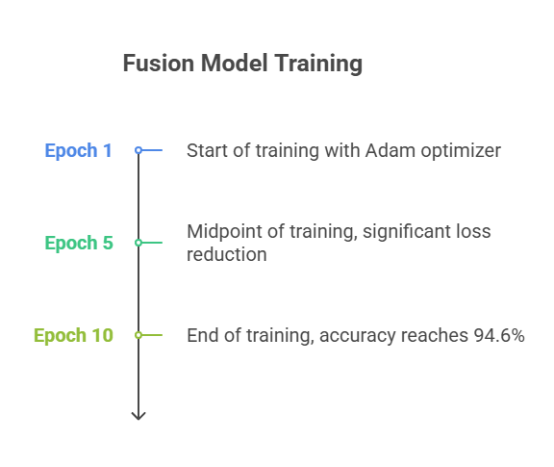
Model Training
Training the Fusion Model
Content:
10 Epochs, Adam Optimizer, LR = 0.001
Loss steadily decreased
Accuracy improved to ~94.6%
Notes:
The model was trained over 10 epochs using Adam optimizer.
The training and validation metrics showed consistent improvement, indicating effective learning.
Loss dropped significantly, and the accuracy exceeded 94% by the final epoch.

Slide 8
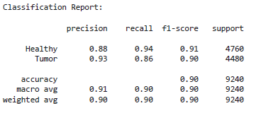
Model Evaluation
Content:
Accuracy: 90.5%
F1 Score: 0.90
Precision (Healthy): 88%
Precision (Tumor): 93%
Notes:
The classification report showed strong performance across both classes.
Tumor detection achieved 93% precision, which is critical in medical applications were false negatives are dangerous.
Overall F1 score confirms balance between precision and recall.

Slide 9
Model Confusion Matrix
Notes:
The confusion matrix confirms the model’s strong predictive capability.
Most predictions fall along the diagonal, indicating correct classifications.
Misclassifications were minimal, validating the fusion model’s effectiveness.

Slide 10
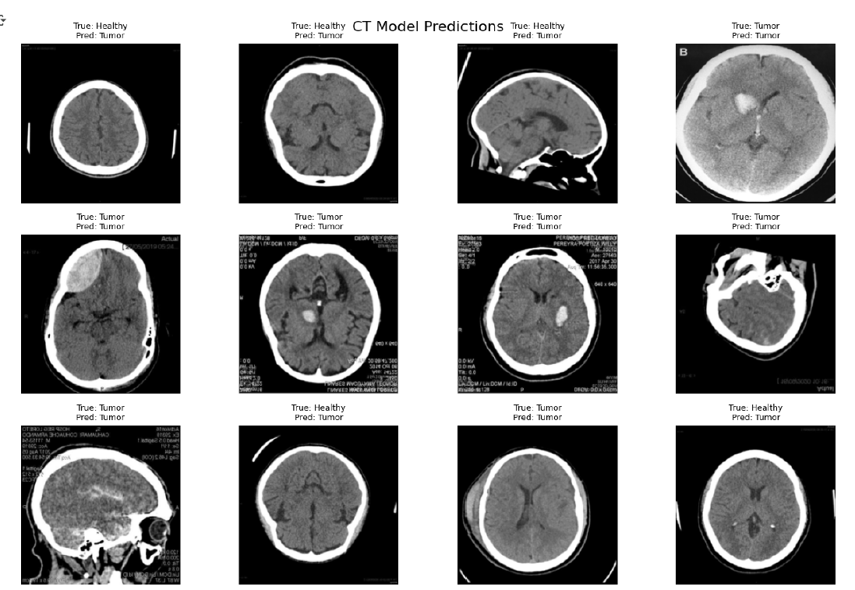
Sample Predictions from CT Model
Notes:
This grid displays a batch of predictions from the CT model alone.
Most predictions match the ground truth labels, reinforcing the model’s standalone capability even without MRI.

Slide 11

Future work
Notes:
The project confirms the value of multimodal learning in medical imaging.
Combining CT and MRI leads to more accurate diagnosis.
Future work could involve tumor localization through segmentation and using pretrained models for transfer learning.

Slide 12
References
Md. Golam Murtoza. (2020). Brain tumor multimodal image (CT & MRI). Kaggle.com. https://www.kaggle.com/datasets/murtozalikhon/brain-tumor-multimodal-image-ct-and-mri/data
‌
T. El-Gazzar, K. Amin, and A. Shalaby, “Deep learning for classifying brain tumors using CT images,” IEEE EMBS Conference on
Biomedical Engineering and Sciences, 2019.‌
Y. Huang et al., “Fusion of multimodal medical imaging data based on deep learning: A review,” Information Fusion, vol. 72, pp. 71–85,
2021.
Notes:
Reference slide

