Slide 1



IceCreamReport
View in Power BI
Last data refresh:
9/3/2020 10:11:25 AM AUS Eastern Standard Time
Downloaded at:
9/3/2020 11:20:01 AM AUS Eastern Standard Time

Slide 2
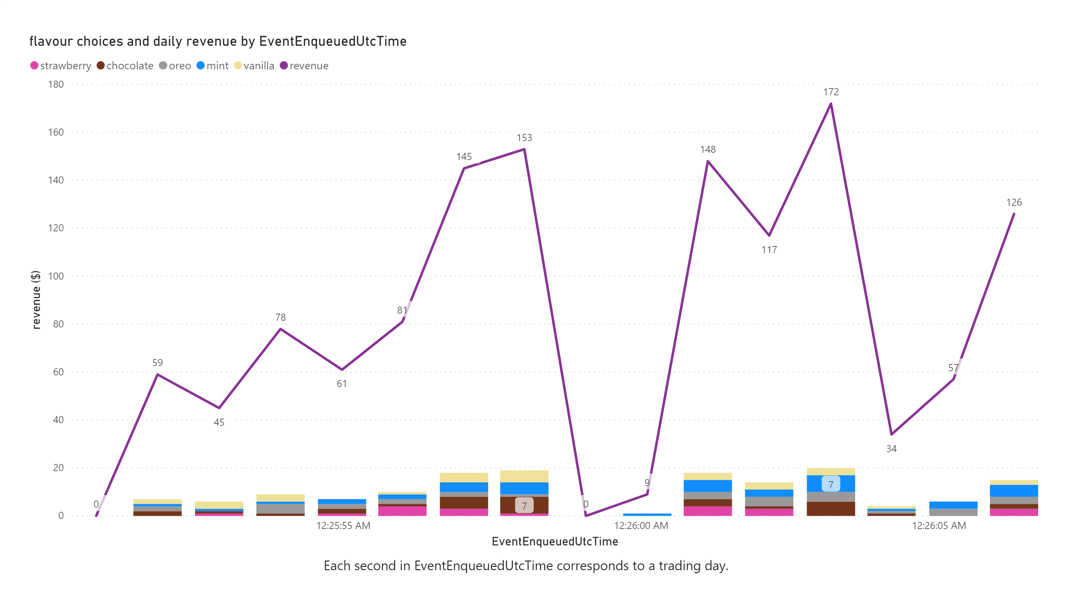

Slide 3
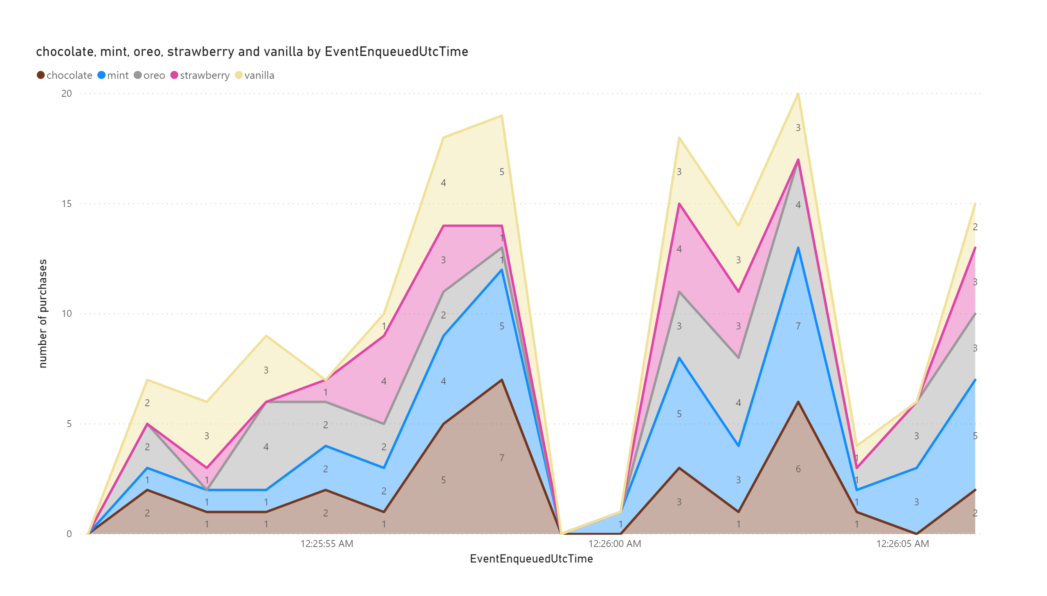

Slide 4
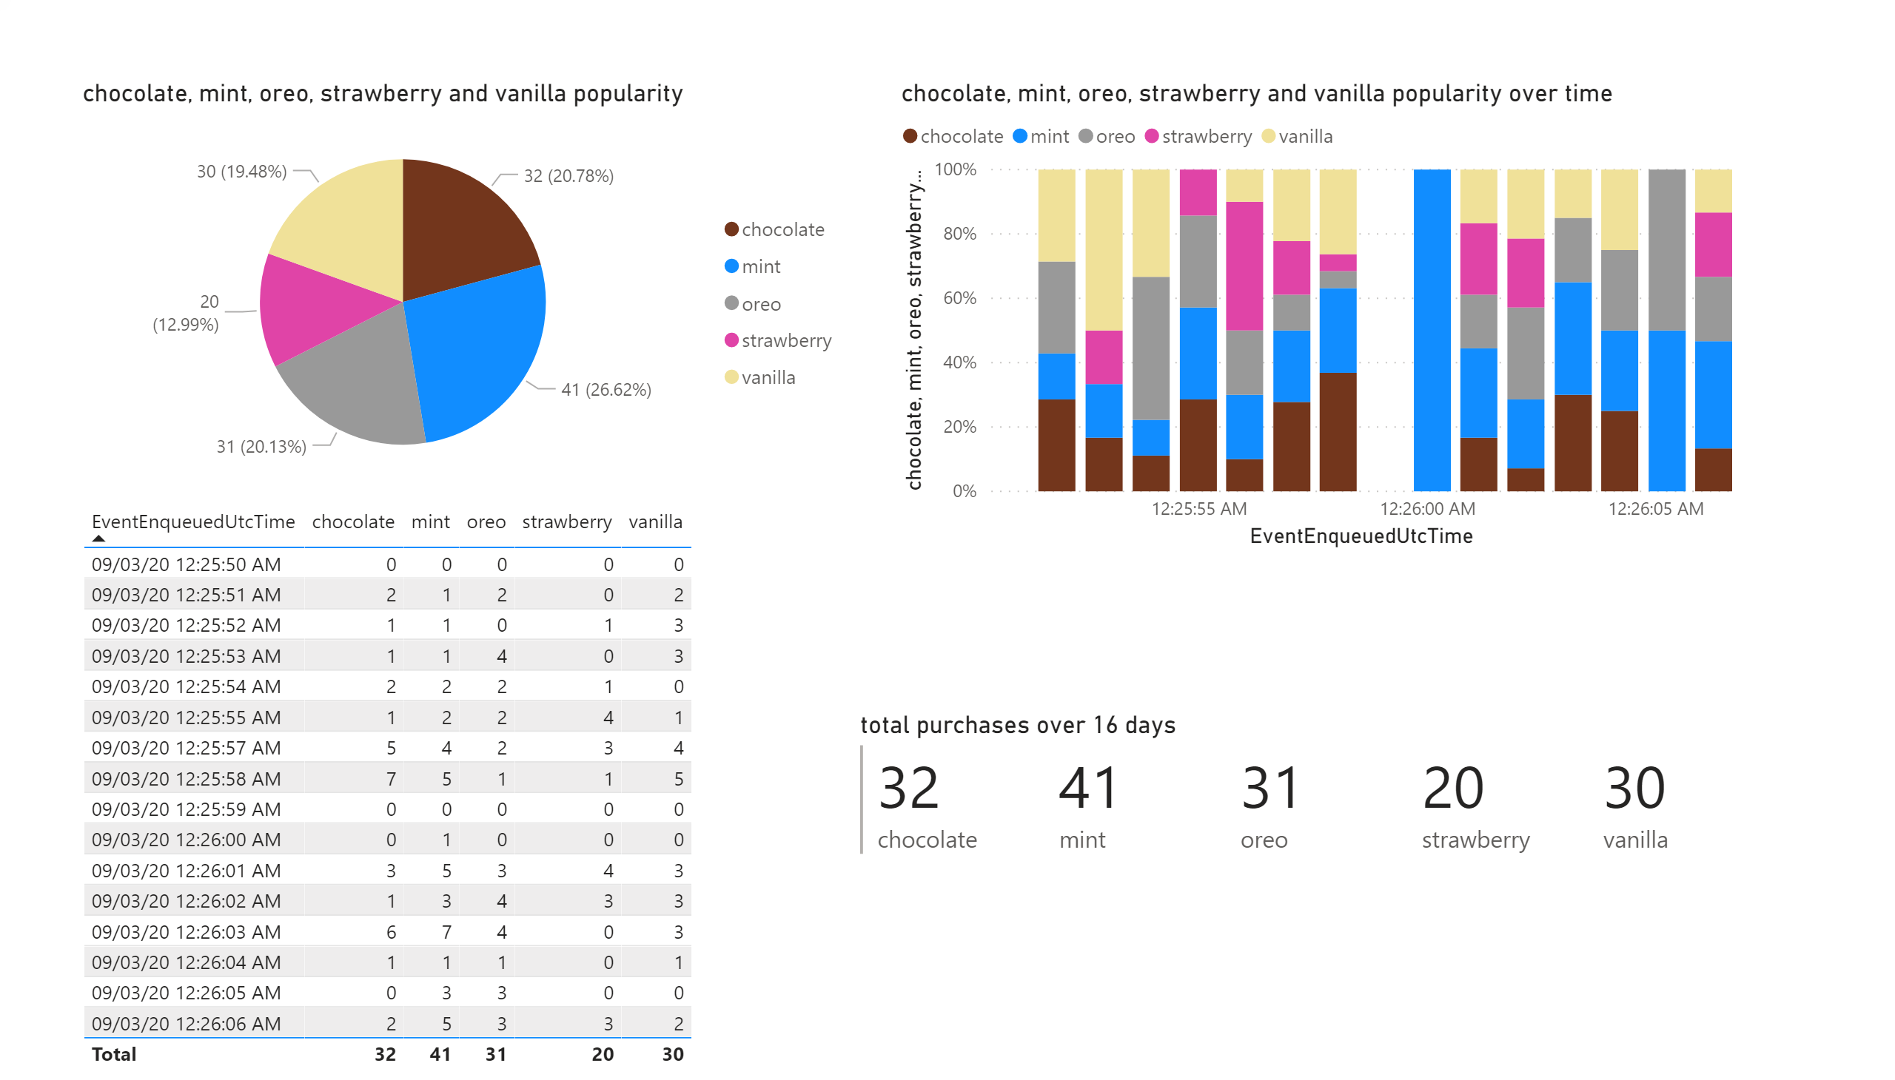

Slide 5
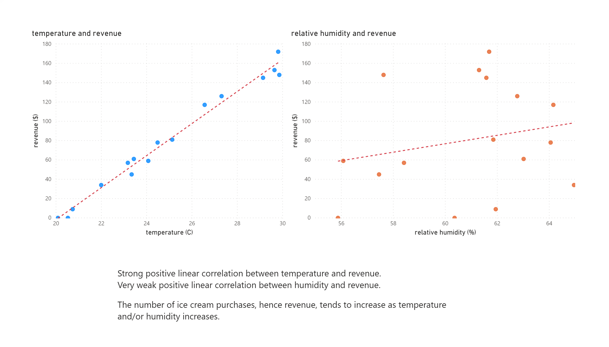

Slide 6
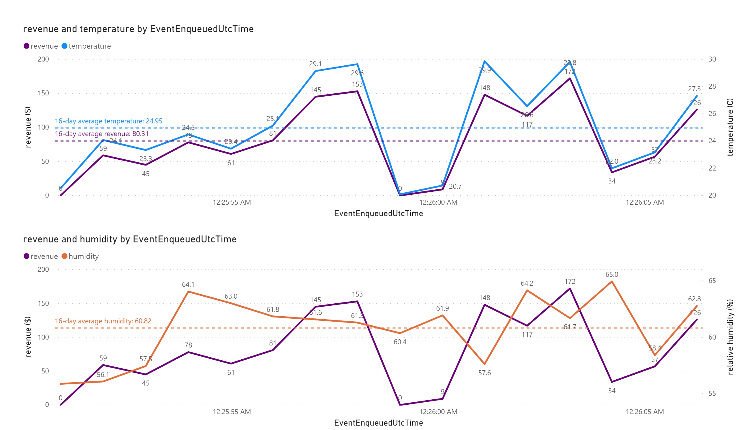

Slide 7
