Slide 1



IceCreamReport
View in Power BI
Last data refresh:
7/6/2020 12:57:08 AM AUS Eastern Standard Time
Downloaded at:
7/6/2020 6:49:53 PM AUS Eastern Standard Time

Slide 2
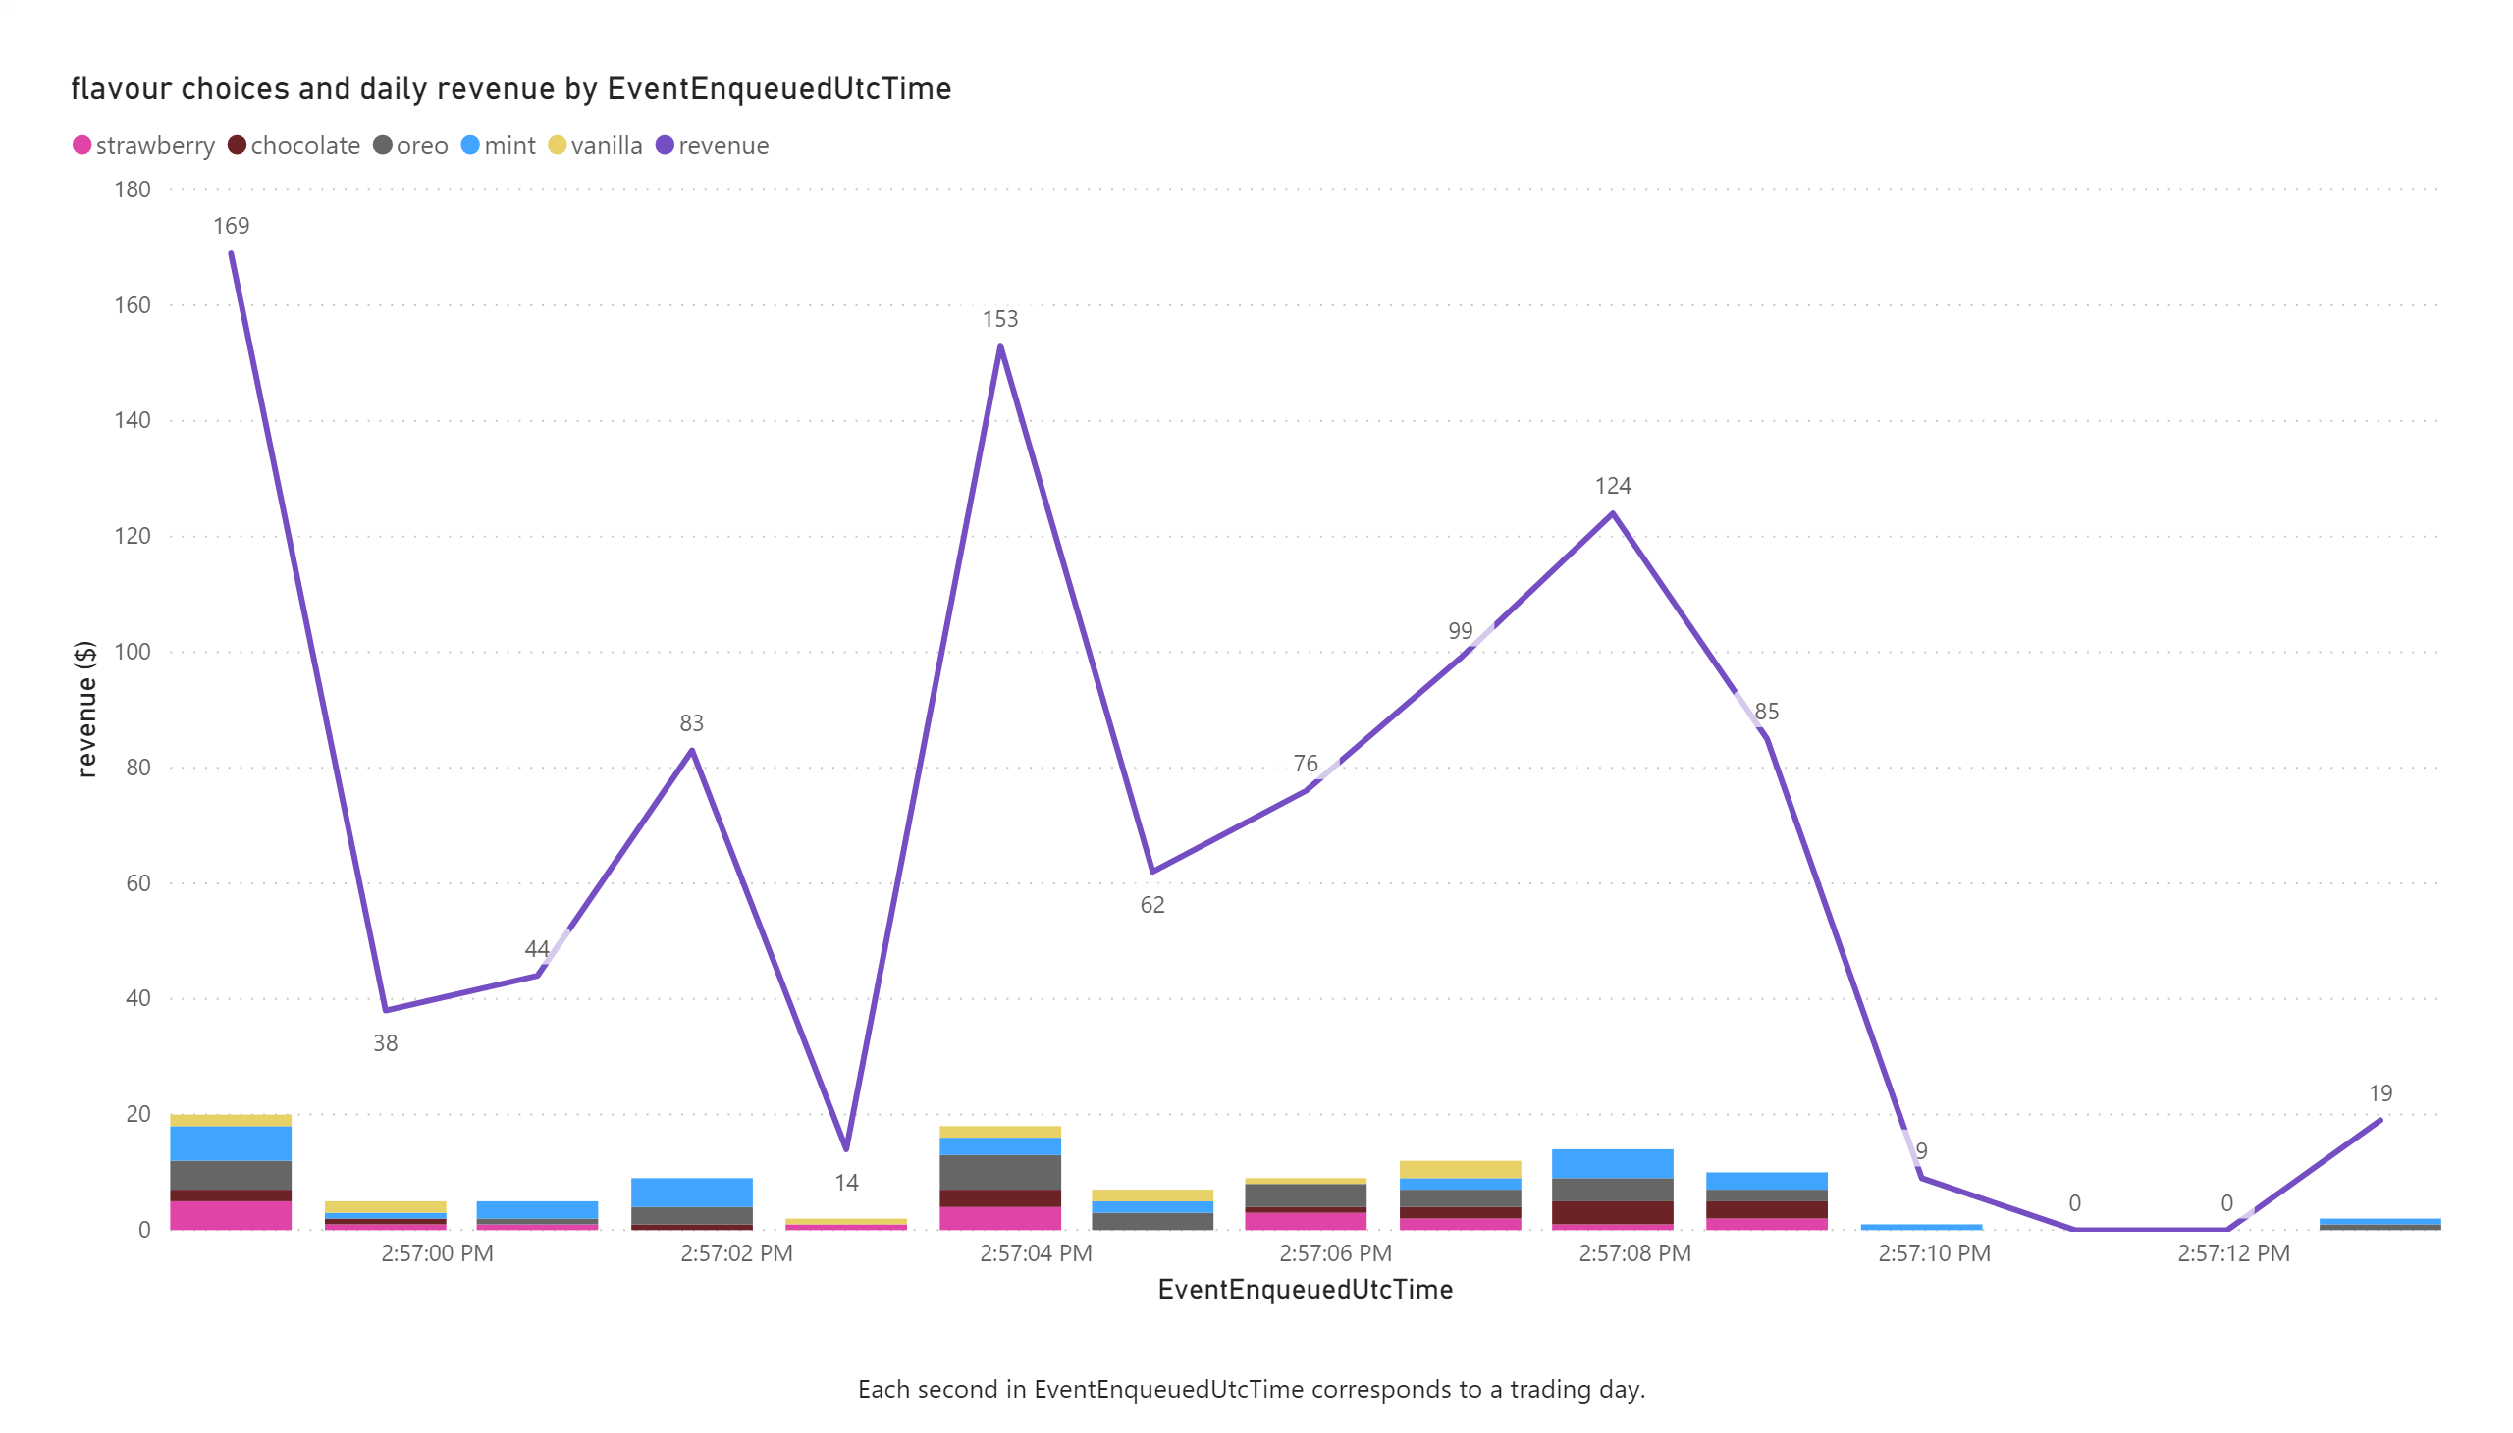

Slide 3
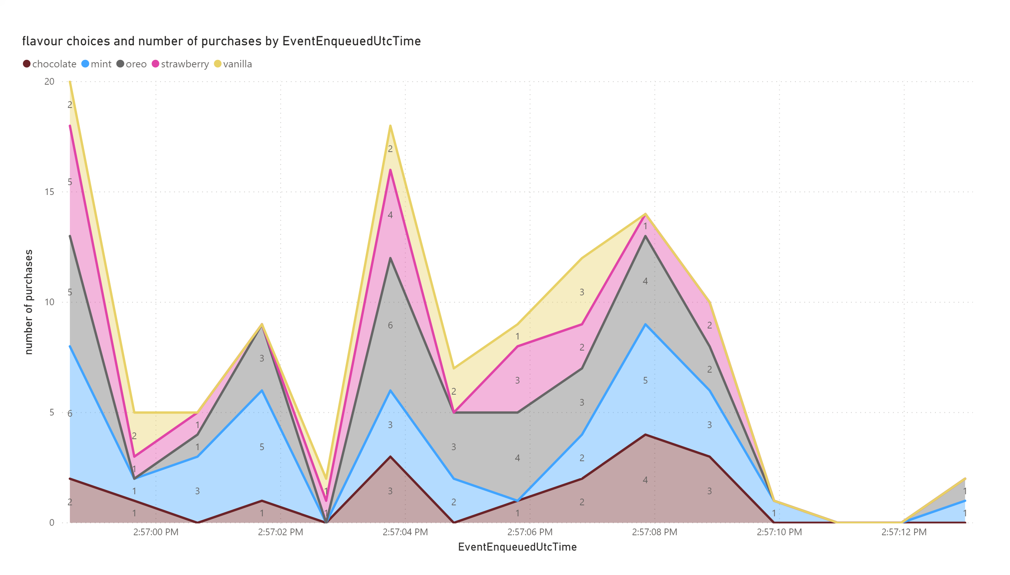

Slide 4
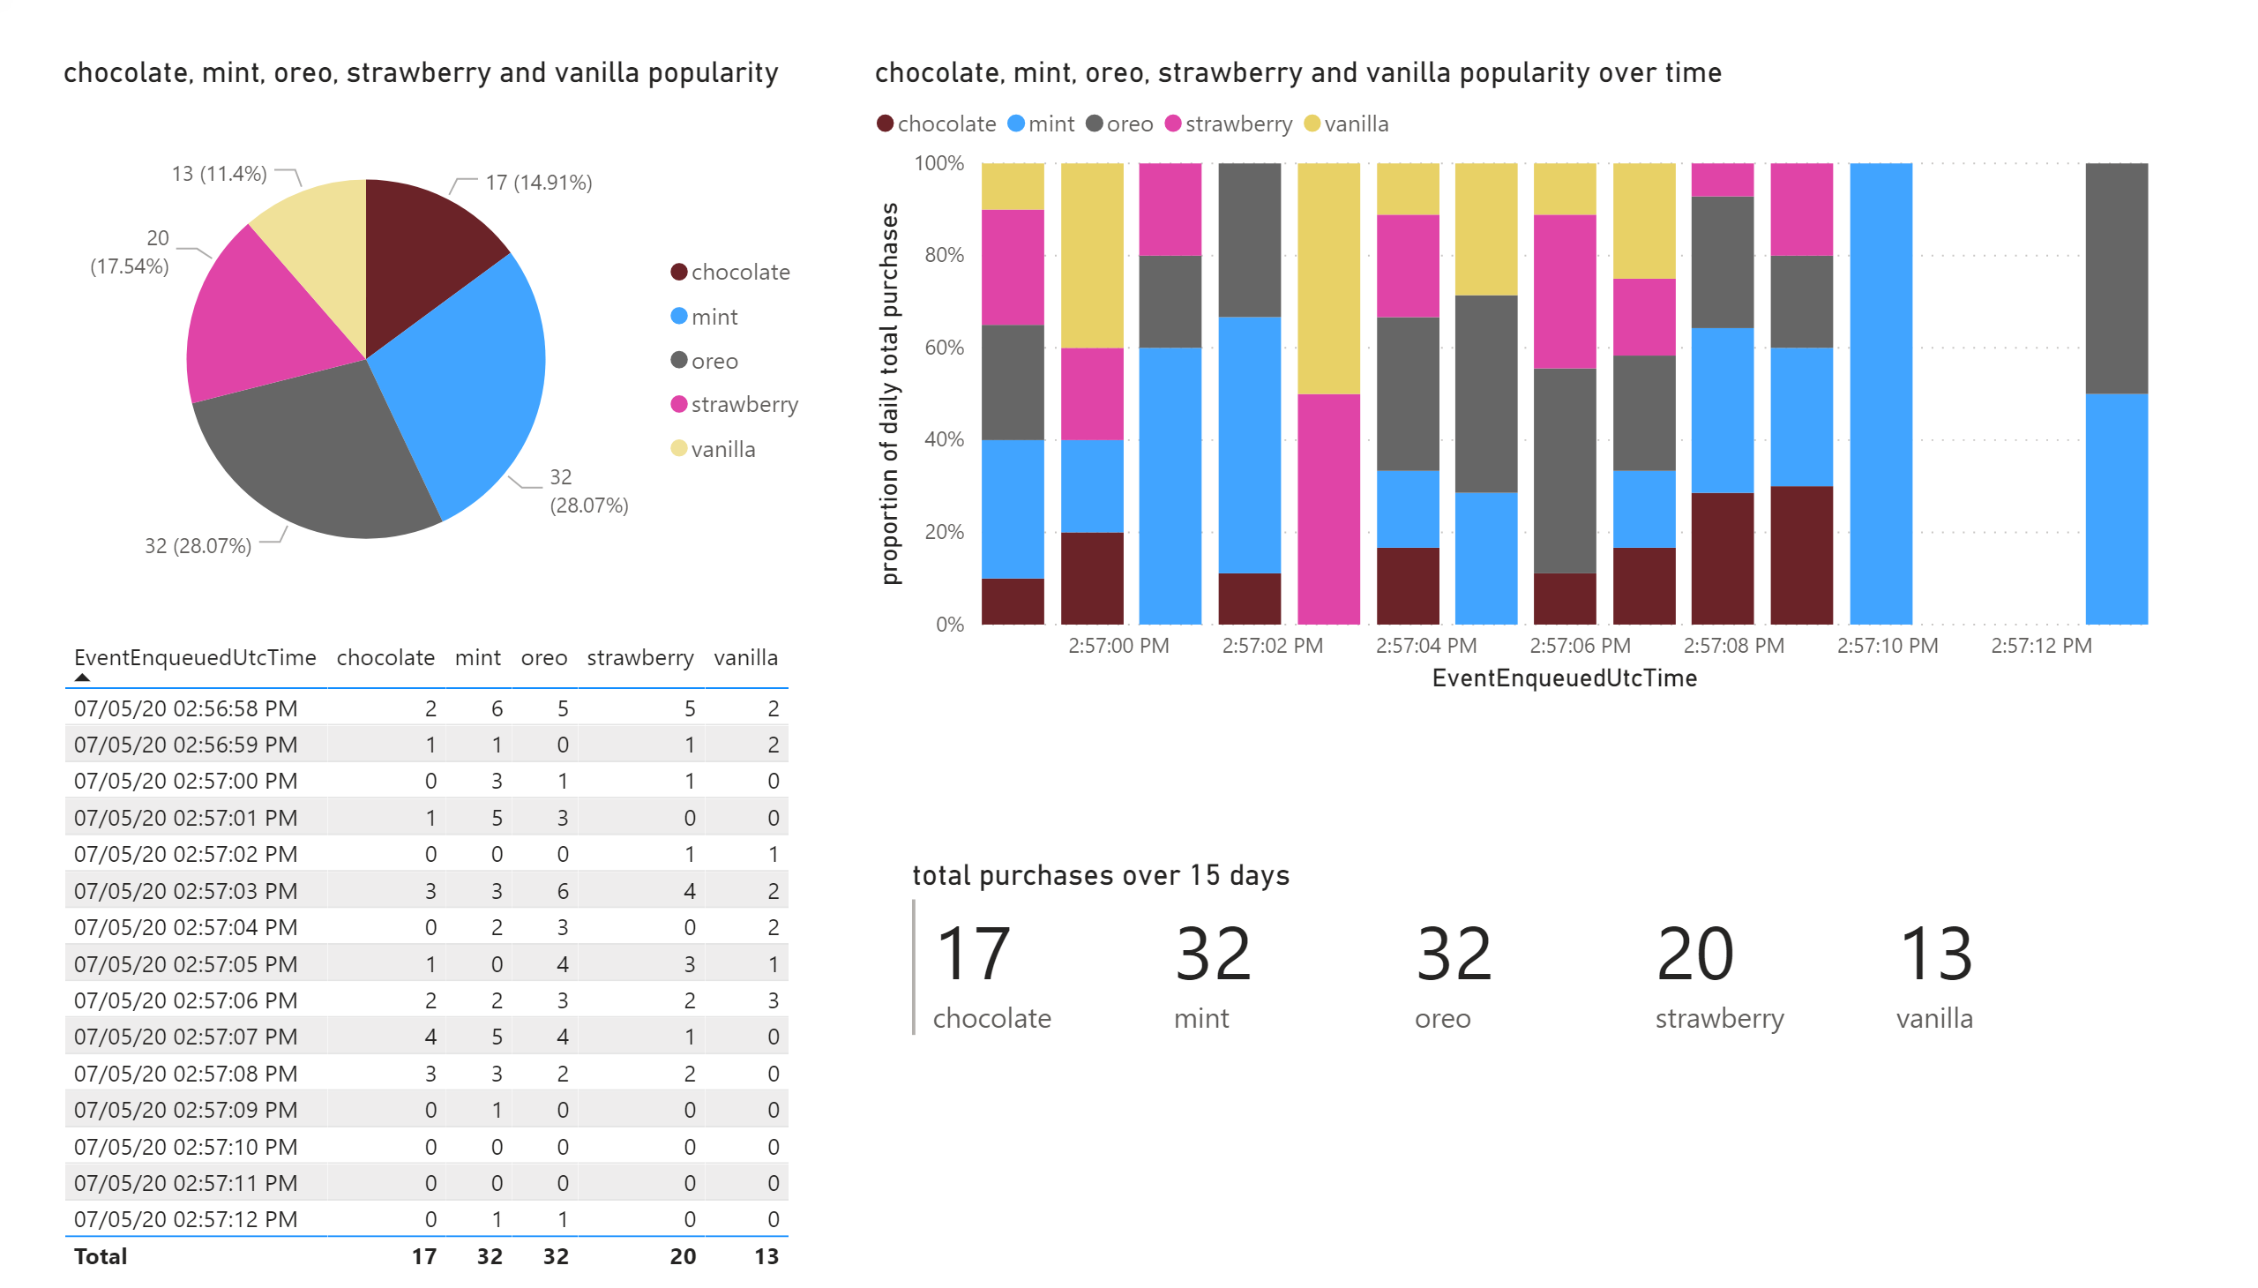

Slide 5
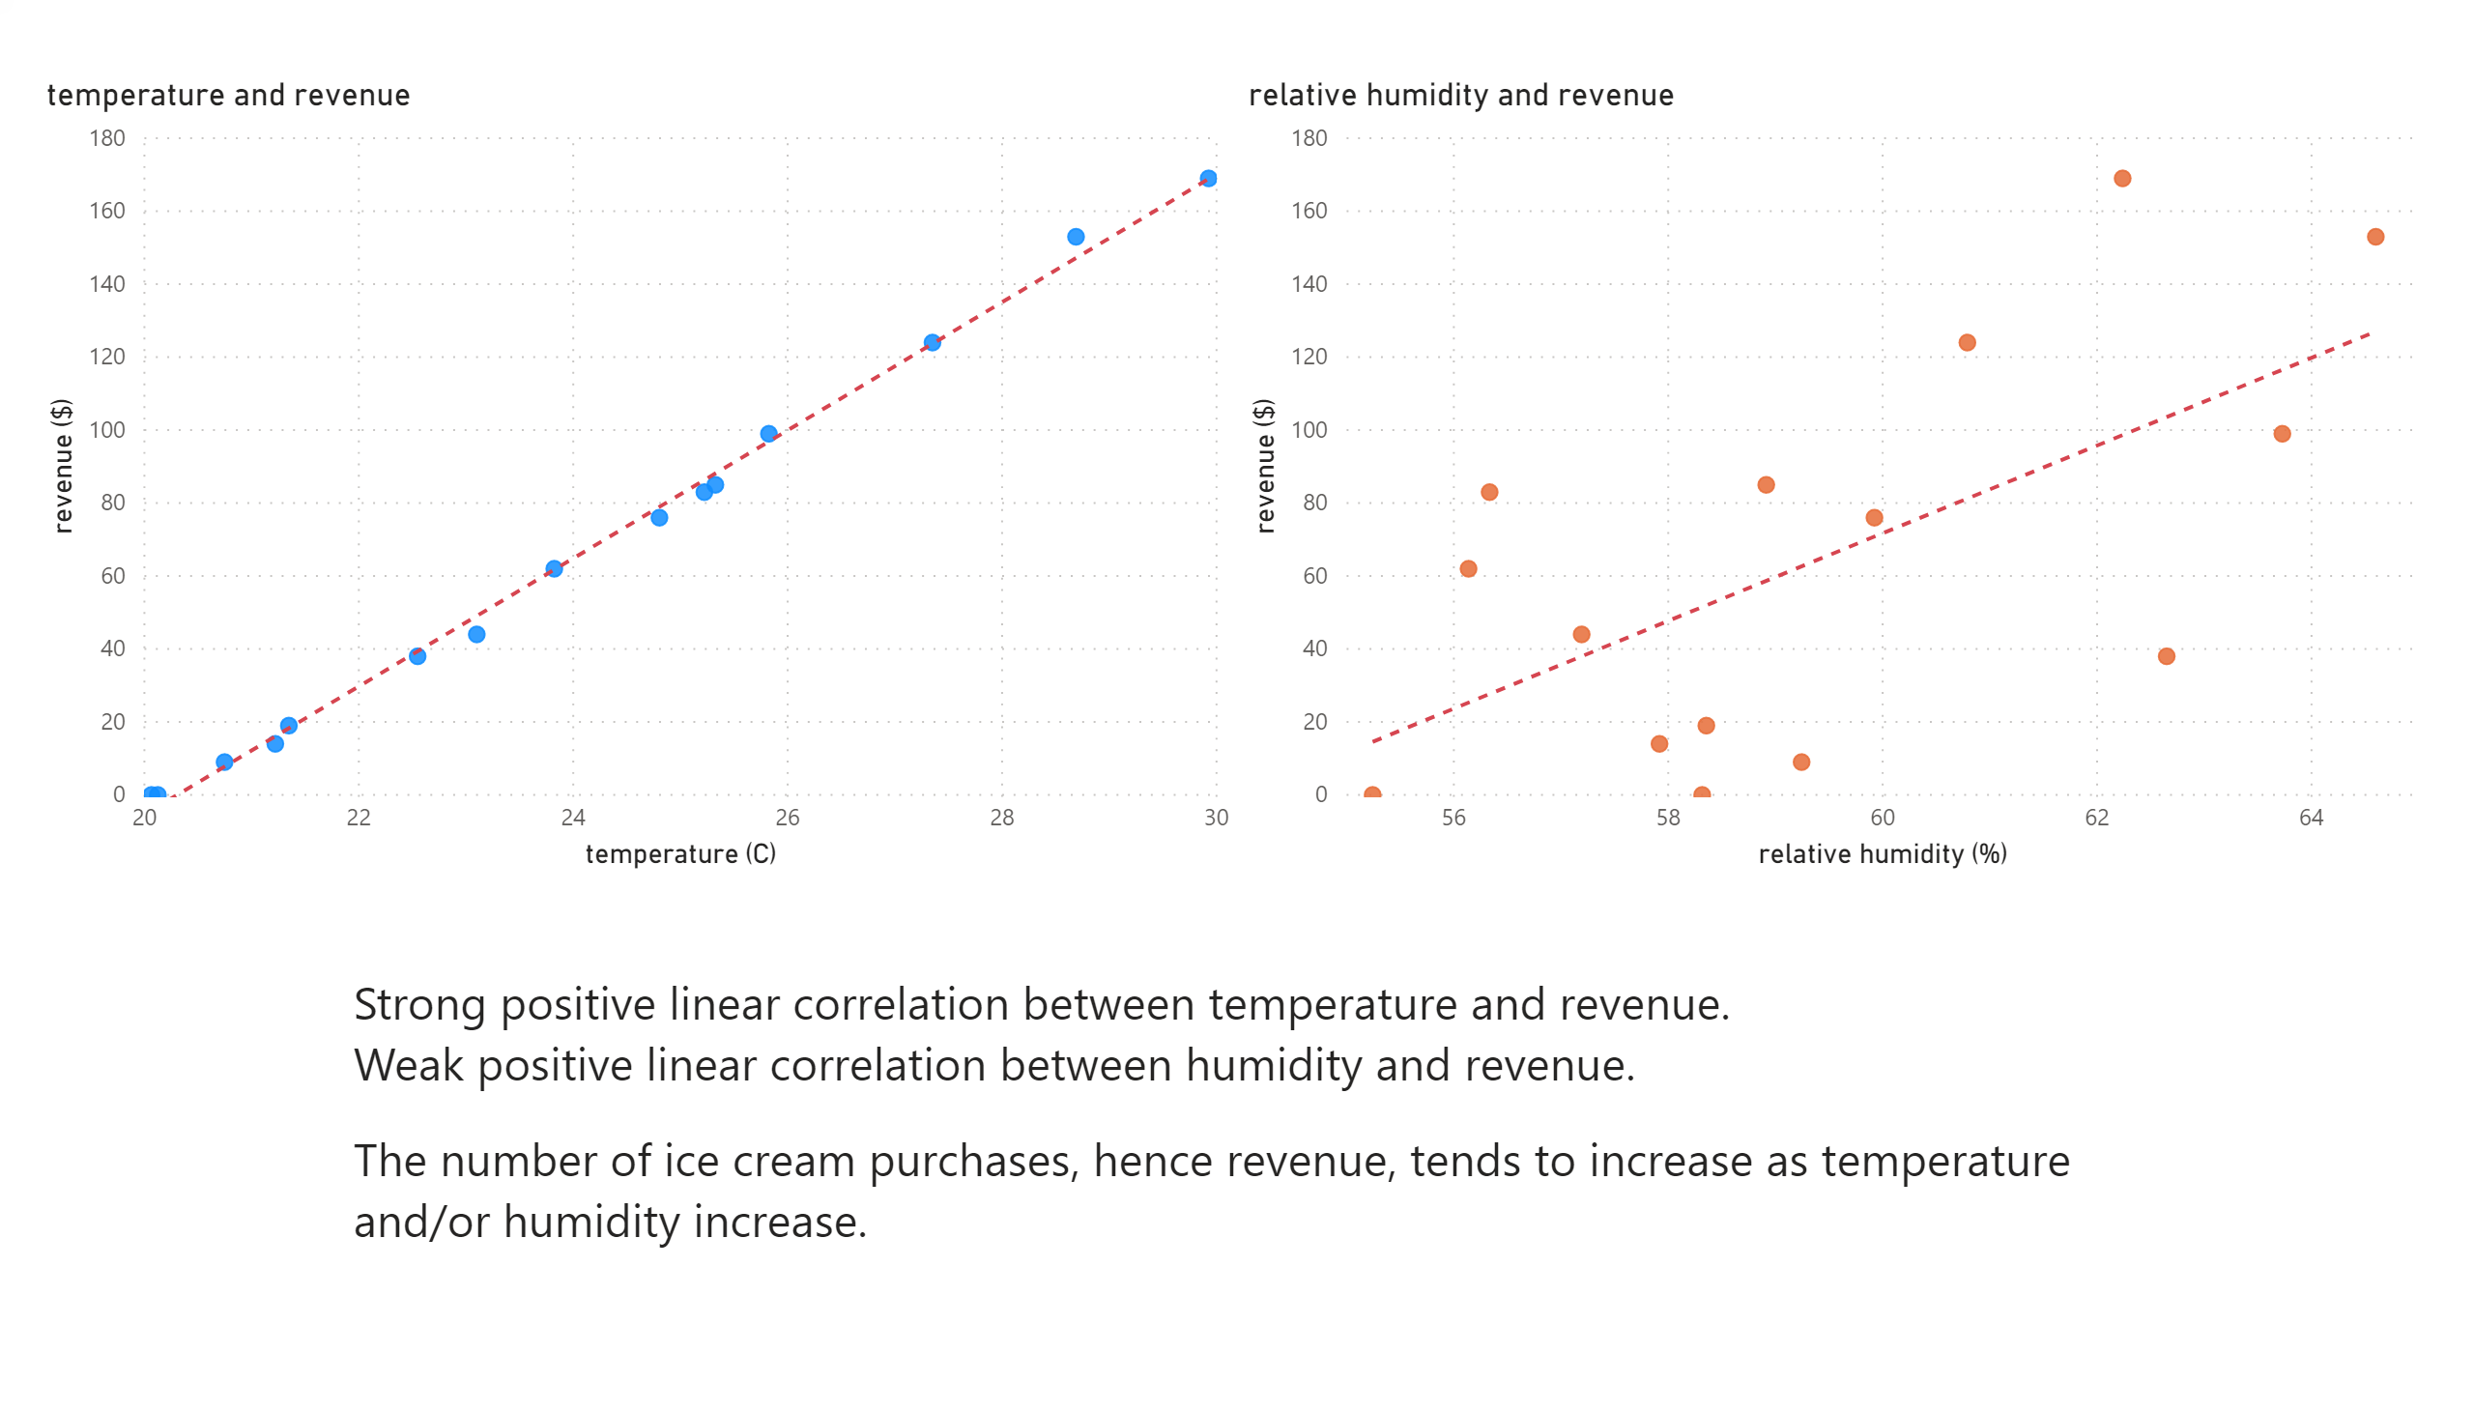

Slide 6
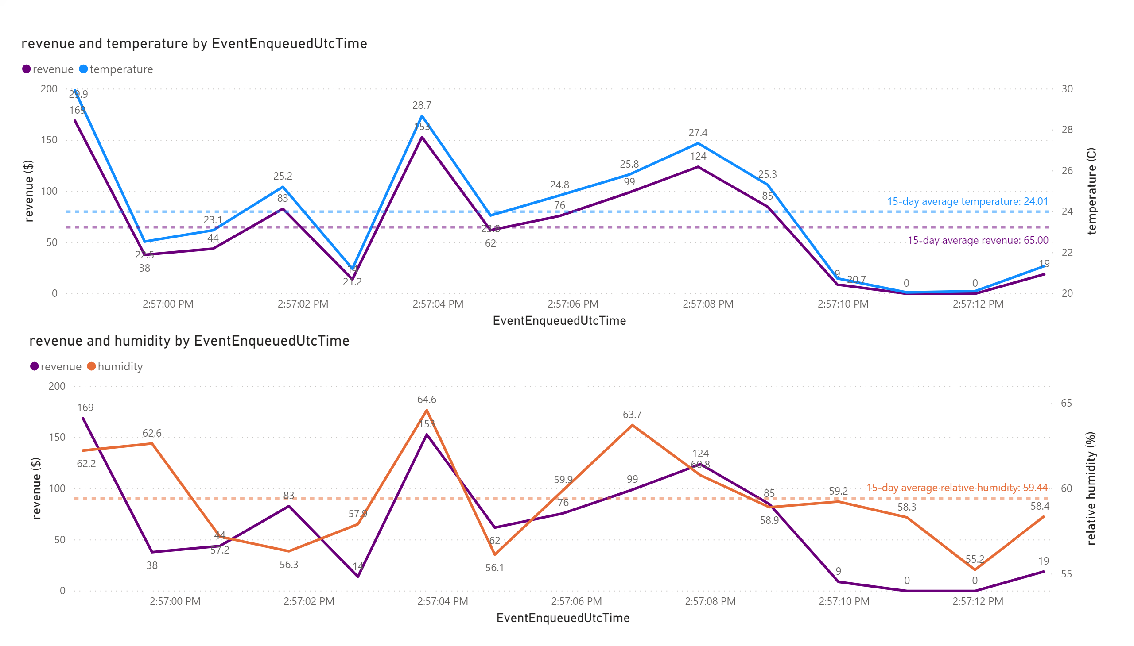

Slide 7
