Slide 1
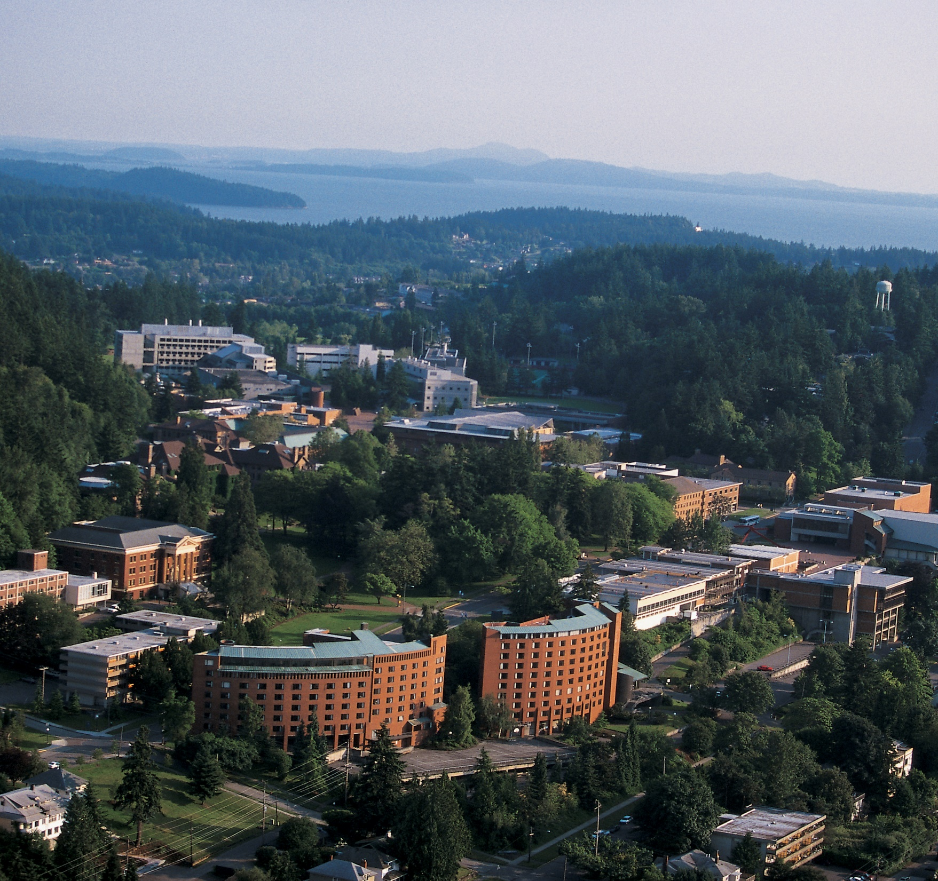


Slide 2
All about Western Washington University
Vision
Western will build a stronger Washington by being an international leader in active learning, critical thinking, and societal problem solving.
We place a very high value on student interaction, academics, community and autonomy
15k Students
5k Faculty & Staff
88% Washington State Residents, 56% female
IT is NOT a core competence, teaching IS

Slide 3
Mandatory Overview Slide
What is Enterprise Infrastructure Services
What isn’t Enterprise Infrastructure Services
The Do’s
What
How

Slide 4










What is EIS?
Manage the network
16,000 Data & 4,000 Phone connections
60+ facilities, with remote locations
Cisco Network
Manage the hybrid datacenters
Nutanix Hyper-Converged Infrastructure
VMWare Hypervisor
Panoply of servers, services, containers
Manage enterprise communications
Legacy PBX
Skype for Business 2015
Security
Computer & Account
Intrusion and Detection

Slide 5

What EIS Isn’t
Academic Technology & User Services
End User Support
Desktop Computer Deployment
Computer Repair
Enterprise Application Systems
Banner & Connected Systems – at the Application Level
Data Analytics
Account creation processes
WebTech
Campus Web Services
Drupal
Islandora

Slide 6
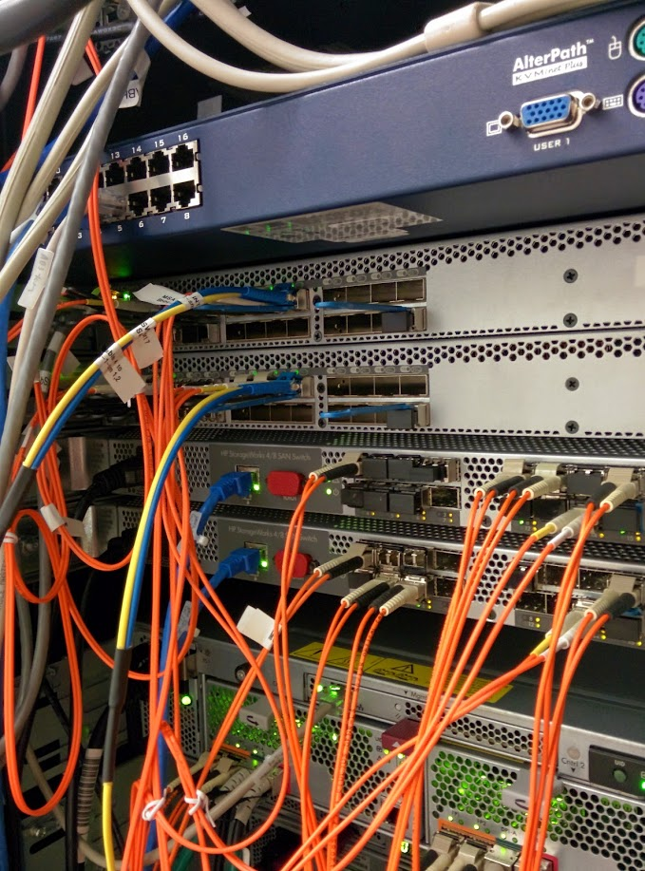
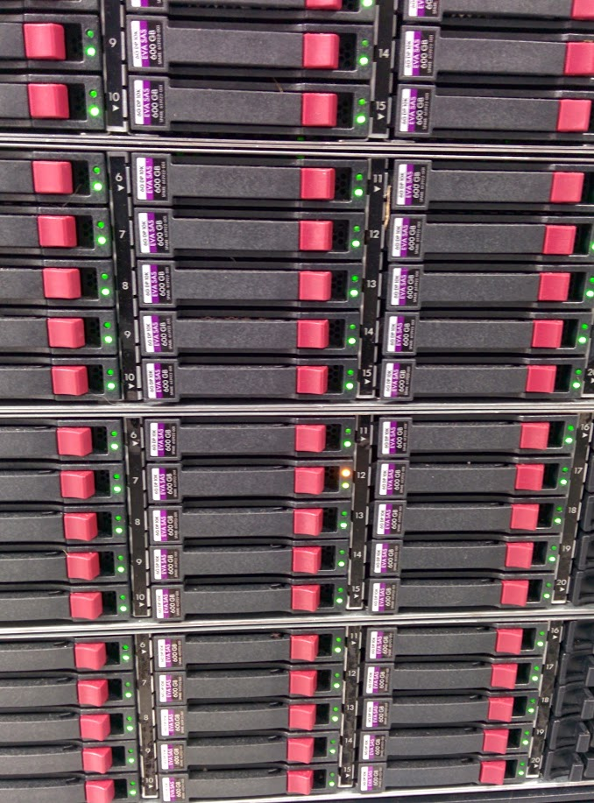
Why are We Here - Physical
End of Life Legacy Environment compounded by aging tools
Requirement of massive forklift upgrades
Multiple critical paths
Separate Network
Separate Tools
Space
Power
Solution – Hyper-converged infrastructure and storage classification
Leverage current investment
Learn a new thing
Don’t over spend on storage

Slide 7

Why are We Here - Employees
Changing of the Environment
Worthy Work
Goal Settings
Changing of the Tools

Slide 8

Challenges
Funding
It is an allocation issue, not resources
People Power
Amazing People & Skills, but not enough numbers
Professional Development
Competition from Seattle and Vancouver
Finding time & funding to train
Policy & Holistic Centralized Planning

Slide 9

How We Do What We Do?
Premise of Developer Operations
DevOps is the combination of cultural philosophies, practices, and tools that increases an organization's ability to deliver applications and services at high velocity: evolving and improving products at a faster pace than organizations using traditional software development and infrastructure management processes. (AWS)
Servers, VMs & Containers
Cloud or On Premise – Hybrid Cloud

Slide 10

What Can We Do For you?
Help you ask the right questions about SaaS, PaaS & IaaS
Encourage Adoption of Current technologies and METHODologies
Integrate Western Identity
Provides secure access to your applications

Slide 11
Questions?

