Slide 1
Building an AWS AI Chatbot in 45 Minutes with CDK
Notes:
Yes that sub-title is a mouthful: We’ll start by defining those qualifiers on Fruits.

Slide 2
Me
Jon Kelly
Amazon Software Development Engineer
4 years of experience
Iowa State alumni

Slide 3
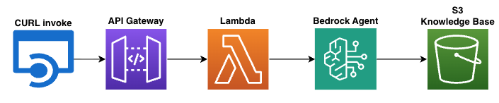
The Goal
Notes:
Curl command to invoke a Lambda via API gateway to prompt a Bedrock AI agent with a S3 knowledge base

Slide 4










What do those symbols mean?
Over 200 different services within AWS
CloudFormation
API Gateway
Dynamo
Lambda
Kendra
ECS
Bedrock
S3
CloudFront
IAM
Elastic Container Service
Simple Storage Service
Identity and Access Management
Notes:
Legos Quick overview of the 4 main services we will be using

Slide 5
Bedrock
AWS platform for running LLMs
Agent and knowledge base configuration
Notes:
Claude, Llama, Nova, Deepseek etc.

Slide 6
S3
Folder on the cloud
Can store anything
Notes:
Simple Storage Service
3kb or 3TB

Slide 7
Lambda
Short lived server set up by Amazon
Self scaling
Notes:
Easy to set up Only pay for the time it is running

Slide 8
API Gateway
Maps HTTP requests to a lambda
Can’t call the lambda directly

Slide 9
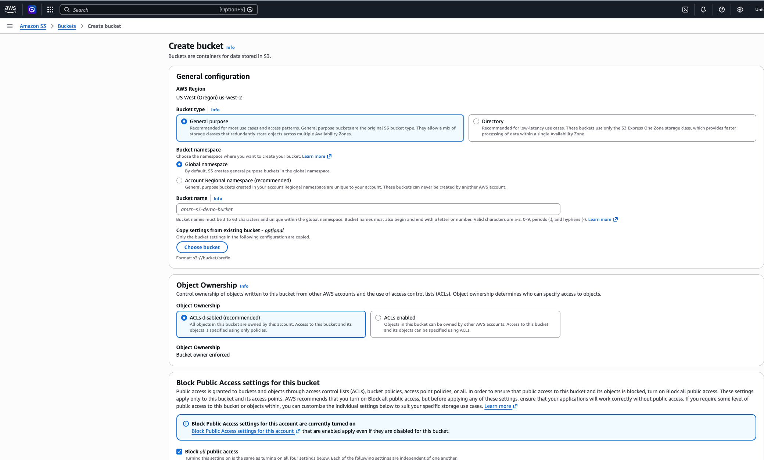
Using AWS services
Create via console or with code (Cloud Development Kit)

Slide 10
Why Infrastructure as Code
Version Control
Reproducible
Dependency ordering
Build with speed using AI
Notes:
Why should I use CDK? See what changed, by who and why with git commit history Code acts the same in test and prod environments CDK knows what order to deploy the infrastructure to prevent permission errors AI can write the code all in one consolidated place

Slide 11
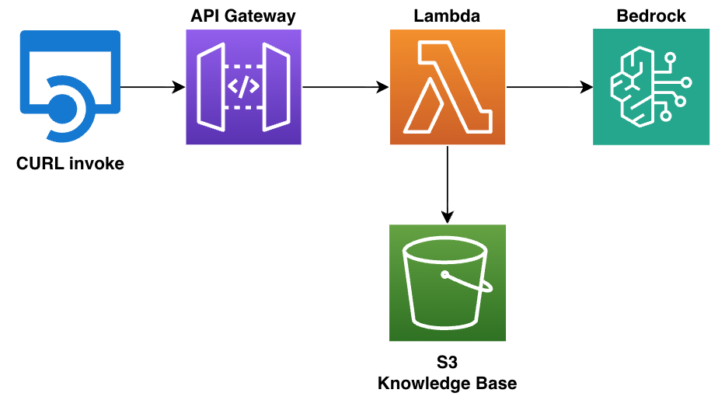
Quick Clarification
Notes:
Agents can take some time to configure and currently don’t have great CDK constructs to build them in code. To speed up the demo I’m instead going to have the lambda include the knowledge base in its prompt to the bedrock model Using an Agent takes more time to configure but - Cheaper as the only search relevant content in the knowledge base - Perform actions to trigger other AWS services - Have multi-step reasoning Short question break

Slide 12
Let’s Build It

Slide 13
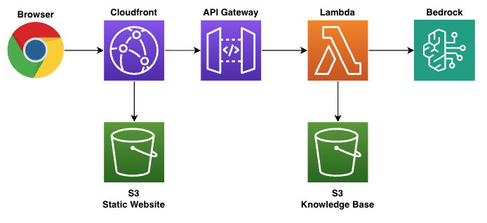
The Stretch Goal

