Slide 1
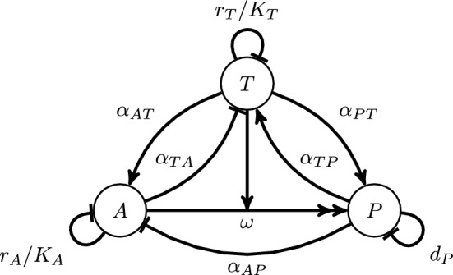
Immune Cell Conversion
Jonathan Levine
Dynamic Models 10/27
Moffett AS et al. Modeling the Role of Immune Cell Conversion in the Tumor-Immune Microenvironment. Bull Math Biol. 2023 Sep 1;85(10):93. doi: 10.1007/s11538-023-01201-z. PMID: 37658264; PMCID: PMC10474003.

Slide 2
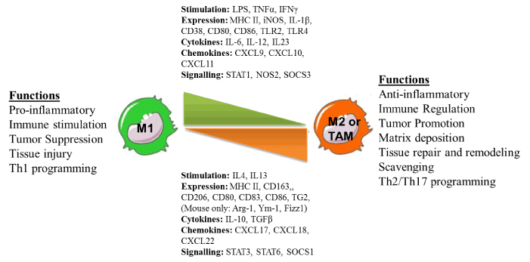
Macrophage Polarization
Nadella V et al. Integr Cancer Sci Therap 2016

Slide 3
Key Feature: Tumors can induce phenotypic switching from Anti-tumor to Pro-tumor state
T: tumor cells
P: pro-tumor immune cells
A: anti-tumor immune cells

Slide 4
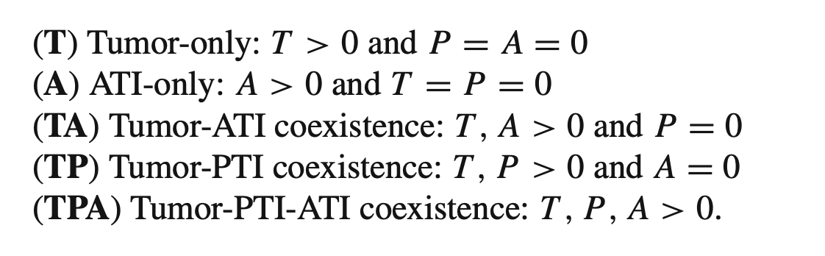
Theoretically Possible Steady States

Slide 5
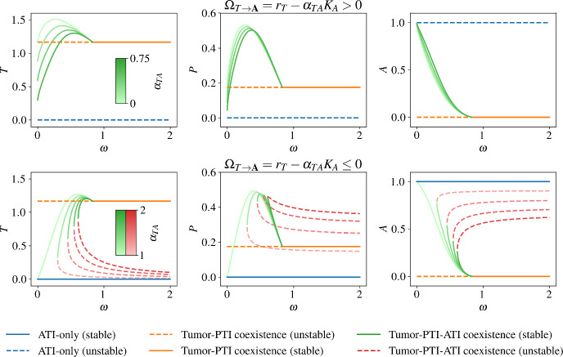
Bifurcation Diagram
Transcritical Bifurcation Between
PTA state and PT state
Transcritical Bifurcation Between
PTA state and PT state state
Saddle-Node Bifurcation creates
Stable and Unstable PTA state
Bistability between a cancer state (orange or green) and cancer-free state (blue) in the second row

