Slide 1
START
thinking of ‘responsive’ as a marketing issue too
Notes:
Isn't mobile a design and development problem?
Isn't it just screen sizes, resolutions, and devices?
Marketing should just contact IT department and get them to design us a new website and that's it.
It is not just an issue for these people.
In fact, we can be champions in driving this.
So how are we going to figure out what we are going to create and manage and maintain content across all these new devices?
EVERNOTE: https://www.evernote.com/shard/s252/sh/ff990681-cd1a-4b83-82bb-f8ba206050bd/aeb9fde0fe3f30c77adade14edfbecab

Slide 2
Don’t be scared of the
G A P
Notes:
Perhaps some of you are new to this whole mobile thing, and youre not sure where to start.
Maybe you kinda understand its important to deliver content on mobile, but the rest of your organization hasnt bought in yet.
Whatever has brought you here today, there might be something that is holding you back.
Theres no more excuses to put of getting started so we're just going to jump right in.
Often our biggest fear is how to make decisions on mobile web, apps, how to treat devices differently, or content …. Understanding our need for mobile.
The gap between where you are and where you want to be may feel huge but thats why we call it a strategy, its like a vision, then you take steps to get there.

Slide 3
1, 2, 3, 4, 5
Notes:
I am going to talk through 5 things you can do when you leave here today, both smaller and bigger picture stuff.

Slide 4
1?
Notes:
As marketers, we no longer get to decide which device people use to access your website.
We can now move on to the strategy of reaching as many people, as often as possible - increasing mental and physical availability.

Slide 5
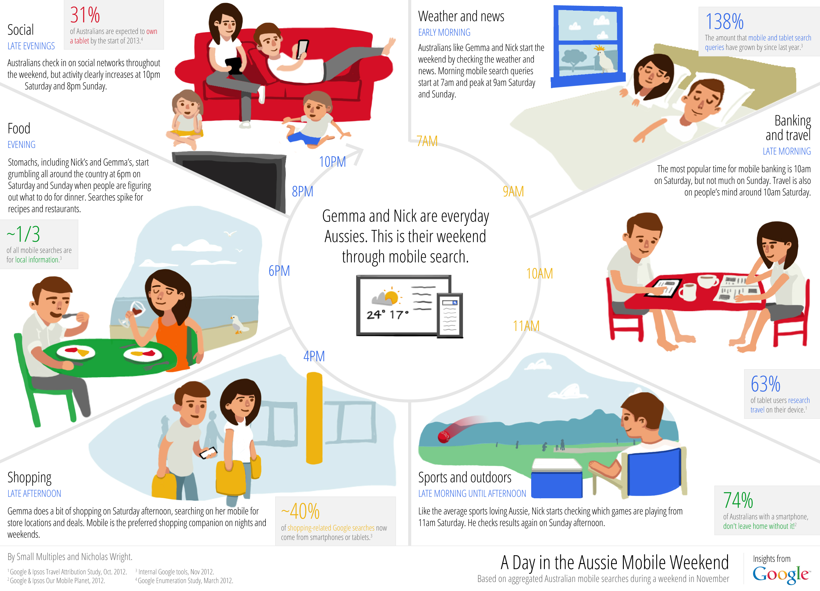
Notes:
Let’s start with this infographic – A Day In The Aussie Mobile Weekend
This can be a key take out to start our hunting and gathering of user data.
People use different devices across different times of the day.
We, as marketers, have to be prepared for that.

Slide 6
Gather and track data
Consider your own site browsers via Google Analytics
Consider all category buyers with professional market research
Consider competitors
Notes:
Consider existing consumers:
Percentage of site visits that come from mobile browsers. Pages or sections of content being accessed on your desktop site from mobile brows
Consider whole category:
Talk to people about your website experience
Are they pinching the screen to view your website?
Could the experience be improved?
Consider competitors
dont restrict yourself to your competitors - that means you will only be as good as they are.
look at sites beyond your reach. get an idea of early adopters and industry leaders.

Slide 7
What to look for
Content offering
User experience (content, navigation, formatting, media)
What to look through
Smart phones
iPhones, Samsung Galaxy, HTC, Blackberry, Xperia
Tablets
iPad, Galaxy Tablet, Surface, Nexus 7, Kindle Fire
Desktops
Apple, Microsoft, Linux

Slide 8
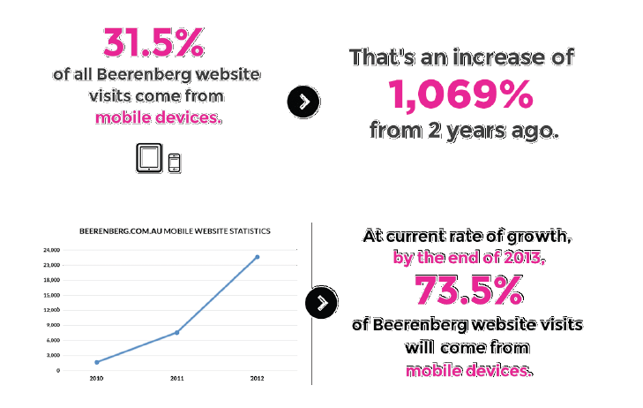
Case study - FMCG

Slide 9
2?
Notes:
Mobile is the best thing that has ever happened to your content.

Slide 10
2. Create flexible, reusable
and consistent content.
Useful
Usable
Purposeful
Profitable
Notes:
MOBILE IS THE BEST THING THAT EVER HAPPENED TO YOUR CONTENT
Mobile just gives us the opportunity to review our content within a constrained medium

Slide 11
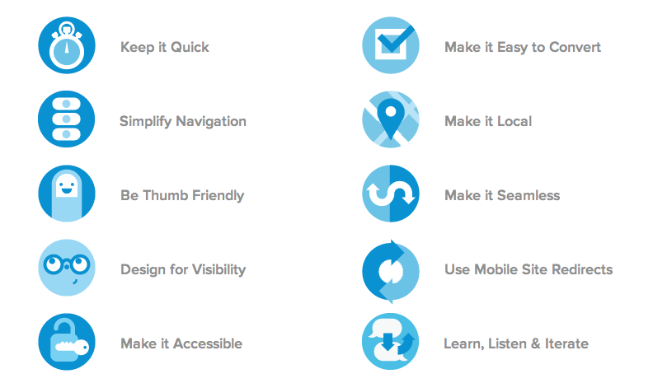
Sexy content (that works)

Slide 12
Key Considerations
Content = Resources
Myth - people want to see less on mobile
Shift your thinking
Don’t duplicate content across platforms
Notes:
Resourcing: who is creating content? What are the responsibilities of these? choose a selection of people across the enterprise to provide content + work load can be shared - different prospective and insight
Shift thinking: get away from marketing content, what people are saying about on Facebook is content, all kinds of places, even more critical.
if you are sharing exactly the same info on Twitter as on Facebook why would I need to follow you on both?

Slide 13
3?

Slide 14
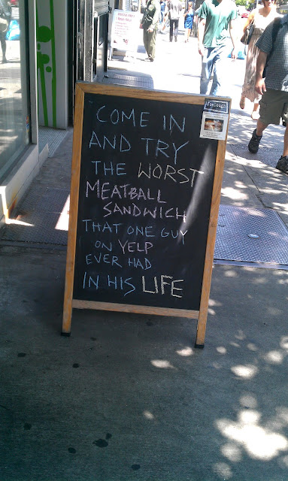

Slide 15
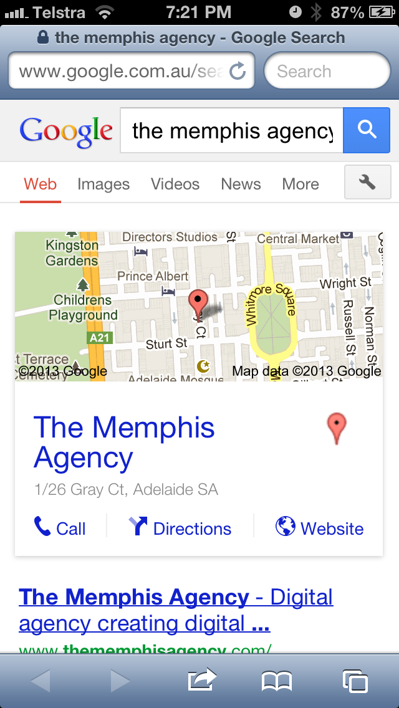
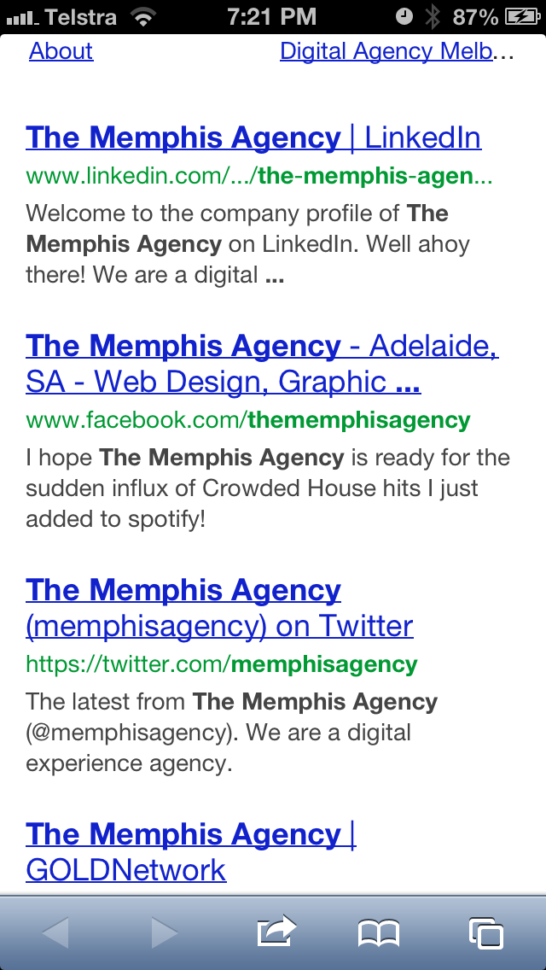

Slide 16
3. Optimise location-based
social platforms
Google + Local (previously Google Places)
FourSquare
Facebook Pages
Review sites – Trip Advisor, Urban Spoon, Yelp

Slide 17
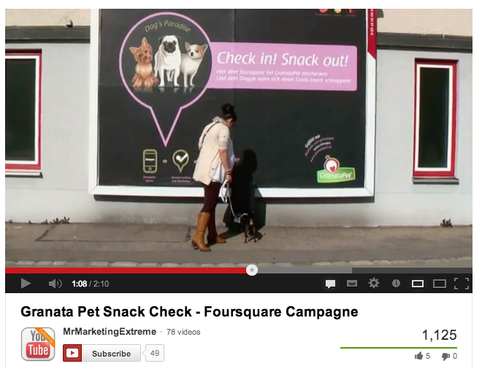
Case study - GrenataPet
Notes:
http://www.youtube.com/watch?v=WxHXAFaaBqo

Slide 18
4?

Slide 19
4. Consider mobile advertising
Maximize reach
Opportunities for dynamic content
Consider browser ads before app ads
Notes:
According to a January 2013 report by CNN, “For the first time, the number of active daily visitors checking Facebook on mobile devices is higher than the number of people checking the social network on the Web
Exciting creative opportunities
All phones come with a browser, not all come with apps.

Slide 20
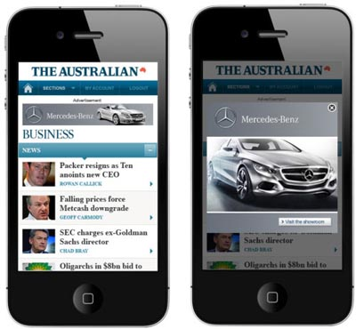

Slide 21
Examples
Facebook mobile ads
AdWords across devices
In-app advertising
Mobile ad networks
Optus Digital Media, News Limited, Fairfax, BigMobile

Slide 22
5?

Slide 23
5. Go responsive!

Slide 24
Nirvana
You've put a plan in place for doing qualitative and quantitative research to help you understand how people are using your mobile content - informed choices about how to prioritize
All of your content is well-written, timely, valuable and it is available to users regardless of the platform they want to consume it on. You can re-use it across platforms.
Your location-based social media platforms are functional, informative and provide value.
You have lead users to your website from mobile advertising, and you understand there is a potential to obtain reach from mobile advertising.
Your site works on any device. You've created a brilliant online user-experience that’s more fluid and more easily accessed on a multitude of devices.
Notes:
You've put a plan in place for doing qualitative and quantitative research to help you understand how people are using your mobile content - informed choices about how to prioritize
All of your content is well-written, timely, valuable and it is available to users regardless of the platform they want to consume it on. You can re-use it across platforms.
Your location-based social media platforms are functional, informative and provide value.
You have lead users to your website from mobile advertising, and you understand there is a potential to obtain reach from mobile advertising.
Your site works on any device. You've created a brilliant online user-experience that’s more fluid and more easily accessed on a multitude of devices.

Slide 25
" If you're wondering if you're going to need to invest in getting your content on mobile, quit hoping you won't have to.
Your customers are already there.”
- KAREN MCGRANE
CONTENT STRATEGY FOR MOBILE

