Slide 1
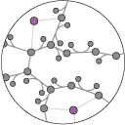
Update on C. diff Genome-scale modelling and tutorial
UCSD Systems Biology Research Group
Jonathan Monk
CJ Norsigian
U01 AMR Modelling Working Group
April 24, 2018

Slide 2
Outline
Update of C. diff reconstruction progress and data collection efforts
C. diff 630 Genome-scale Model of Metabolism (GEM) complete and simulating
Some updates remain (e.g. cell wall synthesis)
Multi-strain models in draft form
31 strains from Baylor (Savidge and Spinler)
Jupyter Notebook live tutorials
1. Loading the C. diff GEM, sampling flux states
2. Integrating RNAseq data with the GEM
Discussion
Call for data!

Slide 3
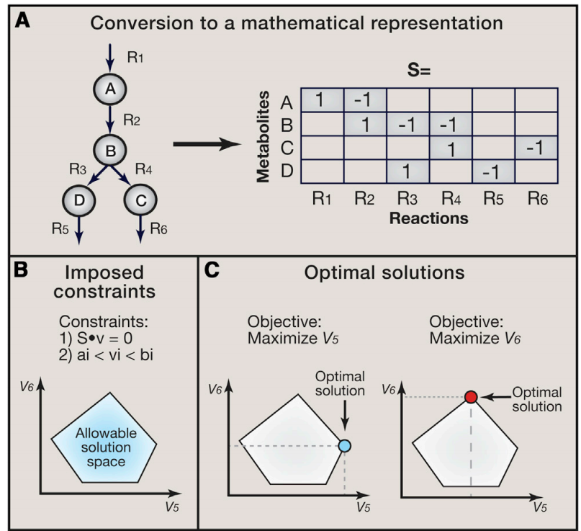
Constraints Based Modelling
Reconstruct network
Convert to mathematical representation
Apply constraints
Mass balance
Energy balance
4. Define an objective:
For example: growth
5. Use linear optimization to solve
O'Brien EJ, Monk JM, Palsson BO: Using Genome-scale Models to Predict Biological Capabilities. Cell 2015, 161(5):971-987

Slide 4
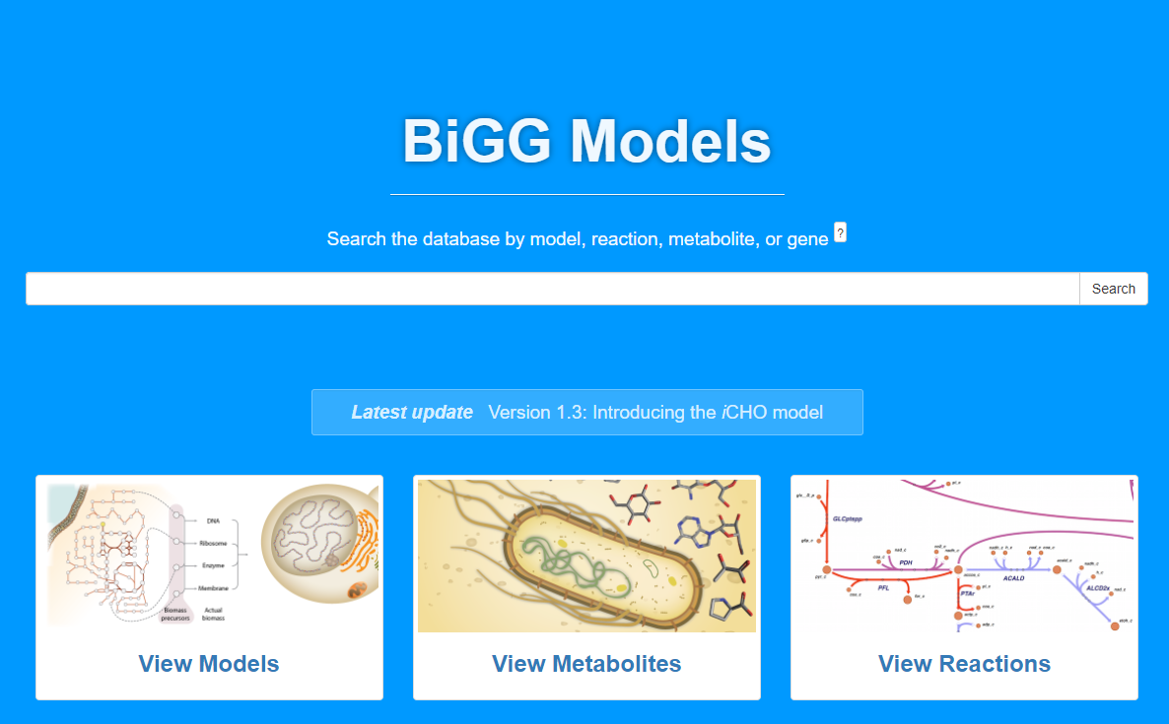
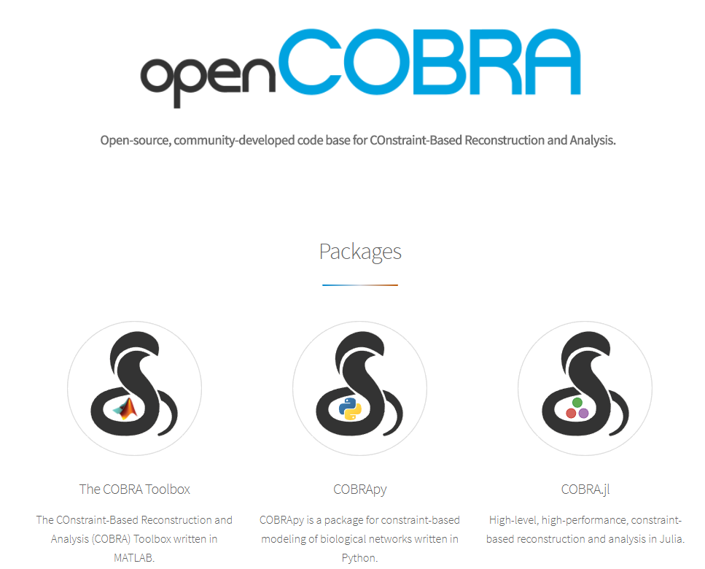
Resources and tools
BiGG: Repository for genome-scale models
Total of 80 available
http://bigg.ucsd.edu
COBRA toolbox:
https://opencobra.github.io/
Today focusing on python version

Slide 5
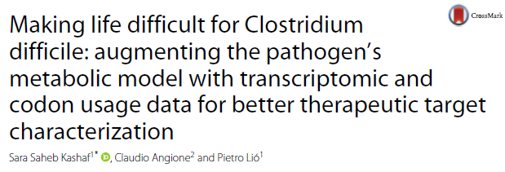
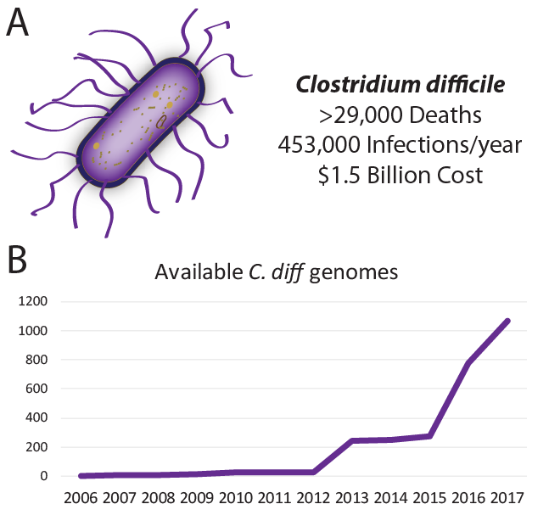
Update on C. diff reconstruction
Building draft reconstruction for C. diff 630 based on previous reconstruction
Kashari et al. 2017
Mapping and standardizing reaction and metabolite IDs to SBRG standard
Collecting data and genome sequences for model expansion and improvement
Baylor proteomics data sets (Tor Savidge)
Additional sequences?
Biolog data?
Others available?

Slide 6
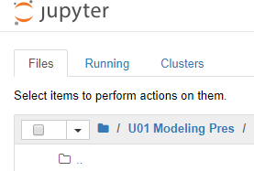
Last Time:
1. Reconstruction example
2. Simple model simulations
3. Application: gene essentiality and growth capabilities on different substrates
Notes:
We are really talking about new ways to analyze differences and heterogeneity within a bacterial species

Slide 7
Today:
1. Sampling Flux States of a Genome Scale Model
2. Simple integration of RNAseq data with a GEM
Notes:
We are really talking about new ways to analyze differences and heterogeneity within a bacterial species

Slide 8
Discussion
Should these be hosted on a dedicated server?
Future presentations focused on using data generated from the U01 to model with?

Slide 9


