Slide 1
ISP Client Reliability Roadmap
August 2005 by Jon Marinello

Slide 2
Introduction
QA and deployment phases take too long and quality is too low.
Investing in key quality improvements within Development will reduce time-to-market with much higher quality.

Slide 3
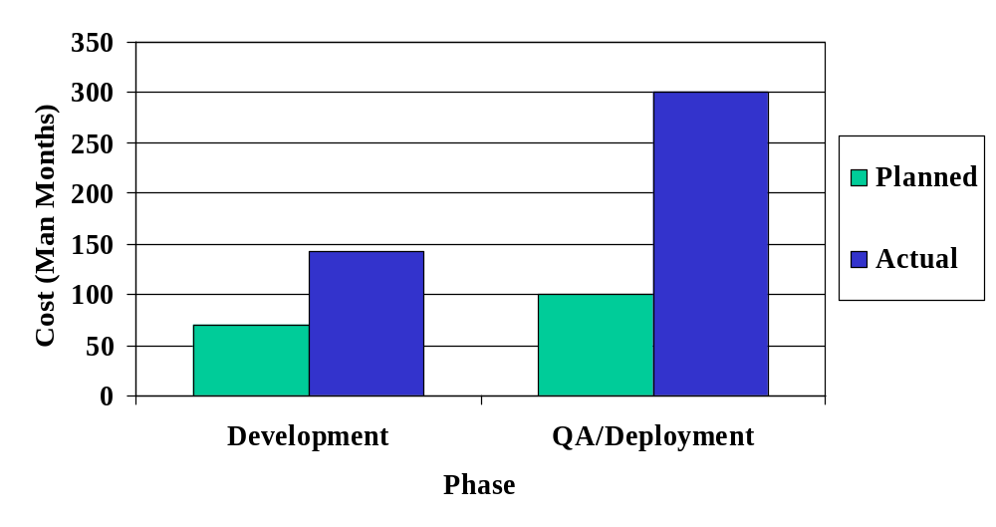
The Problem
The later we find bugs the greater the cost to fix them (Example: Mercury)
Notes:
Currently, we are paying a very, very high price for all the bugs we are finding in QA and worse, once the software is rolled out to production.
Once a bug makes it into QA and is detected there, bugz must be filed and managed across three departments (Dev/QA/PM).
If a bug makes it to production, Client Operations gets involved and bugz must be filed and managed across five departments (Dev/QA/Ops/CRM/PM).
Worse, we are negatively affecting our paying subscribers and in many cases they are churning away.
It is actually takes longer to complete a software release because we have to develop numerous unscheduled point releases.
There is a negative forward impact to high priority follow-on projects because we have to keep pulling back Development and QA resources to work on the previous release due to the bugs that made it into production.

Slide 4
The Problem (cont.)
Currently, elapsed time is too long:
elapsed time
Development
QA/Rollout
With key changes, elapsed time will decrease:
elapsed time
Development
QA/Rollout
Notes:
The problem: Currently we are optimized to spend a minimum of time in the development phase. Unfortunately, we are spending much too much time in QA finding bugs. We are also forced to develop numerous unplanned point releases. The overall elapsed time is much too long.
By investing in key quality improvements within Development we will significantly reduce time-to-market with much higher quality.

Slide 5
Only applies to ISP Client and Shared code
Only applies to the ISP Client and Shared code.
Use on other software systems TBD.
The Accelerator Client will benefit from this work.
Notes:
The contents of this presentation only applies to the ISP Client and Shared code. At the present time, other software systems and teams are not required to follow the recommendations and strategies of this presentation.
As we see the benefits of this approach we may choose to review its application to other software systems and projects as needed.
The Accelerator Client will benefit from this work because it consumes the Shared code (factored out in the 7.5 release).

Slide 6
New Development/QA roles
Development should deliver essentially bug-free code to QA.
QA should only verify that no bugs are present and that the features work as advertised.
Overall significant decrease in calendar time to deliver finished projects.
Notes:
The problem: Currently we are optimized to spend a minimum of time in the development phase. Unfortunately, we are spending much too much time in QA finding bugs. We are also forced to develop numerous unplanned point releases. Worst of all, we are forced to use our subscribers to test our software because we don’t have a comprehensive testing strategy.
QA should verify that no bugs are present instead of spending so much time finding and reporting bugs.
This will increase Development time but shorten QA time with an overall significant decrease in calendar time to deliver finished projects.

Slide 7
New correct & highly reliable code
All new replacement code is of extremely high quality because it is:
Correct.
Highly reliable.
Robust.
Highly maintainable & extensible.
Starting in the Mars release, logs will be uploaded.
Notes:
All new replacement code is of extremely high quality because it is:
Correct – and proven to be before QA and our customers ever see it.
Highly reliable – and proven to be before QA and our customers ever see it. Complete and automated unit/integration/regression testing.
Robust – when any error is detected, all relevant information is collected and reported.
Highly maintainable & extensible – OO design principles are rigorously applied.
Starting in the Mars release, logs will be uploaded which will allow us to do extensive statistical analysis of the information (e.g., top 10 errors).

Slide 8
Comprehensive error detection & reporting
New comprehensive error detection and reporting technology.
Logs contain only error information.
Nested exceptions add critical debugging information.
Complete exception stack back-traces.
Errors usually stop further processing of the task.
Notes:
We now employ a new comprehensive error detection and reporting technology – C++ Nested Exceptions and logging.
Logs contain only error information (no trace). The historical use of trace to help debug problems is problematic; its hard to find errors in the mountain of noise and logs roll over before the error can be reported.
Exceptions are optionally nested to add critical debugging information. As the stack unwinds, each stack frame can add critical debugging information (parameters passed or values computed) to the exception stack back trace.
Complete exception stack back-traces. Just like Java has!
Errors usually stop further processing of the task to avoid reporting spurious errors. In rare cases (< 1-5% of the time) special handling is used. Examples are server failover, backup file access, etc.

Slide 9
Error handling demonstration
We will now view an interactive ISP Client demonstration of the current production client and the new Mars client highlighting the benefits for nested exception reporting.

Slide 10
Automated development testing
All new data model replacement code is tested in an automated fashion.
100% code coverage (verifiable).
Common use cases and boundary conditions.
Unit and integration types of testing.
Regression testing.
Available to QA for review.
Still need end-to-end tests.
Notes:
All new data model replacement code is tested in an automated fashion by development before other developers, QA, Operations and most importantly, our subscribers ever see it.
Automated tests attempt to achieve 100% code coverage (verifiable).
Automated tests cover common use cases and boundary conditions.
Automated tests cover both unit and integration types of testing.
Automated tests are built and run as part of the nightly and QA build process which provides complete regression testing. The value of automated regression testing should be stressed. This allows us to greatly increase our confidence that changes to the code haven’t introduced a problem in existing behavior. This also allows developers to find and fix bugs right when they’re introduced and not days or weeks later.
All automated tests are available to QA and Operations for review.
Automated development testing does not mean we can abandon stress testing and complete end-to-end integration and system testing. These forms of testing are still needed.

Slide 11
Automated development testing (cont.)
All automated tests are scriptable.
Unit tests provide the most bang for the buck.
Automated test results submitted to QA as part of the QA handoff.
Tight integration with the Isp Client build tool.
Scriptable access to all data model software layers.
Notes:
All automated tests are scriptable using the Hammerhead testing framework.
Unit tests provide the lowest cost yet yield the maximum benefit (90+% of all bugs can be caught at the unit level).
Automated test results submitted to QA as part of the QA handoff release notes.
Unit and integration tests are always built and run with every nightly and QA build. The build tool was built to optimize automated testing and not just building code.
Scriptable access to all data model software layers. Each subsystem has its own automated tests. Subsystems are layered. This allows us to script at each level.

Slide 12
Automated testing example
Automated test powered by Hammerhead*
Hammerhead test framework*
Input script*
Generated output
Pass/Fail Result
Property manager code under test*
Known good output*
Property Manager File
* Checked into CVS
Notes:
Developers write an input script in text format that drives the automated unit/integration test.
This script is consumed by the automated test and a output result is generated.
This generated output file is then consumed by the Hammerhead framework along with a previously generated know good output file and these are compared.
If they are the same the test passes, otherwise the test failes.

Slide 13
Automated code coverage reporting
Complete and automated code coverage reporting.
Code coverage reports submitted to QA as part of the QA handoff.
Summary and detailed reporting provided.
Batch and interactive reporting available.
Tight integration with the Isp Client build tool.
Notes:
Complete and automated code coverage reporting based on automated testing.
Code coverage reports submitted to QA as part of the QA handoff release notes (starting with the Mars release).
Summaries by percentage of function calls and statements executed. Details include the actual source code with coverage symbols.
Batch and interactive reporting available. Interactive tool allows developers to quickly “drill-down” to and address coverage gaps.
Code coverage analysis run with every nightly and QA build. The build tool was built to optimize coverage analysis and not just building code.

Slide 14
Bullseye code coverage demonstration
We will now view an interactive demonstration of the Bullseye code coverage tool.

Slide 15
Comprehensive code reviews
All code reviewed.
Documented process.
Permanent record in Bugz and CVS.
Tight integration with Bugz.
Notes:
Every line of code changed or added is reviewed.
We have a documented process that all team members follow.
A permanent record to the code review is contained in Bugz and CVS. All code changes require a filed bugz. All code review comments/discussions and the associated resulting code is stored in the source code in the CVS history (note that once the code review comments are addressed, the comments are removed).
Checkins are grouped and tracked by bugz.

Slide 16
Bugz/CVS code review demonstration
We will now view an interactive demonstration of the Bugz/CVS code review feature.

Slide 17
Automated build tool
Formalized
Repeatable
Integrated
Visible
Highest warning level
Warnings are treated as errors
Project setting enforcement
Notes:
We have a documented and formalized build and packaging process. This process is only executed by approved build managers and only on the approved build machine. Formal builds are never done on developer workstations.
The build process is run every night as well as for formal QA builds. Both nightly and QA builds start with a fresh snapshot of the code from CVS.
Tightly integrated with Microsoft Visual C++ 7.1, CVS, Hammerhead, Bullseye and Doxygen.
Reports are sent to a team defined email distribution list for all nightly and QA builds.
All our code is compiled with the highest warning level (4) with warnings treated as errors so they must be immediately addressed or the client won’t build.
All required Visual C++ project settings are enforced by the build tool.

Slide 18
Generated interface documentation
All interface documentation is generated from the source code.
Generated by Doxygen and GraphViz.
UML Class diagrams and call graphs are generated.
Notes:
All interface documentation is generated from the source code which minimizes the chances for obsolete and inaccurate documentation.
Industry standard tools used.
In addition to the usual textual documentation, UML style class diagrams and call graphs are generated which are extremely helpful.

Slide 19
Documentation demonstration
We will now view an interactive demonstration of the Doxygen interface documentation.

Slide 20
Phased development & deployment
Although we wish we could stop the world and rewrite the current code base, this is not feasible.
Delivery of new code will be delivered in upcoming releases and not all at once.
Mars is planned to contain rewrites of many subsystems.
Follow-on releases will build on previous releases.
Notes:
The business needs feature development to continue release-to-release. We fit in quality improvements when the schedule permits.
New code will be delivered in carefully planned upcoming releases and not all at once.
Mars is planned to contain rewrites (with automated testing and code coverage analysis) of Property Manager, Transaction Manager, Smart Pull, XML Parser as well as many low level (FileSys, Communications, Process, Sync, Web, Registry, Module, Cryptography, Exceptions, Machine Properties and Memory) replacements.
Follow-on releases will build on previous releases.

Slide 21
Summary
QA and deployment phases take too long and quality is too low.
Investing in key quality improvements within Development will reduce time-to-market with much higher quality.
Notes:
By investing in key quality improvements within Development we can reduce the overall time it takes to reach stable production releases. This reduction is realized in QA, deployment as well as a reduction in the number of unplanned point releases. We need to employ a comprehensive testing and coverage strategy within development.
Although we have made a lot of progress in reducing crashes, we need to do much more with respect to logical errors (file I/O, connection failures, etc.). Nested exception reporting will really help us solve this problem.
Development must publish testing and coverage reports to QA.
Over time, QA will take less time to verify a release. As we start to drastically reduce the number of bugs QA will be able to reduce the amount of test coverage needed to ensure a release meets the quality standard.
Since it’s impossible for QA to test every line of code, we are currently forced to release code to our subscribers that has never been tested. Our new testing strategy will solve this problem.

