Slide 1
Path Finding
How the search space for creative tasks is navigated.
Notes:
Thanks alex for the wonderful presentation of problem-finding.
In this section, we would focus on how the search space for creative tasks is navigated.

Slide 2





About me
Third-year PhD Candidate at USC
Research interests: Language Agents, IR, Planning
Notes:
Here is some info about myself.

Slide 3
Challenges of creative planning
Problem-Finding | Path Finding | Evaluation
The search space is unknown or large
The reward is sparse
Writing
Information
Gathering
(e.g. DeepResearch)
Brainstorming
(AI4Science)
Search Space
Reward Space
Notes:
Let’s ground ourselves in why creative planning is hard. Two killer constraints dominate every domain on this slide: the search space is either unknown or effectively infinite, and the reward signal is extremely sparse.
Here we list three examples of creative tasks, writing, information gathering, and ai research assistant.

Slide 4

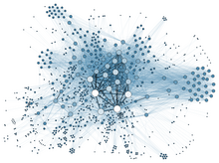


Challenges of creative planning
Problem-Finding | Path Finding | Evaluation
The search space is unknown or large
The reward is sparse
 | ~ infinite | internet | internet + database
Writing
Information
Gathering
(e.g. DeepResearch)
Brainstorming
(AI4Science)
Search Space
Reward Space
Undefined
Sparse
Notes:
Here the search space for creative writing task is ~infinite. Any sequence of tokens is theoretically valid, so brute-force exploration is impossible. The monkey-at-a-typewriter icon is a reminder of that combinatorial explosion in search space.
But what even is a ‘reward’ for writing tasks.
? Coherence? Reader engagement?
When the task is information gathering, for example, deepresearch of ChatGPT, the search space becomes the entire internet—millions of pages with uncertain credibility.
Rewards come only when we cite the right paper or answer the user’s question—events that occur sparsely amid a sea of irrelevant links.
And also, if we use LLM as scientific research assistant that helps generate research ideas and hypothesis. Now we are adding structured databases—protein catalogs, materials datasets—and the open web. The space is even larger and more heterogeneous.
The reward criteria is complicated and ambiguous in this case. For example, whether a hypothesis is scientifically solid and interesting.
So, across domains we face a paradox: unbounded action spaces coupled with needle-in-a-haystack rewards. Any effective agent must therefore marry smart exploration with informative proxies for reward.
In the rest of the talk, I’ll show how constraint-following, hierarchical planning, and human-workflow priors tackle exactly these two pain points.

Slide 5










Conventional Planning
Problem-Finding | Path Finding | Evaluation
Creative Planning
How to find paths?
Notes:
In conventional planning tasks we know the map and the reward layout, but in creative settings both the search space and the reward signals are largely unknown or sparse ​.

Slide 6
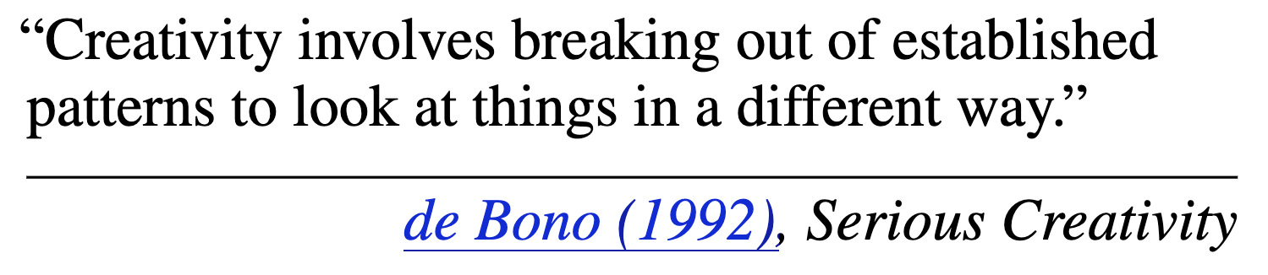
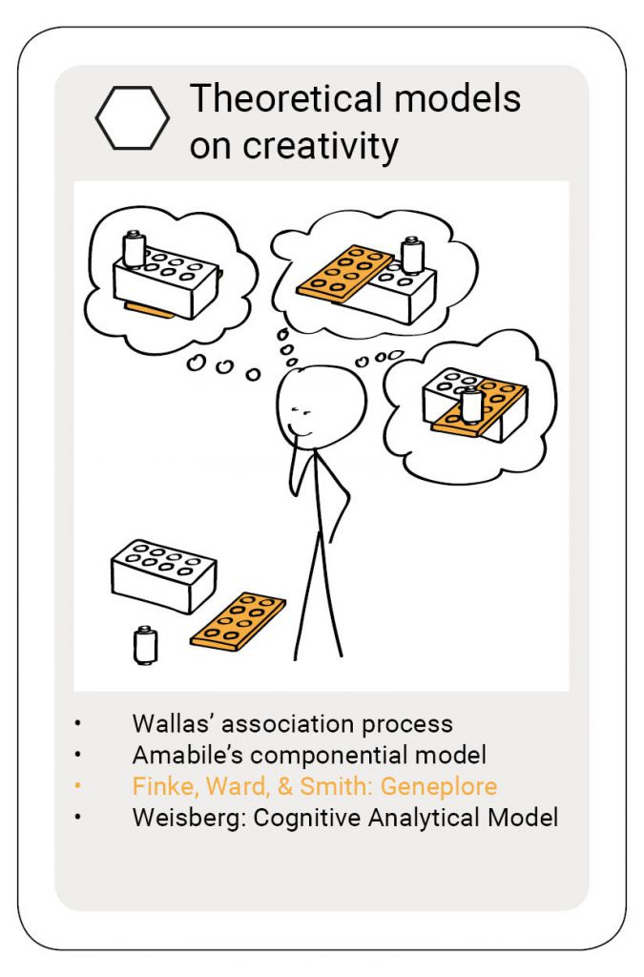
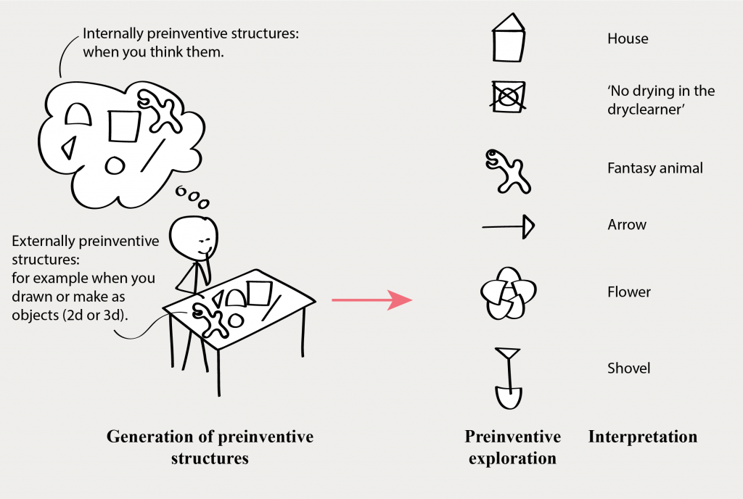
Path-finding: Overview and Background
Geneplore Model (1992):
First cognitive model to break creativity down into an exploratory function
Finke, R. A., Ward, T. B., & Smith, S. M. (1992). Creative cognition: Theory, research, and applications. MIT Press.
Notes:
As the field of creativity research expanded beyond problem-finding, researchers in the earlier 90s explored how humans take novel problem-solving approaches. One such example is the Geneplore Model, developed by Finke et al in 1992. In this model, humans first conceptualize shapes, images and actions (Generation of preinventive structures) and then explore novel combinations of them (exploration). We will build off of this model in this section, and explore ways we can creatively define and explore action spaces in the creative process.

Slide 7
Problem-Finding | Path Finding | Evaluation
Path-Finding – Overview and Background
Search
Hierarchical Planning
Constraint-following
Notes:
In the rest of the talk, I’ll talk how search, hierachical planning are going to help models find creative paths in the search space. and prefossor nanyun Peng will talk about how constraint-following enhances model creativity.

Slide 8
Problem-Finding | Path Finding | Evaluation
Search
Hierarchical Planning
Constraint-following
Search
“Art consists of limitation. The most beautiful part of every picture is the frame.” — G. K. Chesterton, Tremendous Trifles (1909)
Constrained beam search (Hokamp & Liu 2017) inserts required tokens driven by heuristics without harming fluency.

Slide 9

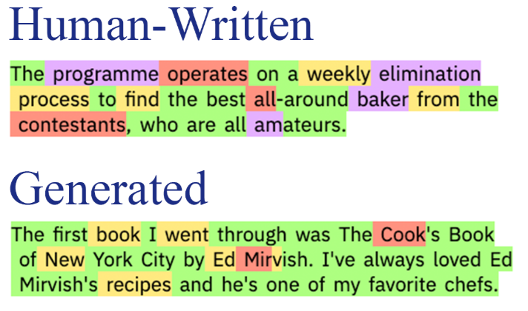
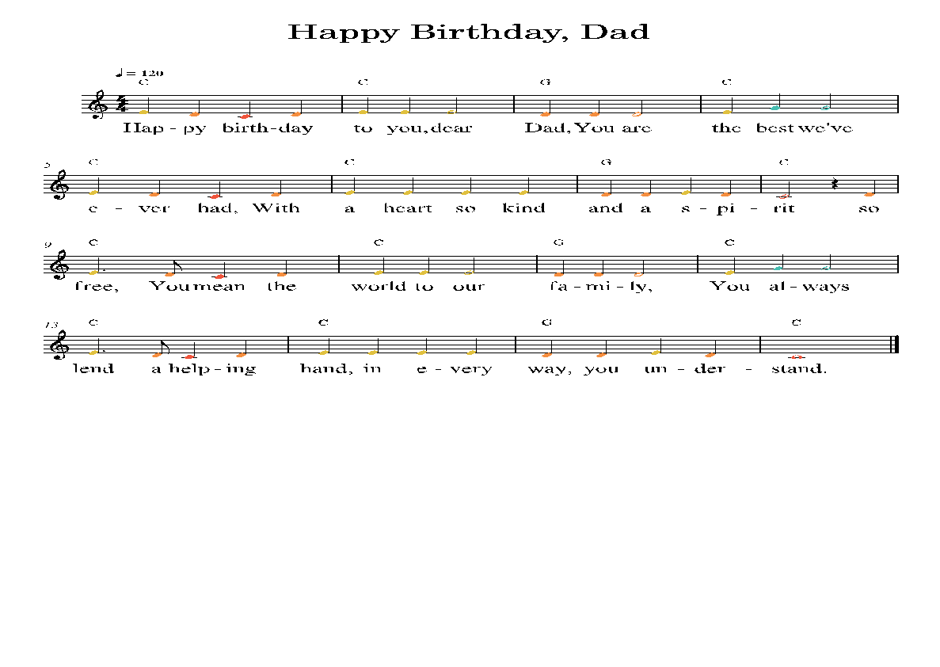
Problem-Finding | Path Finding | Evaluation
Search
Hierarchical Planning
Constraint-following
Examples of Heuristics in Creative Tasks
Human stories have more “high-rank” words than machine generated stories.
Machine generated lyrics are not rhyming correctly.
(Sebastian, et. al. 2019)
(Huang, et. al. 2023)
(Tian, et. al. 2022)

Slide 10
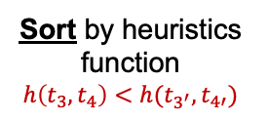














Problem-Finding | Path Finding | Evaluation
Search
Hierarchical Planning
Constraint-following
Constrained Beam Search
Originally
$${ t}_{3′}$$
$${ t}_{4′}$$
$${ t}_{1}$$
$${ t}_{2}$$
$${ t}_{3}$$
$${ t}_{4}$$
$${ t}_{1}$$
$${ t}_{2}$$
$${ t}_{3}$$
$${ t}_{4}$$
Constrained Beam Search
…
$${ t}_{1}$$
$${ t}_{2}$$
$${ t}_{3′}$$
$${ t}_{4′}$$
Sort by heuristics function
$$h\left(t_{3},t_{4}\right)<h(t_{3^{′}},t_{4′})$$

Slide 11
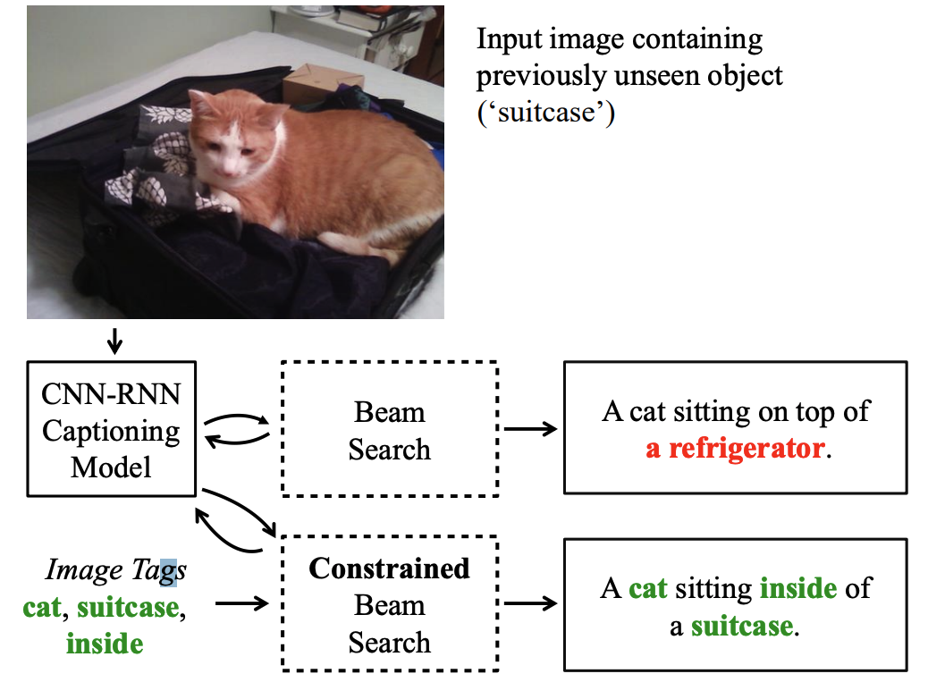
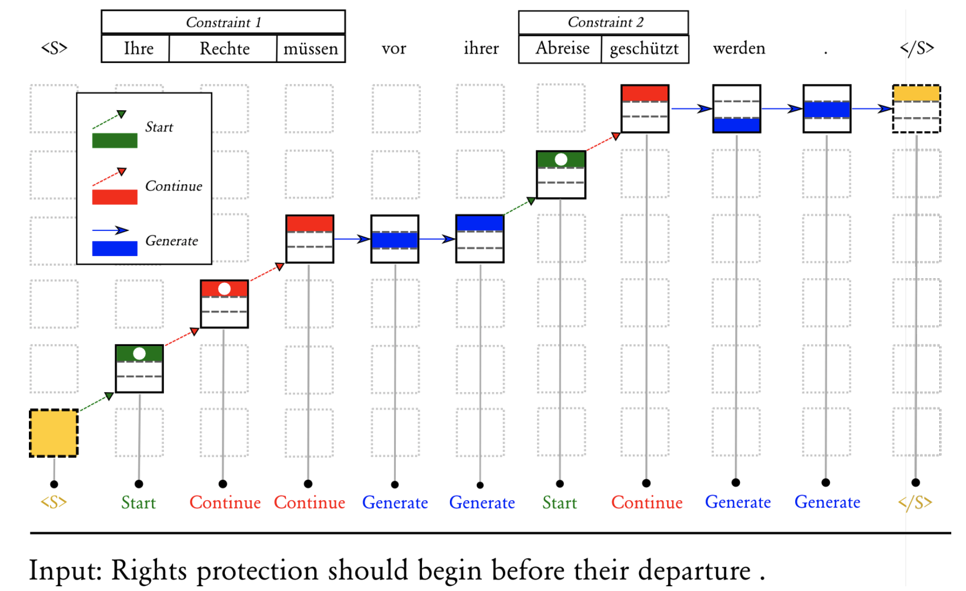
Problem-Finding | Path Finding | Evaluation
Search
Hierarchical Planning
Constraint-following
Constrained Beam Search
OOD image captioning -
Anderson, et. al. 2017
Hokamp, et. al. 2017

Slide 12
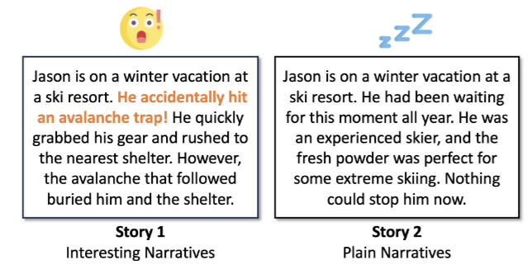
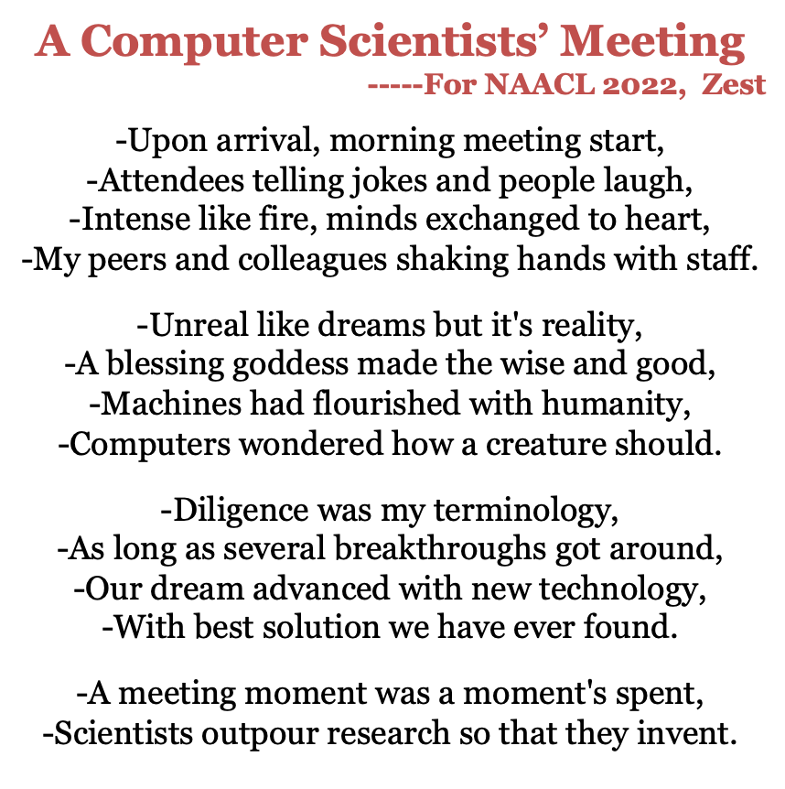
Problem-Finding | Path Finding | Evaluation
Search
Hierarchical Planning
Constraint-following
Constrained Beam Search for Creative Tasks
Not yet human level creative.

Slide 13

Problem-Finding | Path Finding | Evaluation
Search
Hierarchical Planning
Constraint-following
Search
$$S_{n}$$

Slide 14






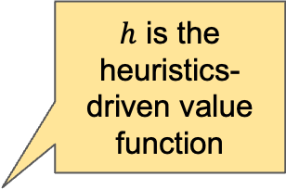
Problem-Finding | Path Finding | Evaluation
Search
Hierarchical Planning
Constraint-following
Search
$$S_{3}$$
$h$ is the heuristics-driven value function
$S_{t+1}= f\left(S_{t},a_{t}\right)$.
$$S_{2}$$
$$S_{…}$$
$$R=r(S_{t+1})+β·h\left(f\left(S_{t},a_{t}\right)\right)$$
$$S_{n}$$
extrinsic
intrinsic
$$a$$

Slide 15


Problem-Finding | Path Finding | Evaluation
Search
Hierarchical Planning
Constraint-following
Search
Is the transition function always available?
$S_{t+1}= f\left(S_{t},a_{t}\right)$.
$$R=r(S_{t+1})+β·h\left(f\left(S_{t},a_{t}\right)\right)$$
extrinsic
intrinsic
Is the step-by-step reward always available?
Can rule-based heuristics lead to true creativity?

Slide 16



Problem-Finding | Path Finding | Evaluation
Search
Hierarchical Planning
Constraint-following
RQ1: Is the transition function always available?
$S_{t+1}= f\left(S_{t},a_{t}\right)$.
Depends on the data regime
 | Low | Mid | High
Start State
Intermediate States
End
Transition Function? | no | no | yes

Slide 17
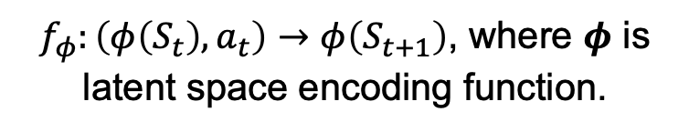
Problem-Finding | Path Finding | Evaluation
Search
Hierarchical Planning
Constraint-following
RQ1: Is the transition function always available?
$S_{t+1}= f\left(S_{t},a_{t}\right)$.
Will cover it later!
Depends on the data regime
What to do if there is no transition function?
Incorporate human knowledge and workflows
$f_{φ}:\left(φ\left(S_{t}\right), a_{t}\right)→φ\left(S_{t+1}\right)$, where 𝝓 is latent space encoding function.

Slide 18

Problem-Finding | Path Finding | Evaluation
Search
Hierarchical Planning
Constraint-following
RQ2: Is the step-by-step reward always available?
$$R=r(S_{t+1})+β·h\left(f\left(S_{t},a_{t}\right)\right)$$
extrinsic
intrinsic
Depends on the data regime
 | Low | Mid | High
Start State
Intermediate State
End
Step-by-step Reward? | no | no | maybe

Slide 19

Problem-Finding | Path Finding | Evaluation
Search
Hierarchical Planning
Constraint-following
RQ2: Is the step-by-step reward always available?
$$R=r(S_{t+1})+β·h\left(f\left(S_{t},a_{t}\right)\right)$$
extrinsic
intrinsic
Depends on the data regime
What if there is no step-by-step reward?
Learn a reward model!
Talk about it more in Eval section.

Slide 20
Problem-Finding | Path Finding | Evaluation
Search
Hierarchical Planning
Constraint-following
RQ3: Can rule-based heuristics lead to true creativity?
$$R=r(S_{t+1})+β·h\left(f\left(S_{t},a_{t}\right)\right)$$
extrinsic
intrinsic
Exploitation vs. Exploration
The extrinsic reward motivates exploitation
The intrinsic reward motivates exploration
Lilian Weng. Exploration Strategies in Deep Reinforcement Learning. Blog Post. 2020.

Slide 21
Problem-Finding | Path Finding | Evaluation
Search
Hierarchical Planning
Constraint-following
Heuristics-driven Search
Reward
Model generations cluster in the low-PPL zone.
The high-PPL zone contains sparse reward.
Heuristics-driven search encourages guided exploration.
Low-PPL
High-PPL

Slide 22
Problem-Finding | Path Finding | Evaluation
Search
Hierarchical Planning
Constraint-following
Search
“Art consists of limitation. The most beautiful part of every picture is the frame.” — G. K. Chesterton, Tremendous Trifles (1909)
Heuristics-driven search steers generations by heuristic function.
Incorporating human workflows encodes proven human workflow patterns to ground models’ high‑level planning.

Slide 23
Problem-Finding | Path Finding | Evaluation
Search
Hierarchical Planning
Constraint-following
Incorporating human workflows
Motivation
From Single-Shot LLM → Workflow Agent
Humans finish goals through structured workflows (gather → decide → act → verify → (loop*)).
Gap. Raw prompting still guesses those hidden latent steps.
Solution. Give the model a planner-executor loop aligned with the real-world workflow.

Slide 24
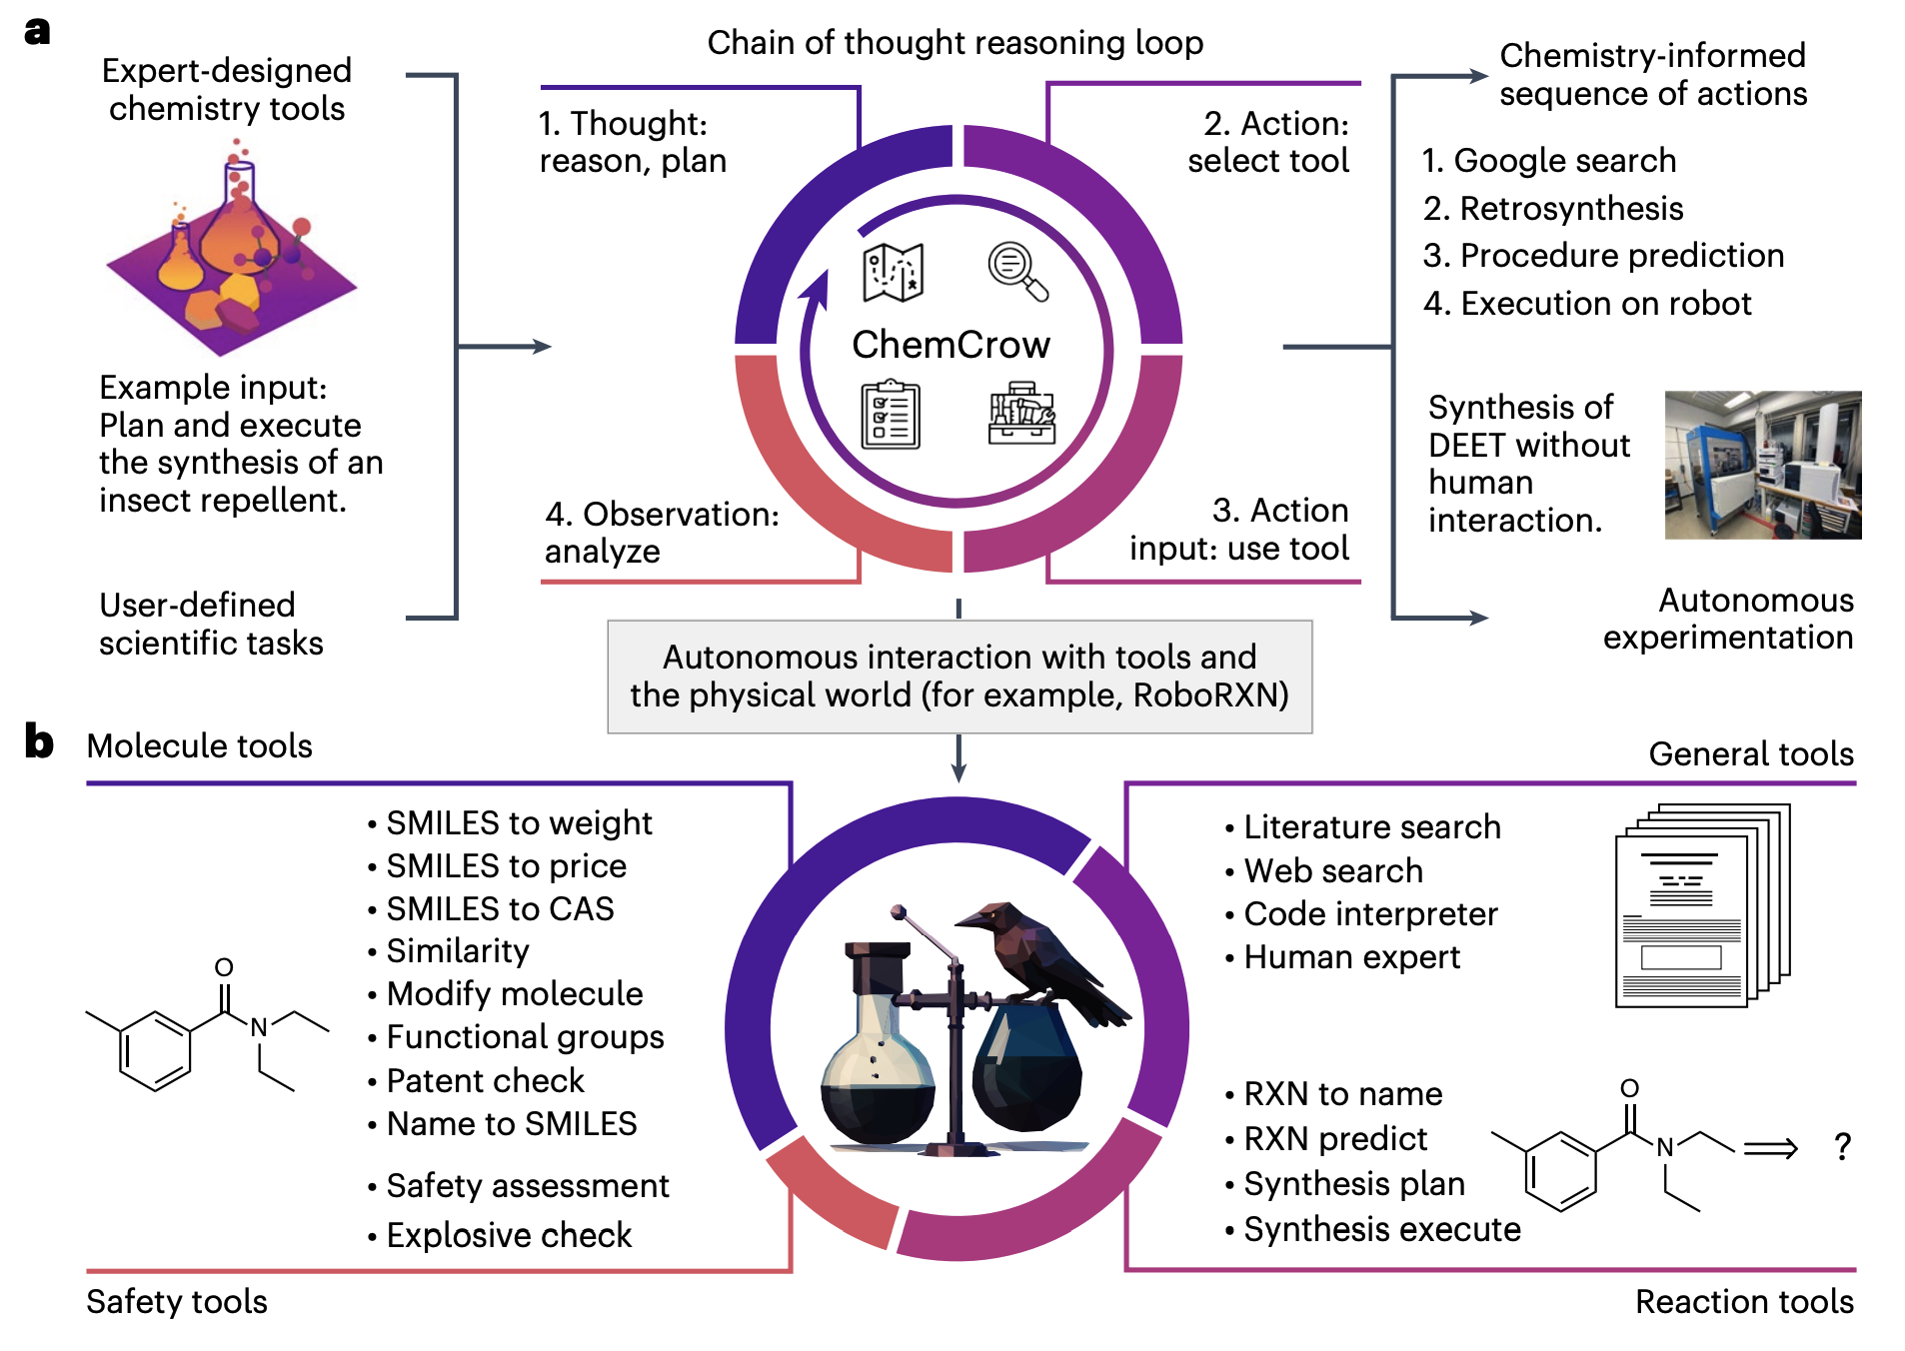
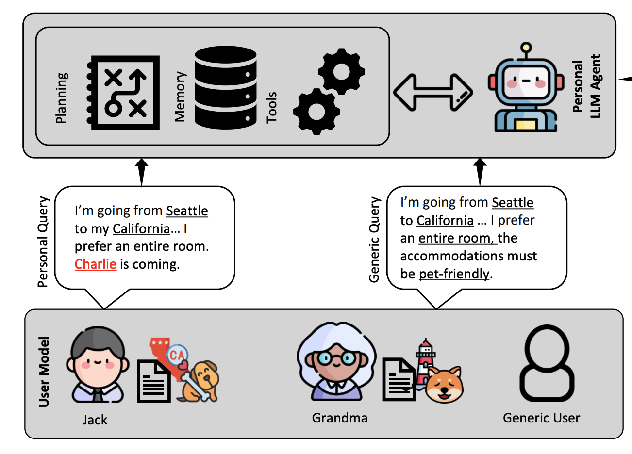
Problem-Finding | Path Finding | Evaluation
Search
Hierarchical Planning
Constraint-following
Examples of Human Workflows for LLM
Scientific discovery
Travel Planning
Look up data → design experiment
→ safety check → iterate
Gather preferences → Build itinerary
→ Budget check
Bran, et. al. 2024
Singh, et. al. 2024

Slide 25
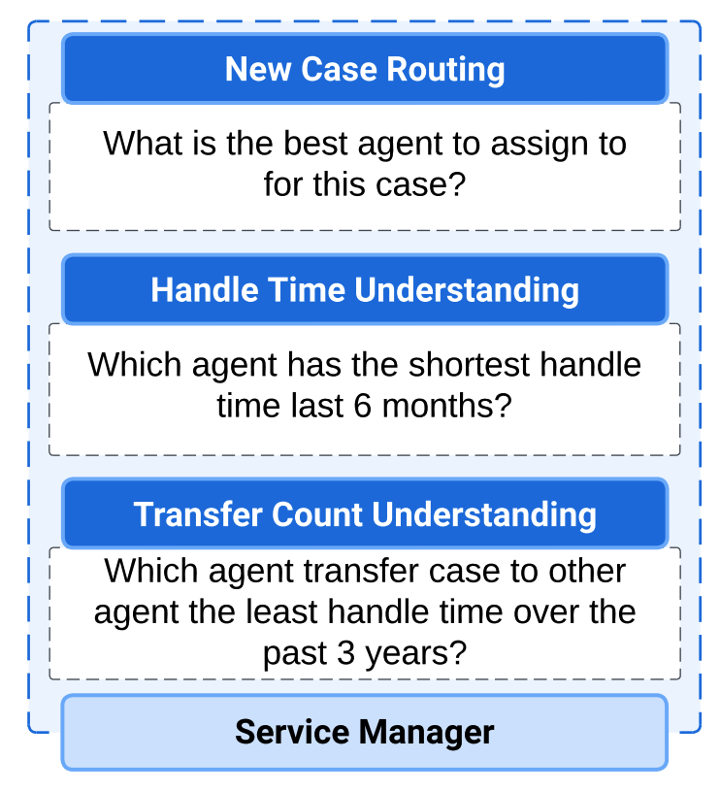
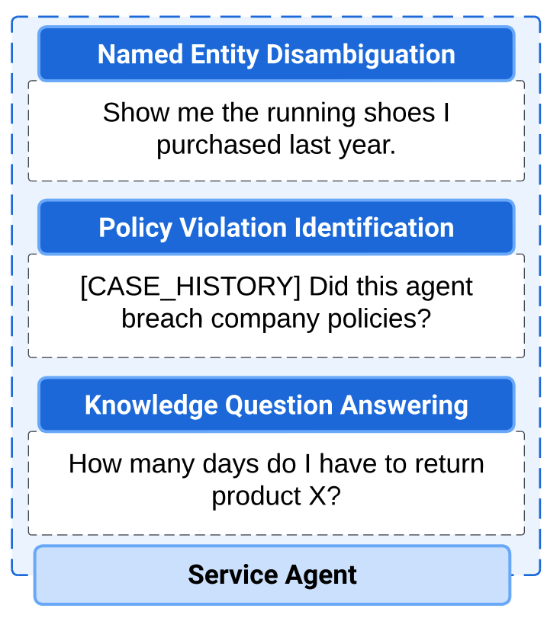

Problem-Finding | Path Finding | Evaluation
Search
Hierarchical Planning
Constraint-following
Examples of Human Workflows for LLM
Customer service
Software ops
Identify intent → Retrieve policy
→ Resolve / escalate
Write code → run → debug → PR
Huang, et. al. 2024
Devin

Slide 26
Problem-Finding | Path Finding | Evaluation
Search
Hierarchical Planning
Constraint-following
How good are workflows in Creative Tasks?
They are effective.

Slide 27
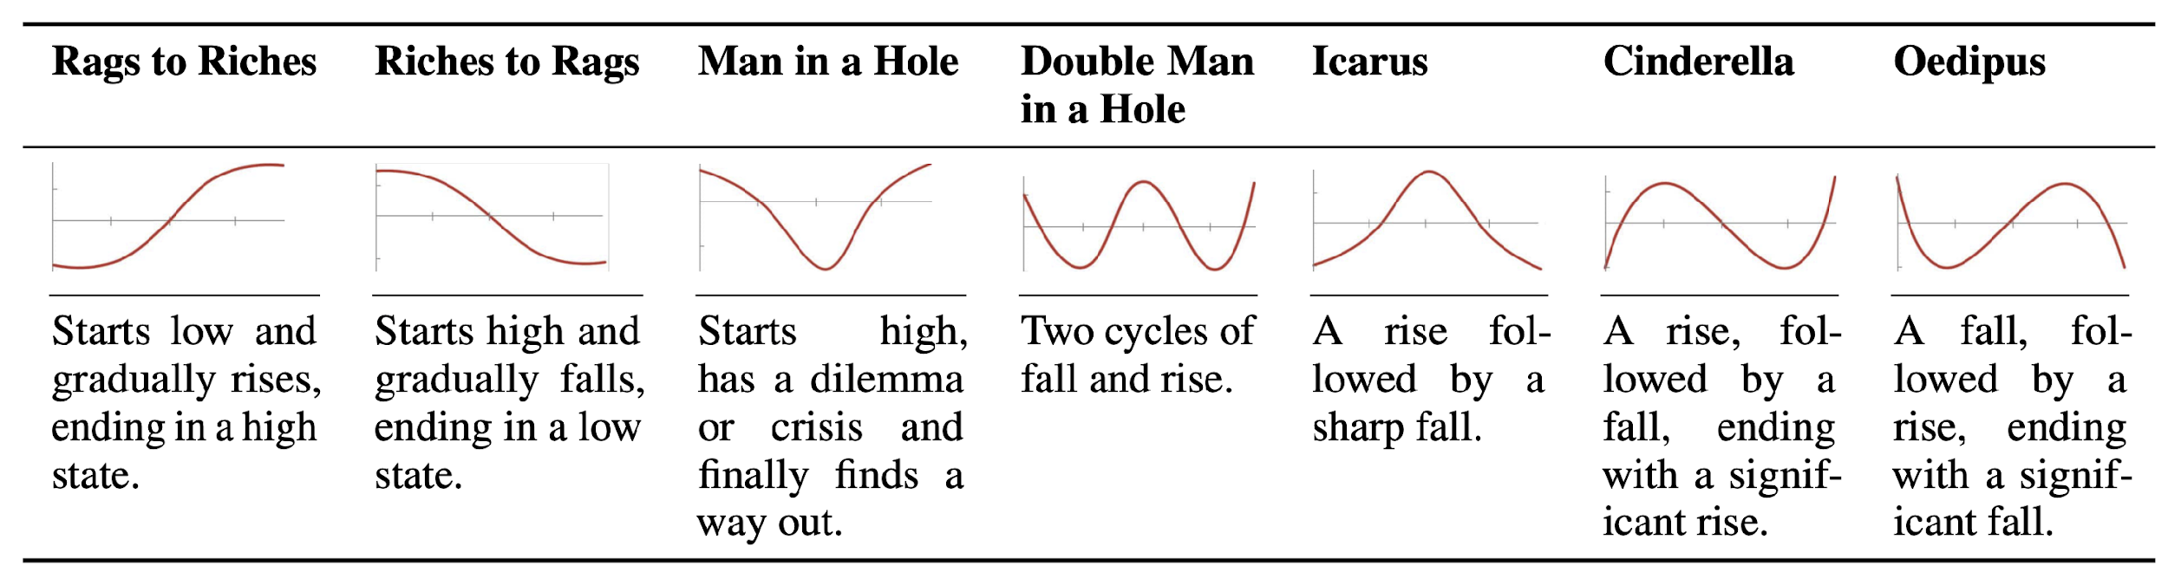
Problem-Finding | Path Finding | Evaluation
Search
Hierarchical Planning
Constraint-following
Case Study of Creative Writing
Table 1. Story arc types that are derived from Vonnegut (1995) and are characterized by transformations of the story’s protagonist(s) across the plot progression.
Notes:
2'10 First, story arcs represent the high-level plot development, such as rises and falls encountered by the main characters. We derived 7 common story arcs from literature, as listed in this table. They include rags to riches, riches to rags, man in a hole, and cinderella. //For example, in the Cinderella schema, the main character starts off in a low position, rises from adversity, faces a setback in the middle, and ultimately rises again, ending with a higher status. pause for 3 seconds

Slide 28
Problem-Finding | Path Finding | Evaluation
Search
Hierarchical Planning
Constraint-following
Case Study of Creative Writing
Turning Point (TP) | Description
TP1 - Opportunity | The introductory event that sets the stage for the narrative.
TP2 - Change of Plans | A pivotal moment where the main goal of the narrative is defined or altered.
TP3 - Point of No Return | The commitment point beyond which the protagonists are invested in goals
TP4 - Major Setback | A critical juncture where the protagonists face significant challenges or failures.
TP5 - Climax | The peak of the narrative arc, encompassing the resolution of the central conflict.
Table 2: Turning Point (TP) Types: a turning point is an event (or plot moment) that significantly influences a plot progression (Papalampidi et al., 2019).
Notes:
2'50 Next, we look at meso-level turning points—these are major events that shape how the plot unfolds, like transitions between rising and falling actions. We identify five key turning points: Opportunity, Change of Plans, Point of No Return, Major Setback, and Climax. The first three focus on setting up the story or building tension, the fourth deepens the conflict, and the final one, the Climax, brings resolution.

Slide 29

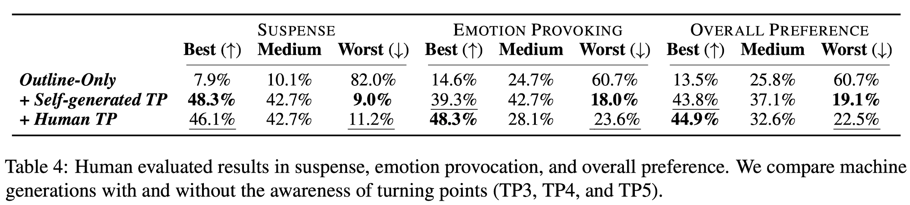

Problem-Finding | Path Finding | Evaluation
Search
Hierarchical Planning
Constraint-following
Case Study of Creative Writing
Planning and reasoning about TP in the story outline
improves overall narrative construction
reduce plot holes
enhance suspense and emotion provocation
Notes:
8’20 Compared to simply instructing the model to generate an outline, then expand it to a full story.
We find that explicitly asking the model to mark these turning points during the planning stage// improves the overall narrative construction including reduced plot holes, enhanced suspense level, and greater emotion provocation.
Interestingly, enforcing the gold turning points that human wrote didn’t further improve the quality. We realize that this is because that such enforcement could disrupt the machine’s generative flow, and make the whole plot illogical

Slide 30
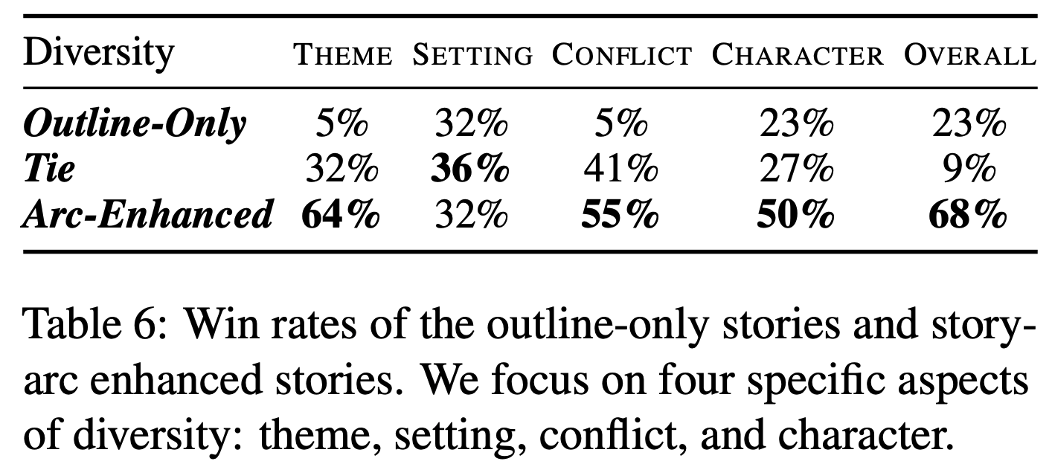
Problem-Finding | Path Finding | Evaluation
Search
Hierarchical Planning
Constraint-following
Case Study of Creative Writing
Incorporating explicit directives about story arcs helps improve narrative diversity
Notes:
9’00 We also found that giving explicit instructions about story arc schemas helps boost diversity in four areas: theme, setting, conflict type, and characters. These results show promising future directions of improving the AI story-telling ability through discourse perspectives.

Slide 31
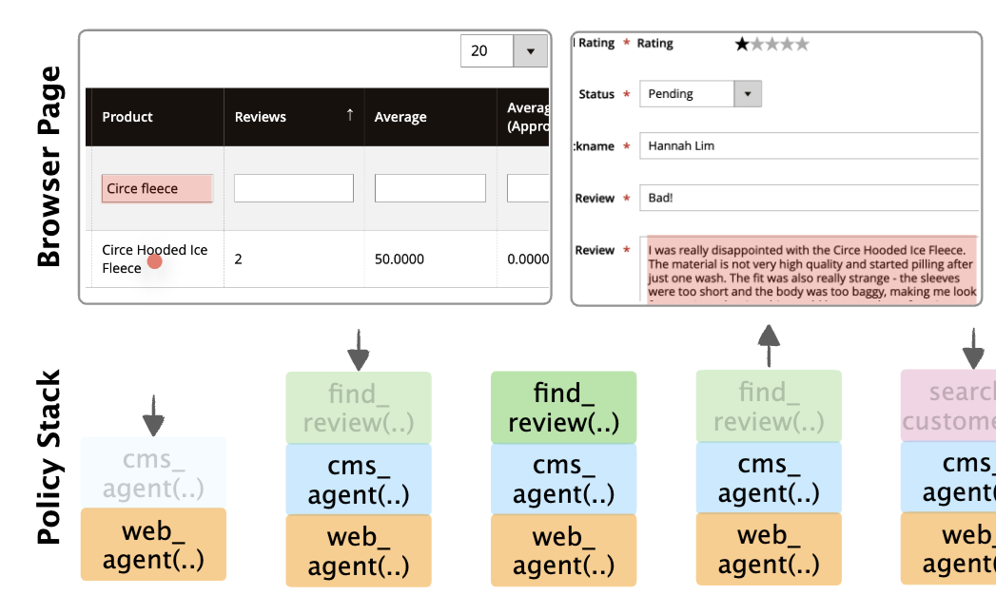
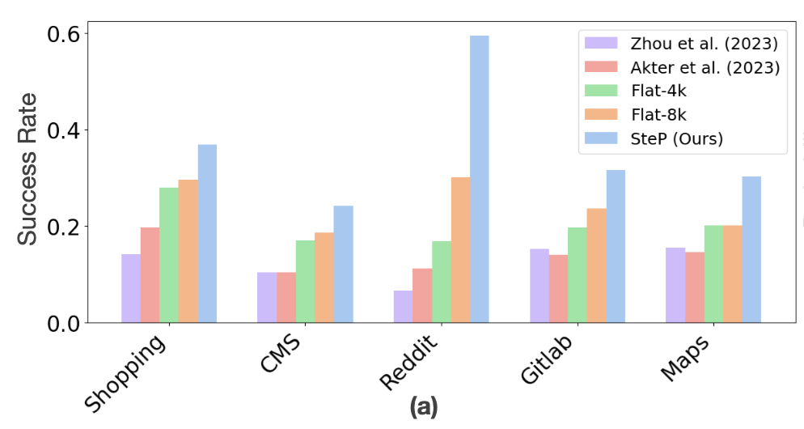
Problem-Finding | Path Finding | Evaluation
Search
Hierarchical Planning
Constraint-following
Case Study of Web Agent Task
Sodhi, Paloma, et al. "SteP: Stacked LLM Policies for Web Actions." First Conference on Language Modeling.

Slide 32
Problem-Finding | Path Finding | Evaluation
Search
Hierarchical Planning
Constraint-following
Why Workflows Help?
Search-space pruning – the agent never explores illegal step permutations.
Constrained – human ordering enforces policy constraints (e.g., authenticate → write → commit).

Slide 33
Problem-Finding | Path Finding | Evaluation
Search
Hierarchical Planning
Constraint-following
Workflows
Reward
Introducing workflows prune the search space.
Low-PPL
High-PPL

Slide 34
Problem-Finding | Path Finding | Evaluation
Search
Hierarchical Planning
Constraint-following
How good are workflows in Creative Tasks
They are effective.
However, the number of workflows are limited
Capture mode | Example artifacts | Typical size
Demonstrations / traces | Click-streams, command‐line history, code notebooks | 10¹ – 10³ per user
SOP / run-books | Markdown docs, Confluence pages, RFCs | sparse
Live feedback | Thumbs-up, critique edits, inline comments | sparse

Slide 35
Problem-Finding | Path Finding | Evaluation
Search
Hierarchical Planning
Constraint-following
Search
“Art consists of limitation. The most beautiful part of every picture is the frame.” — G. K. Chesterton, Tremendous Trifles (1909)
Heuristics-driven search steers generations by heuristic function.
Incorporating human workflows encodes proven human workflow patterns to ground models’ high‑level planning.
Self-exploration enables autonomous learning.

Slide 36


Problem-Finding | Path Finding | Evaluation
Search
Hierarchical Planning
Constraint-following
What are the learning objectives?
Self-exploration enables autonomous learning.
From Trajectory set $T=\left\{τ^{i}\right\}$, where $τ^{i}=(s_{0}^{i},a_{0}^{i},s_{1}^{i},a_{1}^{i},s_{2}^{i},a_{2}^{i},…)$
We can learn
Policy: $π_{θ}\left(a_{t} | s_{t}\right)$
Transition function: $f\left(S_{t},a_{t}\right)$ ${→S}_{t+1}$
Workflows/skills $ω$: $π_{θ}\left(a_{t} | s_{t},ω\right)$

Slide 37
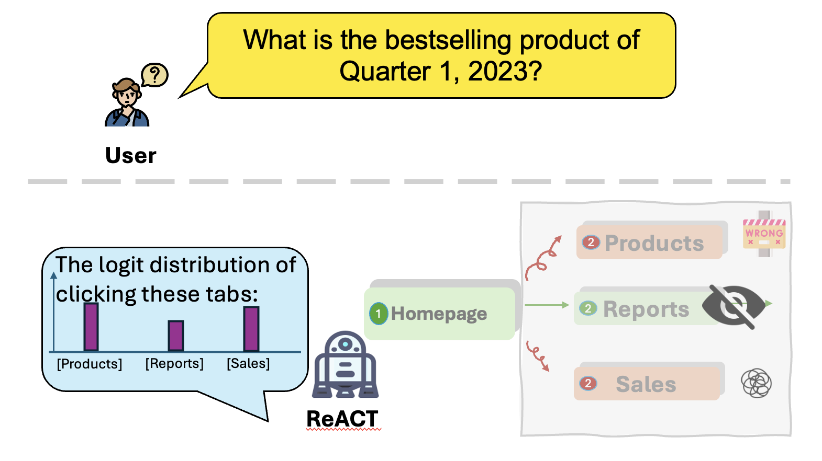




Problem-Finding | Path Finding | Evaluation
Search
Hierarchical Planning
Constraint-following
Self-exploration – learning dynamics
Why exploration is important for creative planning tasks?
Recall that in creative planning tasks, exploration in an environment with very sparse or even deceptive reward.
MDP nature of the task.
The transition function is missing
$f\left(S_{t},a_{t}\right)$ ${→S}_{t+1}$
$$S_{2}$$
$$S_{…}$$
$$S_{n}$$

Slide 38
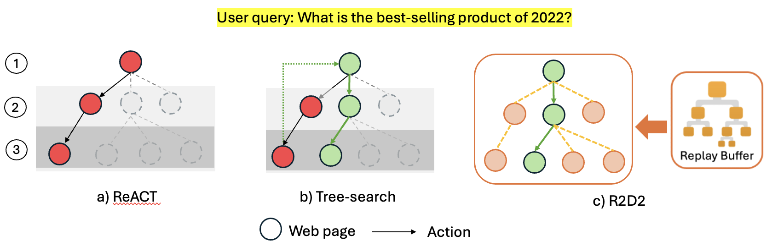
Problem-Finding | Path Finding | Evaluation
Search
Hierarchical Planning
Constraint-following
Self-exploration – learning dynamics
Both ReACT and TreeSearch approaches are Unknown-MDP-based. At each timestep, agents’ observation space is constrained.

Slide 39
Problem-Finding | Path Finding | Evaluation
Search
Hierarchical Planning
Constraint-following
Self-exploration – learning dynamics
Both ReACT and TreeSearch approaches are Unknown-MDP-based. At each timestep, agents’ observation space is constrained.
R2D2 constructs the search space leveraging stored state information from a replay buffer. By transforming the task into a Known MDP.
Huang T, Basu K, Abdelaziz I, et al. R2D2: Remembering, Reflecting and Dynamic Decision Making for Web Agents[J]. arXiv preprint arXiv:2501.12485, 2025.

Slide 40
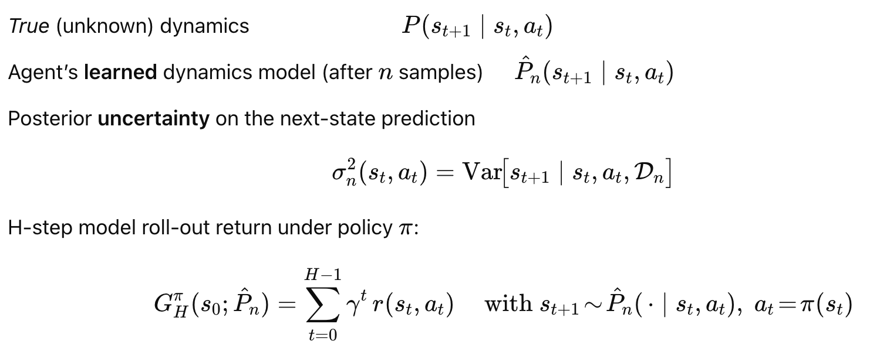
Problem-Finding | Path Finding | Evaluation
Search
Hierarchical Planning
Constraint-following
Better knowledge of environments leads to better agents

Slide 41
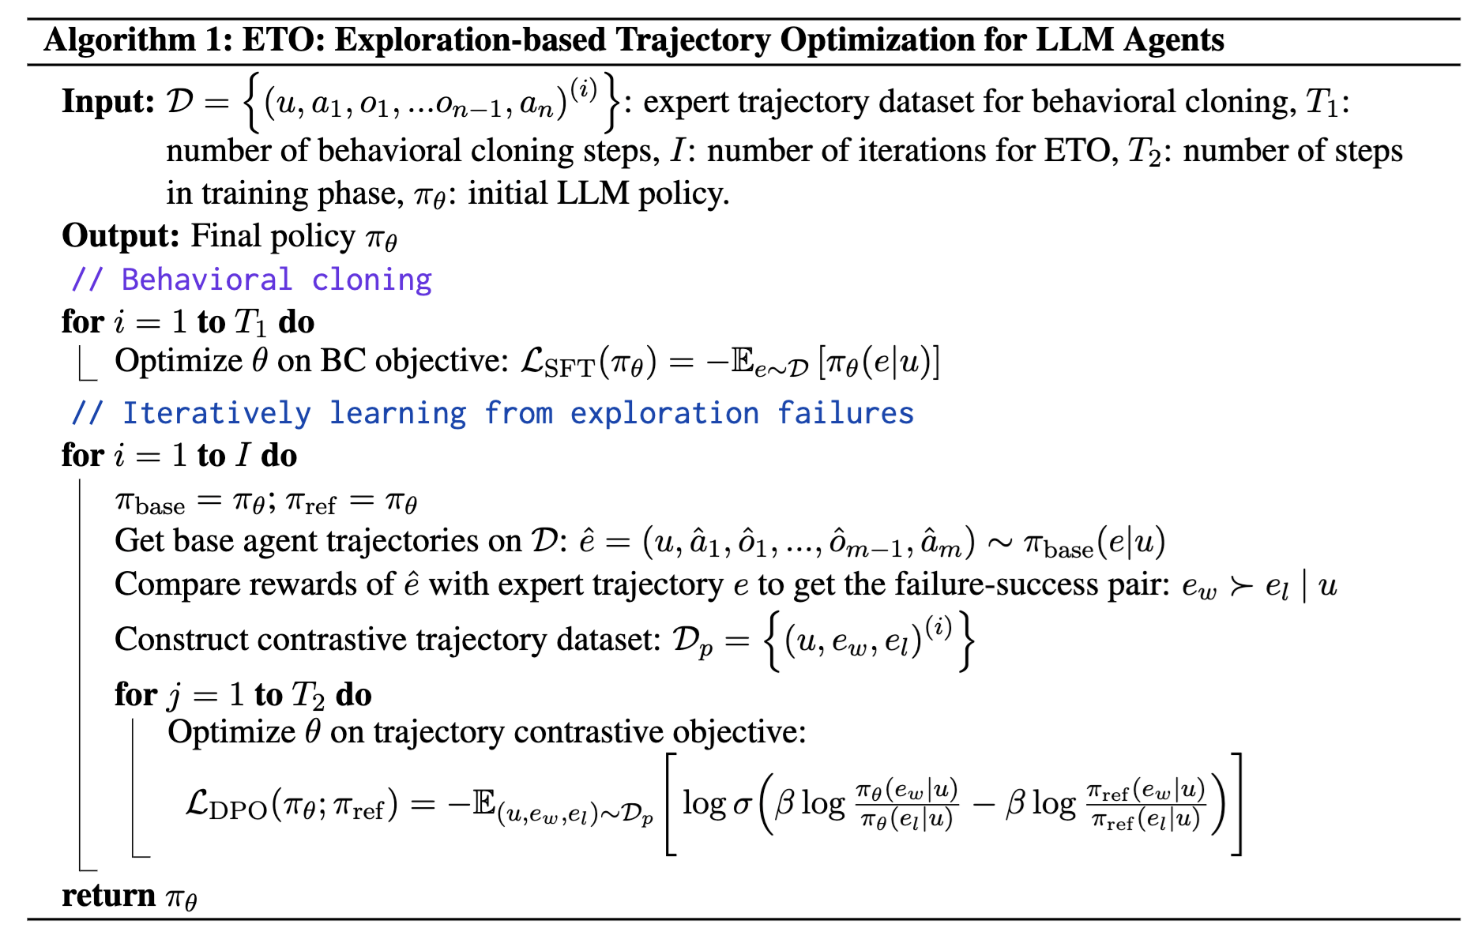
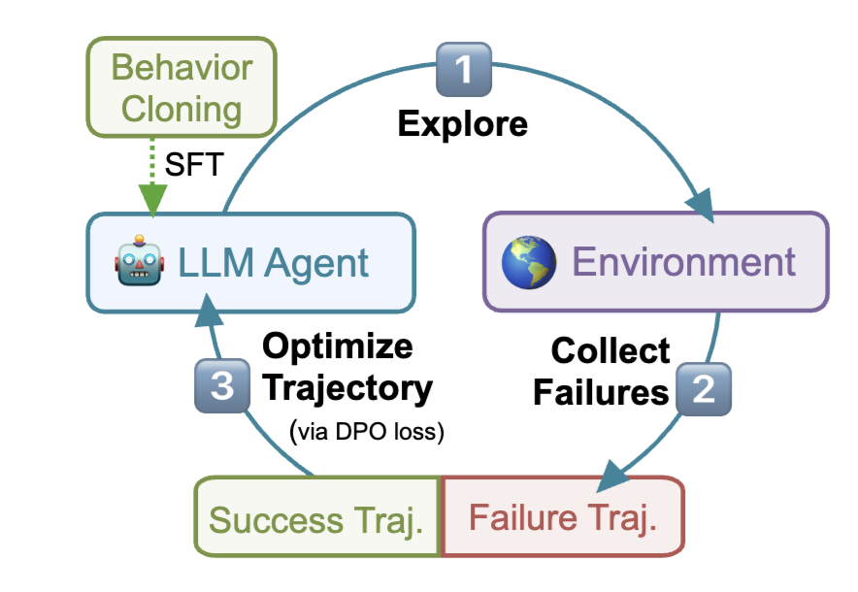
Problem-Finding | Path Finding | Evaluation
Search
Hierarchical Planning
Constraint-following
Learning Policy in Creative Planning Tasks
Song, Yifan, et al. "Trial and Error: Exploration-Based Trajectory Optimization of LLM Agents." Proceedings of
the 62nd Annual Meeting of the Association for Computational Linguistics (Volume 1: Long Papers). 2024.

Slide 42
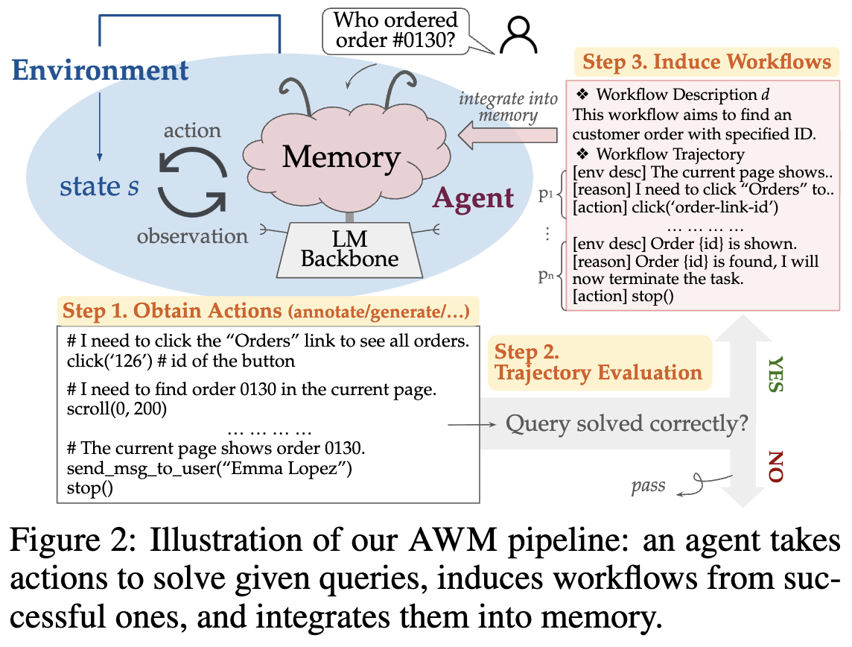
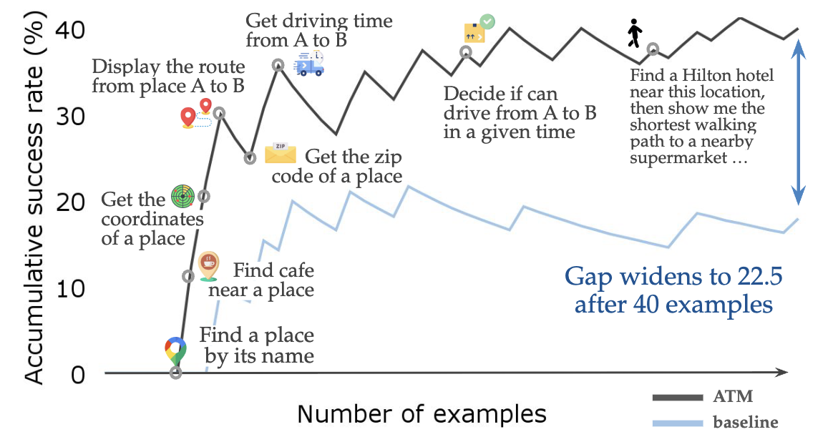
Problem-Finding | Path Finding | Evaluation
Search
Hierarchical Planning
Constraint-following
Learning Workflows in Creative Planning Tasks
Wang, Zora Zhiruo, et al. "Agent workflow memory." arXiv preprint arXiv:2409.07429 (2024).

Slide 43
Problem-Finding | Path Finding | Evaluation
Search
Hierarchical Planning
Constraint-following
Learning Skills from Explorations in Creative Planning Tasks
Wang, Zihao, et al. "Jarvis-1: Open-world multi-task agents with memory-augmented multimodal language models."
IEEE Transactions on Pattern Analysis and Machine Intelligence (2024).

Slide 44
Problem-Finding | Path Finding | Evaluation
Search
Hierarchical Planning
Constraint-following
Research Questions of self-exploration
Strategic vs. Random exploration
Transfer from high-data to low-data regime

Slide 45
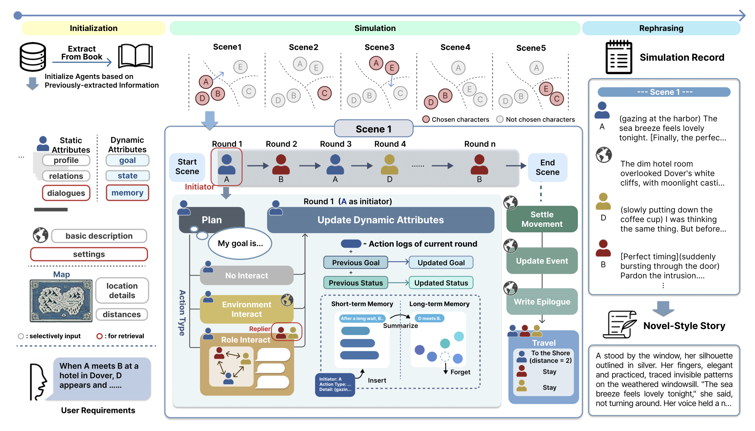
Problem-Finding | Path Finding | Evaluation
Search
Hierarchical Planning
Constraint-following
Transfer from high-data to low-data regime
Xu X, Mei J, Li C, et al. MM-StoryAgent: Immersive Narrated Storybook Video Generation with a Multi-Agent
Paradigm across Text, Image and Audio[J]. arXiv preprint arXiv:2503.05242, 2025.

Slide 46
Problem-Finding | Path Finding | Evaluation
Search
Hierarchical Planning
Constraint-following
Path-Finding – Overview and Background
Search
Hierarchical Planning
Constraint-following

Slide 47
Problem-Finding | Path Finding | Evaluation
Search
Hierarchical Planning
Constraint-following
Hierarchical Planning
Motivation
Long-horizon generation pain-points. Vanilla left-to-right models drift, repeat and lose global coherence after ~3–4 sentences.
Solution pattern.
Decompose what to say (high-level plan) from how to say it (surface realization).
Planning ≈ selecting latent or explicit structure (keywords, sections, latent codes).
Realization = conditioned language model generation
Benefits. Better topicality, diversity, and controllability

Slide 48
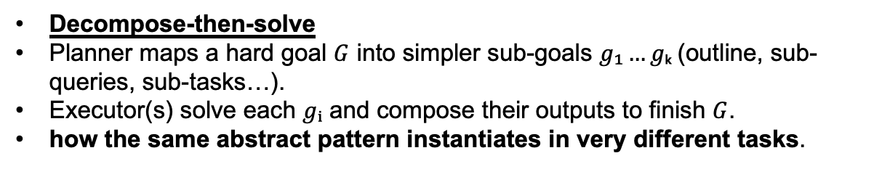
Problem-Finding | Path Finding | Evaluation
Search
Hierarchical Planning
Constraint-following
Hierarchical Planning
Decompose-then-solve
Planner maps a hard goal $G$ into simpler sub-goals $g₁…gₖ$(outline, sub-queries, sub-tasks…).
Executor(s) solve each $gᵢ$ and compose their outputs to finish $G$.
how the same abstract pattern instantiates in very different tasks.

Slide 49
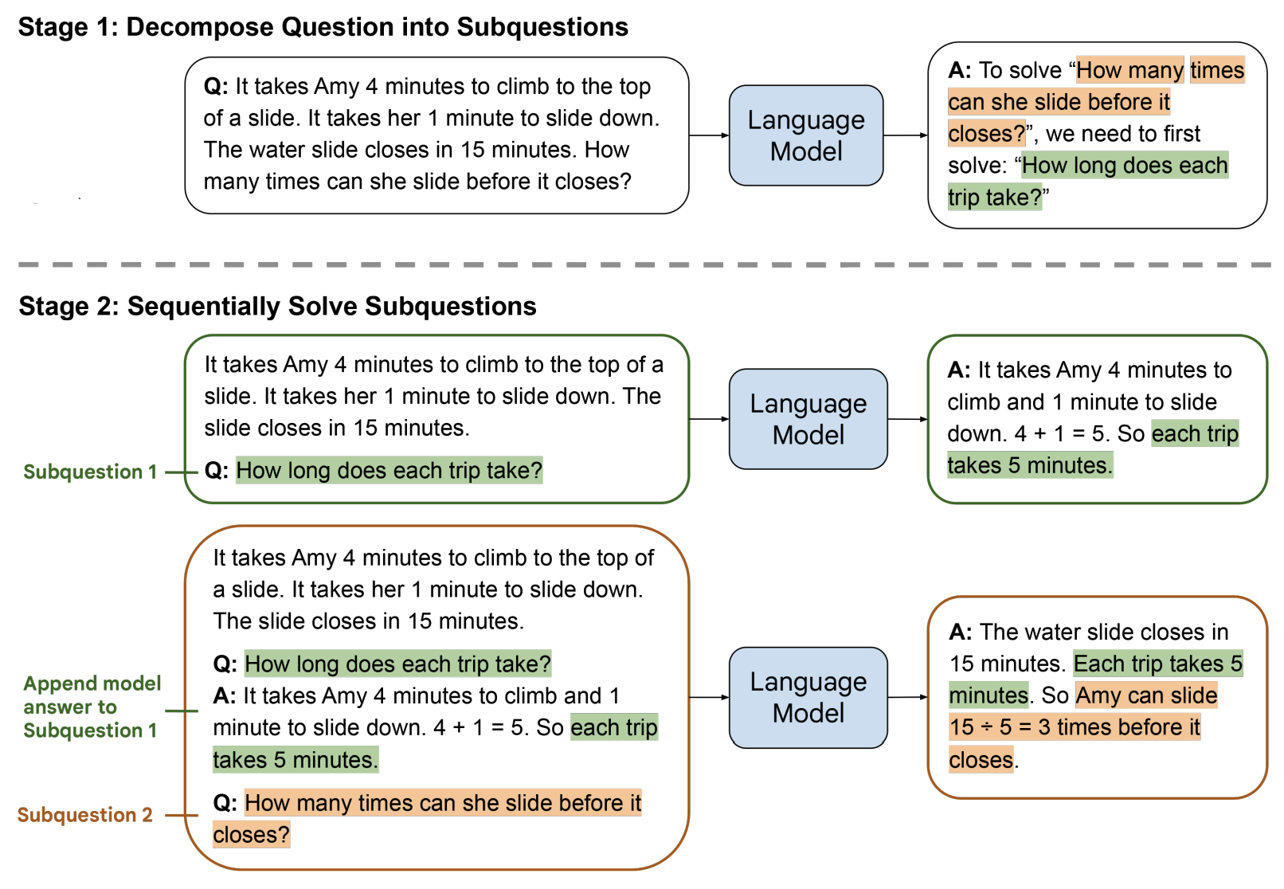
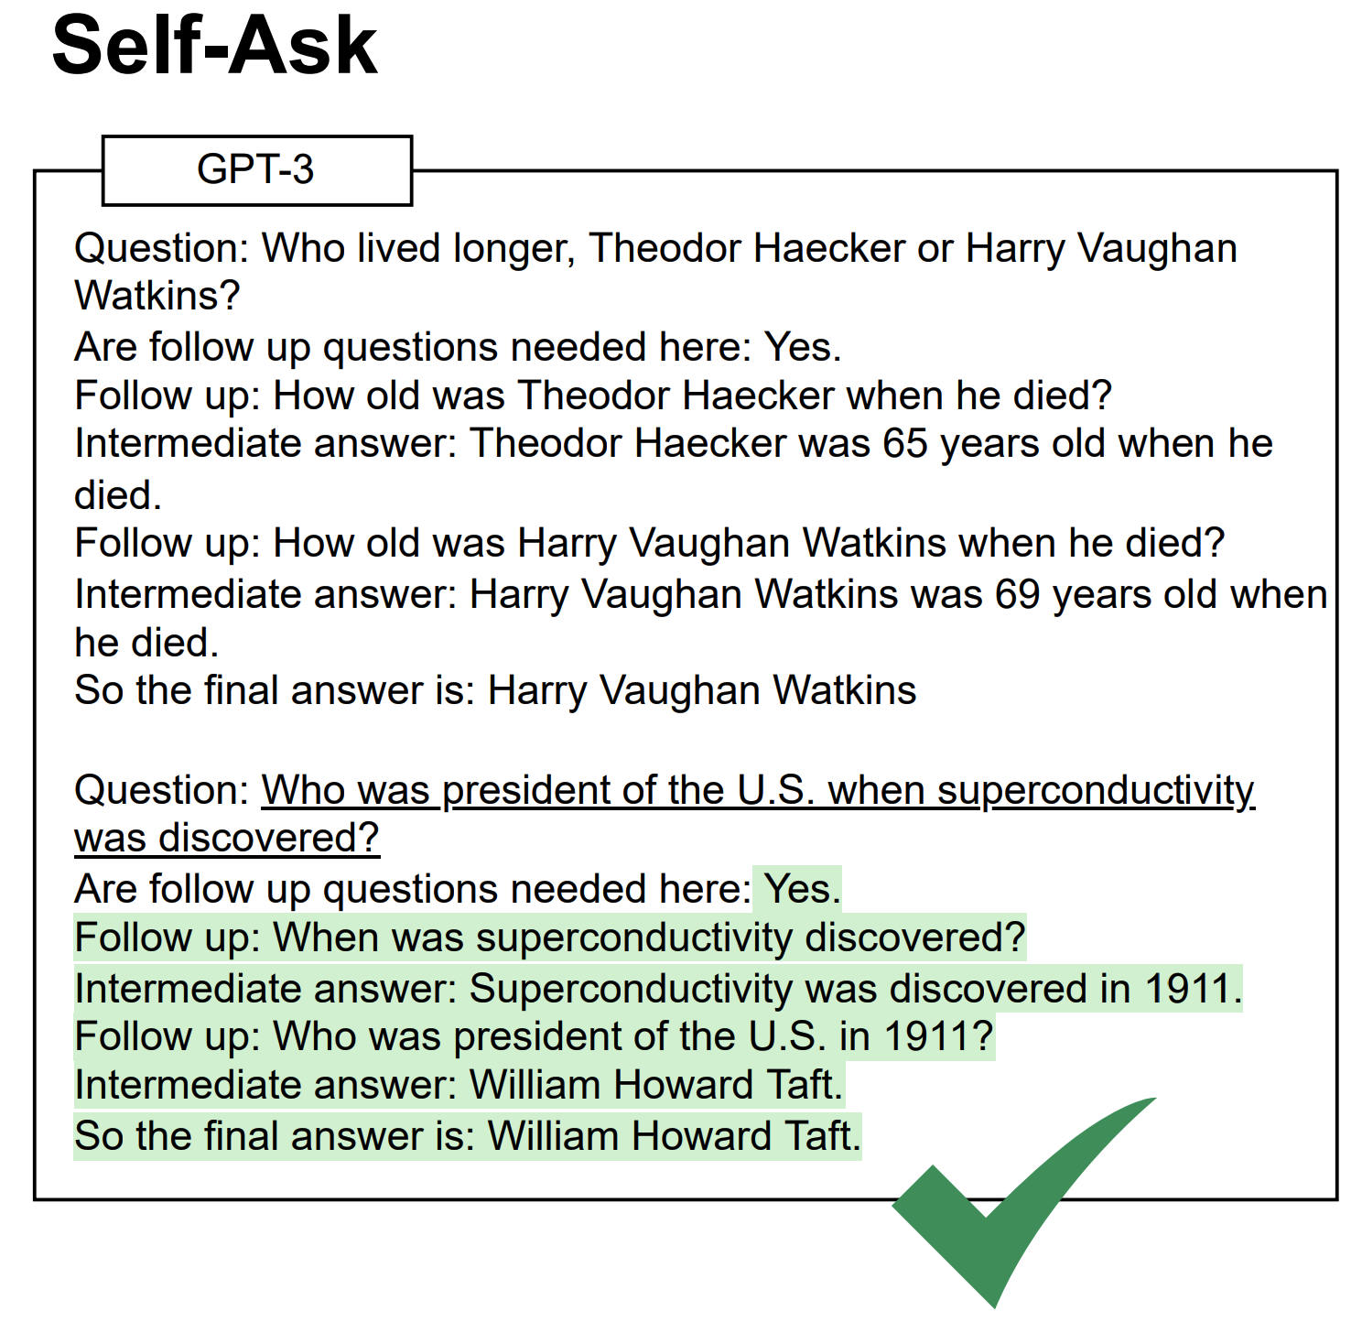
Problem-Finding | Path Finding | Evaluation
Search
Hierarchical Planning
Constraint-following
Examples of Decompose-and-solve in Reasoning Tasks
Press, et. al. 2023
Zhou, et. al. 2023

Slide 50
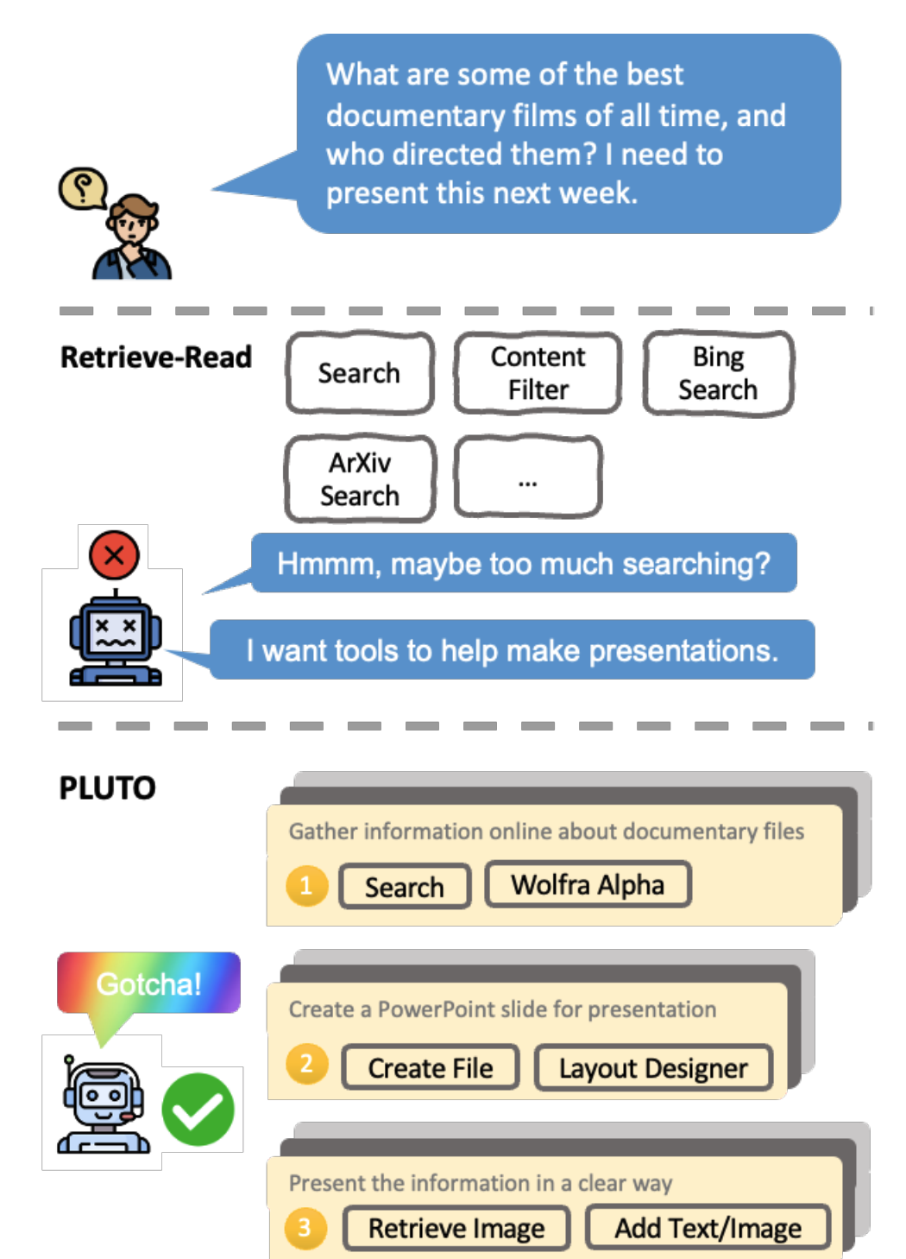
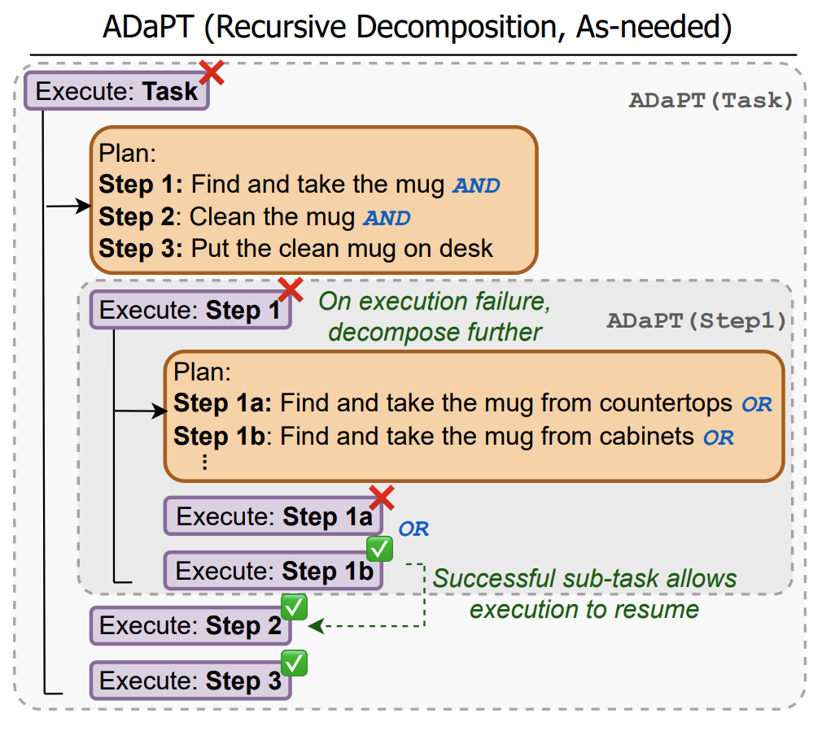
Problem-Finding | Path Finding | Evaluation
Search
Hierarchical Planning
Constraint-following
Examples of Decompose-and-solve in Agentic Tasks
Prasad, et. al. 2024
Huang, et. al. 2024

Slide 51

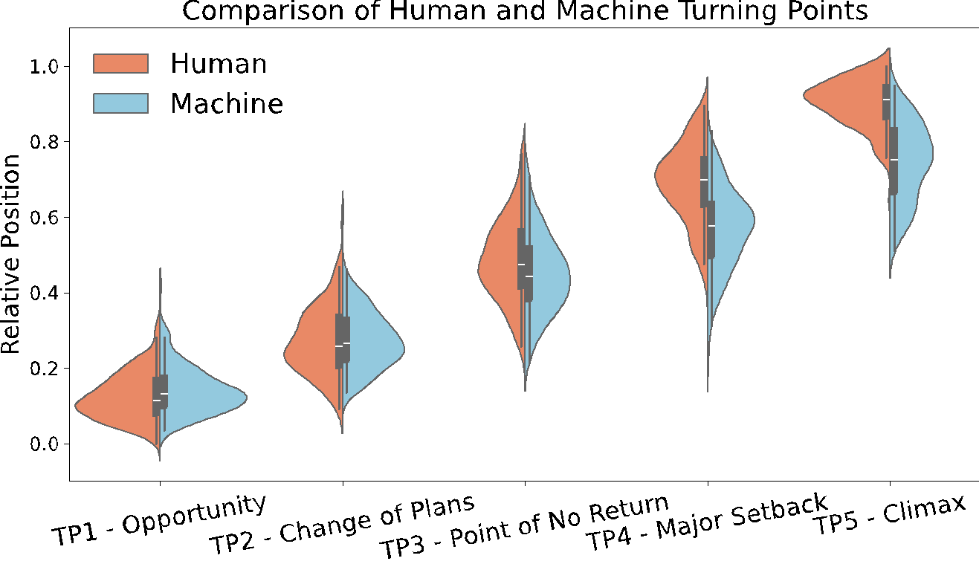
Problem-Finding | Path Finding | Evaluation
Search
Hierarchical Planning
Constraint-following
How good is LLM planning in Creative Tasks?
LLMs incorrectly pace their storytelling relative to human writers.
Learned correct pacing
Struggle to unfold adequately
Early occurrence in AI outputs

Slide 52
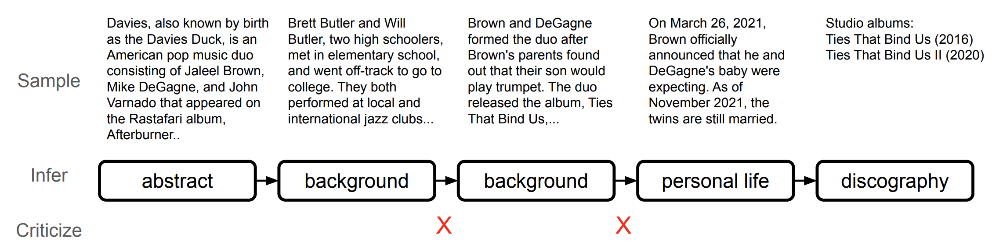
Problem-Finding | Path Finding | Evaluation
Search
Hierarchical Planning
Constraint-following
How good is LLM planning in Creative Tasks?
Deng, Yuntian, Volodymyr Kuleshov, and Alexander M. Rush. "Model Criticism for Long-Form Text Generation." Proceedings of the 2022 Conference on Empirical Methods in Natural Language Processing. 2022.

Slide 53
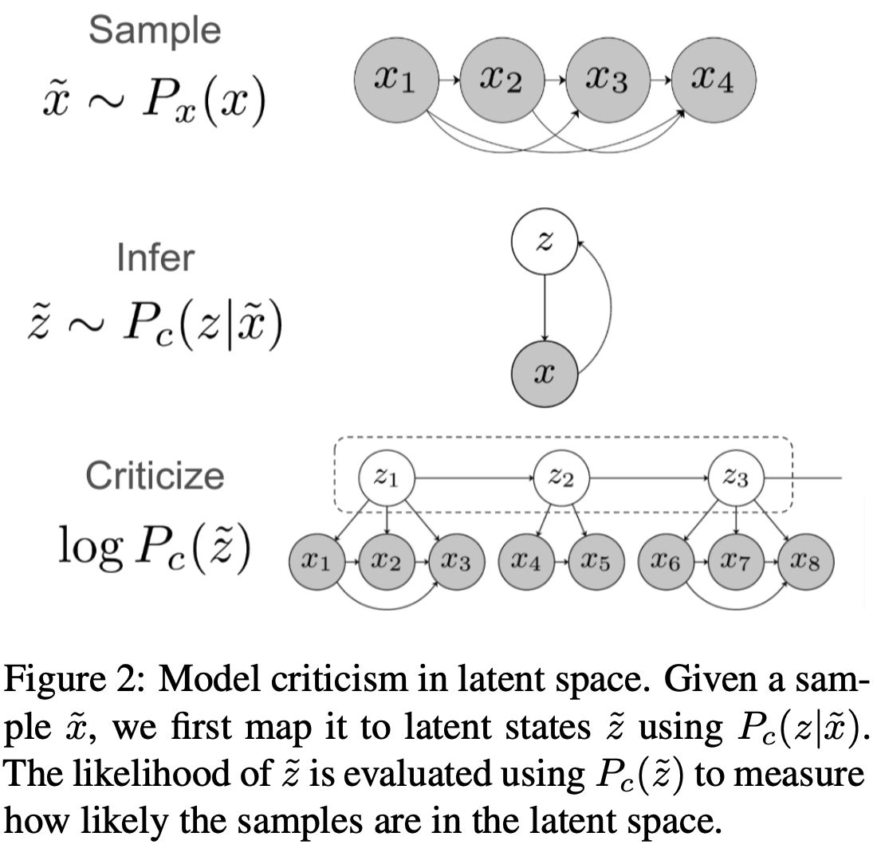
Problem-Finding | Path Finding | Evaluation
Search
Hierarchical Planning
Constraint-following
How good is LLM planning in Creative Tasks?
PPL on token level
PPL on latent space level

Slide 54
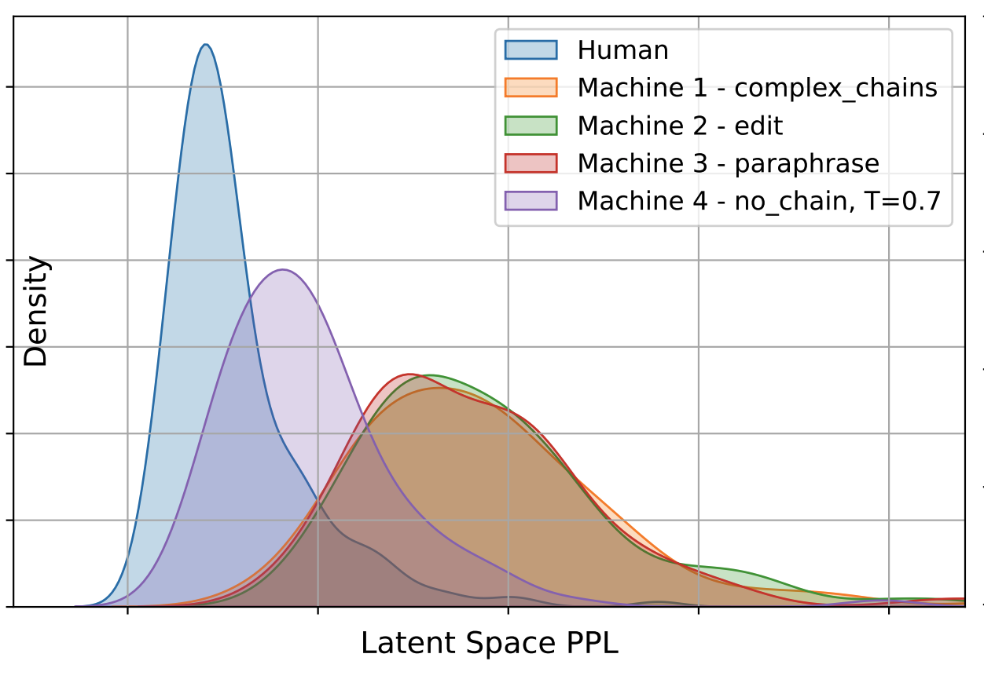
Problem-Finding | Path Finding | Evaluation
Search
Hierarchical Planning
Constraint-following
How good is LLM planning in Creative Tasks?
Latent variables: event triggers
Takeaway:
Human and machine generations are different from a latent space perspective.
Is it possible to fix with SIT?
Tian, et. al. 2024

Slide 55
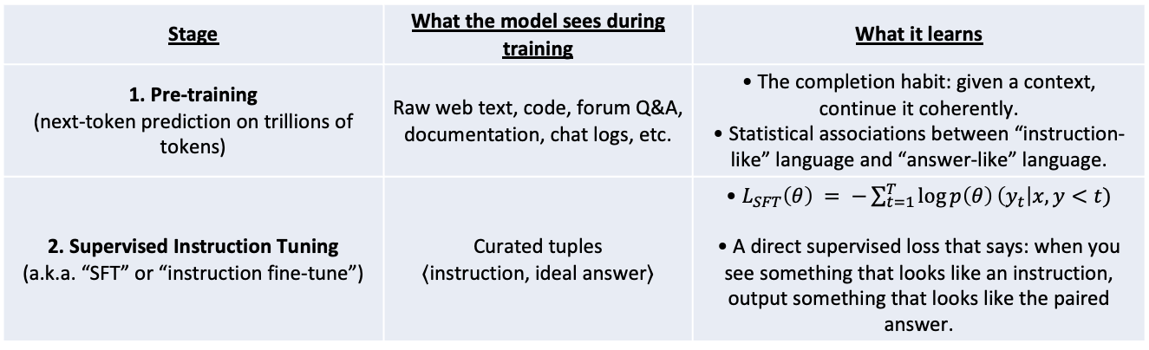
Problem-Finding | Path Finding | Evaluation
Search
Hierarchical Planning
Constraint-following
Is it possible to fix with SIT?
Stage | What the model sees during training | What it learns
1. Pre-training (next-token prediction on trillions of tokens) | Raw web text, code, forum Q&A, documentation, chat logs, etc. | • The completion habit: given a context, continue it coherently. • Statistical associations between “instruction-like” language and “answer-like” language.
2. Supervised Instruction Tuning (a.k.a. “SFT” or “instruction fine-tune”) | Curated tuples ⟨instruction, ideal answer⟩ | • $L_{SFT}\left(θ\right) = −\sum_{t=1}^{T}{\log{p\left(θ\right)}}\left(y_{t}\right|x, y<t)$ • A direct supervised loss that says: when you see something that looks like an instruction, output something that looks like the paired answer.
Not very likely, because the training objective is at surface level.

Slide 56
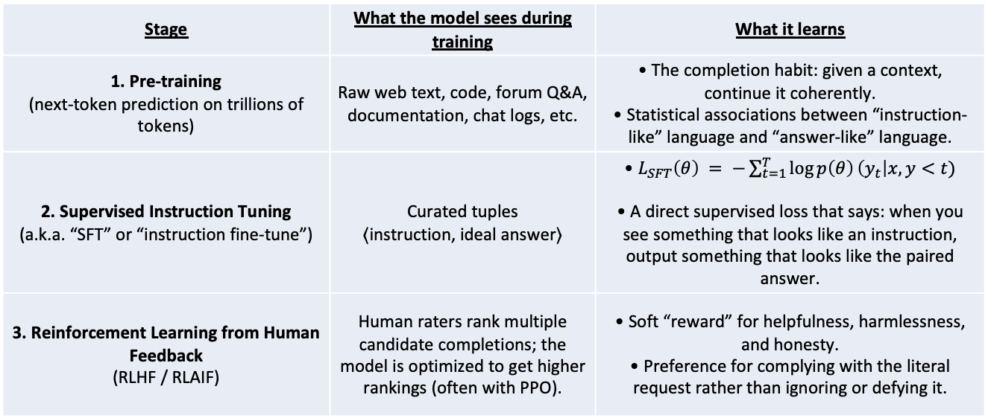
Problem-Finding | Path Finding | Evaluation
Search
Hierarchical Planning
Constraint-following
Is it possible to fix with RLHF?
Stage | What the model sees during training | What it learns
1. Pre-training (next-token prediction on trillions of tokens) | Raw web text, code, forum Q&A, documentation, chat logs, etc. | • The completion habit: given a context, continue it coherently. • Statistical associations between “instruction-like” language and “answer-like” language.
2. Supervised Instruction Tuning (a.k.a. “SFT” or “instruction fine-tune”) | Curated tuples ⟨instruction, ideal answer⟩ | • $L_{SFT}\left(θ\right) = −\sum_{t=1}^{T}{\log{p\left(θ\right)}}\left(y_{t}\right|x, y<t)$ • A direct supervised loss that says: when you see something that looks like an instruction, output something that looks like the paired answer.
3. Reinforcement Learning from Human Feedback (RLHF / RLAIF) | Human raters rank multiple candidate completions; the model is optimized to get higher rankings (often with PPO). | • Soft “reward” for helpfulness, harmlessness, and honesty. • Preference for complying with the literal request rather than ignoring or defying it.
Would RLHF be the savior?
Maybe, depends on the data regime

Slide 57
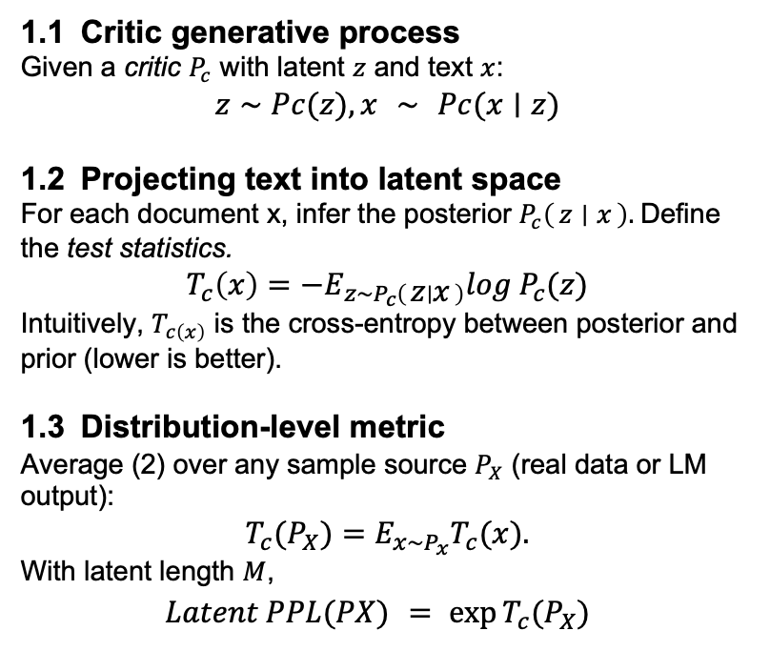
Problem-Finding | Path Finding | Evaluation
Search
Hierarchical Planning
Constraint-following
How good is LLM planning in Creative Tasks?
1.1 Critic generative process
Given a critic $P_{c}$ with latent $z$ and text $x$:
$$z∼Pc(z),x ∼ Pc(x∣z)$$
1.2 Projecting text into latent space
For each document x, infer the posterior $P_{c}\left(z ∣ x\right).$Define the test statistics.
$$T_{c}\left(x\right)=−E_{z\sim P_{c}\left(z ∣ x\right)}log{ P}_{c}(z)$$
Intuitively, $T_{c\left(x\right)}$ is the cross-entropy between posterior and prior (lower is better).
1.3 Distribution-level metric
Average (2) over any sample source $P_{X}$ (real data or LM output):
$$T_{c}​(P_{X}​)=E_{x\sim P_{x}}​​T_{c}​(x).$$
With latent length $M$,
$$Latent PPL(PX) = {\exp{T_{c}(P_{X})}}_{}$$

Slide 58
Story Generation Given Titles
Problem-Finding | Path Finding | Evaluation
Search
Hierarchical Planning
Constraint-following
Title: gymnastics
Without Storyline Planning
With Storyline Planning
Story (generated):
I wanted to learn how to draw.
So, I decided to go to the gym.
I went to the local gym.
I got a lot of good grades.
I was very happy.
Storyline (generated): wanted -> decided -> class -> practiced -> well
Story (generated):
I wanted to be a gymnast.
I decided to learn how to do gymnastics.
I decided to take a class.
I practiced every day.
I was able to do well on the class.
Yao et al. (AAAI 2019). Demo: http://cwc-story.isi.edu/
Notes:
Problem definition:
Our high-level idea: use storyline to guide the story generation and enhance the long-term coherence. btw, the story is actually generated by our system and you can play with this live demo.

Slide 59
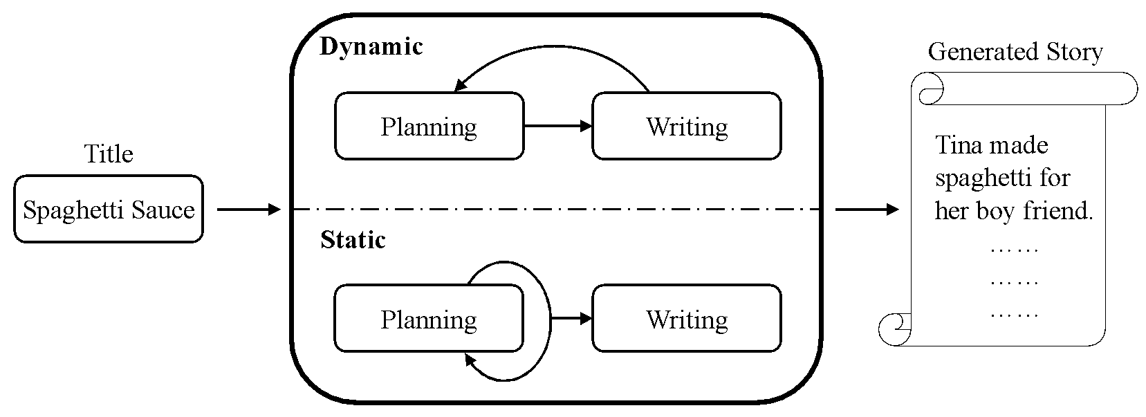
Plan-and-Write Overview
Problem-Finding | Path Finding | Evaluation
Search
Hierarchical Planning
Constraint-following
The planning component generates storylines from titles.
The writing component generates stories from storylines and titles.
Notes:
an overview of our approach: we propose a framework called "plan-and-write", which introduce a planning component, and the writing component.

Slide 60
Plan-and-Write Hierarchical Generation
Problem-Finding | Path Finding | Evaluation
Search
Hierarchical Planning
Constraint-following
The benefits of the storyline
Having a big picture.
The ability to model “what happens next” rather than “what’s the next word”.
More fun interaction and control.
The challenges of incorporating the storyline
How to get the storyline?
How to use the storyline?
Yao et al. (AAAI 2019). Demo: http://cwc-story.isi.edu/
Notes:
The benefit of storyline is obvious,
However, there are also challenges..

Slide 61
No Annotation? Extracting Storylines
Problem-Finding | Path Finding | Evaluation
Search
Hierarchical Planning
Constraint-following
Title: christmas shopping
Story: Frankie had christmas shopping to do.
She went to the store.
Inside, she walked around looking for gifts.
Soon her cart was full.
She paid and took her things home.
Storyline (unsupervised extraction): Frankie -> store -> gifts -> cart -> paid
Extraction tool: the RAKE (Rapid Automatic Keyword Extraction) algorithm.
Notes:
We took a very symbolic approach to extract storylines from stories to provide “silver-standard” annotations. as an initial step and a proof-of-concept.

Slide 62
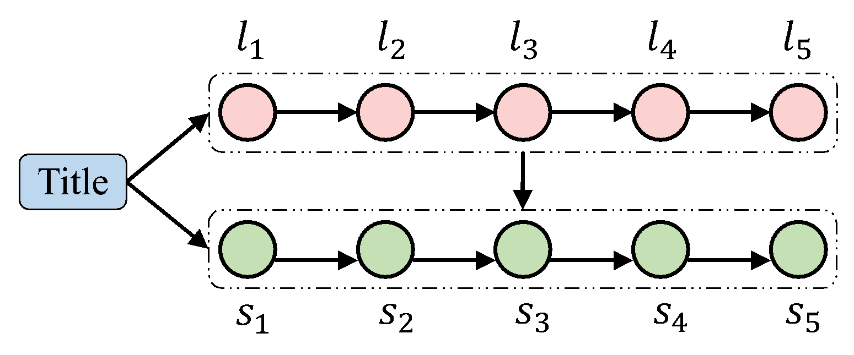
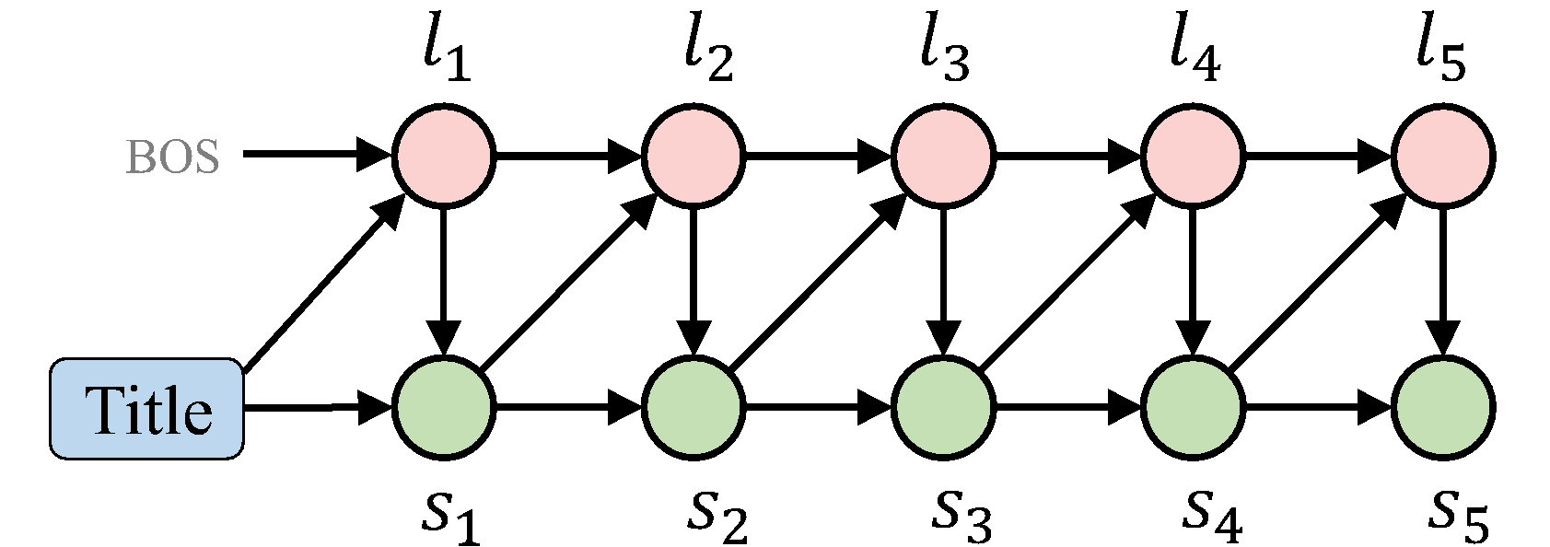




Incorporating Storylines
Problem-Finding | Path Finding | Evaluation
Search
Hierarchical Planning
Constraint-following
Static Schema
Dynamic Schema
At each plan step, we model
At each plan step, we model
At each write step, we model
At each write step, we model
The probabilities are computed by standard language models and sequence to sequence with attention models.
The probabilities are computed by some specifically designed fusion-RNN cells.
Notes:
We explore two ways to incorporate the storyline. Use neural nets to implement.
On a high level, we design gate so that we can take weighted sum of the information from each incoming edges.

Slide 63
Generation Results
Problem-Finding | Path Finding | Evaluation
Search
Hierarchical Planning
Constraint-following
Title: the lost phone
Without Storyline Planning
With Storyline Planning
Story (generated):
When i was a kid, my parents took me to the mall. I was looking for a new pair of shoes. I found a pair that I really liked. I bought them and took them home . I was very happy with my new shoes.
Storyline (generated): phone -> realized house -> was -> looked -> found
Story (generated):
I was looking for my phone.
I realized it was in my house. I wasn't sure where it was. I looked everywhere. I found it in the back yard.

Slide 64
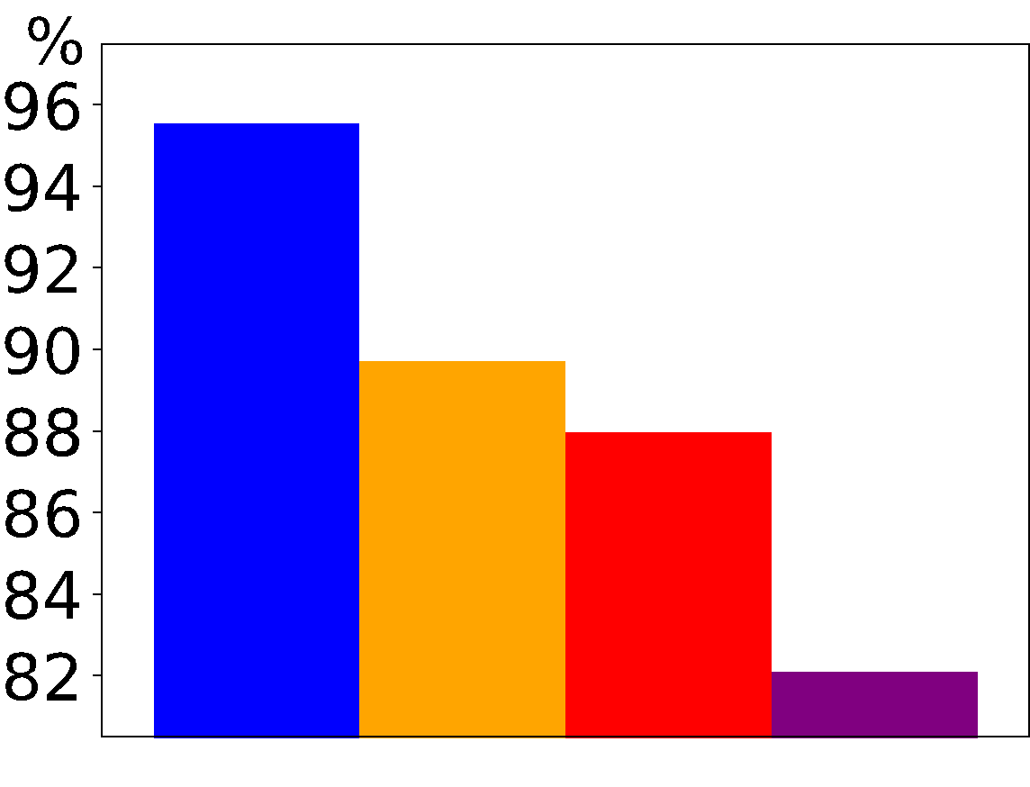
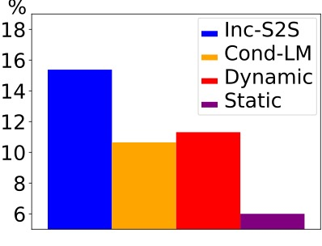
Automatic Evaluation of Repetition
Problem-Finding | Path Finding | Evaluation
Search
Hierarchical Planning
Constraint-following
Inter-story repetition: how much different stories look like each other?
Intra-story repetition: how much different sentences in a story look like each other?
Inter-story repetition rates
Intra-story repetition rates
Notes:
Another contribution of this work is evaluation.

Slide 65
User Preferences
Problem-Finding | Path Finding | Evaluation
Search
Hierarchical Planning
Constraint-following
Aspect | Static vs. Language Model |  | Dynamic vs. Incremental-Seq2Seq
 | Static | LM | Dyna. | Seq2Seq
Fidelity | 38.5% | 16.3% | 35.8% | 12.9%
Coherence | 39.4% | 32.3% | 37.2% | 28.6%
Interesting | 39.5% | 35.7% | 43.5% | 26.7%
Overall | 40.9% | 34.2% | 42.9% | 27.0%
The human study is conducted on Amazon Mechanical Turk (AMT). 233 users were participated in the study.
Notes:
We did human evaluation. ....describe the results... Again, much more results in the paper.

